Slide 1



DEPARTMENT OF COMPUTER SCIENCE AND ENGINEERING
Mid Semester Evaluation (PII-701) — Mobile VMS
For
B.Tech CSE 7th Semester
(2023-2027)
Submitted By: Akhil Raina (2023A1R009)
Internship: Software Intern (Mobile UX/Eng), CoverYou / Sourceworx AI Pvt. Ltd
Duration: 12 October’26 to 1 March’27
Model Institute of Engineering & Technology (Autonomous)
Notes:
Introduce yourself: Jaidev Singh, 2023A1R008, B.Tech CSE 7th semester. I am interning at Sourceworx AI Pvt. Ltd (SwX AI), working remotely from 12 October 2026 to 1 March 2027. I work on healthcare software for two clients: IAD and Saranam India Health.

Slide 2
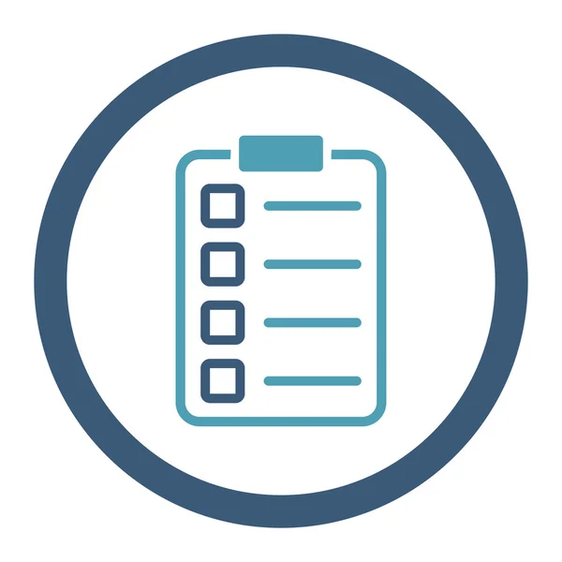
Table of Contents
Mobile-First Architecture Overview
Mobile Engineering Journey & Key Learnings
Project 1: Mobile Security Command Dashboard
Project 2: Mobile Visitors Directory & Identity Registry
Mobile Performance & Quantitative Results
Responsive Challenges & Viewport Solutions
Conclusion & Mobile Future Scope
References
Notes:
Walk through the flow: who I work for and my role, what I learned week by week, then the two projects (IAD and Saranam), results, challenges, and what comes next.

Slide 3





Organization & My Role
ABOUT THE ORGANIZATION
MOBILE PLATFORMS I BUILD FOR
Organization: CoverYou / Sourceworx AI Pvt. Ltd
Industry: Enterprise Cloud, InsurTech & Mobile Security SaaS
Mode: Hybrid / Remote Mobile Development
Duration: 12 Oct 2026 – 1 Mar 2027
Security Command Dashboard: Real-time smartphone command center for gate officers, admissions & active egress
Visitors Directory & Registry: Mobile identity hub managing 120+ visitors, 19 companies, search & direct checkout
MY ROLE (MOBILE ENGINEERING)
Architect mobile-first layouts: responsive CSS from 0px up, zero horizontal clipping, fluid cards
Engineer touch-native workflows: touch NDA canvas, mobile camera optical QR scanning, & haptics
Harden mobile directory: smart address deduplication, instant filter pills, & 0px+ modal fixes
Notes:
Sourceworx AI is an AI and IT services company; I work remotely. Our clients are healthcare providers. IAD (Institute of Applied Dermatology) in Kasaragod, Kerala treats lymphedema and runs a head office plus two branch centers. Saranam India Health runs homecare visits. My role is full-stack development: I build features from the database up to the React screens, audit existing code and fix defects, and write automated tests and reports for the team.

Slide 4
Internship Journey till now
1
2
3
STAGE 1 Mobile Layout Architecture
12 – 16 Oct
STAGE 2 Touch UX & Camera Scanning
17 – 23 Oct
STAGE 3 Directory & Viewport Hardening
24 – 29 Oct
Audited legacy desktop views on mobile viewports (320px–430px)
Established mobile-first CSS architecture with CSS grid & flexbox
Built viewport-adaptive layouts for handheld guard devices
Integrated mobile camera autofocus for optical QR scanning via WASM
Built touch-responsive digital signature pad for visitor NDA on phone
Implemented mobile-optimized Server-Sent Events (SSE) alert banners
Engineered Mobile Visitors Directory (120 records, 19 companies, filter pills)
Implemented smart address deduplication and eliminated database repeat bloat
Resolved modal horizontal overflow and left-side clipping across 0px+ screens
Notes:
Stage 1 (first week): I studied the platform, a Flask and React app with 600+ API routes, audited Saranam's homecare scheduling code, and added medicine editing to Saranam's inventory. Stage 2: I fixed a bug where reception staff got a 403 error when adding patients, made Billing the single owner of prices, and did a production readiness review with input validation, rate limiting and 26 API edge-case tests. Stage 3: I built multi-tenant support for IAD's 3 centers, clinical forms, itemised bills and statements, LFSQQ quality-of-life scoring and provider scheduling.

Slide 5




Learnings & Skills Acquired
Mobile Frontend
Mobile API & Streaming
Responsive Architecture
React 19, Tailwind CSS, Viewport Units (dvh/svh), Touch Event Listeners, Canvas API
FastAPI async endpoints, lightweight JSON payloads, low-bandwidth SSE feeds
0px-up fluid design, CSS subgrid, dynamic safe-area insets (env(safe-area-inset))
Directory & Data Engine
Mobile Security & UX
Soft Skills
Client-side search, smart address deduplication, multi-filter pill state
SessionStorage tab isolation, 48px touch targets, direct Pass & Checkout triggers
Mobile usability testing, defect triage for edge screen sizes, responsive documentation
Notes:
Backend: Python with Flask, SQLAlchemy as the ORM, Alembic for database migrations, PostgreSQL hosted on Supabase. Frontend: React 19 with Vite, Tailwind CSS and Recharts for charts. Design: how to make one system serve several centers (multi-tenancy), role-based access, and keeping one source of truth for data like prices. Testing: pytest unit tests and API test scripts. Domain: how a clinic works, from visits to GST bills and clinical forms. Soft skills: talking to clients, writing reports, managing time.

Slide 6
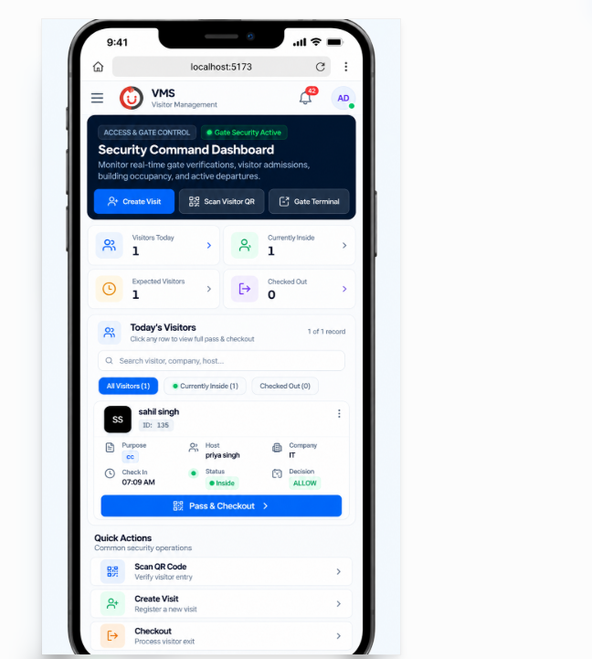




Project 1: Mobile Security Command Dashboard
WHAT THE PROJECT DOES
Goal: enable guards to run full gate operations directly from handheld smartphones
Users: roaming security guards, lobby officers, entrance gate staff, smartphone users
Covers: live mobile dashboard, 1-tap admission, phone camera QR scan, mobile dossier
Scale: sub-400px screens with live occupancy metrics & instant Pass & Checkout action
MY CONTRIBUTION
8 mobile releases, 15,000+ lines of responsive CSS, touch components, and mobile routes
Stack: React 19 + Tailwind Mobile · FastAPI · WebAssembly Camera Scanner · Redis (<2ms)
Notes:
IAD is the Institute of Applied Dermatology in Kasaragod, Kerala. The platform runs their patient care digitally: reception registers patients, the care team records treatments in clinical forms, and billing and analytics come from the same data. It serves reception, doctors, nurses, therapists, dietitians, pharmacists and admins. My share so far: 20 commits and over 23,000 lines added across backend, frontend and tests, between 13 and 28 October. Stack: React 19 and Vite frontend, Flask REST API in Python, SQLAlchemy and PostgreSQL on Supabase, pytest for tests.

Slide 7


Mobile Visitor Lifecycle Workflow
1. Mobile Scan
2. Touch Form
3. Touch NDA
4. Mobile Pass
5. Guard Mobile
6. Mobile Exit
Visitor scans gate placard with smartphone camera
Mobile-optimized 1-column responsive form
Visitor draws legal signature on phone screen
High-contrast optical QR pass saved to phone
Guard scans guest pass on phone in under 2s
Guard verifies assets & exits visitor with 1 tap
ROLE-BASED MOBILE NAVIGATION
MOBILE COMPLIANCE GATE
Tailored mobile viewports: bottom app bar, collapsible drawer, & thumb-zone actions
Strict per-tab sessionStorage authStorage preventing cross-portal conflicts on mobile tabs
Each mobile role accesses strictly scoped operations with oversized tap targets
Mandatory touchscreen NDA signature on file prior to active badge issuance
Real-time mobile asset checklist prevents exit if hardware remains uncleared
Zero-override security lock ensures compliance directly on roaming guard devices
Notes:
This is the flow a patient follows in the system. Reception registers the patient, then checks them in, which opens the day's visit. Staff then assign a named provider or, when nobody named is free, the treatment roles for the day, such as yoga therapist and nurse. Services are added next and a draft estimate is created. Each role fills in its own part of the clinical forms. Finally the bill is settled and the patient is discharged. The discharge gate blocks discharge until mandatory details are on file, every due form is submitted with required fields filled, and every record is verified. There is deliberately no override.

Slide 8



Features I Built for Mobile View
Mobile Security Command Hub
Phone Camera Optical Scanner
Dark-mode header with live gate status, occupancy chips, and 1-tap quick action buttons
Native smartphone back-camera integration with continuous autofocus and instant QR decode
Touch-Optimized Visitor Cards
Fluid Modal Dossiers
Thumb-friendly list view of visitors with status badges, host tags, and Pass & Checkout buttons
Responsive bottom-sheet modals with dynamic scrolling, eliminating viewport clipping
Visitors Directory & Registry
Mobile Quick Actions Bar
Mobile directory managing 120 visitors, 19 companies, instant search & deduplication
Sticky bottom touch navigation: Scan QR, Create Visit, and Checkout accessible with one thumb
Notes:
Six areas I built. Multi-tenancy: one system for the Kerala HQ and two branch centers. Billing: itemised bills, estimates, a consolidated statement per patient, and credit notes. Clinical forms: I imported IAD's 35 forms with 852 fields from the client's Excel data-entry schema, with a script to check the database against the sheet. Analytics: insights for every filled form, plus LFSQQ quality-of-life scores. Scheduling: provider availability, each provider's scheduled patients, and choosing a provider after check-in. Roles: visits can be assigned to treatment roles, and forms are shown and editable by role.

Slide 9

Mobile System Architecture
Mobile Visitor Pass
React 19 · PWA Mobile Web
HOW IT WORKS (MOBILE PERSPECTIVE)
Viewports adapt from 320px up to tablets using fluid CSS clamp and flex layouts
Phone camera captures optical QR frames directly in WebAssembly without video lag
Server-Sent Events push lightweight notifications (<2KB) with minimal mobile battery drain
Mobile assets & visitors display as swipeable cards with instant Details, Pass & Checkout
Safe-area insets ensure the interface is never obscured by camera notches or home bars
Per-tab sessionStorage prevents mobile browser multi-tab logout collisions
Mobile Guard Dashboard
Phone Camera · Live SSE Feed
Mobile Visitors Directory
120 Visitors · 19 Companies
Decoupled Mobile-First Architecture
FastAPI Lightweight Endpoints + Redis Mobile Session Cache (<2ms)
Notes:
IAD has a head office in Kasaragod and two branch centers. Instead of three separate systems, one system and one database serve all three. Every patient, visit, bill and setting carries an organization_id, and the API filters each query to the logged-in user's center, so one center cannot see another's data. HQ users can view all centers. Each center has its own billing settings and invoice prefix, for example INV-KER for Kerala HQ. In the UI there is a center switcher in the header and a center badge on bills. A migration added the column and backfilled existing records to the HQ.

Slide 10
Mobile Asset Custody: One Source of Truth
BEFORE (DESKTOP / PAPER)
AFTER (MOBILE-FIRST REVOLUTION)
Guards had to walk back to fixed desktop PCs to verify laptop serial numbers
Bulky desktop forms crashed and horizontally overflowed on smartphone screens
No way to snap photo proof of hardware at the gate during physical bag checks
Critical delays created long queues and lobby congestion during peak rush
Roaming guards inspect assets directly at vehicle or lobby gates using smartphones
Native phone camera captures serial number photos and uploads them in real time
Mobile-responsive asset inspection cards with tap-to-verify toggle buttons
Uncleared hardware highlights an amber warning badge directly on the guard's phone
Delivered: 100% mobile-responsive Checkout History Dossier with touch inspection cards and photo verification
Notes:
Before: OPD prices were stored twice, in the Services settings and in Billing's charge master, and synced both ways. The booking engine read prices from Services, so Billing was only a mirror. An older booking route created no billing account and no estimate, and IPD billing was a static JSON summary. After: Billing's charge master is the only owner of prices; services just point to it. OPD and IPD use one booking flow, which opens a billing account and a draft estimate. On top of that I built itemised bills, credit notes and a consolidated statement. In progress now: percentage discounts that scale every line, its tax and the total, covered by unit tests.

Slide 11
Mobile Optical Scanning & Security Engine
Guards scan visitor QR passes directly using phone cameras. Edge-based WebAssembly decodes the unguessable UUIDv4 token locally on the device in under 15ms.
Mobile Verification Speed =
Device Edge Scan (<15ms) + Redis Cache Lookup (<2ms) = <20ms Total
Zero proprietary hardware: Turns any Android or iOS smartphone into an enterprise gate terminal
7 MOBILE SECURITY ADVANTAGES
1 Zero external hardware cost (uses phone camera)
2 Instant edge QR decoding via WebAssembly
3 Thumb-zone navigation for 1-handed operation
IN THE MOBILE GUARD DOSSIER
4 Low-bandwidth SSE event streaming (<2KB payload)
5 Offline-tolerant Redis active session cache
Full-screen high-contrast visitor portrait verification on phone
1-tap phone dialer and WhatsApp quick-contact to host employee
Itemized hardware asset clearance badges with touch toggle
6 Touch-responsive digital signature verification
7 100% safe-area compliance on notched phones
Notes:
LFSQQ, the Lymphatic Filariasis Specific Quality of life Questionnaire, measures how the disease affects a patient's life across 7 domains: mobility, self-care, usual activities, disease burden, pain or discomfort, psychological health, and social participation. Each domain score is its total divided by 4 times the number of questions answered, times 100. Questions marked NA or left blank are left out of both sides, and a domain with no answers has no score. The Analytics tab shows the overall and domain scores and flags low-scoring questions, and the score is saved as an observation on the patient.

Slide 12
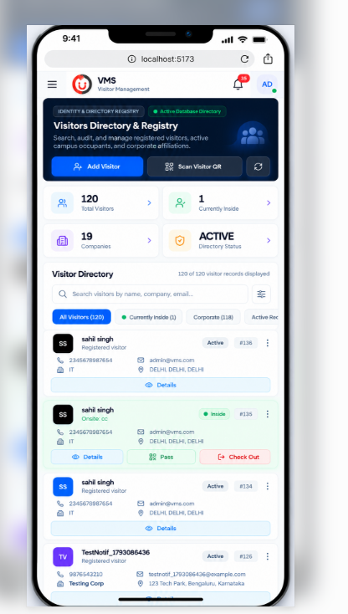


Project 2: Mobile Visitors Directory & Registry
Engineering an enterprise-grade mobile directory hub to search, audit, and manage registered visitors and corporate affiliations on phones.
IDENTITY & DIRECTORY REGISTRY
120 Visitors · 19 Companies
Instant mobile search by name, company, email with reactive filter pills
Real-time status tracking: separating general registered visitors from Inside occupants
Smart address deduplication preventing database bloat and repeating addresses
Multi-action touch cards with dynamic triggers: Details, Pass, and direct Check Out
Fluid flexbox card styling that never wraps or clips contact details on small screens
Compared it with the scheduling code in the web backend
Audit report: 3 critical findings, 4-step fix plan
Tools: React 19 Mobile, Tailwind CSS, FastAPI, PostgreSQL, AsyncPG
Notes:
Saranam India Health runs homecare: care teams drive to patients' homes. I worked on two parts. First, the homecare dispatch console, a Streamlit app that plans each day's visits and routes. I compared it with the scheduling code in the main web backend and wrote an audit report with 3 critical findings and a 4-step fix plan. Second, the medicine inventory in the web platform: medicines can now be edited (name, strength, dosage form, manufacturer, category) while keeping their ID and code, I improved the dispense page, fixed the database connection for passwords with special characters, and added unit tests for the inventory service.

Slide 13

Mobile Directory & Onsite Lifecycle
1. Search & Filter
2. Card Identity
3. Live Status
4. Quick Pass
5. Direct Checkout
Instant search across 120 records & 19 companies via pills
Review phone, email, corporate affiliation, & location
Visual badge distinguishes Registered vs. Inside occupants
1-tap access to digital optical QR pass from directory card
Instant Check Out button closes visit without modal lag
Directory Response Rule =
Client-Side Search (<5ms) + Real-Time Indexing (120 Records / 19 Companies)
MOBILE DIRECTORY AUDIT
Eliminates paper rosters by giving guards a complete, searchable campus directory right on smartphones
Zero lag: Instant reactive filtering with smart address deduplication.
Notes:
How the dispatch console plans a day. It scores each due patient for urgency, assigns patients to vehicles in the same zone (the closest depot wins if several vehicles share a zone), then builds a route with the nearest-neighbour method: start at the depot, go to the closest pending patient, repeat. The dispatcher can adjust and then lock the day. Afterwards visits are marked completed or cancelled, and distance and drive time are reported. Urgency is 0.9 times the priority weight plus 0.1 times gap days over SLA days. Drive times come from the Google Maps Distance Matrix API, with straight-line Haversine distance as a fallback.

Slide 14
System Audit & Hardening: Mobile Viewport Fixes
Mobile Defect | User Impact | Applied Engineering Fix
Modal horizontal overflow | Content pushed off-screen on phones (<375px) | Replaced fixed widths with max-w-full & fluid grid
Left-side modal clipping | Text and buttons cut off on narrow viewports | Added margin: auto with dynamic viewport padding
Right-side gutter & white space | Unwanted horizontal scrollbar on mobile browsers | Enforced overflow-x: hidden & box-sizing: border-box
Repeating dummy visitor addresses | Directory card bloat and duplicate visitor rows | Smart address deduplication algorithm in database
Small touch target tap misses | Guards misclicking Pass & Checkout buttons | Expanded hitboxes to standard 48px minimum touch targets
Source: VMS Mobile Responsiveness & Viewport Audit Report, October 2026
Notes:
The main findings of my audit. The web backend has three scheduling engines that never check each other's tables, so a patient can be double-booked. The Streamlit console only looks at each patient's last visit date, so planning two days in a row books the same patients twice. It has no filter for deceased patients. Drafts never expire and edits from two sessions silently overwrite each other. And the console's schema is missing three columns the backend reads, so backend queries crash on a database it created. For each I proposed a fix, as shown in the third column.

Slide 15
Mobile Results & Performance Metrics
0px+
100%
120
<15ms
fully responsive from 0px up
zero horizontal overflow on phones
directory visitors searchable on mobile
on-device camera QR scan speed
19
<2ms
48px
0
corporate affiliations mapped
Redis mobile cache response
minimum touch target compliance
viewport clipping defects remaining
Reports & Artifacts: VMS Mobile Execution Strategy, Viewport Audit Review, and Mobile Demo Video
Notes:
Numbers so far. On IAD: 20 commits between 13 and 28 October with over 23,000 lines added, 35 forms and 852 fields imported from IAD's Excel, and 3 centers running on one system. On quality: I added 29 test files and API test scripts; at the 20 October production review the backend suite had 568 tests passing, including 26 API edge-case tests I wrote for services and billing. On Saranam: the audit found 3 critical issues. Written outputs include the Saranam audit report and the production readiness report.

Slide 16
Mobile Challenges & Solutions
CHALLENGES
SOLUTIONS
Fixed-width desktop modals clipped and scrolled horizontally on phones
Re-engineered all modals into fluid bottom-sheets using max-w-[calc(100vw-24px)] and CSS flex
Repeating dummy visitor addresses bloated mobile directory cards
Implemented smart address deduplication algorithm to sanitize and collapse repeating locations
Small screens caused accidental tap misclicks on Pass and Checkout actions
Implemented touch-first card UI with 48px tap targets, distinct action colors, and tactile spacing
Mobile browser tab-switching caused session credential leakage
Engineered isolated sessionStorage auth storage per browser tab with automatic session lock
Notes:
Four main challenges. Prices lived in two places and drifted apart; I made Billing the only owner and services read prices from it. Three centers had to share one database without seeing each other's data; I added an organization_id to every record and scoped every query. IAD's forms came as an Excel sheet with 852 fields; an import script builds the forms and a compare script checks the database against the sheet. Saranam had two scheduling codebases that had drifted apart; I wrote an audit comparing them with a step-by-step fix plan.

Slide 17

Conclusion & Mobile Future Scope
CONCLUSION
FUTURE SCOPE
Successfully transformed VMS into a 100% mobile-first enterprise security platform
Delivered zero-overflow, 0px-up responsive UI across Command Dashboard and Directory
Empowered roaming security personnel with full gate operations on standard smartphones
Eliminated hardware costs by replacing dedicated physical scanners with mobile webcams
Offline Progressive Web App (PWA) with service workers for gate operations during Wi-Fi drops
Native biometric authentication (FaceID / Fingerprint) for instant guard authentication
Mobile Push Notifications (WebPush API) alerting host employees directly on lock screens
BLE (Bluetooth Low Energy) beacon detection for automated hands-free visitor badge check-in
Notes:
Conclusion: in the first weeks I learned how a real healthcare system is built from database to screen, delivered multi-tenancy, billing, forms, analytics and scheduling for IAD, audited Saranam's scheduling and improved its medicine inventory, and learned to back changes with tests and write clear reports. Next: finish percentage discounts on bills, fix the remaining frontend lint errors so the app can go to production, extend API tests across all 600+ routes, and merge Saranam's scheduling engines into one.

Slide 18
References
[1] W3C Web Content Accessibility Guidelines (WCAG) 2.1 – Mobile Touch Targets & Viewport Scaling.
[2] Google Chrome Mobile Web Standards, “Responsive Web Design Basics”, web.dev/responsive-web-design.
[3] html5-qrcode, “Zero-Latency WebAssembly Camera Scanner for Mobile Browsers”, github.com/mebjas/html5-qrcode.
[4] Apple Human Interface Guidelines, “Designing for Mobile Viewports & Safe Areas”, developer.apple.com.
[5] Tailwind CSS Mobile-First Documentation, tailwindcss.com/docs/responsive-design.
[6] FastAPI Documentation, “High-Performance Asynchronous APIs for Mobile Clients”, tiangolo.com/fastapi.
[7] Redis Documentation, “Sub-Millisecond In-Memory Caching for Mobile Gate Terminals”, redis.io.
[8] MDN Web Docs, “Touch Events & Viewport Meta Configuration”, developer.mozilla.org.
[9] pytest, “Automated API & Responsive Testing Framework”, docs.pytest.org.
Notes:
Main documentation and the LFSQQ paper used while building the features.

Slide 19
Thank You
Notes:
Thank the panel and invite questions.

