Slide 1
Hospital Mortality Prediction
(Milestone 2)
Hypothesis on what impact independent features have on the target variable
By: Akhil Raj CV

Slide 2
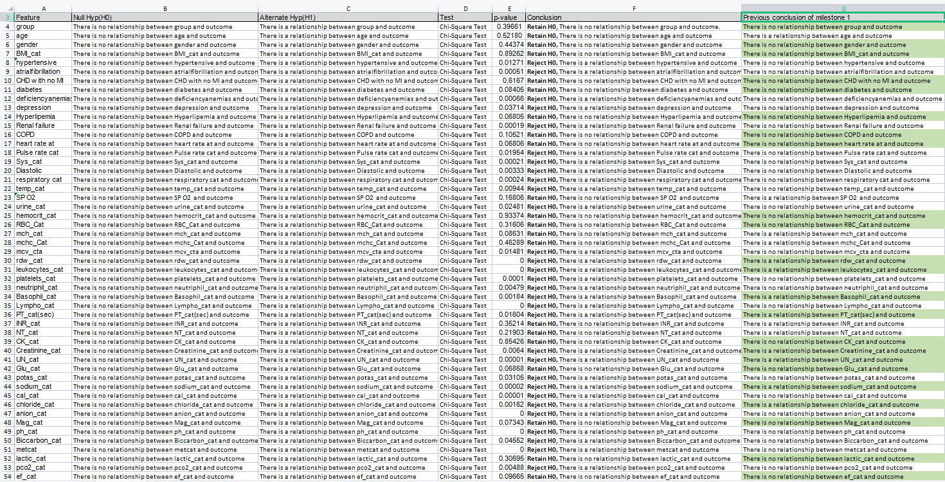

Slide 3
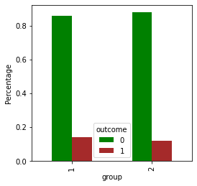
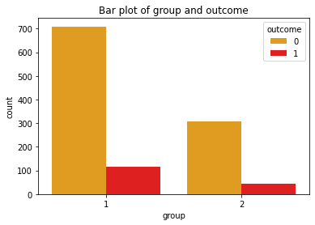
Group
Statistical Approach
Visual Approach
Previous Assumption: There is no relationship between group and outcome
H0: There is no relationship between group and outcome
H1: There is a relationship between group and outcome
Test: Chi-Square test
p-Value: 0.39661
Conclusion: Retain H0, There is no relationship between group and outcome.
Remarks: Previous Assumption was correct
Cross Tab:
outcome 0 1
group
1 709 116
2 309 43

Slide 4
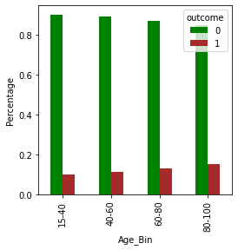
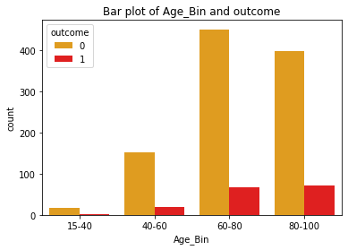
Age
Statistical Approach
Visual Approach
Previous Assumption: There is a relationship between age and outcome
H0: There is no relationship between age and outcome
H1: There is a relationship between age and outcome
Test: Chi-Square test
p-Value: 0.52180
Conclusion: Retain H0, There is no relationship between age and outcome.
Remarks: Previous Assumption was incorrect
Cross Tab:
outcome 0 1
Age_Bin
15-40 18 2
40-60 152 19
60-80 450 67
80-100 398 71

Slide 5
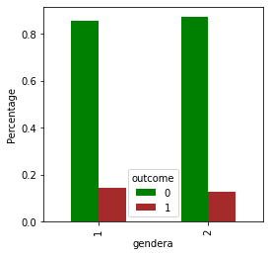
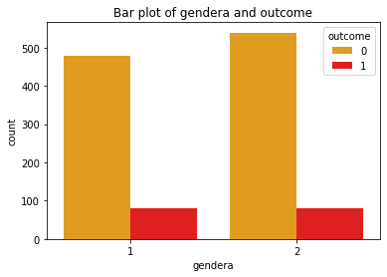
Gender
Statistical Approach
Visual Approach
Previous Assumption: There is no relationship between gender and outcome
H0: There is no relationship between gender and outcome
H1: There is a relationship between gender and outcome
Test: Chi-Square test
p-Value: 0.44374
Conclusion: Retain H0, There is no relationship between gender and output
Remarks: Previous Assumption was correct
Cross Tab:
outcome 0 1
gender
1 479 80
2 539 79

Slide 6
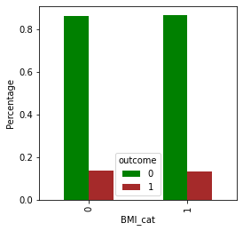
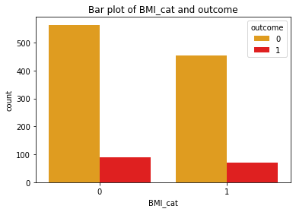
BMI_cat
Statistical Approach
Visual Approach
Previous Assumption: There is no relationship between BMI_cat and outcome
H0: There is no relationship between BMI_cat and outcome
H1: There is a relationship between BMI_cat and outcome
Test: Chi-Square test
p-Value: 0.89262
Conclusion: Retain H0, There is no relationship between BMI_cat and output
Remarks: Previous Assumption was correct
Cross Tab:
outcome 0 1
BMI_cat
0 564 89
1 454 70

Slide 7
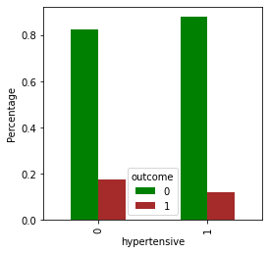
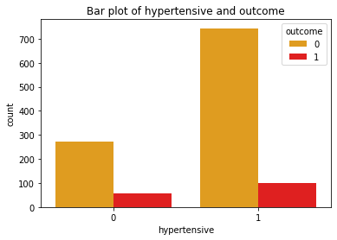
Hypertensive
Statistical Approach
Visual Approach
Previous Assumption: There is no relationship between hypertensive and outcome
H0: There is no relationship between hypertensive and outcome
H1: There is a relationship between hypertensive and outcome
Test: Chi-Square test
p-Value: 0.01271
Conclusion: Reject H0, There is a relationship between hypertensive and output
Remarks: Previous Assumption was incorrect
Cross Tab:
outcome 0 1
hypertensive
0 274 58
1 744 101

Slide 8
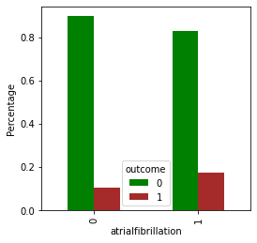
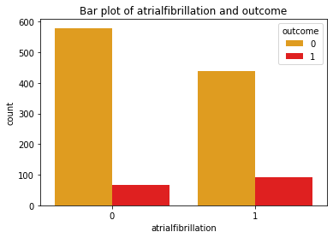
Atrialfibrillation
Statistical Approach
Visual Approach
Previous Assumption: There is no relationship between atrialfibrillation and outcome
H0: There is no relationship between atrialfibrillation and outcome
H1: There is a relationship between atrialfibrillation and outcome
Test: Chi-Square test
p-Value: 0.00051
Conclusion: Reject H0, There is a relationship between atrialfibrillation and output
Remarks: Previous Assumption was incorrect
Cross Tab:
outcome 0 1
atrialfibrillation
0 579 67
1 439 92

Slide 9
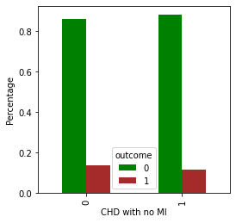
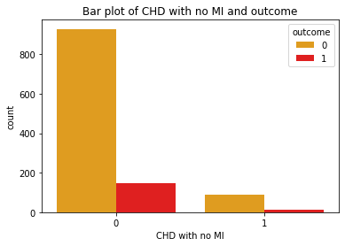
CHD with no MI
Statistical Approach
Visual Approach
Previous Assumption: There is no relationship between CHD with no MI and outcome
H0: There is no relationship between CHD with no MI and outcome
H1: There is a relationship between CHD with no MI and outcome
Test: Chi-Square test
p-Value: 0.6167
Conclusion: Retain H0, There is no relationship between CHD with no MI and output
Remarks: Previous Assumption was correct
Cross Tab:
outcome 0 1
CHD with no MI
0 929 147
1 89 12

Slide 10
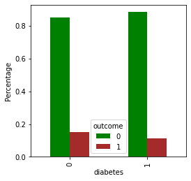
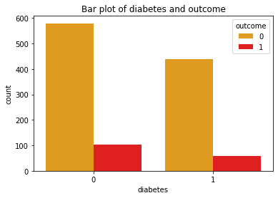
Diabetes
Statistical Approach
Visual Approach
Previous Assumption: There is no relationship between diabetes and outcome
H0: There is no relationship between diabetes and outcome
H1: There is a relationship between diabetes and outcome
Test: Chi-Square test
p-Value: 0.08405
Conclusion: Retain H0, There is no relationship between diabetes and output
Remarks: Previous Assumption was correct
Cross Tab:
outcome 0 1
diabetes
0 579 102
1 439 57

Slide 11
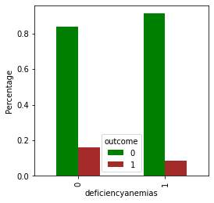
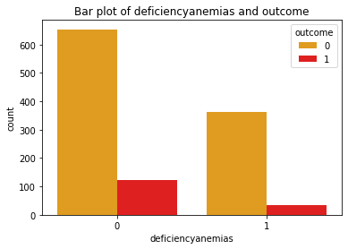
Deficiencyanemias
Statistical Approach
Visual Approach
Previous Assumption: There is no relationship between deficiencyanemias and outcome
H0: There is no relationship between deficiencyanemias and outcome
H1: There is a relationship between deficiencyanemias and outcome
Test: Chi-Square test
p-Value: 0.00066
Conclusion: Reject H0, There is a relationship between deficiencyanemias and output
Remarks: Previous Assumption was incorrect
Cross Tab:
outcome 0 1
deficiencyanemias
0 654 124
1 364 35

Slide 12
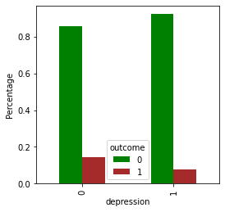
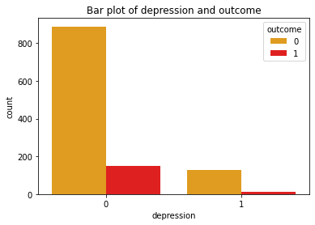
Depression
Statistical Approach
Visual Approach
Previous Assumption: There is no relationship between depression and outcome
H0: There is no relationship between depression and outcome
H1: There is a relationship between depression and outcome
Test: Chi-Square test
p-Value: 0.03714
Conclusion: Reject H0, There is a relationship between depression and output
Remarks: Previous Assumption was incorrect
Cross Tab:
outcome 0 1
depression
0 889 148
1 129 11

Slide 13

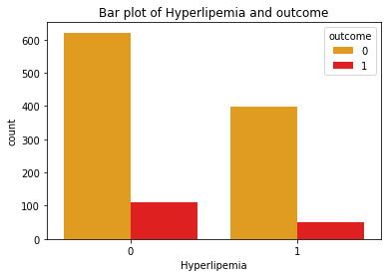
Hyperlipemia
Statistical Approach
Visual Approach
Previous Assumption: There is no relationship between Hyperlipemia and outcome
H0: There is no relationship between Hyperlipemia and outcome
H1: There is a relationship between Hyperlipemia and outcome
Test: Chi-Square test
p-Value: 0.06805
Conclusion: Retain H0, There is no relationship between Hyperlipemia and output
Remarks: Previous Assumption was correct
Cross Tab:
outcome 0 1
Hyperlipemia
0 621 109
1 397 50

Slide 14
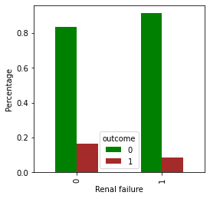
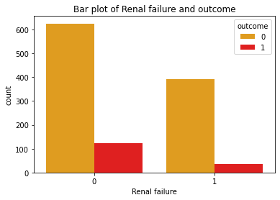
Renal failure
Statistical Approach
Visual Approach
Previous Assumption: There is no relationship between Renal failure and outcome
H0: There is no relationship between Renal failure and outcome
H1: There is a relationship between Renal failure and outcome
Test: Chi-Square test
p-Value: 0.00019
Conclusion: Reject H0, There is a relationship between Renal failure and output
Remarks: Previous Assumption was incorrect
Cross Tab:
outcome 0 1
Renal failure
0 625 122
1 393 37

Slide 15
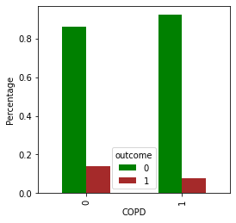
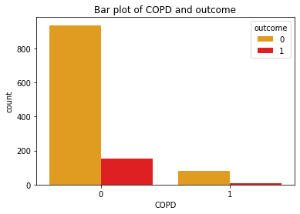
COPD
Statistical Approach
Visual Approach
Previous Assumption: There is no relationship between COPD and outcome
H0: There is no relationship between COPD and outcome
H1: There is a relationship between COPD and outcome
Test: Chi-Square test
p-Value: 0.10521
Conclusion: Retain H0, There is no relationship between COPD and output
Remarks: Previous Assumption was correct
Cross Tab:
outcome 0 1
COPD
0 936 152
1 82 7

Slide 16
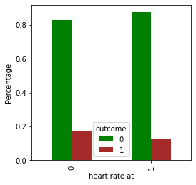
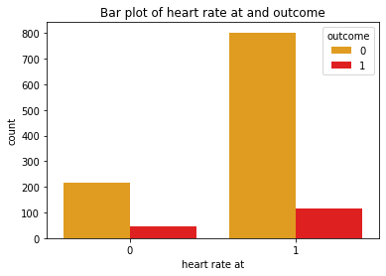
Heart rate at
Statistical Approach
Visual Approach
Previous Assumption: There is no relationship between heart rate at and outcome
H0: There is no relationship between heart rate at and outcome
H1: There is a relationship between heart rate at and outcome
Test: Chi-Square test
p-Value: 0.06806
Conclusion: Retain H0, There is no relationship between heart rate at and output
Remarks: Previous Assumption was correct
Cross Tab:
outcome 0 1
heart rate at
0 216 44
1 802 115

Slide 17

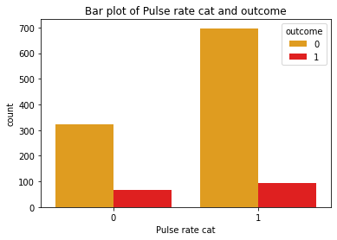
Pulse rate cat
Statistical Approach
Visual Approach
Previous Assumption: There is no relationship between Pulse rate cat and outcome
H0: There is no relationship between Pulse rate cat and outcome
H1: There is a relationship between Pulse rate cat and outcome
Test: Chi-Square test
p-Value: 0.01954
Conclusion: Reject H0, There is a relationship between Pulse rate cat and output
Remarks: Previous Assumption was incorrect
Cross Tab:
outcome 0 1
Pulse rate cat
0 321 65
1 697 94

Slide 18

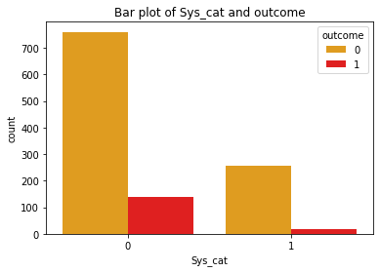
Sys_cat
Statistical Approach
Visual Approach
Previous Assumption: There is no relationship between Sys_cat and outcome
H0: There is no relationship between Sys_cat and outcome
H1: There is a relationship between Sys_cat and outcome
Test: Chi-Square test
p-Value: 0.00021
Conclusion: Reject H0, There is a relationship between Sys_cat and output
Remarks: Previous Assumption was incorrect
Cross Tab:
outcome 0 1
Sys_cat
0 760 140
1 258 19

Slide 19
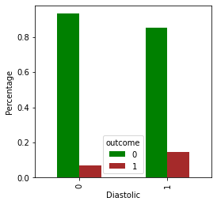
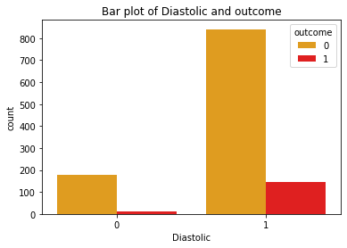
Diastolic
Statistical Approach
Visual Approach
Previous Assumption: There is no relationship between Diastolic and outcome
H0: There is no relationship between Diastolic and outcome
H1: There is a relationship between Diastolic and outcome
Test: Chi-Square test
p-Value: 0.00333
Conclusion: Reject H0, There is a relationship between Diastolic and output
Remarks: Previous Assumption was incorrect
Cross Tab:
outcome 0 1
Diastolic
0 177 13
1 841 146

Slide 20
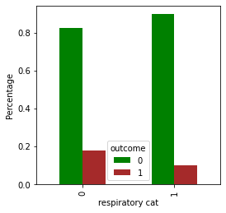
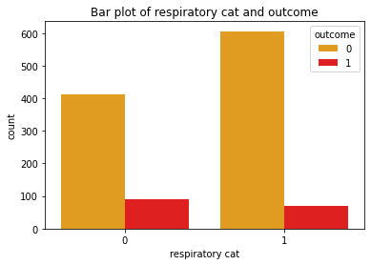
Respiratory cat
Statistical Approach
Visual Approach
Previous Assumption: There is no relationship between respiratory cat and outcome
H0: There is no relationship between respiratory cat and outcome
H1: There is a relationship between respiratory cat and outcome
Test: Chi-Square test
p-Value: 0.00024
Conclusion: Reject H0, There is a relationship between respiratory cat and output
Remarks: Previous Assumption was incorrect
Cross Tab:
outcome 0 1
respiratory cat
0 412 89
1 606 70

Slide 21

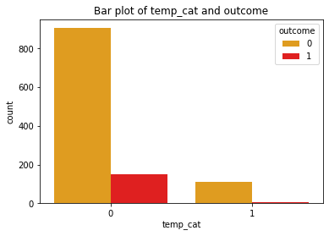
Temp_cat
Statistical Approach
Visual Approach
Previous Assumption: There is no relationship between temp_cat and outcome
H0: There is no relationship between temp_cat and outcome
H1: There is a relationship between temp_cat and outcome
Test: Chi-Square test
p-Value: 0.00944
Conclusion: Reject H0, There is a relationship between temp_cat and output
Remarks: Previous Assumption was incorrect
Cross Tab:
outcome 0 1
temp_cat
0 905 152
1 113 7

Slide 22

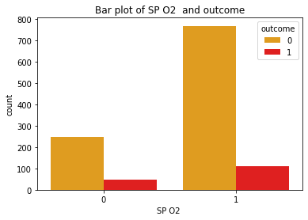
SP O2
Statistical Approach
Visual Approach
Previous Assumption: There is a relationship between SP O2 and outcome
H0: There is no relationship between SP O2 and outcome
H1: There is a relationship between SP O2 and outcome
Test: Chi-Square test
p-Value: 0.16806
Conclusion: Retain H0, There is no relationship between SP O2 and output
Remarks: Previous Assumption was incorrect
Cross Tab:
outcome 0 1
SP O2
0 249 47
1 769 112

Slide 23
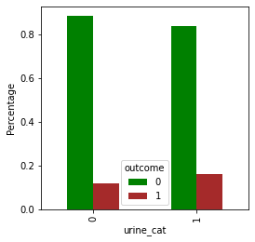
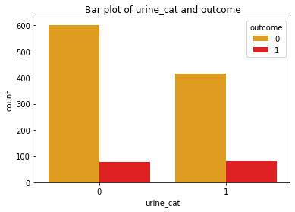
Urine_cat
Statistical Approach
Visual Approach
Previous Assumption: There is no relationship between urine_cat and outcome
H0: There is no relationship between urine_cat and outcome
H1: There is a relationship between urine_cat and outcome
Test: Chi-Square test
p-Value: 0.02481
Conclusion: Reject H0, There is a relationship between urine_cat and output
Remarks: Previous Assumption was incorrect
Cross Tab:
outcome 0 1
urine_cat
0 602 79
1 416 80

Slide 24
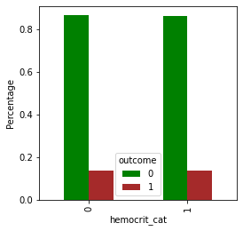
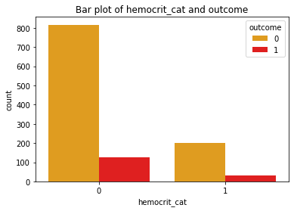
Hemocrit_cat
Statistical Approach
Visual Approach
Previous Assumption: There is no relationship between hemocrit_cat and outcome
H0: There is no relationship between hemocrit_cat and outcome
H1: There is a relationship between hemocrit_cat and outcome
Test: Chi-Square test
p-Value: 0.93374
Conclusion: Retain H0, There is no relationship between hemocrit_cat and output
Remarks: Previous Assumption was correct
Cross Tab:
outcome 0 1
hemocrit_cat
0 816 127
1 202 32

Slide 25


RBC_Cat
Statistical Approach
Visual Approach
Previous Assumption: There is no relationship between RBC_Cat and outcome
H0: There is no relationship between RBC_Cat and outcome
H1: There is a relationship between RBC_Cat and outcome
Test: Chi-Square test
p-Value: 0.31606
Conclusion: Retain H0, There is no relationship between RBC_Cat and output
Remarks: Previous Assumption was correct
Cross Tab:
outcome 0 1
RBC_Cat
0 578 97
1 440 62

Slide 26

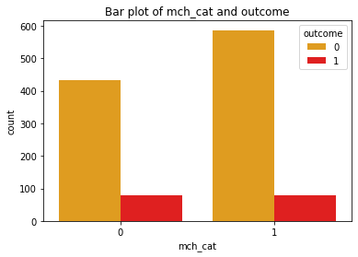
MCH_cat
Statistical Approach
Visual Approach
Previous Assumption: There is a relationship between mch_cat and outcome
H0: There is no relationship between mch_cat and outcome
H1: There is a relationship between mch_cat and outcome
Test: Chi-Square test
p-Value: 0.08631
Conclusion: Retain H0, There is no relationship between mch_cat and output
Remarks: Previous Assumption was incorrect
Cross Tab:
outcome 0 1
mch_cat
0 432 79
1 586 80

Slide 27
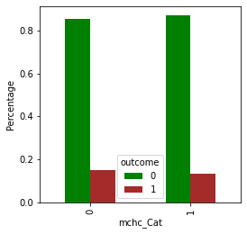
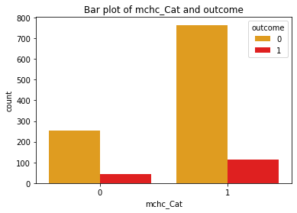
MCHC_Cat
Statistical Approach
Visual Approach
Previous Assumption: There is a relationship between mchc_Cat and outcome
H0: There is no relationship between mchc_Cat and outcome
H1: There is a relationship between mchc_Cat and outcome
Test: Chi-Square test
p-Value: 0.46289
Conclusion: Retain H0, There is no relationship between mchc_Cat and output
Remarks: Previous Assumption was incorrect
Cross Tab:
outcome 0 1
mchc_Cat
0 254 44
1 764 115

Slide 28
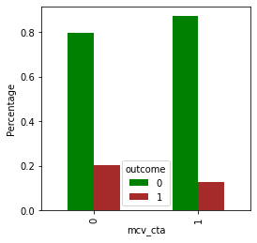
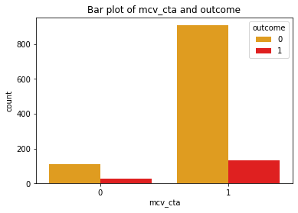
MCV_cta
Statistical Approach
Visual Approach
Previous Assumption: There is no relationship between mcv_cta and outcome
H0: There is no relationship between mcv_cta and outcome
H1: There is a relationship between mcv_cta and outcome
Test: Chi-Square test
p-Value: 0.01481
Conclusion: Reject H0, There is a relationship between mcv_cta and output
Remarks: Previous Assumption was incorrect
Cross Tab:
outcome 0 1
mcv_cta
0 111 28
1 907 131

Slide 29
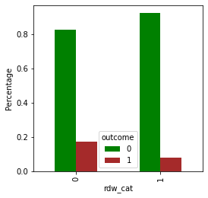
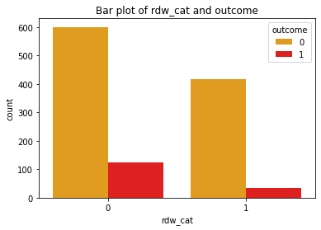
RDW_cat
Statistical Approach
Visual Approach
Previous Assumption: There is a relationship between rdw_cat and outcome
H0: There is no relationship between rdw_cat and outcome
H1: There is a relationship between rdw_cat and outcome
Test: Chi-Square test
p-Value: 0
Conclusion: Reject H0, There is a relationship between rdw_cat and output
Remarks: Previous Assumption was correct
Cross Tab:
outcome 0 1
rdw_cat
0 600 124
1 418 35

Slide 30
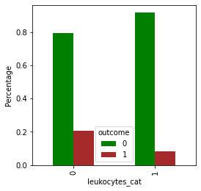
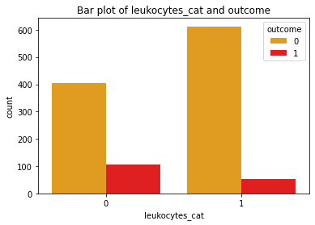
Leukocytes_cat
Statistical Approach
Visual Approach
Previous Assumption: There is a relationship between leukocytes_cat and outcome
H0: There is no relationship between leukocytes_cat and outcome
H1: There is a relationship between leukocytes_cat and outcome
Test: Chi-Square test
p-Value: 0
Conclusion: Reject H0, There is a relationship between leukocytes_cat and output
Remarks: Previous Assumption was correct
Cross Tab:
outcome 0 1
leukocytes_cat
0 406 105
1 612 54

Slide 31
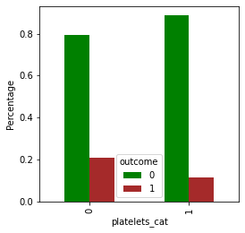

Platelets_cat
Statistical Approach
Visual Approach
Previous Assumption: There is no relationship between platelets_cat and outcome
H0: There is no relationship between platelets_cat and outcome
H1: There is a relationship between platelets_cat and outcome
Test: Chi-Square test
p-Value: 0.0001
Conclusion: Reject H0, There is a relationship between platelets_cat and output
Remarks: Previous Assumption was incorrect
Cross Tab:
outcome 0 1
platelets_cat
0 216 56
1 802 103

Slide 32


Neutriphil_cat
Statistical Approach
Visual Approach
Previous Assumption: There is no relationship between neutriphil_cat and outcome
H0: There is no relationship between neutriphil_cat and outcome
H1: There is a relationship between neutriphil_cat and outcome
Test: Chi-Square test
p-Value: 0.00479
Conclusion: Reject H0, There is a relationship between neutriphil_cat and output
Remarks: Previous Assumption was incorrect
Cross Tab:
outcome 0 1
neutriphil_cat
0 888 151
1 130 8

Slide 33


Basophil_cat
Statistical Approach
Visual Approach
Previous Assumption: There is a relationship between Basophil_cat and outcome
H0: There is no relationship between Basophil_cat and outcome
H1: There is a relationship between Basophil_cat and outcome
Test: Chi-Square test
p-Value: 0.00184
Conclusion: Reject H0, There is a relationship between Basophil_cat and output
Remarks: Previous Assumption was correct
Cross Tab:
outcome 0 1
Basophil_cat
0 703 90
1 315 69

Slide 34


Lympho_cat
Statistical Approach
Visual Approach
Previous Assumption: There is no relationship between Lympho_cat and outcome
H0: There is no relationship between Lympho_cat and outcome
H1: There is a relationship between Lympho_cat and outcome
Test: Chi-Square test
p-Value: 0
Conclusion: Reject H0, There is a relationship between Lympho_cat and output
Remarks: Previous Assumption was incorrect
Cross Tab:
outcome 0 1
Lympho_cat
0 524 122
1 494 37

Slide 35


PT_cat(sec)
Statistical Approach
Visual Approach
Previous Assumption: There is a relationship between PT_cat(sec) and outcome
H0: There is no relationship between PT_cat(sec) and outcome
H1: There is a relationship between PT_cat(sec) and outcome
Test: Chi-Square test
p-Value: 0.01604
Conclusion: Reject H0, There is a relationship between PT_cat(sec) and output
Remarks: Previous Assumption was correct
Cross Tab:
outcome 0 1
PT_cat(sec)
0 705 125
1 313 34

Slide 36


INR_cat
Statistical Approach
Visual Approach
Previous Assumption: There is a relationship between INR_cat and outcome
H0: There is no relationship between INR_cat and outcome
H1: There is a relationship between INR_cat and outcome
Test: Chi-Square test
p-Value: 0.35214
Conclusion: Retain H0, There is no relationship between INR_cat and output
Remarks: Previous Assumption was incorrect
Cross Tab:
outcome 0 1
INR_cat
0 875 141
1 143 18

Slide 37


NT_cat
Statistical Approach
Visual Approach
Previous Assumption: There is a relationship between NT_cat and outcome
H0: There is no relationship between NT_cat and outcome
H1: There is a relationship between NT_cat and outcome
Test: Chi-Square test
p-Value: 0.21903
Conclusion: Retain H0, There is no relationship between NT_cat and output
Remarks: Previous Assumption was incorrect
Cross Tab:
outcome 0 1
NT_cat
0 979 156
1 39 3

Slide 38


CK_cat
Statistical Approach
Visual Approach
Previous Assumption: There is no relationship between CK_cat and outcome
H0: There is no relationship between CK_cat and outcome
H1: There is a relationship between CK_cat and outcome
Test: Chi-Square test
p-Value: 0.85426
Conclusion: Retain H0, There is no relationship between CK_cat and output
Remarks: Previous Assumption was correct
Cross Tab:
outcome 0 1
CK_cat
0 914 142
1 104 17

Slide 39


Creatinine_cat
Statistical Approach
Visual Approach
Previous Assumption: There is a relationship between Creatinine_cat and outcome
H0: There is no relationship between Creatinine_cat and outcome
H1: There is a relationship between Creatinine_cat and outcome
Test: Chi-Square test
p-Value: 0.0064
Conclusion: Reject H0, There is a relationship between Creatinine_cat and output
Remarks: Previous Assumption was correct
Cross Tab:
outcome 0 1
Creatinine_cat
0 588 110
1 430 49

Slide 40


UN_cat
Statistical Approach
Visual Approach
Previous Assumption: There is a relationship between UN_cat and outcome
H0: There is no relationship between UN_cat and outcome
H1: There is a relationship between UN_cat and outcome
Test: Chi-Square test
p-Value: 0.00001
Conclusion: Reject H0, There is a relationship between UN_cat and output
Remarks: Previous Assumption was correct
Cross Tab:
outcome 0 1
UN_cat
0 624 127
1 394 32

Slide 41


Glu_cat
Statistical Approach
Visual Approach
Previous Assumption: There is no relationship between Glu_cat and outcome
H0: There is no relationship between Glu_cat and outcome
H1: There is a relationship between Glu_cat and outcome
Test: Chi-Square test
p-Value: 0.06868
Conclusion: Retain H0, There is no relationship between Glu_cat and output
Remarks: Previous Assumption was correct
Cross Tab:
outcome 0 1
Glu_cat
0 870 127
1 148 32

Slide 42


Potas_cat
Statistical Approach
Visual Approach
Previous Assumption: There is no relationship between potas_cat and outcome
H0: There is no relationship between potas_cat and outcome
H1: There is a relationship between potas_cat and outcome
Test: Chi-Square test
p-Value: 0.03105
Conclusion: Reject H0, There is a relationship between potas_cat and output
Remarks: Previous Assumption was incorrect
Cross Tab:
outcome 0 1
potas_cat
0 62 17
1 956 142

Slide 43


Sodium_cat
Statistical Approach
Visual Approach
Previous Assumption: There is a relationship between sodium_cat and outcome
H0: There is no relationship between sodium_cat and outcome
H1: There is a relationship between sodium_cat and outcome
Test: Chi-Square test
p-Value: 0.00002
Conclusion: Reject H0, There is a relationship between sodium_cat and output
Remarks: Previous Assumption was correct
Cross Tab:
outcome 0 1
sodium_cat
0 171 49
1 847 110

Slide 44


Cal_cat
Statistical Approach
Visual Approach
Previous Assumption: There is no relationship between cal_cat and outcome
H0: There is no relationship between cal_cat and outcome
H1: There is a relationship between cal_cat and outcome
Test: Chi-Square test
p-Value: 0.00001
Conclusion: Reject H0, There is a relationship between cal_cat and output
Remarks: Previous Assumption was incorrect
Cross Tab:
outcome 0 1
cal_cat
0 497 107
1 521 52

Slide 45


Chloride_cat
Statistical Approach
Visual Approach
Previous Assumption: There is a relationship between chloride_cat and outcome
H0: There is no relationship between chloride_cat and outcome
H1: There is a relationship between chloride_cat and outcome
Test: Chi-Square test
p-Value: 0.00162
Conclusion: Reject H0, There is a relationship between chloride_cat and output
Remarks: Previous Assumption was correct
Cross Tab:
outcome 0 1
chloride_cat
0 337 73
1 681 86

Slide 46


Anion_cat
Statistical Approach
Visual Approach
Previous Assumption: There is no relationship between anion_cat and outcome
H0: There is no relationship between anion_cat and outcome
H1: There is a relationship between anion_cat and outcome
Test: Chi-Square test
p-Value: 0
Conclusion: Reject H0, There is a relationship between anion_cat and output
Remarks: Previous Assumption was incorrect
Cross Tab:
outcome 0 1
anion_cat
0 168 67
1 850 92

Slide 47


Mag_cat
Statistical Approach
Visual Approach
Previous Assumption: There is no relationship between Mag_cat and outcome
H0: There is no relationship between Mag_cat and outcome
H1: There is a relationship between Mag_cat and outcome
Test: Chi-Square test
p-Value: 0.07343
Conclusion: Retain H0, There is no relationship between Mag_cat and output
Remarks: Previous Assumption was correct
Cross Tab:
outcome 0 1
Mag_cat
0 324 62
1 694 97

Slide 48


Ph_cat
Statistical Approach
Visual Approach
Previous Assumption: There is no relationship between ph_cat and outcome
H0: There is no relationship between ph_cat and outcome
H1: There is a relationship between ph_cat and outcome
Test: Chi-Square test
p-Value: 0
Conclusion: Reject H0, There is a relationship between ph_cat and output
Remarks: Previous Assumption was incorrect
Cross Tab:
outcome 0 1
ph_cat
0 295 18
1 723 141

Slide 49


Biccarbon_cat
Statistical Approach
Visual Approach
Previous Assumption: There is no relationship between Biccarbon_cat and outcome
H0: There is no relationship between Biccarbon_cat and outcome
H1: There is a relationship between Biccarbon_cat and outcome
Test: Chi-Square test
p-Value: 0.04552
Conclusion: Reject H0, There is a relationship between Biccarbon_cat and output
Remarks: Previous Assumption was incorrect
Cross Tab:
outcome 0 1
Biccarbon_cat
0 464 86
1 554 73

Slide 50


Metcat
Statistical Approach
Visual Approach
Previous Assumption: There is no relationship between metcat and outcome
H0: There is no relationship between metcat and outcome
H1: There is a relationship between metcat and outcome
Test: Chi-Square test
p-Value: 0
Conclusion: Reject H0, There is a relationship between metcat and output
Remarks: Previous Assumption was incorrect
Cross Tab:
outcome 0 1
metcat
0 1006 136
1 12 23

Slide 51


Lactic_cat
Statistical Approach
Visual Approach
Previous Assumption: There is no relationship between lactic_cat and outcome
H0: There is no relationship between lactic_cat and outcome
H1: There is a relationship between lactic_cat and outcome
Test: Chi-Square test
p-Value: 0.30695
Conclusion: Retain H0, There is no relationship between lactic_cat and output
Remarks: Previous Assumption was correct
Cross Tab:
outcome 0 1
lactic_cat
0 796 130
1 222 29

Slide 52


PCO2_cat
Statistical Approach
Visual Approach
Previous Assumption: There is no relationship between pco2_cat and outcome
H0: There is no relationship between pco2_cat and outcome
H1: There is a relationship between pco2_cat and outcome
Test: Chi-Square test
p-Value: 0.00488
Conclusion: Reject H0, There is a relationship between pco2_cat and output
Remarks: Previous Assumption was incorrect
Cross Tab:
outcome 0 1
pco2_cat
0 744 99
1 274 60

Slide 53


EF_cat
Statistical Approach
Visual Approach
Previous Assumption: There is no relationship between ef_cat and outcome
H0: There is no relationship between ef_cat and outcome
H1: There is a relationship between ef_cat and outcome
Test: Chi-Square test
p-Value: 0.09665
Conclusion: Retain H0, There is no relationship between ef_cat and output
Remarks: Previous Assumption was correct
Cross Tab:
outcome 0 1
ef_cat
0 428 78
1 590 81

