Slide 1
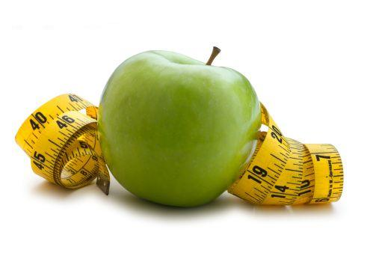
WiseBite
Akhil Ramachandran, Linda Pulickal, Nagarjun Pola

Slide 2
How WiseBite will help you?

Slide 3
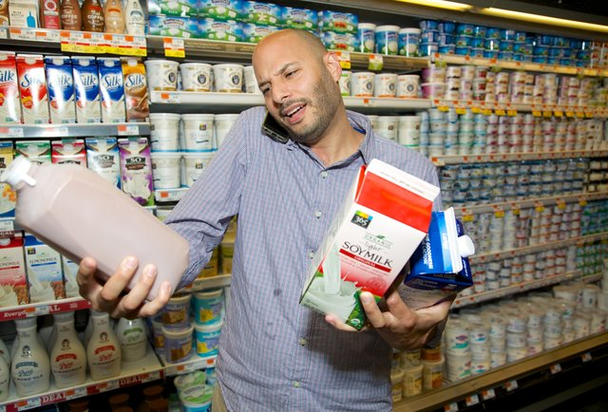
Confused which milk to pick?

Slide 4

How much calories are you having for breakfast?

Slide 5
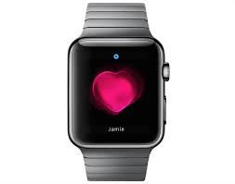
What we did?

Slide 6
How we do it?
Convert what you say to text. (speech to text translation)
Extract food products from the text
Do our magic and get you the nutrition report
Suggest products for you to buy

