Slide 1


Comparative Study of Machine Learning Algorithms in
Predicting the Drag Coefficient of Non-Spherical
Particles
Mineral Processing and Multiphase flows Lab, IIT
Hyderabad
INTERN SUPERVISOR :
Dr. Narshimha Mangadoddy
II301 SUPERVISOR :
Dr. Vishwajeet Mehandia
PRESENTED BY :
Akhil Rathod(2021CHB1364)
1

Slide 2
Introduction:
The drag coefficient (Cd) is a fundamental parameter in chemical engineering, representing the resistance experienced by particles as they move through a fluid.
Understanding and accurately predicting Cd is critical for optimizing processes like fluidized beds, sedimentation, filtration, and particle transport.
Irregular particles pose a unique challenge due to their non-uniform shapes and orientations, which introduce complex dependencies between particle shape, Reynolds number, and fluid properties.
Traditional models, such as those by Haider and Levenspiel, rely on complex empirical equations, which are often limited and falls apart when applied to real- world applications.
Solution is Machine Learning.
The outcomes of this work have applications in optimizing chemical processes, improving industrial equipment design, and contributing to environmental modeling.
3

Slide 3
Literature Survey:
The drag coefficient has been extensively studied for spherical particles, with models correlating Cd to Reynolds number for specific conditions.
Haider and Levenspiel (1989): Developed empirical correlations for both spherical and nonspherical particles, emphasizing particle sphericity.
Yang et al. (2021): Proposed a shape-dependent drag law for nonspherical particles using extensive datasets covering a broad range of Reynolds numbers.
Challenges with existing models:
Limited applicability to irregular particle shapes and orientations.
Dependency on predefined shape descriptors like sphericity(Φ), which cannot capture all irregularities.
Recent advancements include the integration of computational methods, such as machine learning, to predict Cd for irregular particles.
4

Slide 4
Problem statement and Objectives:
Problem Statement :
Analyzing drag forces acting on irregularly shaped particles by finding the drag coefficients.
Develop machine learning models to predict drag coefficients accurately.
Objectives :
Enhance Prediction Accuracy: Develop ML models for accurate Cd prediction for irregular particles.
Improve Process Efficiency: Insights into drag behavior for optimizing systems like fluidized beds.
Address Nonlinear Dependencies: Leverage ML for complex relationship modeling.
Enable Real-World Applications: Models applicable to diverse scenarios.
5

Slide 5
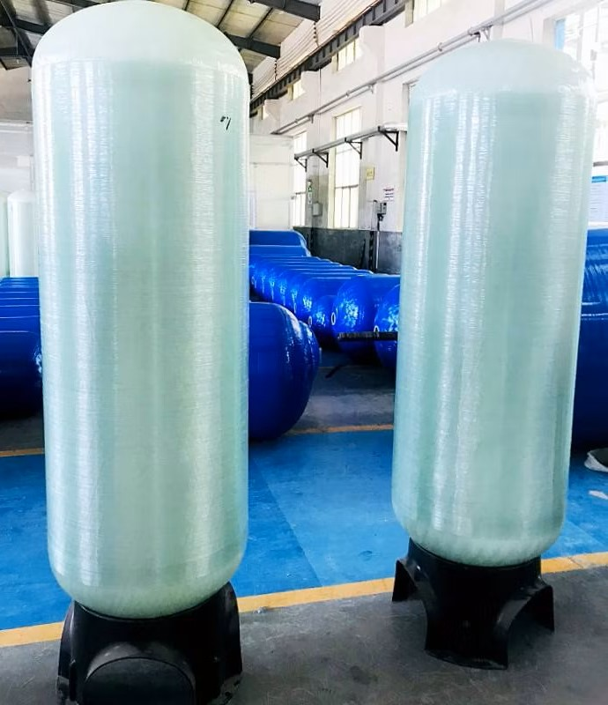
Equipment and Chemicals used:
Vertical 1.5 high pass glass cylinder(Inner radius = 5cm).
High-definition video camera (720 × 1,280 pixels).
Distilled water (ρf = 1,000 kg m3, μf = 0.00102 Pa s at 20°C).
Ethylic alcohol (ρf = 810 kg m3, μf = 0.00172 Pa s at 20°C).
Solution of glycerin diluted by 13.5% volume of distilled water (ρf = 1,235 kg m3, μf = 0.2088 Pa s at 19°C).
Solution of glycerin diluted with 40% of distilled water (ρf = 1,172 kg m3, μf = 0.01499 Pa s at 22°C).
Irregular particles ( i.e. 828 samples )
6

Slide 6


Data Collection and Preprocessing:
828 samples containing features:
1)Fluid viscosity (μf), 2. Particle density (dp) , 3)fluid Density (df) , 4) Diameter(di) , 5) Shape factor(Ψ) , 6)Reynolds number (Re= 0.008-10000).
X = Input samples for ML models [i.e. Shape (828,6)] [1]
Y = Output variable is Drag Coefficient (C_d)[i.e. Shape (828,1)]
W_t = Terminal Velocity
Ψ = Φ/Χ [sphericity Φ and circularity X]
7

Slide 7

Calculation of Ψ :
[ 1 ]
Φ = A_sph/Ap
D_sph = (6m/πρ_p)^1/3
Ψ = Φ/Χ
X = P_mp/P_c
Parameters:
A_sph = surface area of the equivalent sphere.
A_p = particle surface area.
D_sph = diameter of the volume equivalent sphere.
m and ρ_p are the mass and density of particle.
Dl, Dm, and Ds are the three principal axes of the particle and z = 1.6075.
P_mp and P_c are the maximum projection perimeter and the perimeter of the circle equivalent to the maximum projection area A_mp.
8

Slide 8
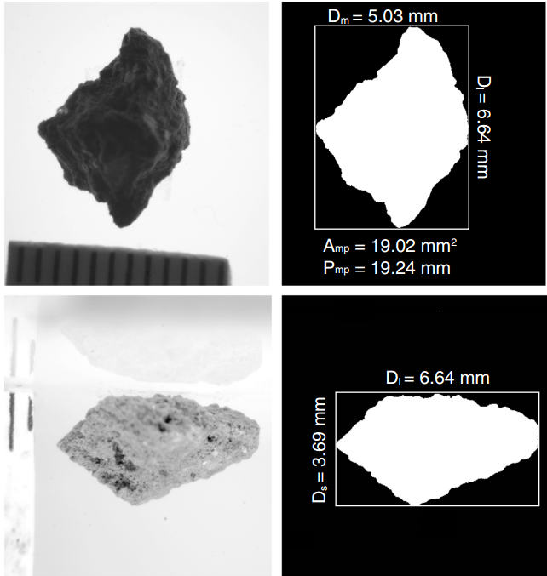
Calculation of Ψ :
The three perpendicular axes( Dl, Dm, and Ds ), A_mp & P_mp are obtained from Image-analysis technique (OpenCV) by high resolution digital photographs of particles shown in fig 1.
The settling velocity(W_t) was measured by frame-by-frame tracking of particle fall velocity by High-definition video camera using a recording rate of up to 50 FPS.
Figure 1 : Image analysis in OpenCV [ 5 ]
9

Slide 9
ML Pipeline and workflow:
1) Experimental Dataset Preparation
2)Data preprocessing and cleaning.
3) Training ML models for Regression
4) Hypertuning parameters by GridsearchCV
Data Collection
Input-(X)
Output-(Y)
Feature Engineering
Model Building and Validation
Model Optimization
7)Selection of Best model
6)Plotting the results
5)Obtaining Metrics
ML model ~ Theoretical model
Scatter plots
Performance metrics and Model Evaluation
10

Slide 10
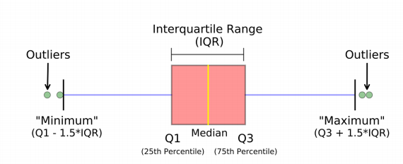
Exploratory Data Analysis and Feature Engineering :
Feature Selection : Forward Selection Method, features that improve prediction of y are iteratively added. This is repeated until additional features do not improve the prediction of y.
Selected features for ML: Re , Ψ .
2) Outlier detection : Inter-quartile range Method[296 outliers were found].
Figure 2 : IQR method [ 3 ]
11

Slide 11
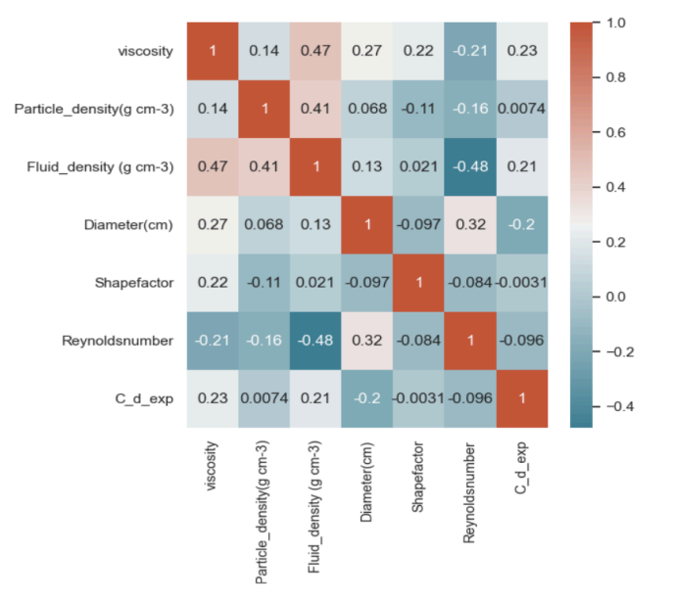
Exploratory Data Analysis:
3) Correlation : Strength of an association between two variables.
4)Data Splitting: 80:20
ML model is trained with 80% of the data and remaining 20% as test set.
5) Hypertuning : GridsearchCV Optimization Process is used.(Model optimization)
Figure 3 : Correlation Heatmap [ 5 ]
12

Slide 12
ML Results:
Algorithm | R2 Score
Linear Regression + Lasso | -0.0088
MLR + Kfold | -0.000973
Polynomial Regression (deg = 3) | 0.0249
Polynomial + Kfold (deg = 3) | 0.026
Support Vector Regression | -0.0091
Artificial Neural Networkn + GridsearchCV | 0.8812
Decision Tree Regression + GridsearchCV | 0.9161
Random Forest Regression + GridsearchCV | 0.9163
Radial Basis Functional Neural Network + GridsearchCV | 0.90
13

Slide 13
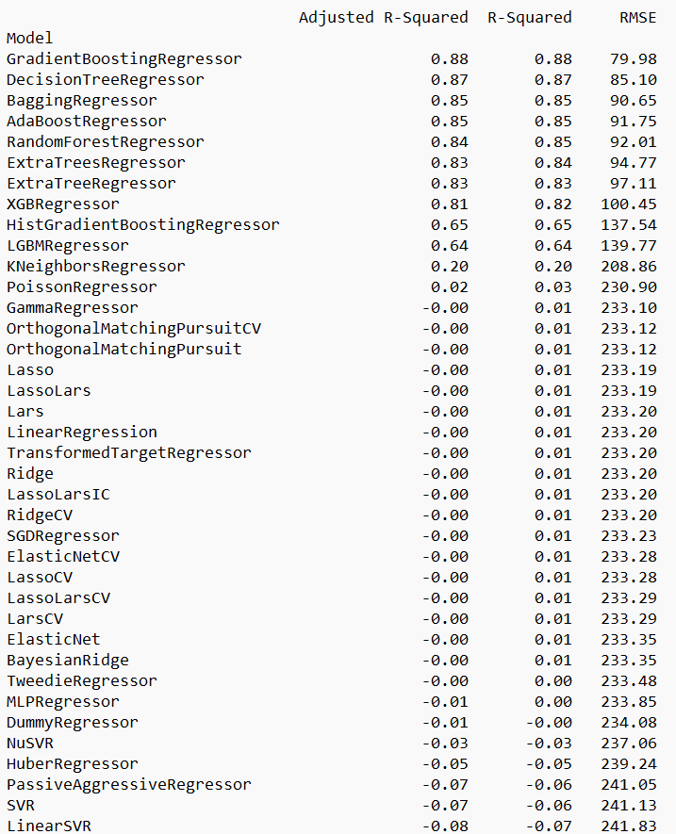
ML Models and results:
Results obtained from Lazy predict are shown in the figure:
Efficient Model Benchmarking.
Preliminary Assessment of Model Suitability.
Guidance for Hyperparameter Tuning.
14

Slide 14
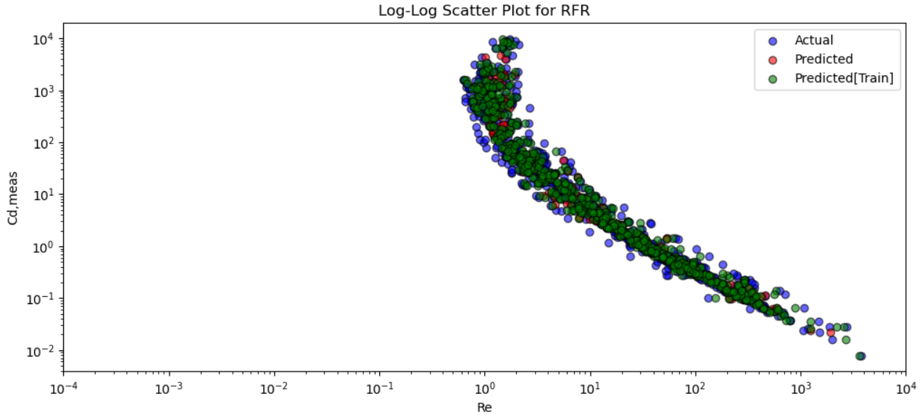
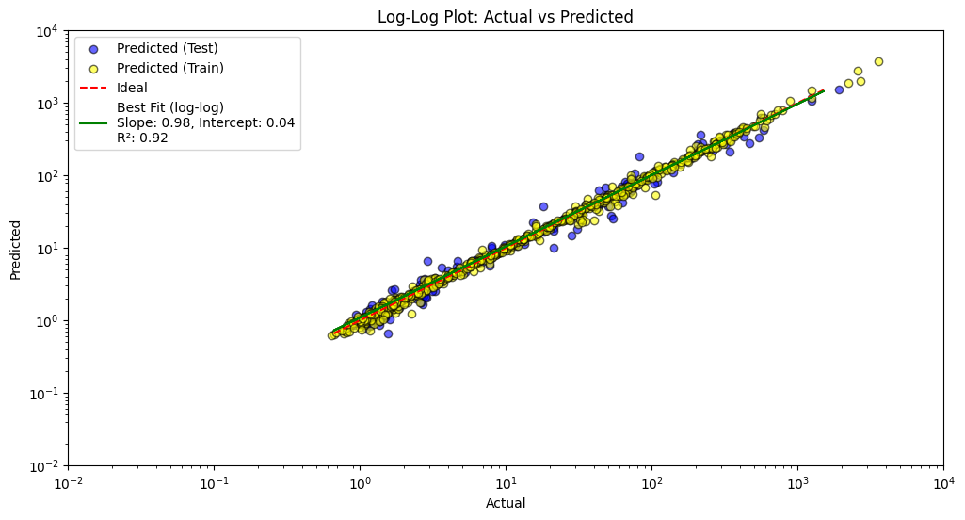
Plot Results and Data Visualization:
Scatter plots of C_d vs Re and Actual vs Predicted both on Log scales in order for better visualization of ideal fit.
Figure 4 : Random Forest Tree (Predicted vs Actual)
Figure 5 :Scatter Plot of C_d vs Re
15

Slide 15
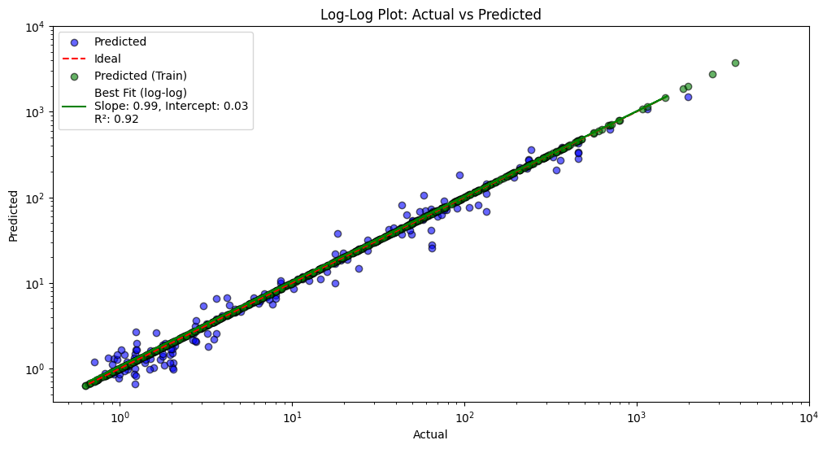
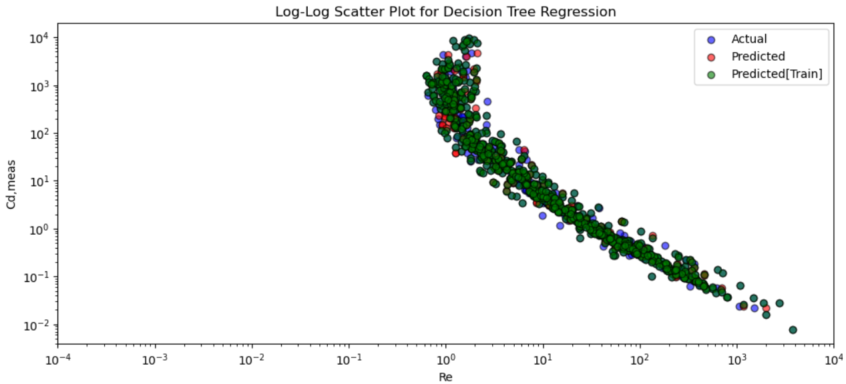
Plot Results and Data Visualization:
Figure 6 : Decision Tree Regression (Predicted vs Actual)
Figure 7 :Scatter Plot of C_d vs Re
16

Slide 16
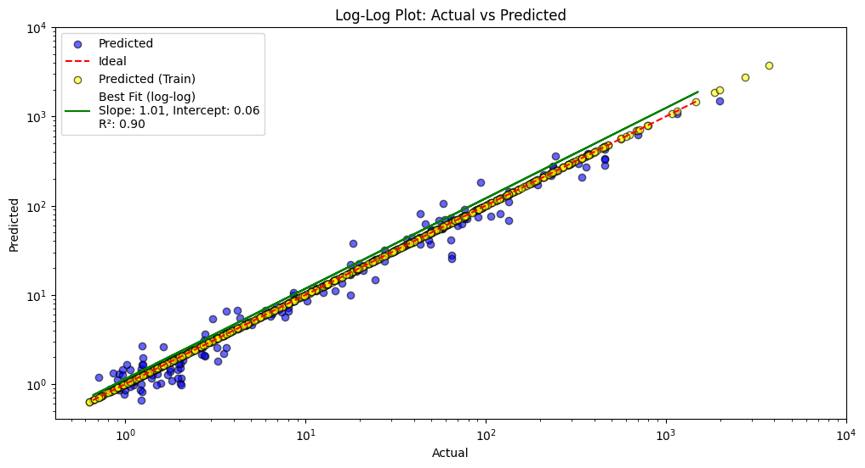
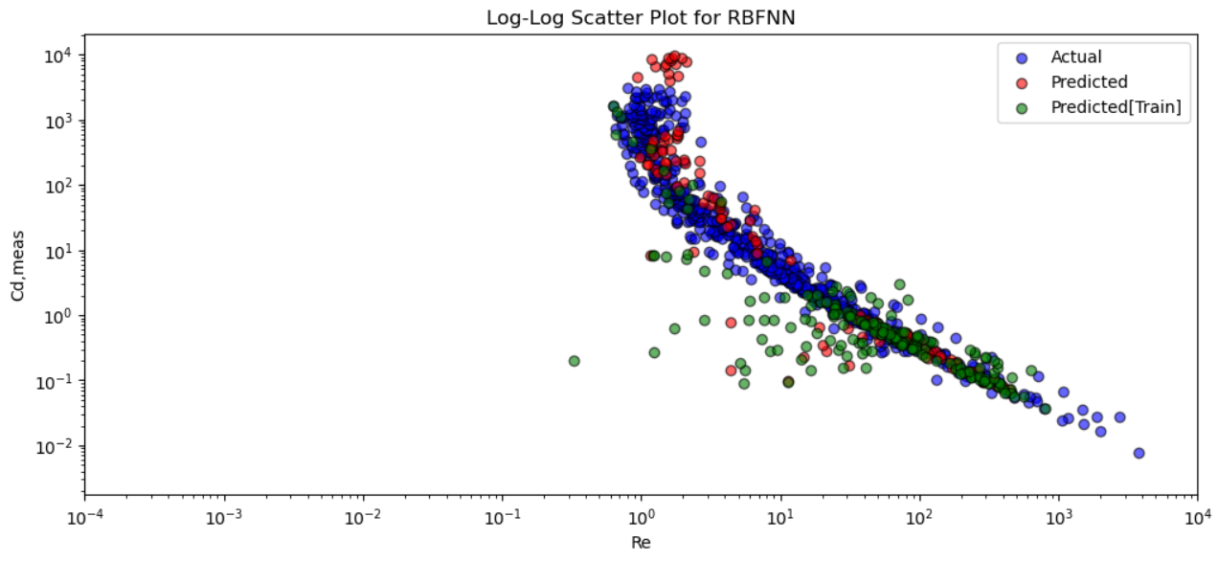
Plot Results and Data Visualization:
Figure 8: Radial Basis Functional Neural Network [ RBFNN] (Predicted vs Actual)
Figure 9 :Scatter Plot of C_d vs Re
17

Slide 17
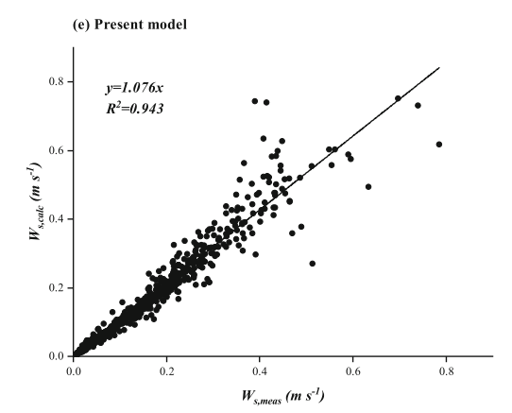
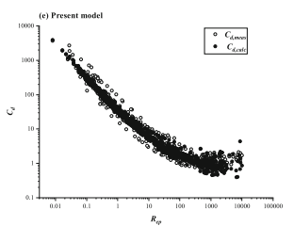
Insights from ML models:
Theoretical Drag law model plots are given below:
Figure 10: Predicted vs Actual plot of latest Model proposed by Fan Yang & Yu-Hong Zeng & Wen-Xin Huai.
Figure 11 : C_d vs Re plot of latest Model proposed by Fan Yang & Yu-Hong Zeng & Wen-Xin Huai.
18

Slide 18
References:
A New One-Equation Model of Fluid Drag for Irregularly Shaped Particles Valid Over a Wide Range of Reynolds Number. [A New One‐Equation Model of Fluid Drag for Irregularly Shaped Particles Valid Over a Wide Range of Reynolds Number - Dioguardi - 2018 - Journal of Geophysical Research: Solid Earth - Wiley Online Library ].
Drag Coefficient and Terminal Velocity of Spherical and Non-Spherical Particles. [(PDF) Drag Coefficient and Terminal Velocity of Spherical and Non-Spherical Particles ]
Powder Technology | Journal | ScienceDirect.com by Elsevier [Powder Technology | Journal | ScienceDirect.com by Elsevier ]
A new model for settling velocity of non-spherical particles. [A new model for settling velocity of non-spherical particles | Environmental Science and Pollution Research ]
OpenCv for finding dimensions of irregular particles : [https://answers.opencv.org/question/111923/detecting-the-shape-of-irregular-objects]
3

Slide 19
Conclusion:
Successfully developed machine learning models to predict drag coefficients suitable for the settlement of non-spherical particles in both laminar and turbulent flows.
Using machine learning techniques, such as Random Forest Regressor, Decision Tree Regressor and Radial Basis Neural Network [RBFNN], we accurately modeled the nonlinear dependencies, providing reliable predictions for various particle shapes and flow conditions.
The approach also provided insights into feature importance, with parameters like Shape factor and Reynolds number showing a substantial influence on Cd values.
Enhanced understanding of the significance of various features in drag prediction.
Demonstrated effective data preprocessing and outlier management techniques.
21

Slide 20
Internship Experience and Learnings :[2 Months]
Internship Learnings:
Gained practical experience in machine learning applications and Deep learning Applications in python.
Enhanced coding and data analysis skills through real-world projects.
Learnt on how to optimize the process.
Developed Communicational skills.
2. Responsibilities:
Experimental Data collection and preprocessing.
Implementing and tuning machine learning models.
Analyzing results and generating insights.
3

Slide 21
Feature Research and challenges:
Transfer learning approaches can be applied to adapt the models for predicting Cd under novel conditions or for different particle-fluid systems.
Focusing on extending these models to predict drag coefficients for even more complex shapes and a wider range of environmental conditions, as irregular shapes often occur in industrial processes and natural environments
Adapting ML models to handle real-time applications, such as sediment transport monitoring or fluidized bed modeling, where rapid predictions of drag coefficients are required.
Future models could integrate with advanced imaging techniques to dynamically analyze particle sphericity and orientation in fluids. This could involve developing new metrics in ML models that directly account for orientation-dependent drag coefficients.
19

Slide 22

23

