Slide 1
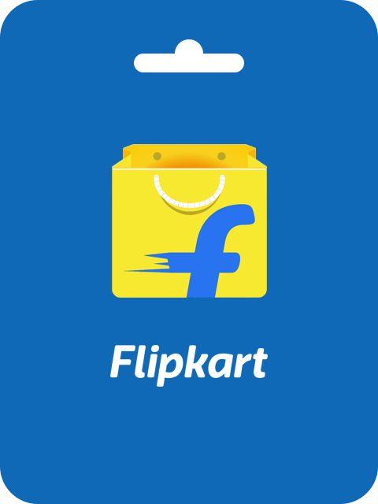
Flipkart’s SEM Strategy
A Deep Dive into India’s E-commerce Leader

Slide 2

Introduction :
Flipkart is one of India’s leading e-commerce platforms, competing with Amazon India, Meesho, and Reliance’s JioMart
Founded in 2007, Flipkart specializes in electronics, fashion, and groceries, catering to a vast Indian audience.
The Indian e-commerce market is projected to grow significantly, driven by increasing internet penetration and digital payments..

Slide 3

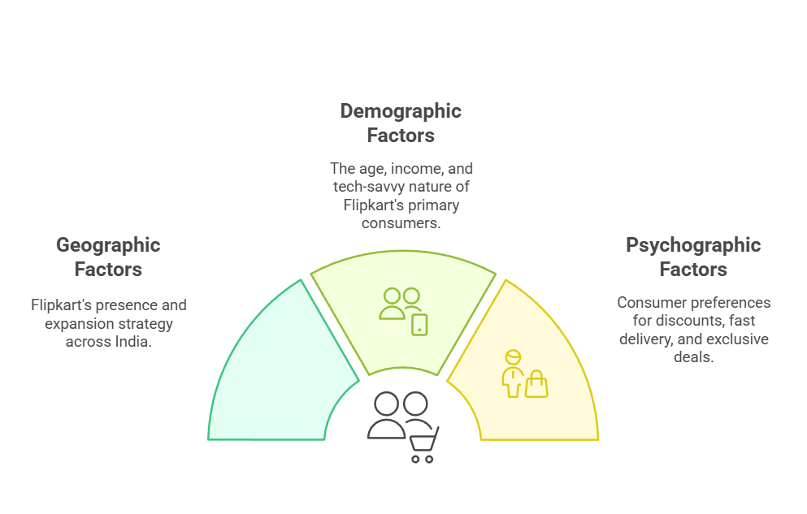
Target Audience

Slide 4
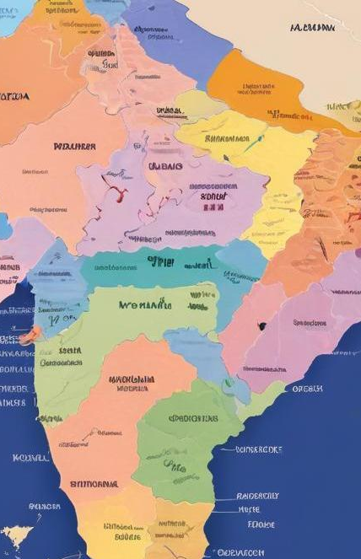
Geographic factors :
Pan-India presence, strong in metro cities and expanding into Tier-2 & Tier-3 regions.
Competes with local marketplaces and offline retail.

Slide 5
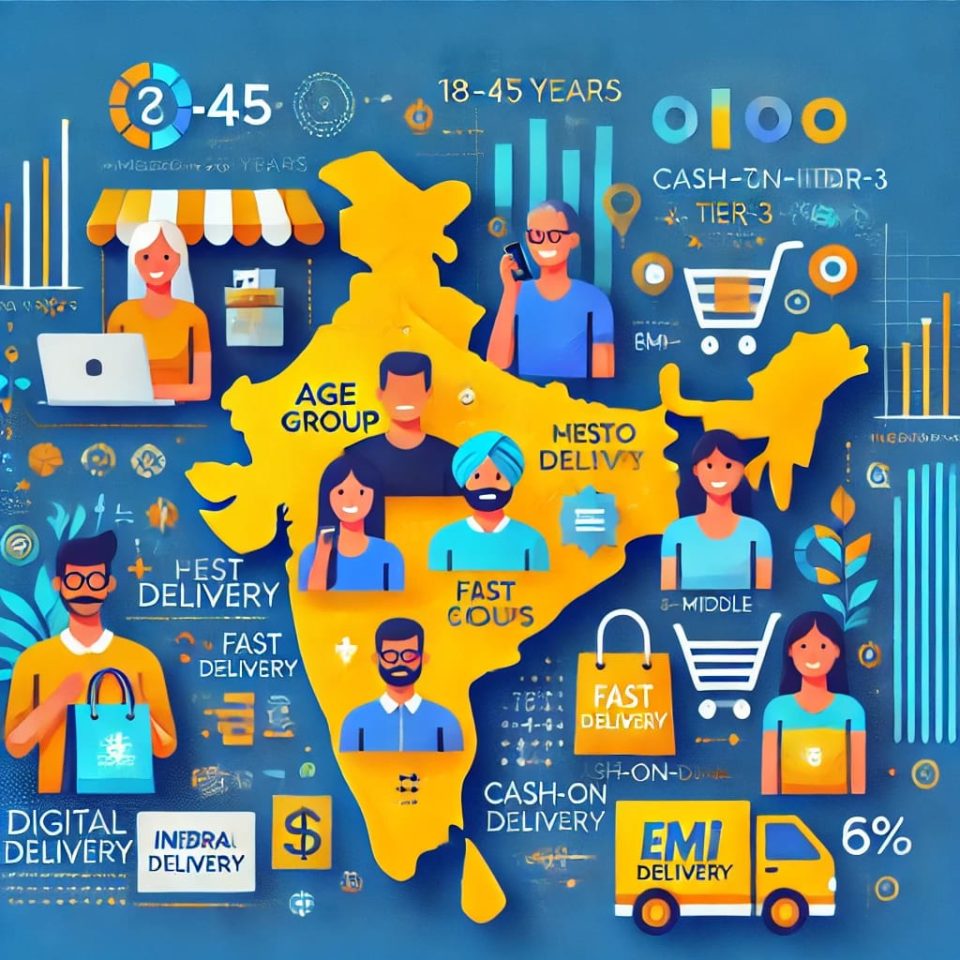
Demographic profile :
Age: 18-45 years (primary consumers).
Income: Middle to upper-middle class, price-sensitive but quality-conscious.
Tech-savvy individuals with access to mobile internet.

Slide 6
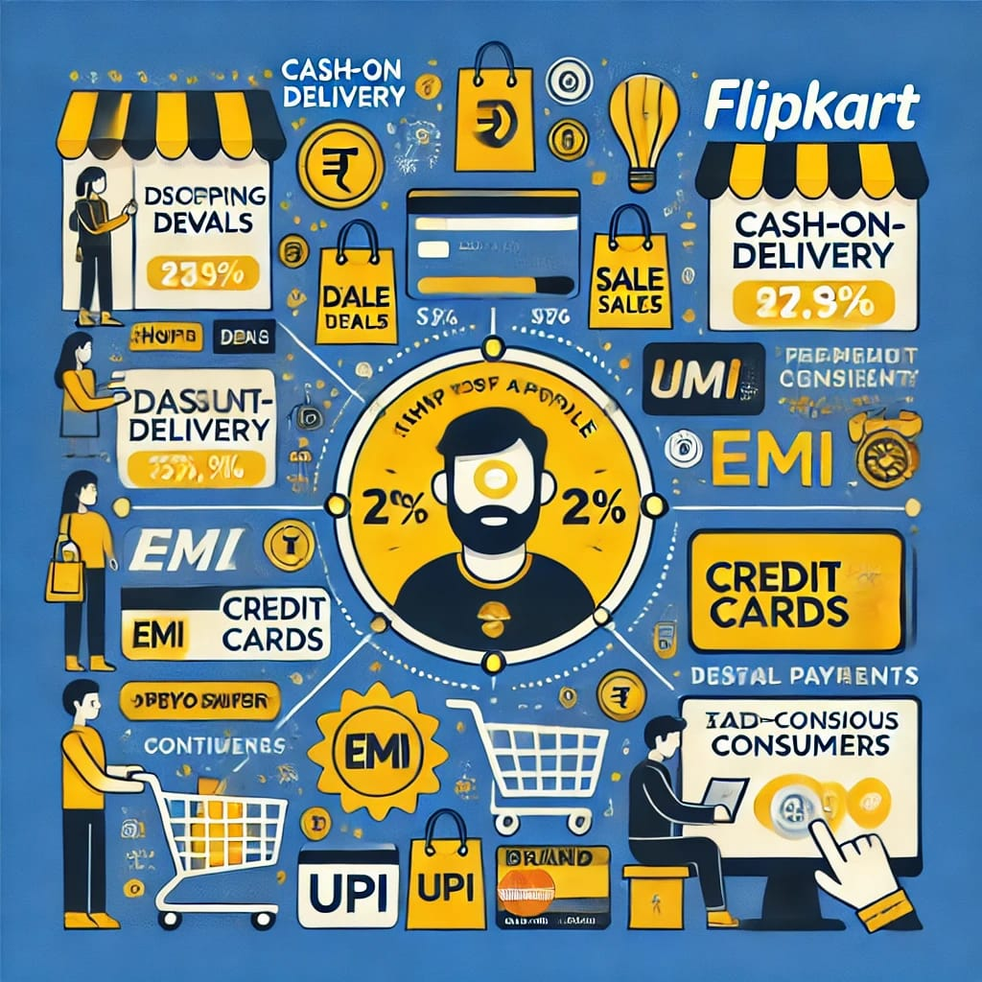
Psychographic preferences :
Preference for discounts, fast delivery, and cash-on-delivery options.
Interest in new product launches, festive sales, and exclusive deals.

Slide 7

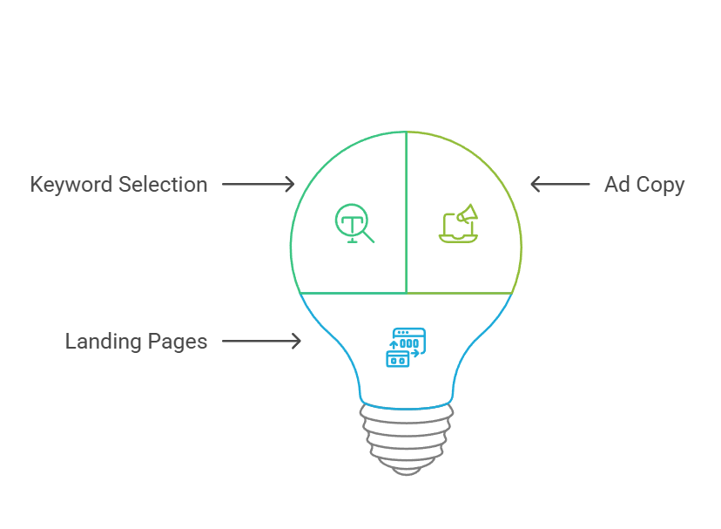
SEM Strategy

Slide 8
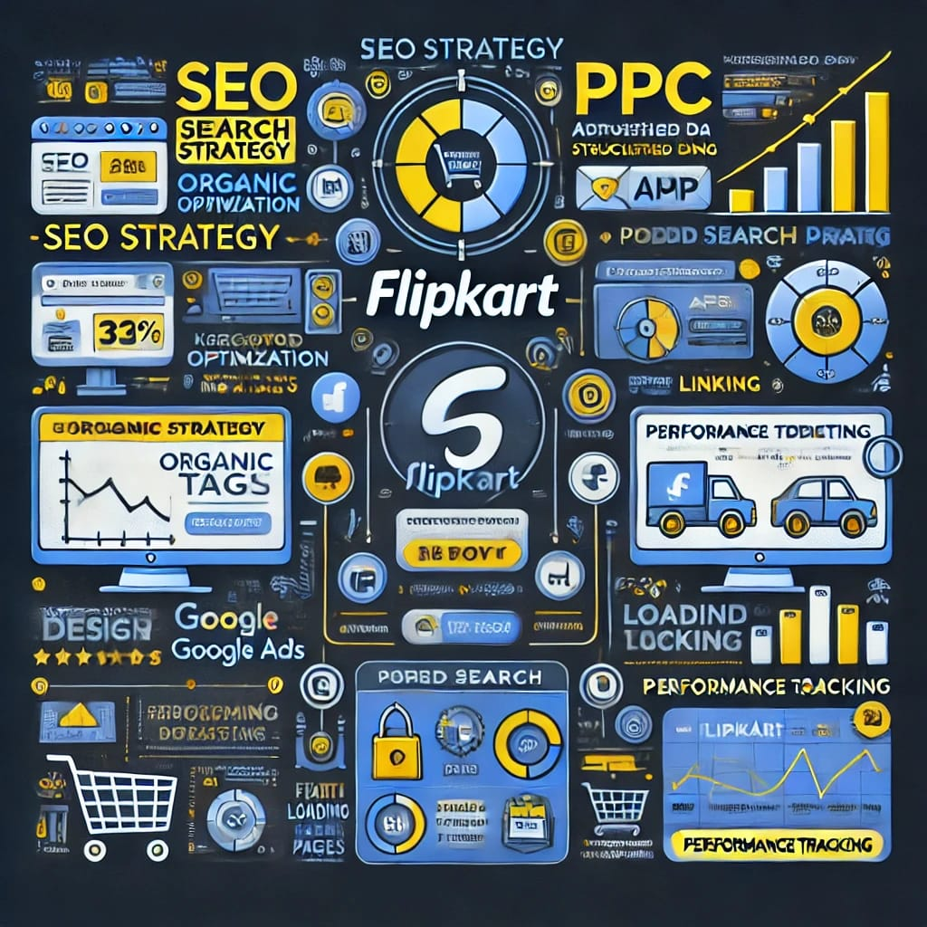
Keyword Selection: High intent product-based keywords (e.g., “buy iPhone 14 online,” “best running shoes under 3000”).
Ad Copy: Focus on discounts, limited-time offers, and free delivery messaging.
Landing Pages: Optimized for quick conversions with clear CTAs.

Slide 9
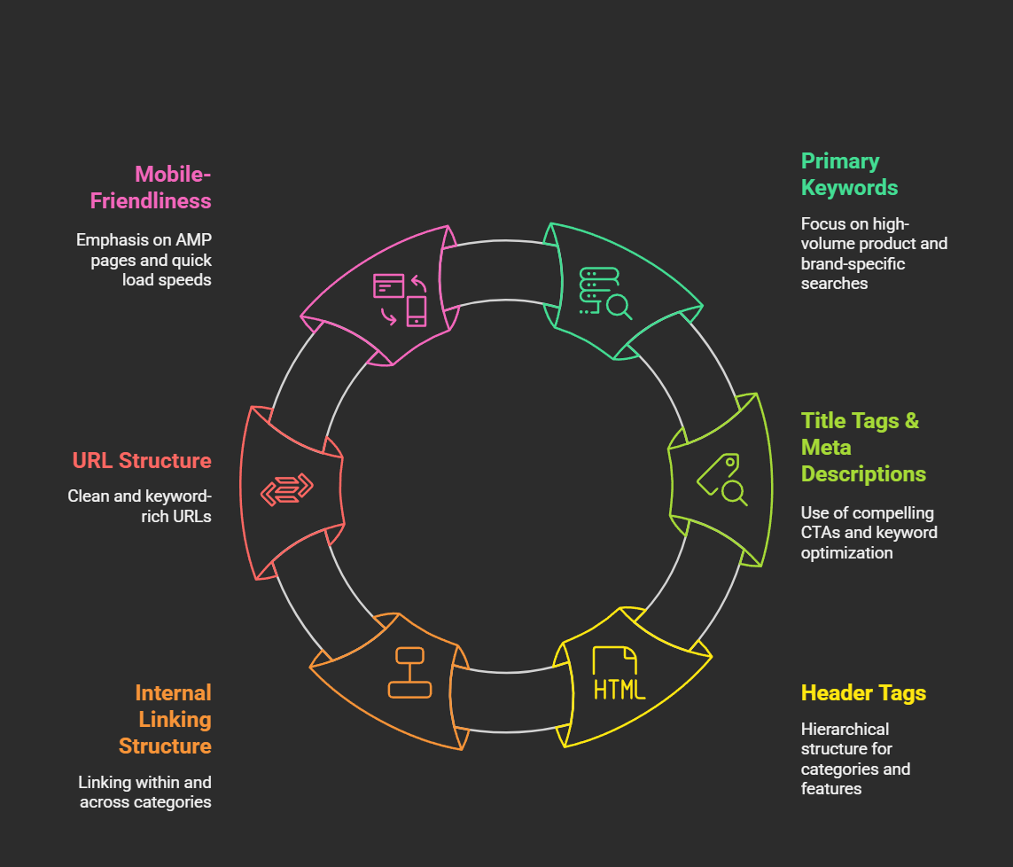
SEO Strategy Breakdown

Slide 10
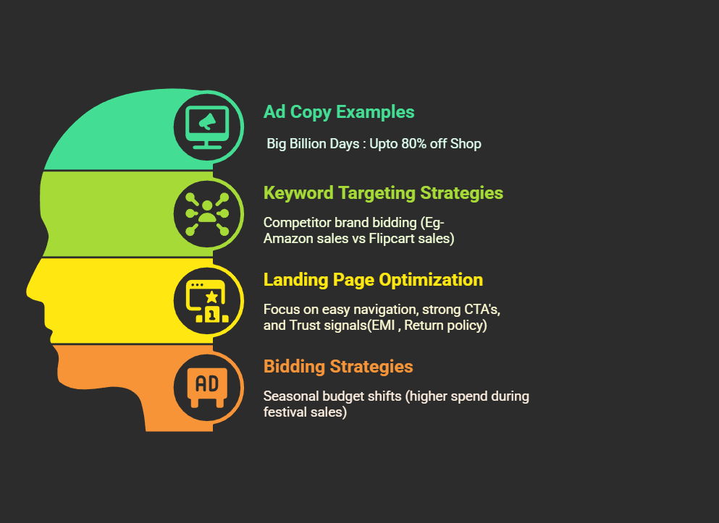
Paid Advertising Campaign Analysis :

Slide 11
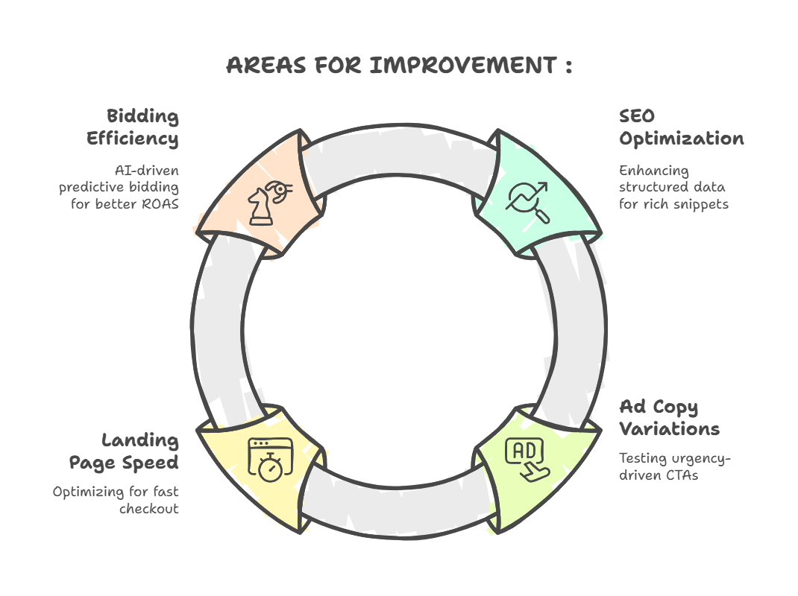

Slide 12
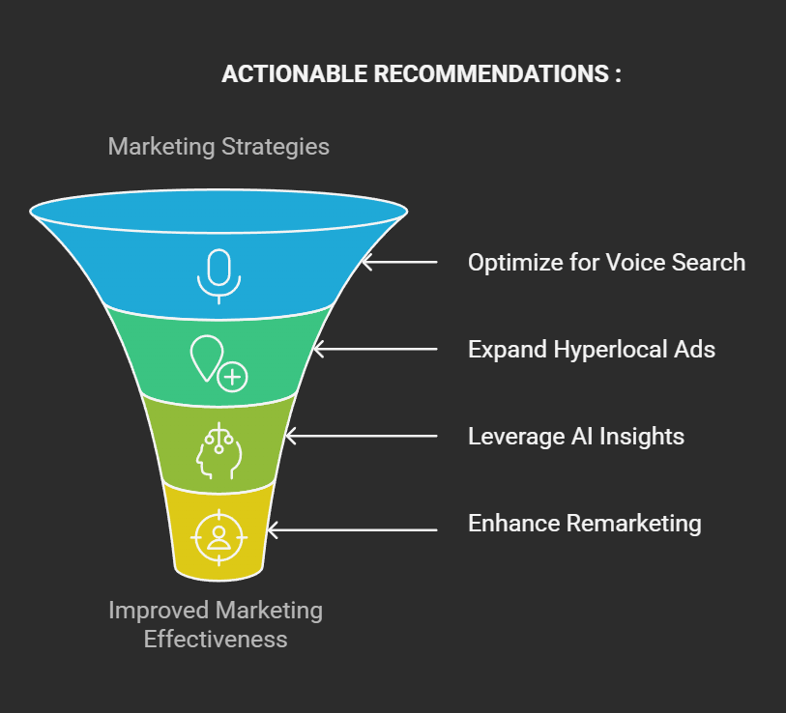

Slide 13
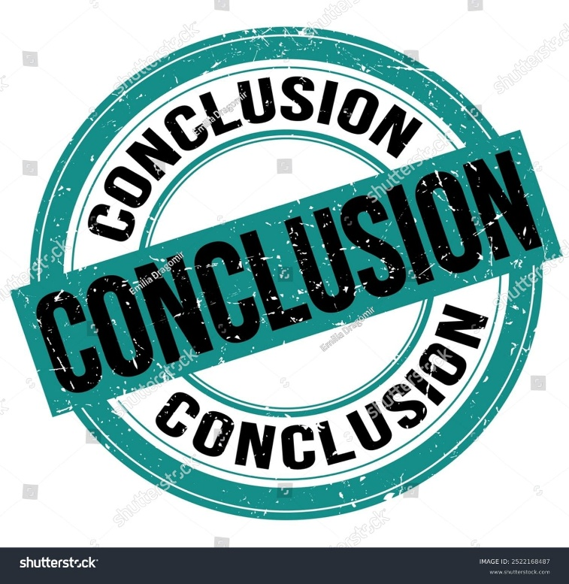
Flipkart has a strong SEM strategy, using both SEO and paid ads to attract customers. It ranks well on Google with product-based keywords and runs effective ads with discounts and fast delivery offers. Its mobile-friendly site also helps improve user experience.
However, there are areas to improve. Flipkart can make its SEO even better by using structured data, testing different ad copies, and using AI to predict search trends. It should also focus more on local ads for smaller cities and improve remarketing to bring back visitors who didn’t buy.
By making these changes, Flipkart can get more traffic, increase sales, and stay ahead in India’s competitive e-commerce market.

Slide 14
Thank you!
By :
Koduru Ganesh Kumar
23BBA00279

