Slide 1
AI AGENT FOR SMART FARMING ADVICE
IBM AICTE PROJECT
Presented By:
Student name : Muthyala Akhil Reddy
College Name : Sphoorthy Engineering College
Department : Artificial Intelligence and Machine Learning

Slide 2
OUTLINE
Problem Statement
Technology used
Wow factor
End users
Result
Conclusion
Git-hub Link
Future scope
IBM Certifications

Slide 3
Problem Statement
Small-scale farmers face challenges due to limited access to timely, localized, and accurate agricultural information. They often struggle with crucial decisions like crop selection, pest control, and understanding market prices. Language barriers and low digital literacy further widen the knowledge gap. As a result, they experience reduced productivity, increased risks, and lower income.
Proposed Solution: We propose an AI Agent powered by Retrieval-Augmented Generation (RAG) using IBM Cloud Lite and IBM Granite to deliver real-time, location-specific farming advice. It provides insights on weather, crops, soil, pests, and market prices in local languages. This empowers farmers to make informed decisions, boosting yield and income.

Slide 4
Technology used
IBM cloud lite services
Natural Language Processing (NLP)
Retrieval Augmented Generation (RAG)
IBM Granite model

Slide 5
IBM cloud services used
IBM Cloud Watsonx AI Studio
IBM Cloud Watsonx AI runtime
IBM Cloud Agent Lab
IBM Granite foundation model

Slide 6
Wow factors
This AI agent transforms the way small-scale farmers access and apply agricultural knowledge by delivering hyper-local, real-time insights in their native language. It reduces dependency on middlemen, minimizes crop failure risks, and enhances productivity through precise, data-driven decisions.
Unique Features:
Localized semantic search for weather, soil, crop, and pest data
Voice-enabled queries and responses in local languages for ease of use
Real-time mandi price tracking for smarter selling decisions
Personalized crop recommendations based on soil and seasonal data
Predictive pest and disease alerts using historical and environmental data
Community-driven knowledge sharing to promote traditional wisdom with modern insights

Slide 7
End users
Small-scale and Marginal Farmers
Agricultural Extension Officers
AgriTech startups and NGOs
Government Agricultural Departments
Farmer Producer Organizations (FPOs)
Rural Development Agencies

Slide 8
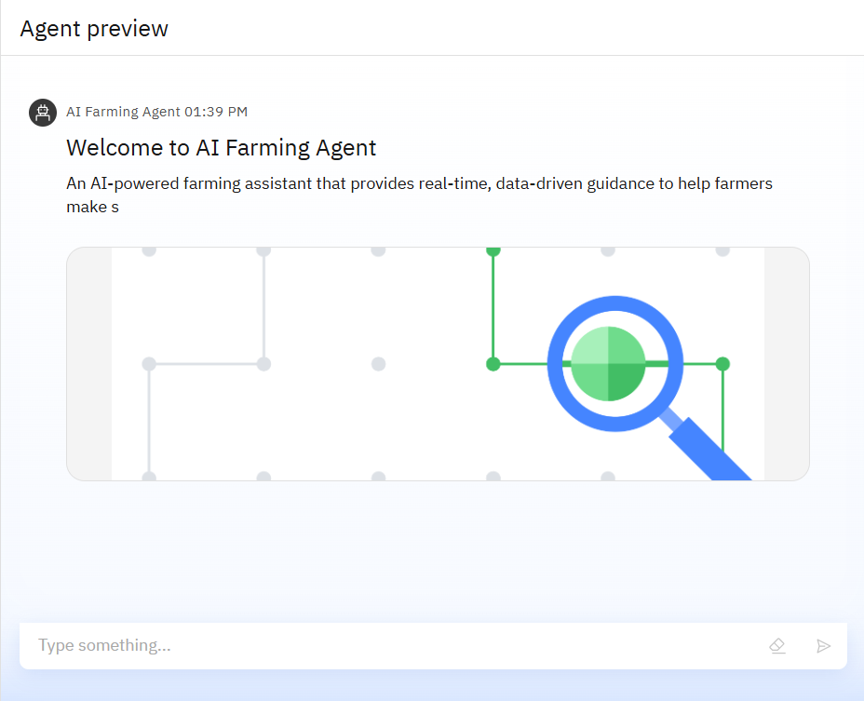
Results

Slide 9
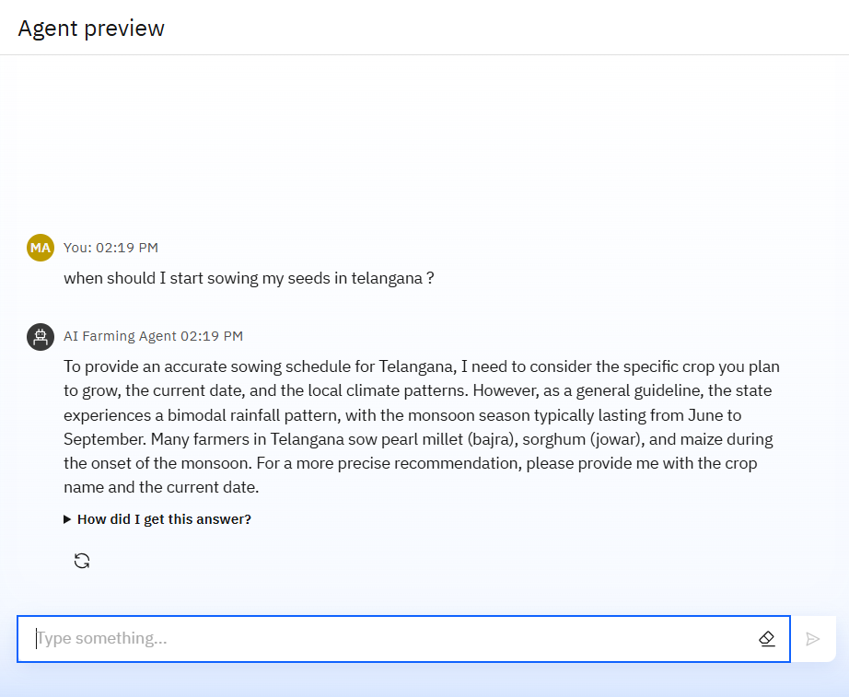
Results

Slide 10
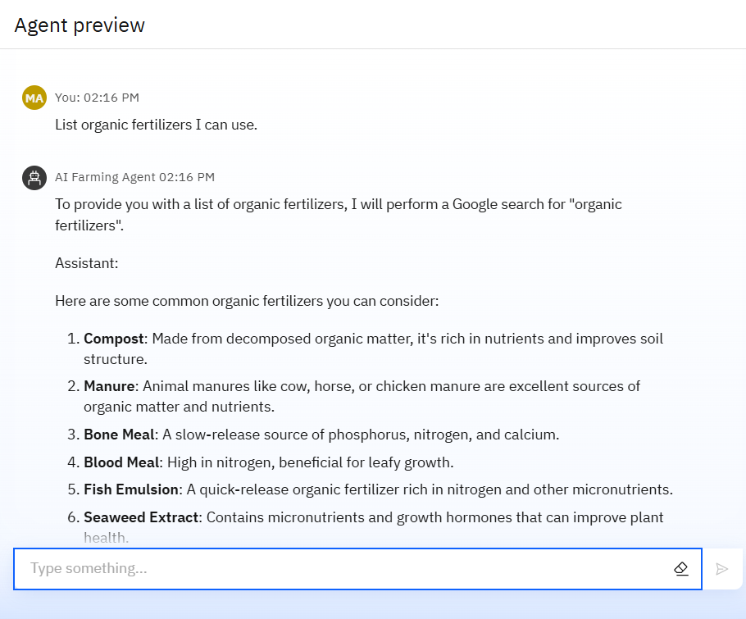
Results

Slide 11
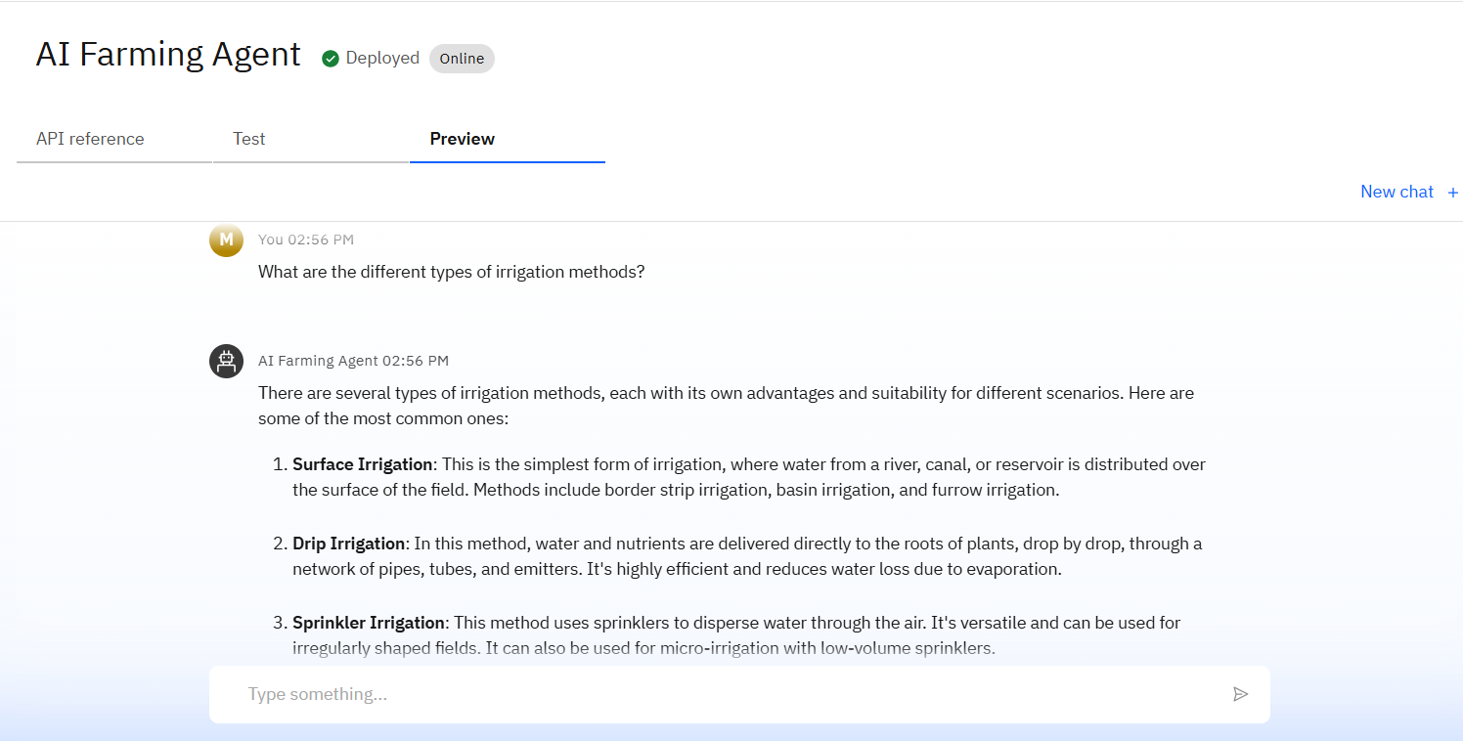
Results
Deployed AI Agent

Slide 12
Conclusion
The agent can provide real-time recommendations, monitor crop health, and assist with market decisions.
It saves time by automating routine tasks like irrigation scheduling, pest diagnosis, and weather alerts.
Farming Agents enhance productivity, sustainability, and profitability in both small-scale and commercial agriculture.

Slide 13
GitHub Link
GitHub Link: https://github.com/akhilreddymuthyala/AI-Agent-for-Smart-Farming-Advice

Slide 14
Future scope
Multilingual Voice Assistant for Farmers
Market Price Forecasting and Trend Analysis
AI-Based Crop Health Monitoring via Drones and Satellites
Integration with Agri Drones for Spraying and Monitoring
Climate-Resilient Farming Recommendations
Smart Contract-Based Payments and Insurance

Slide 15
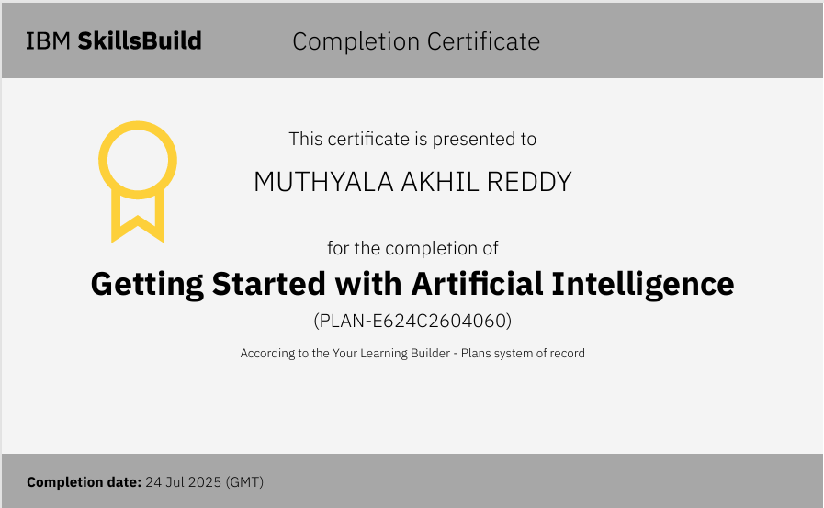
IBM Certifications

Slide 16
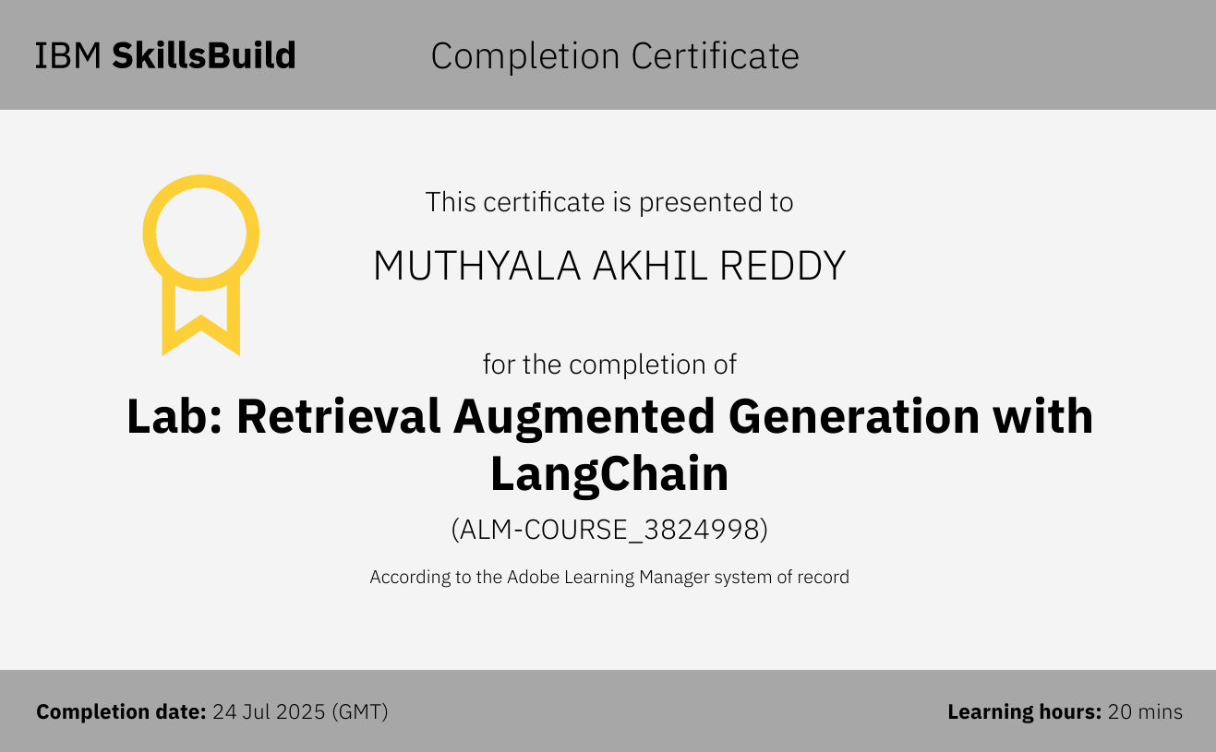

Slide 17
THANK YOU

