Slide 1
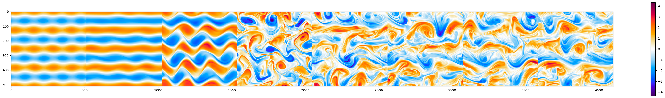
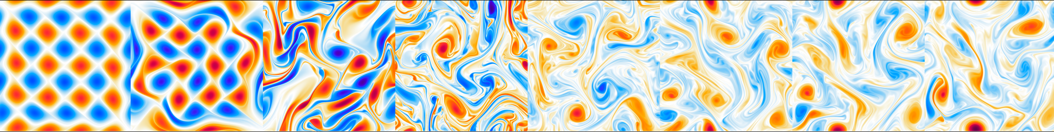



Group 3 : PDE-conditioned flow-matching surrogates
Akhil Sadam
MMAI Project

Slide 2
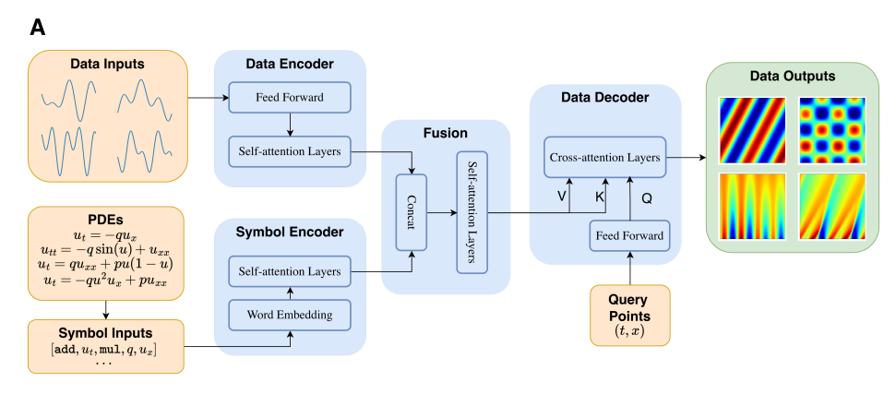

Many tasks require PDEs and video / fluid flow
Common motivation is interpretability and transference
Most basic task is pure alignment and fusion across different PDEs
Prior work (1D, mostly in training PDE distribution):
PI-MFM (Zhu et al., Lu Group / DeepONet Lab)

Slide 3
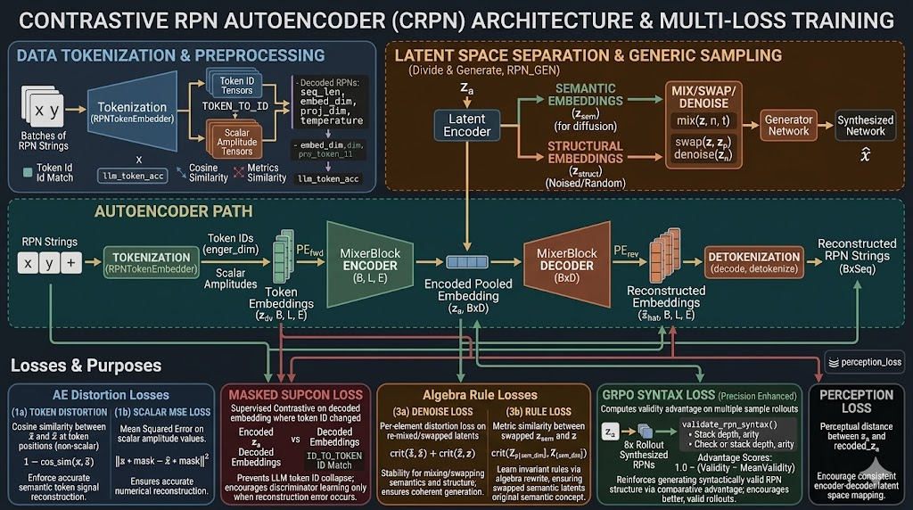
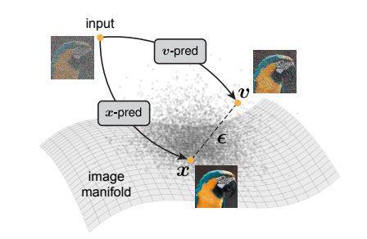
Design
Vision / flow model
Flow-matching
Semantic Fusion: concatenated latent
LLM / PDE autoencoder
https://arxiv.org/pdf/2511.13720

Slide 4
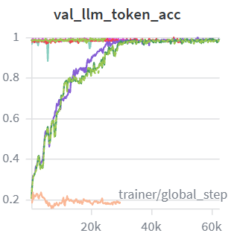
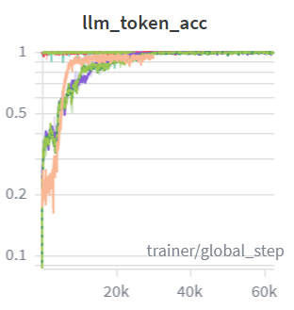
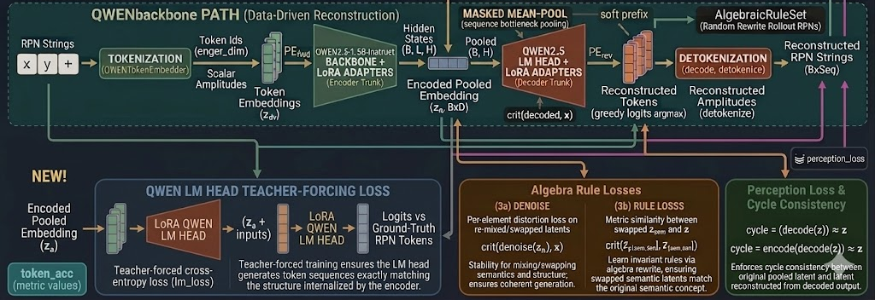
LLM / PDE Encoder
Model | Token acc | Num. RMSE
LLM with algebra | 0.905 | 0.073
LLM wo algebra | 0.905 | 0.096
QWEN LLM | 0.048 | 0.0 (N/A?)
1.3M trainable (LLM) – 1hr
1.5B, 24.5M trainable (Qwen) – 5hr

Slide 5
LLM / PDE Encoder
Model | Token acc | Num. RMSE
LLM with algebra | 0.905 | 0.073
LLM wo algebra | 0.905 | 0.096
QWEN LLM | 0.048 | 0.0 (N/A?)
INPUT
"0.37 3 psi + sin q 0 y jacobian - + +\n",
"q q u cos + cos + dy\n",
LLM
"0.314546 3.034548 psi + sin q y y jacobian - + +", "q q u cos + cos + dy",
QWEN
" sin u 3.33 + v + u * + u - u *\n9 dy + dx\nlap\nv *\ndx\ny -\n5 sin *\ny -\n7 *\ny *\n+\n2 *\n-\n-\n-\n*\n-\n+\n10",
" u y - * 7 jacobian y -\nsin\n psi +\n6,\n-\ndx\n dy\n 3 -\n psi *\n 0.76 *\n 9 * dx -\n sin\n 10 -\n *\n sin\n 8 *\n *\n", ..... \nCOM....btn...key...sci....read
LLM - sampled
"0.275928 2.961881 psi + sin q 0.091960 y v - + +", "q q u cos + cos + dy",
LLM wo algebra
"0.301647 2.986362 psi + sin q y y jacobian - + +", "q q u cos + cos + dy",
LLM wo algebra - sampled
Sampling doesn’t quite produce different structures, just different numbers.
Only the rule based LLM performed okay!
"cos 0.290347 v invlap jacobian jacobian dx psi cos 1.718765 2.049709 jacobian 2.843819 cos dx cos + jacobian cos x jacobian sin cos ……

Slide 6
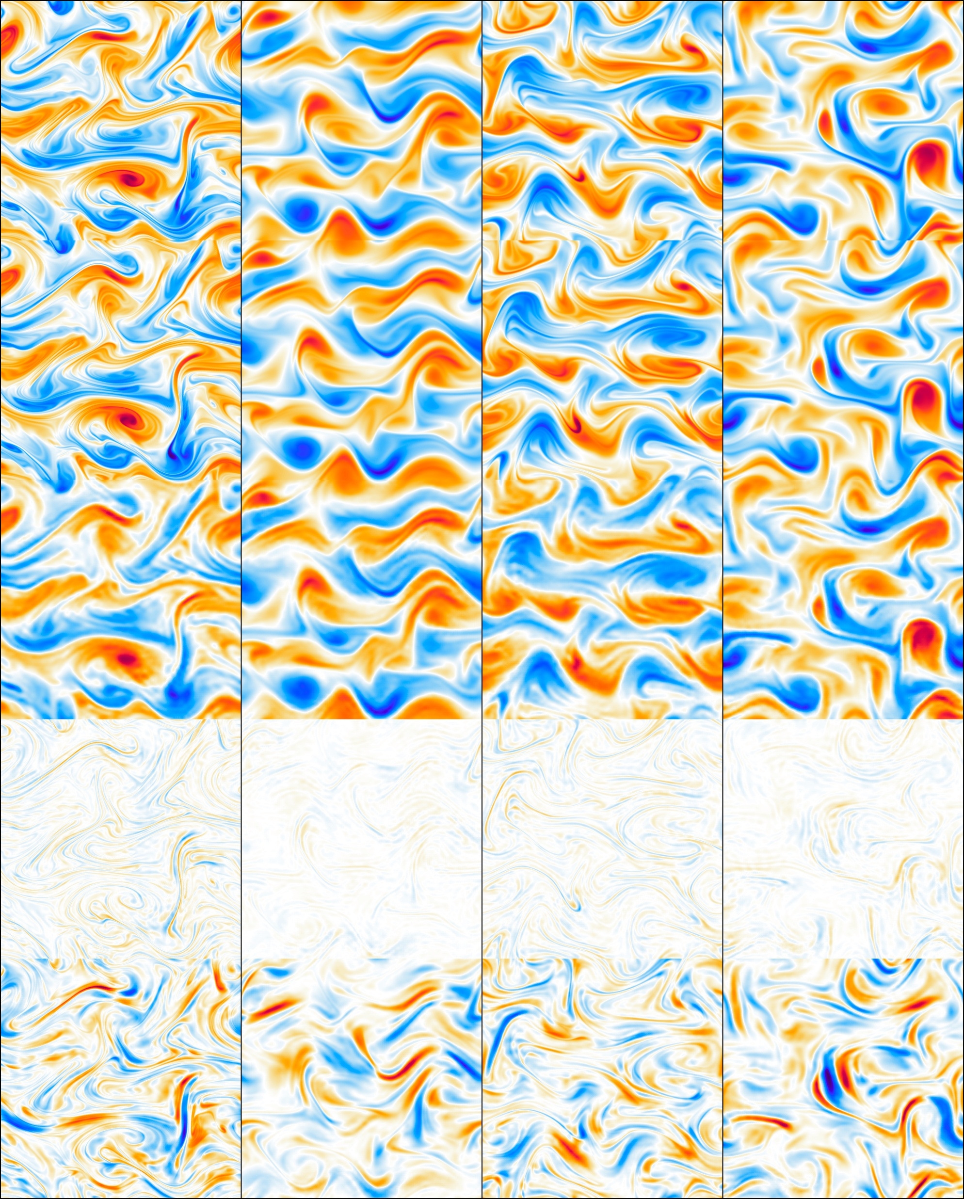
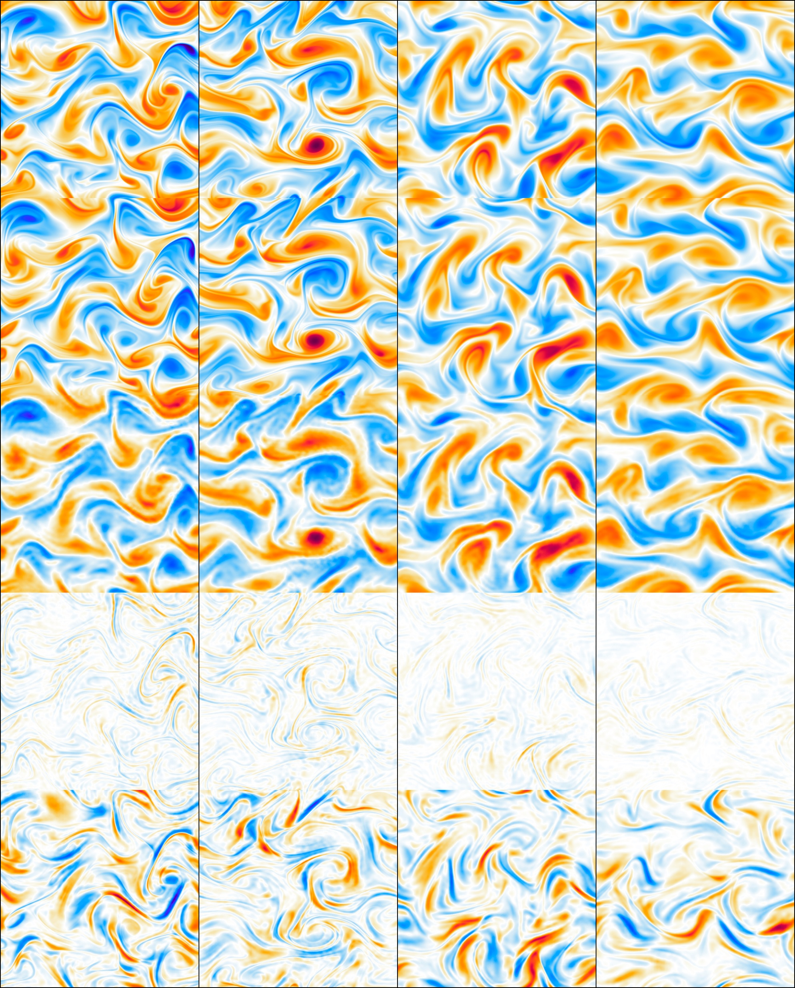
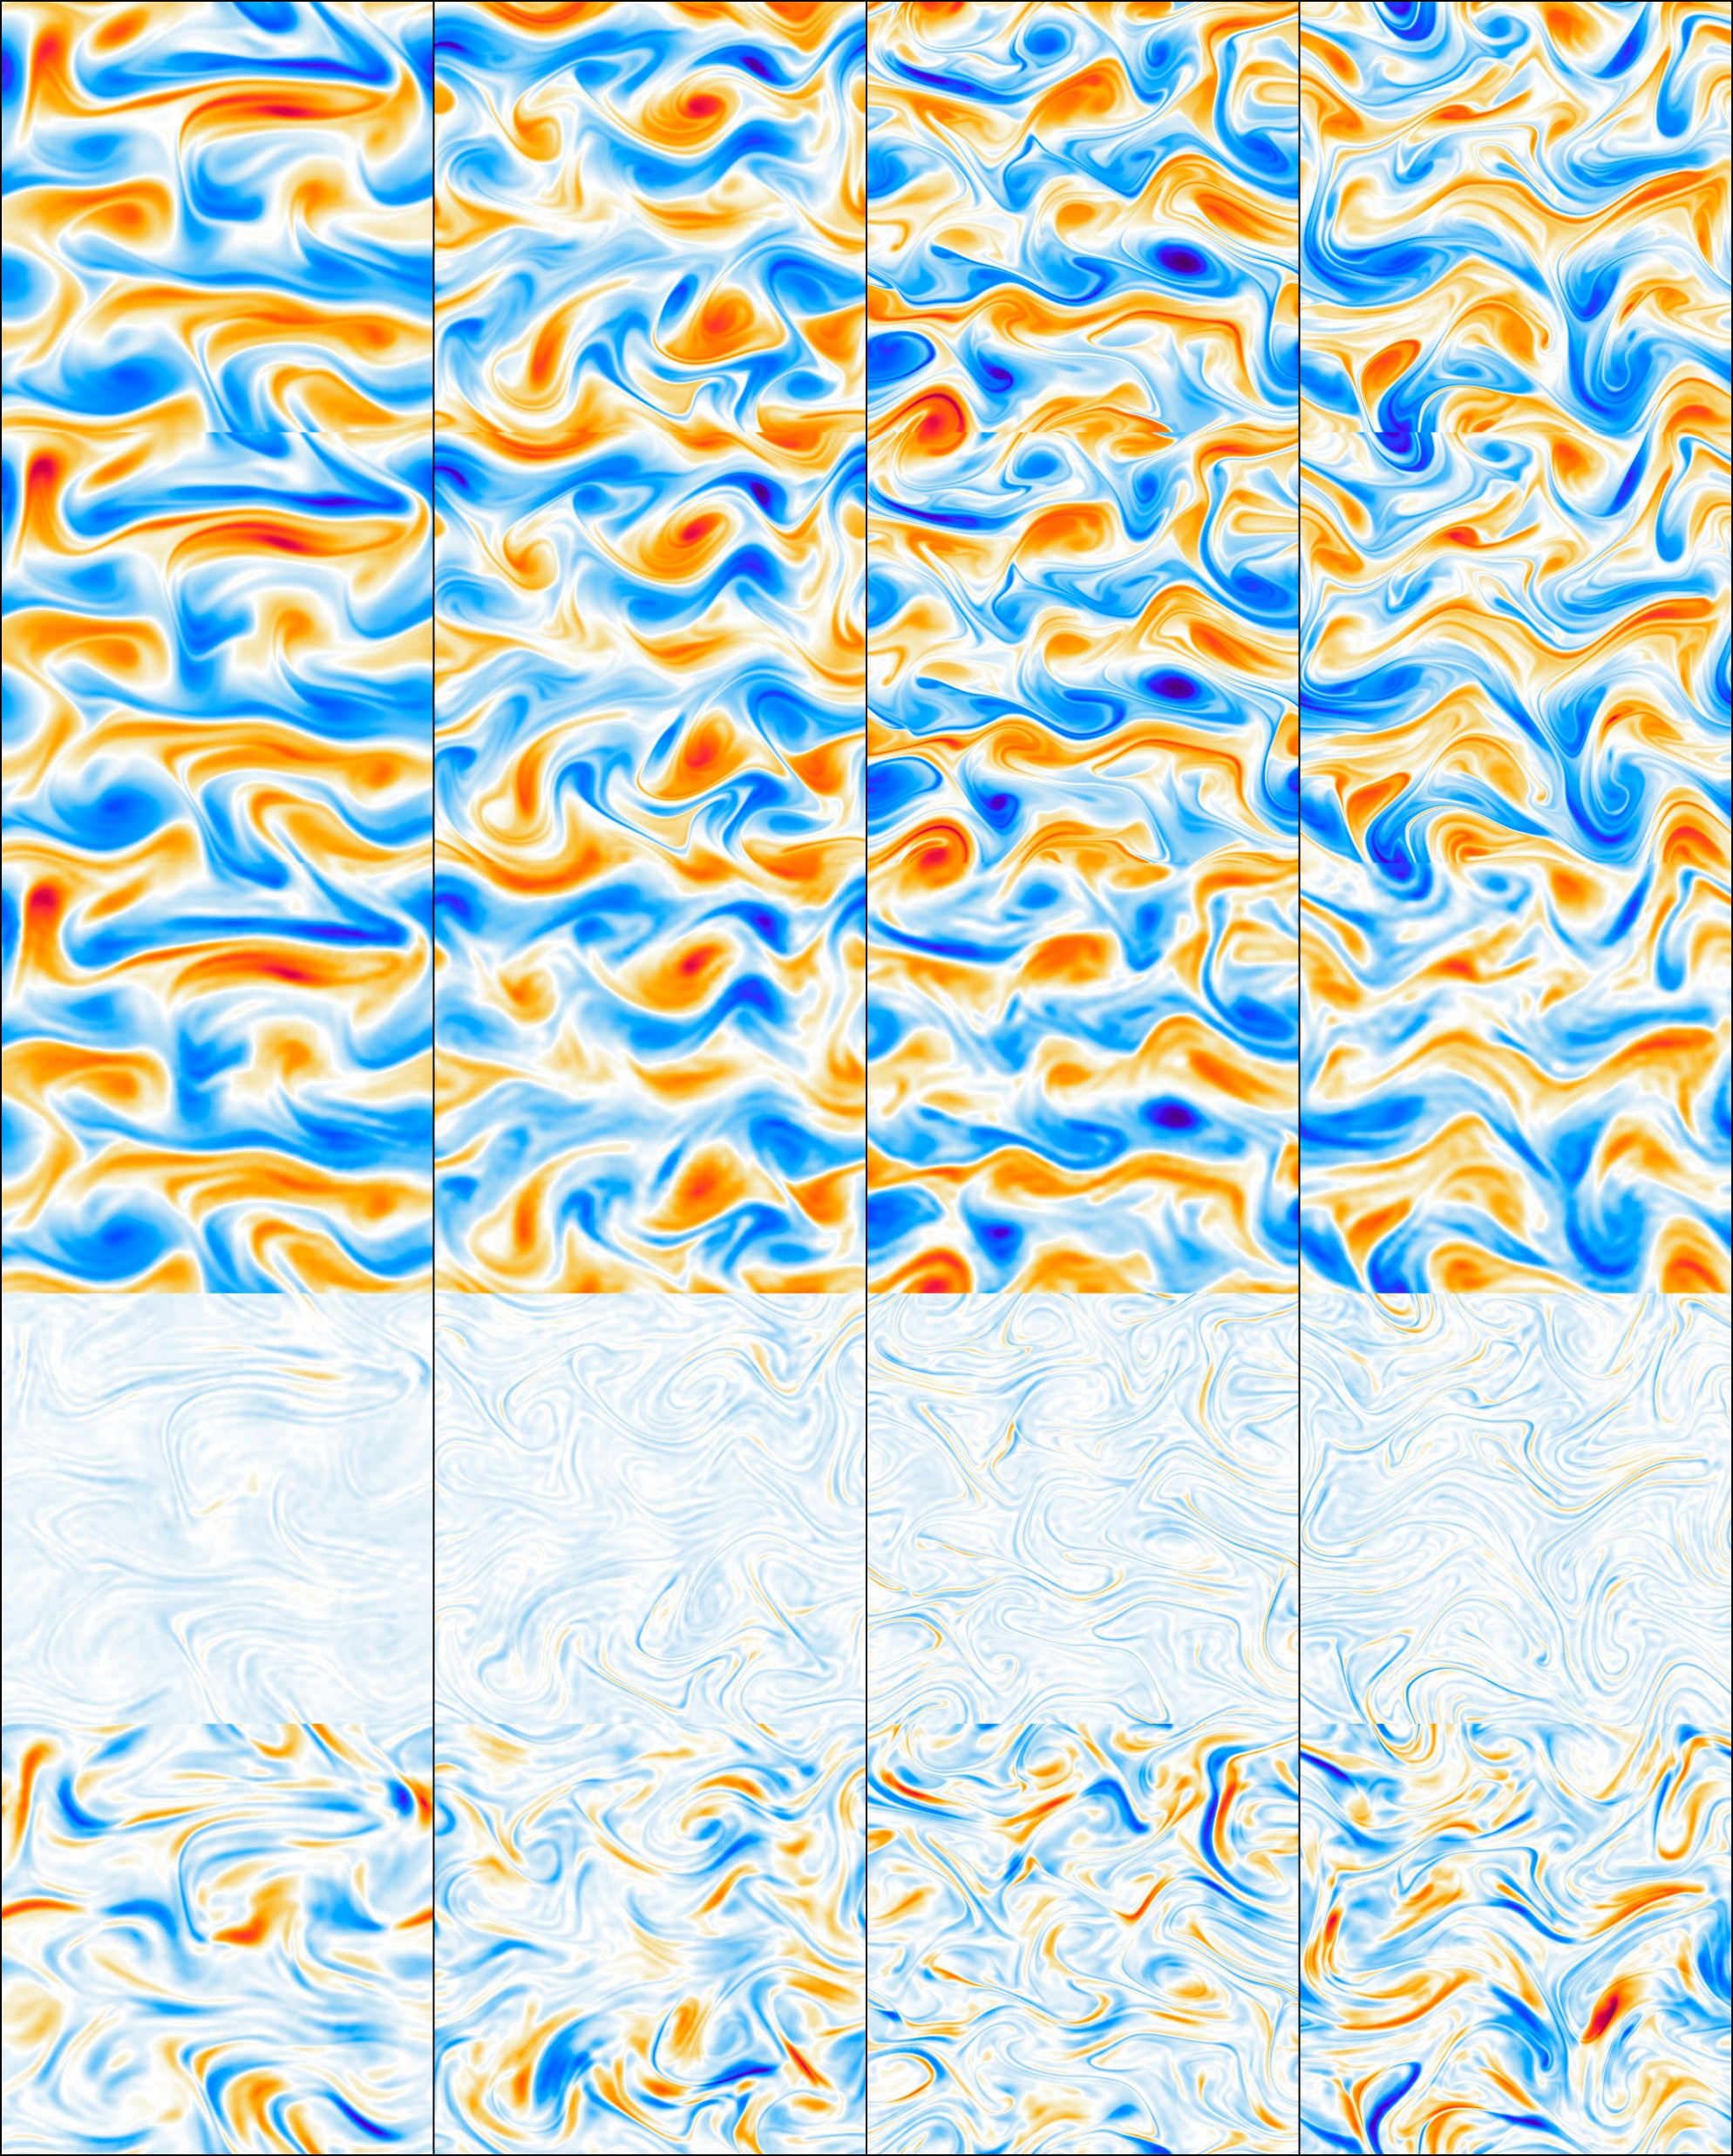
VLM
Model (240 epochs) | RelMSE | PMSE (Err / Signal)
VLM | 0.02102 | 6.77%
VLM wo algebra | 0.03642 | 10.69%
VM (no LLM, baseline) | 0.04809 | 13.39%
About 4 frames (800x true solver), given the current frame
VLM improves with PDE input, but not by much!
Predict for known PDEs, out of distribution not good yet
VLM
VLM wo algebra
VM baseline
Context frame
Target frame
Model prediction
Prediction Error
Prediction Signal
Notes:
PMSE = 1 implies model is equivalent to persistent (last-frame) prediction.

