Slide 1
Real-Time Face and Feature Recognition System
Practical Implementation of Real-Time Facial Recognition
By
Akhil Saxena

Slide 2
Libraries Used
- OpenCV (cv2): A computer vision library for image processing.
- Streamlit: A web application framework for building data apps.
- NumPy: A package for numerical operations (used for handling image arrays).

Slide 3
Loading Haar Cascade Classifiers
Haar Cascade Classifiers are used for detecting faces, eyes, and smiles in images.
We load three classifiers:
1. Face classifier (haarcascade_frontalface_default.xml)
2. Eyes classifier (haarcascade_eye.xml)
3. Smile classifier (haarcascade_smile.xml)

Slide 4
Image Processing Workflow
1. Loop through each image in the dataset.
2. Load and convert images to grayscale.
3. Detect faces using the face classifier.
4. For each face, detect eyes and smiles within the region of interest.
5. Draw bounding boxes around detected features (faces, eyes, smiles).
6. Display the processed image using Streamlit.

Slide 5
Code Example & Output
The code processes images by detecting faces, eyes, and smiles.
Streamlit is used to display the final output with annotations for each detected feature.
Output: Processed images will show:
- Green rectangles around faces
- Red rectangles around eyes
- Blue rectangles around smiles

Slide 6
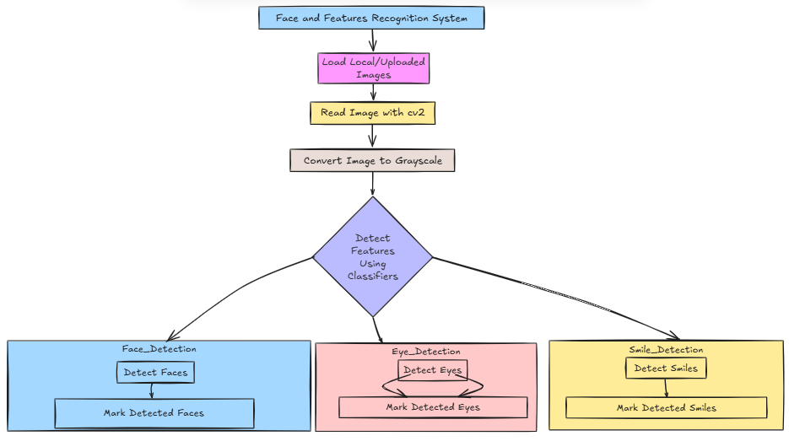

Slide 7
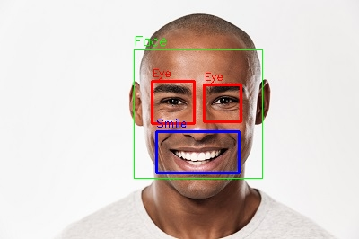
Sample Images

Slide 8
