Slide 1

Faithful Abstractive Malayalam Summarization: Comparative Evaluation of Transformer Models with Hallucination Analysis
Group No: 3
BL.SC.P2DSC25002 AKHIL SEBASTIAN
BL.SC.P2DSC25005 ALLWIN SURESH

Slide 2
Outline
Introduction
Literature Survey
Literature Survey Summary
Research Gaps
Dataset Description
Methodology
Experimental Configurations
Parameter Settings
Evaluation Measures
Results and Analysis
Best Model Discussion
Error Analysis
Conclusion and Future Work

Slide 3
Introduction
Automatic text summarization helps condense large textual content into concise and meaningful summaries.
Abstractive summarization generates new human-like summaries instead of directly extracting sentences.
Transformer-based models have significantly improved multilingual summarization performance.
However, low-resource languages like Malayalam remain underexplored due to limited benchmark datasets and weaker task-specific adaptation.
A major challenge in abstractive summarization is hallucination, where generated summaries contain unsupported or factually incorrect information.
Ensuring both summary quality and factual reliability is essential for trustworthy real-world summarization systems.

Slide 4
Problem Statement
Existing Malayalam summarization research primarily focuses on summary generation quality, with limited emphasis on factual consistency.
Conventional metrics such as ROUGE and BLEU measure lexical overlap but fail to capture hallucinated content effectively.
Performance differences between zero-shot, few-shot, fine-tuned, and retrieval-augmented transformer modelsfor Malayalam summarization remain insufficiently explored.
There is a need for a comparative framework that evaluates both summarization quality and hallucination-aware factual reliability for low-resource Malayalam abstractive summarization.

Slide 5
Objectives
To develop a comparative framework for Malayalam abstractive text summarization.
To evaluate models across different experimental settings:
Zero-shot prompting
Two-shot prompting
Supervised fine-tuning
Retrieval-Augmented Generation (RAG)
To assess summarization quality using standard metrics.
To analyze factual reliability using hallucination-aware evaluation metrics, including faithfulness, context precision, context recall, and hallucination score.
To identify the most effective model configuration for faithful abstractive Malayalam summarization in low-resource settings.

Slide 6
Literature Survey 1
Reference | What Was Done | Techniques / Models Used | Limitations Identified
Nambiar & Sindhya (2021) | Developed Malayalam abstractive summarization framework | Attention-based encoder-decoder Seq2Seq | Traditional architecture; limited scalability compared to transformers
Nambiar (2023) | Improved Malayalam summarization with linguistic enhancement | Attention model + POS tagging | No transformer comparison; limited generalization
Social-Sum-Mal (2024) | Introduced benchmark Malayalam summarization dataset | Dataset creation for article-summary pairs | Focused on dataset contribution, not comparative model evaluation
Parikh et al. (2025) | Surveyed multilingual summarization methods | Transformer-based multilingual review | Review only; no Malayalam-specific experimentation
Tanev et al. (2025) | Evaluated LLaMA for Malayalam summarization | LLaMA-based LLM summarization | Limited hallucination analysis; no broad model comparison

Slide 7
Literature Survey 2
Reference | What Was Done | Techniques / Models Used | Limitations Identified
Prabhakar et al. (2022) | Summarization of Indian legal judgments | Transformer abstractive summarization | Domain-specific; not Malayalam-focused
Gangadharan et al. (2016) | Early abstractive summarization framework | Graph-based conceptual mining | Traditional non-transformer approach
Chandu et al. (2019) | Query-based text summarization | Extractive summarization methods | Not abstractive; limited semantic generation
Ramachandran et al. (2023) | Medical document summarization | Summarization + image decomposition | Domain constrained; no multilingual focus
B. M. G et al. (2023) | Fine-tuned transformers for news summarization | Pretrained transformer fine-tuning | No hallucination/factual consistency evaluation

Slide 8
Literature Survey Summary
Early Malayalam summarization research primarily relied on traditional attention-based and linguistic feature-enhanced neural models, demonstrating feasibility but limited scalability.
Recent studies shifted toward transformer-based and large language models, improving multilingual summarization capability and contextual understanding.
Benchmark dataset availability improved with the introduction of Social-Sum-Mal, enabling standardized Malayalam summarization experimentation.
Existing research has explored summarization in specialized domains such as news, legal, and medical documents, but comparative evaluation across multiple transformer paradigms remain limited.
Most prior work focuses on summary quality metrics, with insufficient attention to hallucination detection, factual consistency, and reliability assessment in low-resource Malayalam summarization.

Slide 9
Research Gap
Existing Malayalam summarization studies primarily focus on traditional neural models or isolated transformer-based approaches, with no comprehensive comparison across multiple modern architectures.
Prior research largely evaluates summary quality using lexical metrics, while hallucination detection and factual consistency analysis remain insufficiently explored.
Comparative analysis of different inference strategies such as zero-shot prompting, few-shot prompting, supervised fine-tuning, and retrieval-augmented generation (RAG) is lacking for Malayalam summarization.
The effectiveness of modern multilingual transformer and instruction-tuned models for faithful low-resource Malayalam summarization remains unclear.

Slide 10
Dataset Sources
Dataset Description
This study combines two Malayalam abstractive summarization datasets to construct a larger and more diverse benchmark corpus for training and evaluation.
Dataset Sources
Dataset | Original Samples | Available Columns | Selected Columns
Social-Sum-Mal | 2,000 | chapter_no, para_no, heading, input, long_summary, extreme_summary, query, answer_summary, topic | input, long_summary
AI4Bharat Malayalam Sentence Summarization | ~16,000+ | id, Sentence, Summary, URL | Sentence, Summary
Why These Columns?
Social-Sum-Mal contains multiple summary formats.
Long summary was selected to maintain consistency with standard abstractive summarization.
AI4Bharat already provides direct article-summary pairs.

Slide 11
Dataset Preparation
Preprocessing Steps
Schema alignment across datasets
Duplicate removal
Missing value filtering
Malayalam-only text filtering
Removal of malformed/noisy entries
Low-information sample filtering
Text normalization
Final Dataset Statistics
Metric | Count
Raw merged corpus | ~18,000–20,000
Final cleaned dataset | 9,698
Training samples | 7,758
Validation samples | 970
Testing samples | 970

Slide 12
Evaluation Metrics
Summarization Quality Metrics
Used to measure lexical overlap and semantic similarity between generated and reference summaries.
ROUGE-1 → unigram overlap (content coverage)
ROUGE-2 → bigram overlap (phrase coherence)
ROUGE-L → longest common subsequence (structural similarity)
BLEU → n-gram precision-based generation accuracy
BERTScore → contextual semantic similarity using transformer embeddings
Hallucination / Reliability Metrics
Used to assess factual grounding and unsupported content generation.
Faithfulness (F) → consistency between generated summary and source article
Context Precision (CP) → proportion of generated content supported by context
Context Recall (CR) → extent of source information reflected in summary
Hallucination Rate (HR) → proportion of severely unsupported summaries
Custom Hallucination Score
HS = 1 - (0.4F + 0.2CP + 0.2CR + 0.2B)
Lower HS = Better factual consistency

Slide 13
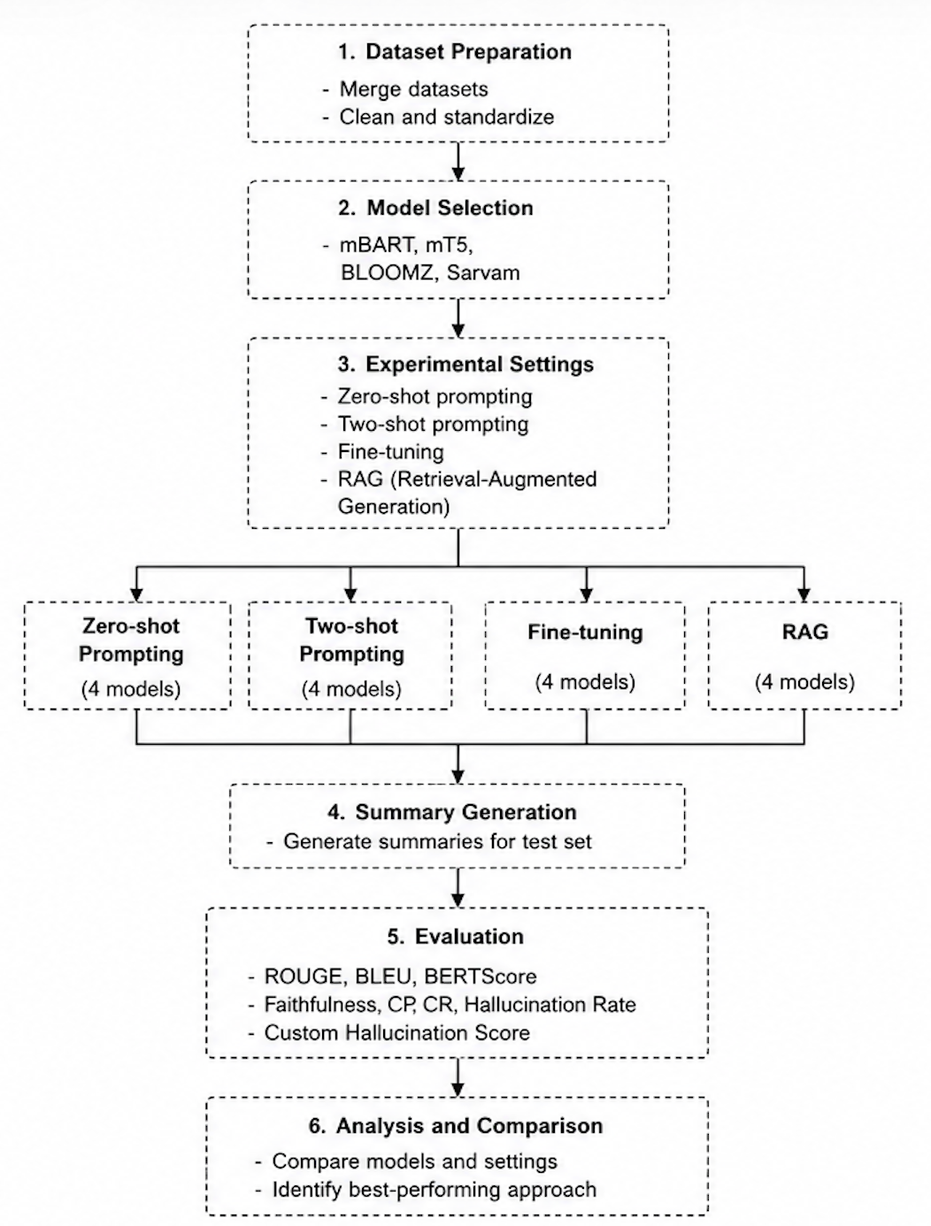
Methodology

Slide 14
Experimental Parameter Settings
Model | Architecture Type | Experimental Use
mBART | Encoder–Decoder Transformer | Zero-shot, Two-shot, Fine-tuning, RAG
mT5 | Text-to-Text Transformer | Zero-shot, Two-shot, Fine-tuning, RAG
BLOOMZ | Instruction-tuned LLM | Zero-shot, Two-shot, Fine-tuning, RAG
Sarvam | Multilingual Instruction LLM | Zero-shot, Two-shot, Fine-tuning, RAG
Prompt-based Settings
Zero-shot: Direct summarization prompt without examples
Two-shot: Prompt with 2 Malayalam article-summary examples
Generation based on pretrained multilingual/instruction-following capability
RAG Settings
Retrieval method: Semantic similarity search
Document chunking for source article segmentation
Retrieved top relevant chunks added to generation prompt
Objective: improve grounding and reduce hallucination

Slide 15
Fine Tuning Parameter Settings
Parameter | Value
Train/Test Split | 80:10:10
Epochs | 5
Optimizer | AdamW
Learning Strategy | Supervised sequence-to-sequence learning
Early Stopping | Enabled
Input Processing | Tokenization + truncation + padding
Model-specific Training
mBART / mT5
Encoder-decoder supervised fine-tuning
Article → input sequence
Summary → target sequence
BLOOMZ / Sarvam
Prompt-based supervised fine-tuning
Instruction-formatted article-summary
pairs
Training Objective
Improve Malayalam summarization adaptation
Reduce hallucinated generation
Learn stronger source-summary mapping

Slide 16
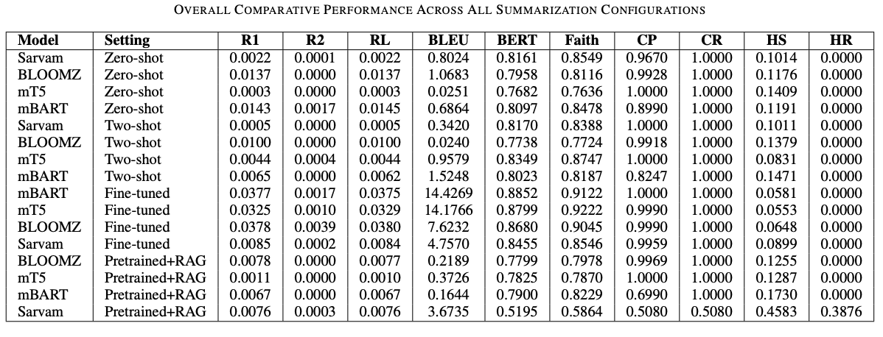
Overall Comparative Performance
Most models generated summaries using information from the source article.
This means important source content was generally retained.
Sarvam RAG performed lower because it could not effectively use the retrieved context.

Slide 17
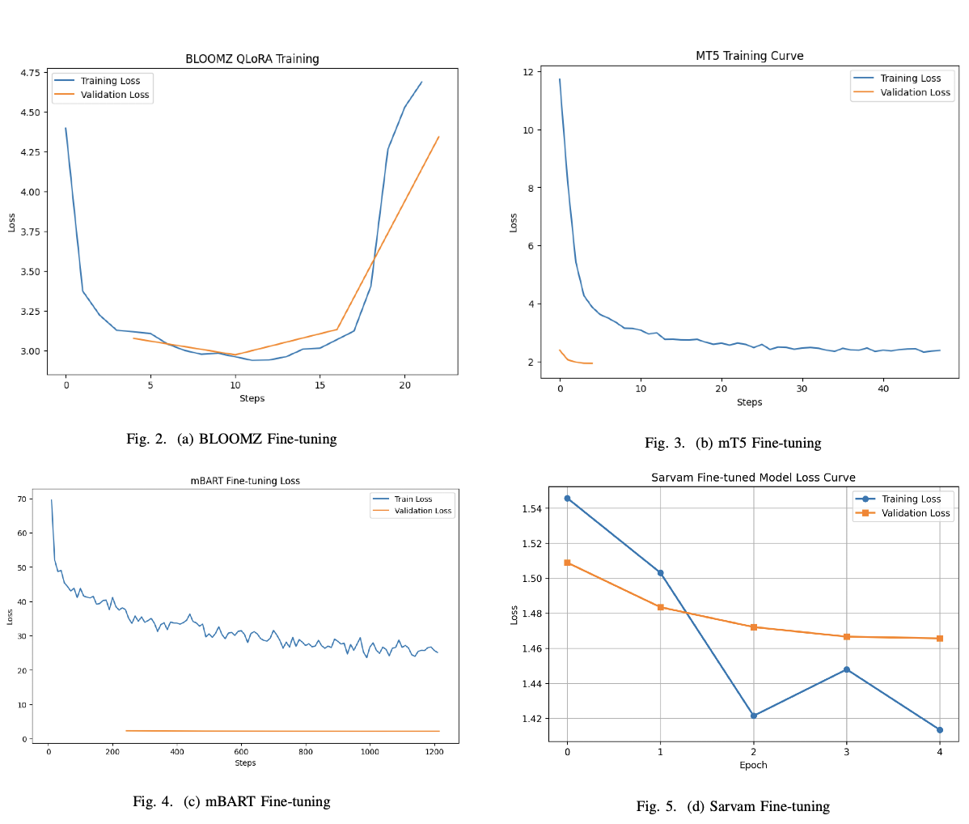
Fine-tuned Model Performance

Slide 18
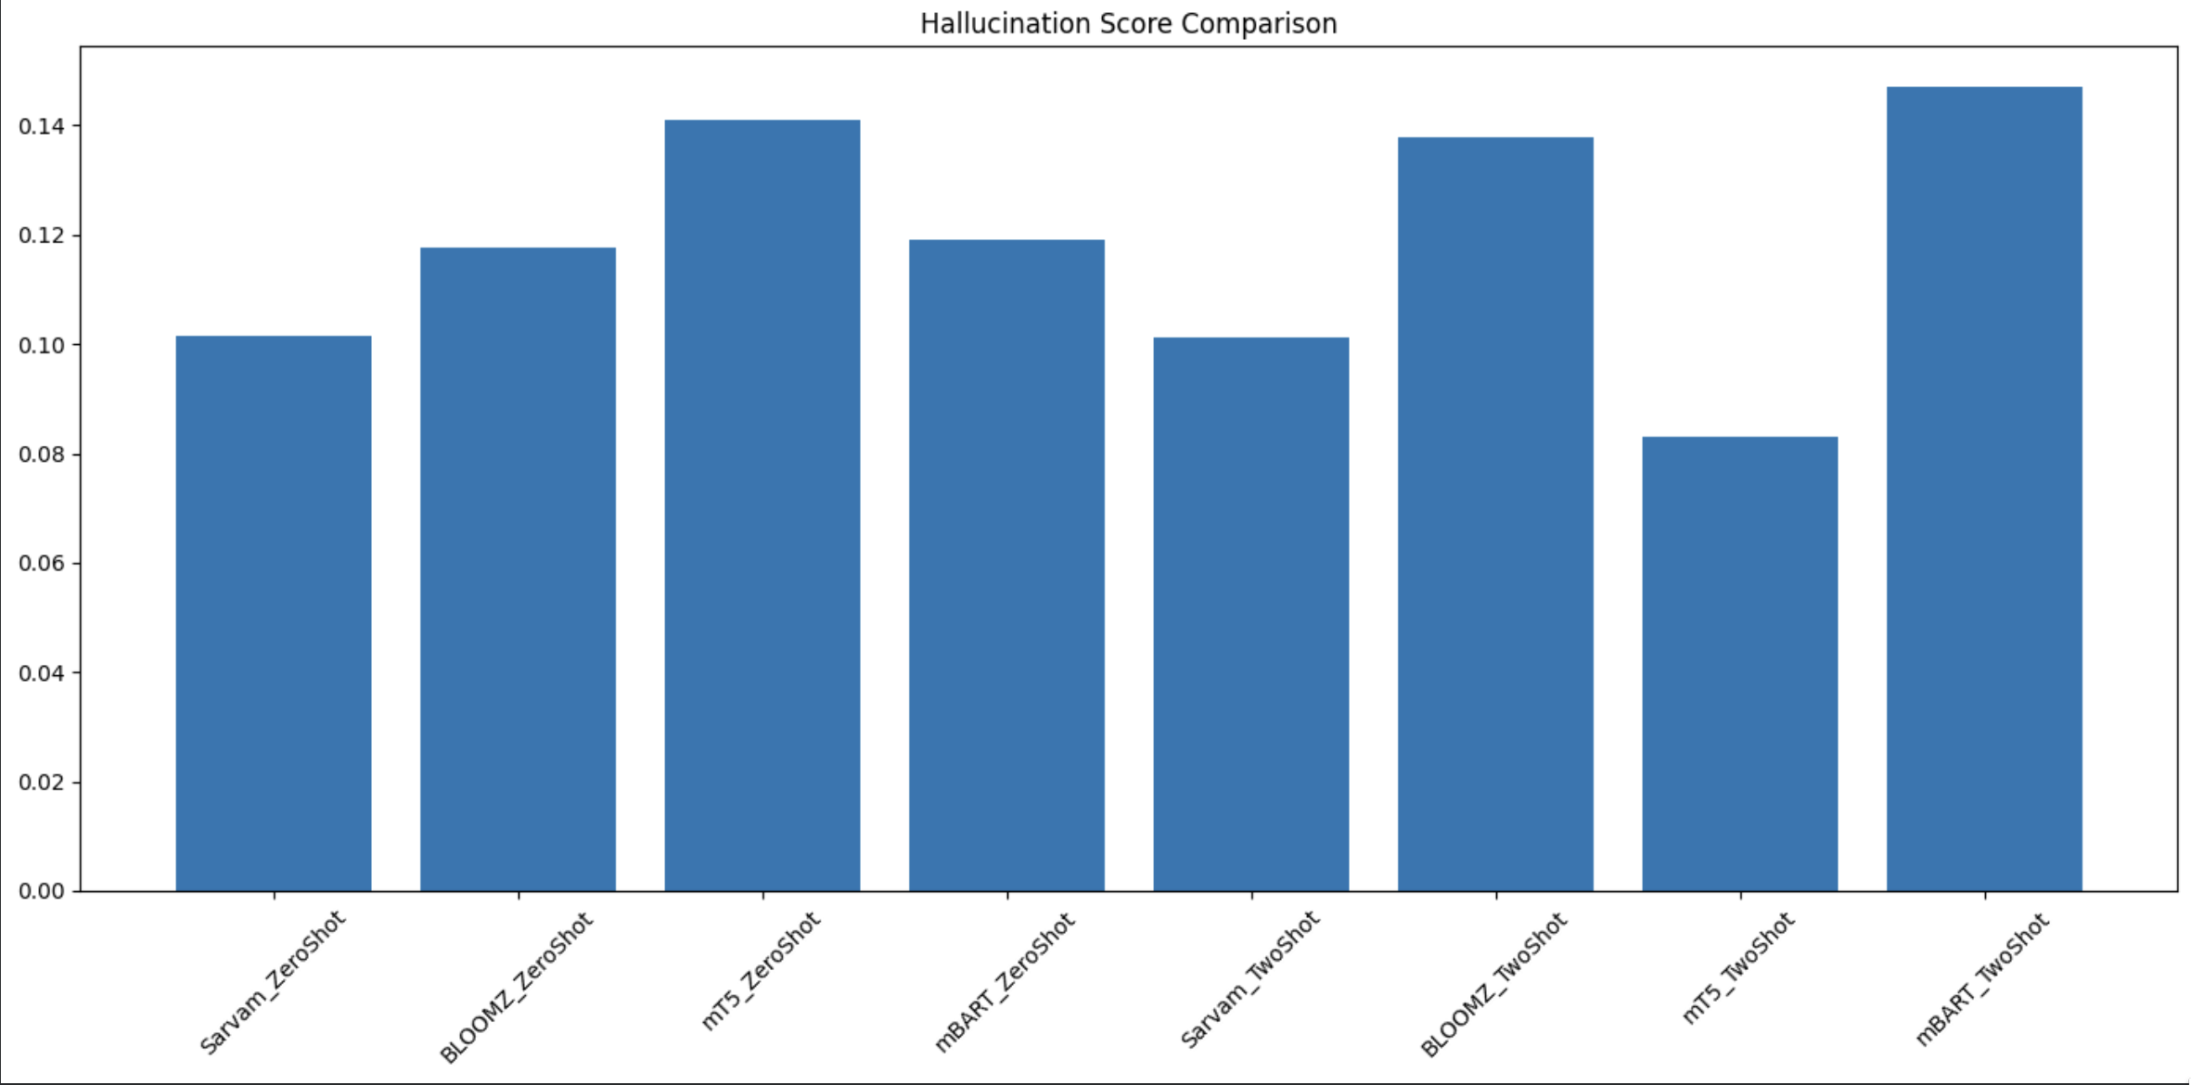
Prompt-based Model Comparison (Zero-shot vs Two-shot)
mT5 improved significantly with two-shot prompting
Hallucination score reduced from 0.141 → 0.083
Better factual grounding with examples
Sarvam remained stable
Similar performance in zero-shot and two-shot
BLOOMZ and mBART showed limited improvement
Prompt examples alone did not consistently improve reliability

Slide 19
Retrieval-Augmented Generation (RAG) Analysis
Model | Faithfulness | Context Precision | Context Recall | HS
BLOOMZ RAG | 0.798 | 0.997 | 1.000 | 0.126
mT5 RAG | 0.787 | 1.000 | 1.000 | 0.129
mBART RAG | 0.823 | 0.699 | 1.000 | 0.173
Sarvam RAG | 0.586 | 0.508 | 0.508 | 0.458
BLOOMZ and mT5 showed moderate grounding improvement
Better contextual support
Lower hallucination tendency than weaker prompt-based settings
mBART showed partial improvement
Retrieval helped factual alignment
Context precision remained lower
Sarvam performed poorly
Lowest faithfulness
Weak context integration
Highest hallucination score
Only model with significant hallucination rate

Slide 20
Best Model Comparison
Metric | Fine-tuned mT5 | Fine-tuned mBART
ROUGE-L | 0.0329 | 0.0375
BLEU | 14.17 | 14.42
Faithfulness | 0.9222 | 0.9122
Hallucination Score | 0.0553 | 0.0581
Why mT5 performed better
Text-to-text encoder-decoder architecture naturally aligns with summarization
Strong multilingual pretraining
Better adaptation to Malayalam after supervised fine-tuning
Improved semantic compression with factual consistency
Interpretation
mBART produced stronger lexical similarity
mT5 produced more factually reliable summaries
For trustworthy summarization, factual grounding is more critical than lexical overlap alone
Key Observations
mT5
Highest faithfulness
Lowest hallucination score
Most reliable factual grounding
mBART
Highest ROUGE and BLEU
Better lexical overlap with reference summaries

Slide 21
Error Analysis
Observed Limitations
Low ROUGE scores across many models
Malayalam allows flexible sentence structure and rich paraphrasing
Semantically correct summaries may still have low lexical overlap
Prompt-based models
Generated fluent but weakly aligned summaries
Lack of task-specific adaptation reduced consistency
RAG limitations
Retrieval quality directly affected performance
Weakly relevant retrieved chunks reduced grounding effectiveness
Sarvam RAG
Poor integration between retrieved context and generation
Higher hallucination tendency compared to other models
Interpretation
Lexical metrics alone cannot fully capture abstractive summary quality
Model architecture strongly influences factual reliability
Retrieval augmentation is only effective when retrieval relevance and model compatibility are strong

Slide 22
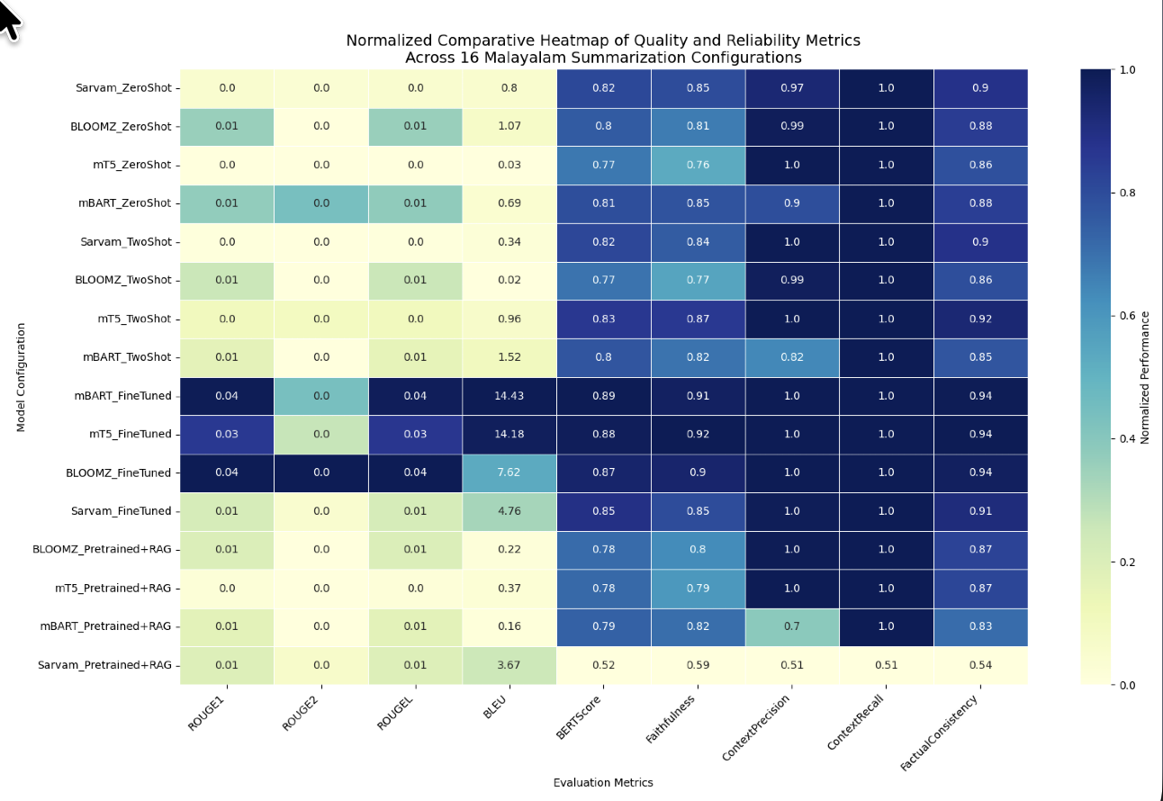
Comparative Heatmap
Fine-tuning delivers the most balanced performance.
Prompt engineering alone cannot ensure reliable summarization.
Retrieval augmentation helps only when the model effectively integrates retrieved evidence.

Slide 23
Conclusion
A comparative evaluation of 16 Malayalam abstractive summarization configurations was performed across:
Zero-shot prompting
Two-shot prompting
Supervised fine-tuning
Retrieval-Augmented Generation (RAG)
Fine-tuned models consistently outperformed prompt-based and RAG approaches in both summarization quality and factual reliability.
Fine-tuned mT5 emerged as the most balanced model, achieving:
Highest Faithfulness (0.9222)
Lowest Hallucination Score (0.0553)
Fine-tuned mBART achieved the strongest lexical overlap performance
Highest ROUGE and BLEU scores
Prompt-based methods showed limited and architecture-dependent improvements.
RAG improved contextual grounding for some models, but performance depended heavily on retrieval quality and model compatibility.
Hallucination-aware evaluation provided deeper insight into factual reliability beyond conventional overlap metrics.

Slide 24
Future Work
Expand the dataset with larger and more diverse Malayalam summarization corpora to improve model generalization.
Improve retrieval quality in RAG using:
stronger embedding models
better chunking strategies
optimized retrieval mechanisms
Incorporate human evaluation for assessing summary readability, coherence, and factual correctness beyond automatic metrics.
Explore larger multilingual instruction-tuned language models for stronger zero-shot and few-shot summarization.
Investigate retrieval-aware fine-tuning to better combine external contextual grounding with supervised learning.
Extend the framework to domain-specific summarization tasks such as news, legal, and medical Malayalam documents.

Slide 25
References
[1] K. Nambiar Sindhya, “Attention based Abstractive Summarization of Malayalam Document,” Procedia Computer Science, vol. 189, pp. 250– 257, 2021, doi: 10.1016/j.procs.2021.05.088.
[2] S. K. Nambiar, D. Peter S., and S. M. Idicula, “Abstractive Summariza- tion of Text Document in Malayalam Language: Enhancing Attention Model Using POS Tagging Feature,” ACM Transactions on Asian and Low-Resource Language Information Processing, vol. 22, no. 2, 2023, doi: 10.1145/3561819.
[3] R. Raj M and D. S. Pankaj, “Social-sum-Mal: A Dataset for Abstractive Text Summarization in Malayalam,” ACM Transactions on Asian and Low-Resource Language Information Processing, vol. 23, no. 11, 2024, doi: 10.1145/3696107.
[4] M. Parikh, A. Gandhi, and R. Tripathi, “Approaches for Summarization of Articles Across Multiple Languages: A Review,” in 2025 Inter- national Conference on Machine Learning and Autonomous Systems (ICMLAS), 2025, doi: 10.1109/ICMLAS64557.2025.10968896.
[5] H. Tanev, A. S. Pillai, and R. V. R., “Leveraging LLaMa for Abstractive Text Summarisation in Malayalam: An Experimental Study,” in Proceed- ings of Recent Advances in Natural Language Processing, pp. 1248– 1255, 2025, doi: 10.26615/978-954-452-098-4-144.

Slide 26
References
[6] P. Prabhakar, D. Gupta, and P. B. Pati, “Abstractive Summarization of Indian Legal Judgments,” in 2022 OITS International Conference on Information Technology (OCIT), Bhubaneswar, India, 2022, pp. 256– 261, doi: 10.1109/OCIT56763.2022.00056.
[7] V. Gangadharan, D. Gupta, J. Jaganadh, and S. Sreekumar, “A Graph Based Conceptual Mining Model for Abstractive Text Summariza- tion,” Indian Journal of Science and Technology, vol. 9, 2016, doi: 10.17485/ijst/2016/v9iS1/99876.
[8] G. V. M. Chandu, A. Premkumar, S. S. K., and N. Sampath, “Extractive Approach For Query Based Text Summarization,” in 2019 International Conference on Issues and Challenges in Intelligent Computing Tech- niques (ICICT), 2019, pp. 1–5, doi: 10.1109/ICICT46931.2019.8977708.
[9] R. Ramachandran, A. Aggarwal, and K. Varshney, “Text Summarization and Image Decomposition of Medical Documents,” in 2023 IEEE Global Conference for Advancement in Technology (GCAT), Bengaluru, India, 2023, pp. 1–6, doi: 10.1109/GCAT59970.2023.10353471.
[10] B. M. G, P. K. R, E. R, S. J. N. R. B, V. Anvitha, and V. Sulochana, “Fine Tuning Pretrained Transformers for Abstractive News Summarization,” in 2023 International Conference on Evolutionary Algorithms and Soft Computing Techniques (EASCT), Bengaluru, India, 2023, pp. 1–5, doi: 10.1109/EASCT59475.2023.10393603.

Slide 27
Thank You

