Slide 1


CAPSTONE PROJECT – MARKETING AND RETAIL ANALYTICS
OLIST-INVENTORY MANAGEMENT
Akhil S R
Mary Josen
Satyabrata Jena

Slide 2
AGENDA
Objective
Key findings
Insights
Recommendation
Appendix
  Data sources
  Data methodology

Slide 3
OBJECTIVE
To identify the most ordered products by quantity and revenue
Pareto Analysis
Market Basket Analysis

Slide 4

THANK YOU
KEY FINDINGS

Slide 5
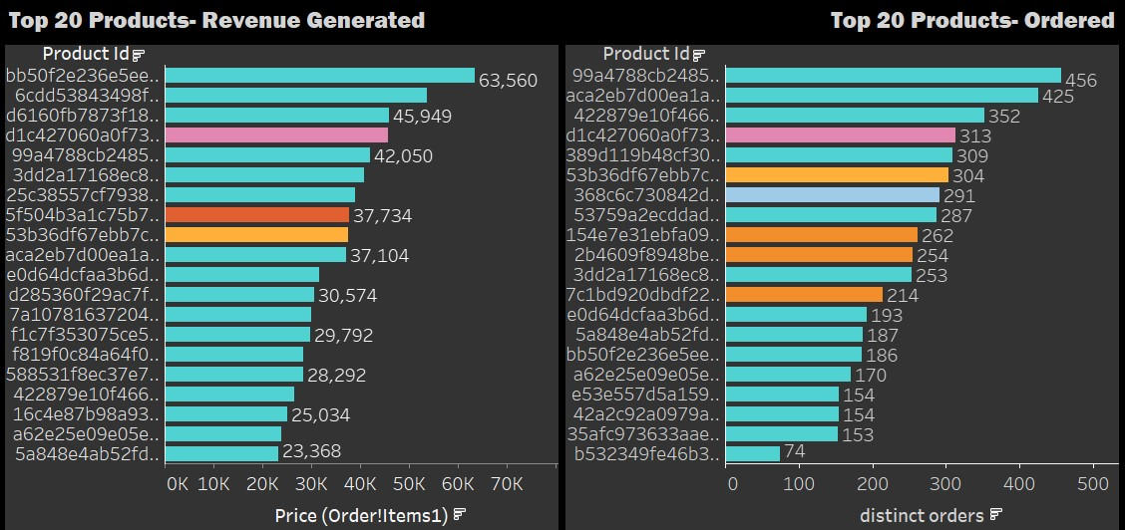
TOP 20 ORDERED PRODUCTS BY REVENUE AND QUANTITY
Highest revenue generated by products with id: bb50f2e236e5eea0100680137654686c belong Toy category and
the corresponding amount is 63560. Most of the Top 20 products with respect to revenue belongs to Toy.
Highest ordered product with id: 99a4788cb24856965c36a24e339b6058 belong to Toy category and
the corresponding total order is 456 . Most of the Top 20 products with respect to orders belongs to Toy itself.

Slide 6
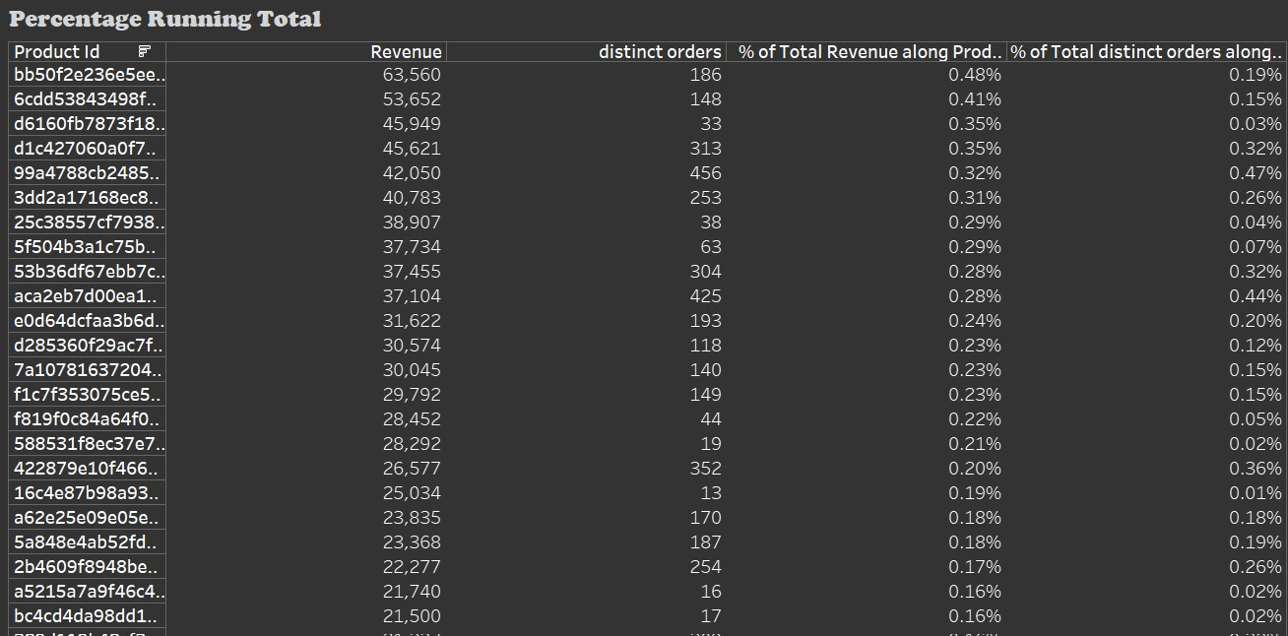
PERCENTAGE RUNNING TOTAL
We made a matrix to find the percentage of total running revenue and quantity ordered by
product id
It made easy for us to identify the product contributions to both revenue and quantity

Slide 7
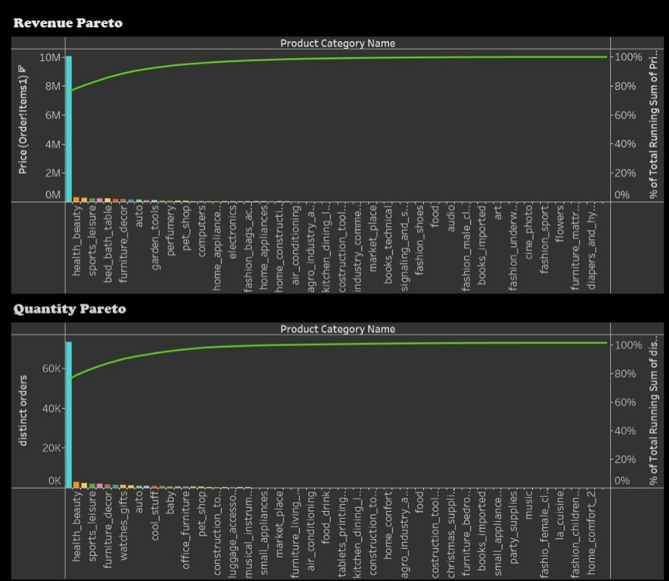
PARETO ANALYSIS
Revenue Pareto
Toys, alone account for 76.24% of the revenue
Toys, health_beauty, and watches_gift ,these three together contribute 80% + of the revenue
Quantity Pareto
Toys, alone account for 75.94% of the total orders
Toys, health_beauty, and bed_bath_table ,these three together contribute 80% + of total orders

Slide 8
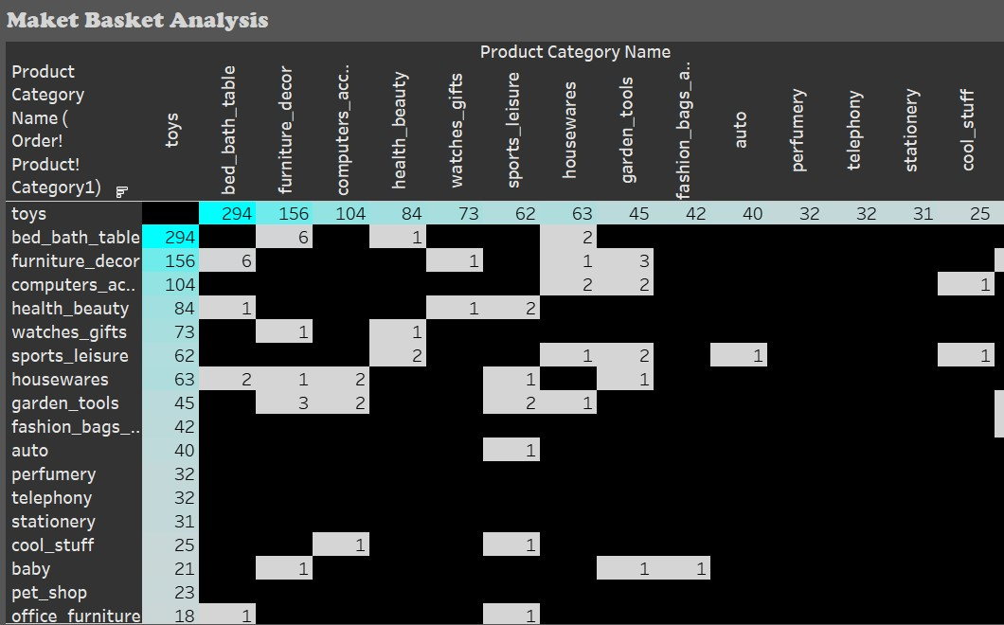
MARKET BASKET ANALYSIS
Analysis identifies frequently ordered category associations
Toys along with bed bath table has been ordered together most of the times, following furniture décor, computer accessories etc.
Books are one of the least ordered associated category

Slide 9
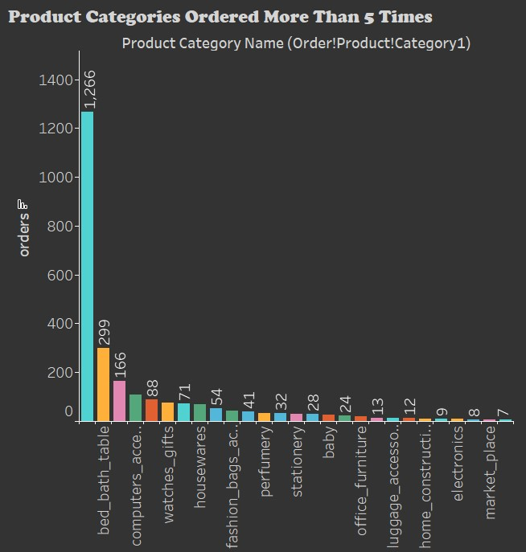
PRODUCT CATEGORY ORDERED
MORE THAN FIVE TIMES
Toys are the most ordered quantity,
we have filtered/limited the range
of value of toys for better visualization.
Total 27 categories are ordered more than five times

Slide 10
INSIGHTS
The category ‘Toys’ constitutes 20% of the products which generates 80% of revenue
The categories apart from toys which are at least ordered 5 times are bed_bath_table, furniture_decor, computer_accessories, health_beauty and have high order quantity for those
The combination of all of the above few categories with toys and each other are frequently ordered

Slide 11
RECOMMENDATIONS
Target customers who are more likely to buy Toys (parents of new born babies)
Maintain inventory for categories that are contributing more than 75% of the revenue
Need to make one more segmentation as sub category, it will improve inventory management better
Providing a membership card for customers who are frequently ordering the products , and with membership card provide customers a discount based on association of products

Slide 12
APPENDIX
Here is an overview of our data dictionary
  Orders information such as order_id, customer_id, order_status
  Order_items information such as order_item_id,product_id, price
  Customers information such as customer_id, customer_state
  Payments information such as payment_type,payment_value
  Products information such as product_id, product_category_name
The following data sources was used:
  All cleaned and merged data dictionaries
  Order_items and products merged data on product_id

Slide 13
DATA METHODOLOGY
The process included:
  Exploratory data analysis and transformation using python
    Replaced missing values with alternatives
    Checked for duplicate records
    Created a new data set for market basket analysis by combining two
    data set , products and order_items
    Exporting the cleaned dataset to excel files
  Further verification with excel
  Data visualization using Tableau

Slide 14
THANK YOU
THANK YOU

