Slide 1
Modeling Global CO₂ Emissions
Akhil Midha

Slide 2
Problem Statement
Examining global Carbon Dioxide (CO₂) emissions
Modeling to predict future CO₂ emissions
Can allow corporations, countries and organizations to monitor and control their CO₂ emissions

Slide 3
Data Cleaning
Merged with Wikipedia country list to obtain continents
Dropped missing values
Reduced dimensionality by eliminating irrelevant or unusable columns

Slide 4
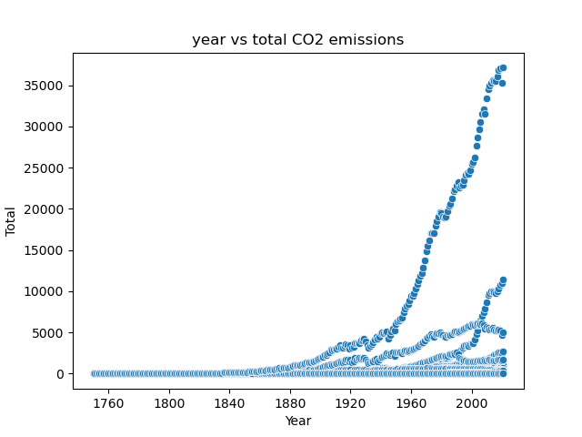

Slide 5
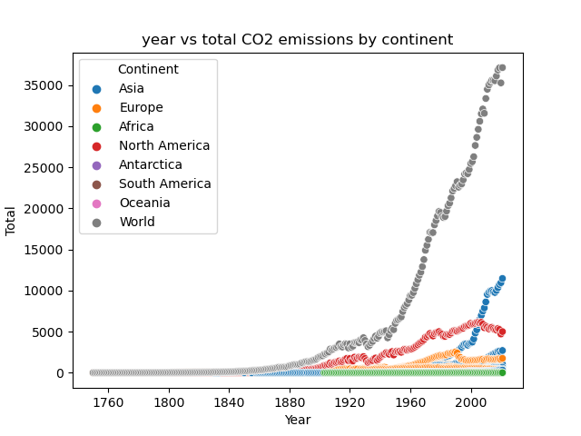

Slide 6
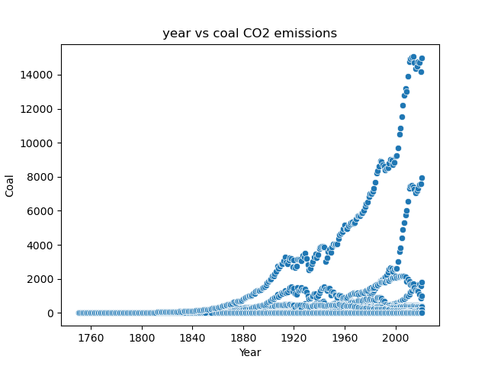

Slide 7
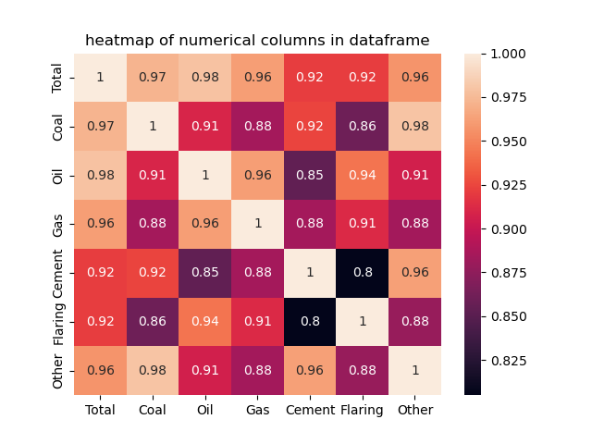

Slide 8
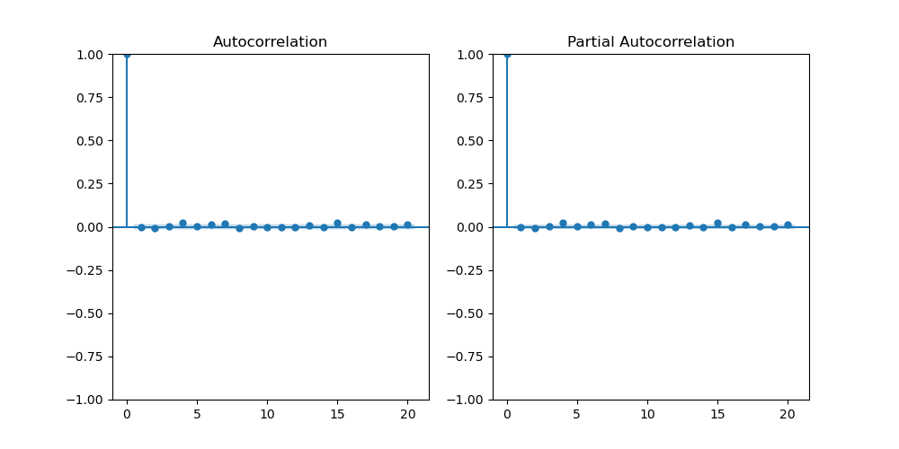

Slide 9
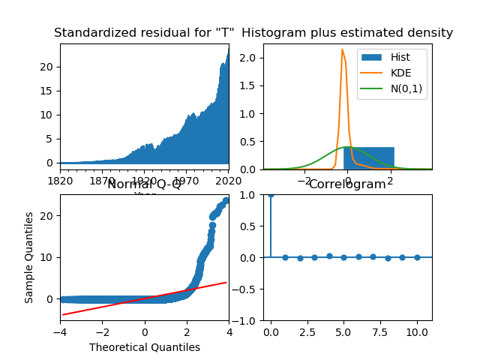
ARIMA (0,0,0), scaled

Slide 10
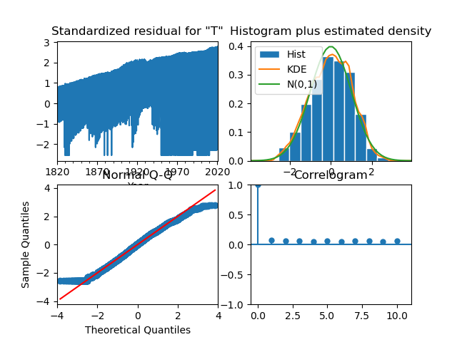
ARIMA (0,0,0), log transformation

Slide 11
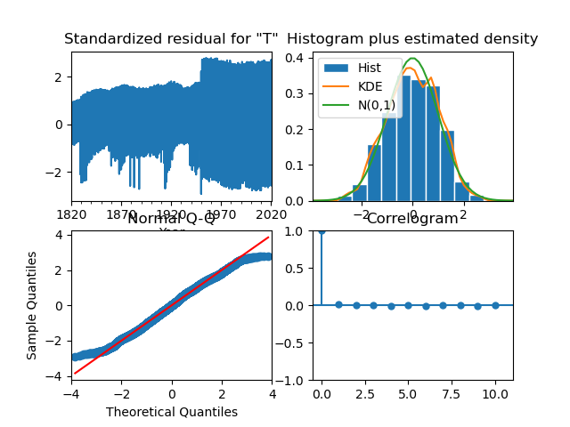
ARIMA (2,0,2), log transformation

Slide 12
Recommendations on Further Use
Compare to other greenhouse gas (GHG) emission data
Prepare for future (Paris Climate Accords, National Goals, etc.)
Pair with other weather data to predict weather patterns

Slide 13
Sources:
The Global Carbon Project's fossil CO2 emissions dataset
Andrew, Robbie M
Peters, Glen P
https://zenodo.org/records/7215364

