Slide 1

"Project Review”
for E-4 2017 Admitted Batch
Submitted as part of Major Project
by
A Sankara Rao (S170128)
N V S S Akhil Varma (S170166)
K Sasi Priyanka (S170428)
Under the Supervision of:
Ch Lakshmi Bala
Department of Computer Science and Engineering
Rajiv Gandhi University of Knowledge Technologies
Srikakulam – 532402
1

Slide 2
CYBER BULLYING DETECTION USING MACHINE LEARNING

Slide 3
ABSTRACT
The usage of social media has grown rapidly over time with the growth of the internet. Social media is an influential platform where we can find both good and bad things. This rapid increase in social connectivity results in online abuse, harassment, cyberbullying, cybercrime, and online trolling. We mainly focus on Cyberbullying, because it directly affects the mental health of a person, particularly this is a serious issue for women, in some cases, some women attempt suicide. Many incidents have recently occurred worldwide due to online harassment, such as sharing private chats, rumors, and sexual remarks. Therefore, the identification of bullying texts or messages on social media has gained a growing amount of attention among researchers. The main purpose of this project is to design and develop an effective technique to detect online abusive and bullying messages by merging natural language processing and machine learning. This project takes a text as input and checks whether it’s cyberbullying comment or not.

Slide 4
INTRODUCTION
Cyber Bullying is an intentional and repetitive action. This means that the bully hurts someone over and over again on purpose using electronic communications like Facebook, Instagram, Twitter and many social media platforms.
Social media is a platform that allows people to post anything like photos, videos, documents extensively and interact with society. Nowadays, social media is involved in different sectors like education, business, and also for the noble cause. Although social media has a lot of benefits, it also has some drawbacks. Using this media, malevolent users conduct unethical and fraudulent acts to hurt others feelings and damage their reputation.
Recently, cyberbullying has been one of the major social media issues. As the digital realm has grown and technology has progressed, cyberbullying has become relatively common, particularly amongst adolescents.

Slide 5
CONT…
This bullying has a physical and mental impact on the victim. The victims choose self-destructive acts like suicide because the trauma of cyberbullying which is hard to be endured. Thus, the identification and prevention of cyberbullying is important to protect teenagers.
Mostly women were getting effected by cyber bullying getting trolled or bullied by passing abusive comments.
So, this project is to detect the abusing comments or trolls based on age, gender, ethnicity, religion and other… .
There are no real world applications implemented on detection of cyber bullying yet, expecting future implementations.

Slide 6
MOTIVATION OF PROJECT WORK
There is no system present in the real world to detect bullying texts. So , we wanted to build a model which detect those sort of texts.
This bullying has a physical and mental impact on the victim. The victims choose self-destructive acts like suicide because the trauma of cyberbullying which is hard to be endured. Thus, the identification and prevention of cyberbullying is important to protect teenagers.
Cyber bullying creates toxic environment in social media, detecting and preventing it can help users to provide a healthy environment.

Slide 7
SCOPE OF PROJECT
Social media platforms:
These models can be used identify and block cyber bullying text in Social media platforms like
Facebook , Instagram , twitter etc..
Email and Instant Messaging:
Companies and Organizations can use cyberbullying detection models to monitor employee
email and instant messaging conversations to detect any instance of cyberbullying in the
workplace

Slide 8
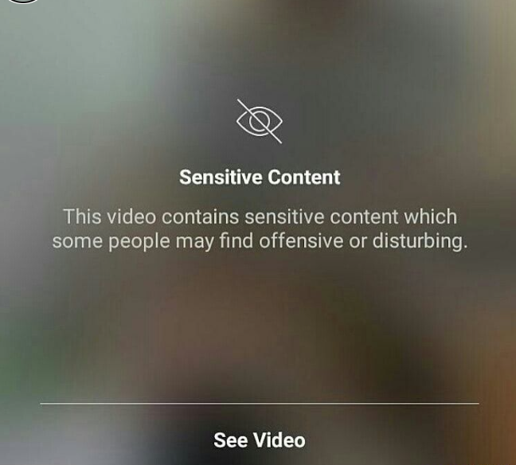
Analysis of Existing Methods/Models/Algorithms
There are some implementations to detect bullying by photos and video contents
In Instagram and Facebook we can find some violent and sexual content masked and showed as sensitive content
The warning sign that is shown before you watch certain Instagram is there in order to help you avoid seeing videos you don’t want to see, for example, sexual or violent content.
This warning in front of videos and photos that have been flagged and reported by the community.

Slide 9
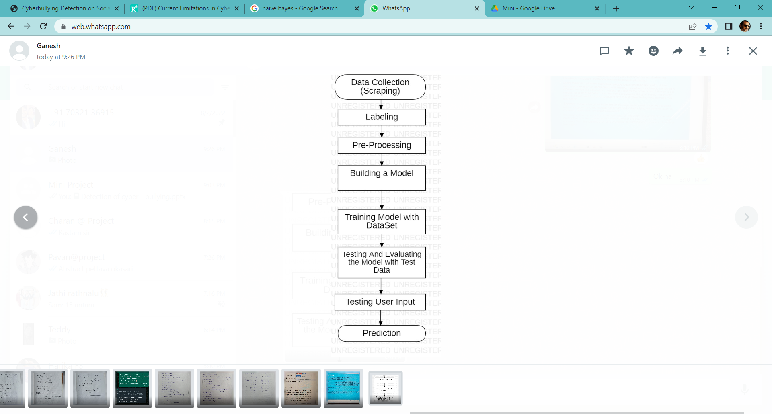
FLOWCHART
Flowchart of the proposed approach
Data collection – Data has been collected through scrapping the comments from Twitter and Youtube.
Labelling – Labelled the collected comments using label studio. Attributes used for labelling are Age, Gender, Ethnicity, Religion, other_cyberbullying, not_cyberbullying. Convert the data into CSV format and get the data set.
Pre-Processing – Cleaned the data by removing the numbers, Hashtags, URLs, Tags from the data and Tokenized means splitting the data into a sequence of lexical tokens and lemmatizing means normalizing the text by switching any kind of word into its base root mode, vectorizing means to change the result data into binary format .

Slide 10
CONT…
Building a model - Used two models – Naïve bayes, Random forest
Naïve Bayes – It is a Predefined model that uses the bayes theorem and classifies based on the overall probability
Random Forest – Predefined model that uses the decision trees to classify the tree have nodes and each node have features the data classified based on the feature and the final result will be the class having max features
Accuracy is measured as the total number of (TP + TN)/(All Cases), while a F1 score is calculated by 2*((precision*recall)/(precision + recall)),
with precision = TP/(TP+FP), and recall = TP/(TP+FN).

Slide 11
CONT…
Training model with data set – The collected data set was split into two parts as 70% and 30%. The 70% data is given into a variable, and this was trained using the model
Testing And Evaluating the model with Test data – The other 30% of the data is taken into another variable this was given for testing to the model
Testing User Input – The user input is taken into a variable and sent for prediction
Prediction – This will classify the input into a class and predicts it’s class

Slide 12
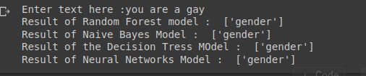
RESULTS
The Data is collected by scraping the web. This data is pre-processed and given to the models to train.
The trained classifier model is given an input from the user to make prediction
Accuracy of NaiveBayes model is: 77.22253284875595%
Accuracy of Random forest model is: 82.51327928431647%
Accuracy of decision tree model is: 78.78110148168857%
Accuracy of MLP classifier model is: 80.69611406206319%

Slide 13
Result Comparison With Other Approaches
From the output of the program, we can observe that the overall accuracy of the Random Forest classifier is better than that of all other classifiers.
So we can say that the Random forest approach is better in classifying the text data into categories. But when we compare the processing time to train the model the other classifying models approach is faster than the Random Forest method.
So if we have time and memory we can use the Random Forest classifier but if are short in memory and time we can go for the Naïve Bayes method or Decision Tree algorithms.

Slide 14
LIMITATIONS
Apart from the well-established challenges that language-use poses (e.g., ambiguity, sarcasm), two factors in the event add further linguistic complexity, namely that of actor role and associated context. In contrast to tasks where adequate information is provided in the text of a single message alone, to completely map a cyberbullying event and pinpoint bully and victim implies some understanding of the dynamics between the involved actors and the concurrent textual interpretation.
We can not determine whether it is bully or not by a single thread on social media, because there may also be a where two friends use abusing words and this can not be considered as bullying
So, cyberbullying detection systems seem not applicable to real world situations
The model cannot detect bully words of the type which are posted each letter in a newline.
Example:(Nigga)
N
I
G
G
A

Slide 15
CONCLUSION
In particular, cyberbullying has become more common and has begun to raise significantly. Also usage of social media is rapidly increasing. So there is a need of automatic cyberbullying detection feature in social media platforms.

Slide 16
REFERENCES
Md Manowarul Islam; Md Ashraf Uddin; Linta Islam; Arnisha Akter; Selina Sharmin; Uzzal Kumar Acharjee, "Cyberbullying Detection on Social Networks Using Machine Learning Approaches"; 2020 IEEE Asia-Pacific Conference on Computer Science and Data Engineering (CSDE), 16-18 December 2020.
Rohith Gandhi, "Naive Bayes Classifier", Towards Data Science, May 5, 2018. [3] Joe Tran, "Random Forest Classifier in Python"; Towards Data Science, May 2, 2020.
Manoj Nain, "Scraping Tweets using Twitter APIs"; Analytics Vidhya, Jul 4, 2020.

Slide 17
Thank You

