Slide 1
Employee Salary Prediction
CAPSTONE PROJECT
Presented By: G R S AKHIL VARMA
College Name: Presidency University
AICTE: STU68232c2b78c351747135531
Department: Computer Science and Engineering (Data Science)

Slide 2
OUTLINE
Problem Statement
System Development Approach
Algorithm & Deployment (Step by Step Procedure)
Result
Conclusion
Future Scope
References

Slide 3
Problem Statement
My project predicts employee salary based on multiple input features such as experience, education, job role, and industry.
This tool can be used by HR departments and corporate planners to streamline salary forecasting, ensure competitive compensation, and support data-driven decision-making across diverse organizational structures.

Slide 4
System Approach
System Requirements:
OS: Windows 10/11, macOS, or Linux
Python: Version 3.8 or higher
RAM: Minimum 4 GB (8 GB recommended)
Browser: Chrome, Firefox, Edge (for accessing Streamlit UI)

Slide 5
System Approach
Required Libraries:
Streamlit: Creating the interactive web application frontend
Numpy: Numerical computations and array operations
Scikit-learn: For Machine learning algorthim and preprocessing
Matplotlib: For Visualization
Pyngrok: Used to create a public URL for your local Streamlit app.
Threading: Used to run multiple operations simultaneously, like running Streamlit and ngrok at the same time.
Joblib: Used to save and load machine learning models efficiently.

Slide 6
Algorithm & Deployment
Step 1: Import Library
Step 2: Load the Data set
Step 3: Preprocessing
Handle Missing value
Encode categorical variables
Splitting Features (X) and Target Variable (y)
Step 4: Exploratory Data Analysis (EDA) - Outlier Detection

Slide 7
Algorithm & Deployment
Step 5: Model Training and Prediction
Step 6: Model Comparison using Pipelines
Step 7: Model Evaluation using Accuracy Score
Step 8: Deploy trained machine learning model as an interactive application.

Slide 8
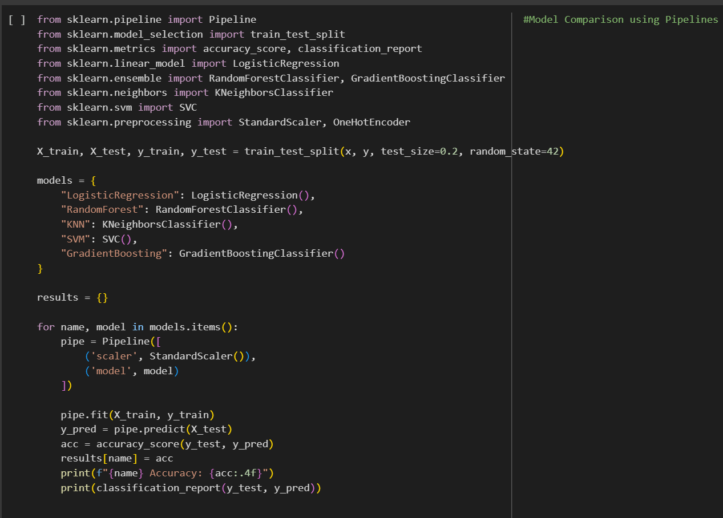
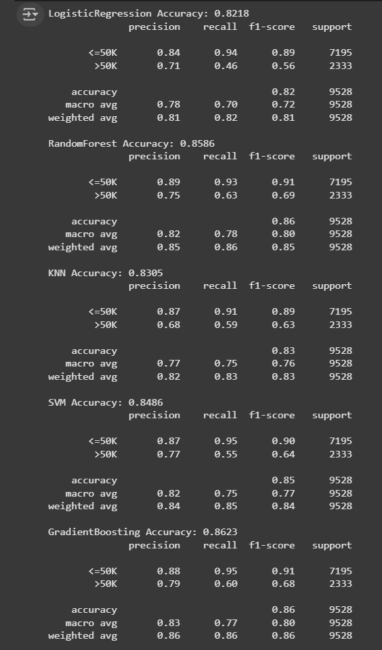
Result
Model Comparison using Pipelines:
Output:

Slide 9
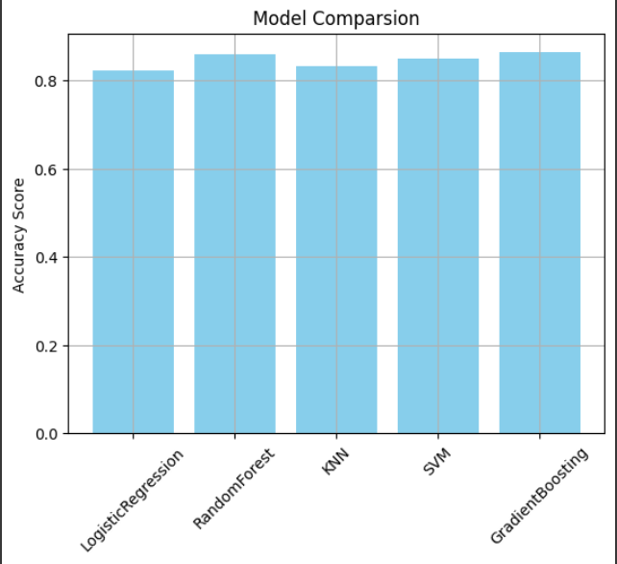
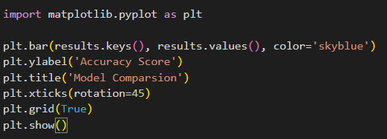
Result
Model Comparsion:

Slide 10
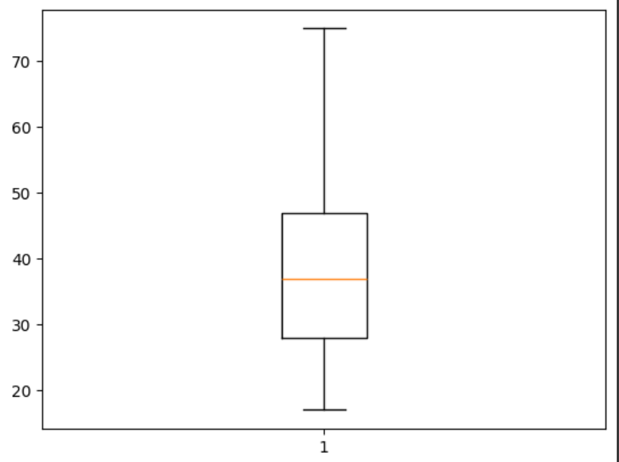
Result
Box Plot:

Slide 11
Result
Github link:
https://github.com/akhilvarmaa07/Employee-salary-prediction.git

Slide 12
Conclusion
Finding:
Model Training & Evaluation:
Multiple machine learning models (Logistic Regression, Random Forest, KNN, SVM, Gradient Boosting) were trained to predict employee salary class.
Model Deployment:
A user-friendly Streamlit web application was developed to:
Collect employee details via an interactive UI

Slide 13
Conclusion
This tool can be used by HR departments and corporate planners to streamline salary forecasting, ensure competitive compensation, and support data-driven decision-making across diverse organizational structures.

Slide 14
Future scope(Optional)
Dynamic Visualization:
We can add Interactive Dashboard, which can be easy to Understand

Slide 15
References
https://jmlr.org/papers/volume12/pedregosa11a/pedregosa11a.pdf
https://pandas.pydata.org/
https://streamlit.io/

Slide 16
THANK YOU

