Slide 1
FinalVisual
File created on: 11/5/22 10:21:59 PM EDT

Slide 2
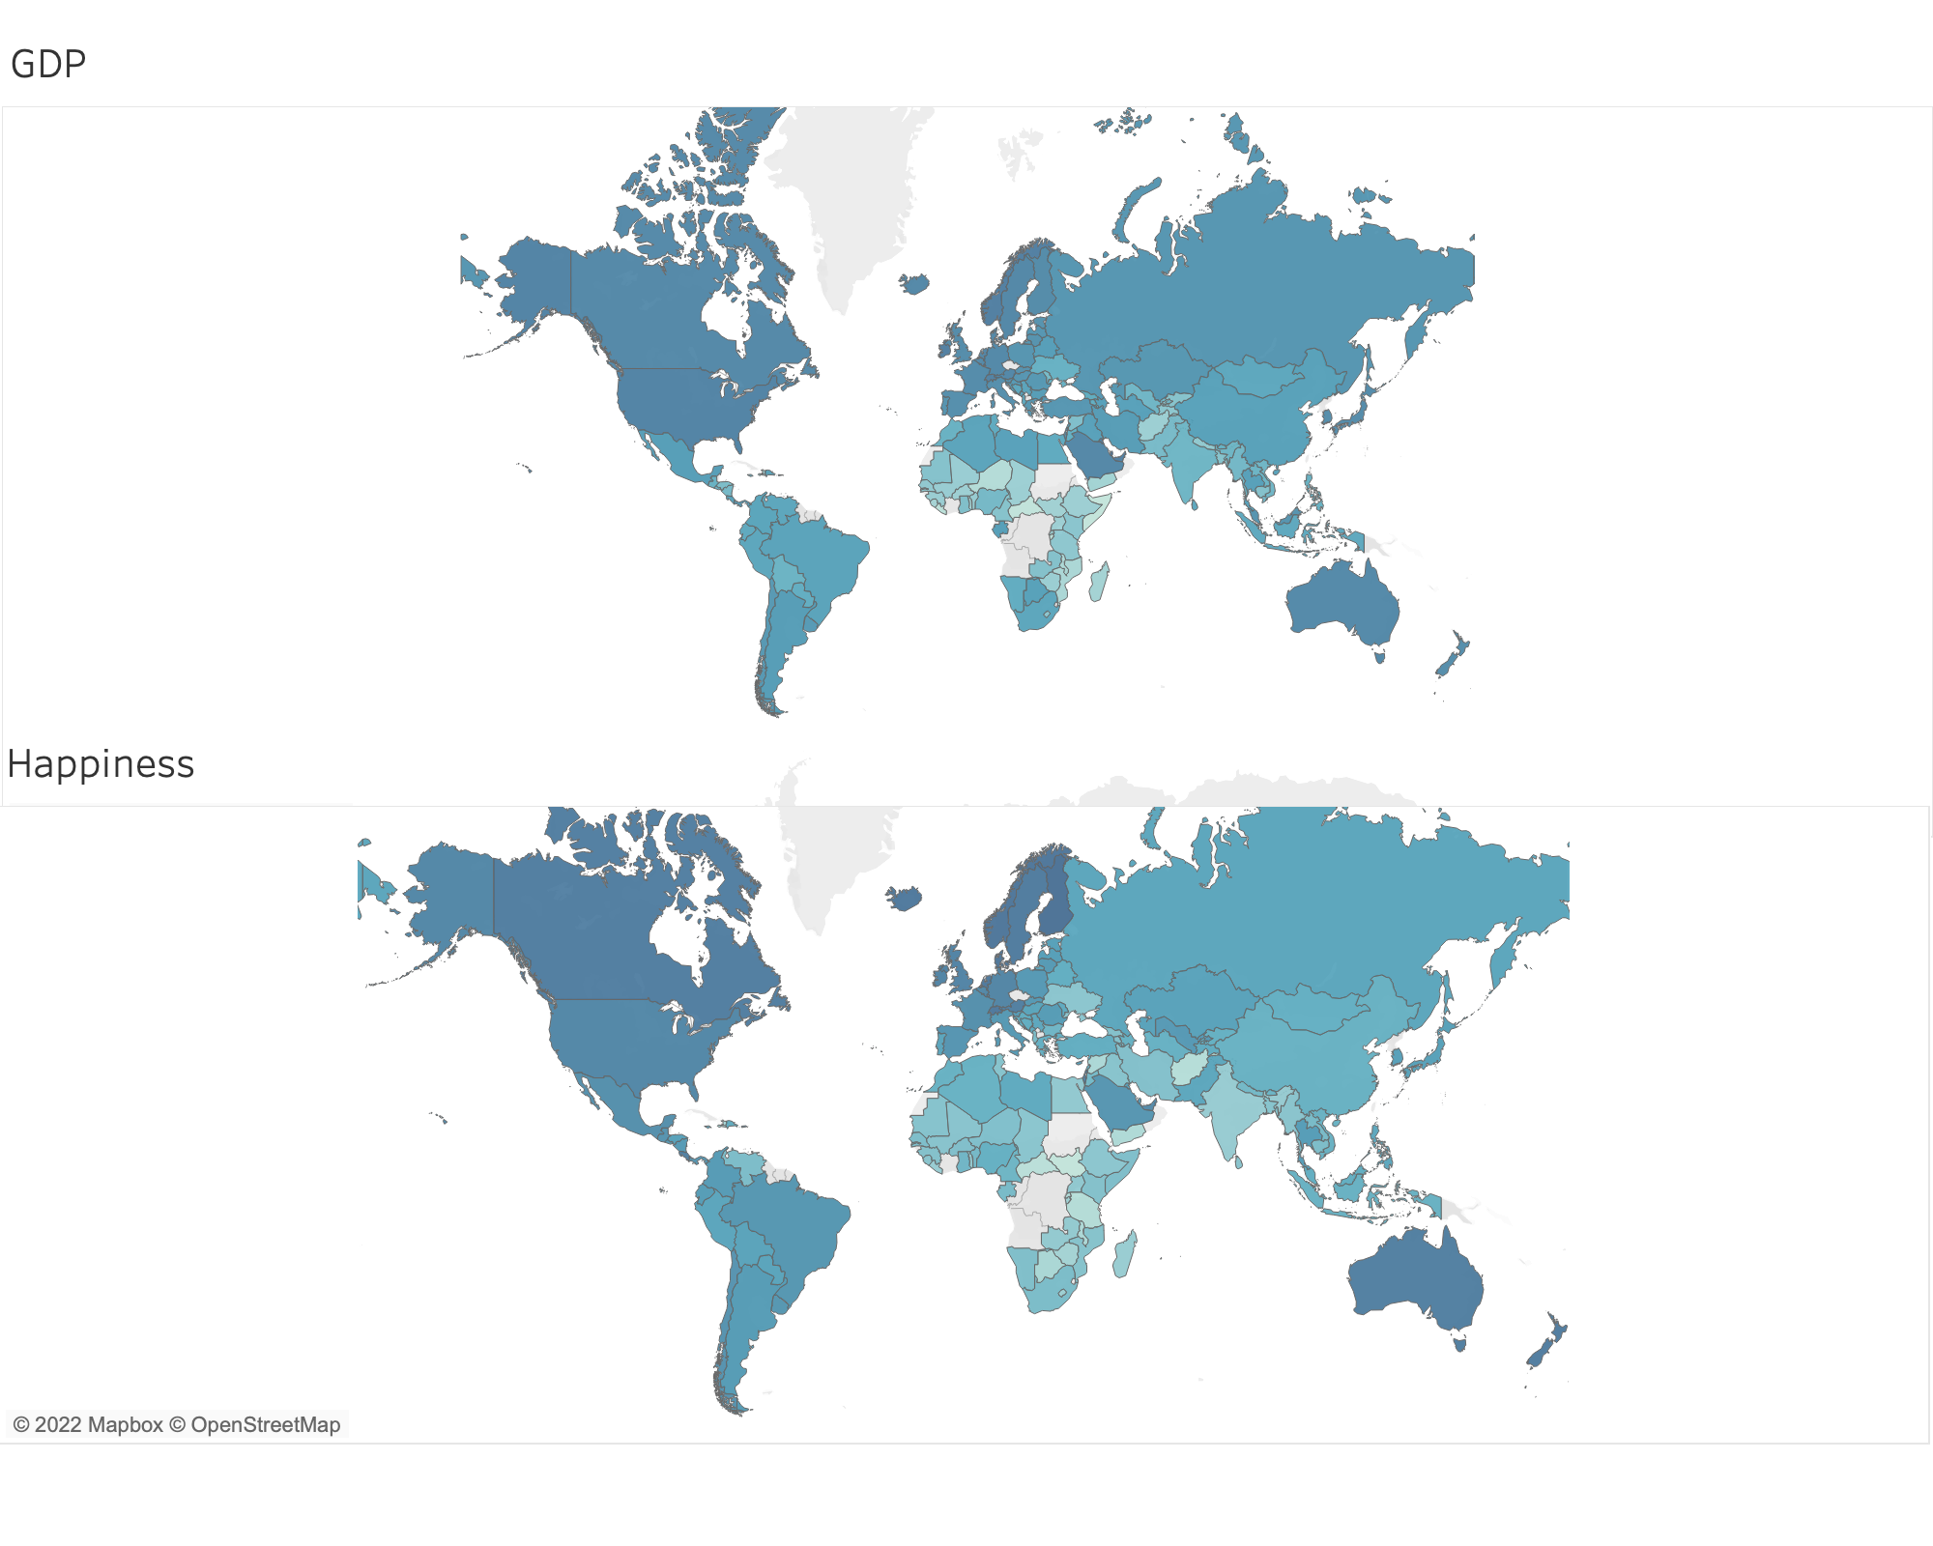

Slide 3
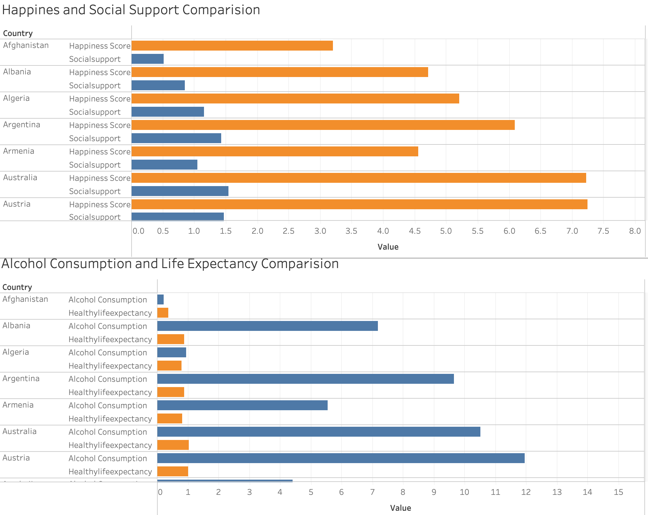

Slide 4
