Slide 1
DATA 603 Group project Presentation on Denver Crime data
Team members:
Harsha Daparti
Laxmi Prasanna Chennadi
Srinivasa Akhil Vutukuri

Slide 2
Introduction:
The data we took is crime data of Denver. The reasons of the crime, traffic crimes, place, time of the crime is recorded in the dataset
This dataset includes criminal offenses in the City and County of Denver for the previous five calendar years plus the current year to date. The data is based on the National Incident Based Reporting System (NIBRS) which includes all victims of person crimes and all crimes within an incident
Data Link : https://www.kaggle.com/paultimothymooney/denver-crime-data

Slide 3
Tools used
Mongo DB
Apache spark SQL
Python
Anaconda ( integration with jupyter notebook)

Slide 4
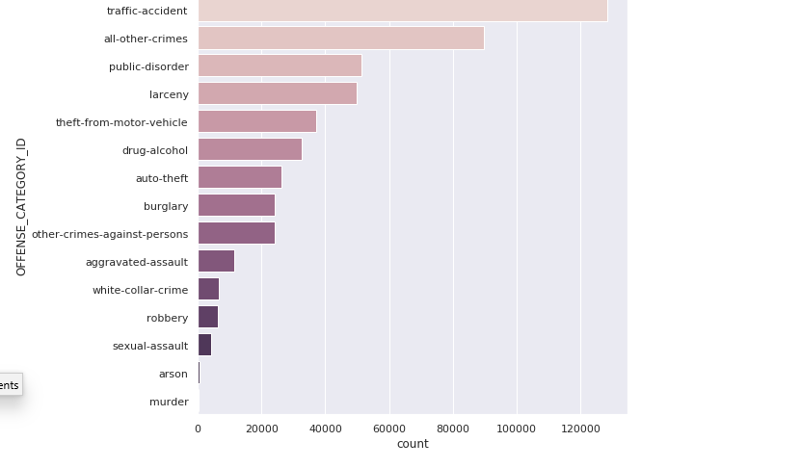
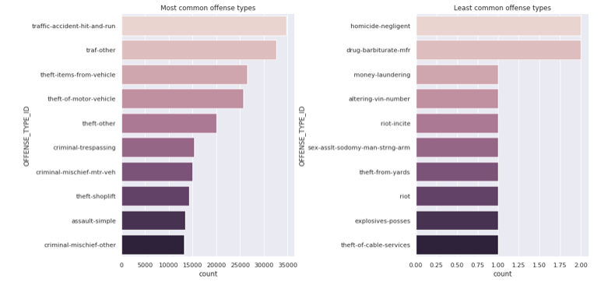
Results

Slide 5
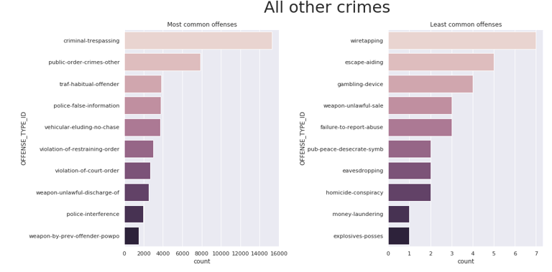
Results extended…

Slide 6
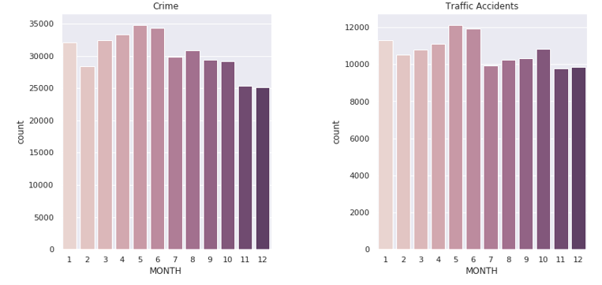
Results extended…

Slide 7
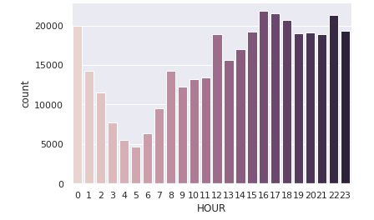
Results extended…

Slide 8
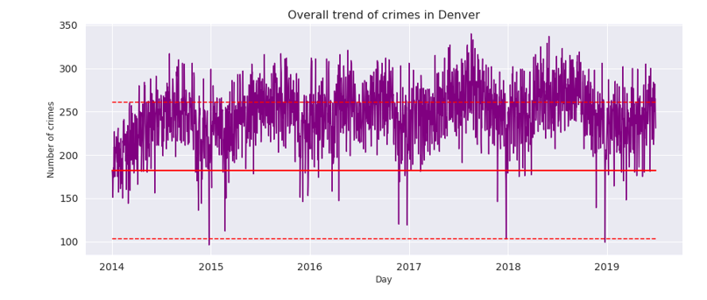
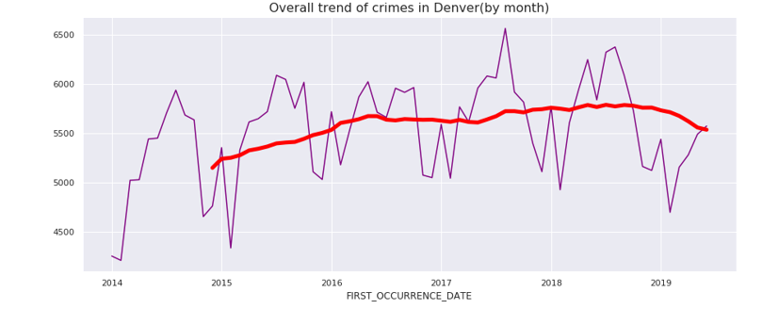
Results extended…

Slide 9

Learnings
Using all the technologies together and creating a suitable environment was the biggest hurdle in this project.
This Photo by Unknown Author is licensed under CC BY

