Slide 1
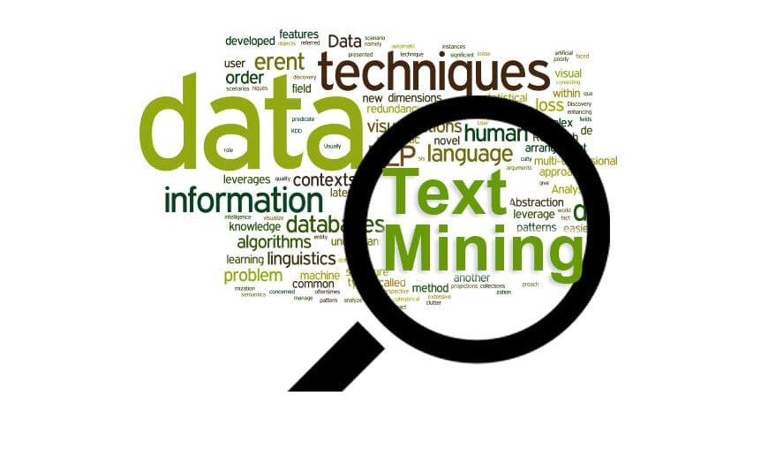
Text tagging using NLP
Capstone Project – Data 606
Srinivasa Akhil Vutukuri

Slide 2
RECAP :
New aggregator dataset with 400,000 rows and with 8 columns
This dataset is around a span of 6 months from march to august 2014
Main columns are category , title , web link , Unix time
Found patterns and seasonality's in my data in deliverable 2
Along with the exploratory analysis I also did some cleaning of my text data
Project aim :
Finding patterns and seasonality's in dataset
To categorize the articles which include business , entertainment, medical and science and technology using their headlines
Retrieving the actual article using article link from the website and finding the similarities if the articles on the similar topic.

Slide 3
Literature Review and Industry Research
As we know there is a data which is hovering around in cloud like structured , unstructured and semi structured data. We can get valuable insights from text mining from product suggestions to fraud detections. So, text mining has a huge impact when it comes to big data industry. We can even make use of chatbots and assign better work allocation for customer care services.
There are much more uses in warehouse managements where one can create tags of various layers of allotment including summarizing and organizing important data from spam using spam filtering.
There is various project on text mining but what I was looking to do different is to retrieve the related article from website article weblink provided from my dataset and get the inferences from different publishers and similarity in the articles as well as the relativity. It might be a challenge as the some of the data web links are inactive which can affect the model and analysis. There are quite a lot of project with quite less predictions. My project goal is to attain an accuracy around 70 to 80%.

Slide 4
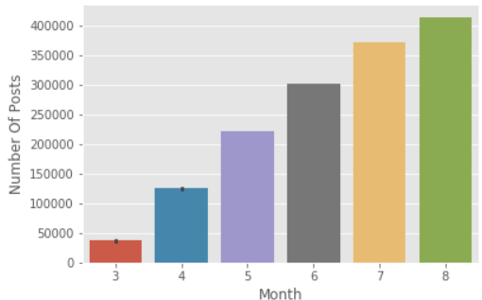

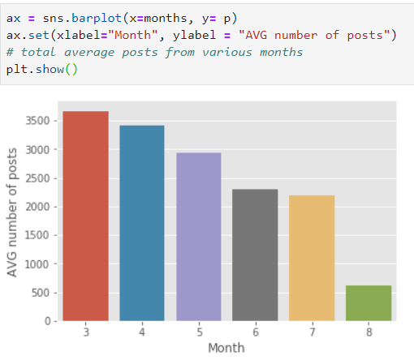
Exploratory Analysis
I faced some difficulties while importing my data as it is not in a readable format. Then after using a separator I got to work with the dataset.
I had some columns with non-significant parameters and after dropping them
I has to find a way to replace my missing values . Instead of dropping I found some replacement through some methods.
I did my analysis on number of posts every month
For average number of articles might differ as the start date is from 10th of march which makes 20 days in the march and 28 days in august because it is till 28th

Slide 5
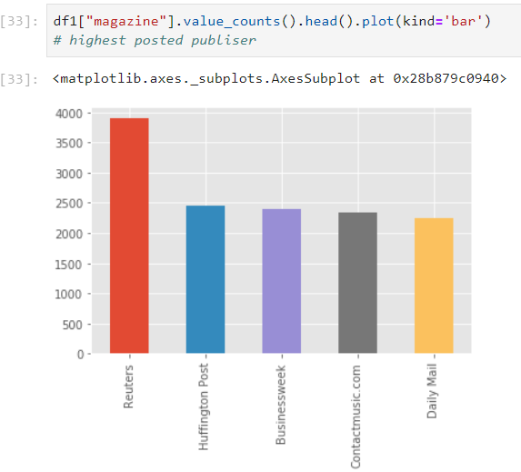
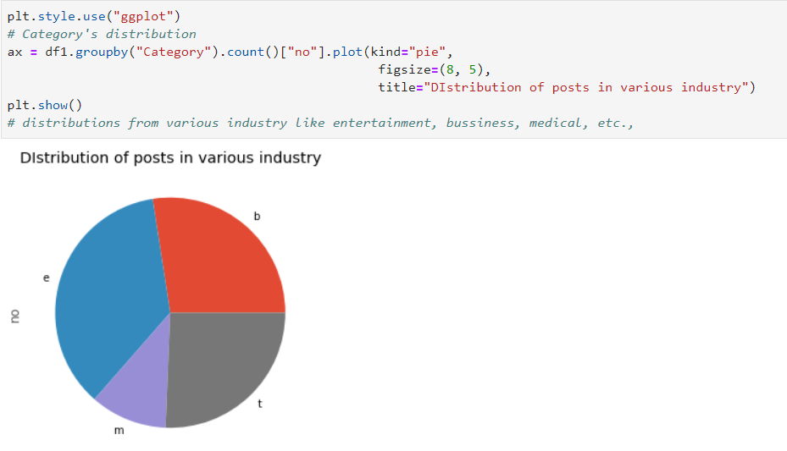
Contd..

Slide 6
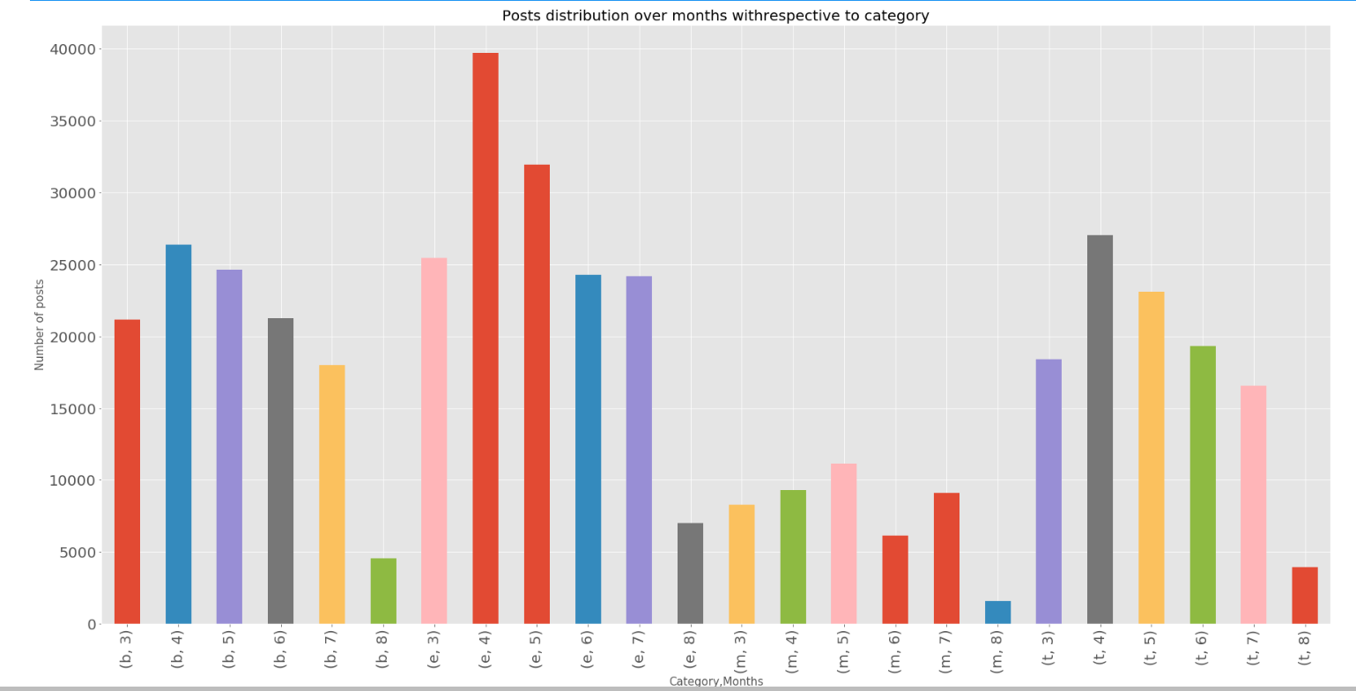
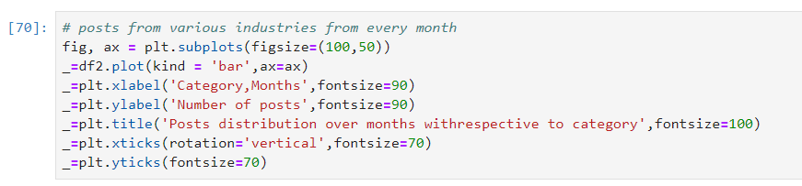
Contd..

Slide 7
Text Cleaning
Removed punctuations
Stop words
Removed numbers from the text data
Changed the data into single case format.
Lemmatization , Stemming
Then I tokenized the words and created a data frame ready for some analysis.

Slide 8
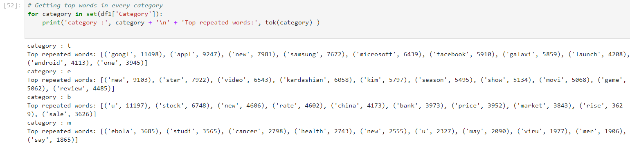
Most trending words

Slide 9
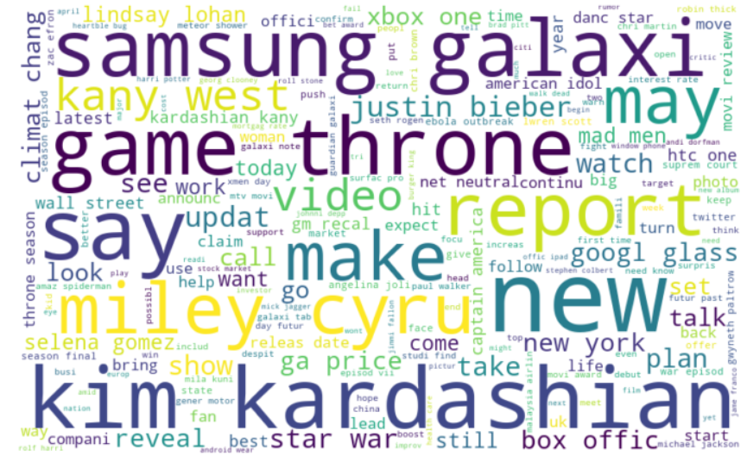
Word Cloud

Slide 10
Models
Logistic
Naïve Bayes
Decision tree
Random forest
Svm

Slide 11
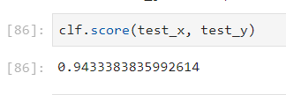
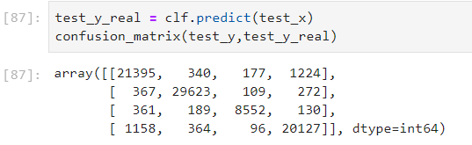
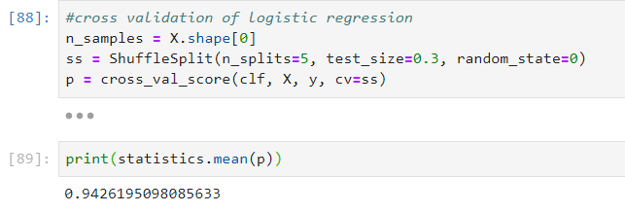
Logistic regression
Perfect for categorical data
Got an good accuracy
Initially though it is over fitting
So, cross validated with shuffle spilt from sklearn to check
Got similar accuracy

Slide 12

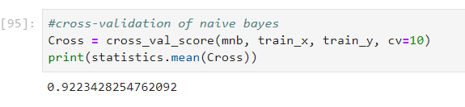
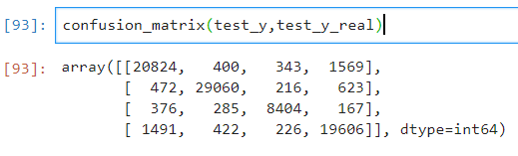
Naïve Bayes
Similar to logistic, got good accuracy
I thought would get much higher than logistic
Cross validated to check

Slide 13


Decision Tree
Didn’t get as expected
Used multiclass to boost but Results are not quite good
Will try to improve by changing parameters and would like to work on it

Slide 14
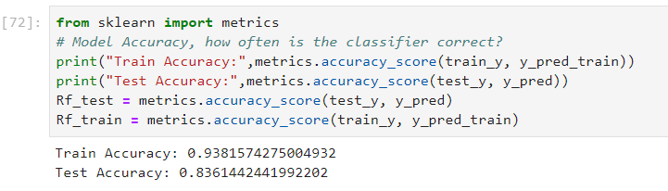
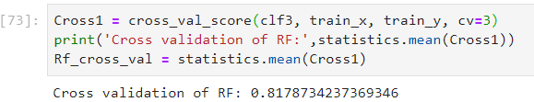
Random forest

Slide 15
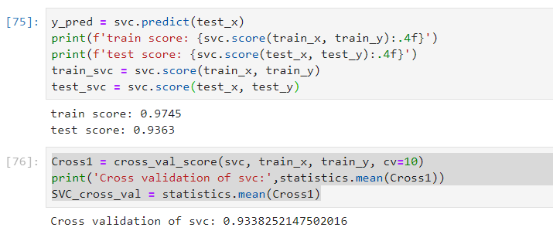
SVM

Slide 16
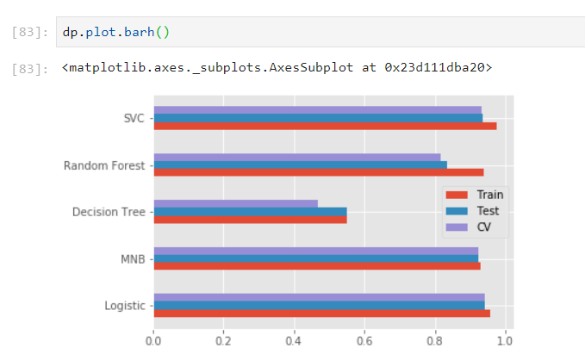
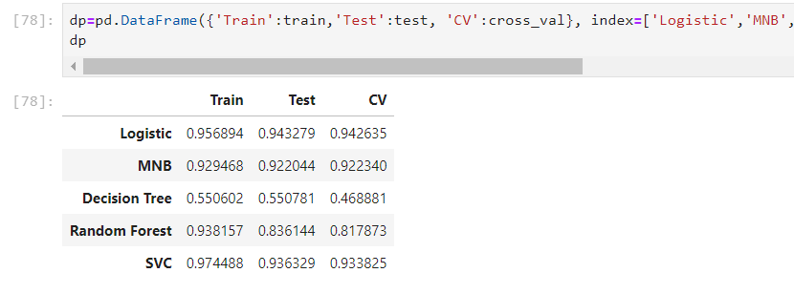
Comparison chart

Slide 17
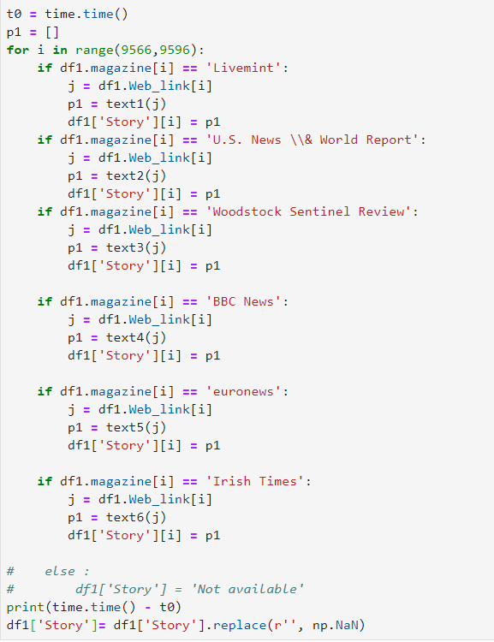
This is to retrieve story using weblink in the dataset

Slide 18
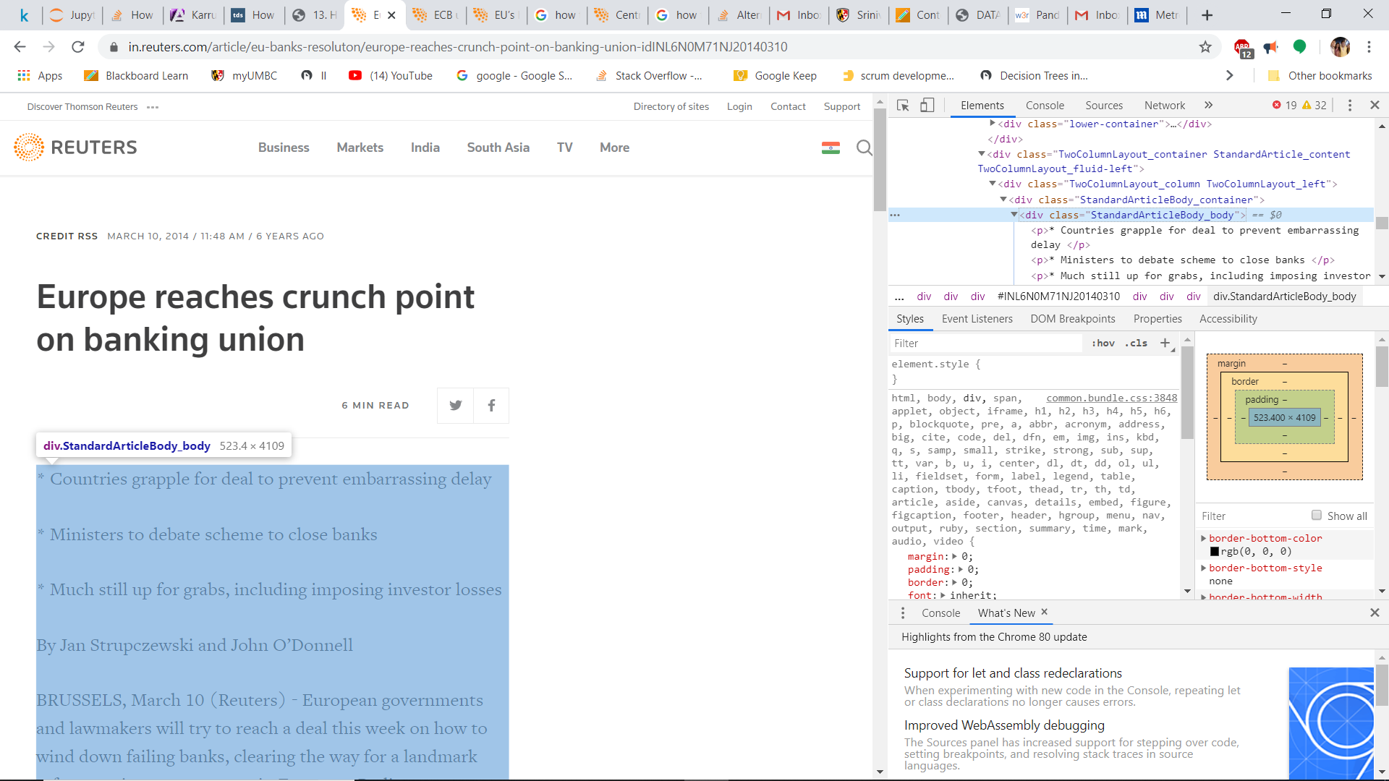

Slide 19
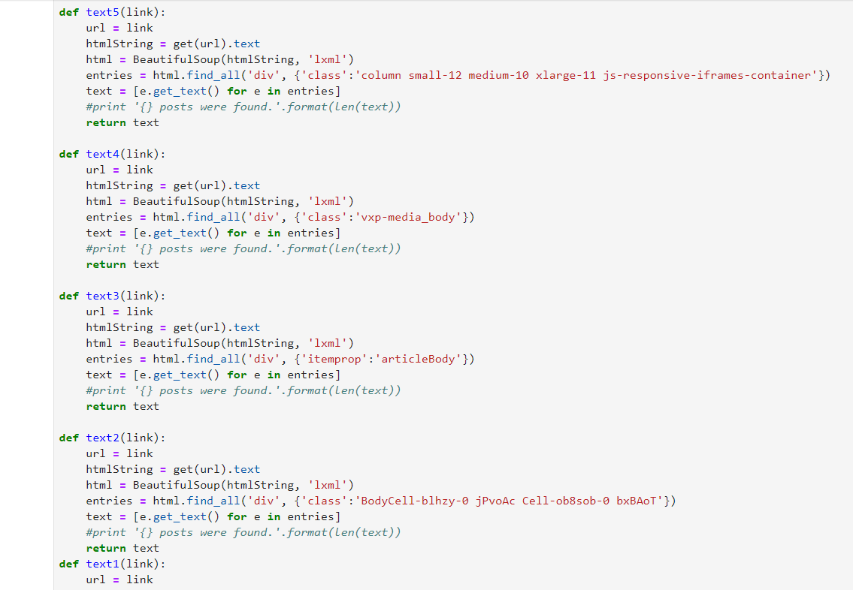
Contd…

Slide 20
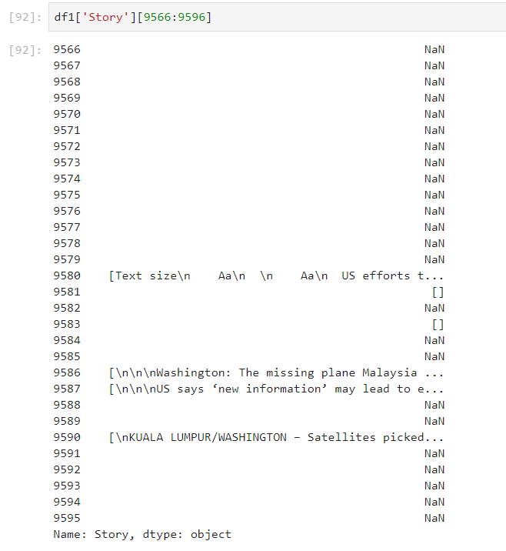
Condt…
4 out of 30 articles are retrieved
85% of the data is inconsistent
Producing meaning observations with such missing data is unrealistic.

Slide 21
Conclusion
Most of the targets are achieved like text cleaning, observing trends, model creation
Meaningful insights from text data to prove initial assumptions like US is most used word, stock is top5 in business sector
Ebola and it’s cure is most trending news in medical sector
Model accuracy is more than 90% which is more than my target
Basic techniques like Logistic regression getting most accuracy
News retrieval couldn’t happen due to insufficient data
Couldn’t achieve one of my goals to compare various articles from various publishers
With 85% missing data it is highly unrealistic to work on this for meaningful observations.

Slide 22

Thank You
Any doubts or feedback
Mail me at v39@umbc.edu

