Slide 1
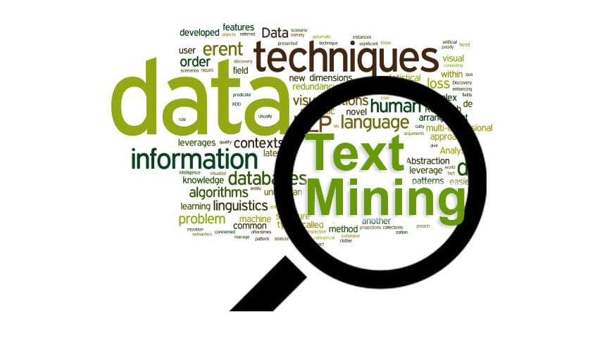
Text tagging using NLP
Capstone Project – Data 606
Srinivasa Akhil Vutukuri

Slide 2
Overview
Literature Review
I will be going through the initial exploratory analysis and my progress
Outcomes of the Analysis and text cleaning

Slide 3
Literature Review and Industry Reserach
As we know there is a data which is hovering around in cloud like structured , unstructured and semi structured data. We can get valuable insights from text mining from product suggestions to fraud detections. So, text mining has a huge impact when it comes to big data industry. We can even make use of chatbots and assign better work allocation for customer care services.
There are much more uses in warehouse managements where one can create tags of various layers of allotment including summarizing and organizing important data from spam using spam filtering.
There is various project on text mining but what I was looking to do different is to retrieve the related article from website article weblink provided from my dataset and get the inferences from different publishers and similarity in the articles as well as the relativity. It might be a challenge as the some of the data web links are inactive which can affect the model and analysis. There are quite a lot of project with quite less predictions. My project goal is to attain an accuracy around 70 to 80%.

Slide 4

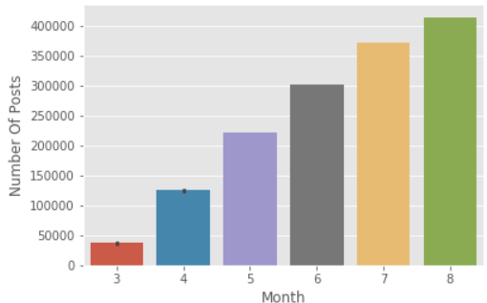
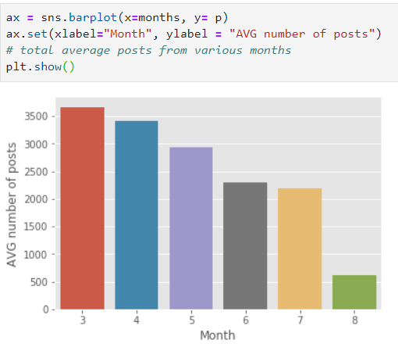
Exploratory Analysis
I faced some difficulties while importing my data as it is not in a readable format. Then after using a separator I got to work with the dataset.
I had some columns with non-significant parameters and after dropping them
I has to find a way to replace my missing values . Instead of dropping I found some replacement through some methods.
I did my analysis on number of posts every month
For average number of articles might differ as the start date is from 10th of march which makes 20 days in the march and 28 days in august because it is till 28th

Slide 5
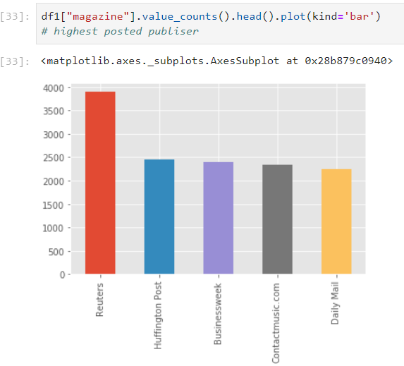
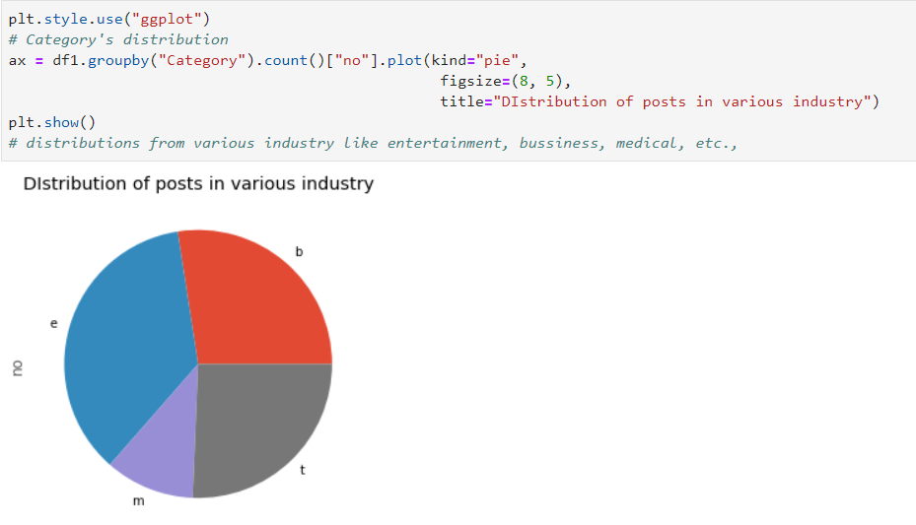
Contd..

Slide 6
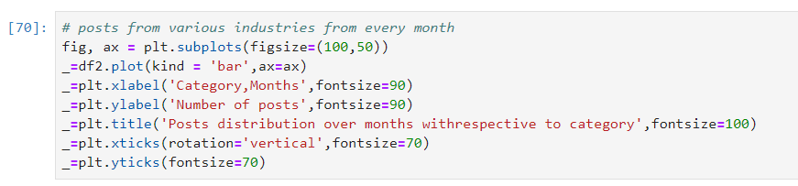
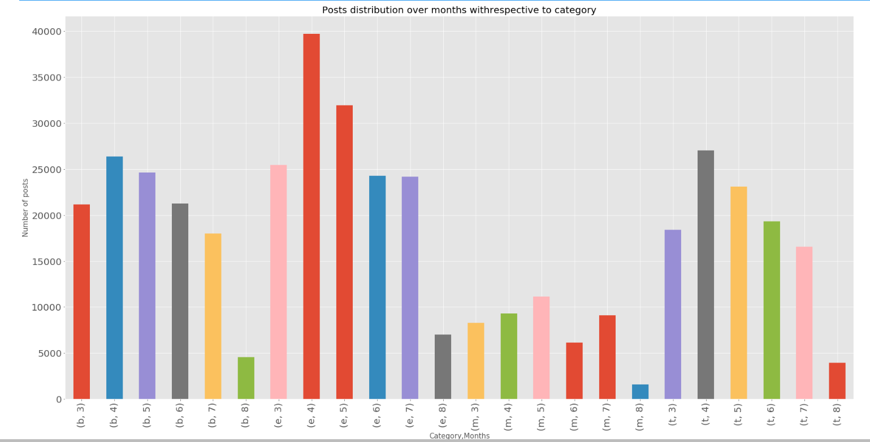

Slide 7
Text Cleaning
Removed punctuations
Stop words
Removed numbers from the text data
Changed the data into single case format.
Then I had done lemmatizations where I faced some issues with the results.
Then I tokenized the words and created a data frame ready for some analysis.

