Slide 1




Employee Management System
Relational Database Design & Analytics using MySQL
Presented by:
G. Akhil Yadav
M. Swamy Yadav
N. Sai Venkatesh Kumar
https://www.linkedin.com/in/akhilyadav25/
https://github.com/akhilyadav2502-stack

Slide 2




About Data Analytics
Data Analytics
Translating raw HR, payroll and leave data into actionable business insights using structured query logic.
Why Data Analytics?
Data bridges finance and strategy. Evidence-based decisions drive better outcomes in any business domain.
Project Scope
60 employees · 6 normalized tables · 21 analytical queries across HR, payroll, qualifications and leave.

Slide 3
Agenda
Objective of the Project
Employee Insights
Job Role & Department Analysis
Qualification & Skills Analysis
Leave & Absence Patterns
Payroll & Compensation Analysis
Challenges, Conclusion

Slide 4
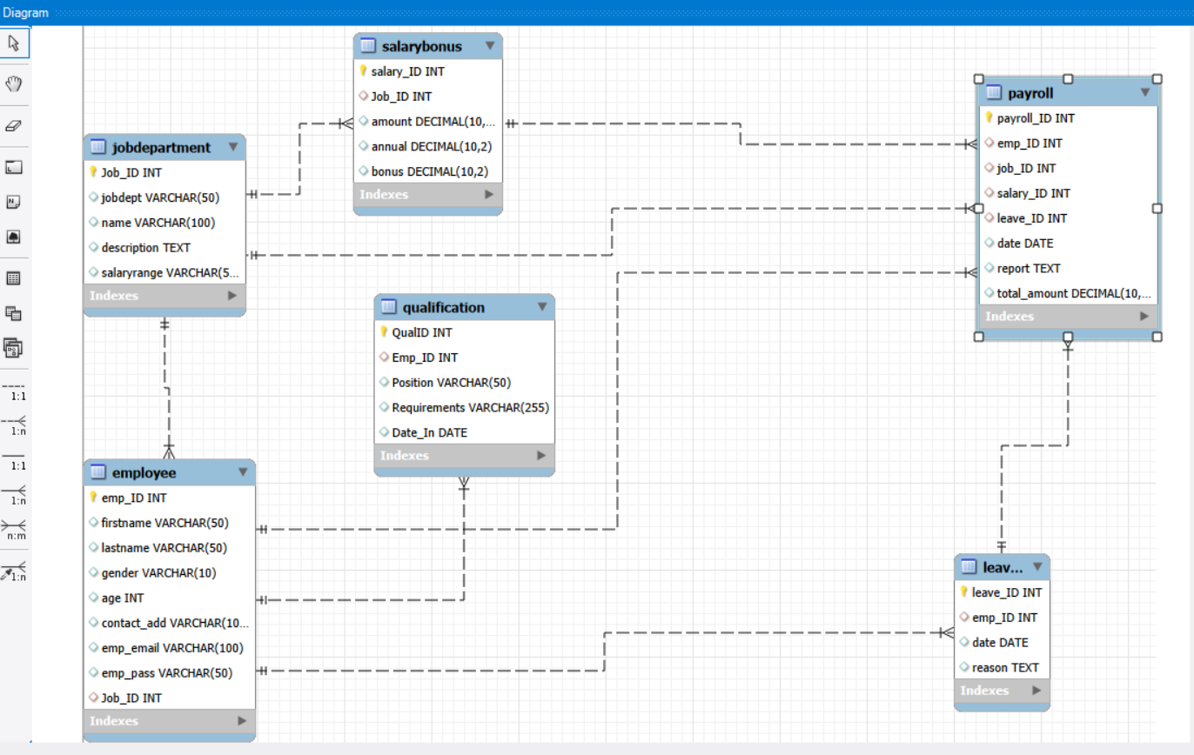
ER-DIAGRAM / Reverse - Engineering

Slide 5
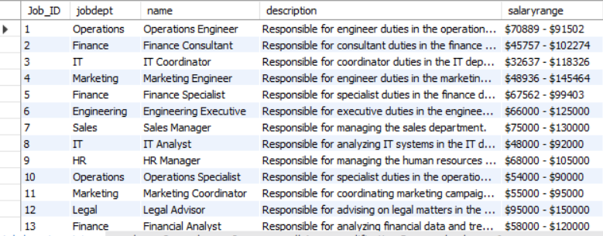
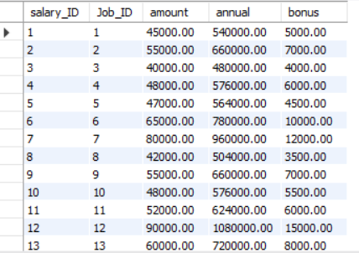
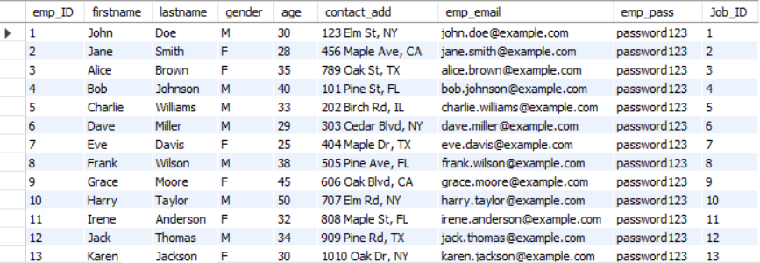
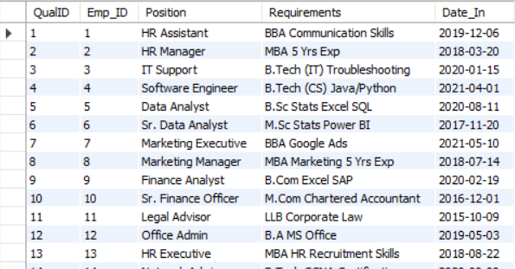
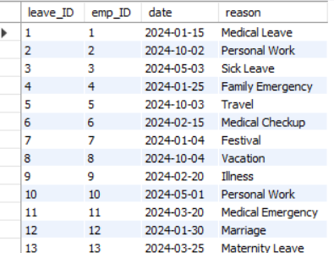
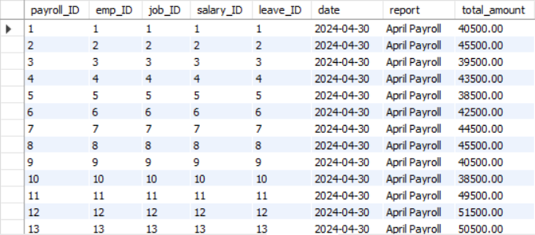
Tables
Job Department table
Salary table
Employees table
Qualification Table
Leaves Table
Payroll table

Slide 6
Project Objective
About the Project
Build a relational Employee Management System using MySQL
Design normalized tables: Employee, JobDepartment, SalaryBonus, Qualification, Leaves, Payroll
Write SQL queries to extract HR, payroll, and performance insights
60 employees across 10+ departments with 21 analytical queries
Database Tables
Employee → JobDepartment → SalaryBonus
Employee → Leaves → Payroll
Employee → Qualification
Key Constraints Used
PRIMARY KEY on every table
FOREIGN KEY with ON DELETE CASCADE / SET NULL
UNIQUE constraint on emp_email
DATE fields in YYYY-MM-DD format
Challenges
Defining correct FK relationships
Cascading updates & deletes
Complex multi-table JOINs
Preventing duplicate emails

Slide 7
Employee Insights
Result Preview
Total Employees: 60
Top Department by Count:
Finance — 9 Employees
Key SQL Concepts Used:
DISTINCT — removes duplicate rows
COUNT() — counts matching rows
GROUP BY — aggregates per department
ORDER BY DESC — sorts highest first
LIMIT 1 — returns only top result
Overview
This section explores the employee table to understand headcount, salary distribution, and expenditure across the company.
Q1: How many unique employees are in the system?
SELECT DISTINCT * FROM employee;
Returns all 60 unique employee records. The DISTINCT keyword ensures no duplicate rows appear.
Q2: Which department has the highest number of employees?
SELECT jobdept, COUNT(Job_id) AS No_of_Employees
FROM jobdepartment
GROUP BY jobdept ORDER BY No_of_Employees DESC LIMIT 1;
Groups jobs by department, counts roles, and returns the top department by headcount.

Slide 8
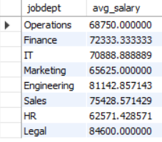
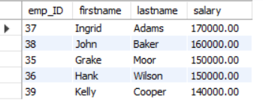

Employee Insights (Contd.)
Q3: What is the average salary per department?
SELECT jd.jobdept, AVG(sb.amount) AS avg_salary
FROM JobDepartment jd
JOIN SalaryBonus sb ON jd.Job_ID = sb.Job_ID
GROUP BY jd.jobdept;
Joins JobDepartment with SalaryBonus and computes average monthly salary per department.
Q4: Who are the top 5 highest-paid employees?
SELECT e.emp_ID, e.firstname, e.lastname, sb.amount
FROM Employee e JOIN SalaryBonus sb ON e.Job_ID = sb.Job_ID
ORDER BY sb.amount DESC LIMIT 5;
Joins Employee and SalaryBonus tables, sorts by salary descending, returns top 5.
Q5: What is the total salary expenditure across the company?
SELECT SUM(total_amount) AS total_salary_expenditure FROM Payroll;
Aggregates the total_amount column across all payroll records.
Average Salary per Department
Top 5 Paid Employees:
Total Payroll Expenditure:

Slide 9
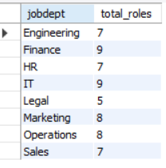
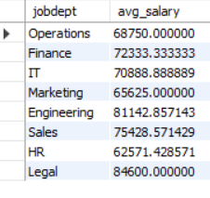

Job Role & Department Analysis
Q6: How many different job roles exist in each department?
SELECT jobdept, COUNT(DISTINCT Job_ID) AS total_roles
FROM JobDepartment GROUP BY jobdept;
Counts unique Job_IDs per department. Finance, IT, Engineering each have 8+ distinct roles.
Q7: What is the average salary range per department?
SELECT jd.jobdept, AVG(sb.amount) AS avg_salary
FROM JobDepartment jd JOIN SalaryBonus sb ON jd.Job_ID = sb.Job_ID
GROUP BY jd.jobdept;
Confirms which departments offer the highest average pay.
Q8: Which job role offers the highest salary?
SELECT jd.Job_ID, jd.jobdept, MAX(sb.amount) AS highest_salary
FROM JobDepartment jd JOIN SalaryBonus sb ON jd.Job_ID = sb.Job_ID
GROUP BY jd.Job_ID, jd.jobdept ORDER BY highest_salary DESC LIMIT 1;
Uses MAX() aggregation. Result: Finance Director at $170,000/month.
Departments And Job roles:
Department And Avg_Salary:
Highest salary of To Particular Role:

Slide 10
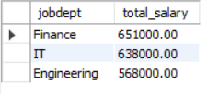
Job Role & Department Analysis
Q9:Which Departments have the Highest Total Salary Allocation
SELECT jd.jobdept, SUM(sb.amount) As total_salary
FROM Employee e
JOIN JobDepartment jd ON e.Job_ID = jd.Job_ID
JOIN SalaryBonus sb ON jd.Job_ID = sb.Job_ID
GROUP BY jd.jobdept ORDER BY total_salary DESC LIMIT 3;
Triple JOIN: links Employee → JobDepartment → SalaryBonus. SUM aggregates payroll per dept.

Slide 11

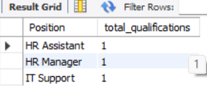
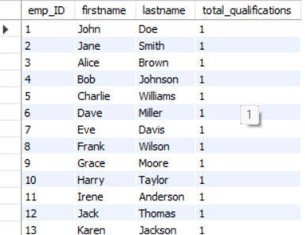
Qualification & Skills Analysis
Q10: How many employees have at least one qualification?
SELECT COUNT(DISTINCT Emp_ID) AS employees_with_qualification
FROM Qualification;
Counts distinct employees in the Qualification table. Result: All 60 employees have at least one qualification listed.
Q11: Which positions require the most qualifications?
SELECT Position, COUNT(*) AS total_qualifications
FROM Qualification
GROUP BY Position ORDER BY total_qualifications DESC LIMIT 3;
Groups qualifications by Position and counts entries. Identifies top 3 most requirement-heavy roles.
Q12: Which employees have the highest number of qualifications?
SELECT e.emp_ID, e.firstname, e.lastname, COUNT(q.QualID) AS total_qualifications
FROM Employee e JOIN Qualification q ON e.emp_ID = q.Emp_ID
GROUP BY e.emp_ID, e.firstname, e.lastname
ORDER BY total_qualifications DESC;
JOINs Employee and Qualification tables. Since each employee has exactly 1 entry, all return count = 1.
Employees With At least One qualification
Positions and Their Qualifications
Employees With Highest No of Qualifications

Slide 12

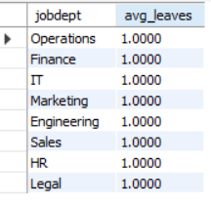
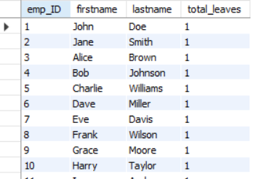
Leave & Absence Patterns
Q13: Which year had the most employees taking leaves?
SELECT YEAR(date) AS year, COUNT(DISTINCT emp_ID) AS employees_on_leave
FROM Leaves GROUP BY YEAR(date) ORDER BY employees_on_leave DESC;
Uses YEAR() function to extract year from DATE field. All 60 leaves are in 2024.
Q14: Average number of leave days per employee per department?
SELECT jd.jobdept, AVG(emp_leave_count) AS avg_leaves
FROM (SELECT emp_ID, COUNT(*) AS emp_leave_count FROM Leaves GROUP BY emp_ID) AS sub
JOIN Employee e ON sub.emp_ID = e.emp_ID
JOIN JobDepartment jd ON e.Job_ID = jd.Job_ID GROUP BY jd.jobdept;
Uses a SUBQUERY to count leaves per employee first, then JOINs to get department average.
Q15: Which employees have taken the most leaves?
SELECT e.emp_ID, e.firstname, e.lastname, COUNT(l.leave_ID) AS total_leaves
FROM Employee e JOIN Leaves l ON e.emp_ID = l.emp_ID
GROUP BY e.emp_ID, e.firstname, e.lastname ORDER BY total_leaves DESC;
Each employee has 1 leave record, so all return total_leaves = 1.
Most Employees Taking Leaves
AVERAGE No Of Leaves Per Department
Most leaves Taken By which Employee

Slide 13

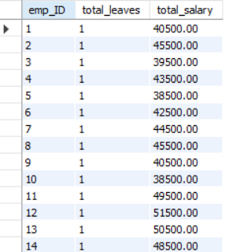
Leave & Absence Patterns
Q16: Total leave days company-wide
SELECT COUNT(*) AS total_leave_days FROM Leaves;
Result: 60 total leave records for 2024.
Q17: Leave vs Payroll Correlation
SELECT e.emp_ID, COUNT(l.leave_ID) AS total_leaves,
SUM(p.total_amount) AS total_salary
FROM Employee e
LEFT JOIN Leaves l ON e.emp_ID = l.emp_ID
LEFT JOIN Payroll p ON e.emp_ID = p.emp_ID
GROUP BY e.emp_ID;
Uses LEFT JOIN to retain all employees even if no leave. Correlates leave count with total salary.

Slide 14

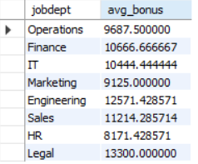
Payroll & Compensation Analysis
Q18: What is the total monthly payroll processed?
SELECT YEAR(date) AS year, MONTH(date) AS month,
SUM(total_amount) AS total_monthly_payroll
FROM Payroll GROUP BY YEAR(date), MONTH(date) ORDER BY year, month;
Extracts year and month from the payroll date. Groups and sums payroll per month. Result: April 2024 total = 2,77,800.
Q19: What is the average bonus given per department?
SELECT jd.jobdept, AVG(sb.bonus) AS avg_bonus
FROM SalaryBonus sb JOIN JobDepartment jd ON sb.Job_ID = jd.Job_ID
GROUP BY jd.jobdept;
Averages the bonus column per department. Finance and Legal show highest average bonuses.

Slide 15


Payroll & Compensation Analysis
Q20: Which department receives the highest total bonuses?
SELECT jd.jobdept, SUM(sb.bonus) AS total_bonus
FROM SalaryBonus sb JOIN JobDepartment jd ON sb.Job_ID = jd.Job_ID
GROUP BY jd.jobdept ORDER BY total_bonus DESC LIMIT 1;
Result: Finance Department — highest total bonus allocation.
Q21: Average Adjusted Salary After Leaves
SELECT AVG(total_amount) AS avg_adjusted_salary FROM Payroll;
Averages the total_amount field from Payroll which already accounts for leave deductions.

Slide 16
Challenges Faced
Technical Challenges
Defining correct table relationships and ensuring accurate use of foreign keys across 6 tables
Maintaining data consistency with cascading updates and deletes (ON DELETE CASCADE vs ON DELETE SET NULL)
Writing complex multi-table JOINs for reports involving employee roles, leaves, and payroll simultaneously
Ensuring all DATE fields follow YYYY-MM-DD format for reliable YEAR() and MONTH() based analysis
Preventing duplicate entries using UNIQUE constraints especially on emp_email field
What I Learned
Hands-on experience with ER diagram design and normalization
Mastered JOIN types: INNER JOIN, LEFT JOIN across 3+ tables
Used subqueries and window functions for advanced analytics
Understood real-world HR data patterns — leave tracking, payroll processing
Gained confidence in writing production-quality SQL queries

Slide 17
Conclusion & Key Findings
Key Findings
60 employees are distributed across 10 departments with Finance having the most job roles (9)
Finance Director is the highest paying role at 170,000/month; total company payroll for April 2024 is 2,778,000
All 60 employees have qualifications on record; roles like CTO and CFO carry the highest skill requirements
All 60 leave records fall in 2024; every employee took exactly 1 leave during the period
Finance department leads in both total salary allocation and total bonus payout
Project Impact
This project demonstrates the ability to:
Design a normalized relational database from scratch
Write 21 analytical SQL queries across 5 business domains
Identify business insights from HR, payroll, and leave data
Apply real-world data constraints: PK, FK, UNIQUE, CASCADE
Tools Used
MySQL 8.0 | MySQL Workbench
SQL: DDL, DML, DQL, Aggregations, JOINs, Subqueries

Slide 18

THANK YOU

