Slide 1
B. Tech ECE PROJECT-1 Review-1
Enhancing Antenna Performance using Metamaterial
Team Members: Guide:
Akhila Pingali-21BEC0584 Dr. Tanmaya Kumar Das
Aryan Paruthi-21BEC0467
Neelesh Kumar Singh-21BEC0187

Slide 2
INTRODUCTION
The relentless growth of wireless communication technologies, primarily driven by the proliferation of mobile devices, the surge in data-intensive applications, and the Internet of Things (IoT), has led to an escalating demand for bandwidth.
The existing bandwidth resources are under significant stress, necessitating innovative solutions to enhance the capacity and efficiency of communication systems.
Among the promising solutions is Multiple Input Multiple Output (MIMO) technology, which plays a crucial role in the evolution of 5G and future wireless communication standards.
MIMO technology enables the utilization of multiple antennas at both the transmitter and receiver ends to improve communication performance.
However, the implementation of MIMO technology, especially in the context of 5G terminals, presents challenges such as the need for optimal isolation between closely spaced antennas and the demand for compact and lightweight designs.
This review delves into the utilization of metamaterials to address these challenges, providing a comprehensive overview of various metamaterial-based single and MIMO antenna designs aimed at enhancing performance metrics such as gain, bandwidth, isolation, and miniaturization.

Slide 3
METAMATERIALS BACKGROUND
Metamaterials are artificially engineered materials designed to exhibit electromagnetic properties that are not found in natural materials.
These properties stem from the specific arrangement of their subwavelength structural elements, rather than their chemical composition. The concept of metamaterials encompasses a wide range of electromagnetic phenomena, including negative refraction, electromagnetic cloaking, and superlensing, which can be leveraged to manipulate electromagnetic waves in unprecedented ways.
The unique properties of metamaterials have spurred significant interest across various fields, including optics, electronics, energy, and medicine.
In the context of antenna design, metamaterials offer innovative solutions to longstanding challenges, enabling advancements in miniaturization, performance enhancement, and multifunctionality.
This review focuses on the application of metamaterials in antenna technology, exploring their potential to revolutionize communication systems

Slide 4
APPLICATIONS OF METAMATERIALS IN ANTENNA DESIGN
Gain Enhancement:
Conventional Challenges: Traditional antennas struggle to achieve high gain with a compact size, often needing large radiating apertures and thick substrates with low permittivity.
Metamaterial Solutions: Metamaterials, like single and dual-layer metasurfaces, manipulate the refractive index and electromagnetic response, allowing gain enhancement without increasing physical size. They also enable consistent directional bore sight radiation, critical for high directivity.
Examples: Incorporating metamaterials into antenna designs significantly boosts gain. A metamaterial-based patch antenna with a single-layer metasurface showed substantial gain improvement, along with potential for filtering and circular polarization.
Bandwidth Enhancement:
Importance of Bandwidth: Bandwidth is crucial for modern communication, affecting the range of frequencies an antenna can operate on, allowing for higher data rates and more reliable links.
Metamaterial Approaches: Metamaterials can enhance bandwidth by enabling compact, efficient designs. By carefully designing unit cells, they create multiple resonances, improving impedance matching over a wider frequency range.
Examples: A 4×4 Butler Matrix with metamaterial structures improved bandwidth by 8.2 times compared to standard designs, meeting the growing demands of advanced communication systems.

Slide 5
Isolation Enhancement:
MIMO Systems: Mutual coupling in MIMO systems reduces isolation and degrades performance. High isolation ensures independent operation of antenna elements.
Metamaterial Techniques: Metamaterials like Electromagnetic Band Gap (EBG) and Defected Ground Structures (DGS) suppress mutual coupling and improve isolation by blocking surface waves and altering current distribution.
Examples: MIMO antennas with EBG structures show significant isolation improvement, suitable for 5G millimeter-wave applications.
Antenna Miniaturization:
Size Constraints: Smaller devices require antenna miniaturization, but traditional methods reduce efficiency and bandwidth.
Metamaterial Solutions: Metamaterials reduce antenna size by manipulating electromagnetic properties with negative permittivity and permeability, maintaining or enhancing performance.
Examples: A metamaterial-based inset-fed patch antenna achieved a 74.83% size reduction while maintaining high efficiency and bandwidth, suitable for mobile and wearable devices.

Slide 6
Radiation Efficiency Enhancement:
Importance of Efficiency: High radiation efficiency ensures effective signal transmission in communication systems.
Metamaterial Benefits: Metamaterials improve radiation efficiency by focusing energy, enhancing impedance matching, and reducing losses.
Examples: Metamaterial-based antennas show improved radiation efficiency, outperforming traditional designs under various conditions.
Multifunctional Metasurfaces:
Integration and Functionality: Metasurfaces integrate multiple antenna functions into a single design, simplifying structures and enhancing performance for advanced communication systems.
Design Flexibility: They enable beam steering, polarization control, and frequency reconfiguration, allowing compact, efficient, and adaptable antennas.
Examples: A metasurface design integrating beam steering and polarization control offers dynamic adjustments, enhancing flexibility and performance in communication systems.

Slide 7
Challenges:
1. Fabrication Complexity: Precise, nanoscale metamaterial fabrication is difficult and costly.
2. Cost-Effectiveness: High fabrication costs limit widespread adoption; cost-effective processes are needed.
3. Performance Trade-offs: Enhancing gain and bandwidth may affect other metrics like efficiency or isolation.
4. Environmental Sensitivity: Metamaterials are sensitive to temperature, humidity, and stress, impacting reliability.
Future Research Directions:
1. Advanced Fabrication: Develop scalable, cost-effective, precise manufacturing techniques.
2. Multifunctional Designs: Create reconfigurable, multifunctional metamaterial-based antennas.
3. Performance Optimization: Optimize gain, bandwidth, efficiency, and size through studies.
4. Environmental Robustness: Improve stability under varying conditions.
5. New Applications: Explore new metamaterial structures and applications for tailored electromagnetic properties.

Slide 8
CURRENT STATUS AND MOTIVATION
Ref | Title, journal, name, YoP | Summary of paper | Remarks
[1] | Syed WH, Neto A. Front-to-back ratio enhancement of planar printed antennas by means of artificial dielectric layers. IEEE Trans Antennas Propag. 2013; 61: 5408–5416. | The paper by Syed W.H. and Neto A. presents a technique to improve the front-to-back ratio of planar printed antennas using artificial dielectric layers. This method reduces unwanted backward radiation, enhancing antenna performance in directional applications. | - Objective: Enhance the front-to-back ratio of planar printed antennas. - Methodology: Use of artificial dielectric layers to reduce backward radiation. - Key Contribution: Proposed a novel technique for directional radiation enhancement. - Validation: Demonstrated through simulations and experiments. - Significance: Improves antenna performance for applications requiring high directivity.

Slide 9
CURRENT STATUS AND MOTIVATION
Ref | Title, journal, name, YoP | Summary of paper | Remarks
[2] | 11 Hou QW, Su YY, Zhao XP. A high gain patch antenna based PN zero permeability metamaterial. Microwave Opt Technol Lett. 2014; 56: 1065–1069. | Hou Q.W. et al. propose a high-gain patch antenna design using a PN zero permeability metamaterial. The metamaterial enhances the antenna's gain by focusing the radiation in the desired direction. | -Objective: Increase patch antenna gain. -Methodology: Use of PN zero permeability metamaterial. -Key Contribution: Achieved high gain through focused radiation. -Validation: Demonstrated through simulations. -Significance: Improves antenna performance in gain-critical applications.

Slide 10
CURRENT STATUS AND MOTIVATION
Ref | Title, journal, name, YoP | Summary of paper | Remarks
[3] | Bouzouad M, Chaker SM, Bensafielddine D, Laamari EM. Gain enhancement with near-zero-index metamaterial superstrate. Appl Phys A. 2015; 121: 1075–1080. | Bouzouad et al. present a method to enhance antenna gain using a near-zero-index metamaterial superstrate. The superstrate improves radiation efficiency and gain by controlling wave propagation. | -Objective: Enhance antenna gain. -Methodology: Use of near-zero-index metamaterial superstrate. -Key Contribution: Improved gain through wave propagation control. -Validation: Supported by experimental results. -Significance: Increases radiation efficiency and overall antenna performance.

Slide 11
Ref | Title, journal, name, YoP | Summary of paper | Remarks
[4] | K. Ramasamy, B. Sapna, M. Jayasheela A novel wearable monopole antenna with controlled SAR using metamaterial Int. J. Microw. Wirel. Technol. (2023), pp. 1-13 | Ramasamy et al. propose a wearable monopole antenna with reduced SAR using metamaterial structures. The metamaterial helps control electromagnetic exposure while maintaining antenna performance. | -Objective: Design a wearable antenna with controlled SAR. -Methodology: Use of metamaterial to reduce SAR levels. -Key Contribution: Achieved reduced electromagnetic exposure in wearable devices. -Validation: Results validated through simulations. -Significance: Enhances safety and performance of wearable antennas.
[5] | M. Berka, U. Özkaya, T. Islam, M. El Ghzaoui, S. Varakumari, S. Das, Z. Mahdjoub A miniaturized folded square split ring resonator cell based dual band polarization insensitive metamaterial absorber for C- and Ku-band applications Opt. Quant. Electron., 55 (8) (2023), p. 699 | Berka et al. introduce a miniaturized dual-band metamaterial absorber using folded square split ring resonator cells. The absorber is polarization-insensitive and designed for C- and Ku-band applications. | -Objective: Develop a dual-band metamaterial absorber. -Methodology: Use of miniaturized folded square split ring resonator cells. -Key Contribution: Polarization-insensitive absorber for C- and Ku-band. -Validation: Demonstrated through simulations. -Significance: Enhances performance for C- and Ku-band applications.

Slide 12
HARDWARE /SOFTWARE DETAILS
Software: Ansys Electronics Suite.
ANSYS Software is a widely-used suite of simulation tools designed for engineering and scientific applications. It offers a broad range of modules that allow users to simulate the behavior of systems across different fields like structural mechanics, fluid dynamics, thermal analysis, electromagnetics, and more. ANSYS is particularly valued in fields like aerospace, automotive, electronics, and healthcare, where simulation of complex physical phenomena is essential for product design and testing. Its robust set of tools enables engineers to predict how products will function in the real world, ensuring that prototypes are thoroughly tested virtually before physical production.
Hardware: As of now, till Review 1, we haven't made use of any hardware equipment.

Slide 13
OBJECTIVE
The objective of this presentation is to provide a comprehensive overview of the utilization of metamaterials in enhancing antenna performance using metamaterials. By reviewing key research developments, we aim to:
To understand the fundamental properties of metamaterials and their unique electromagnetic characteristics.
To make use of Zero Index Metamaterial or ZIM to further improve obtained gain characteristics.
To design metamaterial structure as a superstrate material for gain enhancement.
To understand the challenges, recent advancements, and future potential in integrating metamaterials into modern antenna designs for next-generation communication systems.

Slide 14
METHODOLOGY
As part of our work for the 1st review of our project, we undertook the task of designing and implementing 4 different designs using the Ansys Software. The methodology followed for the 4 designs is as follows:
We designed a rectangular microstrip antenna using a substrate called RT/duroid 5880 with a dielectric constant of 2.2, height(h) = 0.1588 cm so as to resonate at a frequency of 10 GHz.
In the second session, we designed a rectangular microstrip patch antenna using Inset Feeding. There was an impedance mismatch between the feed line and the radiator/patch. Hence, less power was radiated. To improve this, Inset Feeding is another technique.
We designed a rectangular microstrip antenna using Coaxial Feeding, which is basically another type of feeding mechanism, in which the RF Connector is connected at the ground (back side of antenna). It is like a cable that is connected to the TV at our home. It has 3 parts called: Inner Conductor, Outer Conductor and Teflon.
We designed a rectangular microstrip patch antenna using CPW feeding (coplanar waveguide feeding). In this condition, the radiator and ground plane are on the same side.
Once we successfully completed the analysis of the 4 designs above, we used the knowledge and skills gained to replicate the results of the original research paper shared with us.

Slide 15
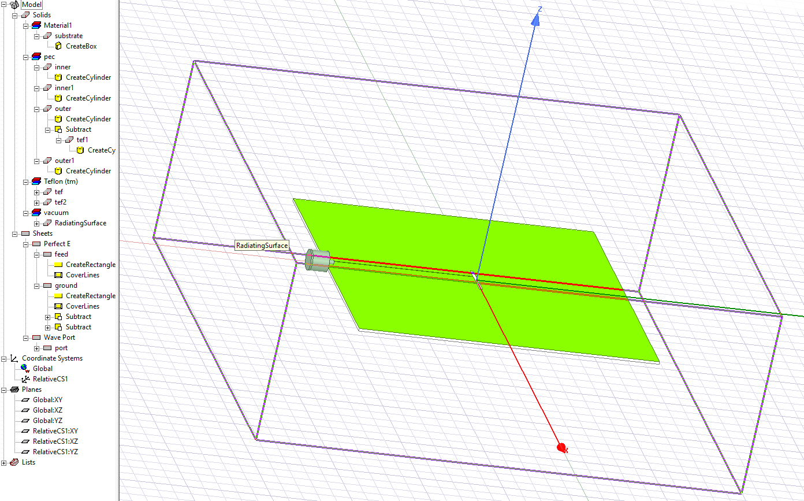
RESULTS
Setup 1

Slide 16
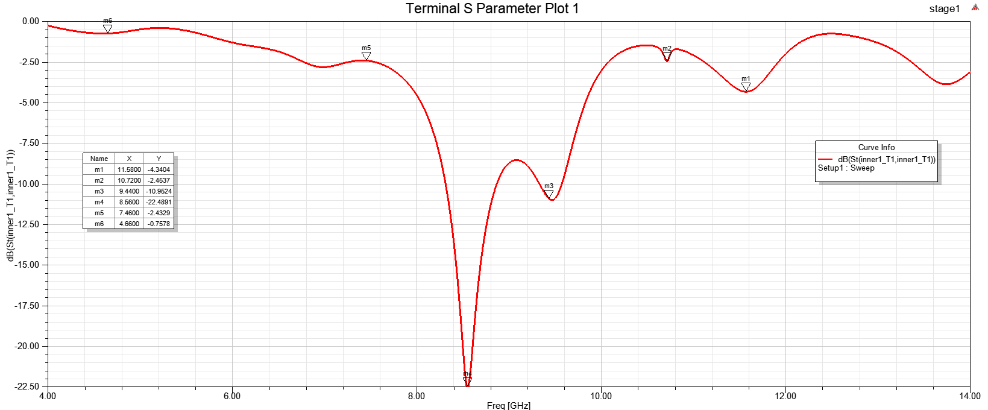
RESULTS
S11 response

Slide 17
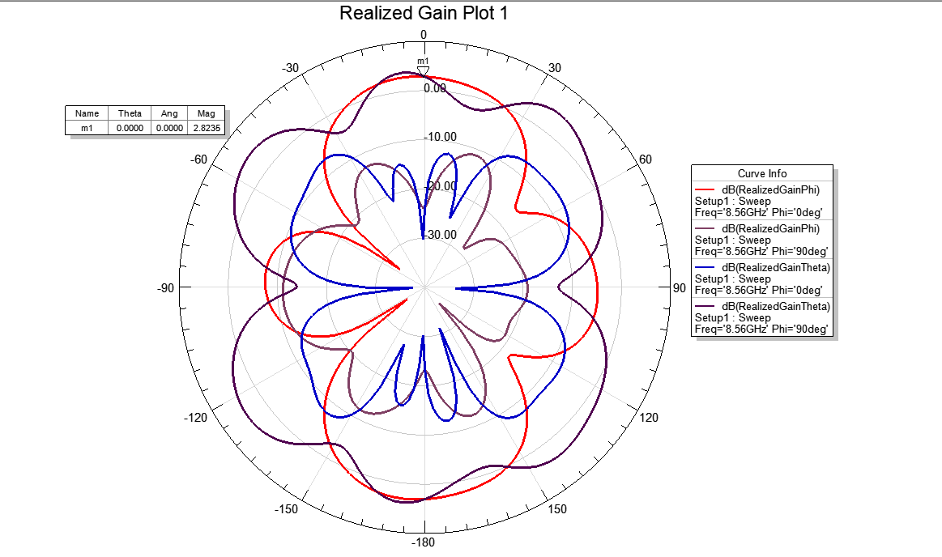
RESULTS
2D radiation pattern at 8.56 GHz

Slide 18
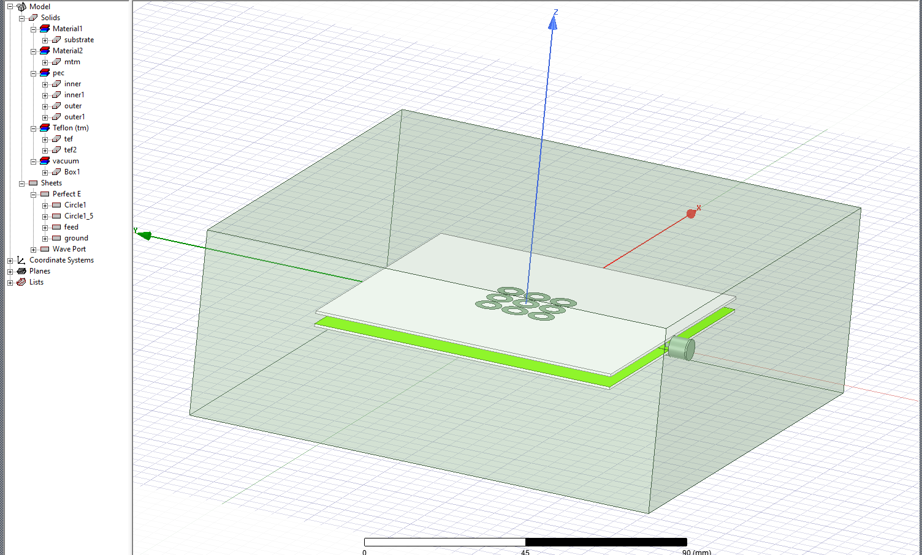
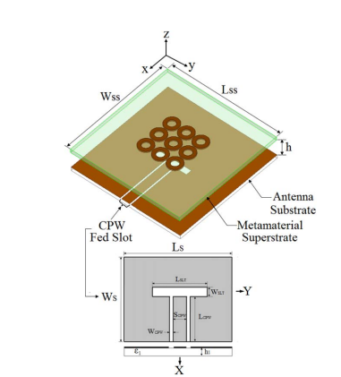
RESULTS
Setup 2
Practical Design
Research Paper Design

Slide 19
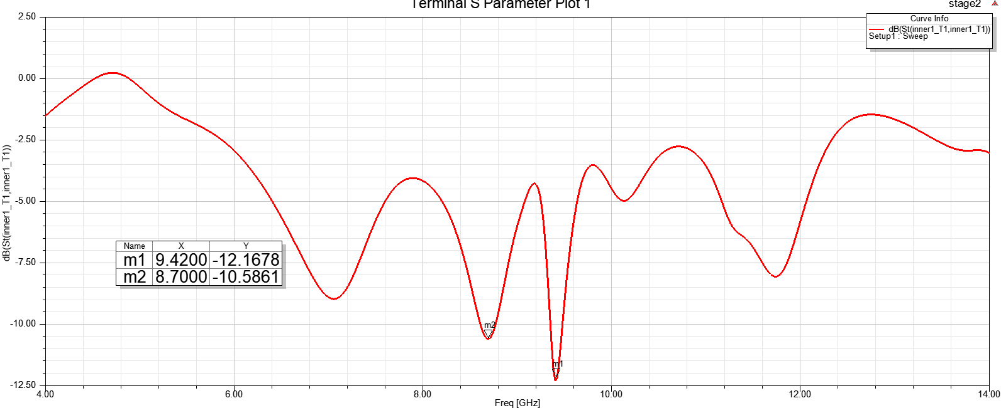
S11 response

Slide 20
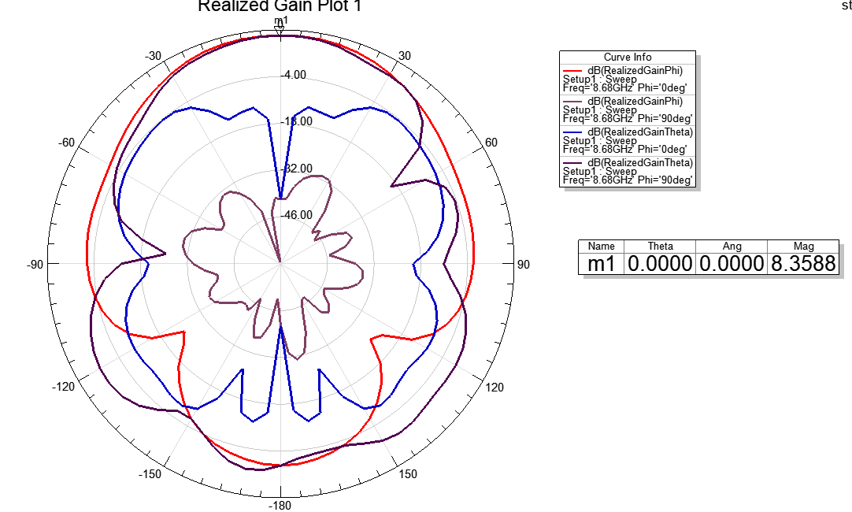
2D radiation pattern at 8.6 GHz

Slide 21
CONCLUSIONS
The incorporation of metamaterials in antenna design marks a cutting-edge innovation, where engineered materials with distinct electromagnetic properties open up new avenues for improving wireless communication, sensing, and imaging technologies.
As research in this area progresses, we can expect further groundbreaking applications that harness the remarkable capabilities of metamaterials.

Slide 22
SCOPE FOR IMPROVEMENT
Metamaterial (MTM)-based antennas have notable benefits but also face limitations. They suffer from resonance frequency saturation, narrow bandwidth, and performance trade-offs due to miniaturization. MTMs show reduced response at higher frequencies and face challenges in manufacturing and reconfigurability. They can be bulky and lossy at microwave frequencies.
While MTMs can enhance gain and isolation, integrating them with beam-steerable antennas is difficult. Current designs mostly address fixed-beam systems, highlighting the need for reconfigurable solutions. Wideband or multi-band isolation remains challenging, and radar systems require MTMs that provide high isolation without added bulk.

Slide 23
SOCIAL IMPACT
The social impact of utilizing metamaterials to enhance antenna performance is significant, as it can drive advancements in communication technologies and enable widespread societal benefits. Key social impacts include:
1. Improved Connectivity: Enhancing antenna performance with metamaterials can lead to better signal quality, coverage, and data speeds in wireless networks. This improves global access to reliable internet, especially in rural and underserved areas, contributing to digital inclusion and reducing the digital divide.
2. Advancements in Healthcare: Metamaterial-based antennas can improve the performance of medical devices such as MRI machines, wearable health monitors, and wireless implants. These innovations can lead to better diagnostic tools and real-time monitoring systems, improving healthcare outcomes.
3. Smart Cities and IoT: High-performance antennas are crucial for the growth of smart cities and the Internet of Things (IoT), where millions of devices are interconnected. This can enhance urban planning, environmental monitoring, and transportation, leading to more efficient, sustainable, and safer cities.
4. Sustainability and Energy Efficiency: Metamaterials can enable the development of smaller, more efficient antennas, reducing the energy consumption of communication devices. This contributes to environmental sustainability by lowering the carbon footprint of global communication infrastructure.
5. Economic Growth: Enhanced antenna performance supports advancements in industries like telecommunications, defense, and aerospace, fostering economic growth, job creation, and innovation. It enables faster deployment of next-generation technologies like 5G and 6G, driving economic development and global competitiveness.

Slide 24
Sustainable Development Goals (SDGs)
1. SDG 9: Industry, Innovation, and Infrastructure
- Relevance: Advanced antenna technologies powered by metamaterials play a critical role in modernizing communication infrastructure, especially with the deployment of 5G, IoT, and other advanced wireless networks. Improved connectivity drives industrial innovation and fosters the development of smart cities and modern industries.
- Elaboration: Enhancing antenna performance leads to more reliable and efficient networks that can support emerging technologies like autonomous vehicles, smart energy grids, and advanced manufacturing, thus strengthening global infrastructure and innovation ecosystems.
2. SDG 3: Good Health and Well-Being
- Relevance: Metamaterial-enhanced antennas have potential applications in medical technologies, such as MRI machines, wearable health devices, and telemedicine, improving health outcomes and access to healthcare.
- Elaboration: With better antennas, remote health monitoring and telemedicine services can become more reliable, allowing for improved healthcare delivery, particularly in remote and underserved areas. This contributes to ensuring healthy lives and promoting well-being for people worldwide.
3. SDG 11: Sustainable Cities and Communities
- Relevance: High-performance antennas are essential for the development of smart cities, which rely on interconnected systems for efficient transportation, environmental monitoring, and energy management.
- Elaboration: The use of metamaterials to improve antenna efficiency contributes to the optimization of smart city technologies, enabling sustainable urban development, improved safety, and better resource management, all of which enhance the quality of life in urban communities.

Slide 25
TIME LINE (Aug. to Nov 2024)
 | August | September | October | November
Initial Team meeting and Initiation on project | ✔️
Literature Review | ✔️ | ✔️ | ✔️
Practice of ANSYS HFSS EM software tool | ✔️ | ✔️ | ✔️
Design and Simulation of metamaterial based planar antenna | ✔️ | ✔️ | ✔️
Fabrication of metamaterial-based antenna |  |  | ✔️ | ✔️
Validation of results |  |  | ✔️ | ✔️
Report Writing |  |  |  | ✔️

Slide 26
References
S. Roy and U. Chakraborty, "Gain enhancement of a dual-band WLAN microstrip antenna loaded with diagonal pattern metamaterials," IET Communications, vol. 12, no. 12, pp. 1448-1453, 2018.
K. Konstantinidis, A. P. Feresidis, and P. S. Hall, "Broadband sub-wavelength profile high-gain antennas based on multi-layer metasurfaces," IEEE Transactions on Antennas and Propagation, vol. 63, no. 1, pp. 423–427, Jan. 2015.
K. Konstantinidis, A. P. Feresidis, and P. S. Hall, "Multilayer partially reflective surfaces for broadband Fabry-Perot cavity antennas," IEEE Transactions on Antennas and Propagation, vol. 62, no. 7, pp. 3474–3481, Jul. 2014.
B. Yuan, Y. H. Zheng, X. H. Zhang, B. You, and G. Q. Luo, "A bandwidth and gain enhancement for microstrip antenna based on metamaterial," Microwave and Optical Technology Letters, vol. 59, no. 12, pp. 3088–3093, Dec. 2017.
L. Asadpor, G. Sharifi, and M. Rezvani, "Design of a high-gain wideband antenna using double-layer metasurface," Microwave and Optical Technology Letters, vol. 61, no. 4, pp. 1004–1010, Apr. 2019.

Slide 27
Thank you

