Slide 1
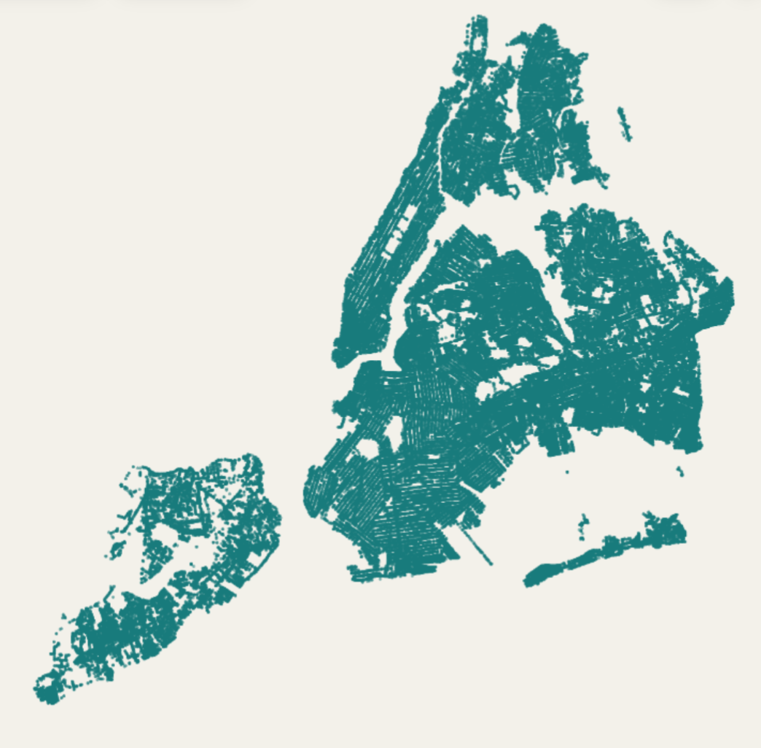
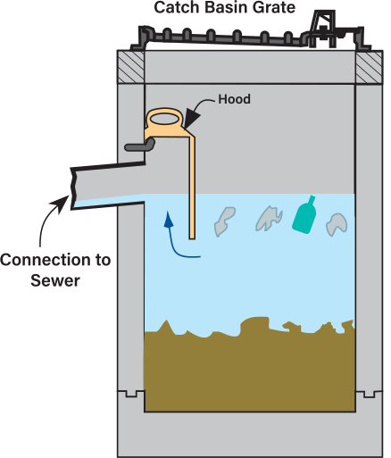
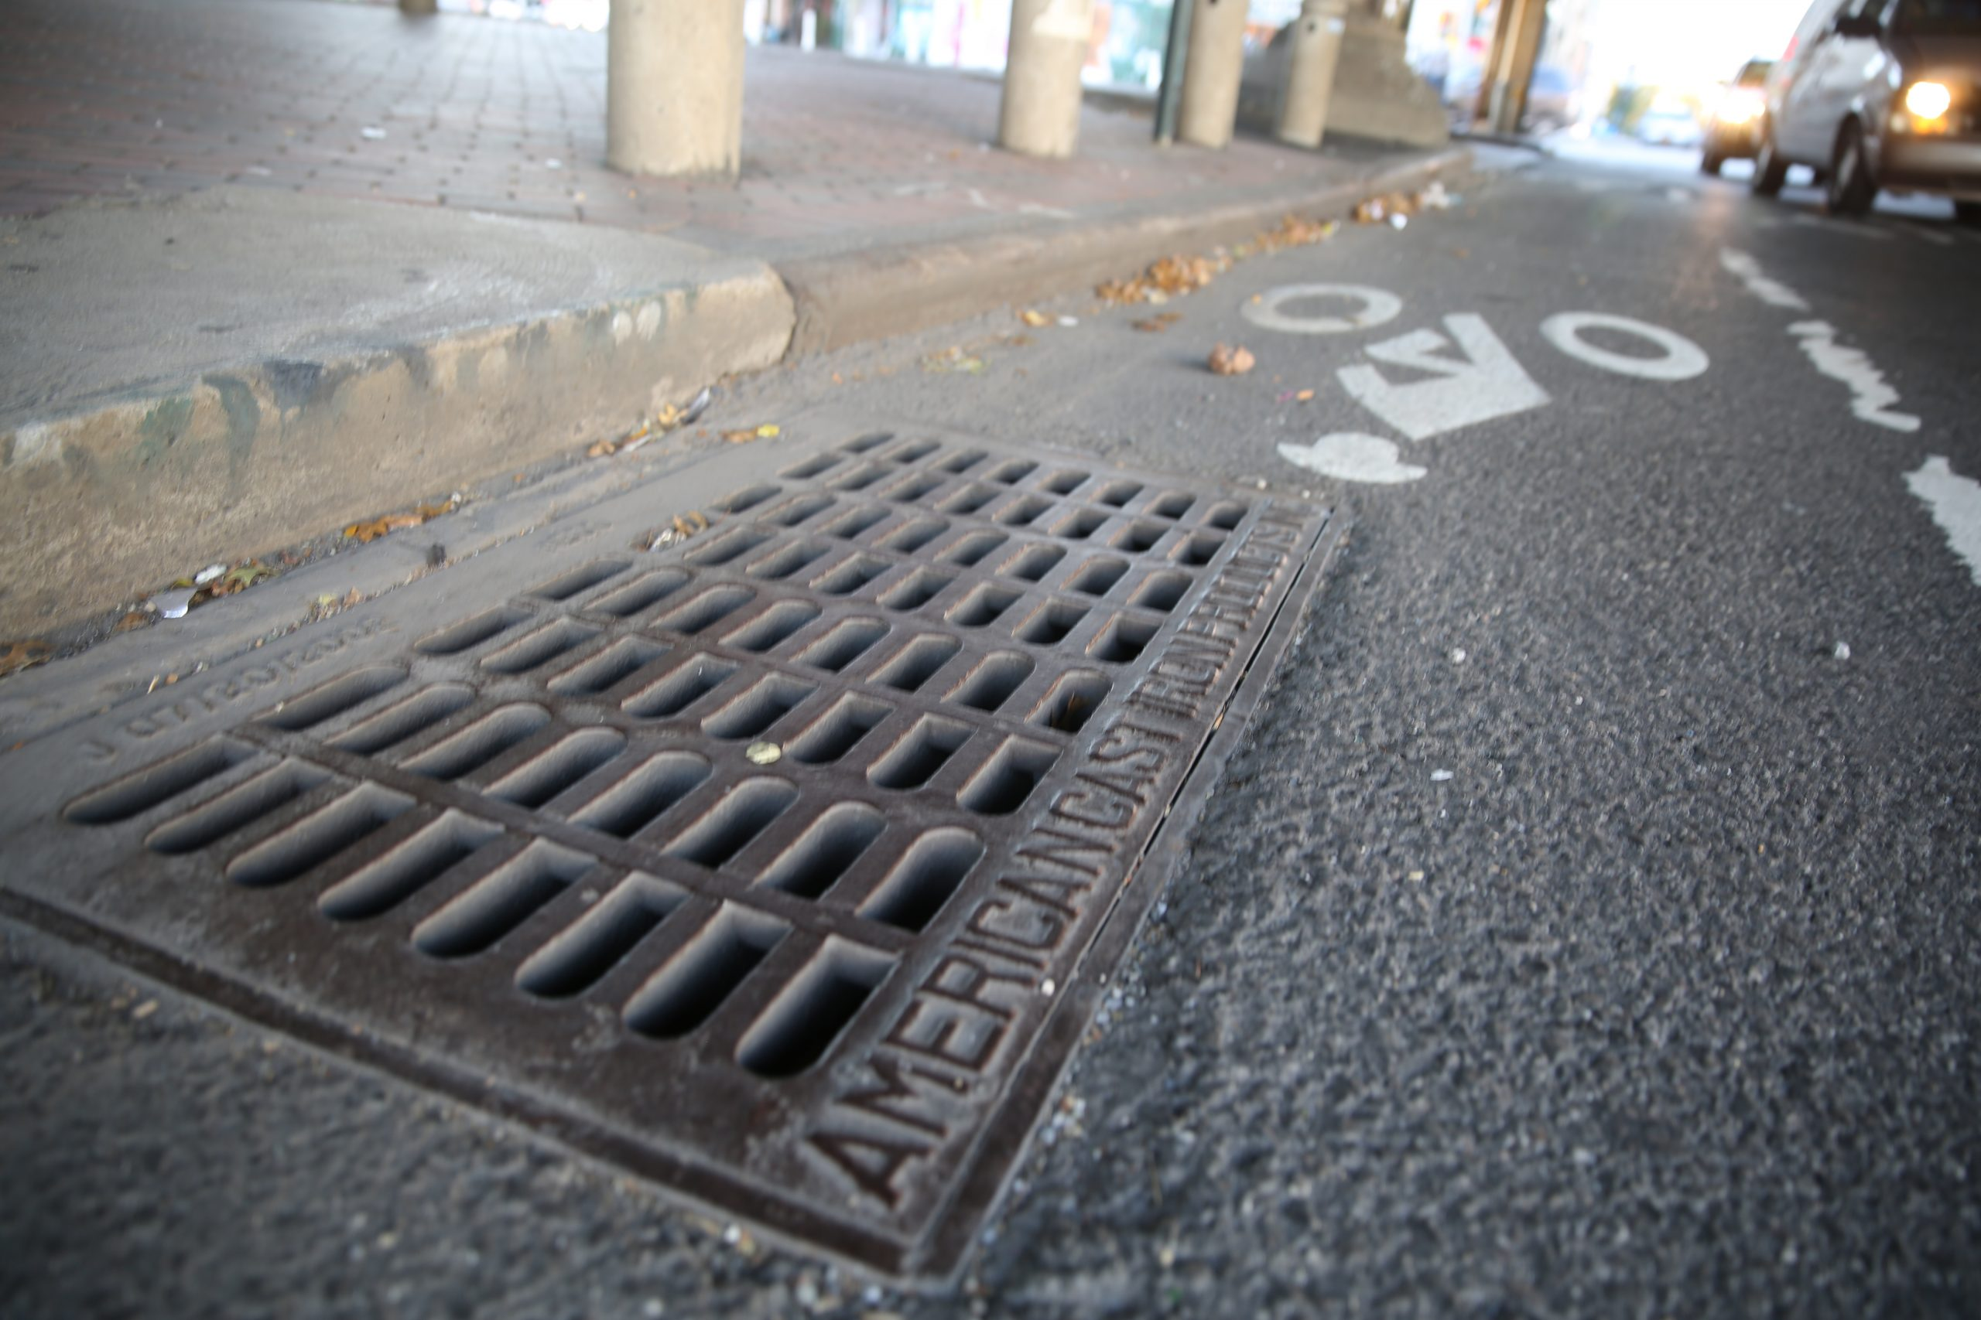
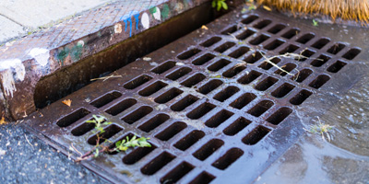
NYC Catch Basins
Mapping New York City’s street wide drainage systems
Theme: Undercurrents
Abhijeet Khirdekar
Data Visualization – Midterm Part 1
Professor Shoushtary

Slide 2

Why Catchbasins?
Why this matters?
Catch basins collect street water runoff. They are important pieces of infrastructure that New Yorkers rely on when it rains. Catchbasins connect to the sewer system and channel stormwater runoff into one of NYC’s 14 wastewater treatment plants, or a nearby waterbody.
Who is this for?
New York City residents, community boards, and environmental planners, such as those who work at the NYC DEP (Dept. of Environmental Protection). This could also help out Civil Engineers and construction workers.
Key Questions:
What street patterns become visible when plotting catch basins?
→ The tension between nature and urban control
Are there discrepancies regarding geographic location and catch basin location and why?
→ Higher density catch basin areas are typically located in areas with NYC’s old streams, shorelines, or flood zones
Are newer, re-zoned neighborhoods equipped with denser, more modern catch basin infrastructure compared to older zones?
→ Infrastructure equity and the wealth inequality.

Slide 3
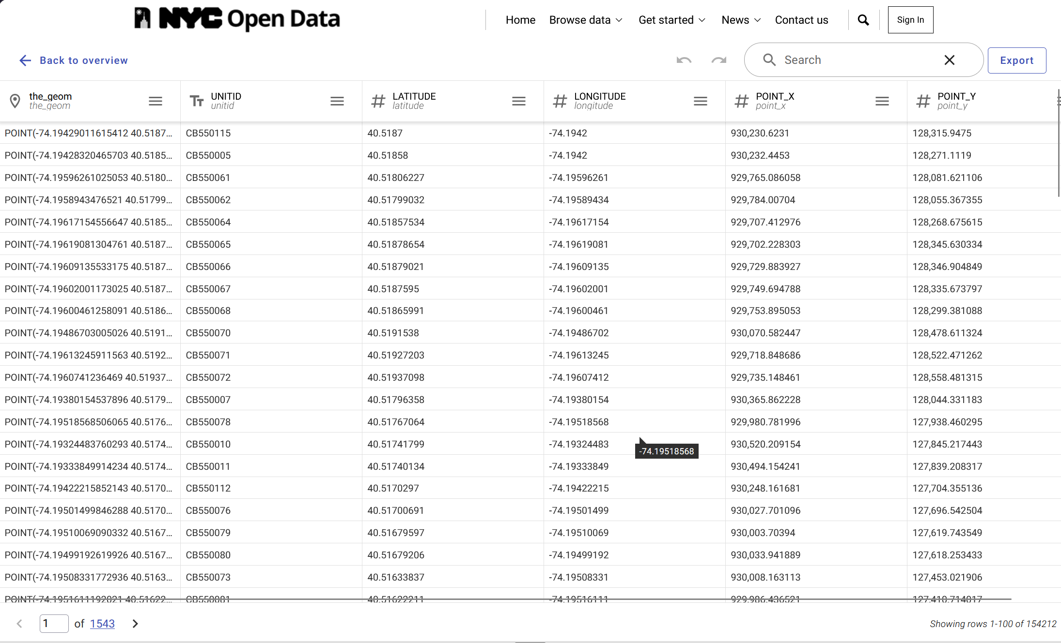

Slide 4
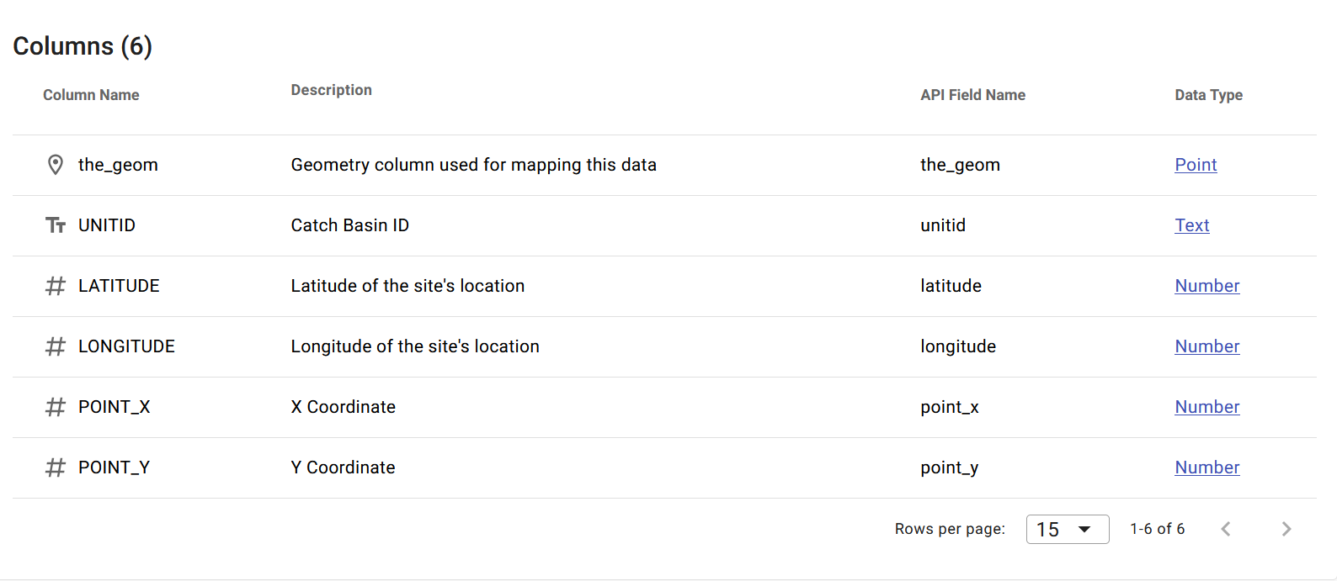
EDA findings / Dataset Breakdown
Dataset: https://data.cityofnewyork.us/Environment/NYCDEP-Citywide-Catch-Basins/2w2g-fk3i/about_data
The CSV file stores 154,212 records
There are 6 columns and no missing values. There are 154,212 unique UNIT ID values
Notes:
Limitations with the dataset:
Limitations with this data:
The dataset doesn’t tell us the condition, capacity, or maintenance history of the catch basin
No information on clogging or downstream capacity

Slide 5
Dataset limitations
Limitations with this data:
The dataset doesn’t tell us the condition, capacity, or maintenance history of the catch basin
No information on clogging or downstream capacity

Slide 6
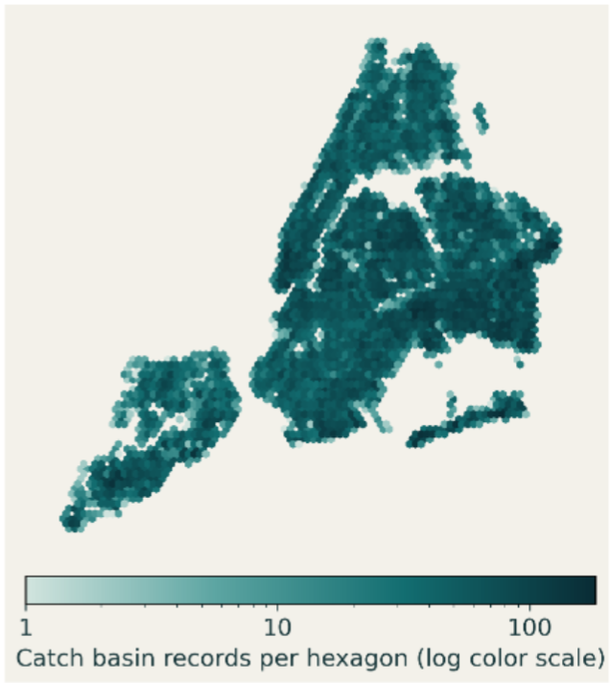
Visual Interface Citywide Catchbasins
The interface will congregate data points into equal-area hexagons for a clear citywide overview which users can zoom into
Hexagons with a higher concentration of catch basins are darker (1 to 100+)
This allows users to identify broad spatial patterns before diving into specific neighborhoods

Slide 7
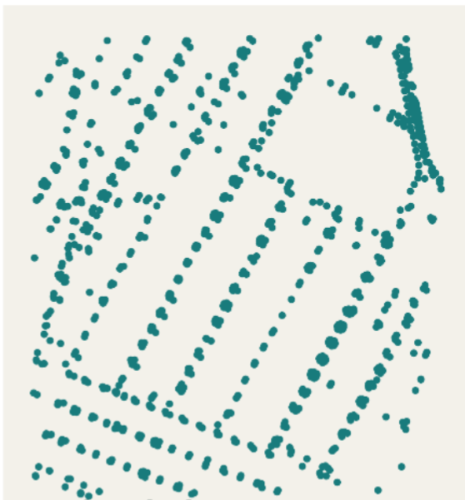
Zoomed in View of the East Village
The map zooms into the selected area when you click a hexagon
The catchbasins layout a grid of the East Village, with Tompkins square park easily recognizable
The user can view all of New York’s catchbasins

Slide 8
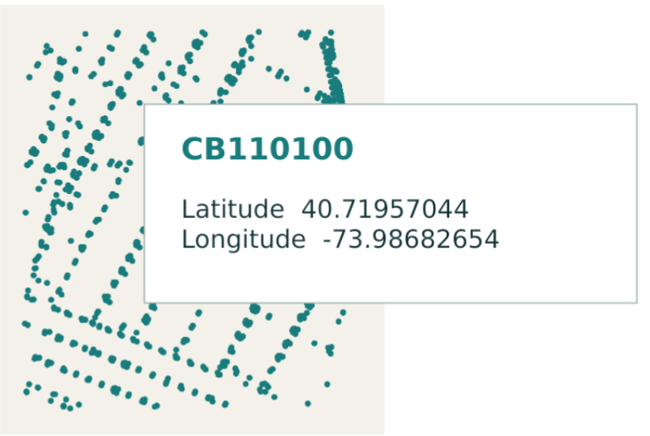
Inspecting a Catchbasin and its data
The user can select a dot and get a record behind each dot
Displays the unique Catch Basin ID alongside its exact latitude and longitude.
Directly connects the front-end visual mapping back to the raw structural data.

Slide 9
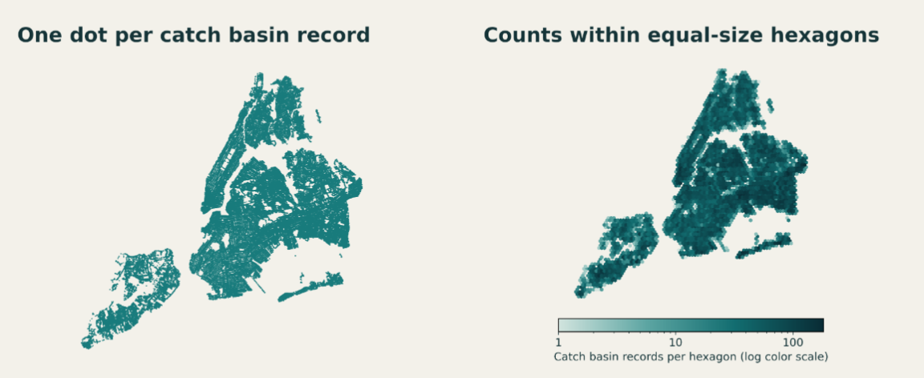
D3 Prototype for Next Week
Considerations
→ Add borough boundaries for more accurate filtering
→ Consider 311 catch basin complaints as a separate layer

