Slide 1
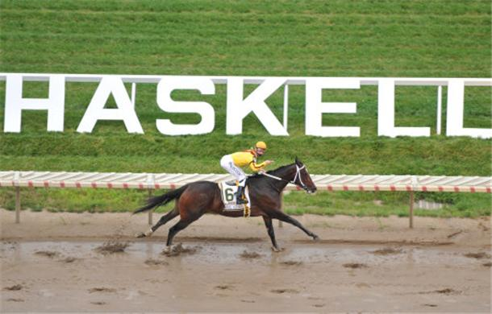
Pony

Slide 2
Choose your tool
Which is better, a hammer or a saw?
  It depends on context!
Programming isn't different
How can we use a variety of different tools?

Slide 3
Change your tools
What if you had a tool that could be either a hammer, or a saw or anything else?
Why can't your language be that way?
Just say “Give me a pony!”

Slide 4
And you have it!
Pony allows a programmer to do just that!
Need FP-style lists?
  Objects?
    With prototype inheritance?
    With type polymorphism?
  Garbage collection?
Get it all, in C!

