Slide 1

Diabetes Healthcare Classification
Team 12
Hardik Bhojwani
Amirhossein Aliyan
Akhil Chandhoke
Reza Seyedhosseini
Sahib Malhotra

Slide 2
Motivation For The Project
Diabetes is one of the most prevalent chronic diseases in the United States,
Understand what factors lead to diabetes in a person.

Slide 3
Data Exploration
Number of Observations: 253680
Data Columns: 22
Diabetes_binary HighBP HighChol
CholCheck BMI Smoker
Stroke HeartDiseaseorAttack PhysActivity
Fruits Veggies HvyAlcoholConsump
AnyHealthcare NoDocbcCost GenHlth
MentHlth PhysHlth DiffWalk
Sex Age Education
Income

Slide 4
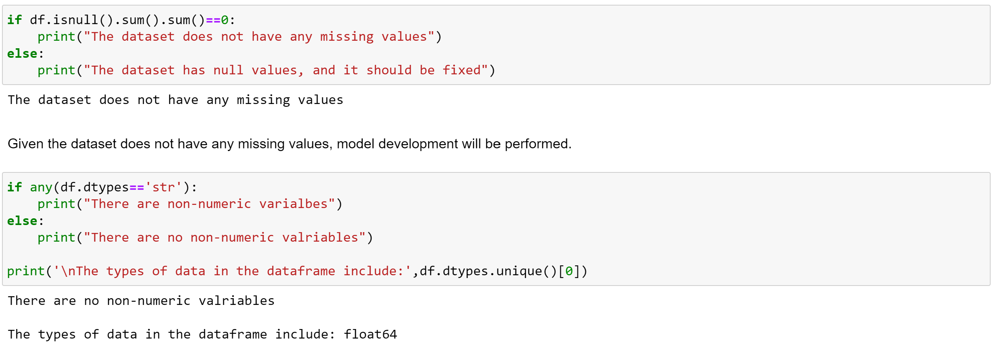
Data Cleaning and type check

Slide 5
Classification Models
Logistic Regression
KNN
Linear SVM
Kernel SVM
Gaussian Naïve Bayes
Decision Tree
Random Forest

Slide 6
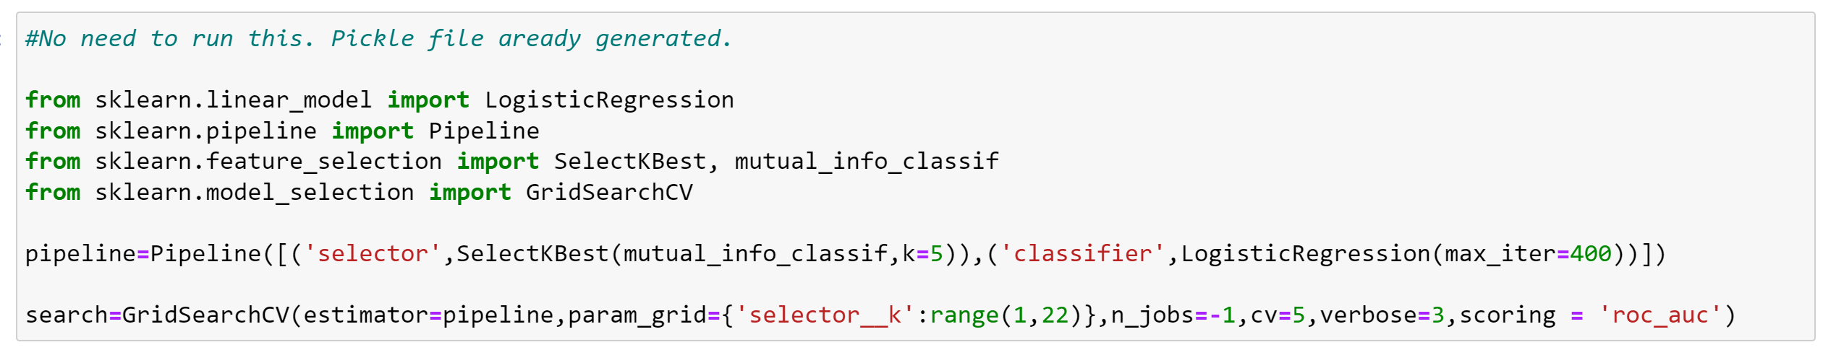
Logistic Regression with Grid Search for feature selection

Slide 7
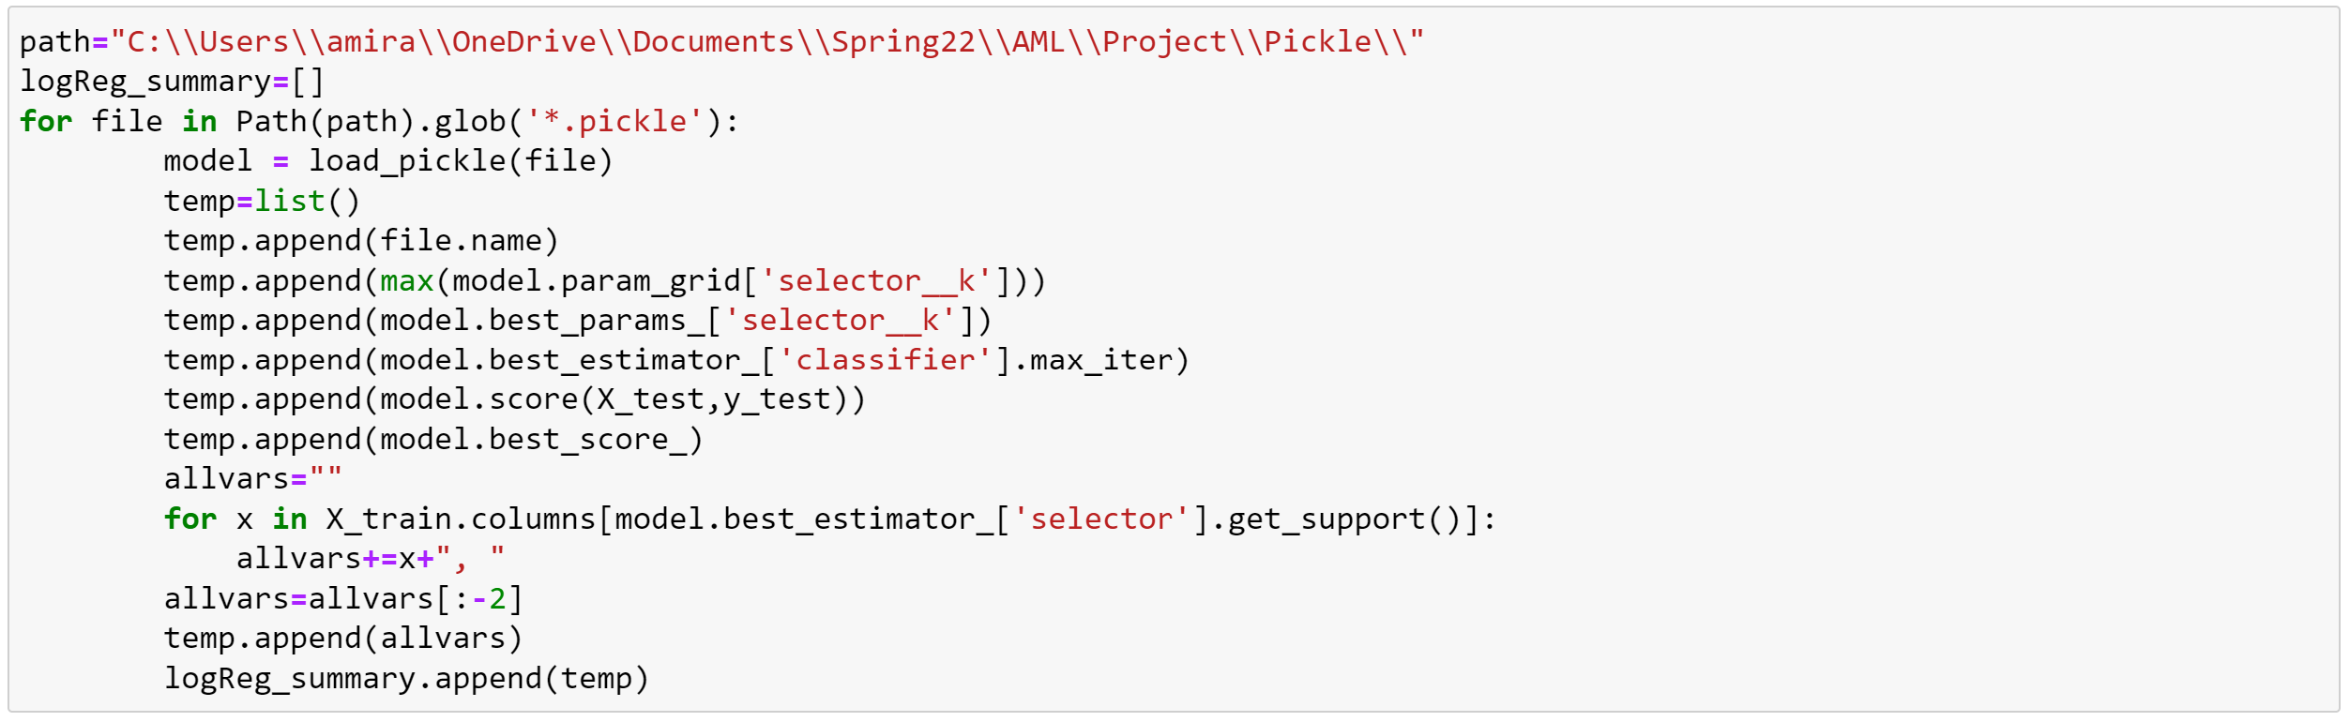
Comparing the obtained results

Slide 8
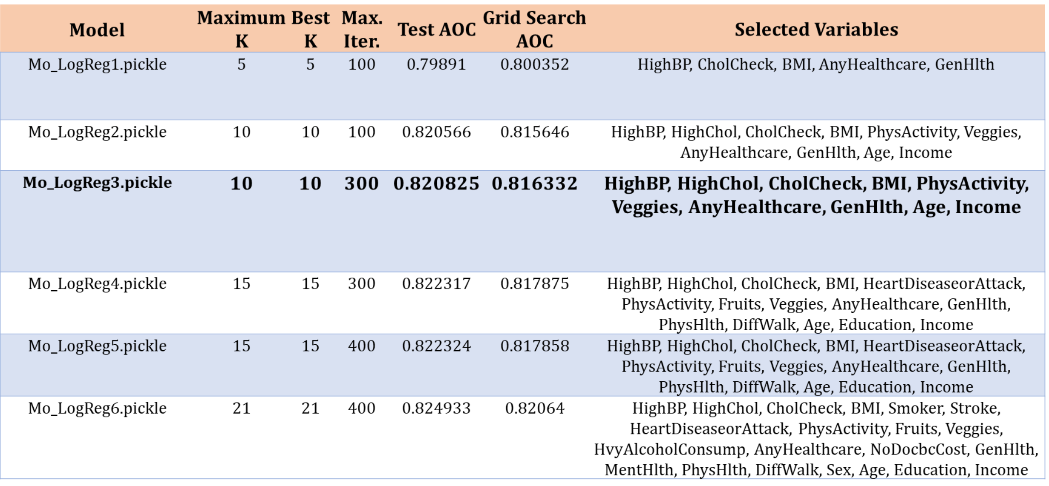
Comparing the obtained results

Slide 9
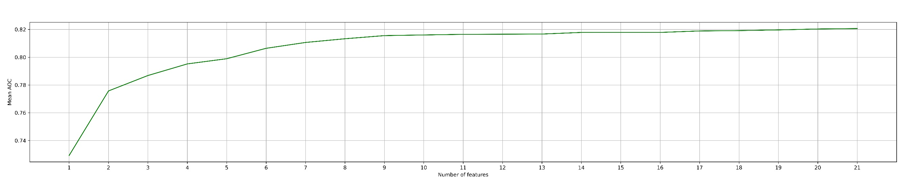
Effect of features on AOC
Characteristic | Value
The train accuracy for Logistic Regression from GridSearchCV | 0.8635
The test accuracy | 0.8626
The best value for parameter C | 0.1

Slide 10
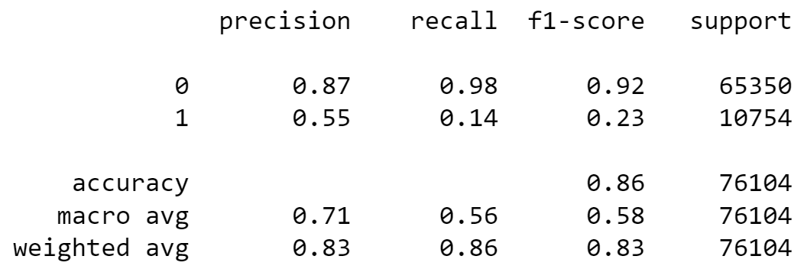
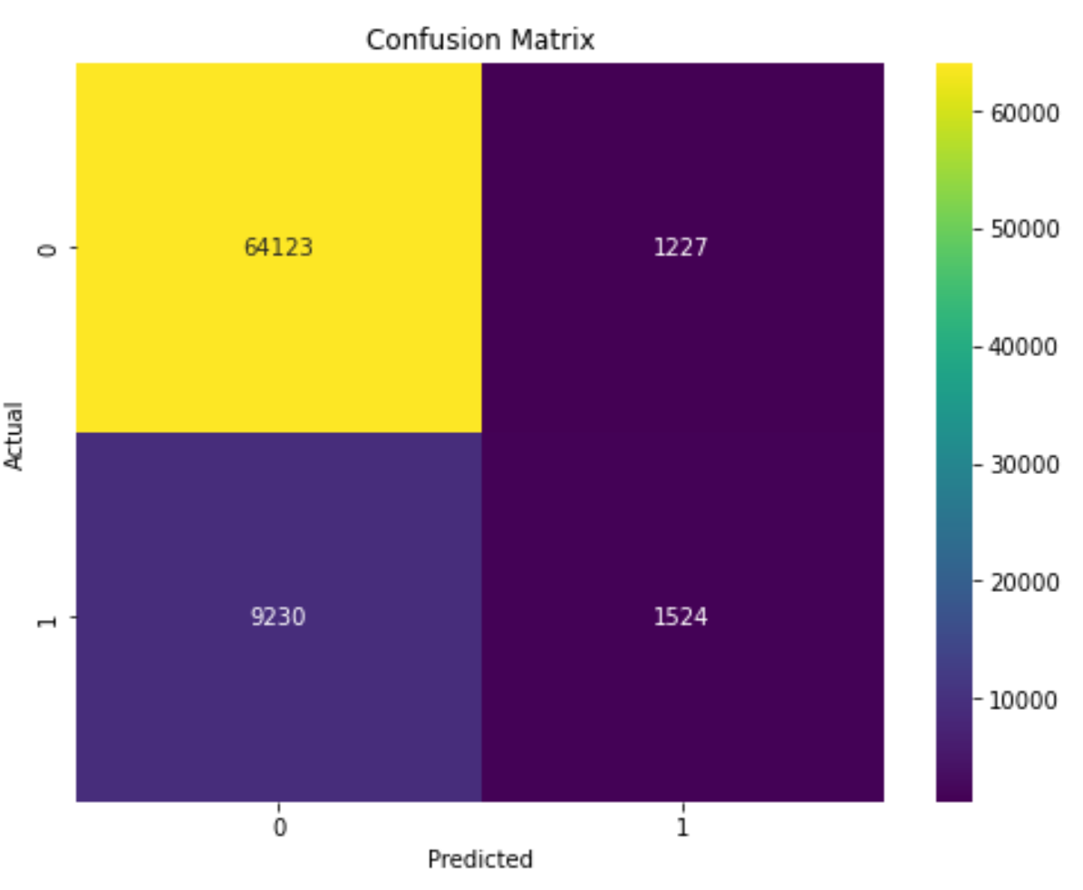
Logistic Regression Results

Slide 11
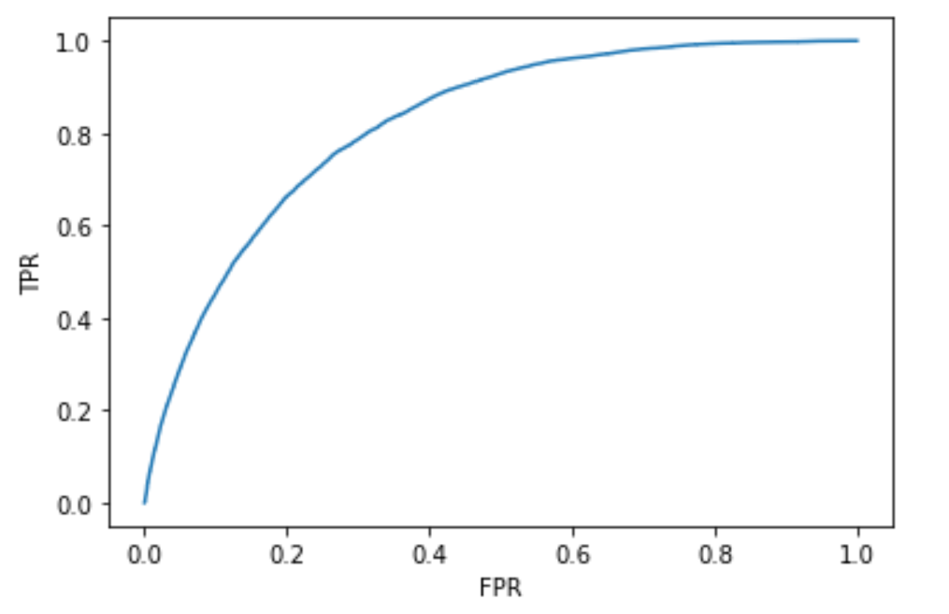
ROC and AUC
AUC for logistic regression: 0.8208250398883623

Slide 12
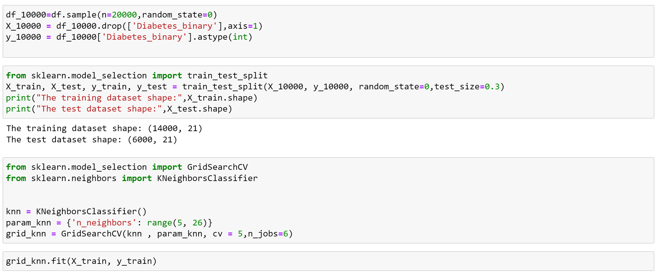
KNN with GridSearchCV

Slide 13
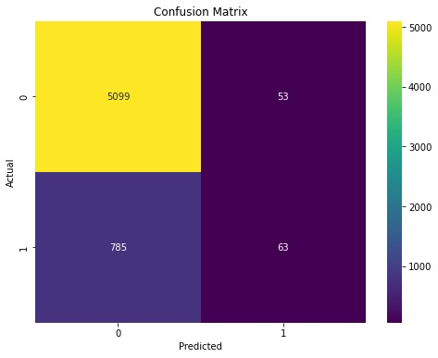
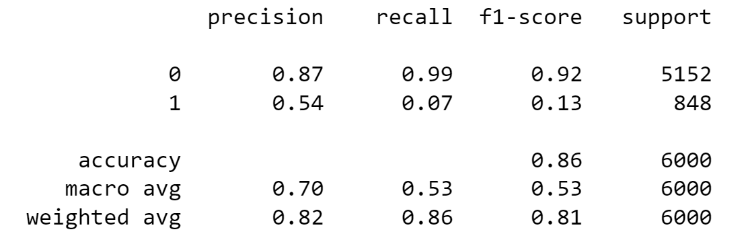
KNN Results
Characteristic | Value
The train accuracy for KNN from GridSearchCV | 0.8611
The test accuracy | 0.8591
The best value for parameter C | 0.1

Slide 14
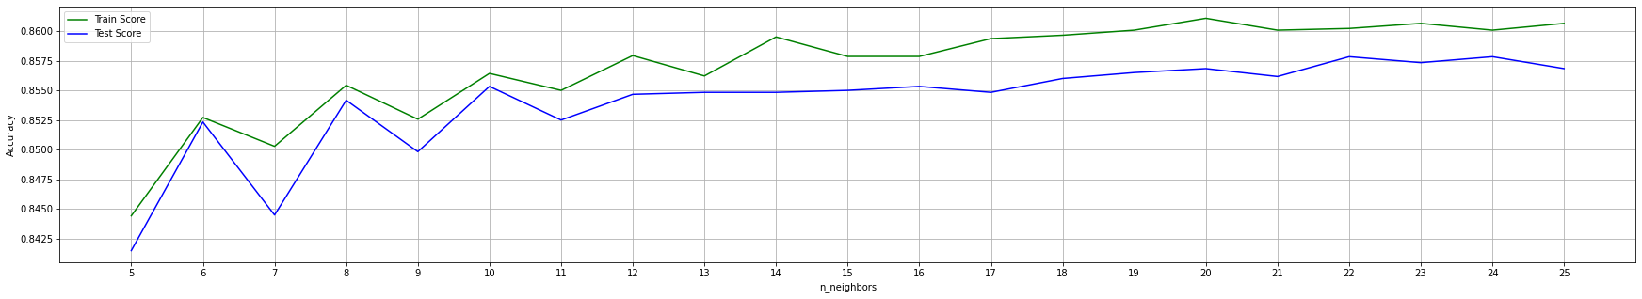
Effect of n_neighbors on accuracy

Slide 15
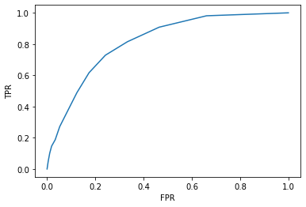
ROC and AUC
AUC for KNN with K=20 with features: 0.8141129933054025

Slide 16
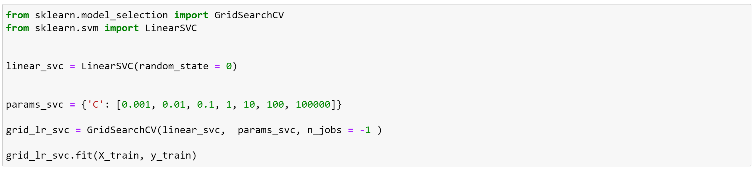
Linear SVM with GridSearchCV
Characteristic | Value
The train accuracy for linear SVM from GridSearchCV | 0.8625
The test accuracy | 0.8644
The best value for parameter C | 0.1

Slide 17
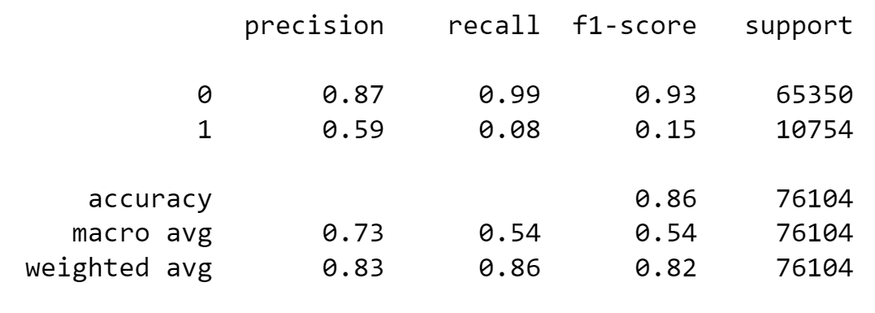
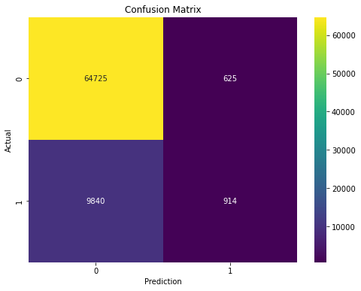
Linear SVM Results

Slide 18
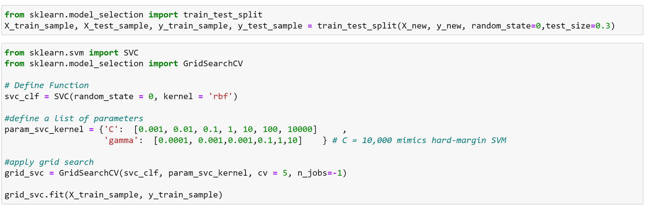
Kernel SVM with GridSearchCV
Characteristic | Value
The train accuracy for Kernel SVM from GridSearchCV | 0.8633
The test accuracy | 0.859
The best value for parameter C and gamma | 10000, 0.0001

Slide 19
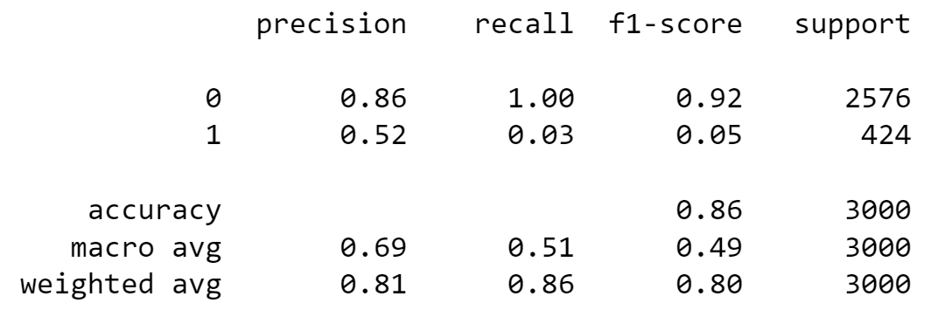
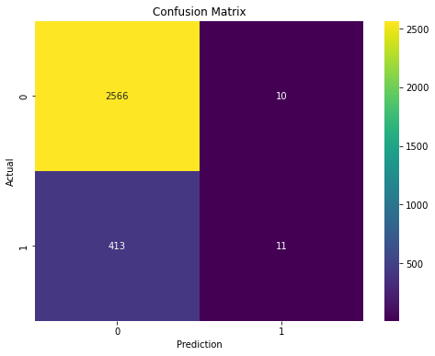
Kernel SVM Results

Slide 20
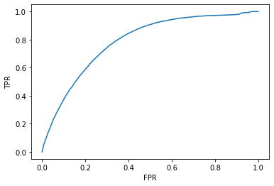
Gaussian Naïve Bayes
AUC for GaussianNB with features:0.7866083095857715
Characteristic | Value
The train accuracy for Gausian NB from GridSearchCV | 0.7727
The test accuracy | 0.7754

Slide 21
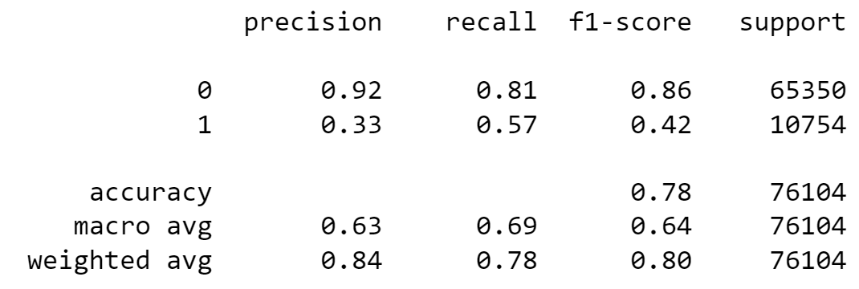
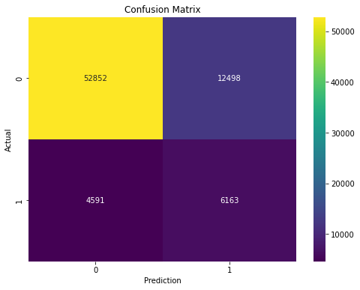
Gaussian Naïve Bayes Results

Slide 22
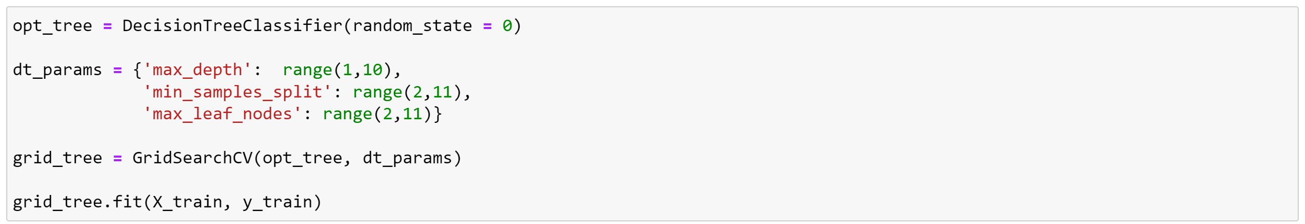
Decision Tree with GridSearchCV
Characteristic | Value
The train accuracy for Decision Tree from GridSearchCV | 0.8471
The test accuracy | 0.8490
The best value for parameter max_depth, max_leaf_nodes, and min_samples_split | 4, 9, 2

Slide 23
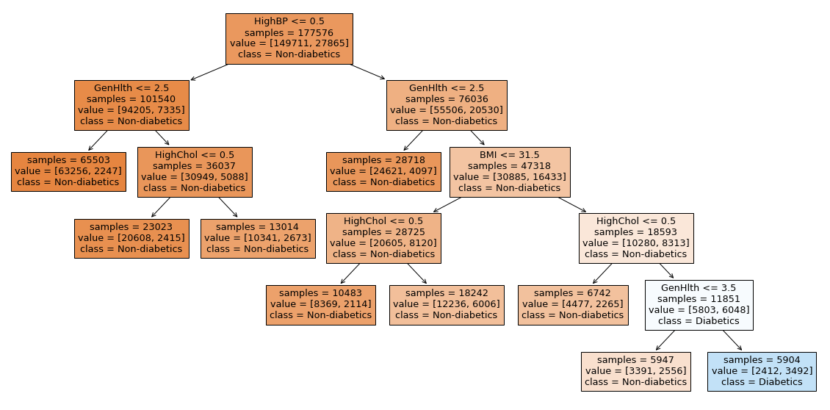
Tree Visualization

Slide 24
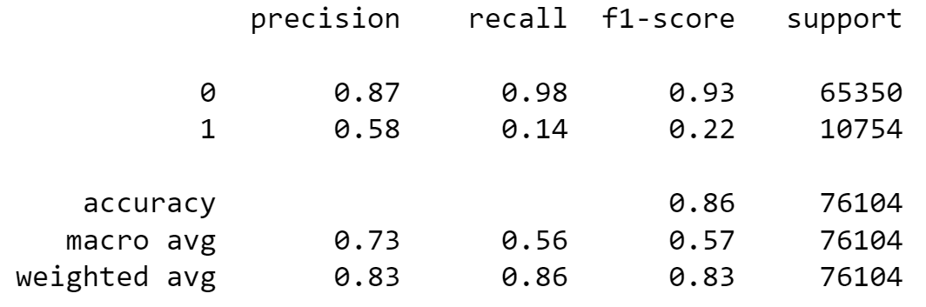

Decision Tree Results

Slide 25
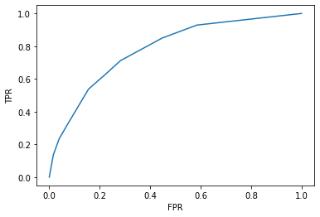
ROC and AUC
AUC for Decision Tree with features:0.7810301592019852

Slide 26
Random Forest
Characteristic | Value
The train accuracy for Random Forest | 0.9774
The test accuracy | 0.8567

Slide 27
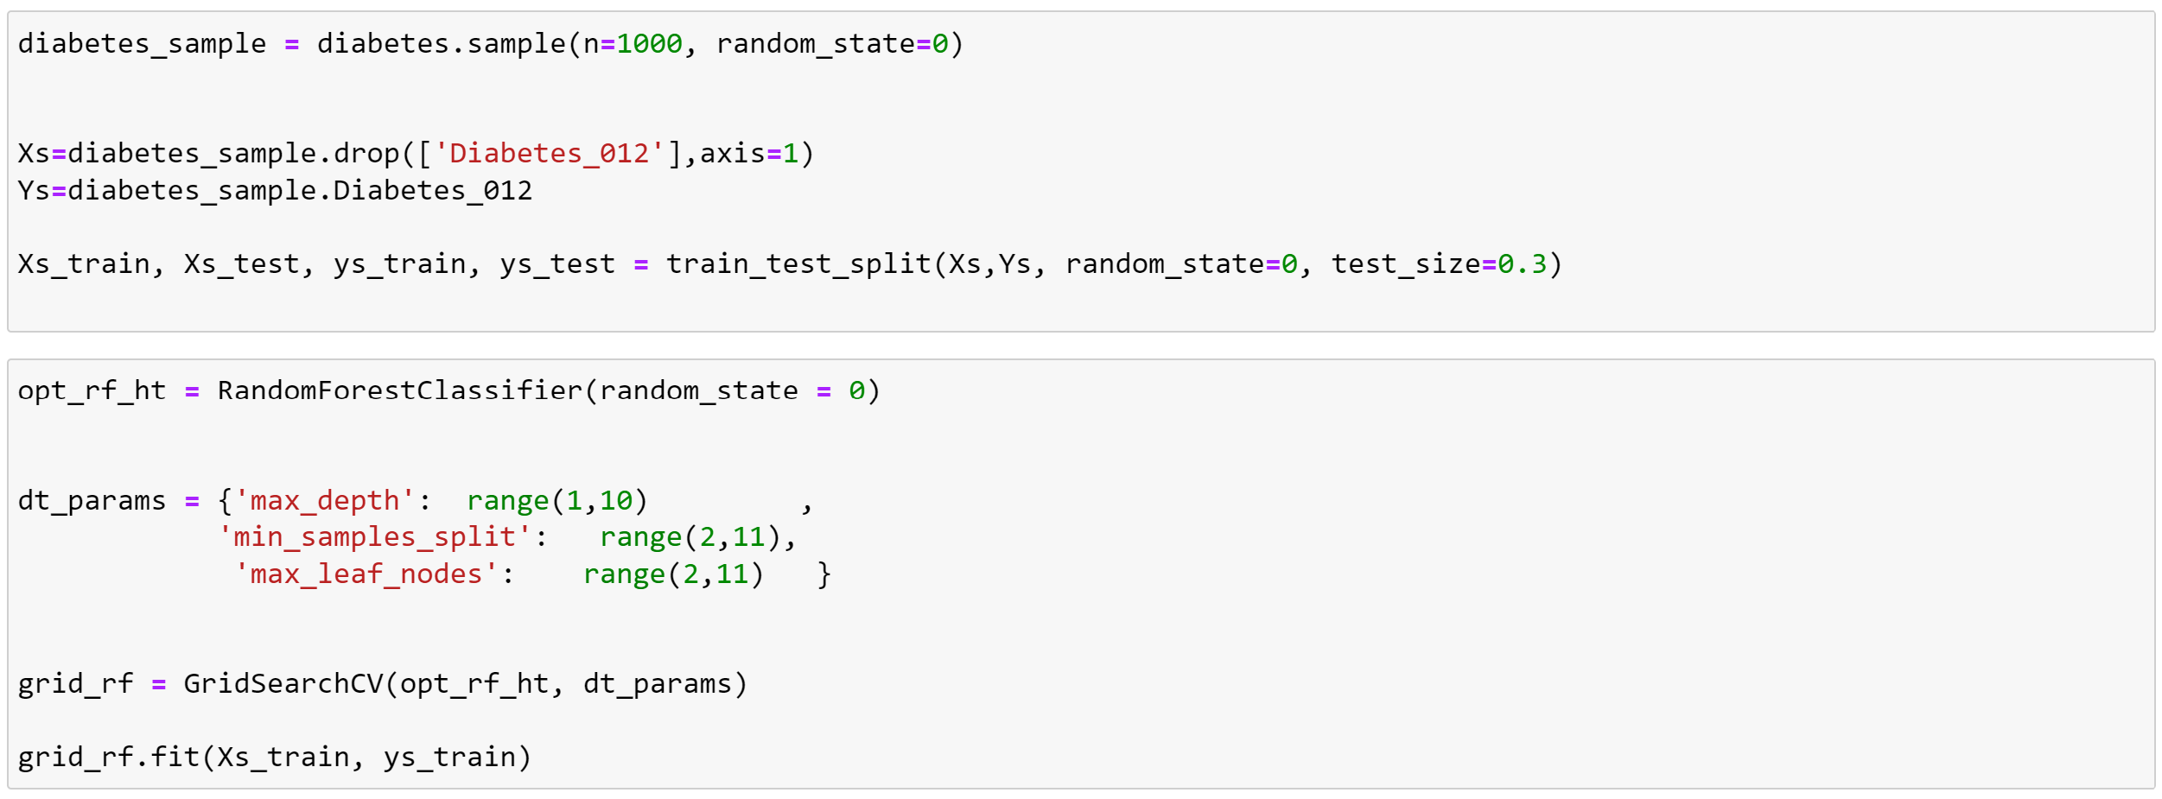
Random Forest with GridSearchCV on sampled data
Characteristic | Value
The train accuracy for Random Forest from GridSearchCV | 0.8628
The test accuracy | 0.8609
The best value for parameter max_depth, max_leaf_nodes, and min_samples_split | 5,10,9

Slide 28
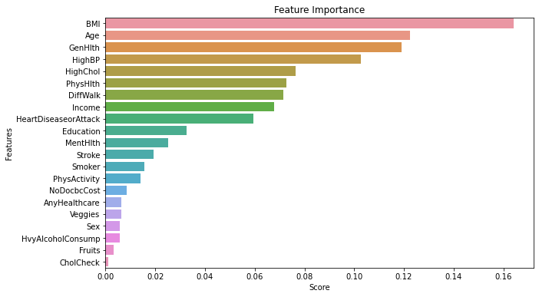
Feature importance based on Random Forest

Slide 29
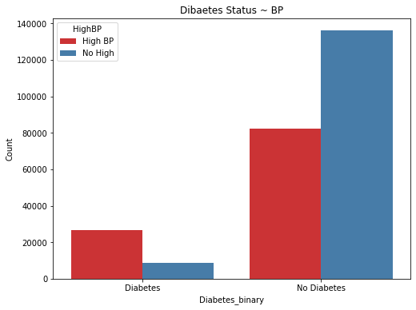
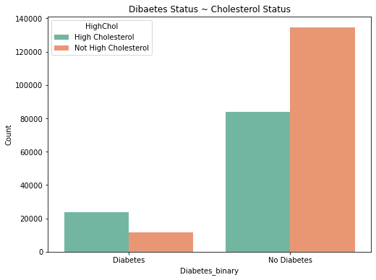
Exploring the data

Slide 30
Summary
Model | Hyperparameter | Test Score | Train Score
Logistic Regression | K=10 | 0.8626 | 0.8635
KNN | K=20 | 0.8591 | 0.8611
Linear SVM | C=0.1 | 0.8644 | 0.8625
Kernel SVM | C and gamma=10000, 0.0001 | 0.859 | 0.8633
Gaussian Naïve Bayes |  | 0.7754 | 0.7727
Decision Tree | max_depth, max_leaf_nodes, and min_samples_split=4, 9, 2 | 0.849 | 0.8471
Random Forest | max_depth, max_leaf_nodes, and min_samples_split=5, 10, 9 | 0.8609 | 0.8628

Slide 31

Thank you for your attention.

