Slide 1
AKHLAQUE AHMAD
PAPER PRESENTATION · 2026
GPU-Native Approximate
Nearest Neighbor Search
with IVF-RaBitQ
Jifan Shi · Jianyang Gao · James Xia · Tamás Béla Fehér · Cheng Long
arXiv:2602.23999
Notes:
Introduce the paper and its objective: an end-to-end GPU-native IVF-RaBitQ system.
[Sources]
- /Users/akahmad/Library/CloudStorage/OneDrive-IndianaUniversity(2)/Vector DB/papers/RabitQ-GPU.pdf, paper page(s) 1.

Slide 2
MOTIVATION
GPU ANNS must optimize four objectives at once
Modern semantic search, RAG, and recommendation operate over massive, high-dimensional embeddings. A useful GPU index must do more than answer queries quickly.
High recall
High QPS
Preserve true neighbors at demanding accuracy targets.
Exploit batching, memory bandwidth, and massive parallelism.
Fast build
Compact index
Avoid expensive graph construction or trained codebooks.
Keep vectors GPU-resident without raw-vector reranking.
02
Notes:
Frame the design problem as a four-way systems trade-off.
[Sources]
- /Users/akahmad/Library/CloudStorage/OneDrive-IndianaUniversity(2)/Vector DB/papers/RabitQ-GPU.pdf, paper page(s) 1.

Slide 3
PROBLEM
Existing GPU indexes occupy different trade-off points
Graph-based indexes
Cluster-based indexes
CAGRA and related methods
IVF-Flat and IVF-PQ
• Strong recall-throughput frontier
• Irregular traversal and memory access
• Heavy graph construction
• Raw or lightly compressed storage
• Regular, GPU-friendly probing
• Fast and simple construction
• IVF-Flat is bandwidth-heavy
• IVF-PQ often reranks raw vectors for high recall
The paper asks whether a cluster-based index can reach graph-like recall and throughput without graph-like build and storage costs.
03
Notes:
Contrast graph-based and IVF-based baselines, then state the paper's central question.
[Sources]
- /Users/akahmad/Library/CloudStorage/OneDrive-IndianaUniversity(2)/Vector DB/papers/RabitQ-GPU.pdf, paper page(s) 1, 2.

Slide 4
CONTRIBUTIONS
The contribution is an end-to-end GPU co-design
01 · Quantization
02 · Distance kernels
Cluster-at-a-time, block-per-vector encoding plus a two-phase parallel grid search.
LUT and bitwise inner-product schemes for the dominant 1-bit filtering stage.
03 · Fused search
04 · Data layout
Filtering, refinement, and top-K selection execute inside one cluster-local kernel.
CSR-like inverted lists and interleaved short codes align storage with warp access.
04
Notes:
Preview the four contributions that structure the remainder of the presentation.
[Sources]
- /Users/akahmad/Library/CloudStorage/OneDrive-IndianaUniversity(2)/Vector DB/papers/RabitQ-GPU.pdf, paper page(s) 2.

Slide 5
METHOD PRIMER
IVF narrows the search; RaBitQ compresses each candidate
Index build
Query time
Raw vectors
IVF clustering
RaBitQ codes
Probe and rank
N vectors in D dimensions
Assign each vector to its nearest centroid
Normalize residuals, rotate, and encode B bits per dimension
Visit nearby lists and estimate distances from codes
IVF controls how many vectors are examined. RaBitQ controls the bytes moved and the cost of scoring each examined vector.
05
Notes:
Explain the division of labor between IVF partitioning and RaBitQ quantization.
[Sources]
- /Users/akahmad/Library/CloudStorage/OneDrive-IndianaUniversity(2)/Vector DB/papers/RabitQ-GPU.pdf, paper page(s) 2, 3.

Slide 6
RABITQ BACKGROUND
RaBitQ encodes direction on a rotated integer grid
1 · Center and normalize
Why this helps
o = (oᵣ − c) / ‖oᵣ − c‖
• No learned quantization codebook
• Distances and dot products are estimated from compact integer codes plus small factors
• Orthogonal rotation preserves geometry while spreading coordinates across the grid
• Bit width B directly controls the storage-accuracy trade-off
2 · Rotate into a shared orthogonal basis
o′ = P⁻¹o and PᵀP = I
3 · Store the closest integer direction
x̂ = arg max ⟨x / ‖x‖, o′⟩
06
Notes:
Walk through centering, normalization, orthogonal rotation, and nearest-direction coding.
[Sources]
- /Users/akahmad/Library/CloudStorage/OneDrive-IndianaUniversity(2)/Vector DB/papers/RabitQ-GPU.pdf, paper page(s) 3.

Slide 7
DESIGN CHALLENGE
A direct RaBitQ port fights the GPU execution model
01
Sequential factor search
The CPU enumerates D·2ᴮ⁻¹ critical scales with per-vector state and a priority queue.
02
Irregular control flow
Fine-grained state updates and branches create warp divergence.
03
No direct SIMD equivalent
CPU packed/shuffle and bit-scan routines do not map directly to SIMT execution.
04
Pipeline overhead
Separate filtering, refinement, and top-K kernels repeatedly touch global memory.
The solution changes both the algorithm and the storage layout—not just the programming language.
07
Notes:
Make clear why GPU-native design is necessary rather than a straightforward CUDA port.
[Sources]
- /Users/akahmad/Library/CloudStorage/OneDrive-IndianaUniversity(2)/Vector DB/papers/RabitQ-GPU.pdf, paper page(s) 2.

Slide 8
GPU INDEX BUILD
Index construction exposes intra-vector parallelism
Balanced K-means
Normalize + rotate
Block per vector
Pack the index
Learn centroids and assign vectors to IVF lists
Process residuals by cluster; use GEMM for the shared orthogonal transform
Threads cooperate across dimensions and candidate scaling factors
Separate 1-bit codes, ex-codes, factors, and vector IDs
>1M
Cluster-at-a-time launches bound temporary storage. Block-per-vector mapping enables intra-vector parallelism and coalesced reads.
960-D vectors quantized per second to 8-bit codes
08
Notes:
Explain the cluster-at-a-time launch granularity and block-per-vector thread mapping.
[Sources]
- /Users/akahmad/Library/CloudStorage/OneDrive-IndianaUniversity(2)/Vector DB/papers/RabitQ-GPU.pdf, paper page(s) 2, 4, 5.

Slide 9
TWO-PHASE RESCALING SEARCH
Algorithm 1 uses two GPU-parallel grids
Objective
maximize f(t) = ⟨x(t), o′⟩ / ‖x(t)‖
1 · Search range
2 · Coarse grid
3 · Fine grid
Use maxᵢ|o′ᵢ| and B to initialize [tstart, tend].
Evaluate Ncoarse uniformly spaced t values in parallel; reduce to tcenter.
Search [tcenter−δ, tcenter+δ] with Nfine parallel samples.
Classical ternary search repeatedly shrinks a unimodal interval. Algorithm 1 keeps that coarse-to-fine idea but uses two fixed GPU-parallel rounds—64 coarse and 32 fine samples in the experiments.
O(1) rounds means fixed synchronization depth; each sample still rounds and scores D coordinates.
09
Notes:
Describe Algorithm 1 line-by-line and clarify that it is inspired by, but does not literally execute, ternary search.
[Sources]
- /Users/akahmad/Library/CloudStorage/OneDrive-IndianaUniversity(2)/Vector DB/papers/RabitQ-GPU.pdf, paper page(s) 5, 9.

Slide 10
SEARCH PIPELINE
Queries become independent work units
Batch rotation
Cluster selection
Pair scheduling
Cluster-local search
Batch merge
One GEMM produces Q′
Top-nprobe centroids
Sort (query, cluster) pairs
Filter, refine, local top-K
Global top-K per query
Sorting pairs by cluster improves code reuse and lets blocks process probed lists independently.
The dominant work happens inside cluster-local search, so the rest of the design is organized around that kernel.
10
Notes:
Follow a batch from rotation through cluster selection, pair scheduling, local search, and final merge.
[Sources]
- /Users/akahmad/Library/CloudStorage/OneDrive-IndianaUniversity(2)/Vector DB/papers/RabitQ-GPU.pdf, paper page(s) 4, 5, 6.

Slide 11
TWO-STAGE DISTANCE ESTIMATION
Most vectors pay only for a 1-bit distance estimate
All candidates in a probed list
Why it matters
1-bit code filter
• Filtering touches many vectors and dominates runtime.
• The ex-code is fetched only for promising candidates.
• High recall does not require loading raw vectors for reranking.
discard
Only survivors
Refine with ex-code
short code
long code
11
Notes:
Explain short-code filtering and ex-code refinement, emphasizing avoided memory traffic.
[Sources]
- /Users/akahmad/Library/CloudStorage/OneDrive-IndianaUniversity(2)/Vector DB/papers/RabitQ-GPU.pdf, paper page(s) 4, 6.

Slide 12
KERNEL CO-DESIGN
Two inner-product kernels target different GPU bottlenecks
Lookup-table kernel
Bitwise decomposition
• Precompute query-dependent partial inner products
• Keep LUTs in shared memory
• Reuse tables across hundreds of threads
• Fast when shared-memory residency is sufficient
• Quantize each query into signed integers
• Decompose the inner product by bit plane
• Use AND + POPCNT over 32 dimensions per operation
• Much smaller shared-memory footprint
At high dimensionality, LUT capacity can limit occupancy; the bitwise kernel remains lightweight.
12
Notes:
Compare the memory-centric LUT method with the compute-centric bitwise method.
[Sources]
- /Users/akahmad/Library/CloudStorage/OneDrive-IndianaUniversity(2)/Vector DB/papers/RabitQ-GPU.pdf, paper page(s) 6, 7.

Slide 13
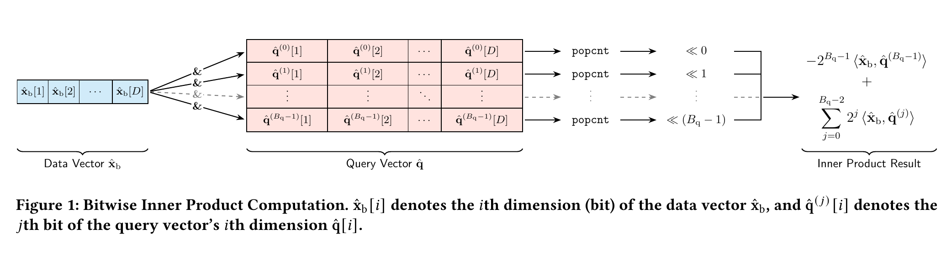
BITWISE KERNEL
Bitwise decomposition turns dot products into popcounts
Pack
Decompose
Accumulate
32 code dimensions per machine word
One binary inner product per query bit plane
Shift and add the weighted popcount results
13
Notes:
Use Figure 1 to show bit-plane decomposition, AND operations, popcount, and weighted accumulation.
[Sources]
- /Users/akahmad/Library/CloudStorage/OneDrive-IndianaUniversity(2)/Vector DB/papers/RabitQ-GPU.pdf, paper page(s) 7.

Slide 14
FUSED CLUSTER-LOCAL SEARCH
One fused kernel keeps intermediate state on chip
1-bit estimate
Candidate filter
Ex-code refine
In-block top-K
Score every code
Reject by lower bound
Improve only survivors
Emit local candidates
Shared memory + registers
Fusion removes sequential kernel launches, intermediate global-memory writes, and synchronization between stages.
14
Notes:
Contrast four separate kernels with the paper's fused cluster-local implementation.
[Sources]
- /Users/akahmad/Library/CloudStorage/OneDrive-IndianaUniversity(2)/Vector DB/papers/RabitQ-GPU.pdf, paper page(s) 7, 8.

Slide 15
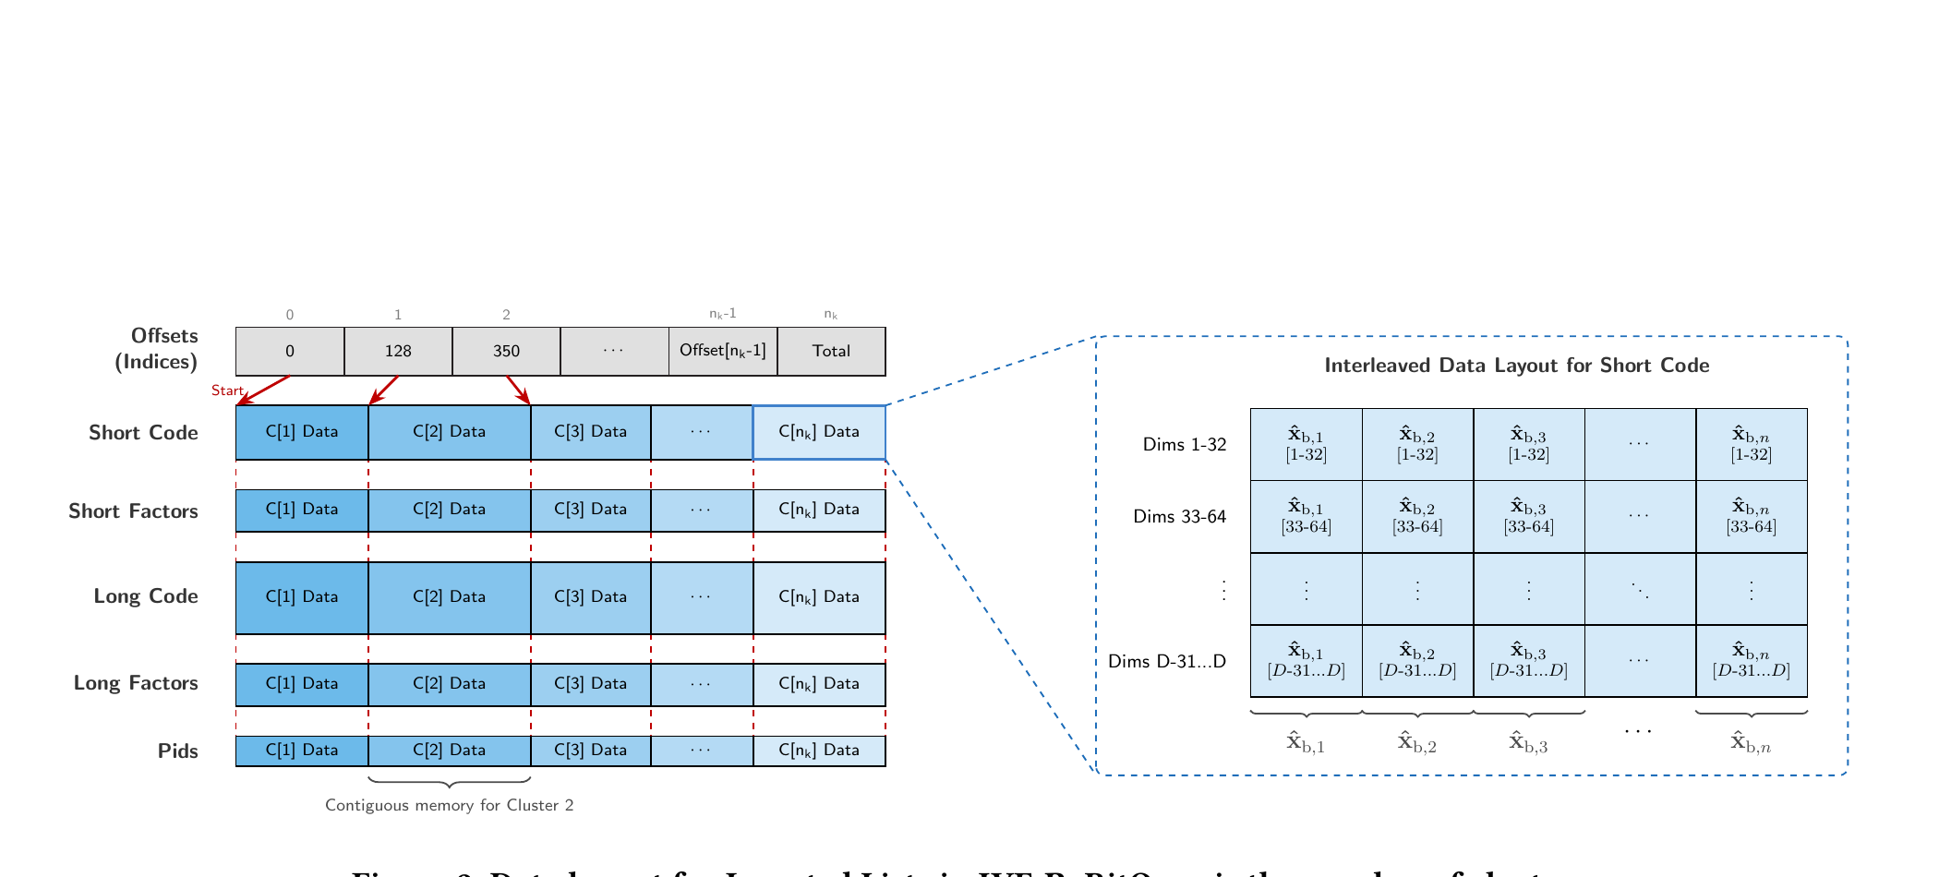
GPU INDEX LAYOUT
The memory layout is designed around the dominant access pattern
CSR-like offsets make each cluster contiguous; short codes are interleaved so a warp reads adjacent dimensions from adjacent vectors.
15
Notes:
Explain the separate arrays for short codes, factors, long codes, and IDs, then the interleaved short-code layout.
[Sources]
- /Users/akahmad/Library/CloudStorage/OneDrive-IndianaUniversity(2)/Vector DB/papers/RabitQ-GPU.pdf, paper page(s) 9.

Slide 16
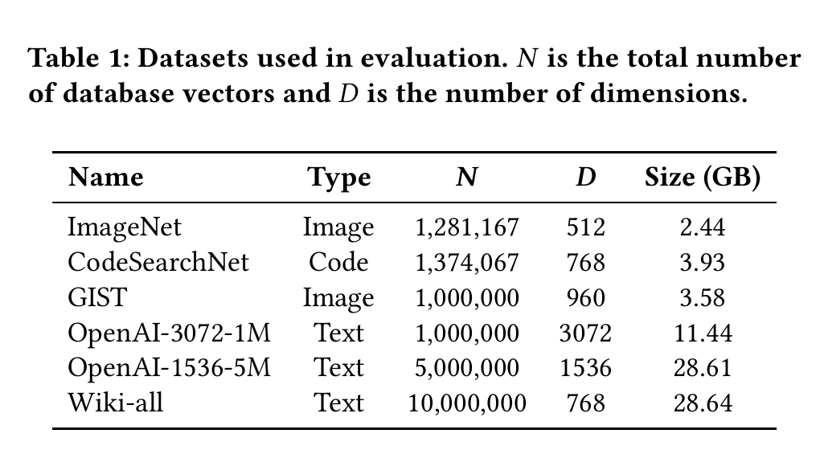
EXPERIMENTAL SETUP
Evaluation spans six diverse vector datasets
Platform
NVIDIA L40S, 48 GB
CUDA 13.1
Ubuntu 22.04
Batch size = 10⁴
Baselines
CAGRA
IVF-Flat
IVF-PQ with / without refinement
RaBitQLib CPU counterpart
Default RaBitQ: 8 bits/dimension · Ncoarse = 64 · Nfine = 32
16
Notes:
Summarize platform, datasets, baselines, batch size, and default RaBitQ settings.
[Sources]
- /Users/akahmad/Library/CloudStorage/OneDrive-IndianaUniversity(2)/Vector DB/papers/RabitQ-GPU.pdf, paper page(s) 9.

Slide 17
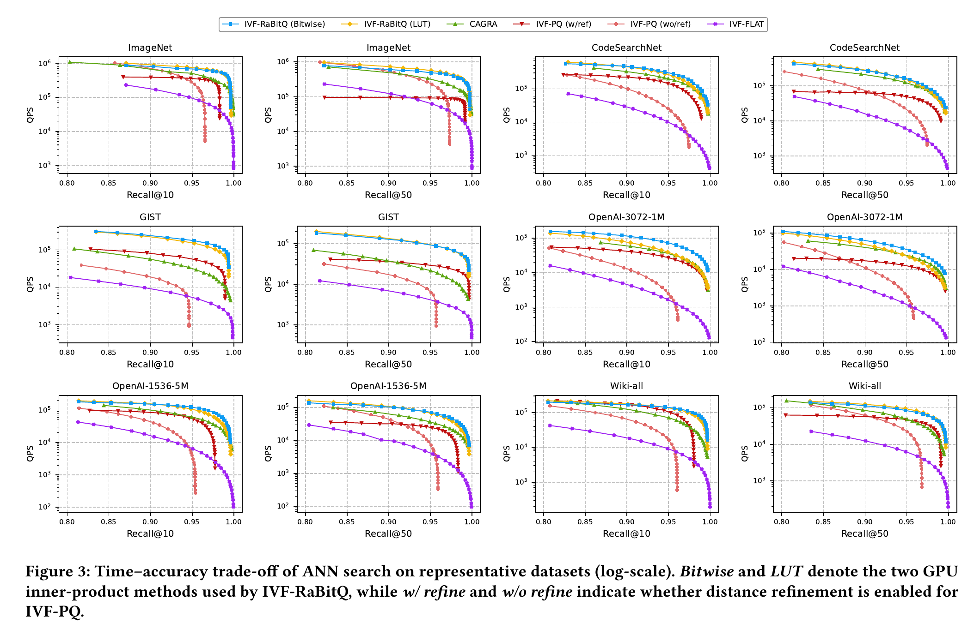
SEARCH PERFORMANCE
IVF-RaBitQ leads the medium-to-high recall region
At Recall = 0.95
2.2×
average QPS vs. CAGRA
2.0–31.4×
QPS vs. IVF-PQ without refinement
Bitwise scales better than LUT on very high-dimensional vectors.
17
Notes:
Read Figure 3 from the high-recall region and compare against CAGRA and both IVF-PQ modes.
[Sources]
- /Users/akahmad/Library/CloudStorage/OneDrive-IndianaUniversity(2)/Vector DB/papers/RabitQ-GPU.pdf, paper page(s) 10.

Slide 18
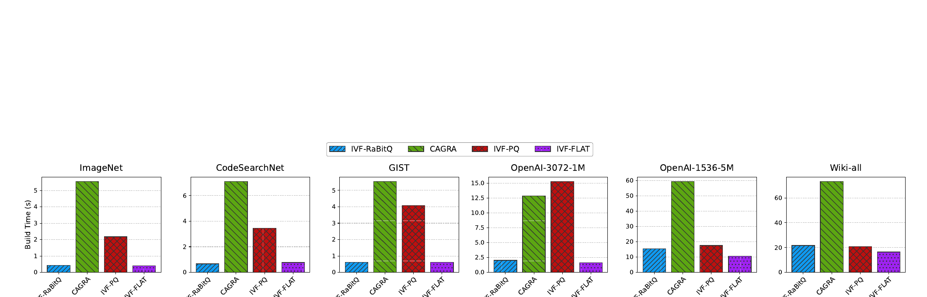
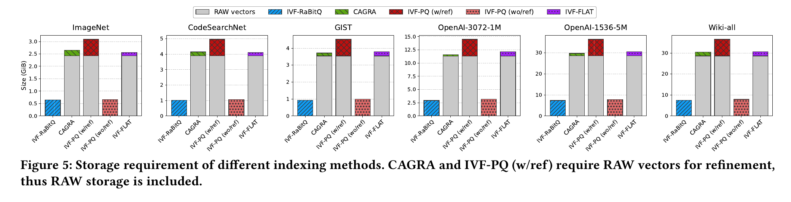
SYSTEM EFFICIENCY
The same index is faster to build and substantially smaller
7.7×
faster index build than CAGRA on average
4.4×
faster build than IVF-PQ on average
Wiki-all example:
7.49 GB for IVF-RaBitQ
>30 GB for CAGRA and IVF-PQ with refinement
18
Notes:
Use Figures 4 and 5 to connect algorithmic simplicity to build time and raw-vector avoidance to storage.
[Sources]
- /Users/akahmad/Library/CloudStorage/OneDrive-IndianaUniversity(2)/Vector DB/papers/RabitQ-GPU.pdf, paper page(s) 11.

Slide 19
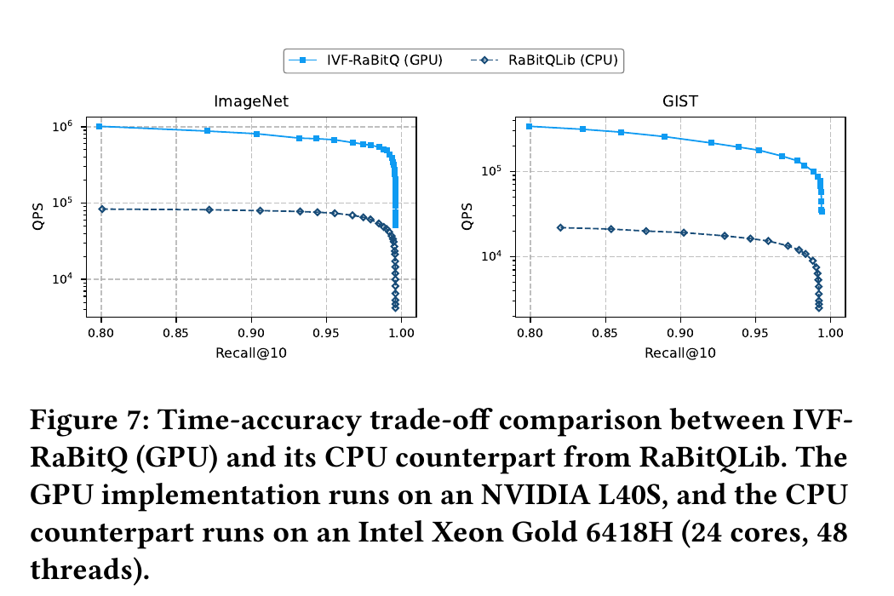
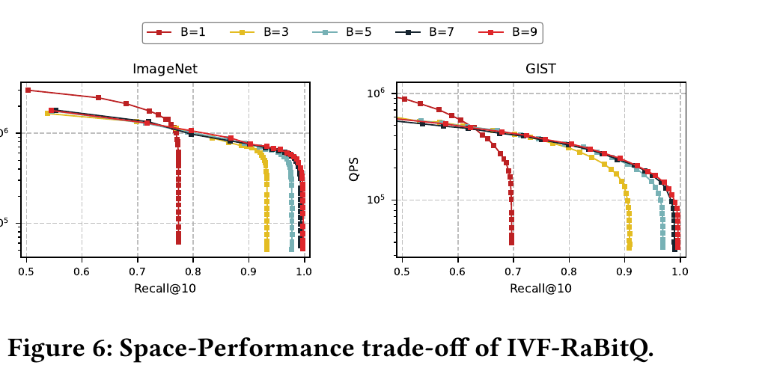
SENSITIVITY AND PORTABILITY
Bit width controls recall; GPU execution preserves accuracy
Quantization-bit trade-off
GPU versus CPU
12.9×
B = 5
>0.95 recall
B = 7
>0.99 recall
average GPU QPS speedup at Recall@10 = 0.95
19
Notes:
Discuss the bit-width control knob, then show that the GPU version matches CPU recall while greatly increasing QPS.
[Sources]
- /Users/akahmad/Library/CloudStorage/OneDrive-IndianaUniversity(2)/Vector DB/papers/RabitQ-GPU.pdf, paper page(s) 11, 12.

Slide 20
TAKEAWAYS
IVF-RaBitQ shifts the
GPU ANNS frontier
GPU-native quantization
Kernel + layout co-design
Strong measured trade-off
Parallel factor exploration makes RaBitQ practical at scale.
Two-stage scoring, bitwise/LUT kernels, and fusion reduce data movement.
High recall and QPS with fast builds and compact storage.
Scope to remember: one L40S, GPU-resident large batches, and an empirically tuned two-phase grid search. Small-batch latency, out-of-core behavior, and broader GPU portability remain useful next questions.
Notes:
Close with the three design lessons, then state the evaluation scope and open questions.
[Sources]
- /Users/akahmad/Library/CloudStorage/OneDrive-IndianaUniversity(2)/Vector DB/papers/RabitQ-GPU.pdf, paper page(s) 2, 12.

