Slide 1
G | Address
MC and SM Graphs
soc-sinaweibo | https://networkrepository.com/soc-sinaweibo.php
web-wikipedia_link_en | https://networkrepository.com/web-wikipedia-link-en13-all.php
edit-frwiki | http://konect.cc/networks/edit-frwiki/
edit-cebwiki | http://konect.cc/networks/edit-cebwiki/
edit-svwiki | http://konect.cc/networks/edit-svwiki/
edit-eswiki | http://konect.cc/networks/edit-eswiki/
edit-dewiki | http://konect.cc/networks/edit-dewiki/
edit-enwiktionary | http://konect.cc/networks/edit-enwiktionary/
wikipedia_link_sh | http://konect.cc/networks/wikipedia_link_sh/
wikipedia_link_de | http://konect.cc/networks/wikipedia_link_de/
edit-frwiktionary | http://konect.cc/networks/edit-frwiktionary/
wikipedia_link_ru | http://konect.cc/networks/wikipedia_link_ru/
wikipedia_link_fr | http://konect.cc/networks/wikipedia_link_fr/
wikipedia_link_sr | http://konect.cc/networks/wikipedia_link_sr/
orkut-links | http://konect.cc/networks/orkut-links/
edit-arwiki | http://konect.cc/networks/edit-arwiki/
wikipedia_link_nl | http://konect.cc/networks/wikipedia_link_nl/
wiki-Talk | http://konect.cc/networks/wiki-Talk/
wikipedia_link_it | http://konect.cc/networks/wikipedia_link_it/
wiki-topcats | https://snap.stanford.edu/data/wiki-topcats.html
MQC Graphs
socfb-B-anon | https://networkrepository.com/socfb-B-anon.php
Flixster | https://networkrepository.com/soc-flixster.php
soc-pokec | http://konect.cc/networks/soc-pokec-relationships/
Hyves | http://konect.cc/networks/hyves/
Douban | http://konect.cc/networks/douban/
WordNet | http://konect.cc/networks/wordnet-words/
slashdot-threads | http://konect.cc/networks/slashdot-threads/
FB-Pages | https://networkrepository.com/fb-pages-politician.php
edit-kywiktionary | http://konect.cc/networks/edit-kywiktionary/
wikilens-ratings | http://konect.cc/networks/wikilens-ratings/
edit-sswiki | http://konect.cc/networks/edit-sswiki/

Slide 2
G | |V| | |E| | d_{max} | G²-AIMD | GPU-Layered | GPU-Hybrid | CPU-Only | CPU+GPU | Gain^{GH2G} | Gain^{CG2GH} | Gain^{CG2C}
soc-sinaweibo | 58.66M | 522.6M | 278.5K | 72.1 | 32.5 | 27.9 | 144.3 | 19.4 | 2.6 | 1.44 | 7.4
web-wikipedia_link_en | 25.92M | 1086.4M | 4271.3K | 151.5 | 222.6 | 147.7 | 227.7 | 117.9 | 1.0 | 1.25 | 1.9
edit-frwiki | 8.833M | 105.9M | 2126.4K | 112.7 | 90.0 | 60.7 | 306.4 | 48.3 | 1.9 | 1.26 | 6.3
edit-cebwiki | 8.483M | 23.59M | 8421.4K | 9.3 | 8.1 | 7.3 | 0.9 | 0.9 | 1.3 | 7.74 | 0.9
edit-svwiki | 7.570M | 43.88M | 5670.0K | 14.1 | 13.3 | 12.2 | 4.7 | 2.7 | 1.2 | 4.53 | 1.7
edit-eswiki | 5.868M | 61.17M | 959.3K | 47.8 | 35.6 | 28.2 | 123.5 | 19.3 | 1.7 | 1.46 | 6.4
edit-dewiki | 5.829M | 110.4M | 818.2K | 79.4 | 52.6 | 46.3 | 245.5 | 33.7 | 1.7 | 1.37 | 7.3
edit-enwiktionary | 5.813M | 54.24M | 3504.0K | 6.0 | 6.2 | 4.8 | 9.6 | 2.3 | 1.3 | 2.09 | 4.2
wikipedia_link_sh | 3.924M | 152.9M | 254.6K | 483.4 | 483.7 | 481.9 | 450.8 | 127.7 | 1.0 | 3.77 | 3.5
wikipedia_link_de | 3.604M | 155.1M | 434.2K | 147.7 | 94.6 | 74.1 | 196.6 | 58.1 | 2.0 | 1.27 | 3.4
edit-frwiktionary | 3.412M | 26.85M | 2487.1K | 4.7 | 3.4 | 2.6 | 0.9 | 1.0 | 1.8 | 2.61 | 1.0
wikipedia_link_ru | 3.370M | 143.9M | 282.6K | 156.7 | 86.0 | 73.6 | 200.6 | 42.9 | 2.1 | 1.71 | 4.7
wikipedia_link_fr | 3.333M | 200.9M | 399.4K | 281.4 | 237.1 | 199.8 | 834.2 | 160.5 | 1.4 | 1.25 | 5.2
wikipedia_link_sr | 3.175M | 206.6M | 369.6K | 434.1 | 494.0 | 409.9 | 346.2 | 158.1 | 1.1 | 2.59 | 2.2
orkut-links | 3.072M | 234.4M | 33.31K | 112.0 | 88.4 | 57.0 | 281.8 | 44.7 | 2.0 | 1.28 | 6.3
edit-arwiki | 2.940M | 20.97M | 916.7K | 5.1 | 4.4 | 3.3 | 5.7 | 1.5 | 1.6 | 2.16 | 3.8
wikipedia_link_nl | 2.623M | 94.93M | 900.4K | 25.5 | 27.7 | 23.3 | 31.8 | 14.2 | 1.1 | 1.64 | 2.2
wiki-Talk | 2.394M | 9.319M | 100.0K | 3.7 | 5.0 | 1.7 | 11.5 | 2.0 | 2.1 | 0.89 | 5.9
wikipedia_link_it | 2.149M | 155.8M | 286.6K | 33.9 | 38.2 | 31.7 | 110.6 | 19.7 | 1.1 | 1.61 | 5.6
wiki-topcats | 1.791M | 50.89M | 238.3K | 3.0 | 3.3 | 1.1 | 4.5 | 0.9 | 2.7 | 1.24 | 5.0

Slide 3
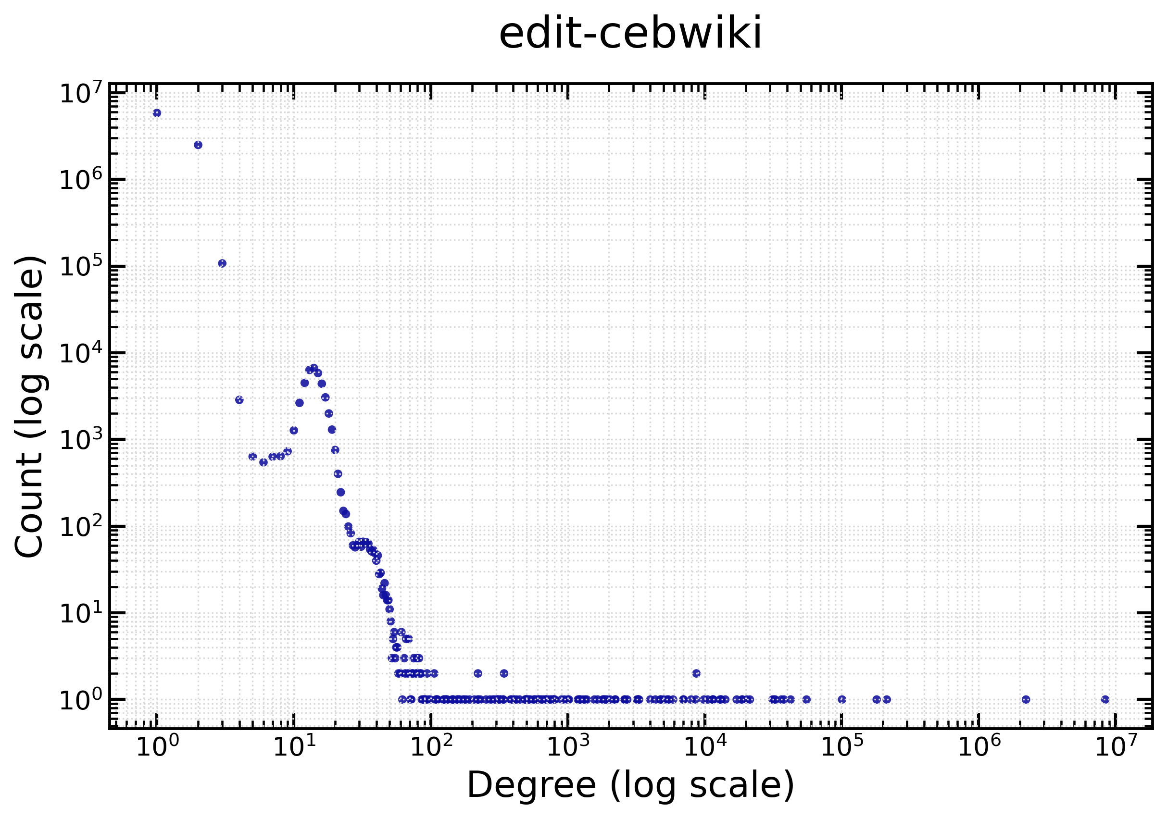
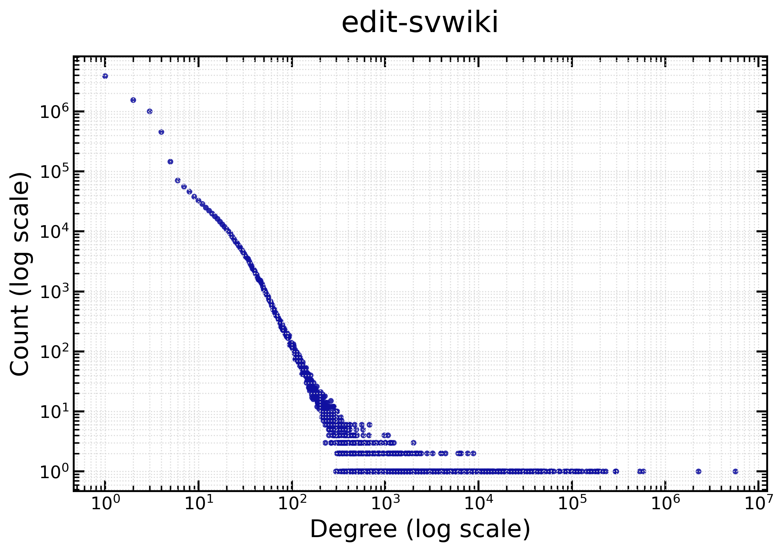
Why CPU is much faster than GPU?
A few vertices are very high degree in the graphs
Since a warp processes a vertex, a high degree vertex causes a warp to take a long time
G | |V| | |E| | d_{max} | G²-AIMD | GPU-Layered | GPU-Hybrid | CPU-Only | CPU+GPU | Gain^{GH2G} | Gain^{CG2GH} | Gain^{CG2C}
edit-cebwiki | 8.483M | 23.59M | 8421.4K | 9.3 | 8.1 | 7.3 | 0.9 | 0.9 | 1.3 | 7.74 | 0.9
edit-svwiki | 7.570M | 43.88M | 5670.0K | 14.1 | 13.3 | 12.2 | 4.7 | 2.7 | 1.2 | 4.53 | 1.7

Slide 4
Parameter Tuning
Parameter | Value | wikipedia_link_fr | edit-eswiki
η / #{warps} | 1000 | 230.3 | 39.5
 | 2000 | 199.8 | 28.2
 | 5000 | 277.1 | 30.8
 | 10,000 | 399.0 | 32.3
CPU Chunk | 10 | 208.4 | 34.9
 | 100 | 162.9 | 28.0
 | 200 | 160.5 | 19.3
 | 500 | 210.8 | 26.1
GPU Chunk | 10K | 187.3 | 26.3
 | 100K | 160.5 | 19.3
 | 500K | 194.0 | 27.0
𝜏_{c} | 1 | 180.2 | 20.1
 | n_{c} / 2 | 160.5 | 19.3
 | n_{c} / 4 | 203.3 | 19.5
Work stealing size:
η tasks from CPU -> GPU
5000 tasks from GPU -> CPU

Slide 5
G | Query | G²-AIMD | GPU-Layered | GPU-Hybrid | CPU-Only | CPU+GPU | Gain^{GL2G} | Gain^{CG2GL} | Gain^{CG2C} | STMatch | EGSM | GAMMA
edit-cebwiki | P1 | 1.0 | 0.7 | 0.8 | 22.7 | 1.1 | 1.3 | 0.6 | 20.4 | 126.0 | 11.1 | OOM
 | P2 | 4.0 | 3.6 | 3.7 | OOT | 4.4 | 1.1 | 0.8 | — | OOT | 52.6 | OOM
 | P3 | 10.2 | 9.6 | 10.6 | OOT | 10.8 | 1.1 | 0.9 | — | OOT | OOM | OOM
 | P4 | 27.7 | 17.5 | 22.0 | OOT | 19.3 | 1.6 | 0.9 | — | OOT | OOM | OOM
 | P5 | 0.7 | 0.4 | 0.5 | 513.0 | 2.4 | 1.6 | 0.2 | 212.0 | 21.2 | OOT | OOM
orkut-links | P1 | 3.1 | 3.0 | 3.1 | 166.0 | 4.1 | 1.0 | 0.7 | 40.5 | 106.2 | OOM | OOM
 | P2 | 60.3 | 51.3 | 67.7 | OOT | 52.7 | 1.2 | 1.0 | — | OOT | OOT | OOT
 | P3 | 183.1 | 167.0 | 185.8 | OOT | 168.3 | 1.1 | 1.0 | — | OOT | OOT | OOM
 | P4 | 199.1 | 171.5 | 219.4 | OOT | 171.5 | 1.2 | 1.0 | — | OOT | OOT | OOM
 | P5 | 26.4 | 19.1 | 23.3 | OOT | 20.6 | 1.4 | 0.9 | — | OOT | OOT | OOT
edit-arwiki | P1 | 7.6 | 7.5 | 7.5 | OOT | 8.3 | 1.0 | 0.9 | — | 462.5 | 193.0 | OOM
 | P2 | 132.9 | 129.4 | 128.9 | OOT | 129.2 | 1.0 | 1.0 | — | OOT | OOM | OOM
 | P3 | 477.7 | 468.7 | 474.4 | OOT | 466.9 | 1.0 | 1.0 | — | OOT | OOM | OOM
 | P4 | 529.7 | 455.0 | 459.4 | OOT | 443.7 | 1.2 | 1.0 | — | OOT | OOM | OOM
 | P5 | 6.6 | 6.4 | 6.4 | OOT | 7.5 | 1.0 | 0.9 | — | 131.8 | OOM | OOM
wiki-topcats | P1 | 0.7 | 0.7 | 0.7 | 1016.9 | 1.3 | 1.1 | 0.5 | 764.5 | 29.7 | OOM | OOM
 | P2 | 5.2 | 5.0 | 5.1 | OOT | 5.6 | 1.0 | 0.9 | — | OOT | OOM | OOM
 | P3 | 14.1 | 15.4 | 13.4 | OOT | 14.2 | 0.9 | 1.1 | — | OOT | OOM | OOM
 | P4 | 27.6 | 16.0 | 22.5 | OOT | 17.6 | 1.7 | 0.9 | — | OOT | OOM | OOM
 | P5 | 1.1 | 1.1 | 1.1 | 36.4 | 2.0 | 1.0 | 0.6 | 18.3 | 48.4 | OOM | OOM
OOT: Execution exceeds 30m
OOM: Out of Memory
— : Cannot compute due to OOT
P1
P2
P3
P4
P5

Slide 6
Experiments with difference cpu-chunk sizes
G | Query | 1 | 10 | 50 | 100 | 200
edit-cebwiki | P1 | 1.1 | 2.77 | 7.19 | 6.81 | 15.69
 | P2 | 4.4 | 5.39 | 8.69 | 15.68 | 21.86
 | P3 | 10.8 | 11.17 | 10.31 | 20.69 | 34.94
 | P4 | 19.3 | 21.18 | 86.9 | 22.22 | 67.73
 | P5 | 2.4 | 4.26 | 10.21 | 14.54 | 7.6
orkut-links | P1 | 4.1 | 7.65 | 15.02 | 18.27 | 29.44
 | P2 | 52.7 | 54.48 | 58.33 | 63.66 | 66.25
 | P3 | 168.3 | 173.9 | 181.2 | 184.6 | 187.4
 | P4 | 171.5 | 176.9 | 188 | 185.7 | 199.6
 | P5 | 20.6 | 22.1 | 24.92 | 32.09 | 43.48
edit-arwiki | P1 | 8.3 | 12.69 | 21.41 | 26.87 | 29.02
 | P2 | 129.2 | 129.7 | 133.5 | 134.8 | 131.6
 | P3 | 466.9 | 477.1 | 483.5 | 496.2 | 512.3
 | P4 | 443.7 | 476.9 | 528.7 | 560.4 | 728.9
 | P5 | 7.5 | 12.26 | 23.41 | 37.94 | 45.95
wiki-topcats | P1 | 1.3 | 5.15 | 9.75 | 13.64 | 20.28
 | P2 | 5.6 | 7.74 | 12.99 | 22.48 | 29.47
 | P3 | 14.2 | 15.17 | 21.88 | 27.39 | 32.48
 | P4 | 17.6 | 18.82 | 22.14 | 31.55 | 33.92
 | P5 | 2.0 | 3.2 | 10.01 | 11.23 | 18.1

Slide 7
G | |V| | |E| | d_{max} | 𝜏_{size} | γ | # root tasks | G²-AIMD | GPU-Layered | GPU-Hybrid | CPU-Only | CPU+GPU | Gain^{GL2G} | Gain^{CG2GL} | Gain^{CG2C} | Quick | FastQC
socfb-B-anon | 2.938M | 41.92M | 4356 | 20 | 0.95 | 399,864 | OOT | 801.2 | 802.3 | 1708.1 | 607.6 | — | 1.3 | 2.8 | OOT | 1625.6
Flixster | 2.523M | 15.84M | 1474 | 30 | 0.95 | 41,319 | 115.8 | 117.0 | 117.3 | OOT | 25.4 | 1.0 | 4.6 | — | OOT | 747.9
soc-pokec | 1.633M | 44.60M | 14,854 | 20 | 0.90 | 573,021 | 546.3 | 239.2 | 240.1 | 362.8 | 210.0 | 2.3 | 1.1 | 1.7 | OOT | 1260.9
Hyves | 1.403M | 5.555M | 31,883 | 20 | 0.80 | 3785 | 35.2 | 39.2 | 38.8 | 1265.0 | 24.4 | 0.9 | 1.6 | 51.8 | OOT | OOT
Douban | 154.9K | 654.3K | 287 | 8 | 0.50 | 20,181 | 26.2 | 26.4 | 26.6 | 73.6 | 6.2 | 1.0 | 4.2 | 11.8 | 1095.1 | OOT
WordNet | 146.0K | 1.314M | 1008 | 5 | 0.80 | 94,500 | 46.8 | 49.3 | 49.5 | 50.3 | 7.5 | 0.9 | 6.6 | 6.7 | 294.9 | 301.2
slashdot-threads | 51.08K | 233.1K | 2915 | 6 | 0.70 | 8421 | 29.3 | 28.8 | 29.0 | 2.7 | 1.5 | 1.0 | 19.2 | 1.8 | 62.5 | 1.2
FB-Pages | 50.52K | 1.638M | 1469 | 23 | 0.90 | 16,009 | 714.7 | 406.3 | 400.5 | OOT | 250.1 | 1.8 | 1.6 | — | OOT | OOT
edit-kywiktionary | 39.88K | 152.9K | 23,237 | 7 | 0.60 | 5294 | 41.5 | 40.6 | 40.7 | 5.4 | 6.7 | 1.0 | 6.1 | 0.8 | 131.4 | 381.5
wikilens-ratings | 5111 | 53.70K | 1730 | 10 | 0.72 | 1262 | 32.9 | 38.3 | 39.6 | 715.4 | 31.7 | 0.9 | 1.2 | 22.6 | OOT | OOT
edit-sswiki | 2022 | 22.23K | 604 | 10 | 0.70 | 490 | 214.9 | 112.3 | 118.2 | 1021.6 | 96.9 | 1.9 | 1.2 | 10.5 | OOT | OOT
Invalid results due to big tasks that GPU cannot handle

Slide 8
MQC Adaptive GPU Chunk
The number of root tasks in MQC varies significantly across datasets.
A fixed GPU chunk size can cause load imbalance and GPU underutilization.
We dynamically calculate the GPU chunk size as:
GPU_chunk=max(root_tasks/c,min_chunk)
c controls the number of chunks.
min_chunk prevents GPU chunks from becoming too small.
add experiments for tuning eta
min_chunk =1000 by default

Slide 9
G | |V| | |E| | d_{max} | 𝜏_{size} | γ | # root tasks | c = 2 | c = 3 | c = 4 | c = 5 | c = 10
socfb-B-anon | 2.938M | 41.92M | 4356 | 20 | 0.95 | 399,864 | 607.6 | 678.6 | 629.5 | 656.3 | 683.5
Flixster | 2.523M | 15.84M | 1474 | 30 | 0.95 | 41,319 | 25.4 | 25.3 | 27.1 | 27.7 | 30.1
soc-pokec | 1.633M | 44.60M | 14,854 | 20 | 0.90 | 573,021 | 210.0 | 241.4 | 225.6 | 223.7 | 231.7
Hyves | 1.403M | 5.555M | 31,883 | 20 | 0.80 | 3785 | 24.4 | 26.6 | 27.3 | 27.1 | 26.8
Douban | 154.9K | 654.3K | 287 | 8 | 0.50 | 20,181 | 6.2 | 6.8 | 8.0 | 9.8 | 12.7
WordNet | 146.0K | 1.314M | 1008 | 5 | 0.80 | 94,500 | 7.5 | 7.2 | 7.0 | 9.7 | 11.0
slashdot-threads | 51.08K | 233.1K | 2915 | 6 | 0.70 | 8421 | 1.5 | 1.8 | 1.8 | 3.5 | 3.6
FB-Pages | 50.52K | 1.638M | 1469 | 23 | 0.90 | 16,009 | 250.1 | 256.2 | 250.2 | 239.0 | 249.0
edit-kywiktionary | 39.88K | 152.9K | 23,237 | 7 | 0.60 | 5294 | 6.7 | 6.7 | 4.6 | 5.4 | 12.4
wikilens-ratings | 5111 | 53.70K | 1730 | 10 | 0.72 | 1262 | 31.7 | 32.0 | 32.2 | 33.4 | 33.4
edit-sswiki | 2022 | 22.23K | 604 | 10 | 0.70 | 490 | 96.9 | 104.3 | 104.6 | 105.8 | 106.0

