Slide 1
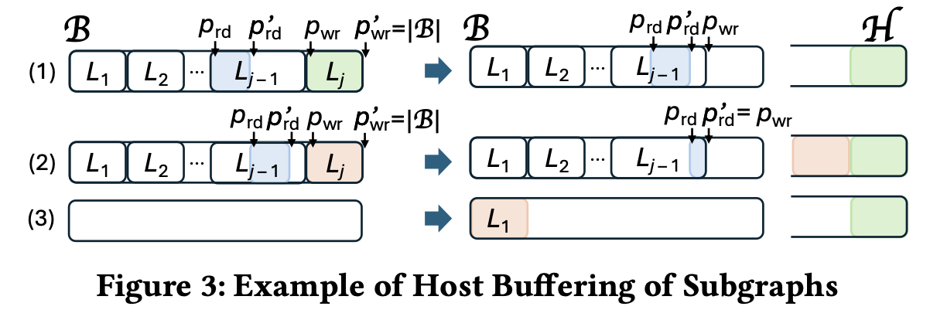
Managed Memory Spill Buffer
Too slow to read/write to managed memory buffer.
Example:
wikipedia_link_ru
total run time: 105.2 sec
host buffer read/write: 20.3 sec

Slide 2
Host Resident Buffer
Create with new
After returning from kernel, copy data to/from host buffer
Bulk copy data instead of copying each subgraph
Brd
H
wikipedia_link_ru
total run time: 76.6 sec
host buffer read/write: 1.3 sec

Slide 3
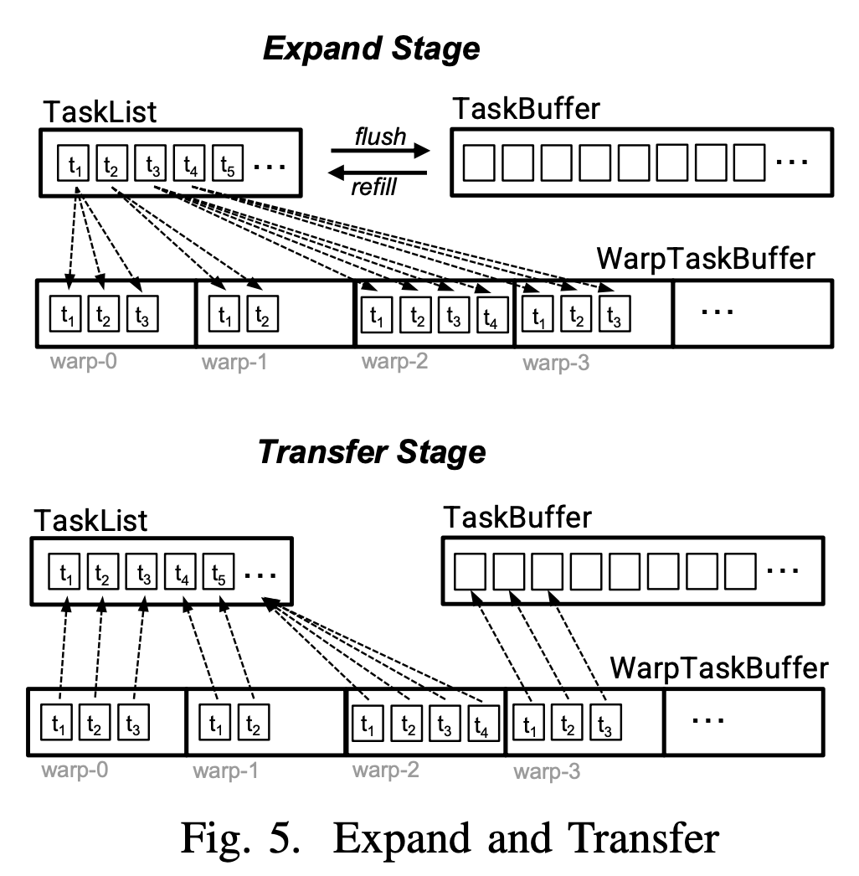
Quasi Clique Application

Slide 4
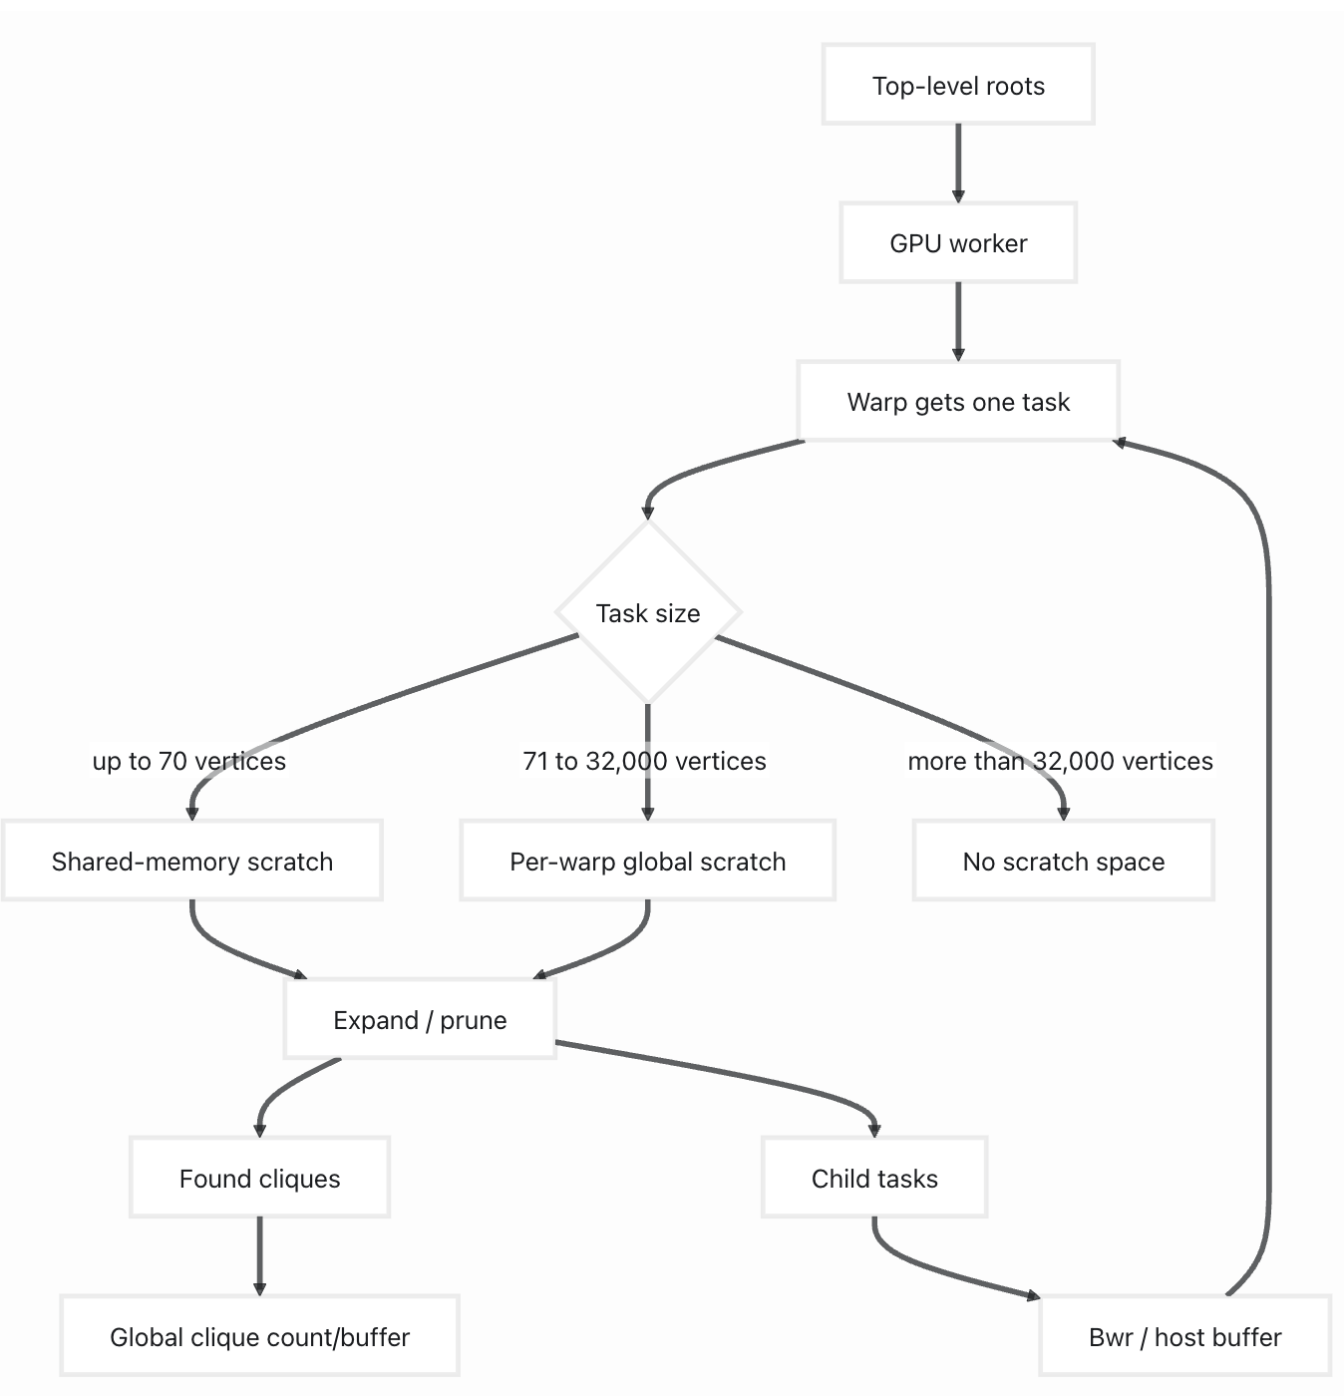
Scratch Buffer
top level tasks
 |  | v
2-hop neigh

Slide 5
Scratch Buffer
top level tasks
 |  | v
2-hop neigh
per warp scratch
with 32000 it sums to 6.5GB

Slide 6
Handlink Big Tasks
root vertices
 |  | v
2-hop neigh
root vertices with big tasks are separated at initialization step, using CPU threads (by OpenMP)
regular root vertices
big_root vertices
master schedules big_root
vertices to CPU threads only

Slide 7
Why CPU is much faster than GPU?
A few vertices are very high degree in the graphs
Since a warp processes a vertex, a high degree vertex causes a warp to take a long time

Slide 8
Why hybrid-copy is faster than layered?
In the layered case, a fixed η may underutilize GPU cores, increasing runtime. (currently η=2000)
Ping-pong execution processes the entire buffer, resulting in faster runtime.
dataset | G2AIMD (pingpong) | gpu-layered | gpu-hybrid-drop | gpu-hybrid-copy
edit-nlwiki | 11.3 | 20.0 | 12.4 | 11.0
experiments with other values of eta
eta values | 1,000 | 2,000 | 5,000
edit-nlwiki | 20.5 | 18.4 | 16.8

Slide 9
Why hybrid-drop is slower than layered?
It was caused by an incorrect gpuchunk setting:
Hybrid-Drop used 100K, while the others used 1M.
dataset | G2AIMD (pingpong) | gpu-layered | gpu-hybrid-drop | gpu-hybrid-copy
web-wikipedia_link_en13-all | 150.7 | 225.3 | 317.9 | 147.3

Slide 10
Why hybrid is slower than layered? (SM)
Dataset not included in experiments!!
dataset | query | G2AIMD (pingpong) | gpu-layered | gpu-hybrid-drop | gpu-hybrid-copy
zhishi-baidu-internallink | 6 | 42.4 | 42.5 | 558.7 | 507.6
5 executions
gpu-layered | gpu-hybrid-drop | gpu-hybrid-copy
331.9 | 281.0 | 183.09
234.4 | 175.6 | 479.54
149.7 | 429.7 | 180.02
42.4* | 177.5 | 182.85
191.6 | 41.6* | 476.47
gpu-hybrid-copy summary:
Total time (s): 181.56
at switch dump_to_host time (s): 3.44
other dump_to_host time (s): 24.86
load_from_host time (s): 31.78
* Did not overflow to host

Slide 11
Why hybrid is slower than layered? (SM)
Dataset not included in experiments!!
dataset | query | G2AIMD (pingpong) | gpu-layered | gpu-hybrid-drop | gpu-hybrid-copy
zhishi-baidu-internallink | 6 | 42.4 | 42.5 | 558.7 | 507.6
Execution with No overflow
Execution with overflow
eta
level i
eta
level i
level i+1
level i+1
host buffer
it spilled 482,573,443 tasks to host during expansion, spending 90.28 s in the expand kernel.
Total time (s): 181.56
at switch dump_to_host time (s): 3.44
other dump_to_host time (s): 24.86
load_from_host time (s): 31.78

Slide 12
show if layered approach is better than g2aimd in MC and SM. as it is not good on MQC.

Slide 13
MC Application
G2-AIMD vs GPU-Layered: sometimes G2-AIMD is almost 5x faster, other cases GPU-Layered can be close to 2x faster
Why G2-AIMD can be faster? Because we tuned \eta for the MC application (see sheet “MC-para”) with 1000, 2000, 5000, and find 2000 to work well in general. However, for some data \eta is too small to fully utilize GPU cores, such as edit-nlwiki. The time improves to 16.8 sec with \eta=5000, but still slower than 11 sec for G2-AIMD.
That motivates us to try combine G2-AIMD and GPU-Layered.

Slide 14
Experiments with large values of \eta
Dataset | G2-AIMD | 1000 | 2000 | 5000 | 10000 | 20000
orkut-groupmemberships | 14.1 | 32.7 | 25.0 | 20.0 | 14.1 | 14.0
edit-nlwiki | 11.3 | 20.5 | 18.4 | 16.8 | 10.9 | 10.9

Slide 15
MC Application
We combine G2-AIMD and GPU-Layered to produce GPU-Hybrid. GPU-Hybrid switches from G2-AIMD to GPU-Layered upon the first time a chunk overflows GPU pingpong memory buffer.
The switch is achieved by saving all ping-buffer remaining (unexpanded) subgraphs + all pong-buffer subgraphs to host buffer, which are then read back to GPU buffer array for layered extension.

Slide 16
MC Application
CPU+GPU outperforms GPU-Hybrid in 28 of 50 cases, achieving speedups of up to 14.21×.
In the remaining cases where CPU+GPU is slower, the performance degradation is negligible, occurring only for short-running executions (i.e., less than 10 seconds).
CPU+GPU consistently outperforms the CPU-only implementation, delivering speedups of up to 12.78×.
select some dataset to show, which performs well not just ratio but also execution time

Slide 17
Dataset Selection Reminder
Redo eta selection for MC, it may not be 2000 anymore. If possible, find why old time results are longer than what they should be
In experiments, we cannot have each application with a separate set of datasets. Reviewers will argue that we are selecting favorable datasets for each application, and will ask you to try some dataset in application 1 that you did not use in application 2 on application 2 in revision, which can perform poor causing rejection after revision.
Normal people will do what reviewers expect: use a common set of datasets, like in Table 1. Then each application reports performance on datasets in Table 1.

Slide 18
Dataset Selection Reminder
You have to select favorable datasets for all 3 applications. The only exception is that you can claim QC cannot run on datasets in Table 1 due to Guimu’s 2-hop device memory CSR, so you pick smaller graphs that QC can run
You can say that QC can be improved by k-means binning + GPU streams + CPU subgraph construction pipelining, but will be future work. So let’s assume this will be considered/accepted/passed by reviewers. Let’s at least pick Table 1 to be used by MC and SM, first 2 applications.

Slide 19
Dataset Selection Reminder
I think in a paper, Table 1 with more than 20 datasets is an overkill as we do not have such space in main text. We can put more data to appendix, but we do not need to show all your data (esp. those unfavorable ones). However, Table 1 cannot have less than 10 - 12 datasets, too few is a concern. If you cannot find 20 working well for both MC and SM, at least find, e.g., 16.
Let’s first find k datasets that are really good for MC. It can be 20, but can also be 40-50. Throw away really unfavorable datasets for MC. You need larger k since some of them may need to be dropped further due to poor performance on SM, and after dropping, we hope to still see 20 datasets we can put in Table 1.

Slide 20
Dataset Selection Reminder
Then, move on to Application 2: SM. There is no point to try any dataset outside k selected for MC. We may shrink the k datasets to k’ further, but hopefully k’ is 20, or at least 16.
In SM, we try to find datasets with large max-deg and small avg-deg, but CPU+GPU is still not helpful (in fact, worse than GPU-only, like 99% of GPU-only). So our focus now is on hoping GPU-layered >> G2-AIMD. When we shrink MC’s good datasets, we need to make sure we pick those with good GPU-layered >> G2-AIMD, or at least have a significant portion like that.
Goal: For SM application, we can argue that we do not have deep recursion tree (depth decided by query graph size), but our GPU-layered design is favorable over G2-AIMD. If we cannot show GPU-layered >> G2-AIMD, reviewer will say that you can just use G2-AIMD, reject our paper due to SM application

Slide 21
Dataset Reminder
For QC, GPU-layered ~= G2-AIMD, though for two datasets where GPU-only throws some large-candidateSet tasks, GPU-layered >> G2-AIMD. Note that GPU-layered and G2-AIMD throw the same task sets.
GPU-layered ~= G2-AIMD because G2-AIMD does not encounter device buffer overflow issue so no wasted chunk computation [need verification]. G2-AIMD has no eta limit, so if no overflow, is going to be good.
However, GPU-hybrid will not help since GPU-layered ~= G2-AIMD, no one is much faster than the other. So we should focus how CPU + GPU >> GPU-layered
Make sure datasets in Table 1 run OOM. If not, then QC (with some parameters set) gives good results and can be added to Application 3. Kick out those in Table 1 that do not run OOM, but gives bad QC results.

Slide 22
Datasets for QC
Make sure datasets in Table 1 run OOM. If not, then QC (with some parameters set) gives good results and can be added to Application 3. Kick out those in Table 1 that do not run OOM, but gives bad QC results.
All datasets in Table 1 ran out of memory (OOM) when using the QC dataset format (2-hop neighbors). For many datasets, the output file could not even be generated because its size would reach terabytes (TBs). Only the following datasets could be generated:
310G wikipedia_link_sh
623G wikipedia_link_sr
1.8T wikipedia_link_de
364G link-dynamic-frwiki

Slide 23
SM Application
G2-AIMD fails in two cases due to out-of-memory (OOM) errors and is consistently slower than GPU-Layered, with slowdowns of up to 1.98×.
GPU-Layered outperforms GPU-Hybrid in nearly all cases.
The CPU-only implementation is prohibitively slow for this application, which also limits the performance of the CPU+GPU approach in CPU-bound scenarios.

Slide 24
MQC Application
G2-AIMD runs out of memory on two datasets and is up to 2.43× slower.
GPU-Layered consistently outperforms GPU-hybrid.
Fixed GPU chunk sizes caused poor utilization, motivating adaptive chunk sizing.
The combined CPU+GPU approach consistently outperforms GPU-Layered by up to 21.1×.

Slide 25
MQC Adaptive GPU Chunk
The number of root tasks in MQC varies significantly across datasets.
A fixed GPU chunk size can cause load imbalance and GPU underutilization.
We dynamically calculate the GPU chunk size as:
GPU_chunk=max(root_tasks/c,min_chunk)
c controls the number of chunks.
min_chunk prevents GPU chunks from becoming too small.
add experiments for tuning eta
try min_chunk = 100 for 2 small datasets

Slide 26
Host Buffer
spill to H
Bwr
H
90% filled → press brake pedal
new tasks are not expanded after this point. However, tasks on the fly are fully expanded, and may exceed Bwr capacity. Such tasks are spilled to H

Slide 27
Buffer Reservation – System
struct BufferReservation{
ull vt;
bool to_host;
__device__ __host__ bool valid()const{
return vt!=INVALID_BUFFER_POS;
}
};
BufferReservation is a small value returned by append
The system tries the device buffer first. If failed, it appends on host buffer.
In hybrid-drop mode, it does not append on host
BufferReservation result=Bwr.append(sglen);
if(!result.valid() and !hybrid_drop_mode){
result=H.append(sglen);
result.to_host=true;
}
return result;

Slide 28
Buffer Reservation – App
The application calls append, and checks if the reservation is valid.
Switches to device or host buffer based on to_host flag.
auto reservation = append(task_size);
if(!reservation.valid()) return;
auto& buffer = reservation.to_host? H:Bwr;
ull start = reservation.vt;
...

Slide 29
Why OOM-Fixed version of G2-AIMD Faster?
Both versions stop expanding when append can no longer safely write.
Difference:
G2-AIMD: overflow is set early, after a threshold, e.g. 90%.
G2-AIMD OOM-Fixed: overflow is set only when append returns an invalid write location.
So OOM-Fixed may avoid premature failed iterations, making it faster.
Dataset | G2-AIMD (OOM-Fixed) | G2-AIMD
wikipedia_link_it | 33.91 | 33.8
sx-stackoverflow | 21.52 | 71.7

Slide 30
Why G2-AIMD is Faster
Not a valid statement!!
Checked with a simplified system where only device buffer is used and there was no overflow for dataset
In some cases, G2-AIMD outperforms GPU-hybrid even when neither system overflows.
G2-AIMD follows a simpler GPU execution path.
Our system uses adaptive device and host buffers to protect against overflow.
This flexibility requires additional capacity checks, overflow tracking, and destination selection.
The generic buffer interface keeps more state alive, which can change compiler optimizations and register allocations.

Slide 31
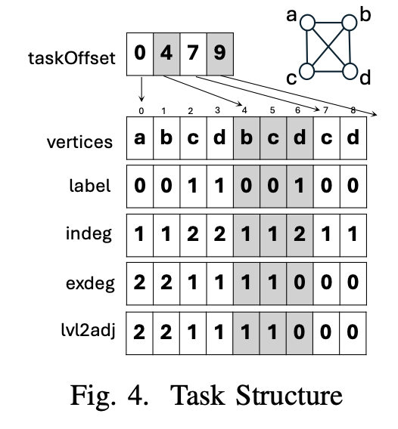
QC Task
This is the task structure used by both original and current implementation.

Slide 32
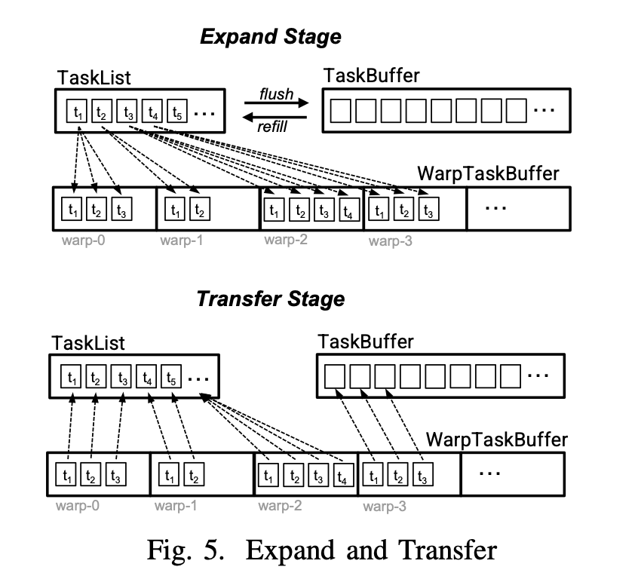
Task Expansion
In the original implementation all of these allocations are static, which can easily overflow as graph size become larger. This is the reason why program crashes for many graphs.
In our implementation we have Brd, Bwr, H which can better handle expansion.
For temporary intersection and pruning operations, it uses a per warp buffer explained in next slide.

Slide 33
Scratch Buffers
QC uses scratch storage as a per-warp working copy of the current task.
Pruning, sorting, candidate removal, degree updates, and child generation operate on this temporary copy before writing the resulting task to Bwr or H.
Smaller (<70 candidates) tasks use shared-memory buffer
Medium (71-32000 candidates) tasks use global memory
Big tasks were dropped in original implementation of BigData’25 paper

Slide 34

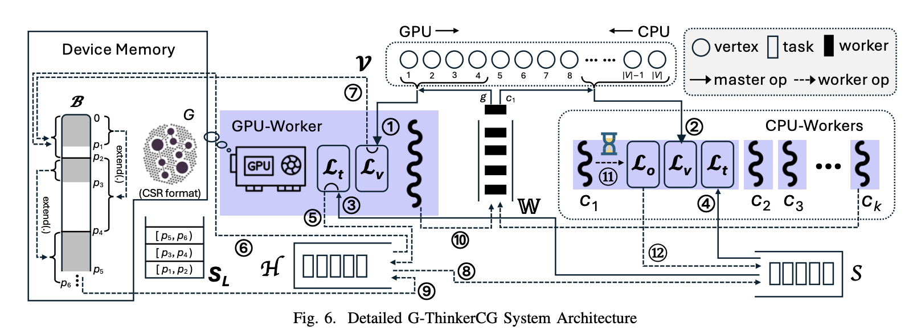
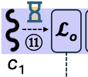

Handling Big Tasks
CPU →
big_root
Large root tasks are placed in a dedicated big_root queue.
CPU workers prioritize big_root before processing the regular queue.
As recursion progresses, candidate sets become smaller.
When a task times out, it is decomposed into smaller subtasks:
Still large → place in big_S for CPU-only processing.
Small enough → place in the regular queue S.
still a
big task
big
big_S

Slide 35
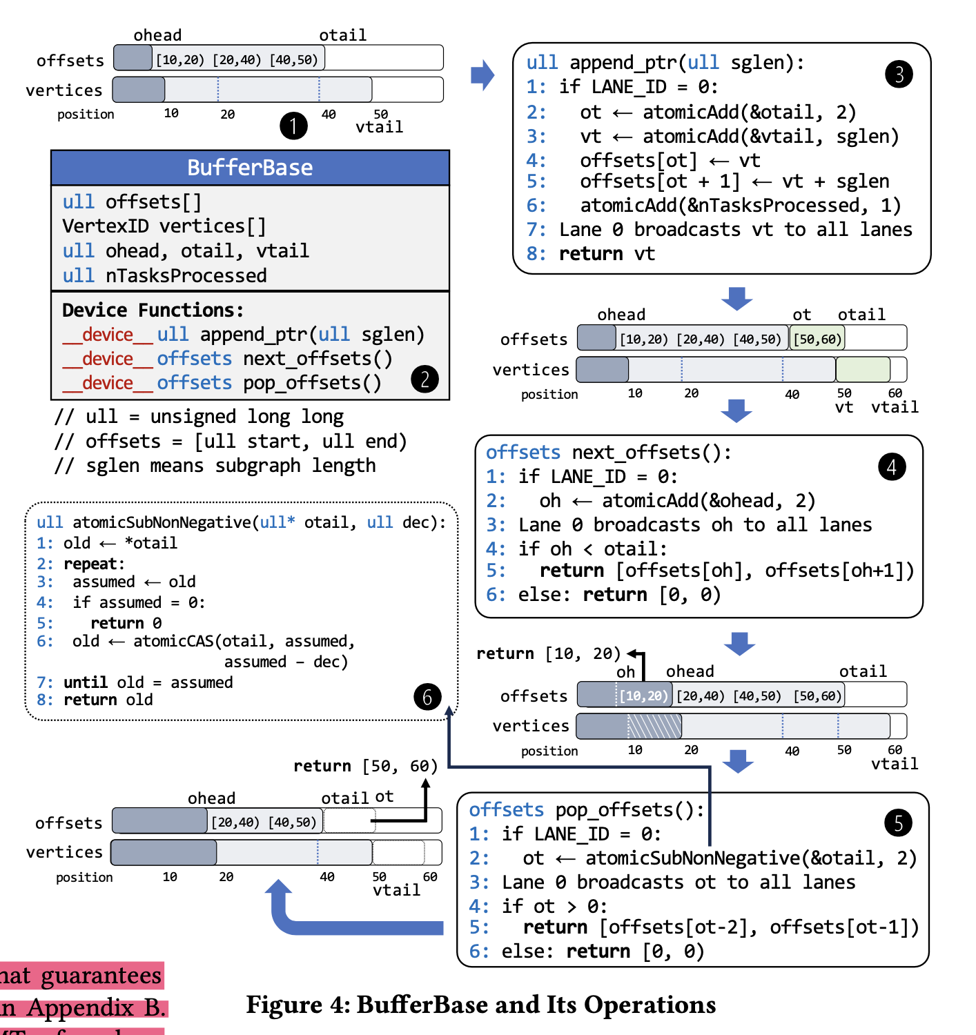
now, the warps are not reading directly from host, rather this is copied in bulk.

Slide 36
Previously, it was [start, mid, end) because mid was used in SM app to store prefix information.
Now the offsets are truly [start, end).
The mid is moved to subgraph. The first element of subgraph is the mid point, e.g.:
[2, s1, s2, c1, c2, c3, … ]
indicates 2 elements (s1, s2) are the partial match, and remaining are the candidates

Slide 38
Queries for SM
P1
P2
P3
P4
P5

