Slide 1

Proceedings of the VLDB Endowment (PVLDB) 2025

Slide 2
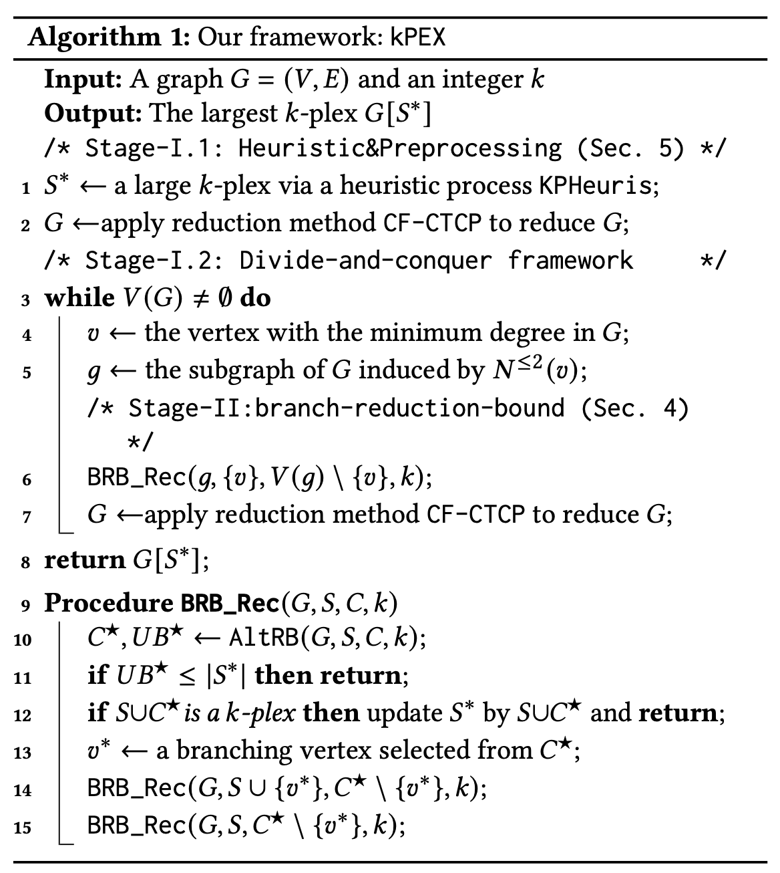

Slide 3

Notations
S*
S
C
Largest k-plex found so far
All of S
A subset of C
$$(H∩C)$$
H
An imaginary k-plex to be found
Must be larger than S* i.e. |S|>=|S*|+1

Slide 4


Alt-RB
C
S*
S
C_{L}
C_{R}
Largest k-plex found so far
All of S
Up to UB_{L} vertices can come from C_{L}
A subset from C_{R}
$$(H∩C_{L})$$
$$(H∩C_{R})$$
H
An imaginary k-plex to be found
Must be larger than S* i.e. |H|>=|S*|+1

Slide 5
Alt-RB
C
S*
S
C_{L}
C_{R}
Largest k-plex found so far
All of S
Up to UB_{L} vertices can come from C_{L}
At least |S*|+1-|S|-UB_{L} vertices must come from C_{R}
LB_{R}= |S*|+1-|S|-UB_{L}
H
S
Up to UBL vertices from CL
At least |S*|+1-|S|-UB_{L} vertices from C_{R}
An imaginary k-plex to be found
Must be larger than S* i.e. |H|>=|S*|+1

Slide 6
Alt-RB
C
S*
S
C_{L}
C_{R}
Largest k-plex found so far
All of S
Up to UB_{L} vertices can come from C_{L}
At least |S*|+1-|S|-UB_{L} vertices must come from C_{R}
Prune those vertices which can’t support this requirement
H
An imaginary k-plex to be found
Must be larger than S* i.e. |H|>=|S*|+1

Slide 7
Alt-RB
C
S*
S
C_{L}
C_{R}
Largest k-plex found so far
All of S
At least |S*|+1-|S|-UB_{R} vertices must come from C_{L}
Up to UB_{R} vertices can come from C_{R}
H
An imaginary k-plex to be found
Must be larger than S* i.e. |H|>=|S*|+1

Slide 8
Alt-RB
C
S*
S
C_{L}
C_{R}
Largest k-plex found so far
All of S
At least |S*|+1-|S|-UB_{R} vertices must come from C_{L}
Up to UB_{R} vertices can come from C_{R}
Prune those vertices which can’t support this requirement
H
An imaginary k-plex to be found
Must be larger than S* i.e. |H|>=|S*|+1

Slide 9

Alt-RB
C
S
C_{L}
C_{R}
All of S
At least |S*|+1-|S|-UB_{R} vertices must come from C_{L}
Up to UB_{R} vertices can come from C_{R}
Alternate
C
S
C_{L}
C_{R}
All of S
Up to UB_{L} vertices can come from C_{L}
At least |S*|+1-|S|-UB_{L} vertices must come from C_{R}

Slide 10
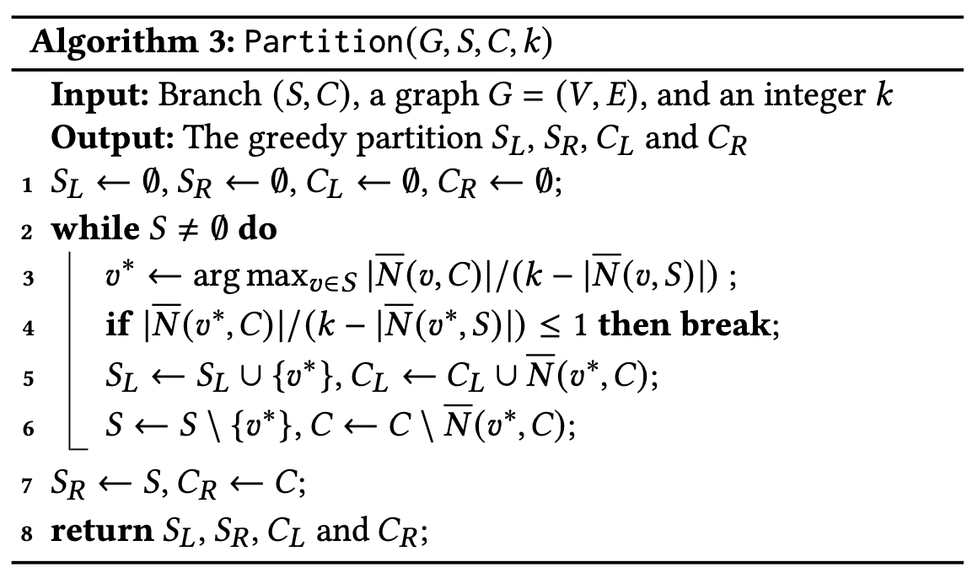
Partitioning C
v in S_{L} has More non-neighbors than support
S
C
S_{L}
S_{R}
C_{L}
C_{R}
Non-neigh. of v

Slide 11
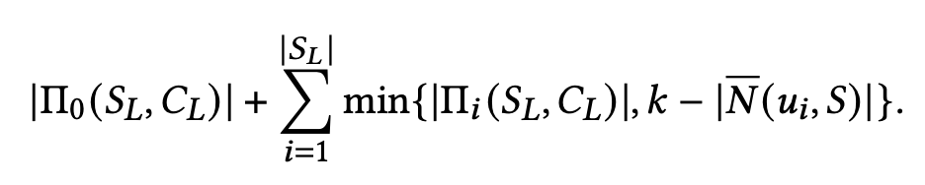

Upper Bounding
Non-neigh of $v_{i}∈S_{L}$ in C_{L}

Slide 12
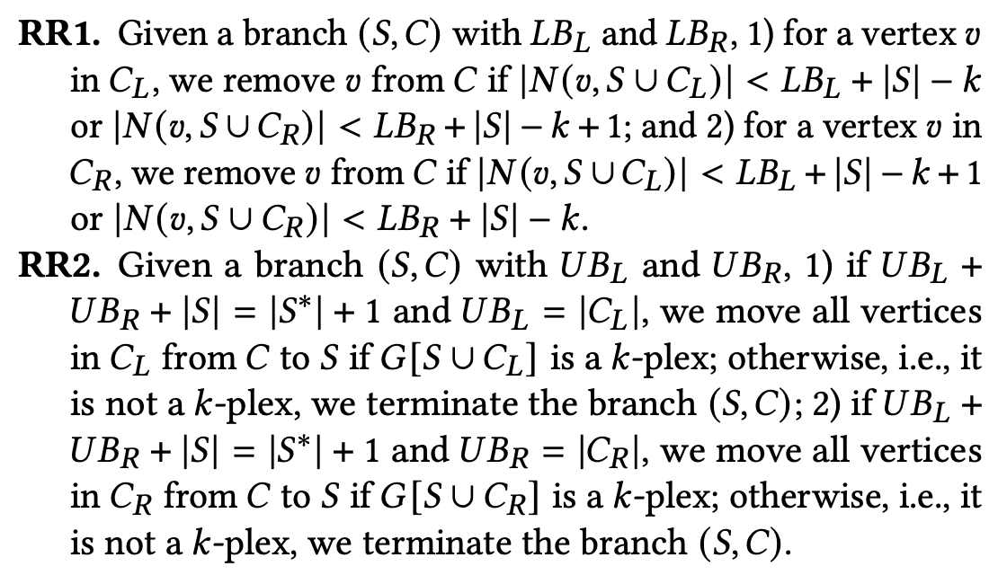
Reducation Rules

Slide 13
Experiments – Datasets

Slide 14
Extending UMkP

Slide 15
Extending UMkP

Slide 16
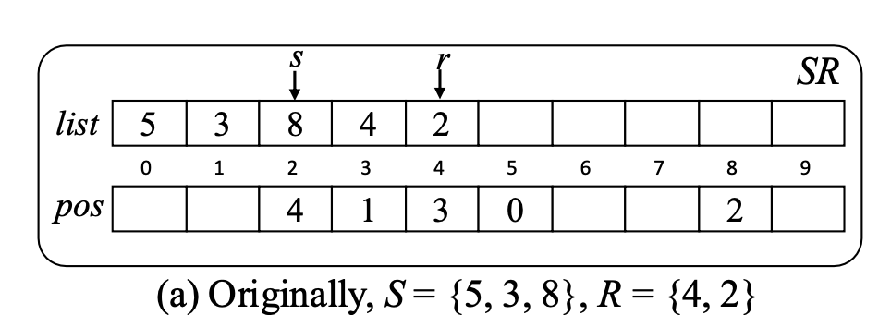
Data Structures
S
R
0 | 0 | 0 | 1 | 1 | 1 | 0 | 0 | 1 | 0
0 | 0 | 1 | 0 | 0 | 0 | 0 | 0 | 0 | 0
UMkP
kPEX
+ Reused in recursive calls
+ Constant time insertion, deletion, lookup
− Bad for intersection operation
− Created for every recursive call
+ Constant time insertion, deletion, lookup
+ Good for intersection operation

Slide 17
Adding Branching Schemes to kPEX
kPEX uses binary branching
Select a vertex in C with min d_{g}(.)
UMKP
Pivot Branching
S-Based Branching

Slide 19
Extending kPEX

Slide 20
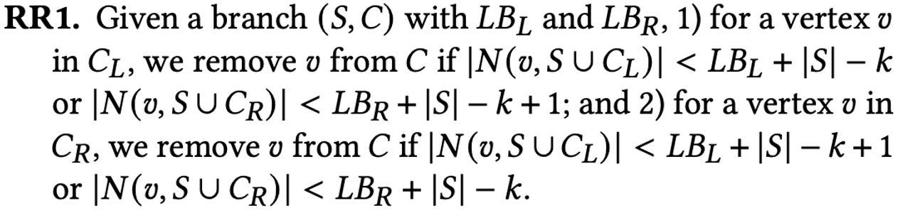
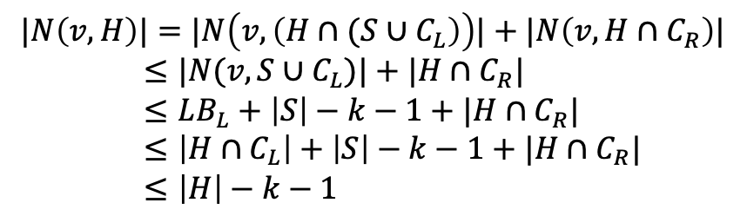
Proofs
C
S
C_{L}
v
C_{R}
All of S
At least LB_{L}=|S*|+1-|S|-UB_{R} vertices must come from C_{L}
Up to UB_{R} vertices can come from C_{R}
Proof by contradiction: Assume a larger k-plex can be found when $|N\left(v, S∪C_{L}\right)|≤LB_{L}+\left|S\right|−k−1$
$$|N\left(v, H\right)|=|N\left(v, \left(H∩{(S∪C}_{L}\right)\right)|+|N\left(v, H∩C_{R}\right)|$$
$≤|N(v, S∪C_{L})|+|H∩C_{R}|$
$≤LB_{L}+\left|S\right|−k−1+|H∩C_{R}|$
$≤\left|H∩C_{L}\right|+\left|S\right|−k−1+|H∩C_{R}|$
$≤\left|H\right|−k−1$
Violates k-plex requirements!!

Slide 21
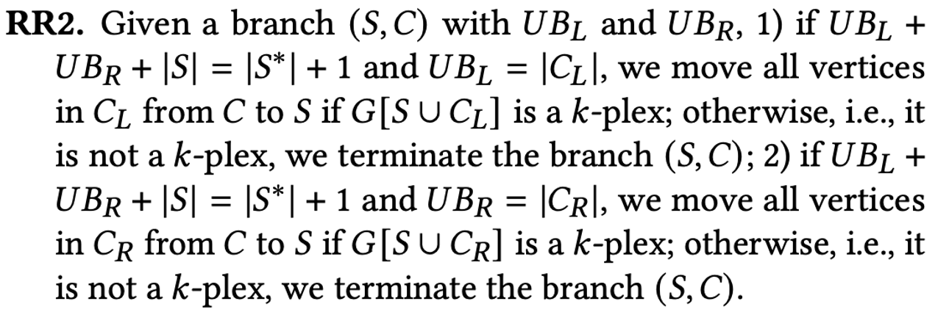
Proof
C
S
C_{L}
C_{R}
|S|
+
UB_{L}
+
UB_{R}
= |S*|+1
|C_{L}|=UB_{L} implies all of C_{L} should be part of H, otherwise H can’t be larger than S*.

Slide 22
Size increase in bnb

Slide 23
Validation Time
validation: percentage of time spent in bnb to make sure an even larger kplex is not found after finding MkP

Slide 24
Kplex size

Slide 25
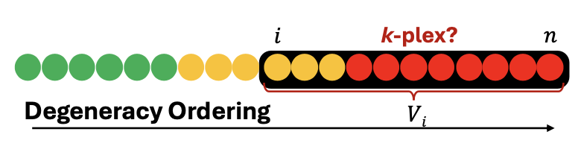



Heuristic to find initial k-plex
k-plex?
$$i$$
$$n$$
$$Vi$$
UMkP
kPEX

