Slide 1

Proceedings of the VLDB Endowment (PVLDB) 2025

Slide 2
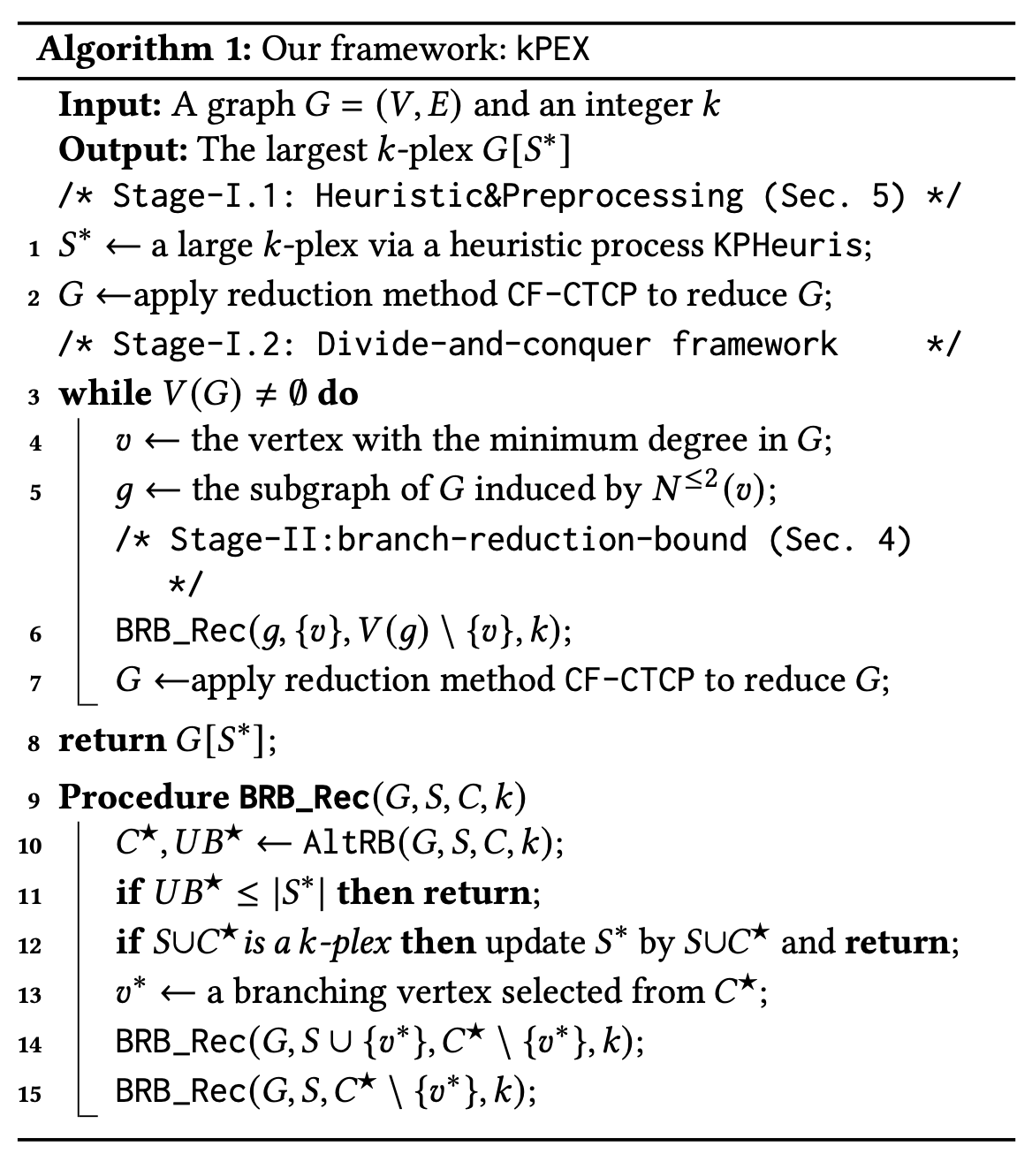
kPlexT pruning technique is also applied here
min degree vertex is selected

Slide 3
AltRB

Slide 4

Notations
S*
S
C
Largest k-plex found so far
All of S
A subset of C
$$(H∩C)$$
H
An imaginary k-plex to be found
Must be larger than S* i.e. |H|>=|S*|+1

Slide 5


Alt-RB
C
S*
S
C_{L}
C_{R}
Largest k-plex found so far
All of S
Up to UB_{L} vertices can come from C_{L}
A subset from C_{R}
$$(H∩C_{L})$$
$$(H∩C_{R})$$
H
An imaginary k-plex to be found
Must be larger than S* i.e. |H|>=|S*|+1

Slide 6
Alt-RB
C
S*
S
C_{L}
C_{R}
Largest k-plex found so far
All of S
Up to UB_{L} vertices can come from C_{L}
At least |S*|+1-|S|-UB_{L} vertices must come from C_{R}
LB_{R}= |S*|+1-|S|-UB_{L}
H
S
Up to UBL vertices from CL
At least |S*|+1-|S|-UB_{L} vertices from C_{R}
An imaginary k-plex to be found
Must be larger than S* i.e. |H|>=|S*|+1

Slide 7
Alt-RB
C
S*
S
C_{L}
Prune those vertices which can’t support this requirement
C_{R}
Largest k-plex found so far
All of S
Up to UB_{L} vertices can come from C_{L}
At least |S*|+1-|S|-UB_{L} vertices must come from C_{R}
H
An imaginary k-plex to be found
Must be larger than S* i.e. |H|>=|S*|+1

Slide 8
Alt-RB
C
S*
S
C_{L}
C_{R}
Largest k-plex found so far
All of S
At least |S*|+1-|S|-UB_{R} vertices must come from C_{L}
Up to UB_{R} vertices can come from C_{R}
H
An imaginary k-plex to be found
Must be larger than S* i.e. |H|>=|S*|+1

Slide 9
Alt-RB
C
S*
Prune those vertices which can’t support this requirement
S
C_{L}
C_{R}
Largest k-plex found so far
All of S
At least |S*|+1-|S|-UB_{R} vertices must come from C_{L}
Up to UB_{R} vertices can come from C_{R}
H
An imaginary k-plex to be found
Must be larger than S* i.e. |H|>=|S*|+1

Slide 10

Alt-RB
C
S
C_{L}
C_{R}
All of S
At least |S*|+1-|S|-UB_{R} vertices must come from C_{L}
Up to UB_{R} vertices can come from C_{R}
Alternate
C
S
C_{L}
C_{R}
All of S
Up to UB_{L} vertices can come from C_{L}
At least |S*|+1-|S|-UB_{L} vertices must come from C_{R}

Slide 11
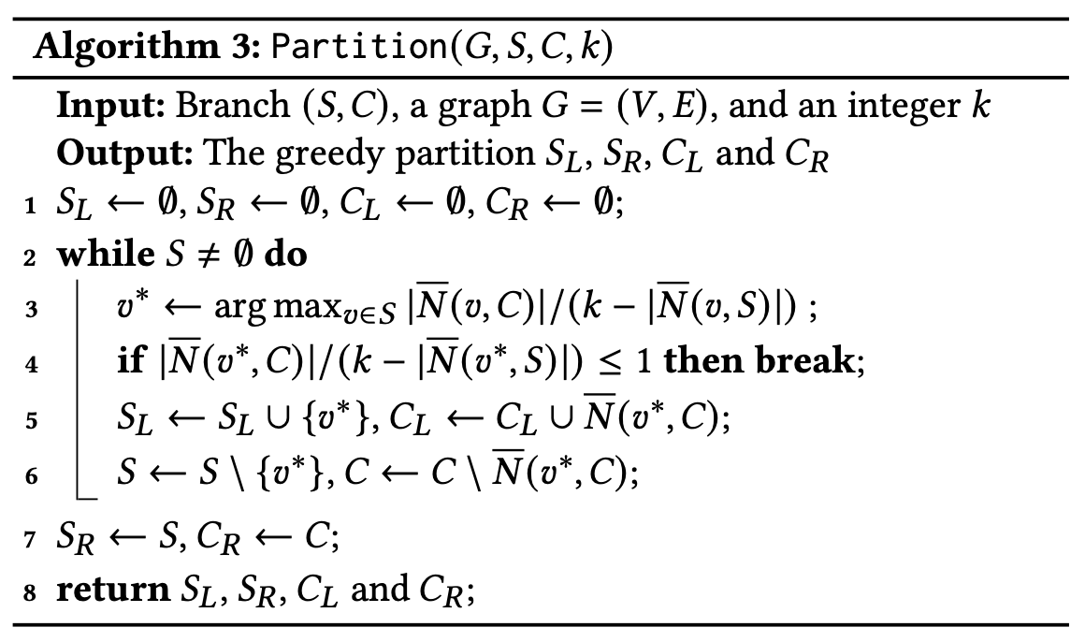
Partitioning C
v in S_{L} has More non-neighbors in C than its support.
S
C
S_{L}
S_{R}
C_{L}
C_{R}
C has no restriction to vertices in SR: vertices in SR are still valid even if all vertices in C are added to S
Non-neigh. of v

Slide 12
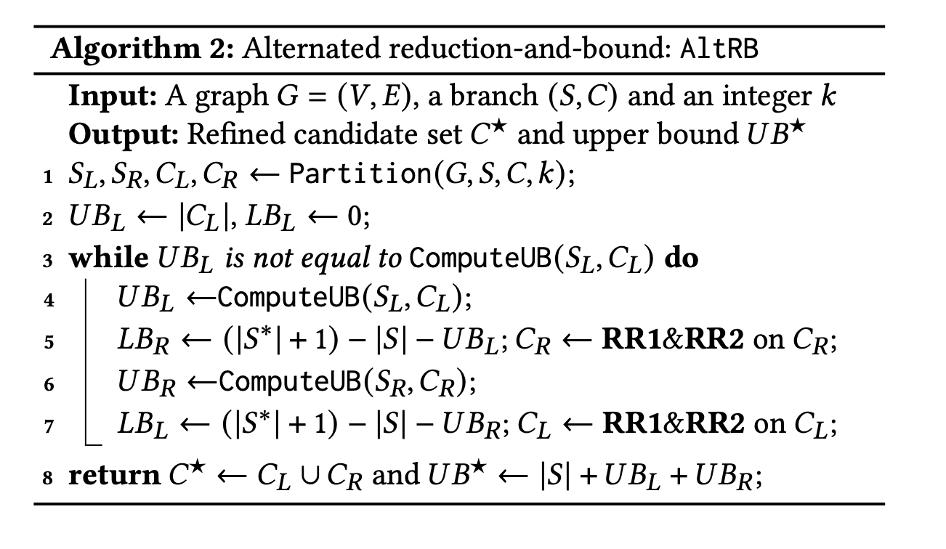

Slide 13
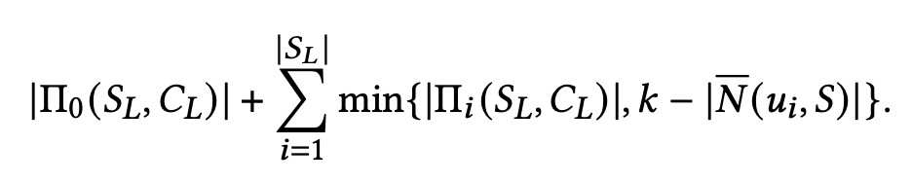

Upper Bounding
Non-neigh of $u_{i}∈S_{L}$ in C_{L}
u_i would be invalid if we bring in more than k-|N’(u_i, S)| from Pi_i

Slide 14
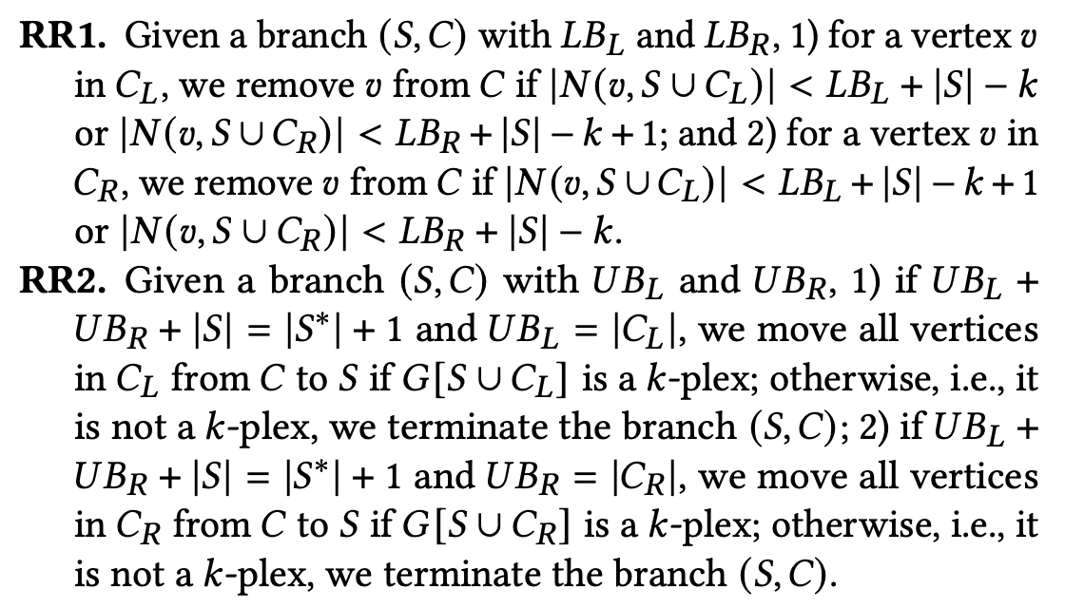
Reducation Rules

Slide 15
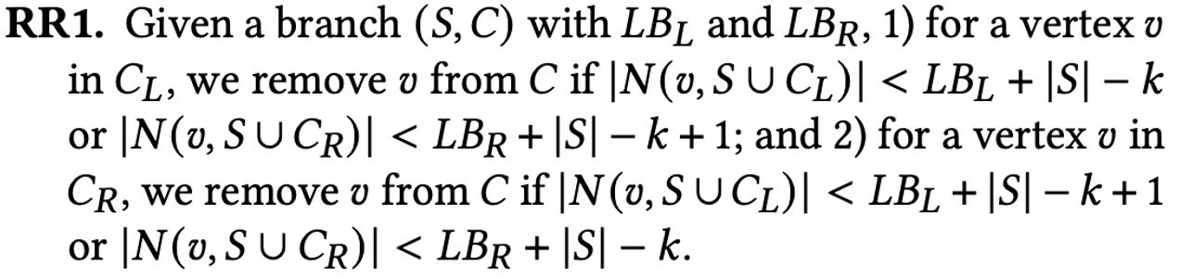

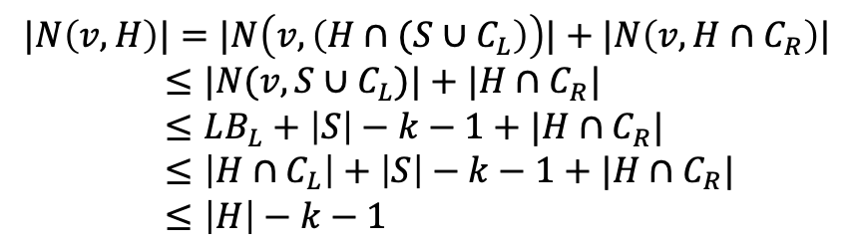
Proofs
C
S
C_{L}
v
C_{R}
All of S
At least LB_{L}=|S*|+1-|S|-UB_{R} vertices must come from C_{L}
Up to UB_{R} vertices can come from C_{R}
Proof by contradiction: Assume a larger k-plex can be found when $|N\left(v, S∪C_{L}\right)|≤LB_{L}+\left|S\right|−k−1$
$$|N\left(v, H\right)|=|N\left(v, \left(H∩{(S∪C}_{L}\right)\right)|+|N\left(v, H∩C_{R}\right)|$$
$≤|N(v, S∪C_{L})|+|H∩C_{R}|$
$≤LB_{L}+\left|S\right|−k−1+|H∩C_{R}|$
$≤\left|H∩C_{L}\right|+\left|S\right|−k−1+|H∩C_{R}|$
$≤\left|H\right|−k−1$
$$\left|H\right|=\left|S\right|+\left|\left(H∩C_{L}\right)\right|+|(H∩C_{L})|$$
Violates k-plex requirements!!

Slide 16
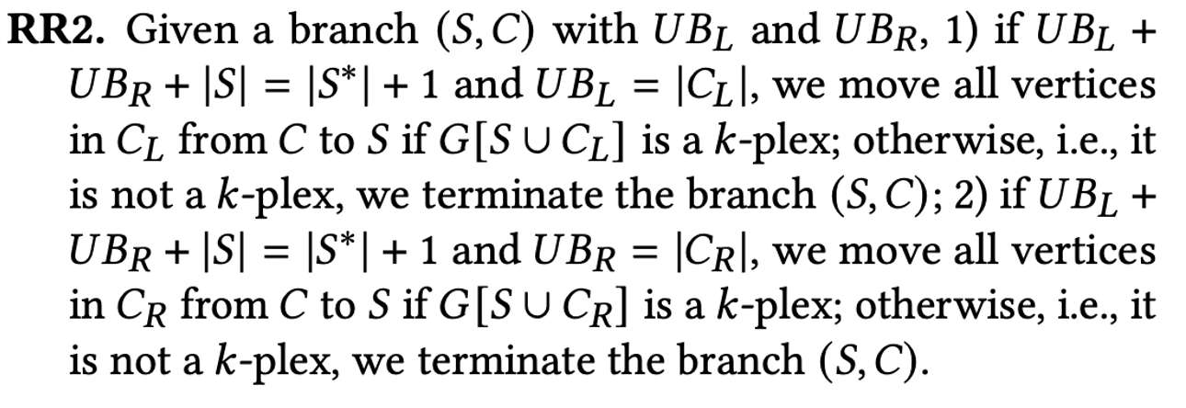
Proof
C
S
C_{L}
C_{R}
|S|
+
UB_{L}
+
UB_{R}
= |S*|+1
do ablation study disabling RR2
assume that UBL and UBR has been tightened, such that |S|+UBL+UBR = |S*|+1,
|C_{L}|=UB_{L} implies all of C_{L} should be part of H, otherwise H can’t be larger than S*.
Add all CL to S, or eliminate branch
look in the code where CL is added to:
SL or SR

Slide 17
Adding Branching Schemes to kPEX
kPEX
  Introduced a new branching rule (AltRB)
  Used binary branching
UMKP
  Pivot Branching (k<=5)
  S-Based Branching (k>5)

Slide 18
Reutilizing the Pi calculated in Partition(.):
Can’t reutilize because C is changed in reduction, possibly S as well

Slide 19
Where are vertices add in RR2, in SL or SR?
vertices are added in S, and partition is calculated again
not only if RR2 executed, rather in every iteration.
Partition is not expensive with bitset
Pi(v) = Non_adj[v] & C
find all set operations
partition is recalled in each iteration
using two matrices: neighbors, non-neigh
Non_adj = ~Adj

Slide 20
How branch pruning is done in RR2
when RR2 fails, UB=|S*| and return
which makes this branch useless

Slide 21
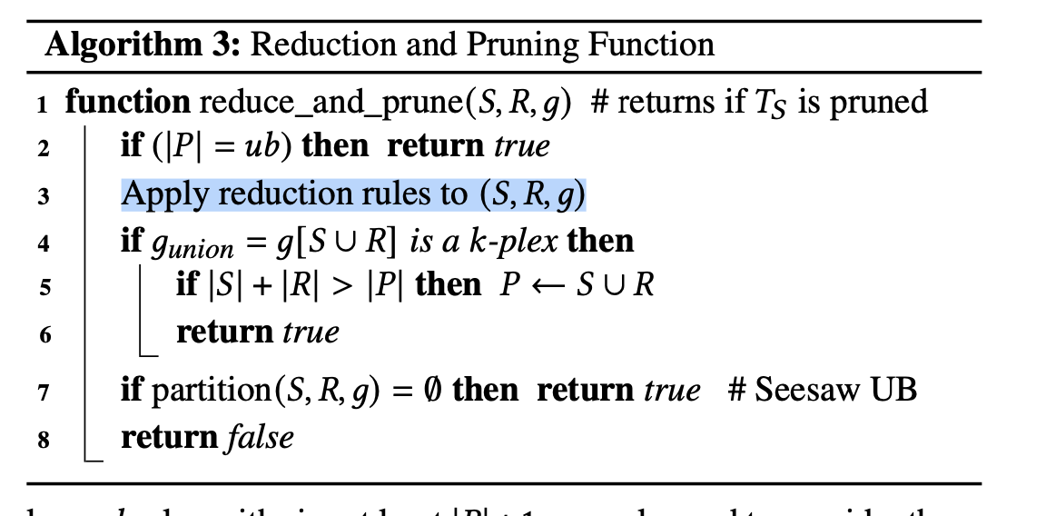
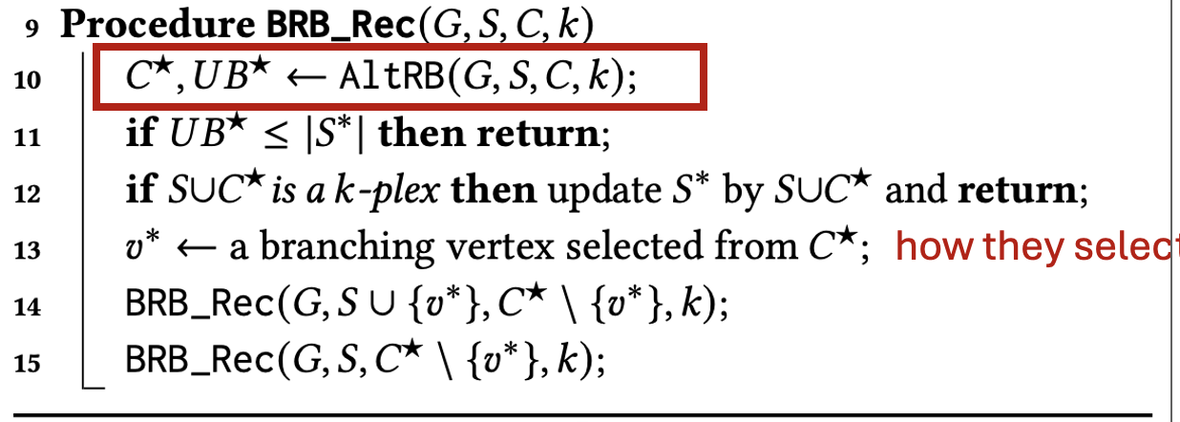
Solutions for ML
UMKP = our UMKP solution
AltRB = UMKP integration with AltRB
kPEX = kPEX solution by Cheng Long
Pivot_Br = kPEX with pivot branching method
S_Br = kPEX with S branching method

Slide 22
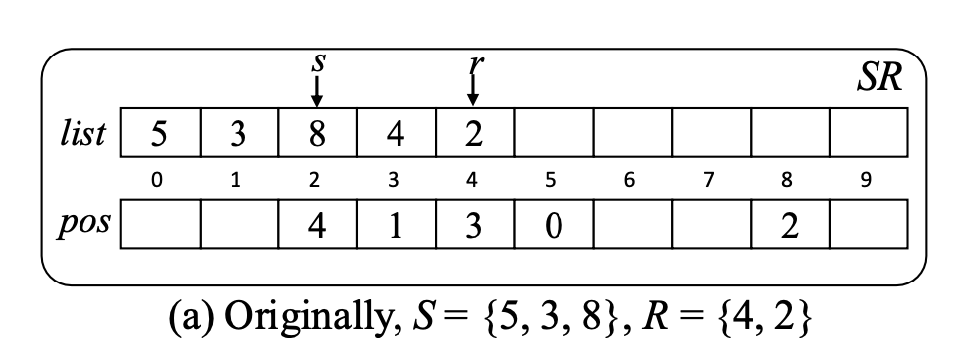
Data Structures
S
R
0 | 0 | 0 | 1 | 1 | 1 | 0 | 0
0 | 0 | 1 | 0 | 0 | 0 | 0 | 0
UMkP
kPEX
+ Reused in recursive calls
+ Constant time insertion, deletion, lookup
− Bad for intersection operation
− Created for every recursive call
+ Constant time insertion, deletion, lookup
+ Good for intersection operation
reading process for bitmap
details on UMkP structure

Slide 23
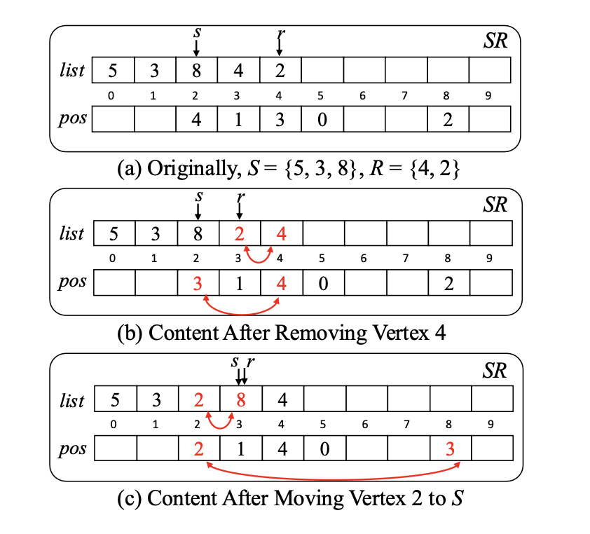
Data Structures – UMkP
Created initially for the size of G_reduced
Constant time search:
if(pos[v] <=s): v is in S
else if (pos[v]<=r): v is in R
else v does not exist
Supports onion type storage
4 is removed in current branch, but it was a valid candidate in parent branch. when backtracking will happen, just restore the value of r at parent.
when a vertex is removed, it’s moved to r, and then decrement r

Slide 24
Data Structures – kPEX
bit-coded representation of S and R
created for every recursive call
size: 2-hop neighbor graph of v_{i}
word
ull buff[sz>>6+1]
0 | 1 | 0 | 0 | 0 | 1 | 0 | 0
0 | 1 | 0 | 0 | 0 | 1 | 0 | 0
0 | 1 | 0 | 0 | 0 | 1 | 0 | 0

Slide 25
Data Structures – kPEX
ull buff[sz>>6+1]
word
0 | 1 | 0 | 0 | 0 | 1 | 0 | 0
To read first value in this buff, call count trailing zero
__builtin_ctzll(word)
that returns val = 2…
to read successive element:
input: 2
val++
mask = word >> val & 63
val+=__builtin_ctzll(mask)
that evaluates val = 6
input: val=2, word_id=0
val++
mask = word >> (val & 63)
while(mask==0)
word_id++, val=word_id*64
mask = word >> (val & 63)
val+=__builtin_ctzll(mask)
which evaluates to val=66

Slide 26
Data Structures – kPEX
ull buff[sz>>6+1]
wid 0
wid 1
words
0 | 0 | 0 | 0 | 0 | 1 | 0 | 0
0 | 1 | 0 | 0 | 0 | 1 | 0 | 0
each word is 64 bit long, when mask is 0 it’s skipped and return value is set to next word_id*64
Successive Iterations (input: val=prev_value)
val++
wid=val/64,
mask=words[wid] >> (val % 64)
while(mask==0 && wid < n)
wid++, val=wid*64
mask = words[wid]
if(mask!=0)
val+=__builtin_ctzll(mask)
else
val=null // structure is empty
First iteration code:
wid=0, val=0
mask=words[wid]
while(mask==0 && wid < n)
wid++, val=wid*64
mask = words[wid]
if(mask!=0)
val+=__builtin_ctzll(mask)
else
val=end // structure is empty

Slide 27
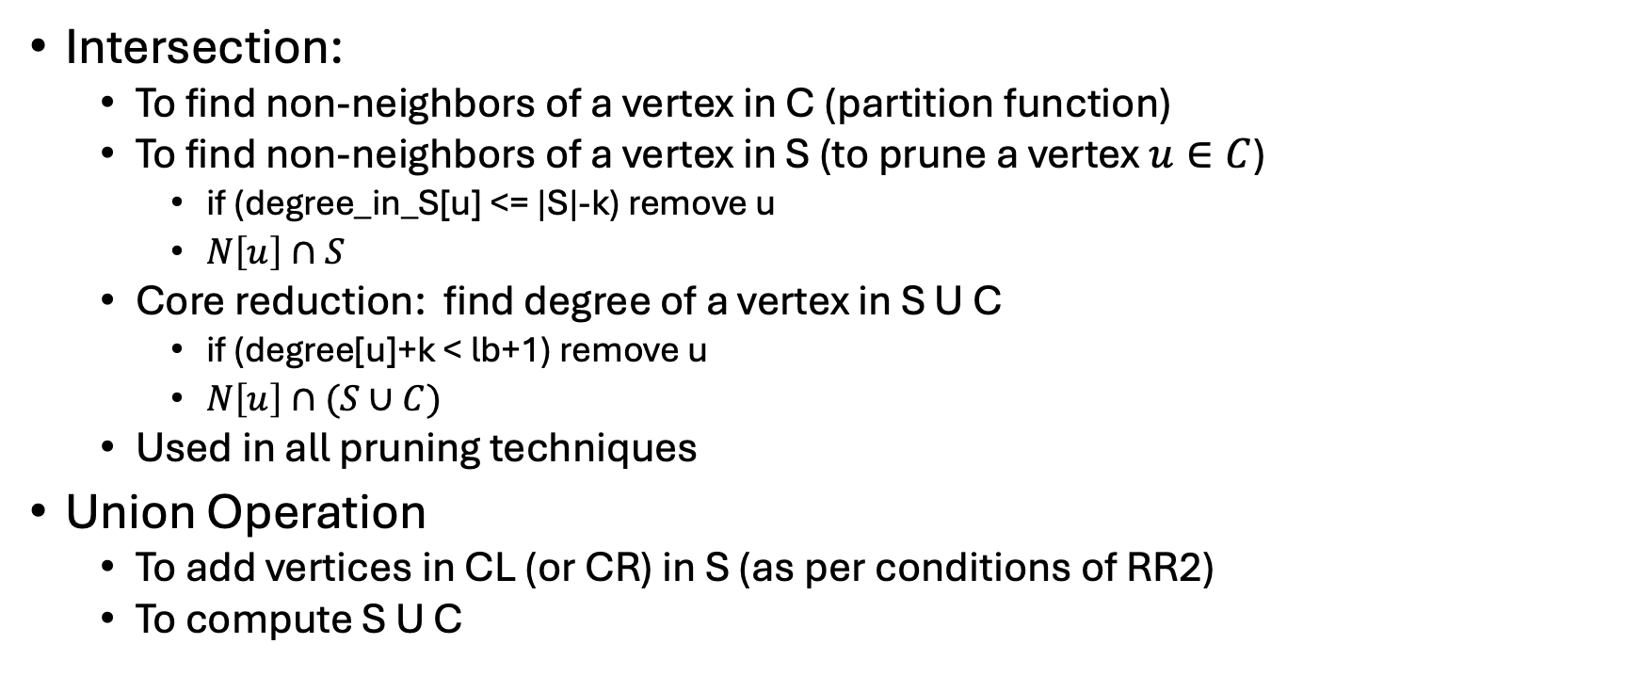
Set operation
Intersection:
  To find non-neighbors of a vertex in C (partition function)
  To find non-neighbors of a vertex in S (to prune a vertex $u∈C$)
    if (degree_in_S[u] <= |S|-k) remove u
    $N\left[u\right]∩S$
  Core reduction: find degree of a vertex in S U C
    if (degree[u]+k < lb+1) remove u
    $N\left[u\right]∩(S∪C)$
  Used in all pruning techniques
Union Operation
  To add vertices in CL (or CR) in S (as per conditions of RR2)
  To compute S U C

Slide 28
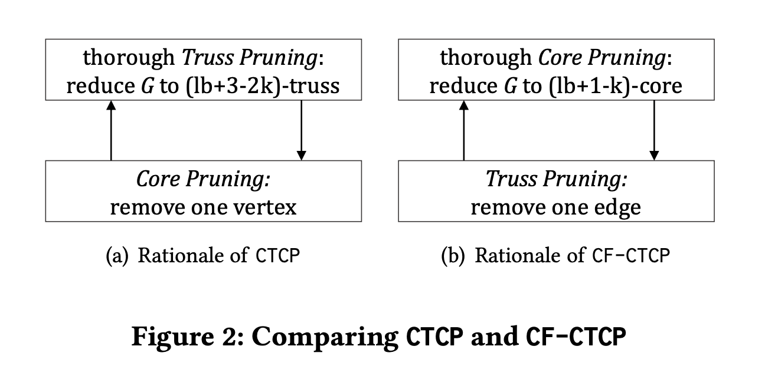
CF-CTCP

Slide 29
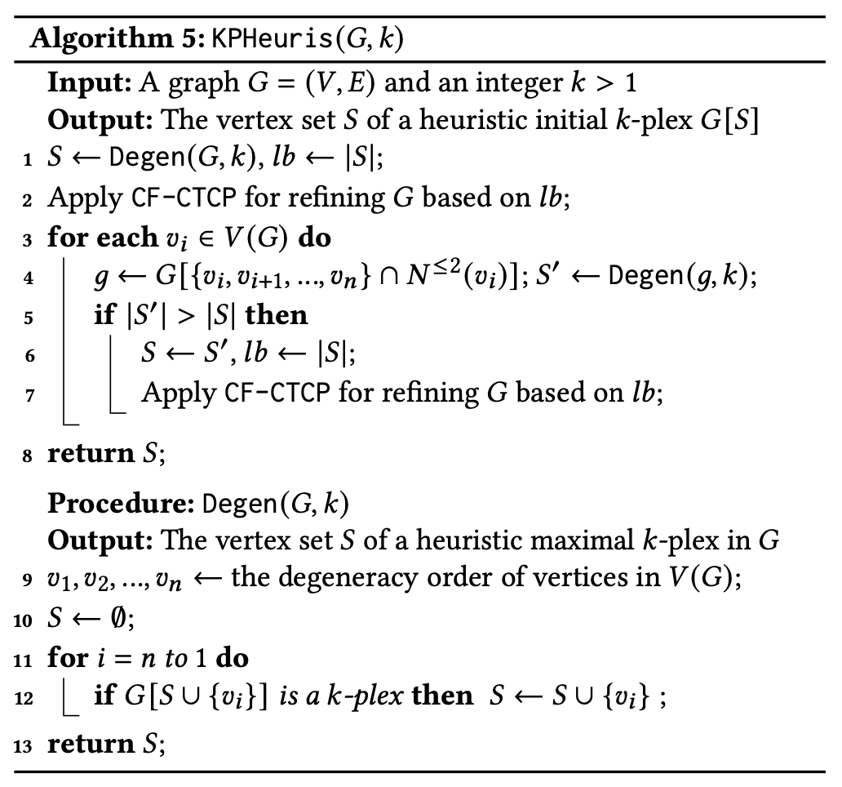
Degeneracy Ordering
S

Slide 30
Solutions
UMkP
UMkP+ UMkP + all 3 techniques of kPEX
kPEX
kPEX-S kPEX + S-Based branching
kPEX-R kPEX + R-Based branching
kPEX-P kPEX + Pivot-Based branching

Slide 31
Dataset
2948 graphs
k=2, 3, 4, 5, 6, 7, 8, 9, 10, 15, 20 (11 values)
2948 × 11 = 32,428 configurations
  19,841: empty graphs after preprocessing
  12,587: config. to solve in bnb

