Slide 1
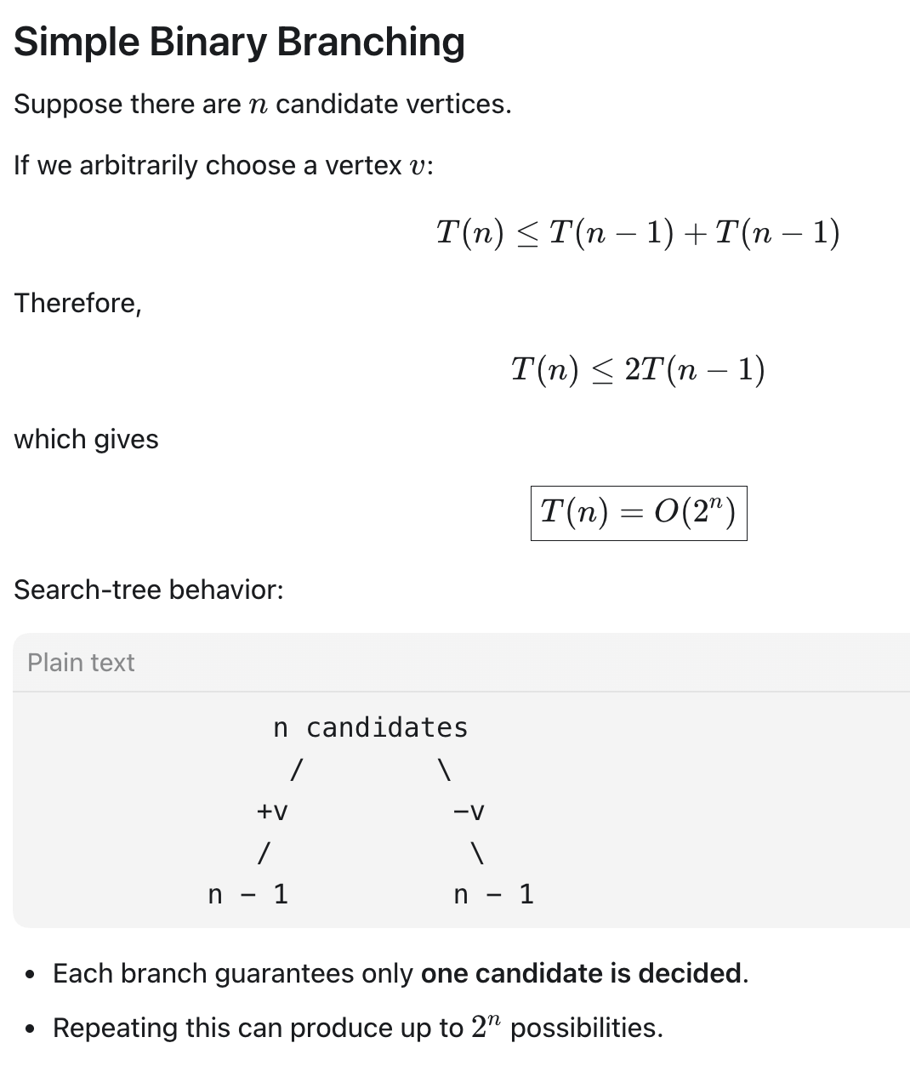

Slide 2
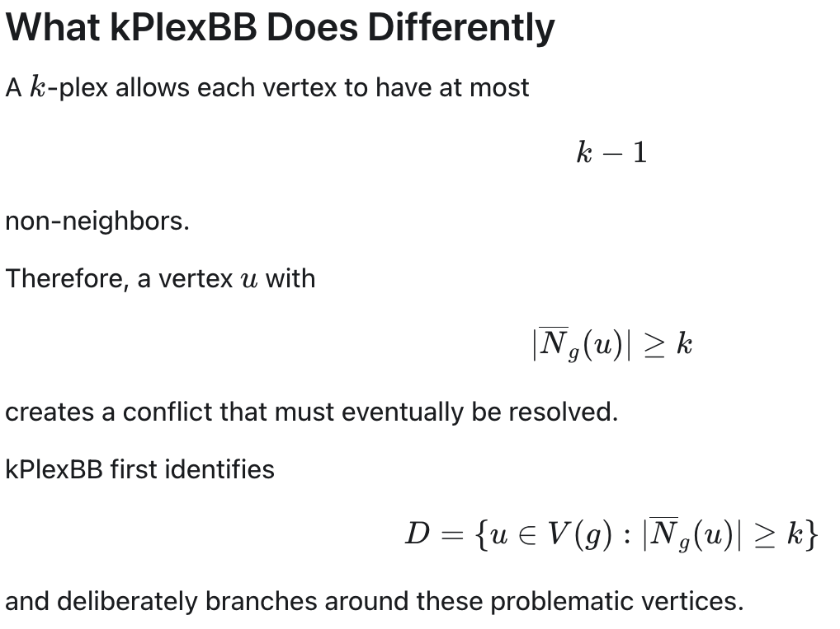
a vertex is not counted towards non-neighbors of itself

Slide 3
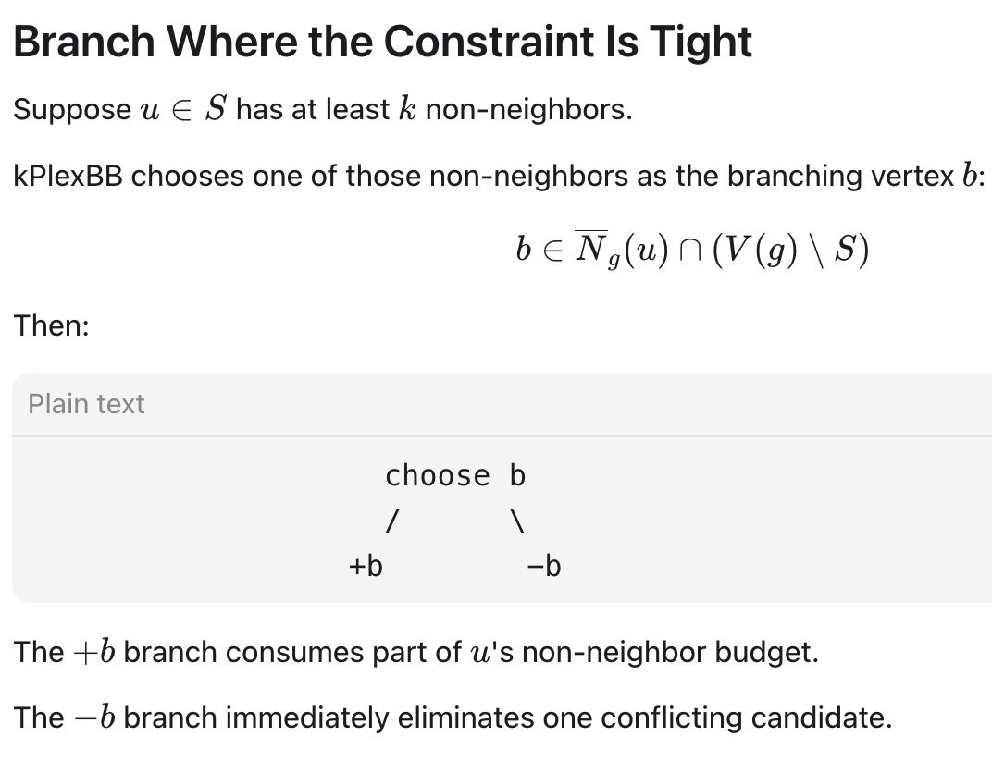

Slide 4
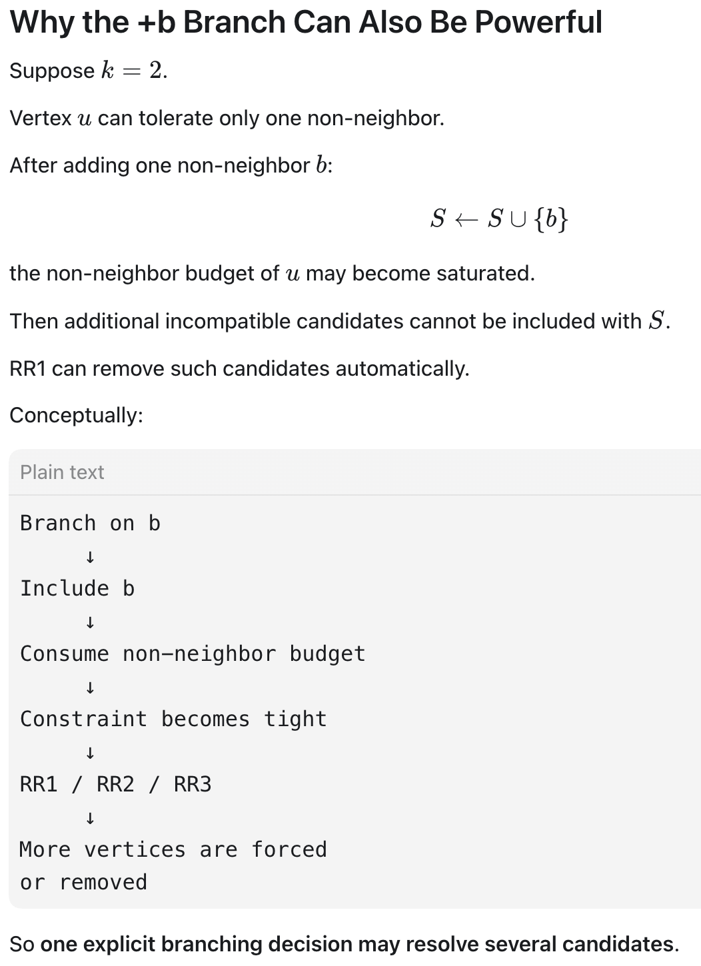

Slide 5
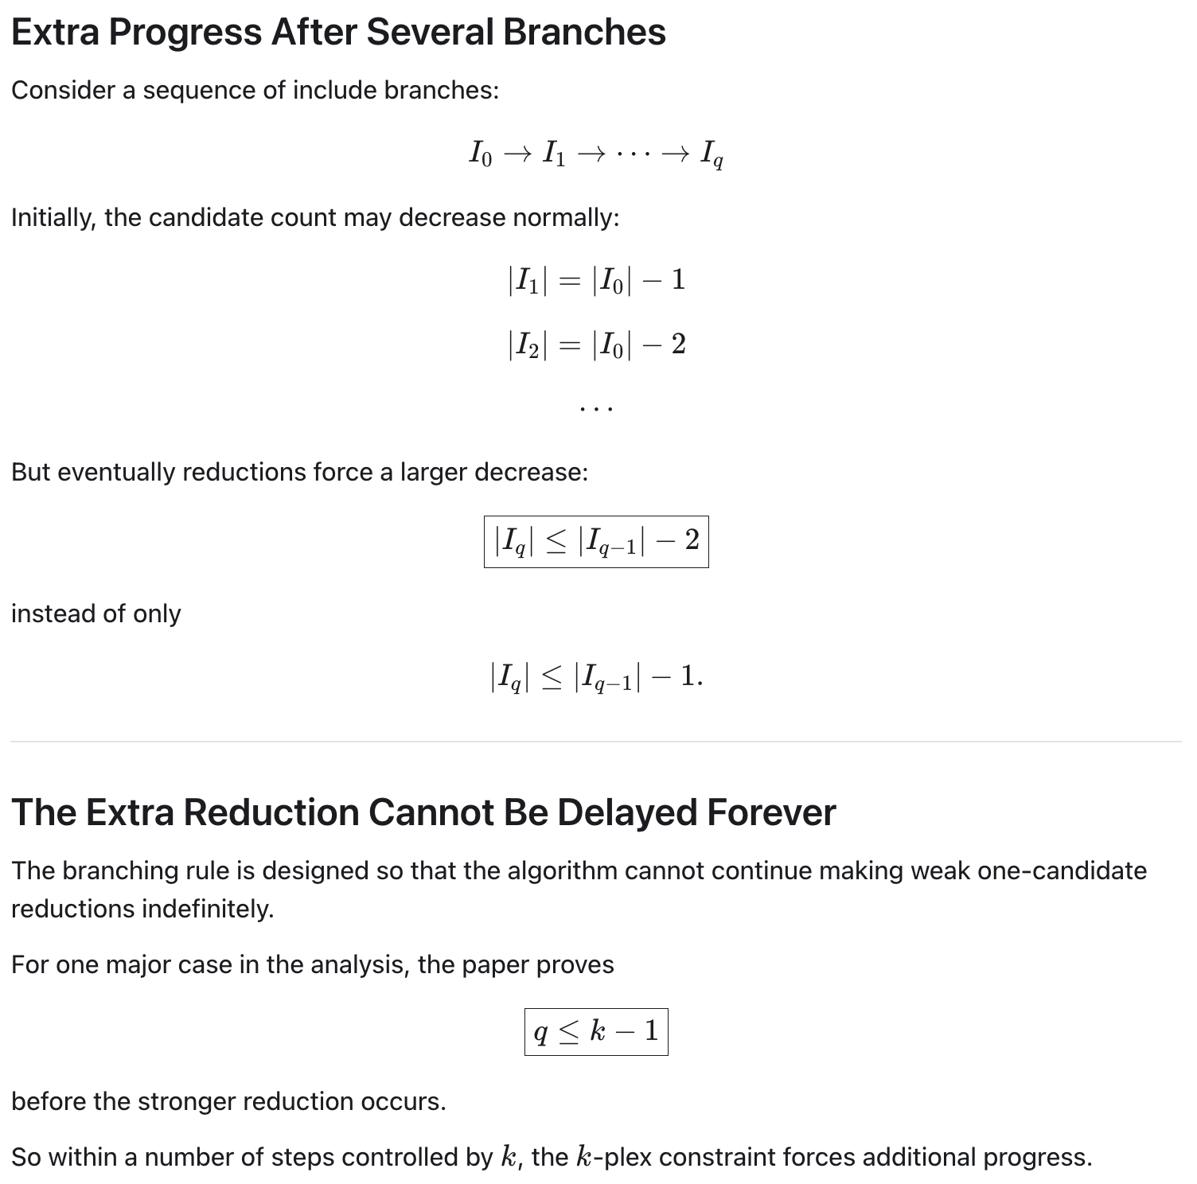

Slide 6
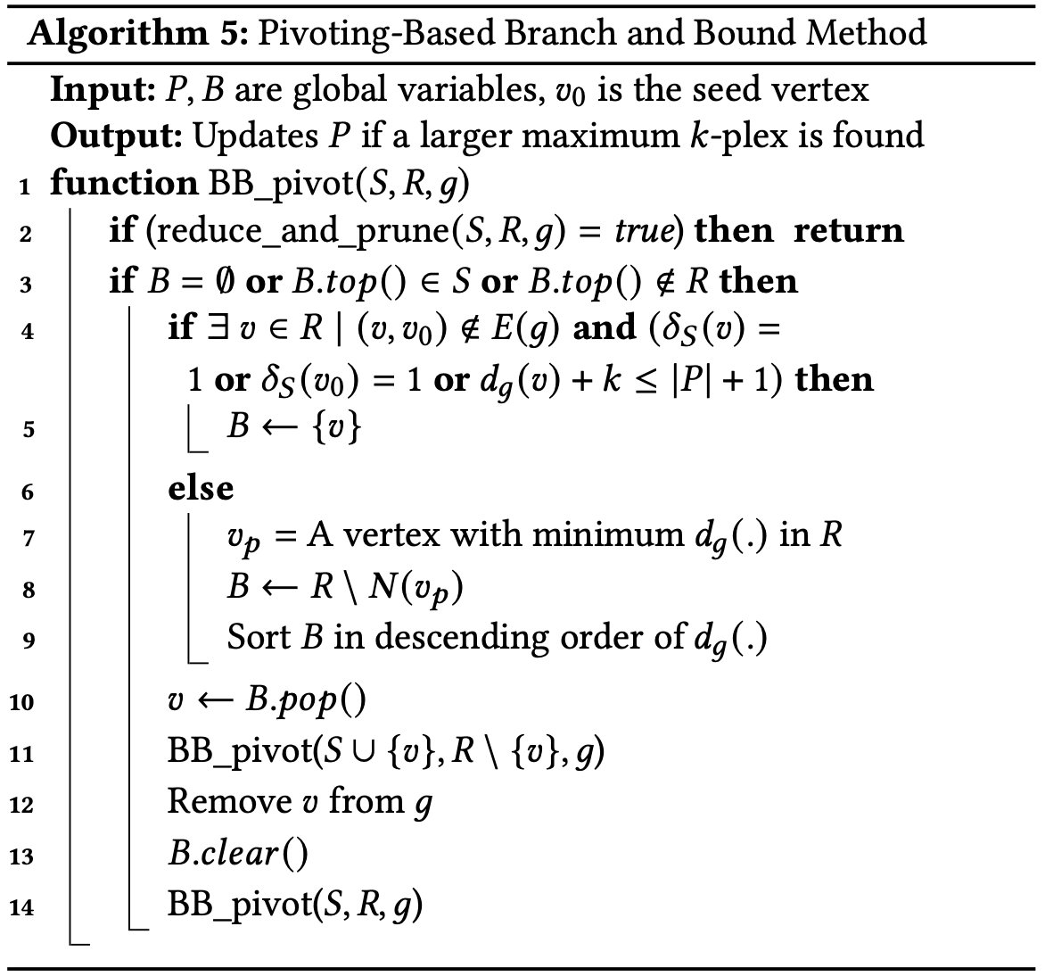
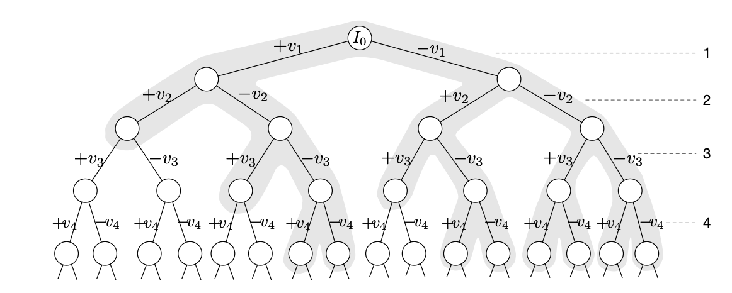
Binary Branching (Cont.)

Slide 7
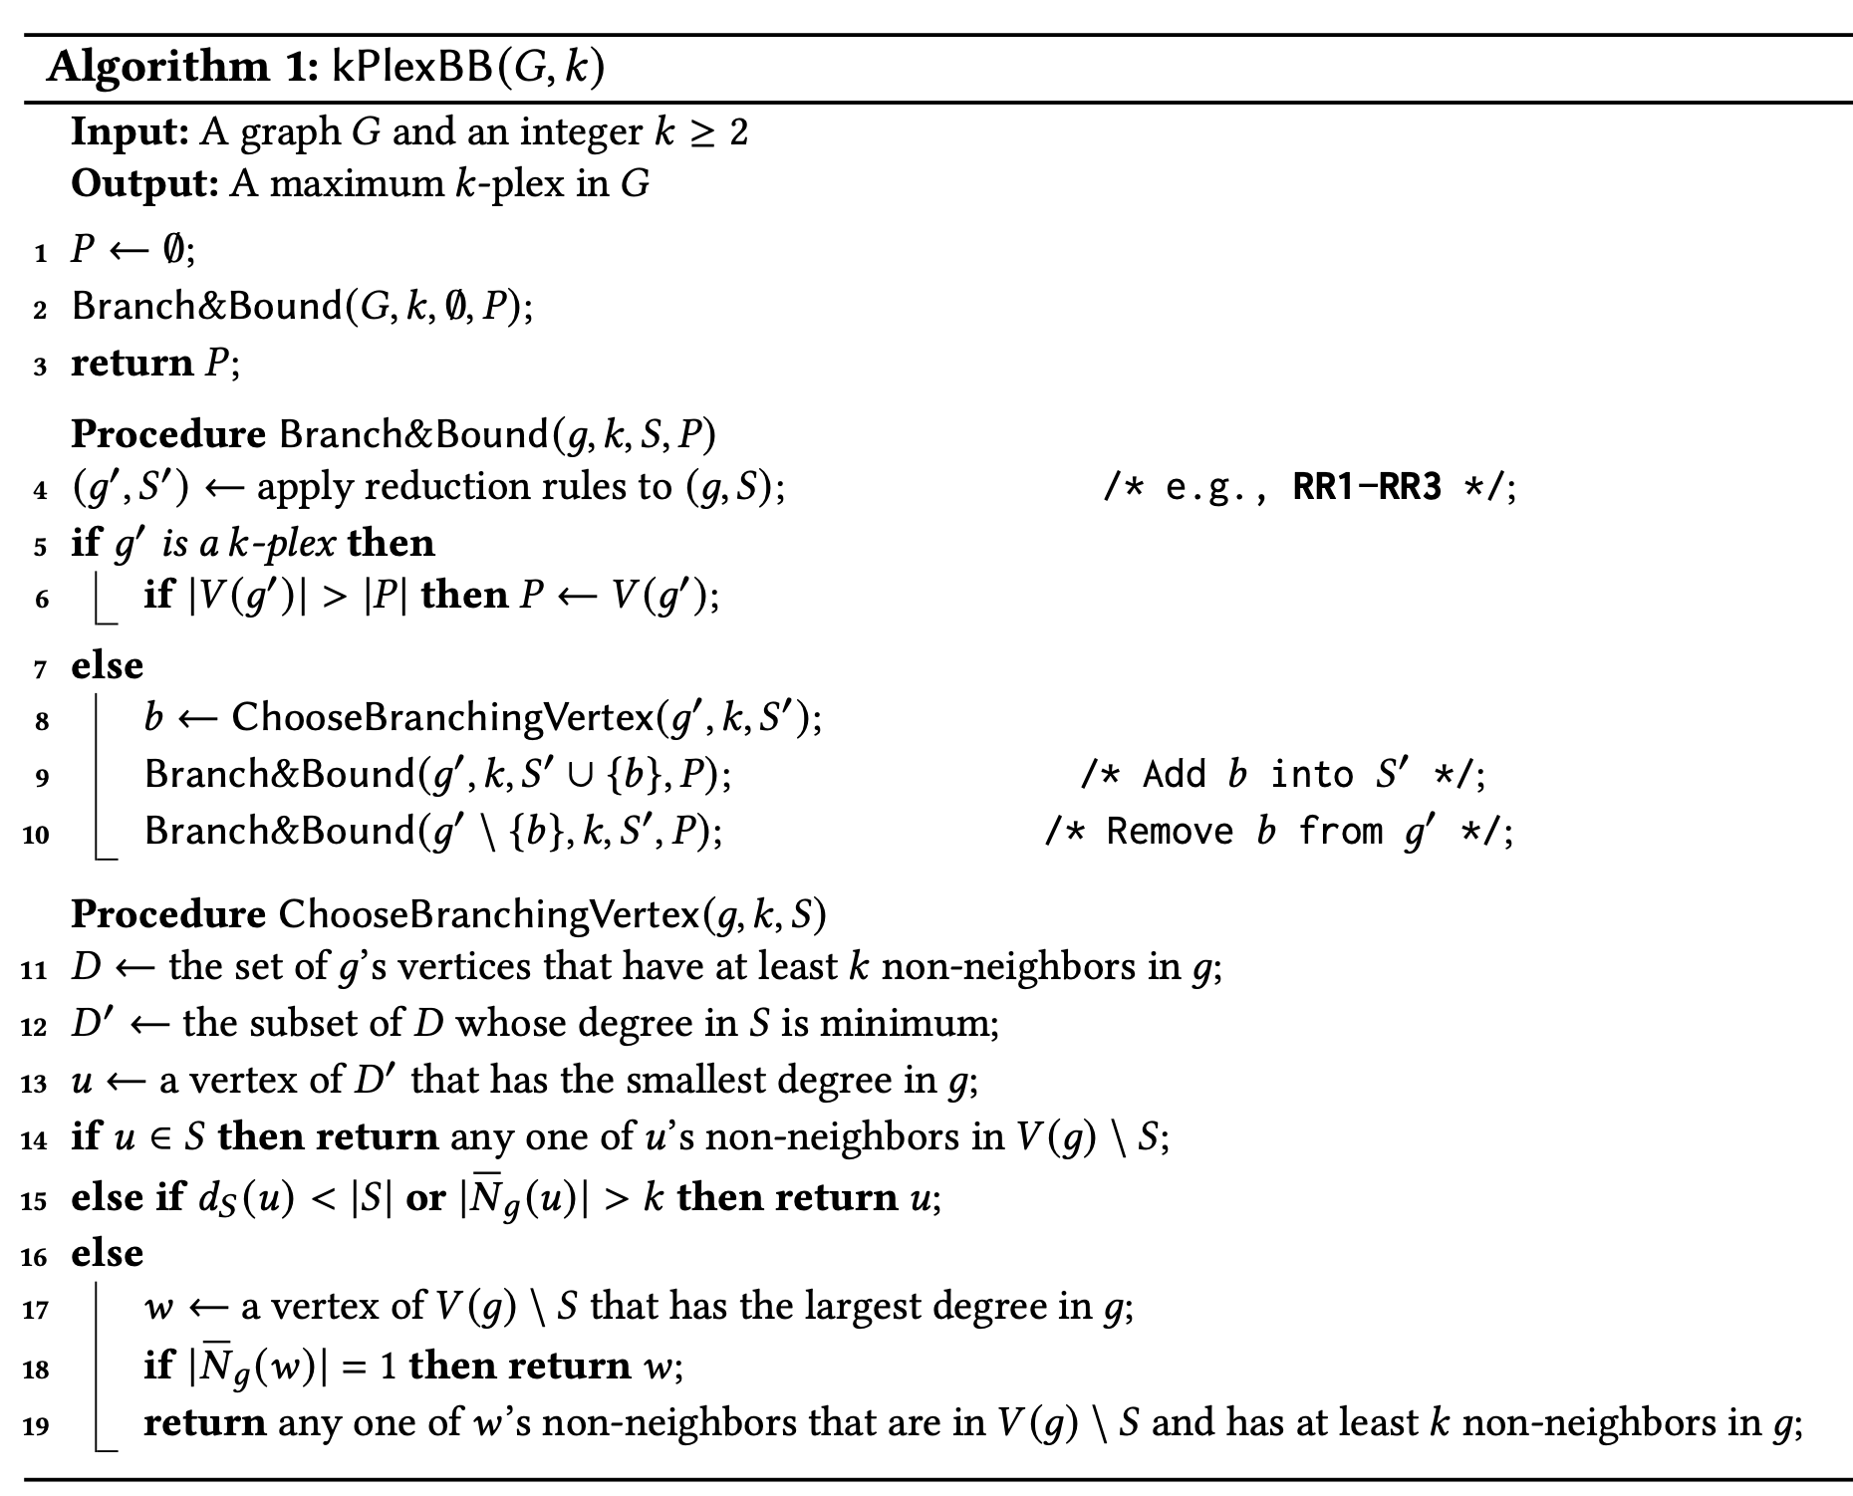

Slide 8
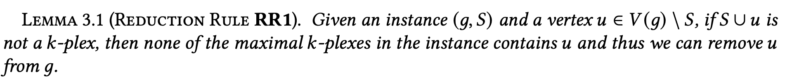


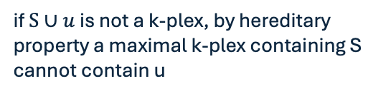
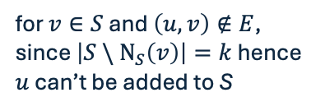

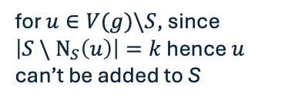
Reduction Rules – RR1
when $S∪u$ is not a k-plex
u
u
$k$
u
$k−1$
v
S
g
S
g
S
g
if $S∪u$ is not a k-plex, by hereditary property a maximal k-plex containing S cannot contain u
for $v∈S$ and $\left(u,v\right)∉E$, since $\left|S \backslash { N}_{S}\left(v\right)\right|=k$ hence $u$ can’t be added to S
for $u∈V(g)\backslash S$, since $\left|S \backslash { N}_{S}\left(u\right)\right|=k$ hence $u$ can’t be added to S

Slide 9
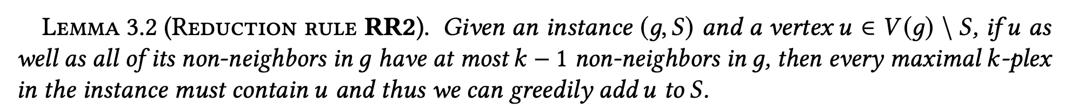
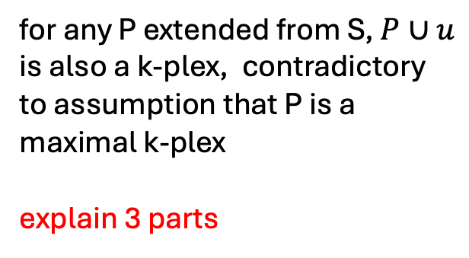

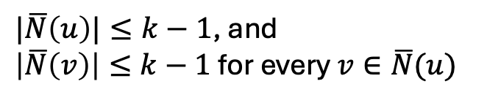
Reduction Rules – Directly Adding to S
BR2
$$\overline{N}(u)$$
u
P
g
$|\overline{N}\left(u\right)|≤k−1$, and
$\left|\overline{N}\left(v\right)\right|≤k−1$ for every $v∈\overline{N}(u)$
Proof
for any P extended from S, $P∪u$ is also a k-plex, contradictory to assumption that P is a maximal k-plex
explain 3 parts

Slide 10
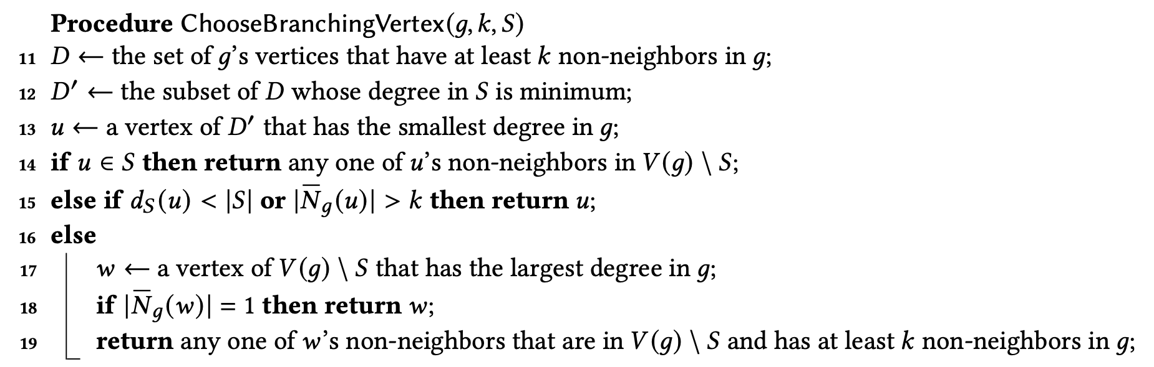

$$\left|{\overline{N}}_{g}\left(u\right)\right|≥k$$
D
S
C
g
D cannot be empty, otherwise g is a k-plex
Therefore, u is a valid vertex

Slide 11

$$\left|{\overline{N}}_{g}\left(u\right)\right|≥k$$
D
S
C
g
D cannot be empty, otherwise g is a k-plex
Therefore, u is a valid vertex
u already have some non-neighbors in S, adding it will increase constraints

Slide 12

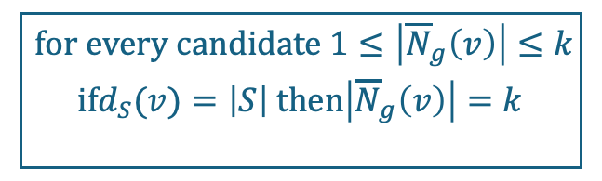
$$\left|{\overline{N}}_{g}\left(u\right)\right|≥k$$
D
S
C
g
D cannot be empty, otherwise g is a k-plex
Therefore, u is a valid vertex
when it fails, $D=D’$ because min $d_{S}=\left|S\right|$
$$\boxed{\begin{aligned} for every candidate 1≤\left|{\overline{N}}_{g}\left(v\right)\right|≤k \\ ifd_{S}(v)=\left|S\right| then\left|{\overline{N}}_{g}\left(v\right)\right|=k \\ \end{aligned}}$$

Slide 13
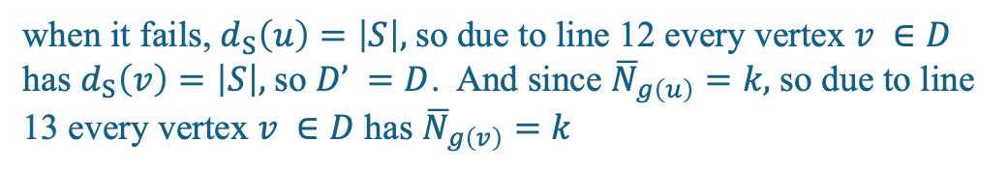
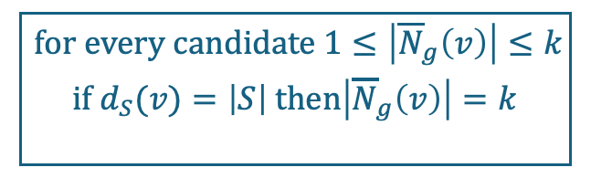
$$\left|{\overline{N}}_{g}\left(u\right)\right|≥k$$
D
S
C
g
D cannot be empty, otherwise g is a k-plex
Therefore, u is a valid vertex
to maximize probability of triggering line 18
$$\boxed{\begin{aligned} for every candidate 1≤\left|{\overline{N}}_{g}\left(v\right)\right|≤k \\ if d_{S}(v)=\left|S\right| then\left|{\overline{N}}_{g}\left(v\right)\right|=k \\ \end{aligned}}$$
when it fails, $d_{S}\left(u\right)=\left|S\right|,$so due to line 12 every vertex $v ∈D$ has $d_{S}\left(v\right)=\left|S\right|,$so $D’ =D$. And since ${\overline{N}}_{g\left(u\right)}=k,$ so due to line 13 every vertex $v ∈D$ has ${\overline{N}}_{g\left(v\right)}=k$

Slide 14
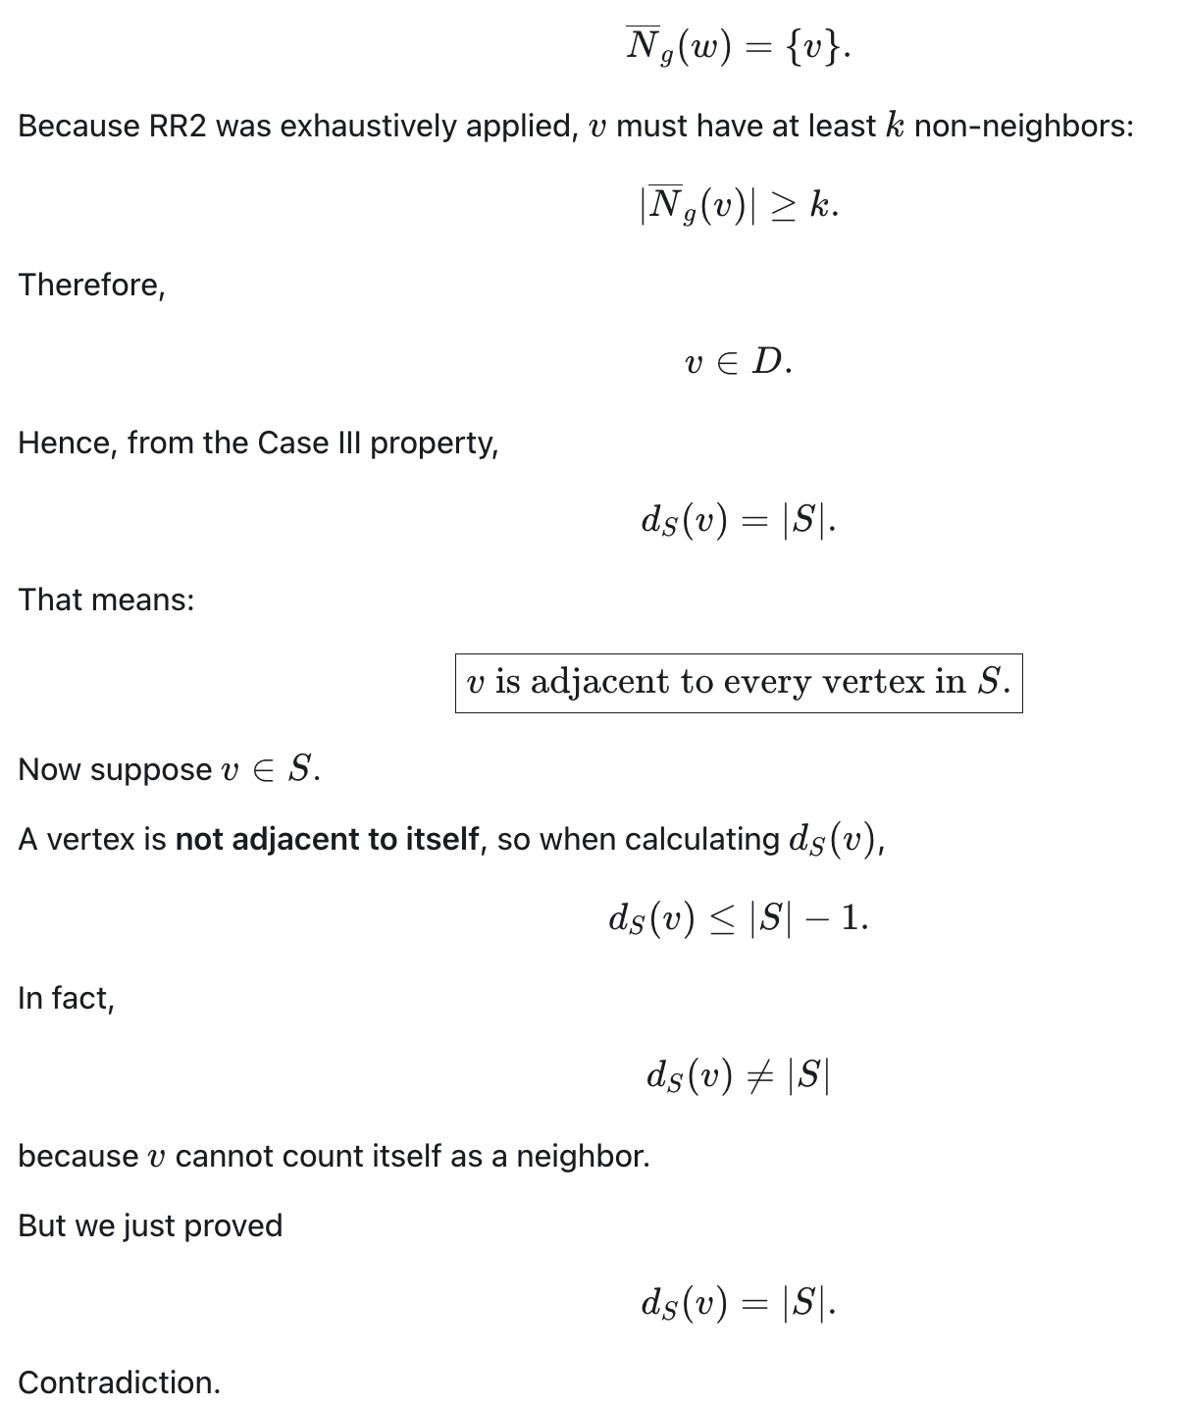

$$\left|{\overline{N}}_{g}\left(u\right)\right|≥k$$
D
S
C
g
Line 18: why is w returned?
v will be pulled in soon in subsequent rounds. But if we return v instead, then it can take a long time to get in w.
todo: try variants
1. line 15 simply returns u
2. line 18 returns v

Slide 15
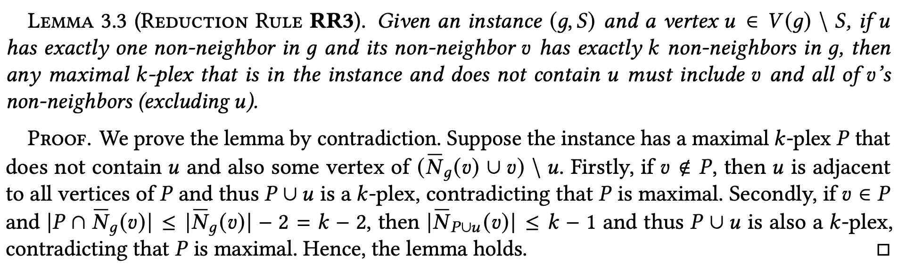




Reduction Rules – RR3
v
u
$k−1$
S
g
$k−1$
u
v
u
P
$≤k−2$
g
P
g
Case 1: v not in P
Case 2:

