Slide 1
CODEJAM
LAB SUBMISSIONS
[LAB 5]

Slide 2
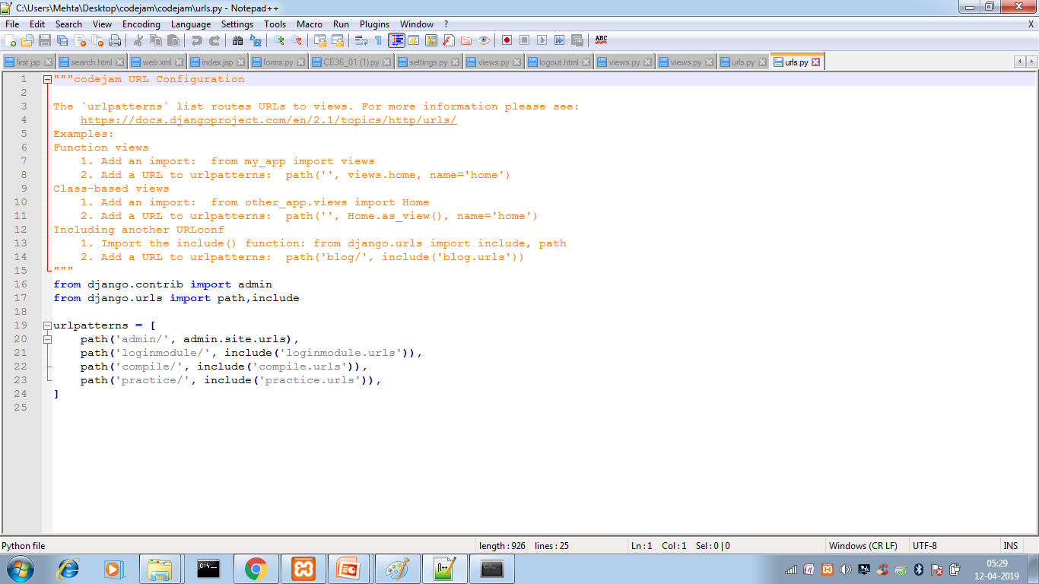
DJANGO WEBAPP TEMPLATE-[CODEJAM]urls.py

Slide 3
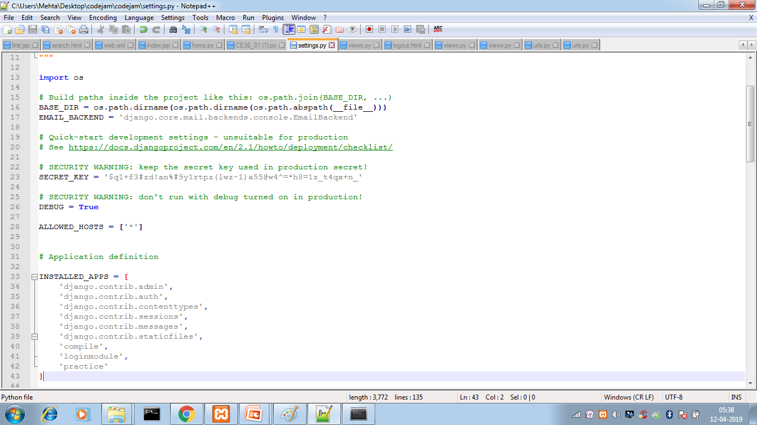
Settings.py:[INSTALLED_APPS]

Slide 4
App’s urls.py contains total apps to be created and such entry are also provided in app’s settings.py
Thus CODEJAM shows 3 apps.

Slide 5
TOTAL 3APPS
LOGINMODULE
-User log in by valid username and password else registers for 1st time.
COMPILE
-The user participates in the contest where solving the problem gives points.
PRACTISE
-The user can practise coding by checking output of code written.

Slide 6
Models.py file defines data for application. All tables descriptions are defined in model.py file.
Views.py file defines programs to manipulate and access data defined in models.py file. Most of the functions (business logic) are specified in views.py. Various functionalities defined in views.py can be access on frontend (web pages) via templates. References to these templates (html, css, scripts etc) are stored in urls.py.

Slide 7
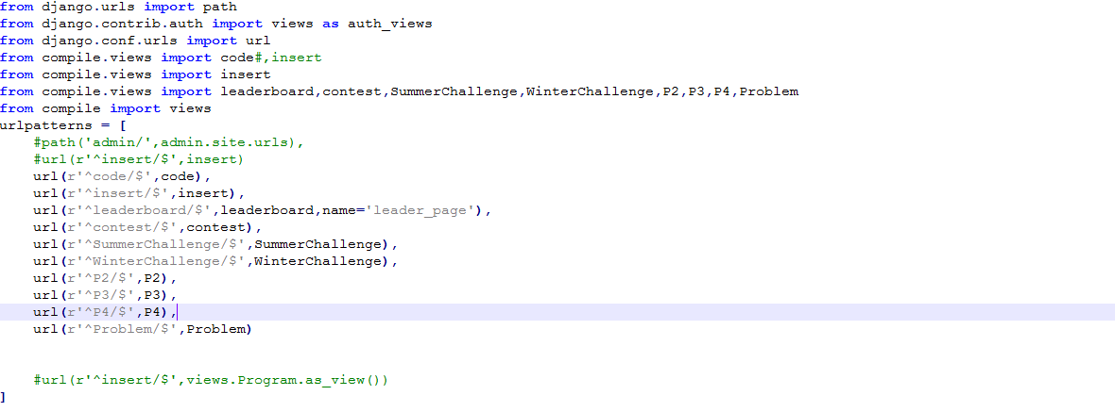
DJANGO WEBAPP TEMPLATE-[COMPILE]urls.py

Slide 8
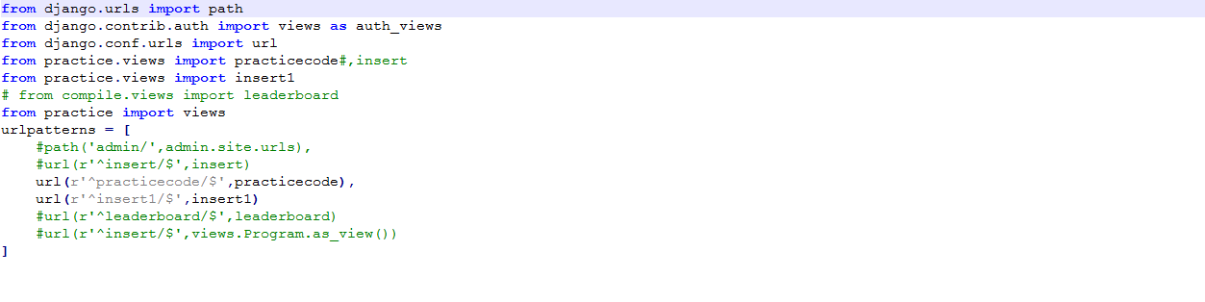
DJANGO WEBAPP TEMPLATE-[PRACTISE]urls.py

Slide 9
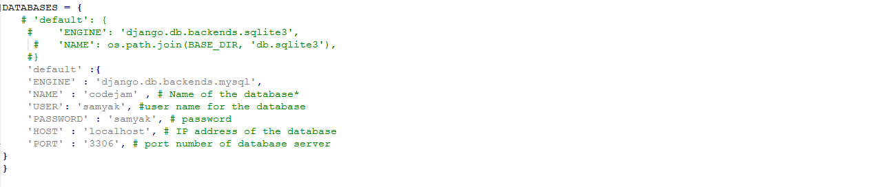
[LAB 6]-DBCONNECTION {settings.py}

Slide 10
To use mysql database you must have installed mysqlclient.
you can install using following command: $pip3 install mysqlclient –user
Thus database connection is done by providing database name,username,password.

Slide 11
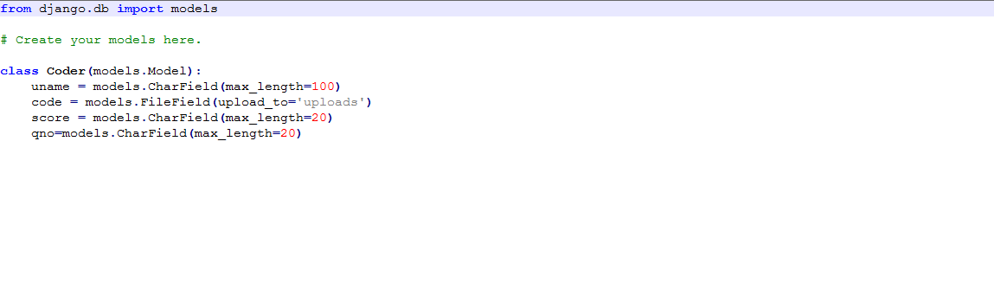
COMPILE-[models.py]

Slide 12
One way to create database tables and access it in the application is through models.py file. Every application of a Django project has a models.py file, which describe the schema for the project. It describes database table as a class .

Slide 13
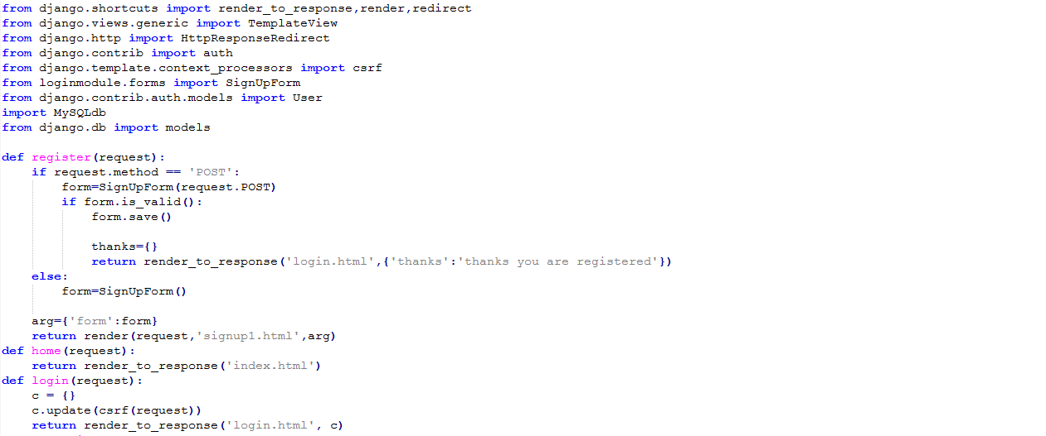
LAB 7-[LOGINMODULE WITH CSS] views.py of LOGIN APP

Slide 14
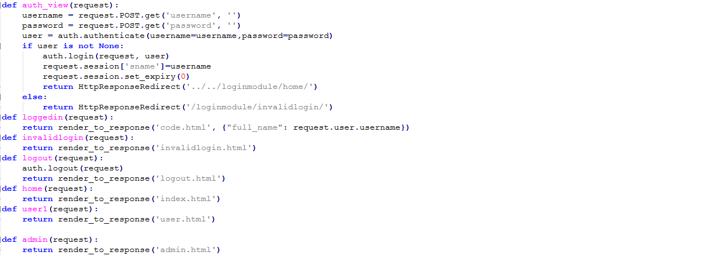

Slide 15
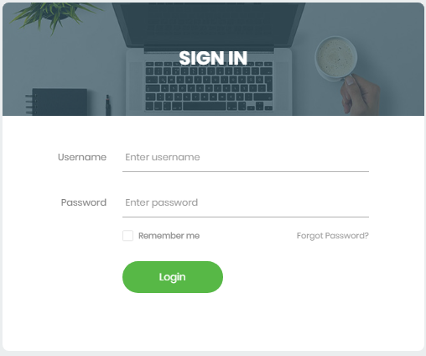
LOGIN PAGE

Slide 16
auth_view : This is the core part where we are reading data from login.html and comparing it with database using django’s auth module. On successful authentication we call ‘loggedin’ view and on failure we call ‘invalidlogin.
After that different login pages are made for each view.
Here, {% block content %} {% endblock %} is the part where other htmls can put their content.

Slide 17
Run usual makemigration and migrate commands from project’s root directory. (where manage.py is located).
To add css files, First, create a directory called static in your loginmodule directory. Django will look for static files there, similarly to how Django finds templates inside loginmodule/templates.

Slide 18
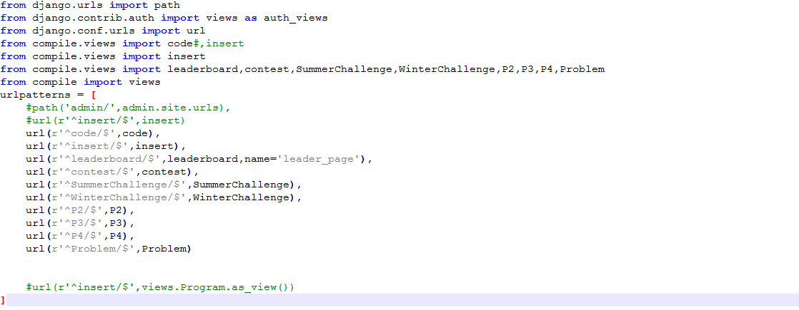
[LAB 8-Retrieve data from database and display in html page] COMPILE-urls.py

Slide 19
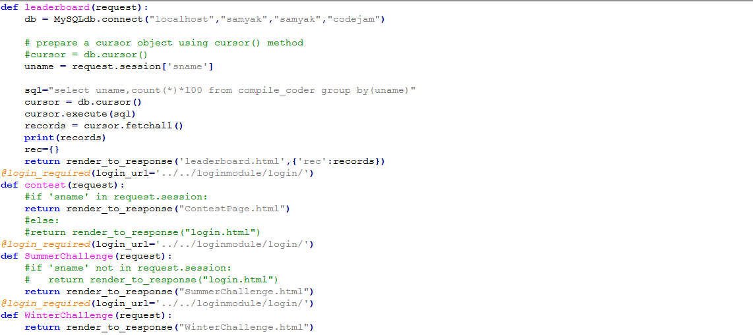
Views.py

Slide 20
In views.py file various queries are written for retrieving data or list from database to print into the html page.
Thus following code need to be written using if-else to print data from database.

Slide 21
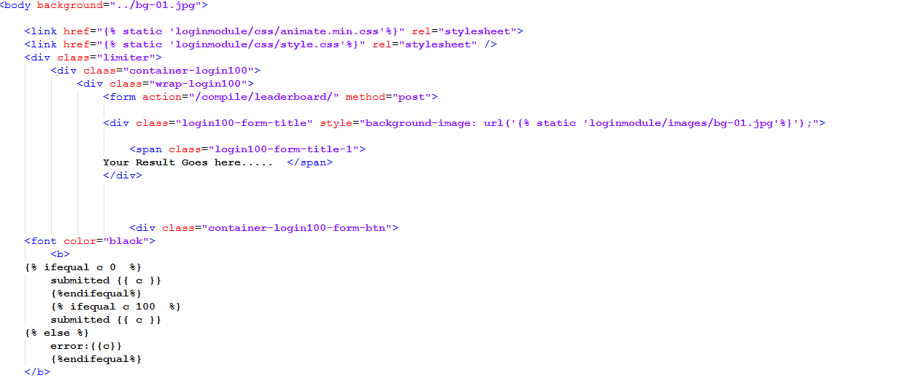
insert.html: retreives data from database

Slide 22
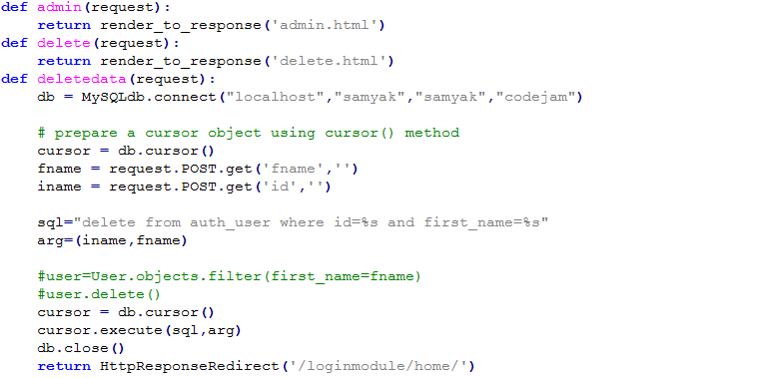
Lab 9:Sessios,Users and Registrations

Slide 23
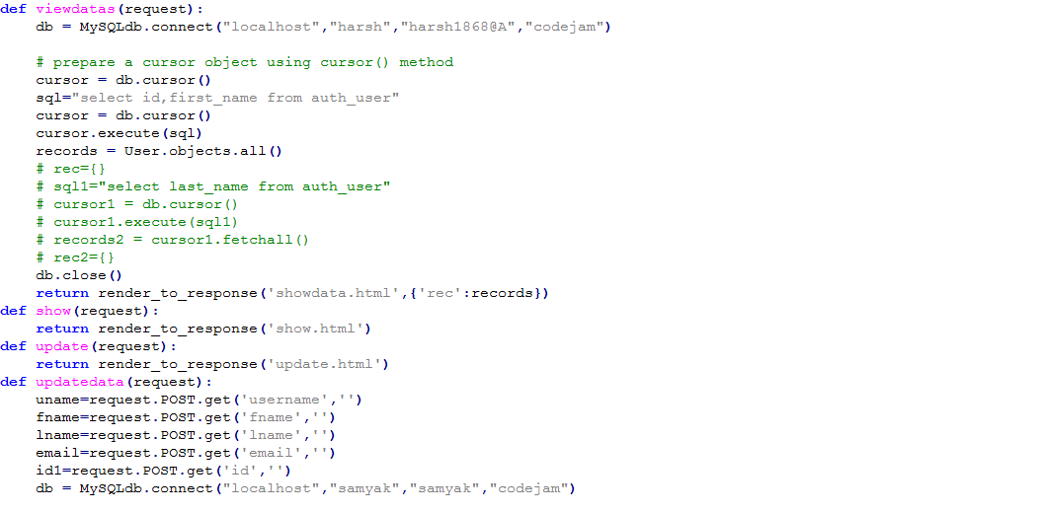
Views.py for ADMIN to UPDATE,ADD and DELETE

Slide 24
Different views are created for admin so that he/she can perform ADD,UPDATE,DELETE operation.

