Slide 1
CODEJAM #CODING CONTEST

Slide 2
INTRODUCTION
The CODEJAM is a coding platform for all the techno coders who want to :
[1]PRACTISE
[2]CONTEST

Slide 3

HOME PAGE:

Slide 4
TOTAL 3 APPS:
LOGINMODULE
COMPILE
PRACTISE

Slide 5
LOGIN MODULE
The users can register from SIGN IN if not having an account else can login into his/her own account.
For example the user is not having account then all the fields are to be provided such as
-Username
-Password
-Firstname
-Lastname
-Email

Slide 6
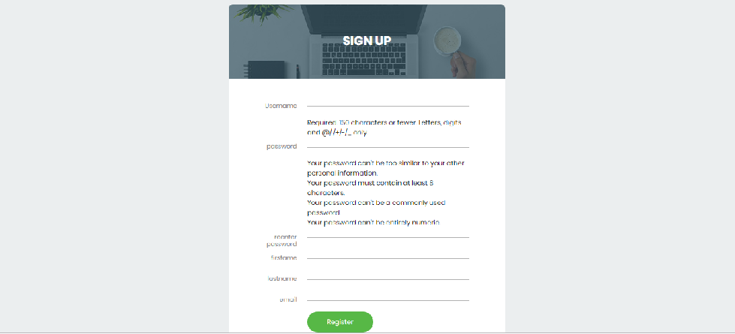
Sign up page:

Slide 7
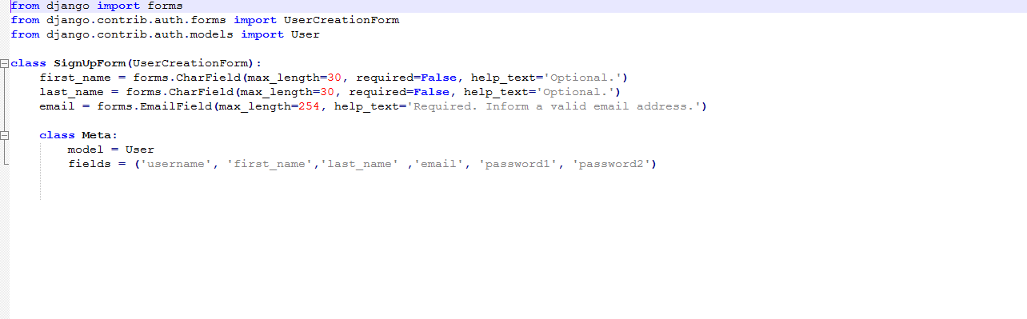
SIGN UP FORM

Slide 8
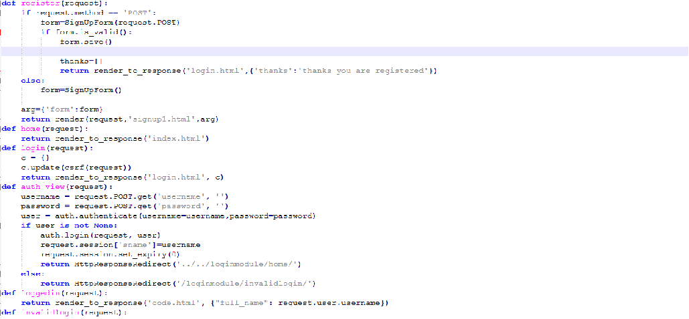
SIGN UP – LOGIN FORM(views.py)

Slide 9
Clicking the register button all the fields are VALIDATED and gives error if not validated.
UNIQUE username is provided so that there is no duplication and proper details are stored in database CODEJAM for new user.

Slide 10
EMAIL VERIFY
As the new user registers,an EMAIL is provided showing the WELCOME message from website owners.
The email is sent to the user which the user has written in registration form.

Slide 11
LOGIN USER
Thus,If the user is already having an account then he/she can login by providing valid username and password.
If provided invalid then error is given as there is no user.

Slide 12
USER’S HOME PAGE
Now on HOME PAGE There are 2 options provided to the user whether he/she wants to just practise or participate in contest.
[1]Practise
[2]Contest

Slide 13
IF USER SELECT TO #PRACTISE:
PRACTISE

Slide 14
By clicking this, a TEXT BOX is provided and then user can write and practise coding and check the output.
Clicking Submit button the code is compiled with the help of OS MODULE and then accordingly it gives out OUTPUT of the code written or else shows ERROR indicating what is missing.

Slide 15
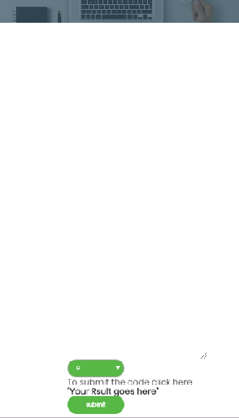
Practise coding

Slide 16
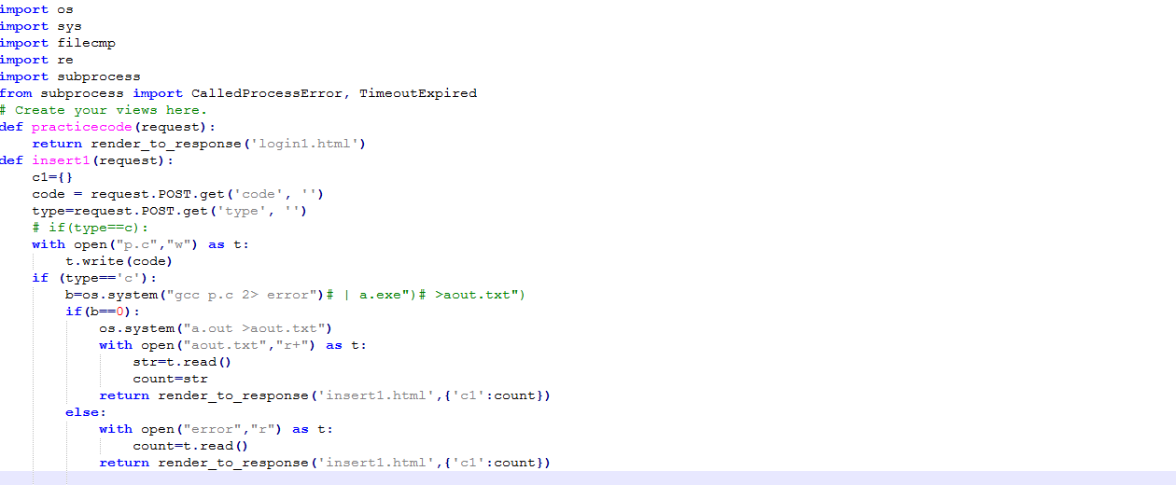
Views.py file for PRACTISE

Slide 17
IF USER CHOOSES TO CONTEST:
COMPILE

Slide 18
This selection opts for 2 choices
SUMMER CHALLENGE
WINTER CHALLENGE

Slide 19
Choosing any Challenge There occurs 5 questions which occurs and then user can solve the problems according to his/her capability.
Clicking the solve button the user selects the language in which code is to be written and then selects the language.

Slide 20
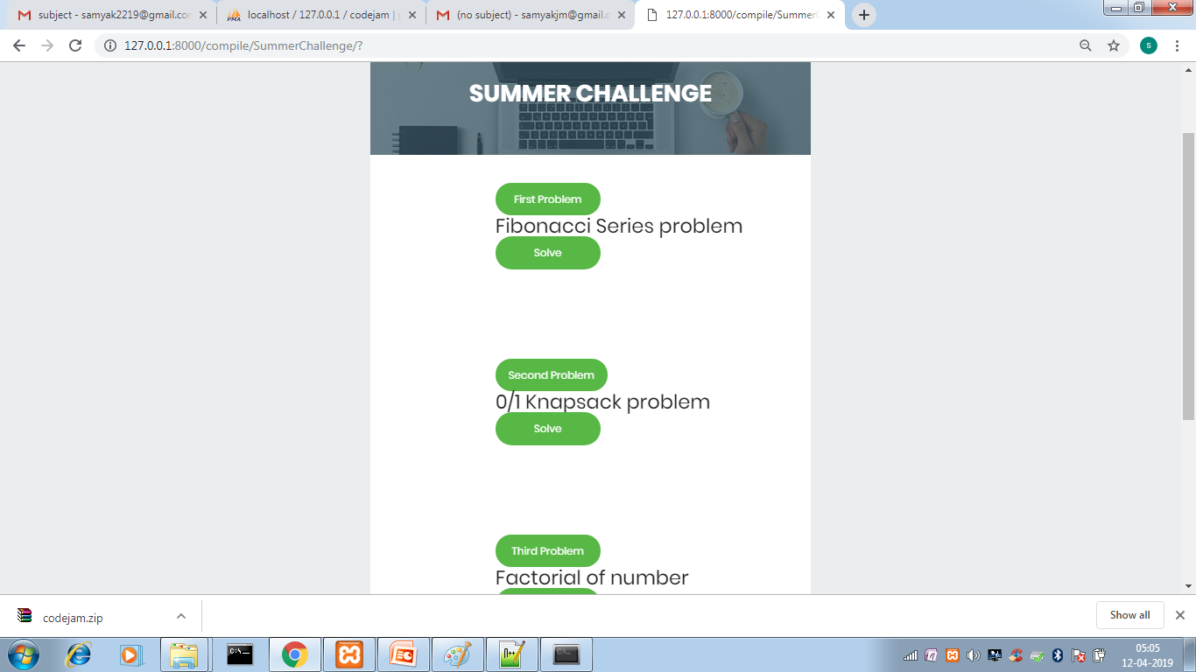
SHOWING 5 problems:

Slide 21
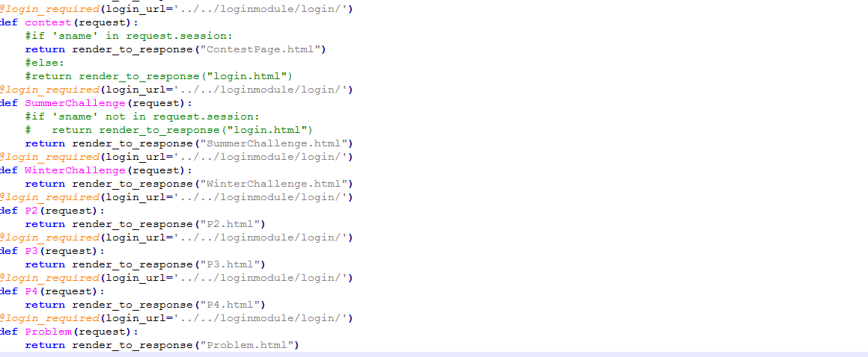
VIEWS.PY for contest

Slide 22
If the code is correct and matches the OUTPUT file then 100 POINTS are given to the user else the corresponding ERROR is generated.
Then The user can solve other questions and gain points.

Slide 23
VIEW LEADERBOARD
The user can view LEADERBOARD and the Users are sorted according to the points.

Slide 24
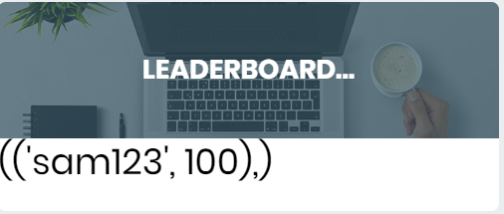
Show leaderboard as per the points:

Slide 25
ADMIN FUNCTIONALITY
The ADMIN is allowed to ADD,UPDATE the user as he/she owns the website.
So these functionality are provided to ADMIN to control the website.

Slide 26
Thus,the User can practise and code and view the leaderboard according to the points scored.
This is the main functionality this website.
Any suggestions regarding the website are welcomed.

Slide 27
MADE BY:
Ashish kotecha(CE-72)
Samyak mehta(CE-76)
Harsh moradiya(CE-81)

Slide 28
THANK YOU

