Slide 1
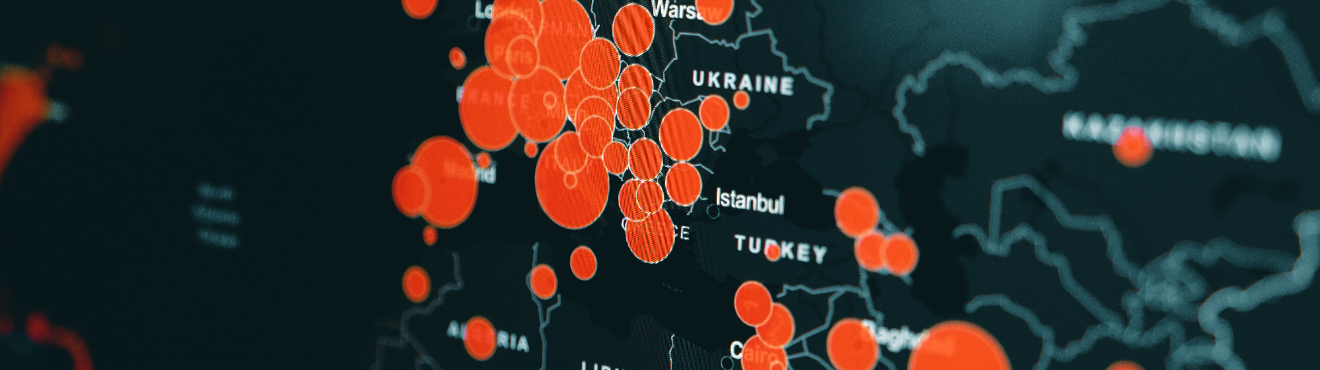
Data Analysis Report for Fond Rouge
Akhmadjonov Sherzodbek, SAP
July 15, 2025

Slide 2
Introduction
Key Findings
Visual Insights
Summary & Takeaways

Slide 3
Project Overview
Fond Rouge: European luxury brand across 15+ cities
Dataset: Sentiment, refund, revenue data per location
Objective: Analyze customer sentiment & refund trends, US & Global
Tools: SAP + Data visualization tools

Slide 4
Key Findings
💰 Highest refund rates: France, United Kingdom, United States
🙂 Best sentiment: Italy, Switzerland
⚠️ Refund-to-revenue ratio shows strong regional variance
Sentiment correlates moderately with refund pressure

Slide 5
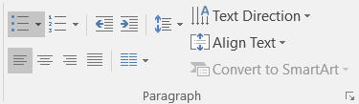
Insert page title (sentence case)
First level
Second level
Third level
NOTE: Delete the yellow stickers when finished.
The text placeholders have different, preformatted text levels. Each level has different formatting (font size, indent, bullet).
To jump between the preformatted text levels, use the Increase List Level and Decrease List Level buttons in the Paragraph toolbar.
Type your text in the placeholder.
Click the Increase List Level button in the Paragraph toolbar to go to the next level.
If you need a bullet list, choose level 2.
Avoid working with spaces, other bullets, or bullets in the wrong level. Only when you use the right levels it is possible to reset the slide layout.

Slide 6
Insert page title (sentence case)
First level
Second level
Third level

Slide 7
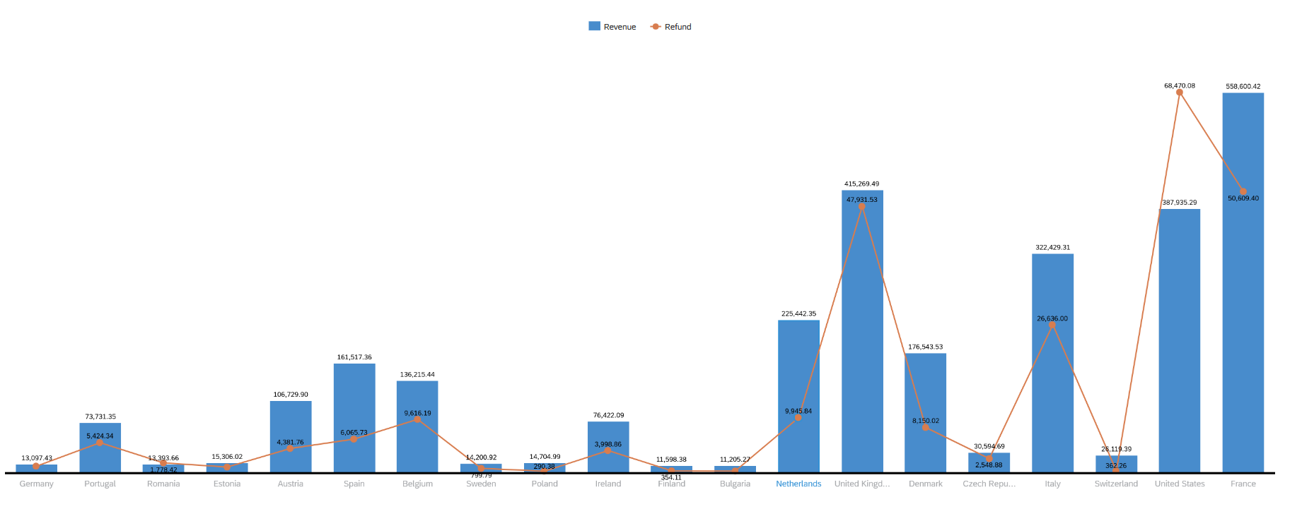
Visuals & Insights

Slide 8
“Without data, you’re just another person with an opinion.”
W. Edwards Deming

Slide 9
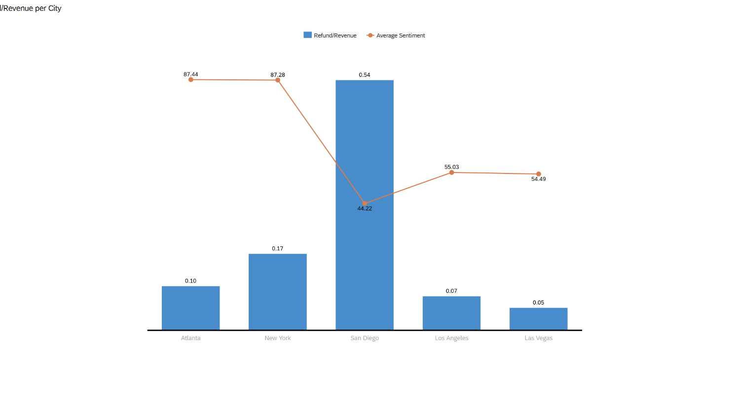

Slide 10
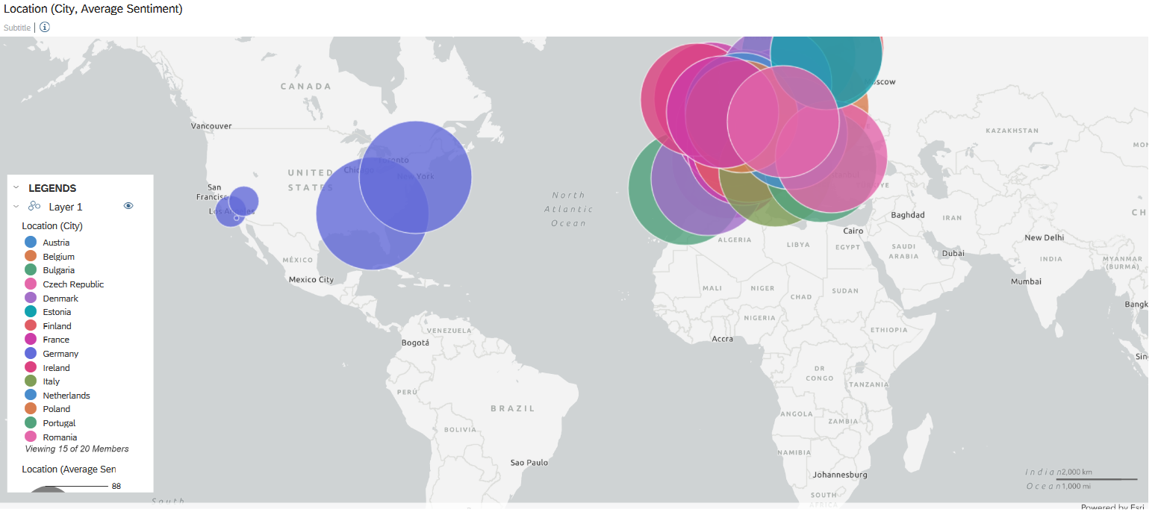
Visuals & Insights

Slide 11

Thank you.
Sherzodbek Akhmadjonov
Business Informatics
University of Debrecen
Hungary, Debrecen

