Slide 1
Modeling trend in temperature volatility using generalized LASSO
Arash Khodadadi

Slide 2
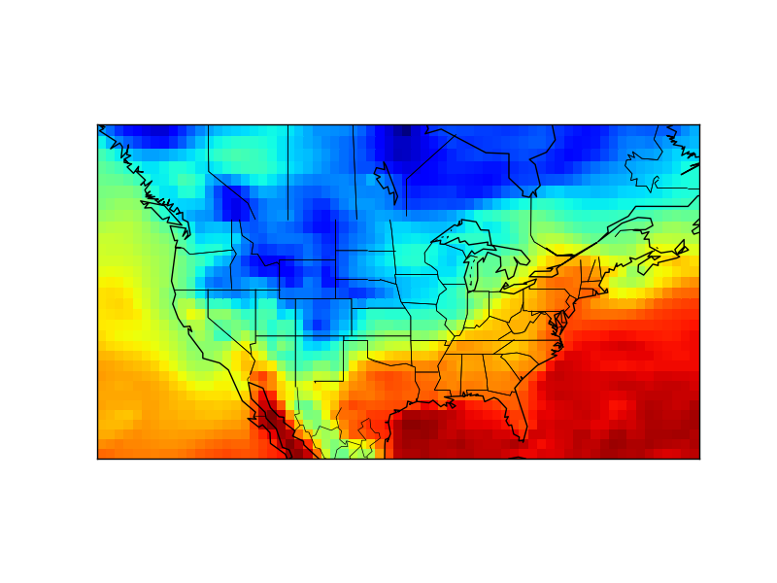

Slide 3
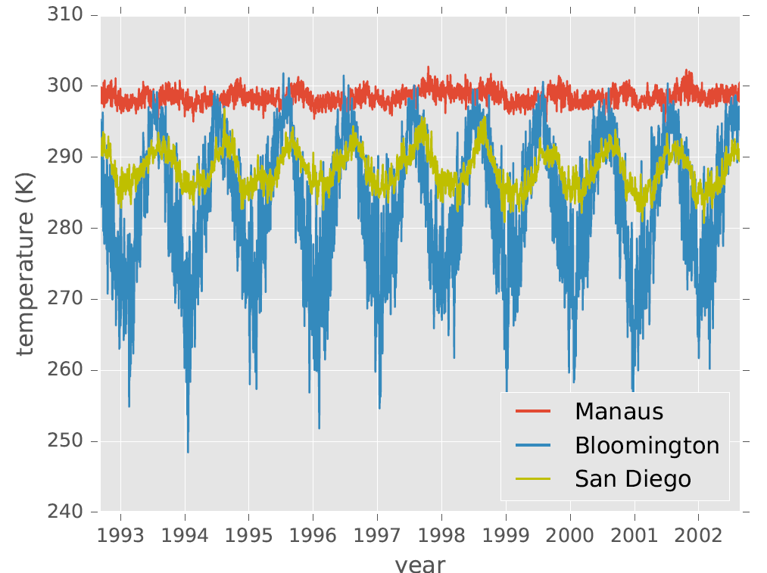

Slide 4
We have 52000 of these time-series
They have different trends and periodic components
The periodic component is not necessarily sinusoidal.
We don’t really care about the shape of the trend and the periodic terms. We just want to get rid of them!
These observations suggest a non-parametric approach.

Slide 5
Modeling trend:
We need to model the trend in the variance of the time-series
Data is spatio-temporal

Slide 6
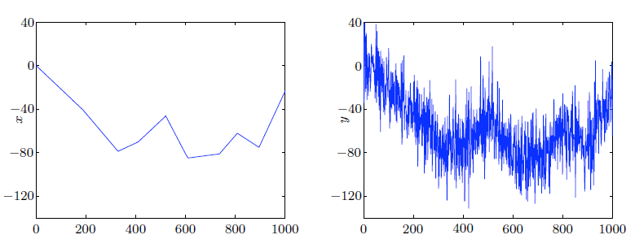
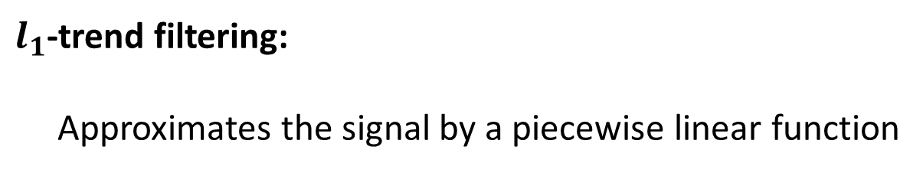
$l_{1}$-trend filtering:
Approximates the signal by a piecewise linear function
From Kim et al., 2009

Slide 7
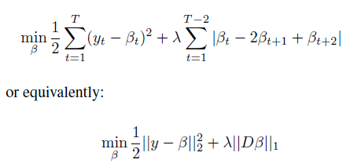
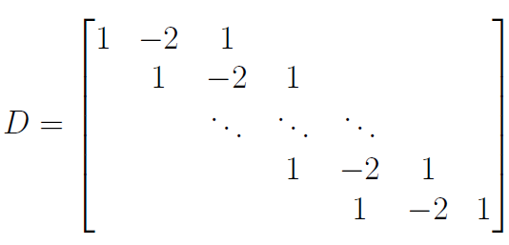
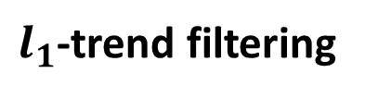
$l_{1}$-trend filtering

Slide 8
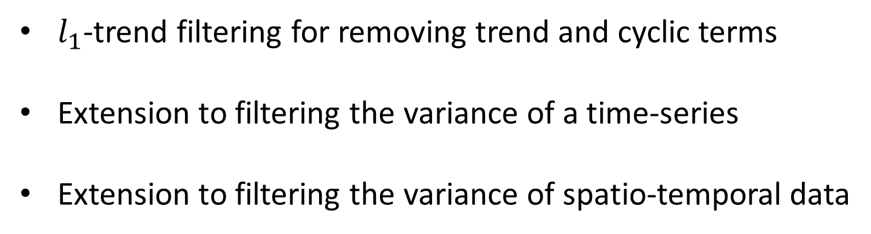
Outline
$l_{1}$-trend filtering for removing trend and cyclic terms
Extension to filtering the variance of a time-series
Extension to filtering the variance of spatio-temporal data

Slide 9

Outline
$l_{1}$-trend filtering for removing trend and cyclic terms
Extension to filtering the variance of a time-series
Extension to filtering the variance of spatio-temporal data

Slide 10
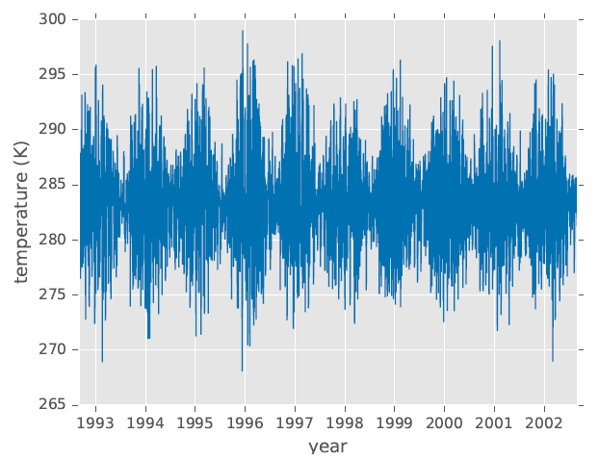
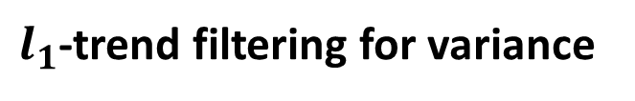
$l_{1}$-trend filtering for variance
Motivating example

Slide 11



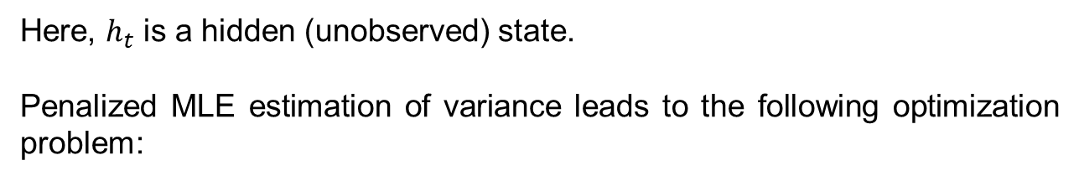
$l_{1}$-trend filtering for variance
Here, $h_{t}$ is a hidden (unobserved) state.
Penalized MLE estimation of variance leads to the following optimization problem:

Slide 12
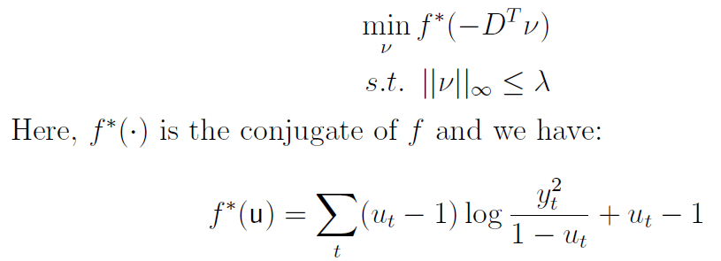
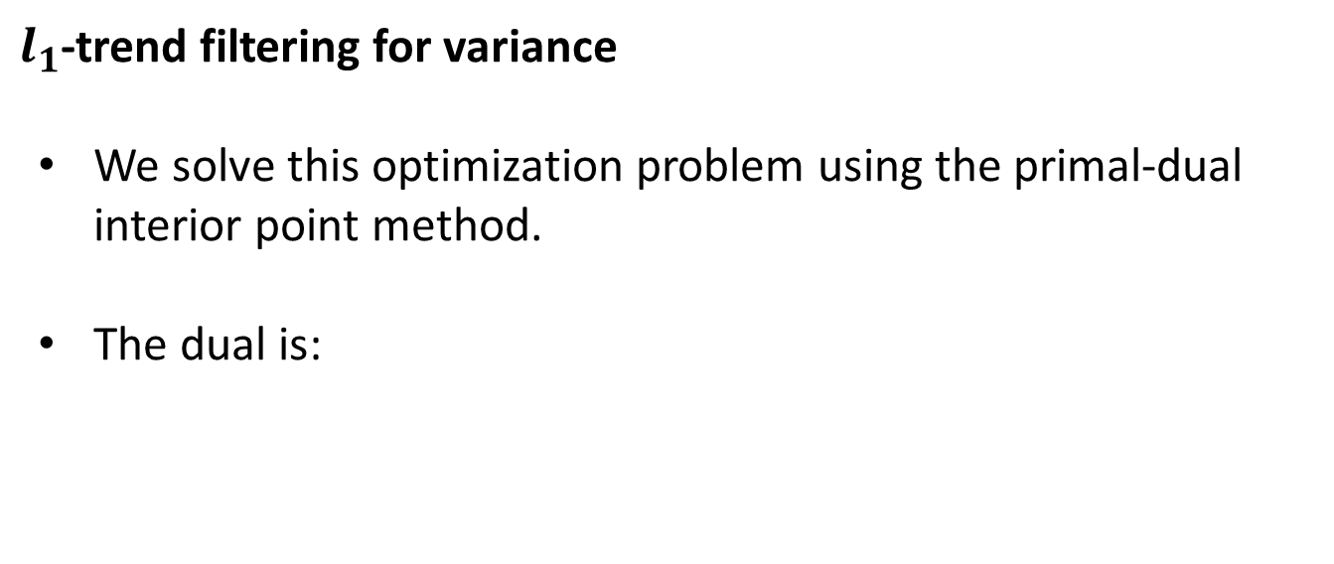
$l_{1}$-trend filtering for variance
We solve this optimization problem using the primal-dual interior point method.
The dual is:

Slide 13
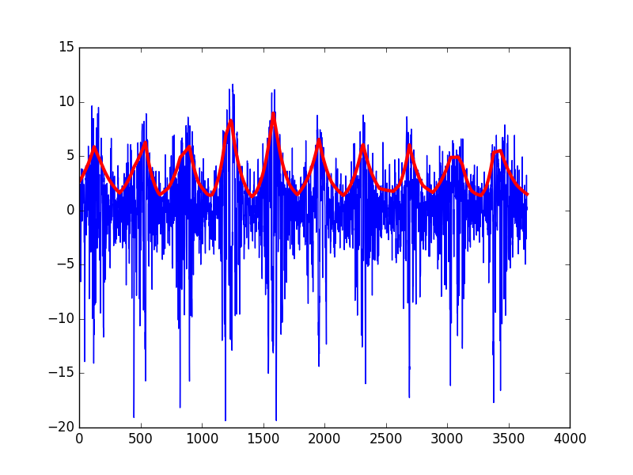
$l_{1}$-trend filtering for variance

Slide 14

$l_{1}$-trend filtering for variance
Detecting trend:
We penalize deviation from a linear trend in the average of $h$ over each year.

Slide 15
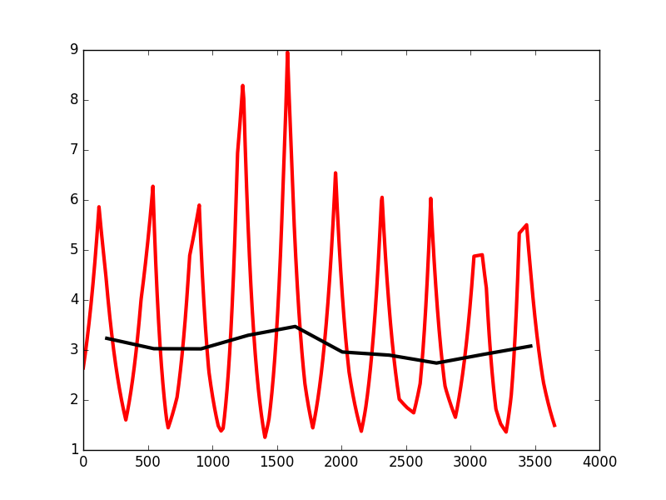
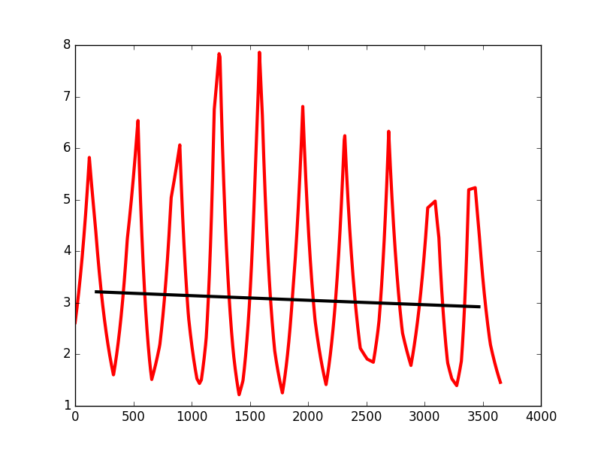
$l_{1}$-trend filtering for variance
Detecting trend:

Slide 16

$l_{1}$-trend filtering for variance
Choosing $λ$: since we perform MLE, we can use BIC to choose the optimal value of $λ$.

Slide 17
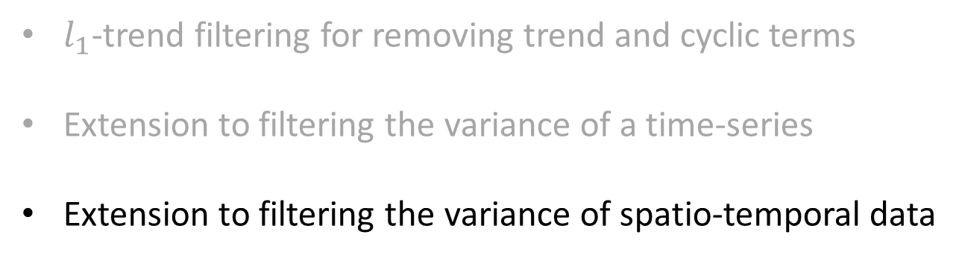
Outline
$l_{1}$-trend filtering for removing trend and cyclic terms
Extension to filtering the variance of a time-series
Extension to filtering the variance of spatio-temporal data

Slide 18
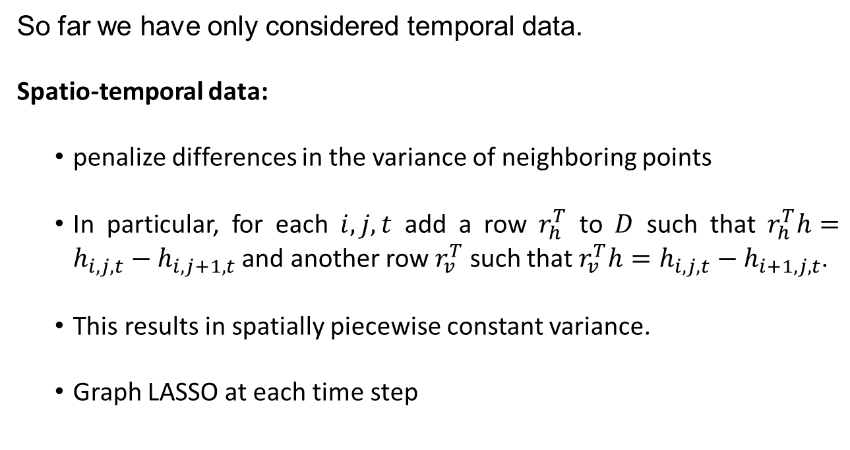
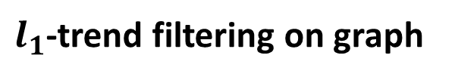
$l_{1}$-trend filtering on graph
So far we have only considered temporal data.
Spatio-temporal data:
penalize differences in the variance of neighboring points
In particular, for each $i,j,t$ add a row $r_{h}^{T}$ to $D$ such that $r_{h}^{T}h=h_{i,j,t}−h_{i,j+1,t}$ and another row $r_{v}^{T}$ such that $r_{v}^{T}h=h_{i,j,t}−h_{i+1,j,t}$.
This results in spatially piecewise constant variance.
Graph LASSO at each time step

Slide 19
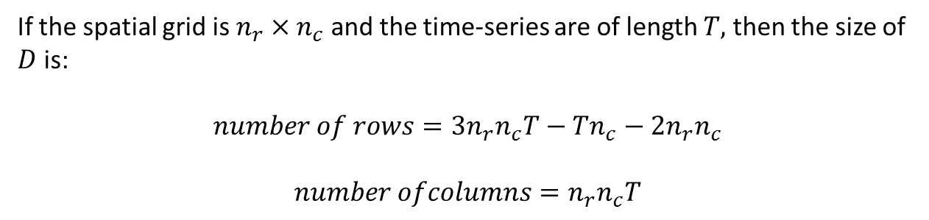
$l_{1}$-trend filtering on graph
Optimization:
We need to solve the same optimization problem:
If the spatial grid is $n_{r}×n_{c}$ and the time-series are of length $T,$ then the size of $D$ is:
$$number of rows=3n_{r}n_{c}T−Tn_{c}−2n_{r}n_{c}$$
$$number ofcolumns=n_{r}n_{c}T$$

Slide 20
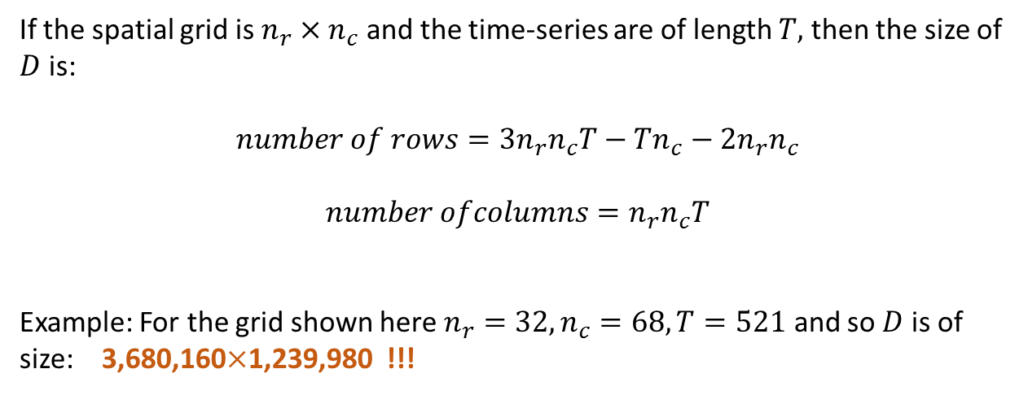
$l_{1}$-trend filtering on graph
Optimization:
If the spatial grid is $n_{r}×n_{c}$ and the time-series are of length $T,$ then the size of $D$ is:
$$number of rows=3n_{r}n_{c}T−Tn_{c}−2n_{r}n_{c}$$
$$number ofcolumns=n_{r}n_{c}T$$
Example: For the grid shown here $n_{r}=32,n_{c}=68, T=521$ and so $D$ is of size: 3,680,160$×$1,239,980 !!!

Slide 21
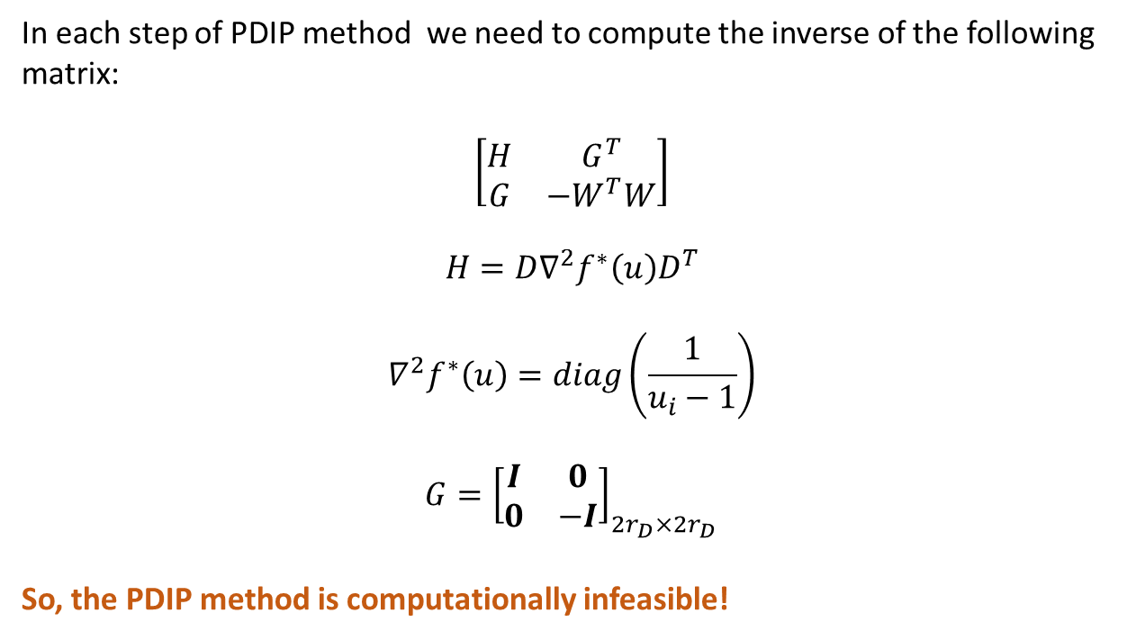
$l_{1}$-trend filtering on graph
Optimization:
In each step of PDIP method we need to compute the inverse of the following matrix:
$$\left[\begin{matrix}H & G^{T} \\ G & −W^{T}W\end{matrix}\right]$$
$$H=D∇^{2}f^{∗}\left(u\right)D^{T}$$
$$∇^{2}f^{∗}\left(u\right)=diag\left(\frac{1}{u_{i}−1}\right)$$
$$G={\left[\begin{matrix}I & 0 \\ 0 & −I\end{matrix}\right]}_{{2r}_{D}×{2r}_{D}}$$
So, the PDIP method is computationally infeasible!

Slide 22
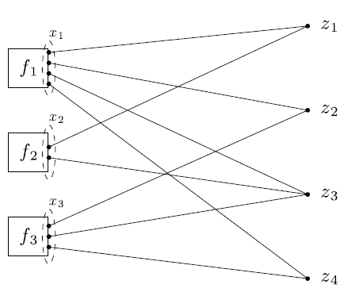
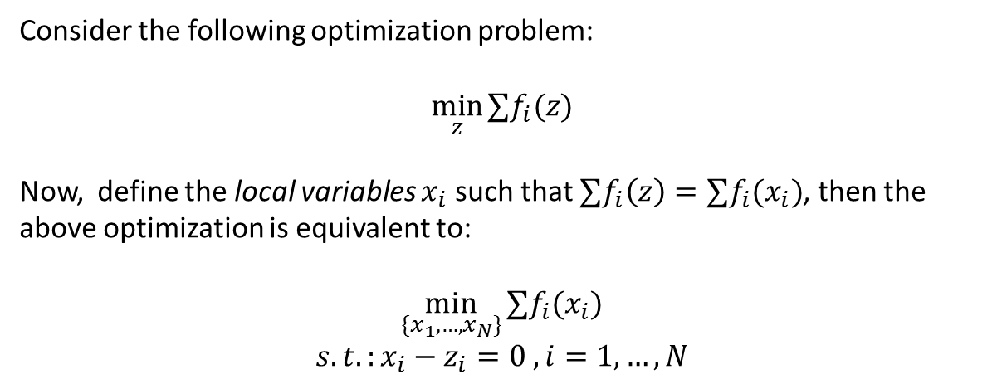
Consensus Alternative Direction Method of Multipliers (ADMM):
Consider the following optimization problem:
$$\min_{z}{∑f_{i}(z)}$$
Now, define the local variables $x_{i}$ such that $∑f_{i}\left(z\right)=∑f_{i}(x_{i})$, then the above optimization is equivalent to:
$$\min_{\{x_{1},…, x_{N}\}}{∑f_{i}(x_{i})}$$
$$s.t.:x_{i}−z_{i}=0 , i=1,…, N$$

Slide 23
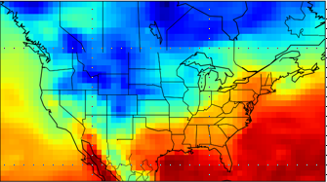
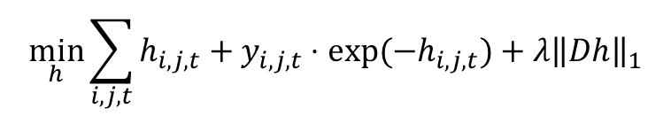
Consensus ADMM for $l_{1}$-trend filtering on graph
$$\min_{h}{\sum_{i,j,t}{h_{i,j,t}+y_{i,j,t}⋅exp⁡(−h_{i,j,t})}+λ{\left\|Dh\right\|}_{1}}$$
time

Slide 24


Consensus ADMM for $l_{1}$-trend filtering on graph
$$\min_{h}{\sum_{i,j,t}{h_{i,j,t}+y_{i,j,t}⋅exp⁡(−h_{i,j,t})}+λ{\left\|Dh\right\|}_{1}}$$
$$x_{1}$$
$$x_{2}$$
time

Slide 25




Consensus ADMM for $l_{1}$-trend filtering on graph
$$\min_{\{x_{1},…, x_{N}\}}{∑f_{i}(x_{i})}$$
$$s.t.:x_{i}−z_{i}=0 , i=1,…, N$$
ADMM steps:

Slide 26
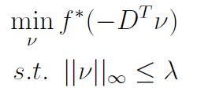
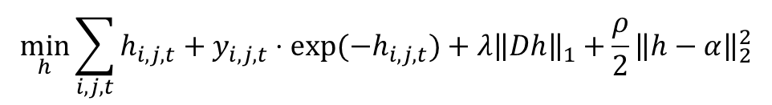

Consensus ADMM for $l_{1}$-trend filtering on graph
Each x-update step has the following form:
$$\min_{h}{\sum_{i,j,t}{h_{i,j,t}+y_{i,j,t}⋅exp⁡(−h_{i,j,t})}+λ{\left\|Dh\right\|}_{1}+\frac{ρ}{2}{\left\|h−α\right\|}_{2}^{2}}$$
The dual is:
Where the conjugate function is obtained as follows:
$$f^{∗}\left(u\right)=\max_{h}{{ u}^{T}h−h−{\left[diag \left(y\right)\right]}^{2}e^{−h}−\frac{ρ}{2}{\left\|h−α\right\|}_{2}^{2}}$$
This leads to solving equations in the form $ae^{−h}+bh+c=0 →$Lambert function

Slide 27
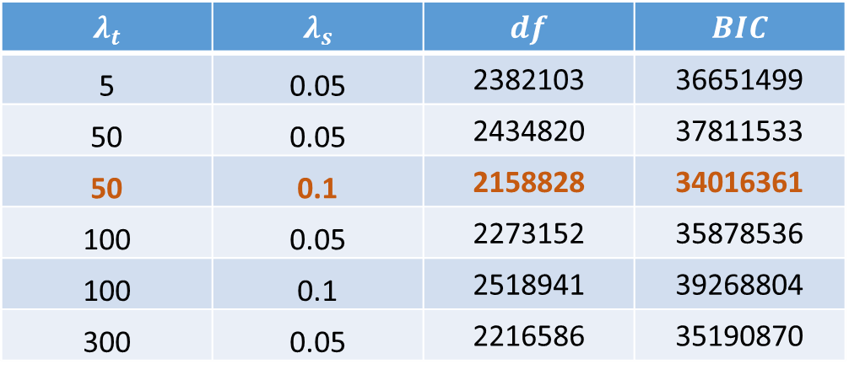

Choosing optimal $λ$ using BIC:
$$λ_{t}$$ | $$λ_{s}$$ | $$df$$ | $$BIC$$
5 | 0.05 | 2382103 | 36651499
50 | 0.05 | 2434820 | 37811533
50 | 0.1 | 2158828 | 34016361
100 | 0.05 | 2273152 | 35878536
100 | 0.1 | 2518941 | 39268804
300 | 0.05 | 2216586 | 35190870

Slide 28
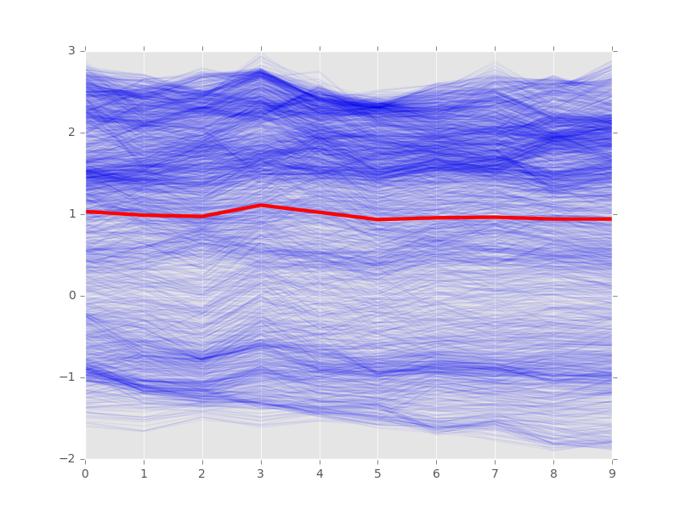
Mixed-effect model analysis

Slide 29
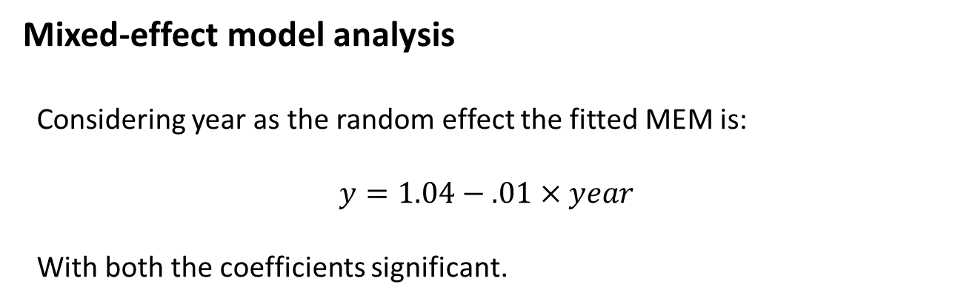
Mixed-effect model analysis
Considering year as the random effect the fitted MEM is:
$$y=1.04−.01×year$$
With both the coefficients significant.

Slide 30
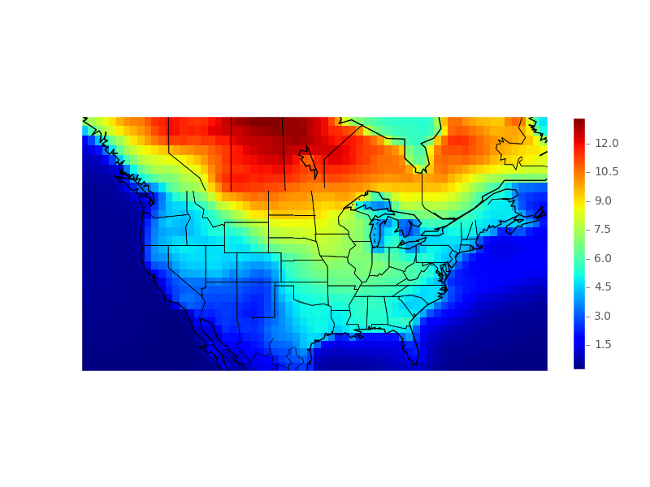
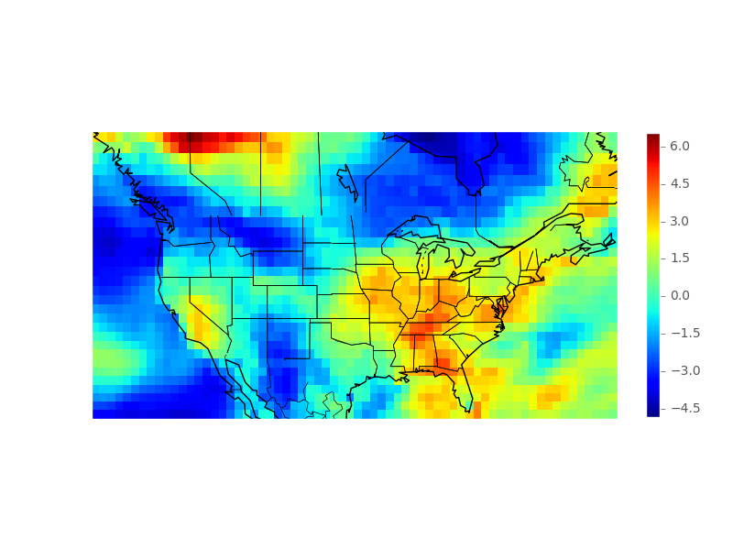
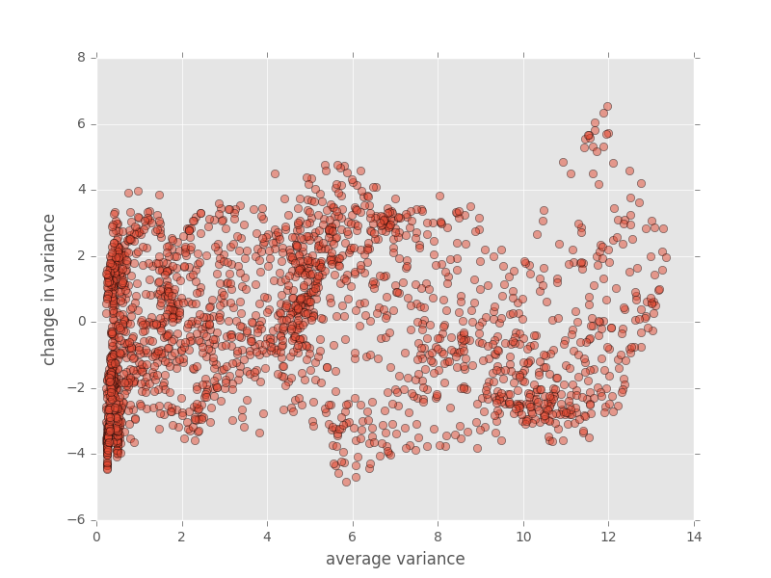
Change in estimated variance
Average variance
Change in variance

