Slide 1
Moozeek NLP
AMANDA HOSMAN

Slide 2

Overview
Moozeek is a new streaming app which lets you listen to tunes from major labels on the web or via the Moozeek app. Like it's competitors: Pandora and Spotify, Moozeek recommends similar artists to your playlist but also adds new and upcoming artists based off similarities and artist selection upon creating an account.

Slide 3
Moozeek would like to add a 'relevant artists' section solely formulated from recent keyword searches in their app for a more accurate listening experience.
Moozeek would like to add a 'relevant artists' section solely formulated from recent keyword searches in their app for a more accurate listening experience.

Slide 4
The course
SUBREDDIT DATA
MODELING
PLAN
Gather data from the subreddits of two artists/musicians in different genres.
Identify the classification model with higher accuracy/recall score to get the key differences that a Moozeek needs to improve attraction from the competitor's audience.
Communicate out the improvement criterias to bring in better subscription rates to maximize profit from marketing expenses.

Slide 5



Lana Del Rey
Metallica

Slide 6
About selected artists
Lana Del Rey:
Rose to fame in 2011 when her song ‘Video Games’ gained popularity on Youtube.
Best known for her studio album ‘Ultraviolence’ released in 2014.
Music genre: ‘indie-pop’ and ‘sad-core’’
Metallica:
Rose to fame in 1986 with their third album Master of Puppets.
Their most recognized song is ‘Enter Sandman’
Music genre: ‘heavy metal’

Slide 7
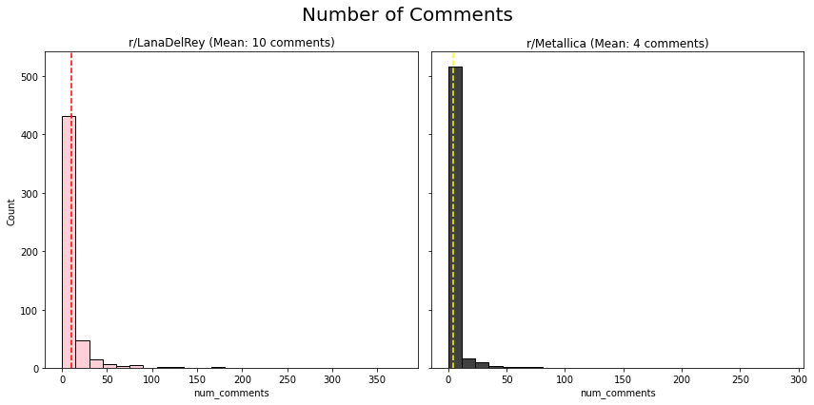

Slide 8
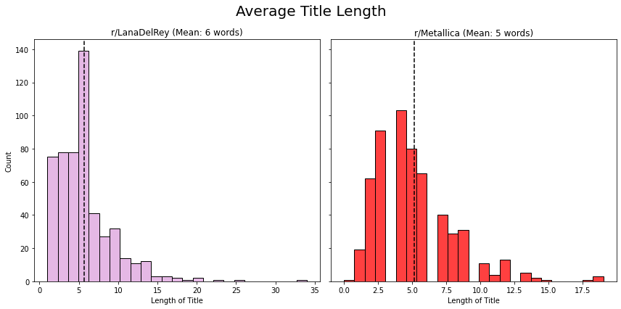

Slide 9
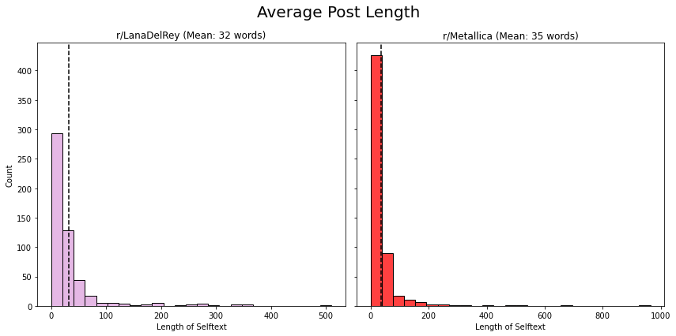

Slide 10
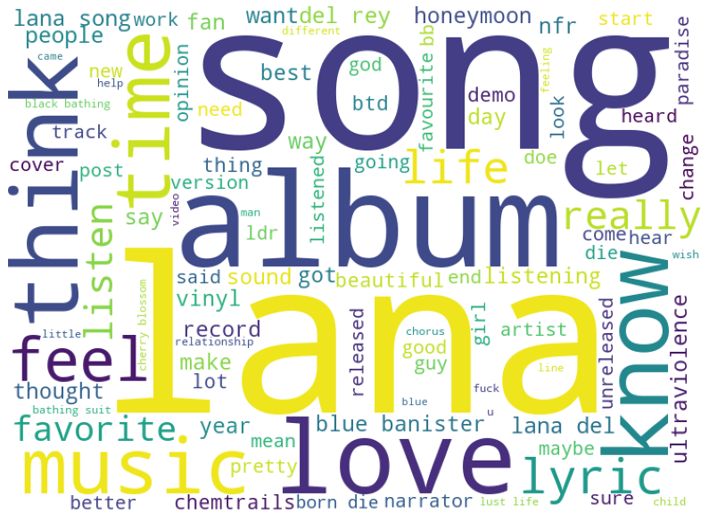
r/lanadelrey top words

Slide 11
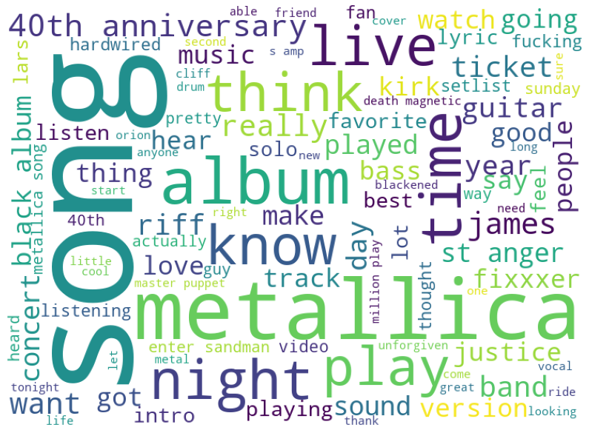
r/metallica top words

Slide 12
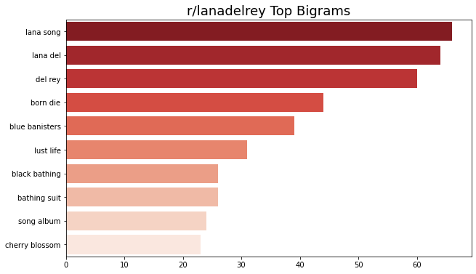
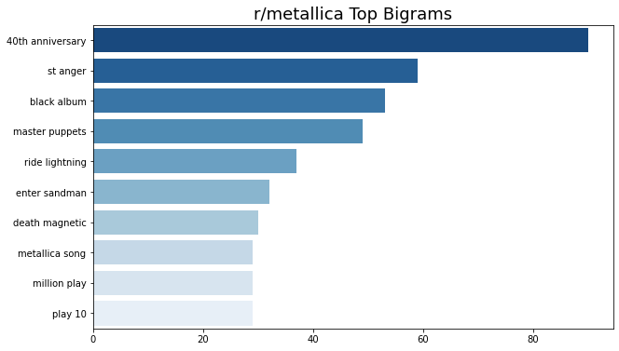
Top bigrams

Slide 13
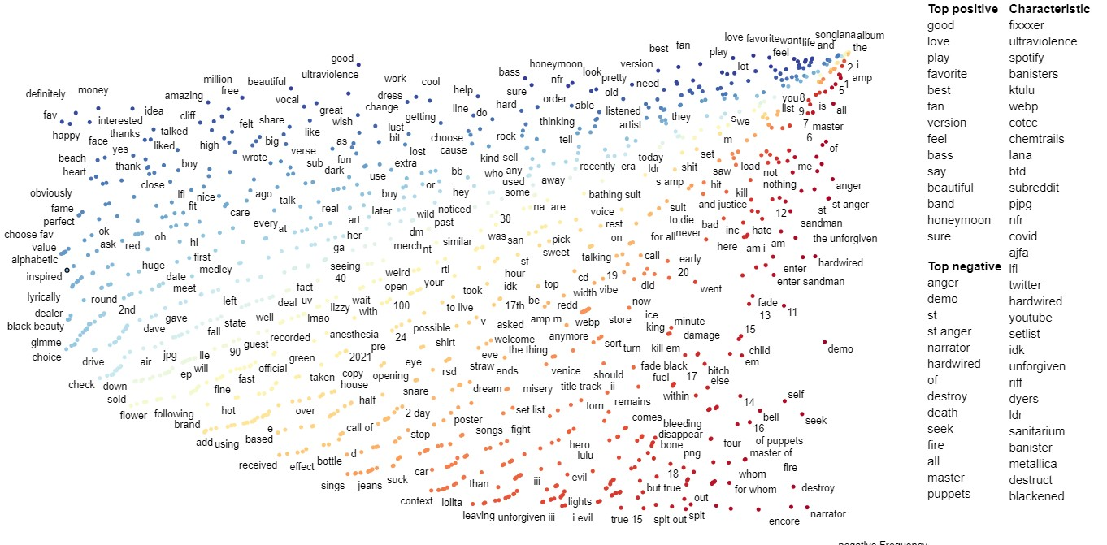
Click to interact with scatterplot

Slide 14
Conclusion:
The model we chose to better classify the posts for r/lanadelrey and r/metallica is the linear regression model with tfid vectorizer due to its higher r2 score, recall and f-1 score as a whole.
Recommendations:
When someone wants to listen to a certain genre, they do not want to be interupted with a sudden change of tone/tune. Classifying keywords should be a priority to categorize the correct artist to the correct genre. Also, makes a run for a great listening experience.
Dig further into keyword predicitions for moods in regards to genre.
Metallica

