Slide 1

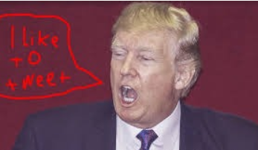
TRUMP TWEETS' ANALYSIS
Group G1-6
Akash Khowala
Amit Singla
Neel Chomal
Pankaj Bhootra
Wu Yinxiao

Slide 2
Project Objective
Our objective will be to establish certain definitive findings around the ramifications of Trump’s market takes which could potentially be of use in designing systemic strategies.

Slide 3
Data
No. | Description
1 | Twitter dataset provided by Professor
2 | Kaggle Tweets dataset
3 | Market Trends, eg. US Treasury dataset

Slide 4
Methodology
Topic Analysis – Finding out key words, for example – jobs, trade, military, etc. using clustering to study the impact of Trump’s tweets on the respective industry/sector.
Sentiment Analysis – We will be segregating the tweets on ‘positive’, ‘negative’ and ‘neutral’. This will help us generate data for our prediction analysis.
Exploratory Data Analysis (EDA) – The objective here is to find out the variables that have an impact on the market trends (e.g. treasury yields) for the analysis we will be doing later in the project
Hypothesis Testing – Recognizing correlation between treasury interest rates over time as compared to Trump’s tweets. For example, in case of treasury yields:
Yes – Trump’s hypothesis have an impact on the treasury yield curve rates.
No – Trump’s tweets do not have an impact on the treasury yield curve rates.
Predictive Analysis – We aim to build a predictive model to incorporate all the above analysis and predict market trend given a Trump tweet.

