Slide 1

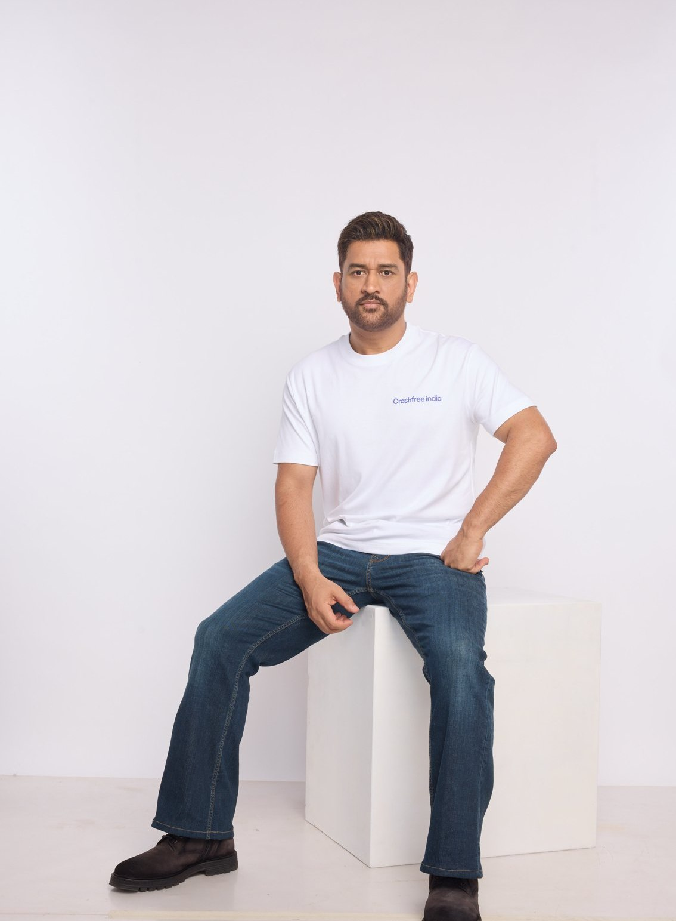



AUGUST 2026 · NEW DELHI
EXPRESSION OF INTEREST · NATIONAL ROAD SAFETY BOARD
Crashfree India
Application to Working Group 2:
Safe Roads, Speeds & Vulnerable Road Users
Expert-guided student audits that end in built fixes, 31 sites, 7 completed
Technology the system uses: AI enforcement with police, public tracking dashboards
MS DHONI · GOODWILL AMBASSADOR,
CRASHFREE INDIA
Published audit reports and policy research, anchored to the IRC codes
Submitted to the Chairperson and Members, Working Group 2, National Road Safety Board
crashfreeindia.org

Slide 2
BEFORE THE SLIDES
A letter to the Working Group
New Delhi · August 2026
Respected Chairperson and Members of Working Group 2,
Crashfree India is a young road safety nonprofit, registered as the Vision Zero Trust, co-founded with the Indian Road Safety Council, and backed by a three-year, US$3 million commitment from Cars24. Our core work is road infrastructure: trained student teams audit dangerous locations under senior experts, to IRC codes and MoRTH checklists, and we walk each recommended fix through the road-owning authority until it is built, tracked on a public dashboard. MS Dhoni carries this message to the country as our Goodwill Ambassador.
In our first year we audited 31 high-risk locations across 18 cities with teams from 20 institutions, secured 25+ written approvals from road-owning authorities, and implementation has started at 15 sites, with 7 already fully built. SATARK, our AI enforcement platform, has screened over 3,00,000 vehicles for police in Jaipur and Bengaluru and has now reached Gurugram. Four open public data platforms and a national youth pipeline complete the picture.
The pages that follow introduce the organisation briefly, then set out the work most relevant to this Working Group in the detail its mandate deserves. Everything shown is running today, is public, and is offered to the Board without cost. We would be honoured to contribute.
Respectfully,
Akhtar Hussain
Mission Lead, Crashfree India · akhtar@crashfreeindia.org · crashfreeindia.org

Slide 3





HOW THIS DECK IS ORGANISED
Five sections, from who we are to what we offer
1
About us, and how we work
04 – 06
Who we are, our approach to the road crash crisis, and why this Working Group.
2
What we have built
07 – 14
Every public-facing programme, audits, enforcement tech, victim support, open data, youth, campaigns.
3
Our people
15 – 16
The team, its capabilities, and the expert bench around the work.
4
Project Rakshak in depth
17 – 26
The deep dive matched to this Working Group's mandate, evidence, method, results.
5
How we can contribute
27 – 28
Four concrete, no-cost offers to the Working Group.

Slide 4

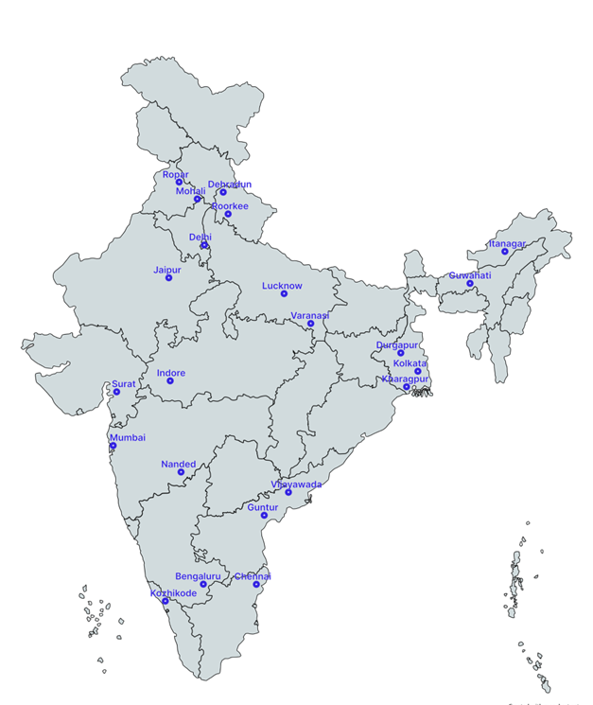



01 · ABOUT US
SECTION 1 OF 5 · ABOUT US
Crashfree India: a nonprofit that adds capacity to road safety work
Registered as the Vision Zero Trust · Co-founded by Cars24 and the Indian Road Safety Council · Working since June 2025 · New Delhi
Evidence first
Structured field audits, file reviews and research to official standards, not opinion.
Institutional collaboration
We work through PWDs, NHAI, transport departments, police and District Road Safety Committees.
Youth-led capacity
Trained student teams from IITs, NITs and SPAs add the auditing hands the system needs.
Technology for follow-through
Public dashboards track every recommendation from submission to completion.
The Group's mandate is our daily work: audits that end in built fixes, evidence for managing speeds, and streets designed around pedestrians and riders.
Where we work today, 18 cities, north to south.
Crashfree India · Expression of Interest — Working Group 2
04 / 28

Slide 5


01 · ABOUT US, OUR APPROACH
SECTION 1 OF 5 · ABOUT US
Our approach: work with the system, and prove it with data
Four steps, applied to every problem we take up, from a dangerous junction to a stalled compensation claim.
1 · Evidence
2 · Institutional partnership
3 · Technology
4 · Follow-through
Field audits, file reviews and research to official standards.
→
Work through the authority that owns the problem, never around it.
→
Dashboards, AI and WhatsApp tools that fit how officials already work.
→
Every recommendation tracked publicly to completion.
31 sites audited · 50+ stakeholder consultations
31 sites audited · 50+ stakeholder consultations
25+ written approvals · 4 DRSCs · MoUs with police
25+ written approvals · 4 DRSCs · MoUs with police
Aasha · SATARK · 4 open data platforms
Aasha · SATARK · 4 open data platforms
Implementation started at 15 sites · 7 fully built
Implementation started at 15 sites · 7 fully built
We do not replace the system and we do not campaign against it. We add hands, evidence and tools to work the system has already committed to.
Crashfree India · Expression of Interest — Working Group 2
05 / 28

Slide 6



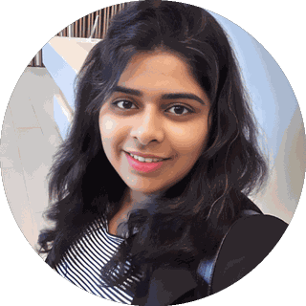
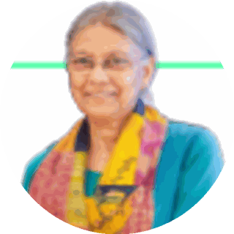
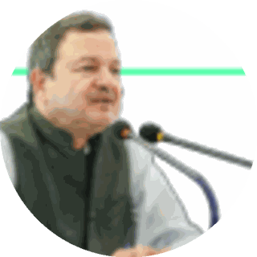
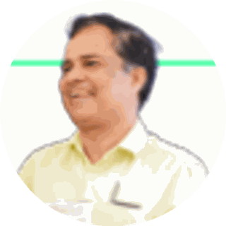
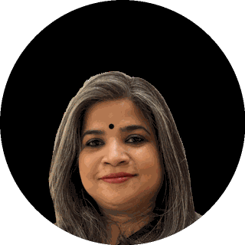
01 · WHY WORKING GROUP 2
SECTION 1 OF 5 · ABOUT US
Why Working Group 2, and what we bring to it
The Group's mandate matches the deepest part of our portfolio. Three focus areas where we are ready on day one.
Black-spot rectification at scale
Our audit-to-implementation pipeline is running in 18 cities, the Group's rectification agenda is our core work.
EXISTING CAPABILITIES WE PUT ON THE TABLE
31 trained audit teams
Public tracking portal
District pilots: GGM · SWD · Jaipur
Gig-rider safety study
Standards for audits & speed management
Audit instruments anchored to IRC codes and MoRTH checklists, with masterclass-trained student teams.
7 sites fully built
Expert bench on call
Protecting vulnerable road users
Pedestrian-first audits, our published gig-rider safety study, school-zone screening, evidence ready for VRU standards.
SUBJECT-MATTER EXPERTS ALREADY ENGAGED ON THIS AGENDA
Dr. Richa Ahuja Asst Professor, IIT Kharagpur
Prof. Geetam Tiwari TRIP Centre, IIT Delhi
Abhay Damle Ex-Joint Secretary, MoRTH
Dipak Dash Senior journalist, Times of India
Sarika Panda Bhatt Co-founder & Trustee, Raahgiri Foundation
Crashfree India · Expression of Interest — Working Group 2
06 / 28

Slide 7
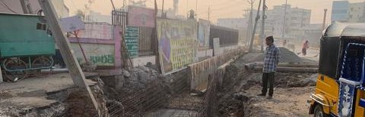
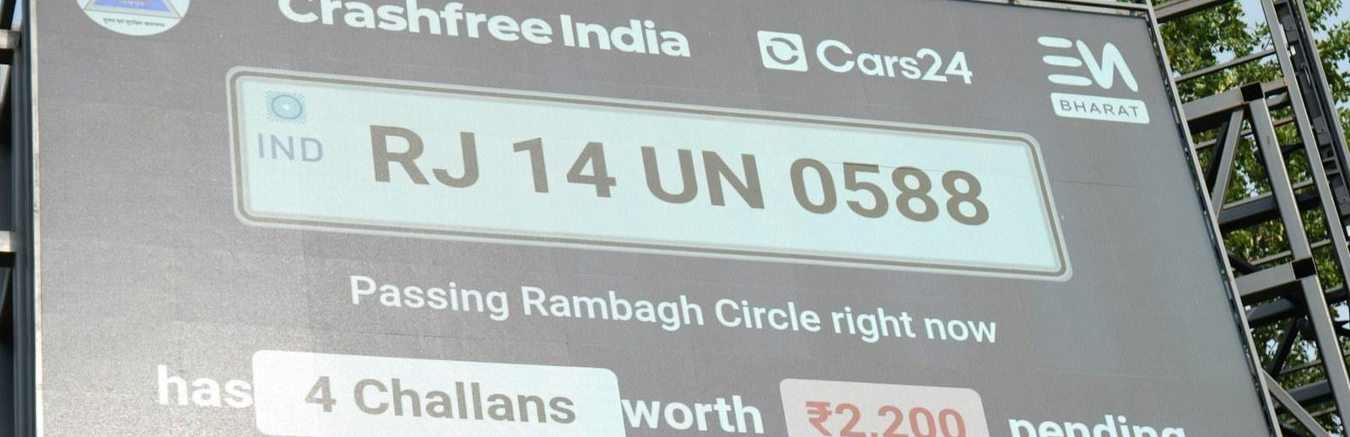
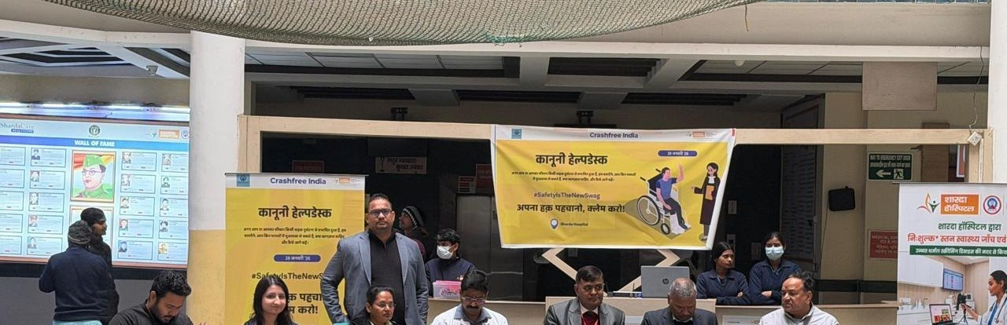
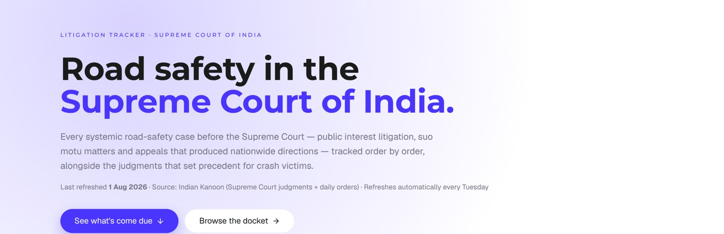
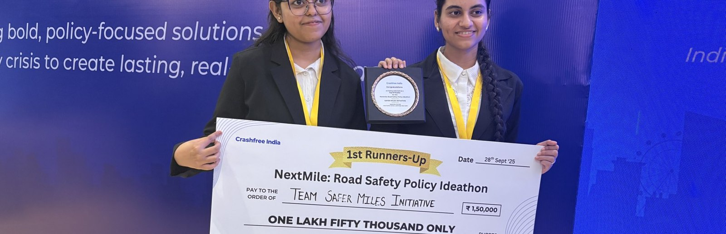
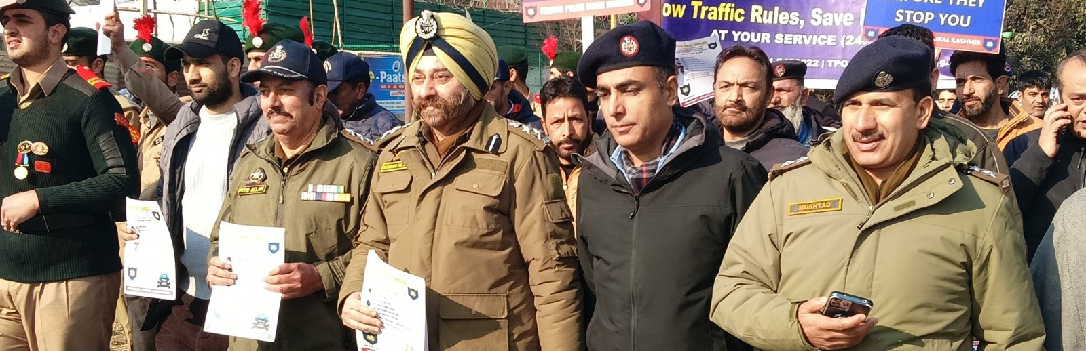
02 · WHAT WE HAVE BUILT
SECTION 2 OF 5 · WHAT WE HAVE BUILT
Six lines of work, one connected system
Audits create data · data supports policy · policy guides the field. Everything below is live today.
Project Rakshak
SATARK enforcement
Victim support
Student-led road audits, fixed with authorities
AI support that helps police find high-risk vehicles
Aasha chatbot, calculator, hospital helpdesks
31 sites · 7 fixes fully built
3,00,000+ vehicles screened
100+ victims helped in first 4 days
Open public data
Youth & policy
Public campaigns
Four self-updating data platforms, free to use
NextMile ideathon and national dialogue series
Road Safety Month with police & schools; MS Dhoni
36 states & 50 cities covered
2,000+ participants engaged
1M+ citizens reached
Crashfree India · Expression of Interest — Working Group 2
07 / 28

Slide 8
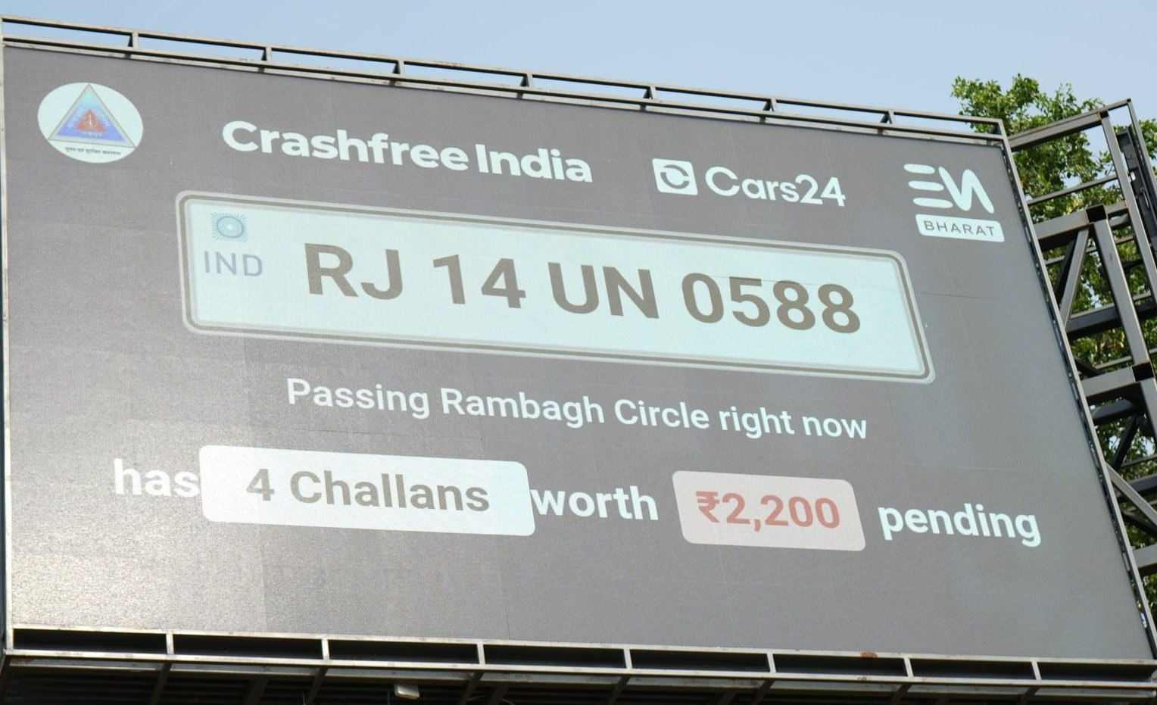
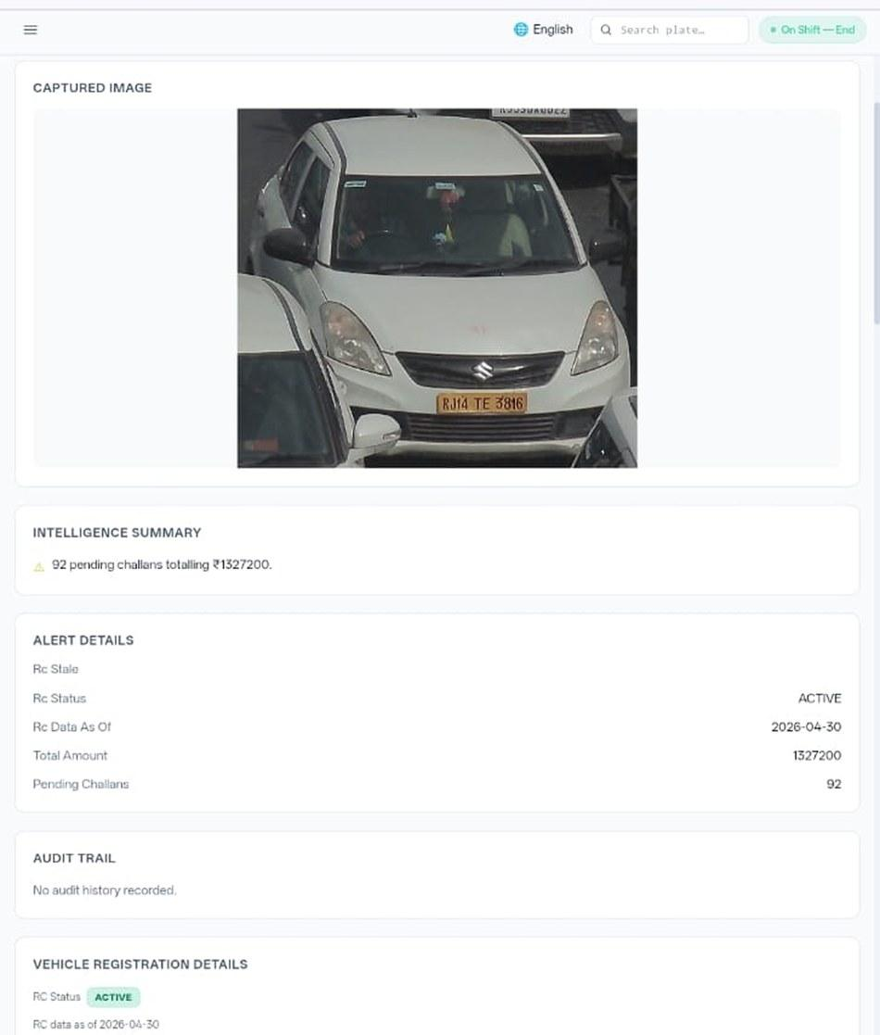








02 · WHAT WE HAVE BUILT, ENFORCEMENT TECHNOLOGY
SECTION 2 OF 5 · WHAT WE HAVE BUILT
SATARK: AI that helps police stop the right vehicle
Built with Cars24 engineers. Reads number plates, checks government records, and alerts officers to repeat offenders, in real time.
3,00,000+
₹30 Cr+
vehicles screened
pending challan value identified
350+
70,019
high-risk vehicles intercepted
vehicles found with pending challans
LIVE · Jaipur & Bengaluru
NEW · Gurugram
Officer view, challans,
RC & compliance status.
Bengaluru's Trinity Circle billboard was India's first, covered by Deccan Herald and national press. Pune and Ahmedabad are next.
Rambagh Circle, Jaipur, live plate, pending challans and dues on a public billboard.
ANPR camera
Plate read
Records check
Risk flag
Officer alert
Billboard
Interception
Enforcement
Crashfree India · Expression of Interest — Working Group 2
08 / 28

Slide 9
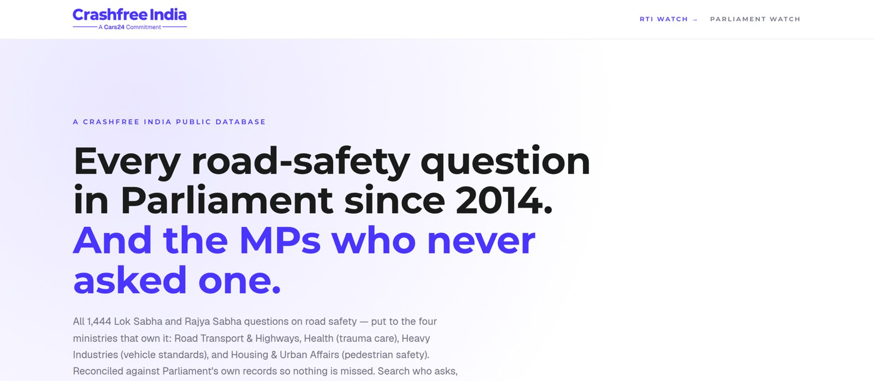



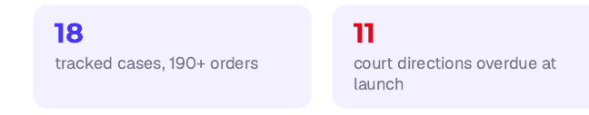
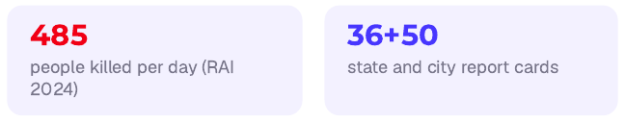
02 · WHAT WE HAVE BUILT, OPEN PUBLIC DATA
SECTION 2 OF 5 · WHAT WE HAVE BUILT
Live public data platforms, free for any authority
Four platforms, each turning a scattered public record into structured, citable evidence. The Parliament tracker is shown live, as captured this week.
National Road-Infrastructure
Defect Repository
DAILY · 07:00 IST
An AI pipeline reads local-language news every morning and turns road-defect reports into structured, mapped, ranked evidence, each entry carrying its verbatim source.
Potholes
Missing signage
Unlit stretches
Blind curves
Broken dividers
146
districts scanned daily
13
languages read
21
defect codes tracked
Road Safety in Parliament: all 1,444 questions since 2014 across four ministries; 275 of 540 sitting Lok Sabha MPs have never asked one.
Local news → AI extraction → confidence gate → human review → public map. Live across Bihar, UP and Rajasthan districts today.
Supreme Court Litigation Tracker
WEEKLY · LIVE
Crash Data Dashboard
ANNUAL · OPEN DATA
Every systemic road-safety matter before the Supreme Court, orders indexed, precedent judgments digested, refreshed every Tuesday.
MoRTH's annual 'Road Accidents in India' books as a usable product: report cards for 36 states and 50 cities, every number reconciled against the printed books, open licence (CC-BY).
Crashfree India · Expression of Interest — Working Group 2
09 / 28

Slide 10
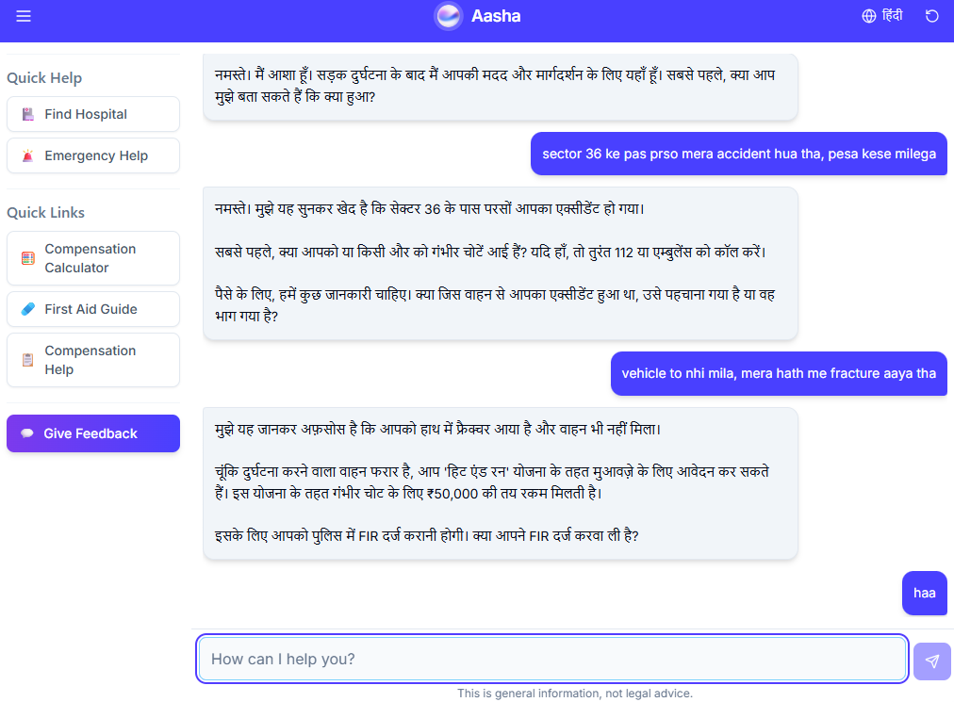
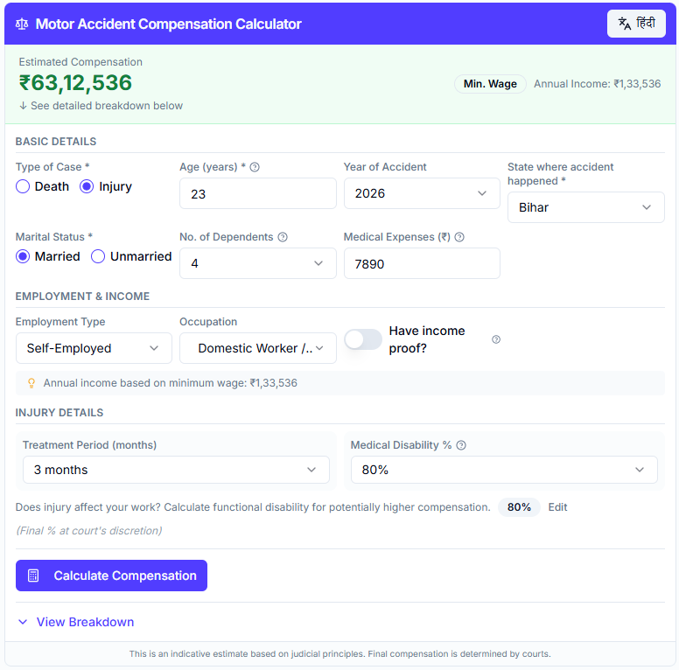
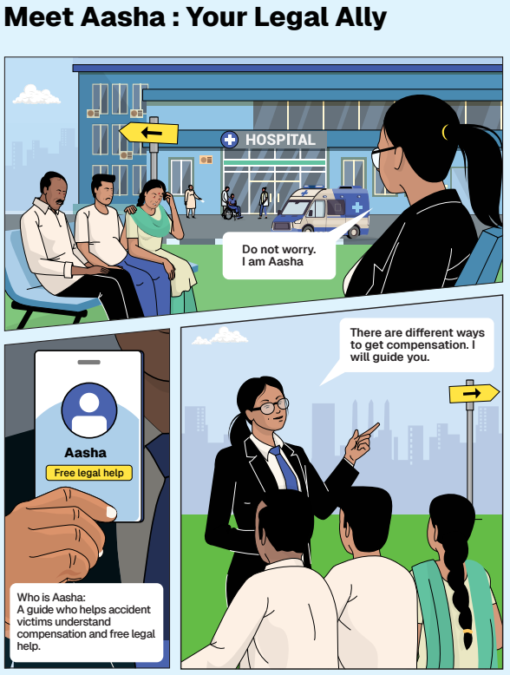
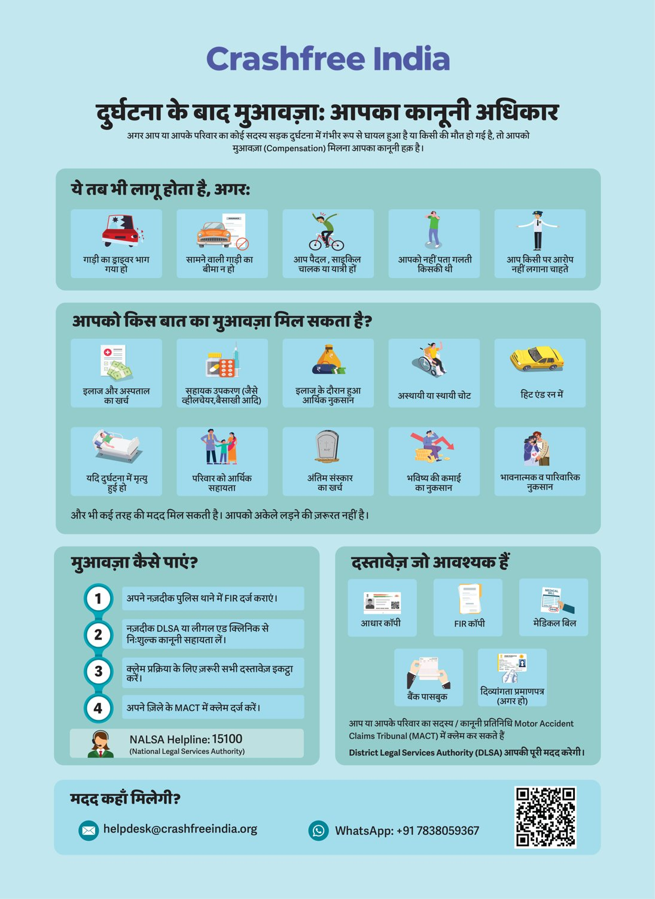




02 · WHAT WE HAVE BUILT, VICTIM SUPPORT
SECTION 2 OF 5 · WHAT WE HAVE BUILT
Help a family can actually use, in their language
From the first hours after a crash to the final compensation order, on WhatsApp, on paper, and in person.
Aasha chatbot
Compensation Calculator
'Meet Aasha' comics
Hindi rights guide
India's first AI legal companion for crash victims, on WhatsApp and voice, no app needed.
Free instant estimates computed on Supreme Court principles (Sarla Verma, Pranay Sethi).
Plain-language legal education that families actually read, at desks and in schools.
All three compensation routes, NALSA 15100 and the Cashless Treatment Scheme 2025.
Hospital helpdesks bring all of this to the trauma-ward bedside , 100+ victims supported in the first four days, run with DLSA and Neev Foundation.
Crashfree India · Expression of Interest — Working Group 2
10 / 28

Slide 11
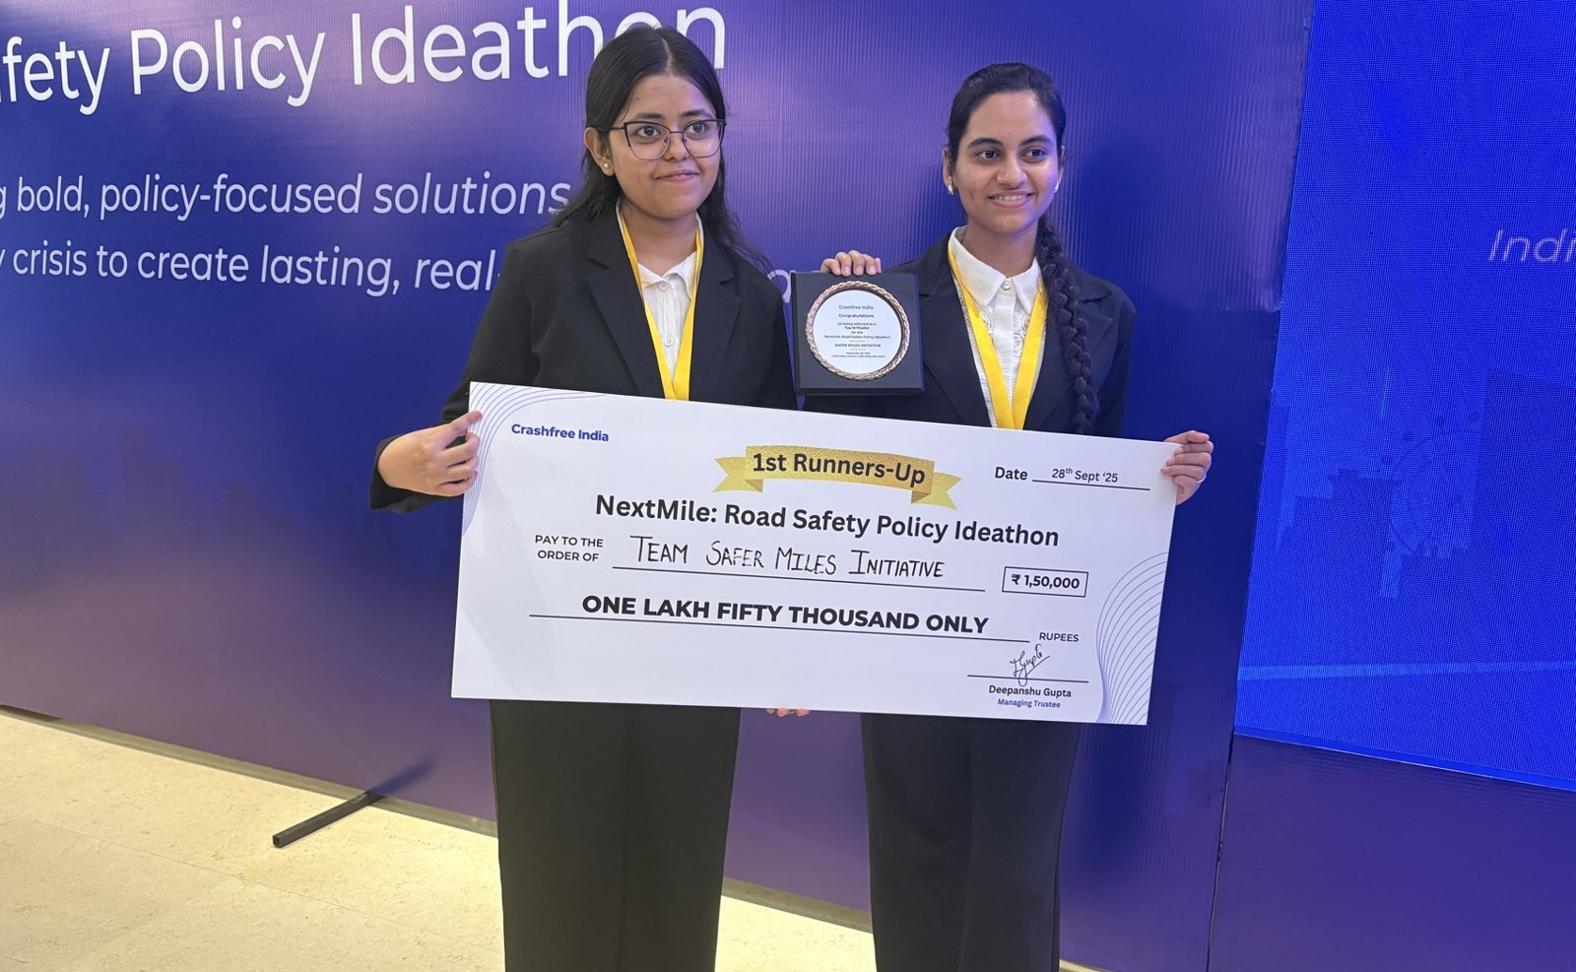
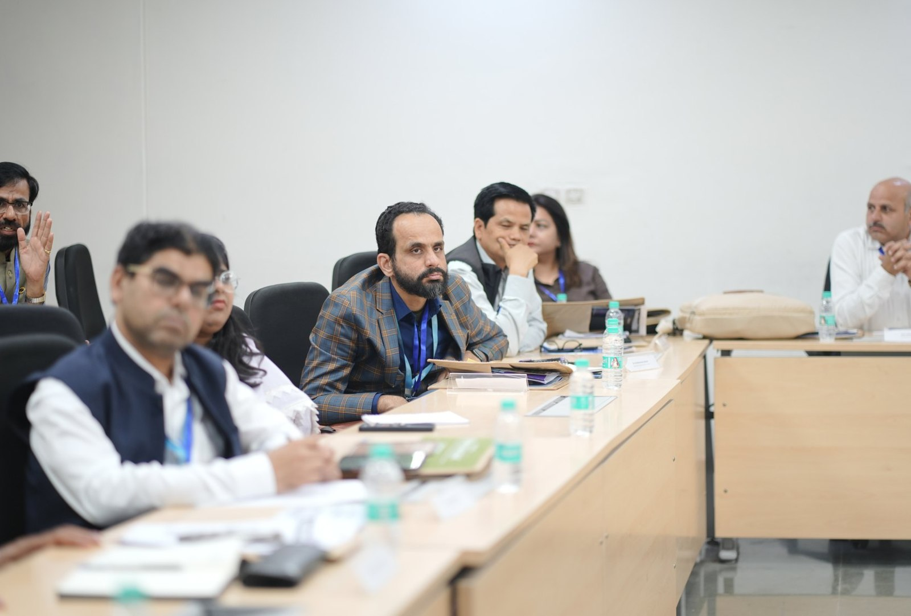



02 · WHAT WE HAVE BUILT, YOUTH & POLICY
SECTION 2 OF 5 · WHAT WE HAVE BUILT
Young talent and senior experts, working the same problem
A steady pipeline of engineers and policy minds, so road safety work never runs out of hands.
National Road Safety Dialogue Series
200+ live attendees; speakers from MoRTH, CIRT, AIIMS Trauma Centre, CSIR-CRRI and ARAI.
Three sessions so far
Bus safety · Delivery rider safety · Good Samaritan law & the Cashless Treatment Scheme.
NextMile: Road Safety Policy Ideathon, grand finale, 28 Sep 2025, New Delhi.
National Road Safety Implementation Forum, IIT Delhi: 60+ experts from MoRTH, WHO, UNICEF, iRAP and CSIR-CRRI reviewed the work.
Advocacy on video
Our YouTube channel documents hazards and fixes on camera: ground-audit walkthroughs, Dialogue Series recordings and victim-education explainers. A public record any authority can cite.
2,000+
250+
700+
10
Mentors and jury from the Government of Rajasthan, NIUA, OMI, NASSCOM and CSEP judged the student teams; winning tracks now feed our audit and research pipeline.
participants
concept notes
teams
finalist teams
Next: 'Be a Rakshak' university chapters at IITs, NITs and SPAs.
Crashfree India · Expression of Interest — Working Group 2
11 / 28

Slide 12
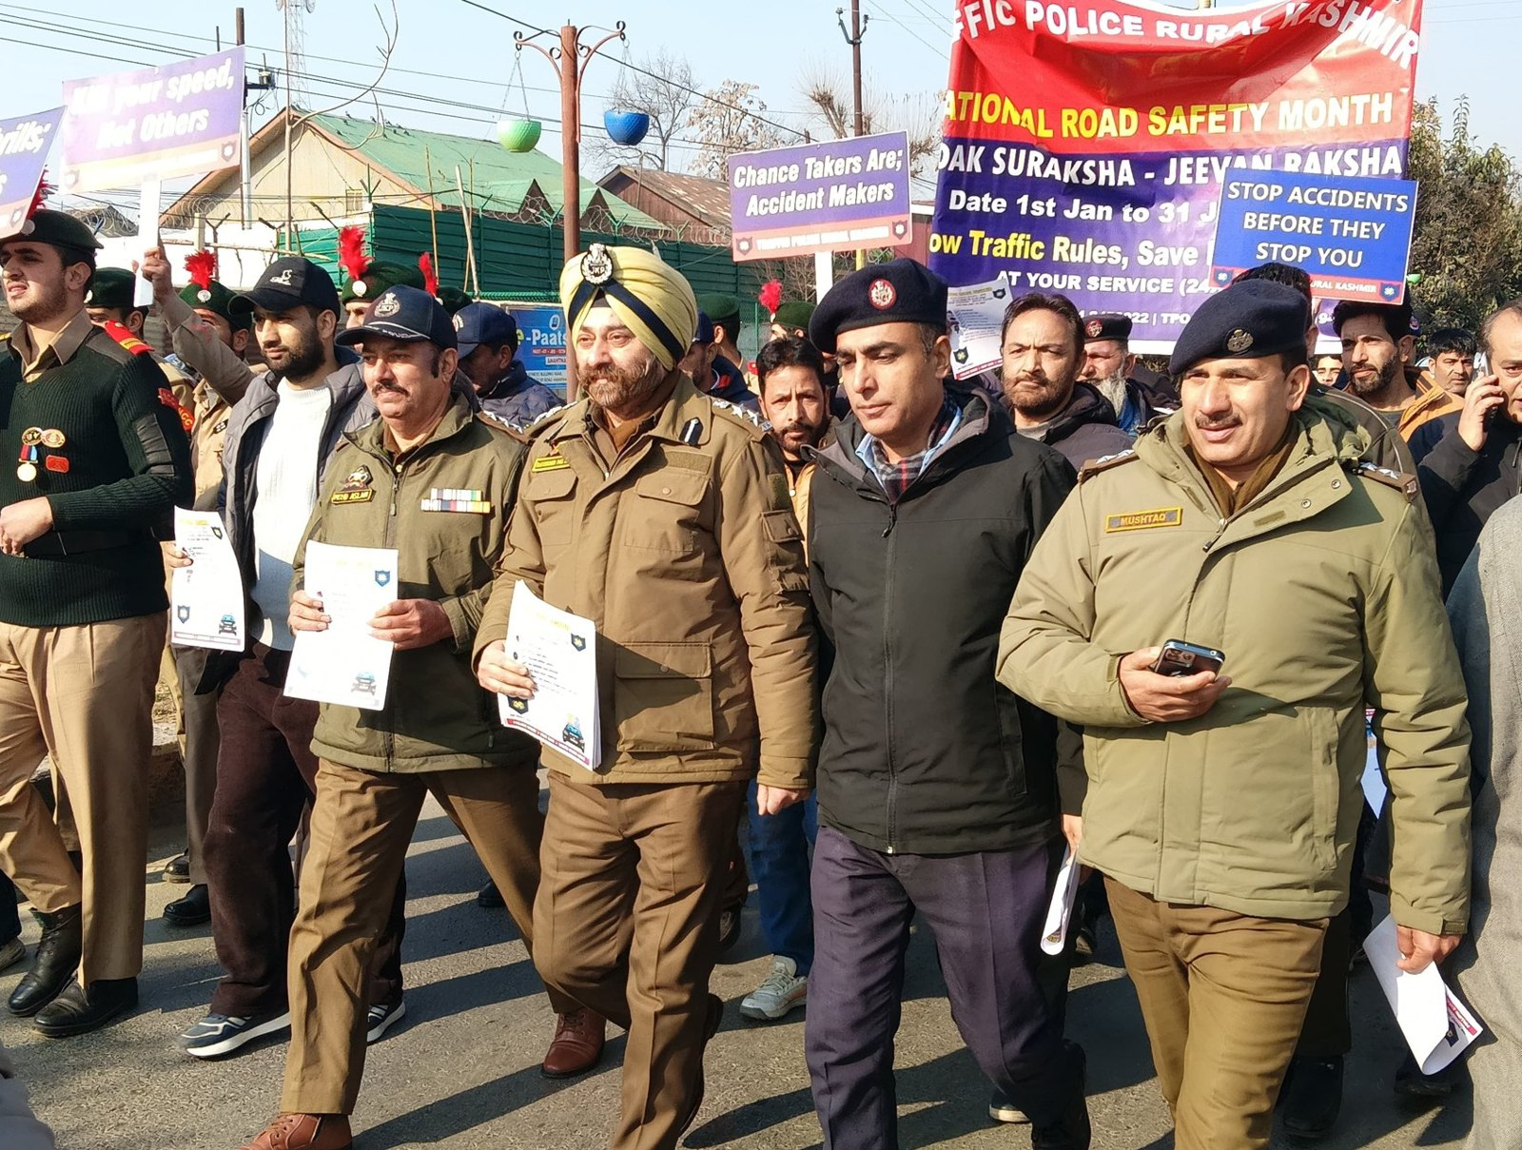
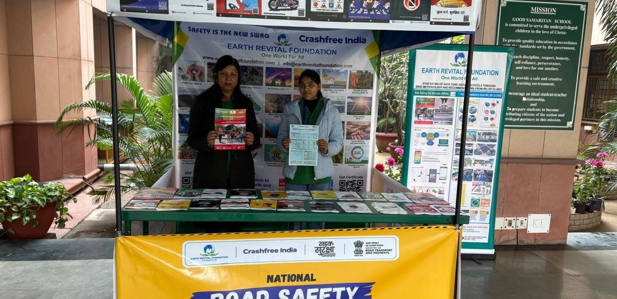
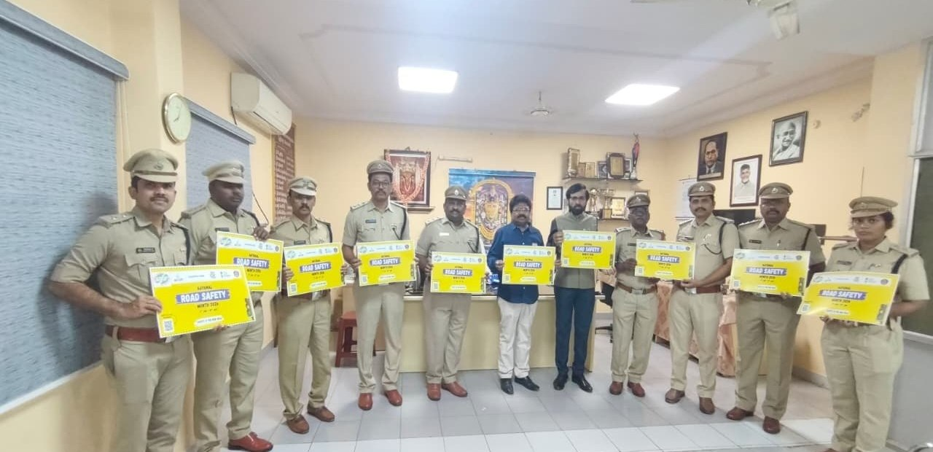
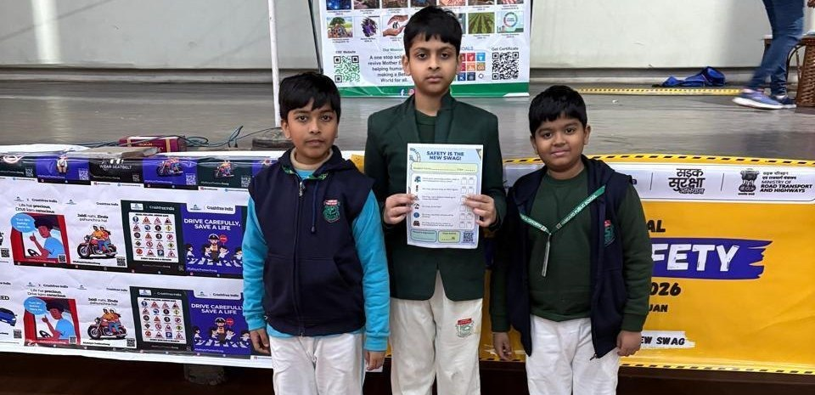
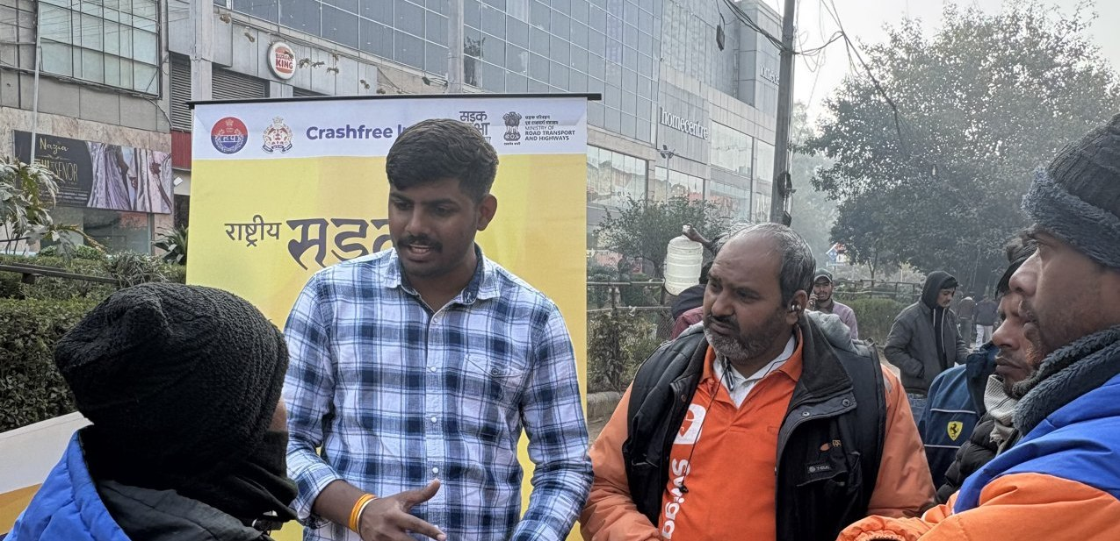
02 · WHAT WE HAVE BUILT, ON THE GROUND
SECTION 2 OF 5 · WHAT WE HAVE BUILT
Road Safety Month 2026, run with the system
With district police, schools, hospitals and delivery platforms, in Hindi and local languages.
CFI stall at a government office
Materials briefing with police staff
National Road Safety Month rally, on the road with district traffic police, Jan 2026.
School programme with certificates
Delivery-rider outreach, Swiggy & Instamart
1M+ citizens reached across campaigns in year one.
Crashfree India · Expression of Interest — Working Group 2
12 / 28

Slide 13
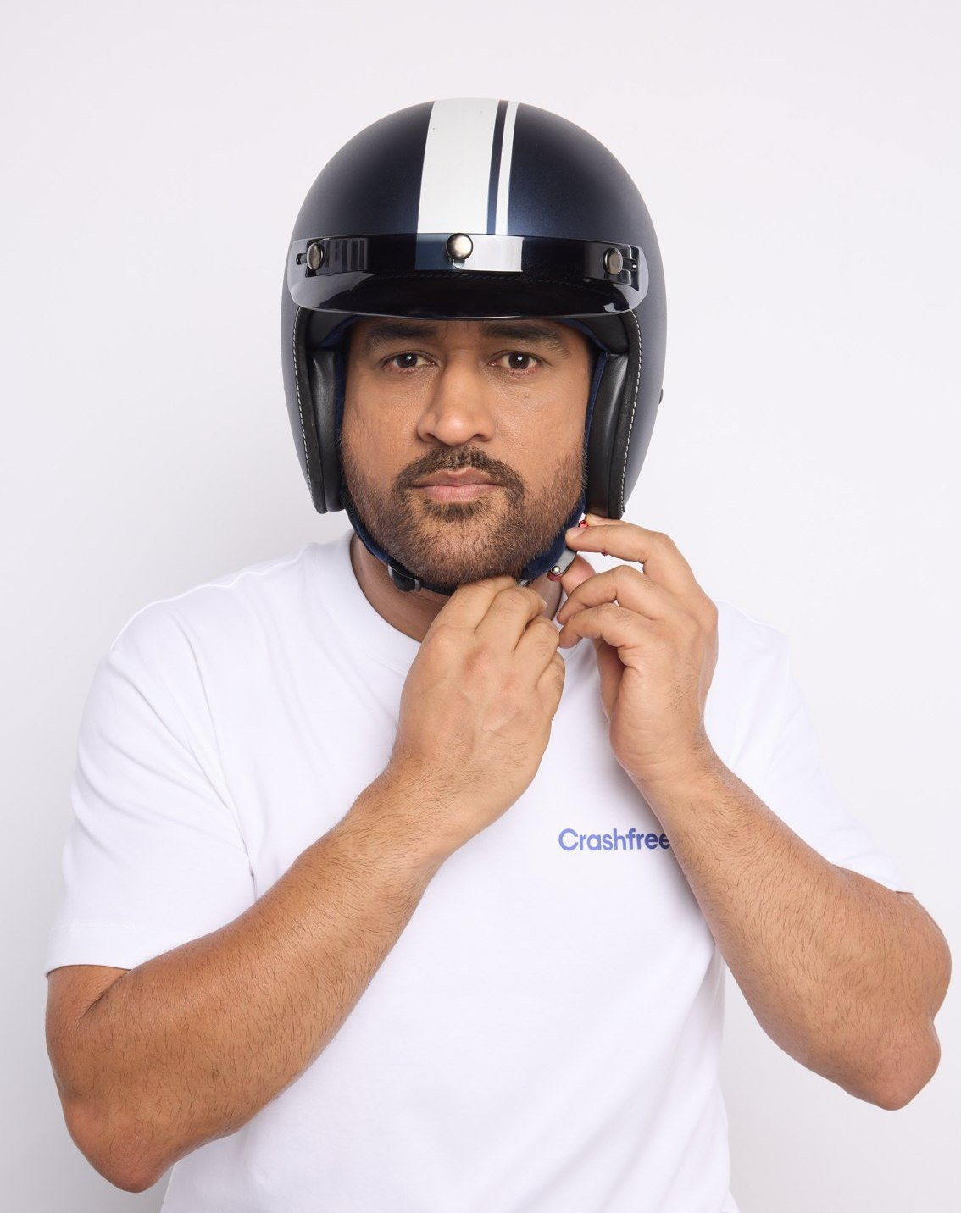
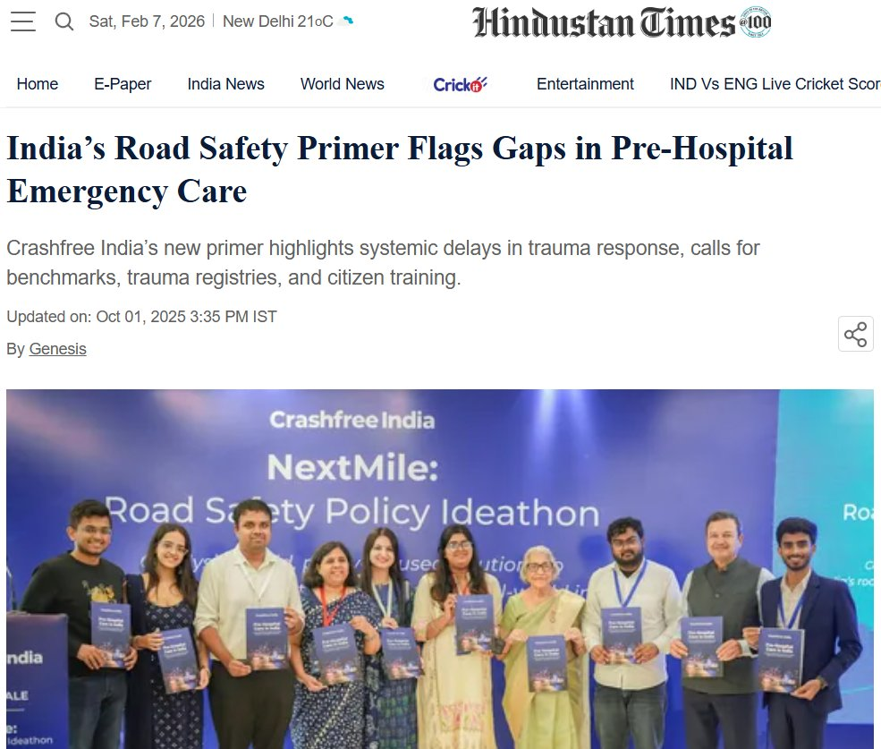
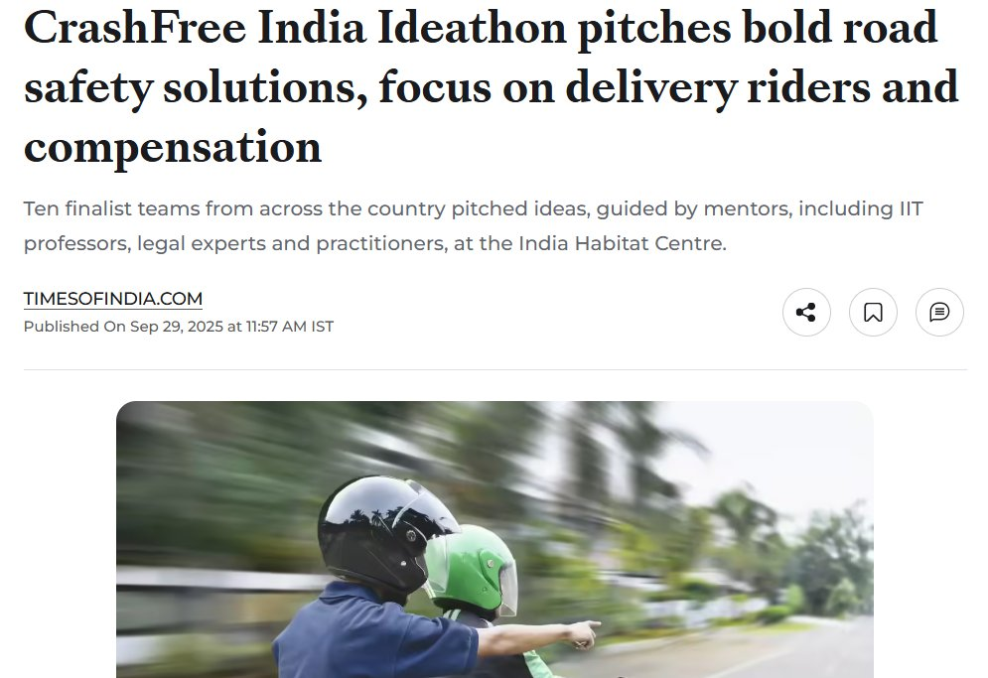

02 · WHAT WE HAVE BUILT, PUBLIC VOICE
SECTION 2 OF 5 · WHAT WE HAVE BUILT
MS Dhoni gives road safety a national voice
AS SEEN IN THE PRESS
"We already know what is going wrong. What we need now is more responsibility, more discipline, more respect for life."
ThePrint, on the NextMile
ideathon finale.
MS Dhoni, at the National Road Safety
Implementation Forum, IIT Delhi
Hindustan Times, on our
Pre-Hospital Care Primer.
Deccan Herald
Economic Times
Fortune India
MS Dhoni, Goodwill Ambassador, announced April 2026.
IndiaSpend
Scroll.in
The Wire
Dhoni's voice powers 'Be a Rakshak', school-zone safety and compensation-awareness campaigns.
Times of India
Business Standard
Crashfree India · Expression of Interest — Working Group 2
13 / 28

Slide 14
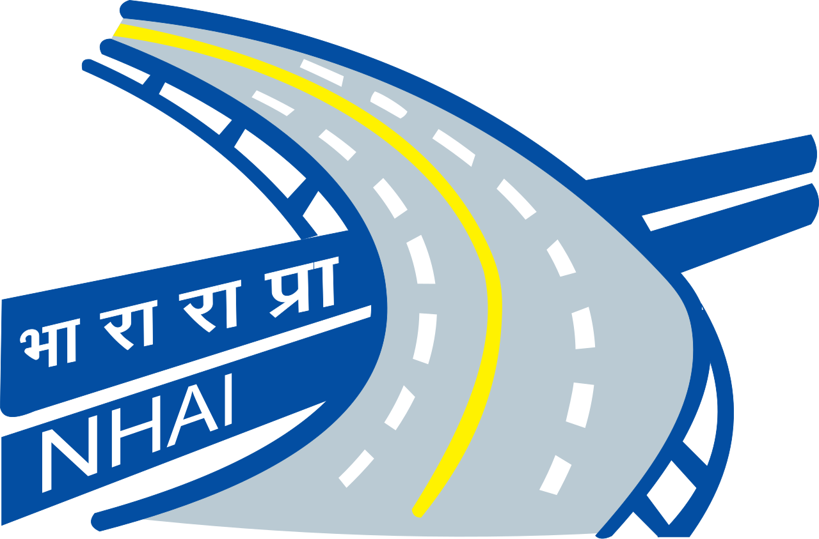
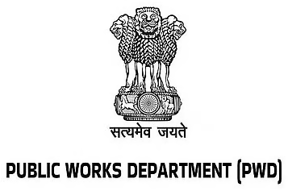
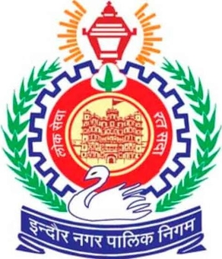
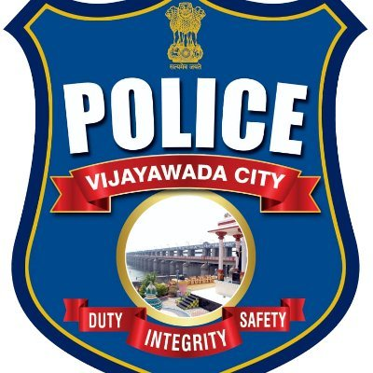
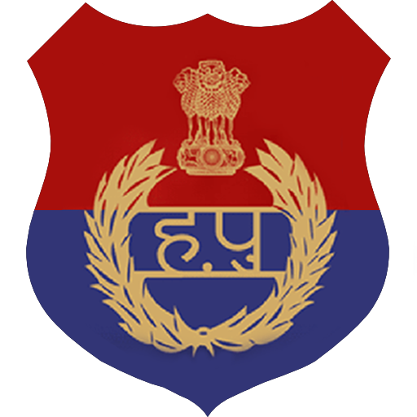
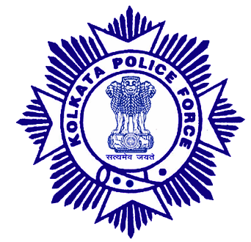
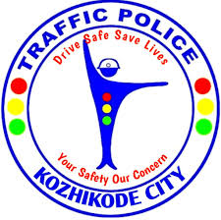
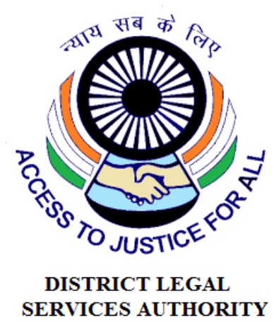















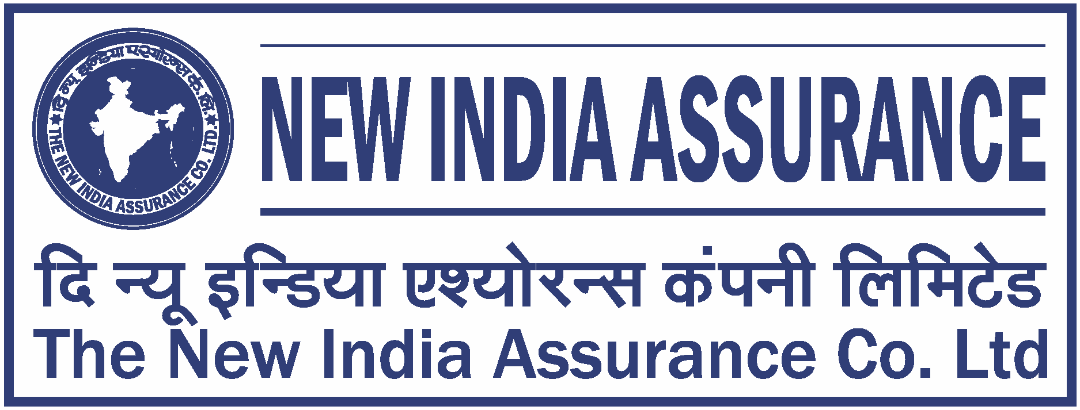
02 · WHAT WE HAVE BUILT, THE NETWORK
SECTION 2 OF 5 · WHAT WE HAVE BUILT
The institutions around the work
As they appear in our working decks, engagement ranges from formal MoUs and written approvals to jury, mentoring and research collaboration.
AUTHORITIES & PUBLIC BODIES WE WORK WITH
UNIVERSITIES & INSTITUTES FIELDING AUDIT TEAMS
EXPERT & ECOSYSTEM PARTNERS
Plus: Jaipur Traffic Police & Gurugram Police (MoUs) · CPWD & district administrations · Bloomberg, Johns Hopkins, Centre for Green Mobility and PwC experts on juries and reviews.
Crashfree India · Expression of Interest — Working Group 2
14 / 28

Slide 15
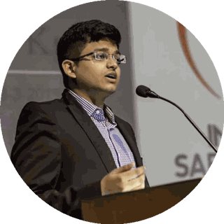
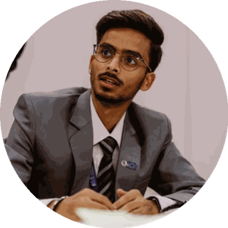
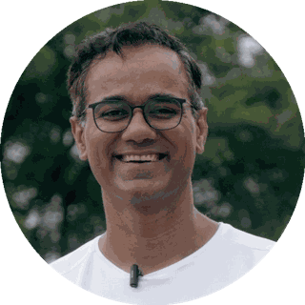
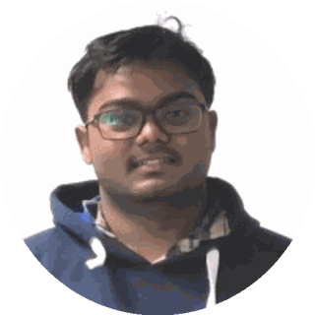
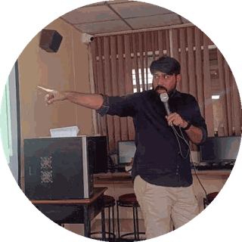
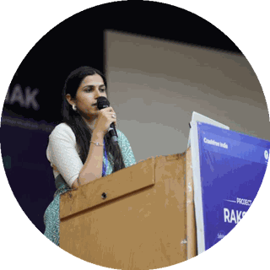
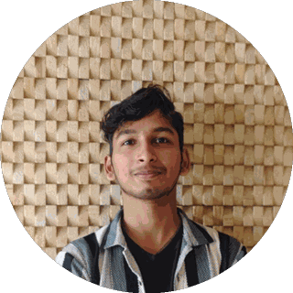
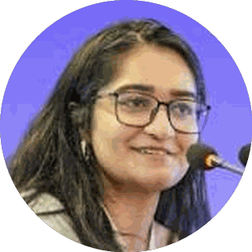
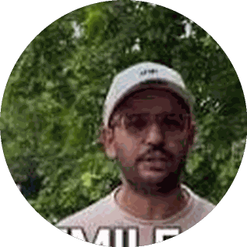




03 · OUR PEOPLE
SECTION 3 OF 5 · OUR PEOPLE
A full-time team built for this work
Engineering, law, policy, product and field operations, under trustees who have led Indian road safety for a decade.
Amar Srivastava
Deepanshu Gupta
Gajendra Jangid
President · Founder, Indian Road Safety Campaign · Member, National Road Safety Council
Managing Trustee · Founder, IRSC · Global Youth Coalition for Road Safety
General Secretary · Co-founder, Cars24
THE FULL-TIME TEAM
Akhtar Hussain Mission Lead
Shubham Kumar Policy & Advocacy
Muskan Yadav Programmes
IIT Delhi · ex-Bain · strategy, programmes, new initiatives, partnerships and product
NALSAR Hyderabad · programmes, policy advocacy, legal research, government relations
TISS · district programmes, Project Rakshak, infrastructure interventions, DRSC work
Krishna Jain Tech & Product
Aastha Shreeharsh Development Communications
Rohan Sharma Cause Marketing
Builds and runs Aasha, SATARK and the open public data platforms
HKUST · institutional communications, government relations
Awareness campaigns, digital advocacy, community mobilisation
Ishita Rathore People & Culture
Yuvraj Yadav Operations
Lovish Creative (Video)
Talent and hiring, volunteers, the 75+ intern engineering corps
Field operations across 18 cities · works with police on SATARK and enforcement rollouts
Video explainers, ground-audit films and the YouTube channel
Shipra Kushwaha Creative (Graphic)
Plus 75+ engineering interns and 31 student audit teams.
Guides, comics and bilingual campaign material families actually read
In-house capabilities: road-engineering audits · legal & policy research · AI product development · district operations · behaviour-change communication
Crashfree India · Expression of Interest — Working Group 2
15 / 28

Slide 16









03 · OUR PEOPLE, THE EXPERT BENCH
SECTION 3 OF 5 · OUR PEOPLE
Advised by the people who built India's road safety practice
Prof. Geetam Tiwari, Board of Advisors
Piyush Tewari, Board of Advisors
Professor Emerita & Chair, TRIP Centre, IIT Delhi · four decades of transport safety research
Founder & CEO, SaveLIFE Foundation · Architect of the Good Samaritan Law · Zero-Fatality Corridors
JURY, MENTORS & REVIEWERS AROUND OUR WORK
Justice J.R. Midha
Abhay Damle
Vaibhav Dange
Dr. Maya Tandon
R. Venkat Ratnam
Delhi High Court (Retd.)
Ex-JS, MoRTH
Ex-Advisor, MoRTH
Sahayta Trust
Government of Punjab
Akhilesh Srivastava
Aishwarya Raman
Neeraj Kumar
R.S. Pandey
Dipak K. Dash
ITS India · IRF
OMI Foundation
Tata AIG
FICCI Road Safety
Times of India
Engaged through the National Road Safety Dialogue Series: Balraj Bhanot (ex-Chair, CMVR-TSC) · I.V. Rao (TERI; ex-Maruti Suzuki) · D.P. Saste (CIRT / ex-MoRTH) · Dr. Sushma Sagar (AIIMS Trauma) · Dr. S. Velmurugan (CSIR-CRRI), and jurors from OMI, NIUA, WRI, CII and Tata AIG.
Crashfree India · Expression of Interest — Working Group 2
16 / 28

Slide 17





04 · PROJECT RAKSHAK, WHAT IT IS
SECTION 4 OF 5 · PROJECT RAKSHAK
Project Rakshak, in one sentence
Trained student teams, guided by senior road-safety experts, audit dangerous road locations, and Crashfree India walks each recommended fix through the road-owning authority until it is built.
Students audit
Experts verify
Authorities build
Teams from IITs, NITs and SPAs collect data on-site: traffic, conflicts, 900+ stakeholder surveys.
Mentors anchor every audit to IRC codes and MoRTH checklists before anything is proposed.
The fix goes to the PWD, corporation or NHAI in its own format, and we track it to completion.
Four phases each cohort: Research & problem identification → Stakeholder engagement & audits → Analysis & costed solutions → Reporting & authority engagement
Crashfree India · Expression of Interest — Working Group 2
17 / 28

Slide 18

04 · PROJECT RAKSHAK, WHY IT MATTERS TO WG-2
SECTION 4 OF 5 · PROJECT RAKSHAK
Identification has outpaced rectification, capacity is the constraint
The knowledge exists; the pipeline that turns identified risk into completed engineering needs more trained hands.
13,795
5,036
20–80%
black spots identified nationally (MoRTH)
permanently rectified so far (Parliamentary Standing Committee, 2024)
crash reduction where low-cost engineering fixes are applied (iRAP & PIARC)
Raised crossings, traffic calming, lighting and safer intersections are proven, affordable counter-measures. What limits progress is steady, supervised auditing capacity and follow-through, working under the road-owning authority.
Project Rakshak was designed for precisely this constraint: trained auditing capacity that supports road-owning agencies, and tracks every fix to completion.
Audit findings on the executive engineer's desk, the road-owning authority acts.
Crashfree India · Expression of Interest — Working Group 2
18 / 28

Slide 19
04 · PROJECT RAKSHAK, YEAR ONE
SECTION 4 OF 5 · PROJECT RAKSHAK
Cohort 1: a national footprint, now delivering
120+
31
25+
15
→
→
→
locations screened
sites audited, 11 official black spots
written authority approvals
sites in implementation, 7 fully built
31 student teams · 20 institutions including nine IITs · 900+ stakeholder surveys · 17 subject-matter experts guiding and reviewing every audit
North: Ropar, Dehradun, Roorkee, Delhi, Lucknow, Varanasi · East: Guwahati, Durgapur · West & Central: Indore, Mumbai, Surat · South: Vijayawada, Guntur, Kozhikode, Chennai, among 18 cities.
Estimated 20–50% crash reduction at treated sites once complete , based on WHO / iRAP evidence for these counter-measures; we will verify with before-and-after data as implementations finish.
Cohort-1 sites across India.
Crashfree India · Expression of Interest — Working Group 2
19 / 28

Slide 20






04 · PROJECT RAKSHAK, THE PAPER TRAIL
SECTION 4 OF 5 · PROJECT RAKSHAK
Approvals in writing, from the authorities that own the roads
A sample of the 25+ approval and acknowledgement letters issued by public works and district authorities.
APPROVING AUTHORITIES INCLUDE
PWD Kerala
PWD Uttar Pradesh
PWD Punjab
CPWD + Addl. Collector, Indore
ADDA Durgapur
R&B Andhra Pradesh
GCC Chennai
BMC Mumbai
Crashfree India · Expression of Interest — Working Group 2
20 / 28

Slide 21




04 · PROJECT RAKSHAK, ON THE GROUND
SECTION 4 OF 5 · PROJECT RAKSHAK
From approval to construction, and to completion
Live status from our public implementation tracker, August 2026.
7 sites fully implemented
Outer Ring Road (Delhi) · IIT Madras Taramani Gate (Chennai) · Dafi Toll Plaza (Varanasi) · Akurli Road Underpass (Mumbai) · C-49 Commercial Area (Durgapur) · Chuttugunta Circle (Guntur) · Rau Gol Square (Indore)
Parking rationalisation, Durgapur
Fresh markings, Guntur
6 more partially implemented : Kunnamangalam & Chevayur (Kozhikode), TIDEL Park (Chennai), Shivpur (Varanasi), Tejaji Nagar (Indore), Civil Lines (Roorkee); action initiated at further sites.
MARQUEE CASE, OUTER RING ROAD, SOUTH DELHI
On our audit, PWD built a continuous 1.8 m accessible pedestrian corridor, upgraded drainage at ponding sites, installed bollards against footpath encroachment, and deployed camera-backed speed-feedback boards.
Footpath construction, Indore
Signage, Mumbai
Crashfree India · Expression of Interest — Working Group 2
21 / 28

Slide 22




04 · PROJECT RAKSHAK, TRANSPARENCY
SECTION 4 OF 5 · PROJECT RAKSHAK
A public dashboard tracks every site to completion
Every site tracked
From submission through approval to completed construction, regardless of who audited it.
The PRAGATI parallel
The PM's PRAGATI platform showed what visible follow-up does for stuck projects. Same principle here, for road safety fixes.
What the Board gains
Live public dashboard, every site, its authority, risk level and implementation stage.
An honest, live read on how quickly road-owning agencies can act, evidence for capacity planning, not just compliance.
Crashfree India · Expression of Interest — Working Group 2
22 / 28

Slide 23






04 · PROJECT RAKSHAK, METHOD
SECTION 4 OF 5 · PROJECT RAKSHAK
Anchored to the codes your engineers already use
IRC codes & MoRTH checklists
Every audit instrument is built on them, nothing bespoke, nothing incompatible.
Expert review at every step
Prof. Geetam Tiwari (TRIP Centre, IIT Delhi) chairs our advisory work; every instrument is expert-reviewed before field use.
Masterclasses before fieldwork
Prof. Tiwari on the Safe System approach; Dr. S. Velmurugan (CSIR-CRRI) on IRC-131 and SP-55.
Authority engagement is continuous, audit teams present to the engineers who own the road.
Handover in the authority's format
Findings arrive as the PWD or corporation needs them, ready to action, tracked publicly after.
Crashfree India · Expression of Interest — Working Group 2
23 / 28

Slide 24
04 · PROJECT RAKSHAK, THE EXPERT LAYER
SECTION 4 OF 5 · PROJECT RAKSHAK
Seventeen experts work with us on infrastructure improvement
Academics and practitioners who guide the student teams through fieldwork and independently review every audit before it reaches an authority.
AK
AB
AS
PK
RK
RK
Amandeep Kumar
Dr. AVA Bharat Kumar
Asha SVT
Parveen Kumar
Rashmeet Kaur
Rajat Kalsi
Urban Transport Planner, KPMG
Asst Prof., Vignan University
Ph.D. Scholar, IIT Delhi
Ph.D., IIT Delhi
Ph.D., IIT Delhi
Road Safety Expert
PA
MN
HK
SS
SP
PK
Priyanshu Aman
Mehraab Nazir
Dr. Hemant Kumar Suman
Dr. Shriniwas S Arkatkar
Dr. Sandeep Peeke
Dr. Purnima K Chowdhury
Ph.D., IIT Delhi
Ph.D., IIT Delhi
Asst Prof., CTRANS, IIT Roorkee
Professor, SVNIT Surat
Asst Prof., SPA Vijayawada
Asst Prof., SPA Bhopal
AB
VS
AS
MS
KK
Dr. Anshu Bamney
V. Sai Sesidhar
Ashish Shrivastava
Mridul Sharotary
Kushal Khivansara
Asst Prof., IIT Mandi
Ph.D., IIT Kharagpur
Engineer, Traffic & Transport Planning
Planner, EY
TRIP Centre, IIT Delhi
From IIT Delhi, IIT Roorkee, IIT Mandi, IIT Kharagpur, SVNIT, SPA Vijayawada, SPA Bhopal, Vignan University, KPMG and EY , the same mix of academia and practice the Working Group draws on.
Crashfree India · Expression of Interest — Working Group 2
24 / 28

Slide 25
04 · PROJECT RAKSHAK, THE LONG VIEW
SECTION 4 OF 5 · PROJECT RAKSHAK
Built to be institutionalised: not built to depend on us
Three audit tracks matched to road types, and a role for CFI that narrows over time.
Track A, Institutional
Track B, NGO partners
Track C, Certified RSAs
IIT / NIT / SPA teams under expert mentors
Field teams; desk-reviewed and re-verified by CFI
CSIR-CRRI-certified auditors, full IRC SP-88
Urban arterials, in-town state highways, district roads
District & peri-urban corridors
National highways, complex junctions
Today
CFI runs cohorts, quality-controls audits and stewards the public portal.
Next
Rakshak Audit Manual v1.0 codifies the method; universities field their own teams; NGOs run Track B directly.
Mature
States engage certified RSAs for Track C without CFI as intermediary; the portal remains the shared public record.
Crashfree India · Expression of Interest — Working Group 2
25 / 28

Slide 26





04 · VULNERABLE ROAD USERS
SECTION 4 OF 5 · PROJECT RAKSHAK
A growing evidence base on those most at risk
Roughly 70% of India's road crash fatalities are vulnerable road users, pedestrians, motorcyclists, bicyclists.
OUR PUBLISHED STUDY: 'WHEN RISKS BECOME ROUTINE' (FEB 2026)
~45%
1 in 2
~70%
of India's crash fatalities are two-wheeler users, rising year on year
delivery riders in a 431-rider Mumbai crash study had already crashed
of families at our crash-compensation helpdesks are vulnerable road users
Forty pages and 87 references, published February 2026. Enforcement sees the risk too: Bengaluru's challans against delivery riders rose from 30,968 in 2023 to 63,718 in nine months of 2025. The study lands on two first levers, rider training and helmet compliance, and has been shared with platforms and police.
Fatality trends by road-user type, 2014–2023 (MoRTH; via IndiaSpend).
Pedestrian-first audits
Every Rakshak audit documents crossings, footpaths and lighting as designable protections, 900+ stakeholders consulted.
School zones
College-led, standards-based school-zone screening under exploration as the next extension of the audit platform.
Enforcement that protects VRUs
SATARK helps police prioritise the small share of vehicles with the worst records, targeted, fair, technology-led.
Crashfree India · Expression of Interest — Working Group 2
26 / 28

Slide 27
05 · HOW WE CAN CONTRIBUTE
SECTION 5 OF 5 · OUR CONTRIBUTION
Four concrete offers to Working Group 2
All four are ready today, need no funding from the Board, and can begin within weeks.
1
Ready evidence for standard-setting
Site-level audit data, crash-pattern analysis and costed intervention designs across emerging hotspots and official black spots, for rectification protocols and speed-management guidance.
2
A live testing ground
Active district relationships in Gurugram, South-West Delhi and Jaipur offer a ready pipeline to pilot or stress-test draft recommendations before national rollout.
3
Ground-level implementation diagnostics
Granular, field-verified insight into how DRSCs and road-owning agencies actually move, meeting cadence, data use, follow-through.
4
Technical bench strength on request
Our academic and expert network stands ready for drafting, review and technical input on road design, speed and VRU standards.
Crashfree India · Expression of Interest — Working Group 2
27 / 28

Slide 28



We would be honoured to contribute
to Working Group 2.
Our evidence, our district relationships, our technology and our expert bench are available to the Board, in whichever form is most useful.
"We already know what is going wrong. What we need now is more responsibility, more discipline, more respect for life."
MS Dhoni · Goodwill Ambassador, Crashfree India
crashfreeindia.org
akhtar@crashfreeindia.org · helpdesk@crashfreeindia.org
Crashfree India · A Cars24 commitment · Operated by Vision Zero Trust, New Delhi

