Slide 1

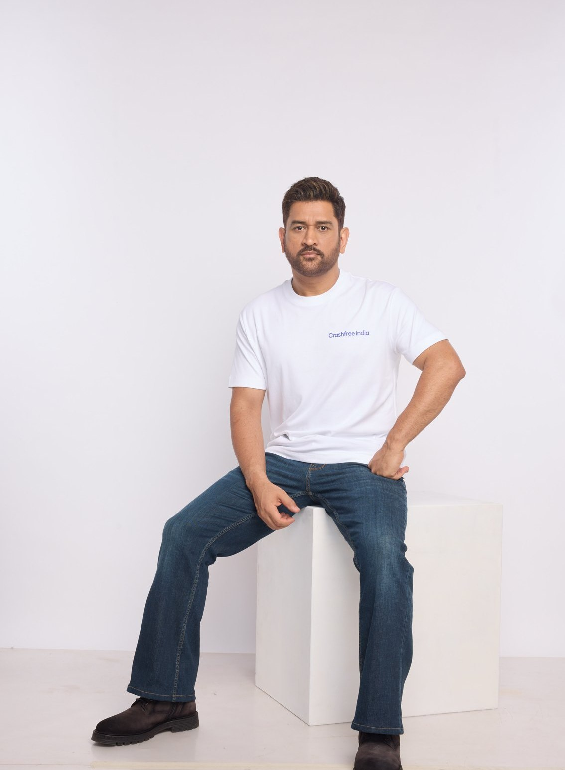



AUGUST 2026 · NEW DELHI
EXPRESSION OF INTEREST · NATIONAL ROAD SAFETY BOARD
Crashfree India
Application to Working Group 5:
Post-Crash Care, Policy Standards & State Implementation
Tools families actually use: Aasha on WhatsApp, calculator, hospital helpdesks
Published policy research: Justice Unserved and the Pre-Hospital Care Primer
MS DHONI · GOODWILL AMBASSADOR,
CRASHFREE INDIA
Hand in hand with authorities: 4 district committees, Rajasthan, police MoUs
Submitted to the Chairperson and Members, Working Group 5, National Road Safety Board
crashfreeindia.org

Slide 2
BEFORE THE SLIDES
A letter to the Working Group
New Delhi · August 2026
Respected Chairperson and Members of Working Group 5,
Crashfree India is a young road safety nonprofit, registered as the Vision Zero Trust, co-founded with the Indian Road Safety Council, and backed by a three-year, US$3 million commitment from Cars24. We work alongside public authorities: our student teams audit dangerous locations under senior experts, our technology helps police and administrators see their own pipelines, and our support tools stand with families after a crash. MS Dhoni carries this message to the country as our Goodwill Ambassador.
Our post-crash work began with evidence. 'Justice Unserved', our study of the hit-and-run compensation pipeline, showed how few eligible families ever receive what the law promises, and our follow-up brief, 'Deposited But Not Delivered', found ~₹986 crore of already-awarded compensation sitting unclaimed in just five cities. Since then we have joined four District Road Safety Committees, mapped Rajasthan's scheme office-by-office with the Transport Department, and built the tools families actually use, the Aasha chatbot, a compensation calculator, hospital helpdesks that supported 100+ victims in their first four days, and plain-language guides in Hindi.
The pages that follow introduce the organisation briefly, then set out the work most relevant to this Working Group in the detail its mandate deserves. Everything shown is running today, is public, and is offered to the Board without cost. We would be honoured to contribute.
Respectfully,
Akhtar Hussain
Mission Lead, Crashfree India · akhtar@crashfreeindia.org · crashfreeindia.org

Slide 3




HOW THIS DECK IS ORGANISED
Five sections, from who we are to what we offer
1
About us, and how we work
04 – 06
Who we are, our approach to the road crash crisis, and why this Working Group.
2
What we have built
07 – 14
Every public-facing programme, audits, enforcement tech, victim support, open data, youth, campaigns.
3
Our people
15 – 16
The team, its capabilities, and the expert bench around the work.
4
Post-crash care in depth
17 – 24
The deep dive matched to this Working Group's mandate, evidence, method, results.
5
How we can contribute
25 – 26
Four concrete, no-cost offers to the Working Group.

Slide 4

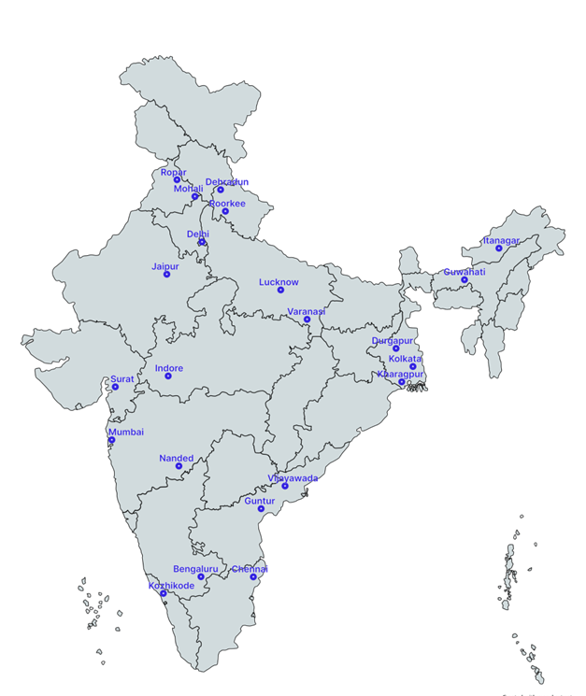



01 · ABOUT US
SECTION 1 OF 5 · ABOUT US
Crashfree India: a nonprofit that adds capacity to road safety work
Registered as the Vision Zero Trust · Co-founded by Cars24 and the Indian Road Safety Council · Working since June 2025 · New Delhi
Evidence first
Structured field audits, file reviews and research to official standards, not opinion.
Institutional collaboration
We work through PWDs, NHAI, transport departments, police and District Road Safety Committees.
Youth-led capacity
Trained student teams from IITs, NITs and SPAs add the auditing hands the system needs.
Technology for follow-through
Public dashboards track every recommendation from submission to completion.
Everything in this deck serves the Group's agenda: faster compensation, stronger EMS evidence, and support victims can actually use.
Where we work today, 18 cities, north to south.
Crashfree India · Expression of Interest — Working Group 5
04 / 26

Slide 5


01 · ABOUT US, OUR APPROACH
SECTION 1 OF 5 · ABOUT US
Our approach: work with the system, and prove it with data
Four steps, applied to every problem we take up, from a dangerous junction to a stalled compensation claim.
1 · Evidence
2 · Institutional partnership
3 · Technology
4 · Follow-through
Field audits, file reviews and research to official standards.
→
Work through the authority that owns the problem, never around it.
→
Dashboards, AI and WhatsApp tools that fit how officials already work.
→
Every recommendation tracked publicly to completion.
31 sites audited · 50+ stakeholder consultations
31 sites audited · 50+ stakeholder consultations
25+ written approvals · 4 DRSCs · MoUs with police
25+ written approvals · 4 DRSCs · MoUs with police
6 live public products
6 live public products
7 sites fully implemented · 6 more partially
7 sites fully implemented · 6 more partially
We do not replace the system and we do not campaign against it. We add hands, evidence and tools to work the system has already committed to.
Crashfree India · Expression of Interest — Working Group 5
05 / 26

Slide 6



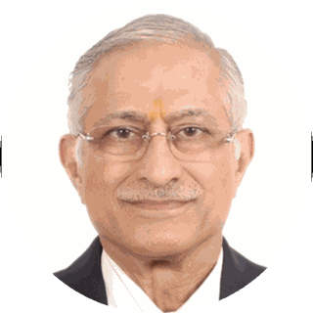
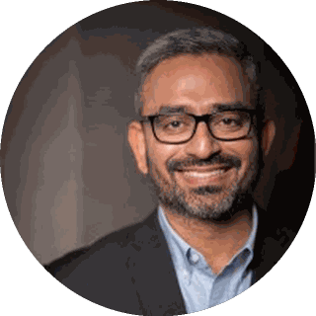
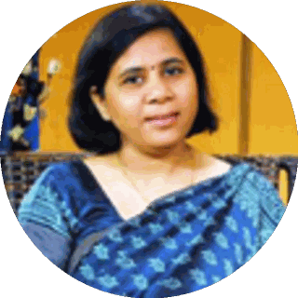
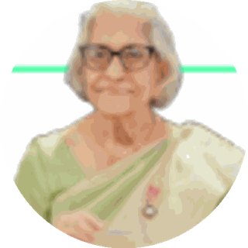
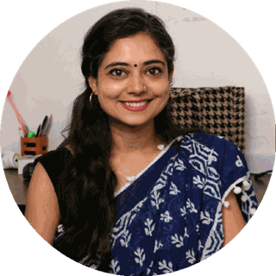
01 · WHY WORKING GROUP 5
SECTION 1 OF 5 · ABOUT US
Why Working Group 5, and what we bring to it
The Group's mandate matches the deepest part of our portfolio. Three focus areas where we are ready on day one.
Clearing the compensation pipeline
Pendency is measured in years and thousands of crores. Our district work shows exactly where files stall, and how visibility clears them.
EXISTING CAPABILITIES WE PUT ON THE TABLE
Justice Unserved evidence
Rajasthan portal blueprint
4 DRSC working seats
Legal bench: MACT + DLSA
Victim-facing standards & tools
Aasha, the calculator, guides and helpdesks, working models for the citizen-facing standards WG-5 will set.
Aasha + calculator live
Trauma-ward helpdesks
EMS & trauma-care evidence
The Pre-Hospital Care Primer benchmarks ERSS-112 and documents state innovations, a ready baseline for care standards.
SUBJECT-MATTER EXPERTS ALREADY ENGAGED ON THIS AGENDA
Justice J.R. Midha Retd., Delhi HC · MACT process architect
Piyush Tewari SaveLIFE Foundation · Good Samaritan Law
Dr. Sushma Sagar Prof. & In-charge, Trauma Surgery, JPN Apex Trauma Centre, AIIMS
Dr. Maya Tandon Sahayta Trust · trauma-response pioneer
Mishika Singh Neev Foundation · legal helpdesks
Crashfree India · Expression of Interest — Working Group 5
06 / 26

Slide 7
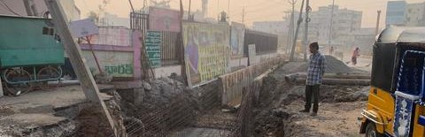
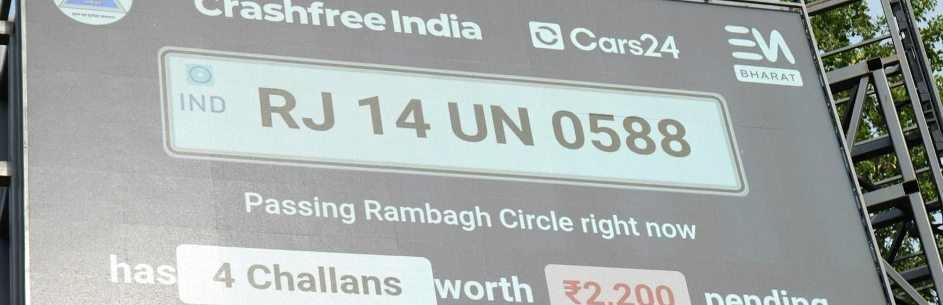
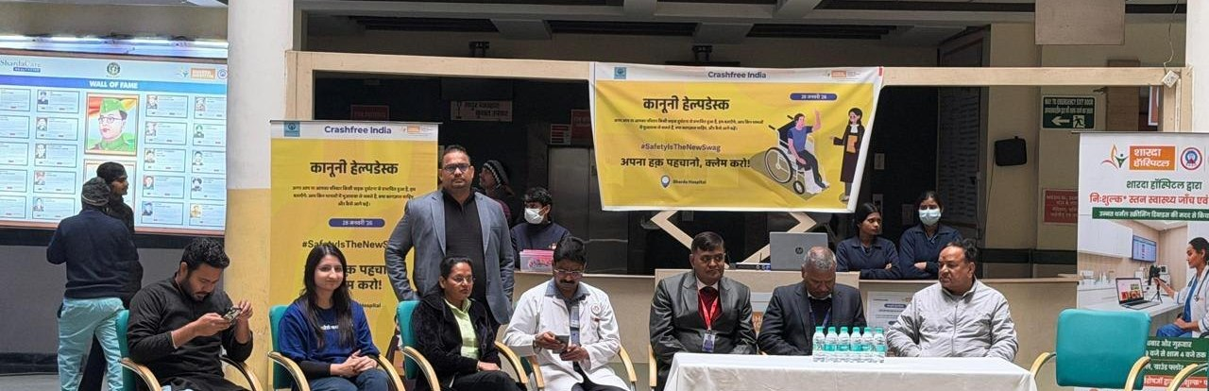
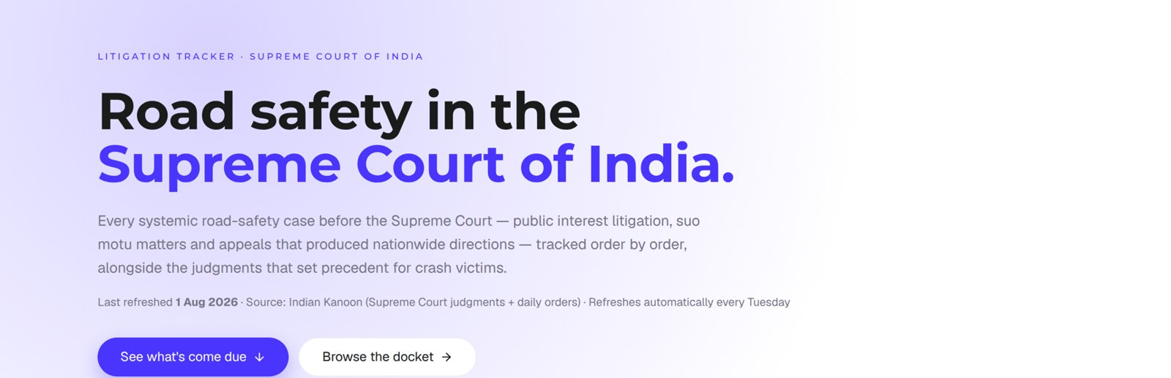
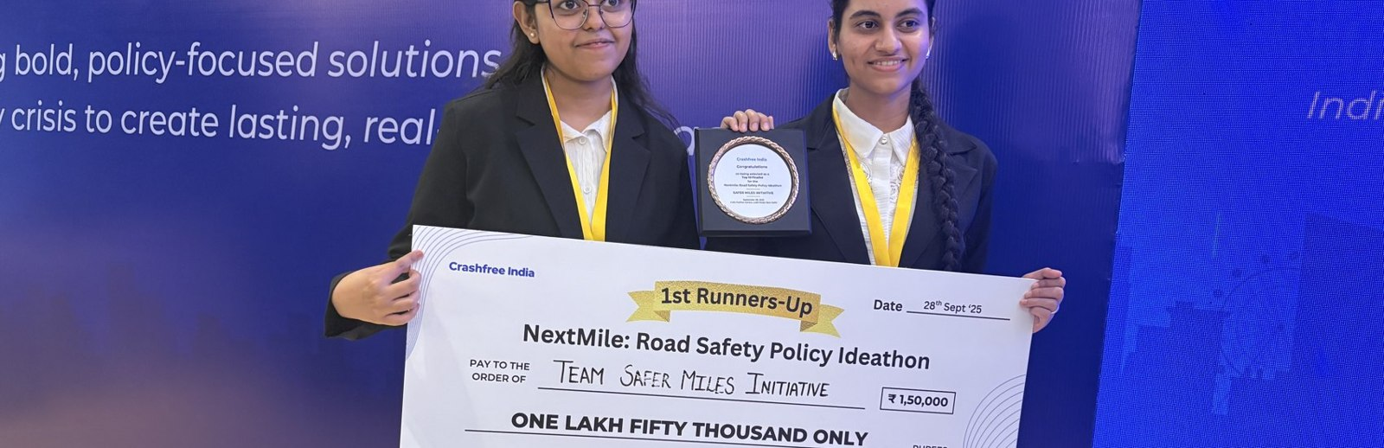
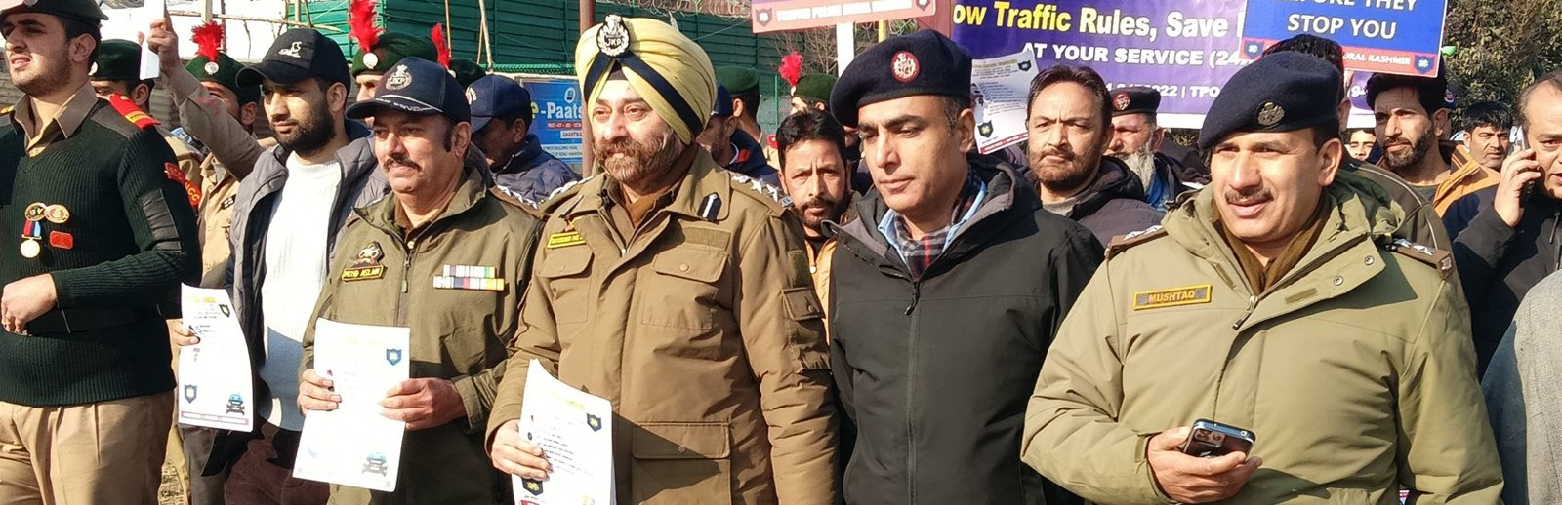
02 · WHAT WE HAVE BUILT
SECTION 2 OF 5 · WHAT WE HAVE BUILT
Six lines of work, one connected system
Audits create data · data supports policy · policy guides the field. Everything below is live today.
Project Rakshak
SATARK enforcement
Victim support
Student-led road audits, fixed with authorities
AI support that helps police find high-risk vehicles
Aasha chatbot, calculator, hospital helpdesks
31 sites · 7 fixes fully built
3,00,000+ vehicles screened
100+ victims helped in first 4 days
Open public data
Youth & policy
Public campaigns
Four self-updating data platforms, free to use
NextMile ideathon and national dialogue series
Road Safety Month with police & schools; MS Dhoni
36 states & 50 cities covered
2,000+ participants engaged
1M+ citizens reached
Crashfree India · Expression of Interest — Working Group 5
07 / 26

Slide 8
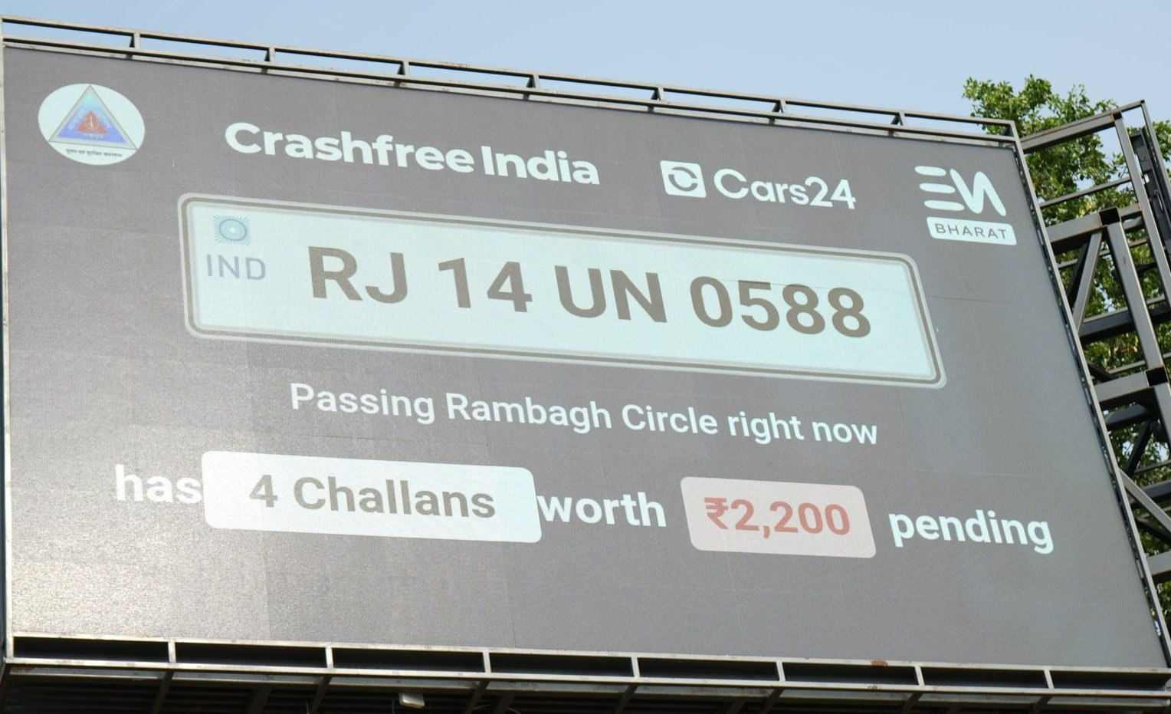
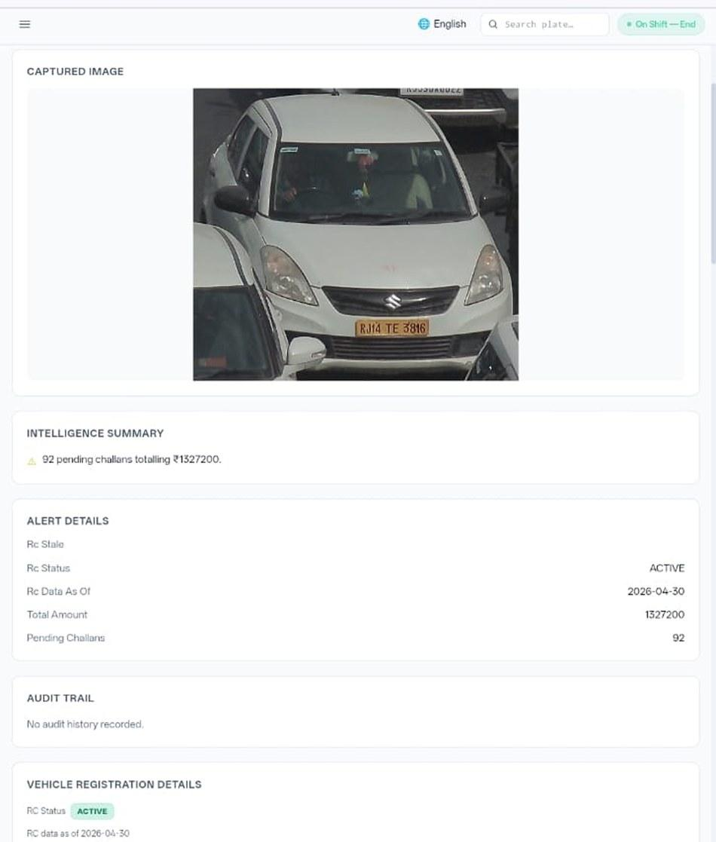








02 · WHAT WE HAVE BUILT, ENFORCEMENT TECHNOLOGY
SECTION 2 OF 5 · WHAT WE HAVE BUILT
SATARK: AI that helps police stop the right vehicle
Built with Cars24 engineers. Reads number plates, checks government records, and alerts officers to repeat offenders, in real time.
3,00,000+
₹30 Cr+
vehicles screened
pending challan value identified
350+
70,019
high-risk vehicles intercepted
vehicles found with pending challans
LIVE · Jaipur & Bengaluru
NEW · Gurugram
Officer view, challans,
RC & compliance status.
Bengaluru's Trinity Circle billboard was India's first, covered by Deccan Herald and national press. Pune and Ahmedabad are next.
Rambagh Circle, Jaipur, live plate, pending challans and dues on a public billboard.
ANPR camera
Plate read
Records check
Risk flag
Officer alert
Billboard
Interception
Enforcement
Crashfree India · Expression of Interest — Working Group 5
08 / 26

Slide 9
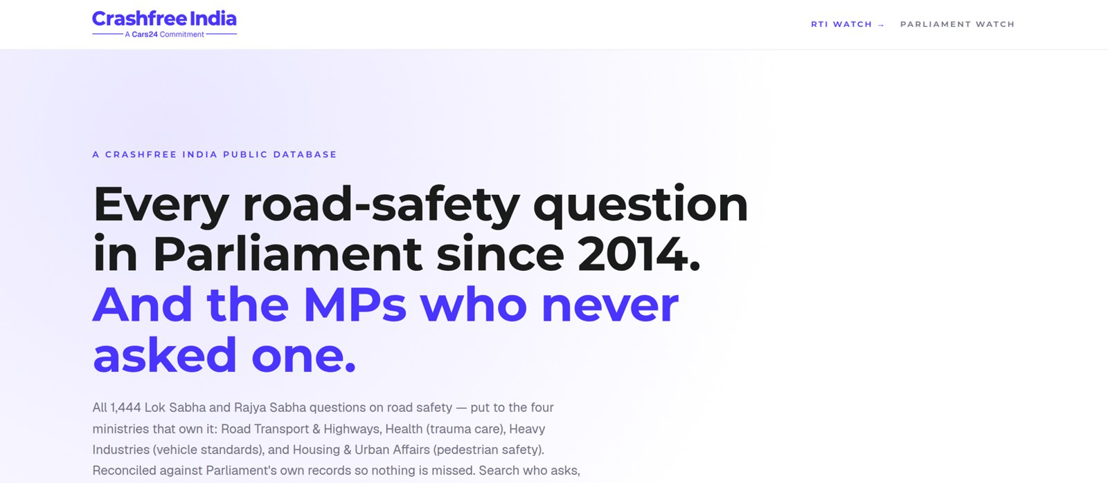
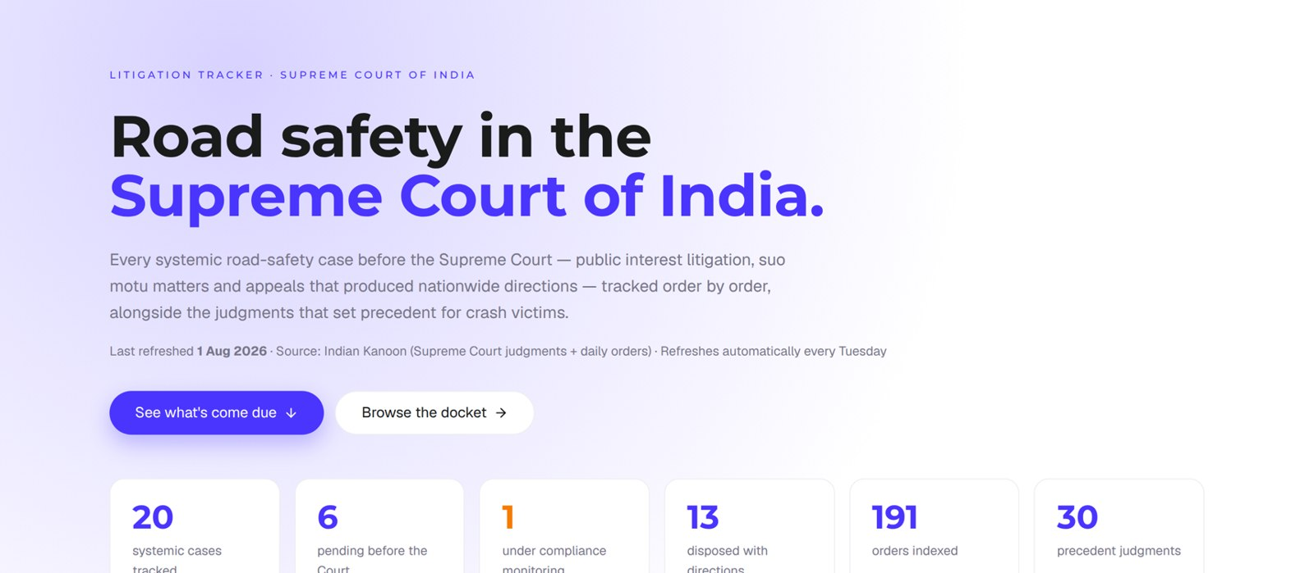


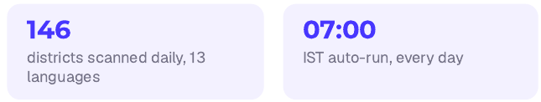
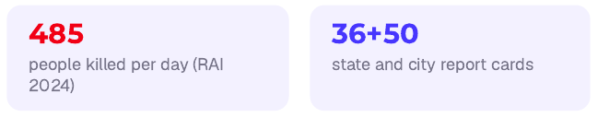
02 · WHAT WE HAVE BUILT, OPEN PUBLIC DATA
SECTION 2 OF 5 · WHAT WE HAVE BUILT
Live public data platforms, free for any authority
Four platforms, each turning a scattered public record into structured, citable evidence. The two trackers are shown live, as captured this week.
Road Safety in Parliament: all 1,444 questions since 2014 across four ministries; 275 of 540 sitting Lok Sabha MPs have never asked one.
Supreme Court Litigation Tracker: 20 systemic cases, 191 orders indexed, 30 precedent judgments. Refreshes every Tuesday.
Road-Infrastructure Defect Repository
DAILY · 07:00 IST
Crash Data Dashboard
ANNUAL · OPEN DATA
An AI pipeline reads local-language news from 146 districts every morning and turns road-defect reports, potholes, missing signage, unlit stretches, into structured, mapped evidence.
MoRTH's annual 'Road Accidents in India' books as a usable product: report cards for 36 states and 50 cities, every number reconciled against the printed books, open licence (CC-BY).
Crashfree India · Expression of Interest — Working Group 5
09 / 26

Slide 10
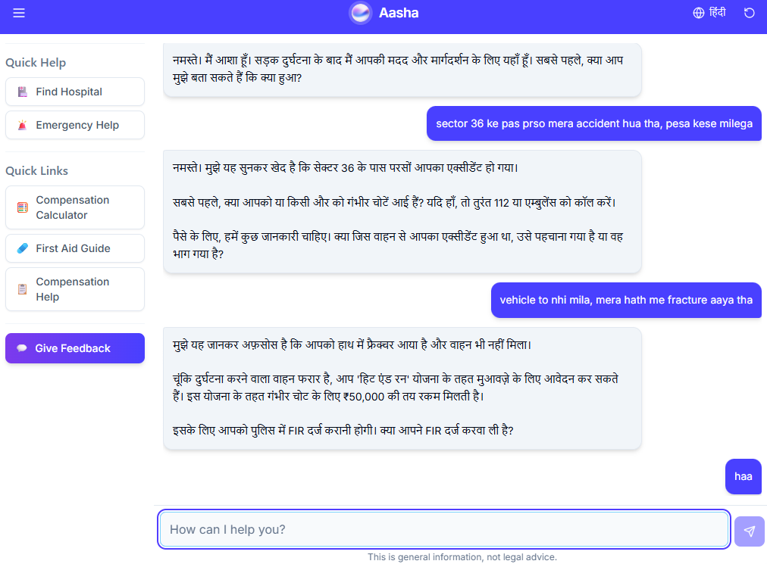
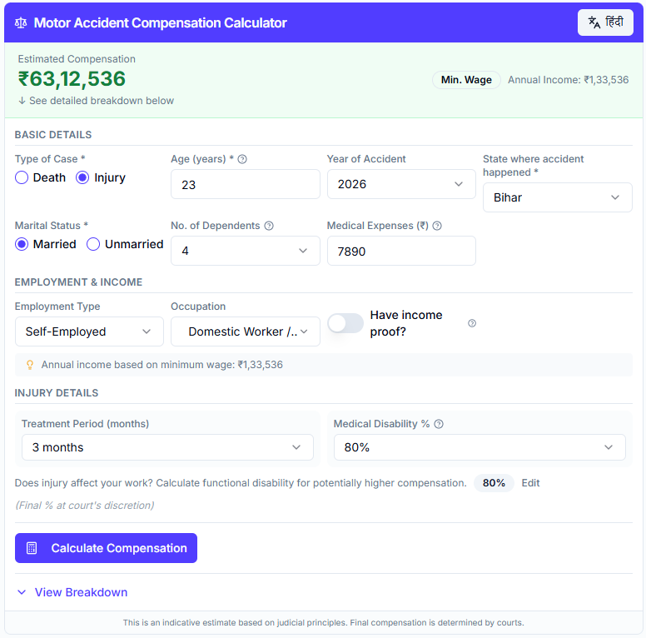
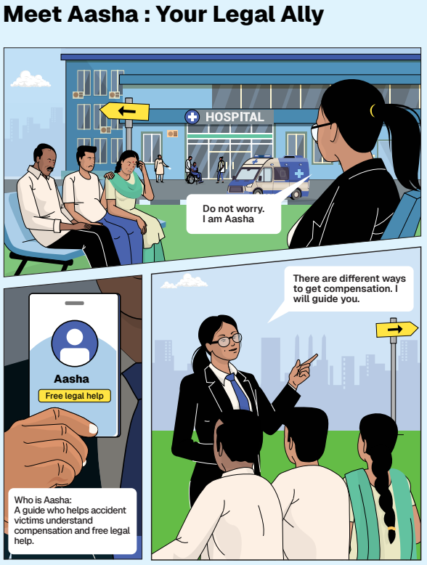
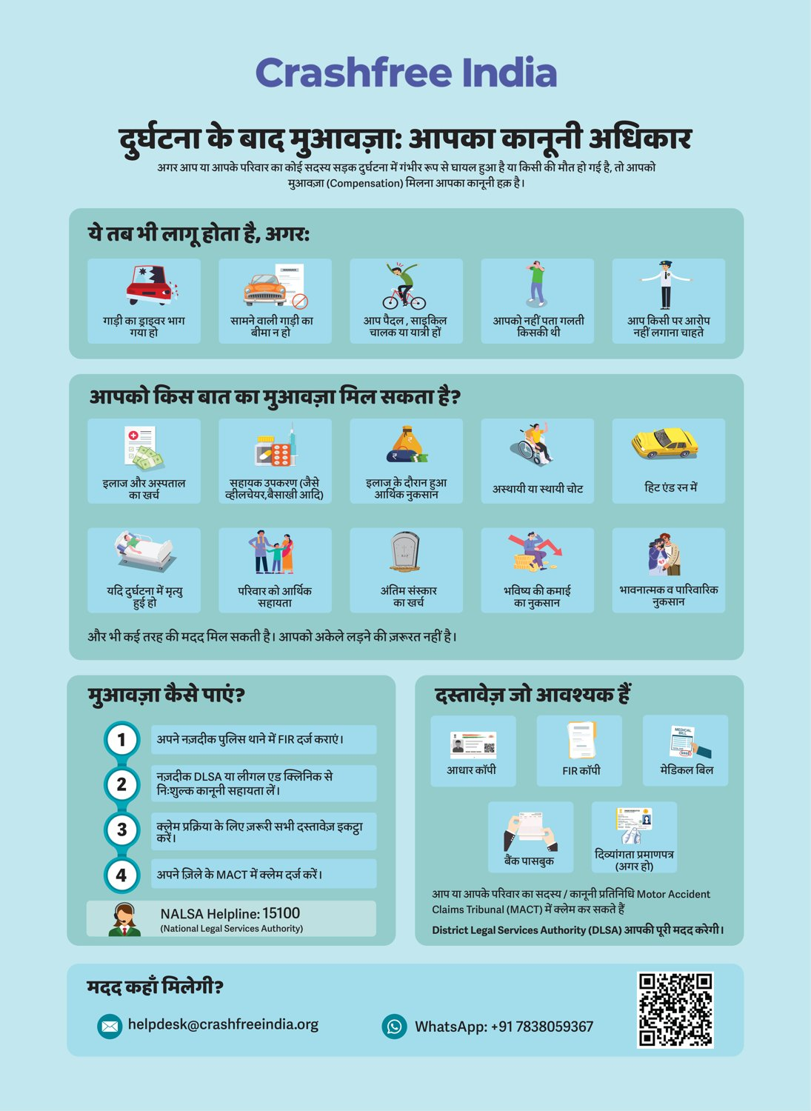



02 · WHAT WE HAVE BUILT, VICTIM SUPPORT
SECTION 2 OF 5 · WHAT WE HAVE BUILT
Help a family can actually use, in their language
From the first hours after a crash to the final compensation order, on WhatsApp, on paper, and in person.
Aasha chatbot
Compensation Calculator
'Meet Aasha' comics
Hindi rights guide
India's first AI legal companion for crash victims, on WhatsApp and voice, no app needed.
Free instant estimates computed on Supreme Court principles (Sarla Verma, Pranay Sethi).
Plain-language legal education that families actually read, at desks and in schools.
All three compensation routes, NALSA 15100 and the Cashless Treatment Scheme 2025.
Hospital helpdesks bring all of this to the trauma-ward bedside , 100+ victims supported in the first four days, run with DLSA and Neev Foundation.
Crashfree India · Expression of Interest — Working Group 5
10 / 26

Slide 11
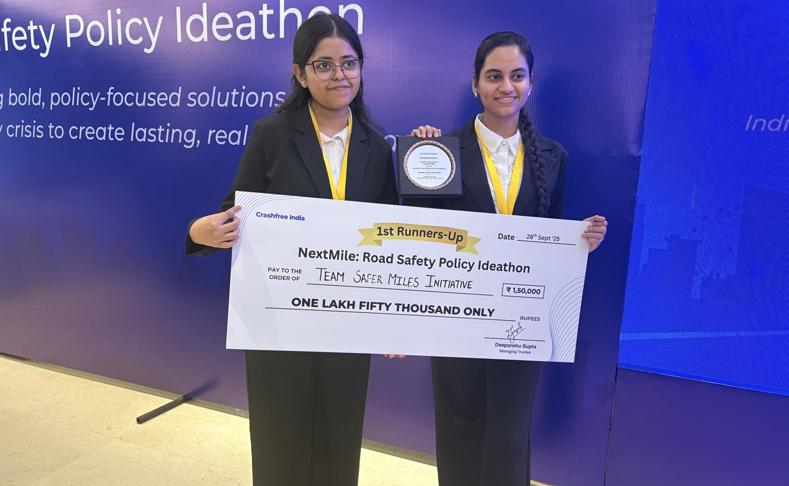
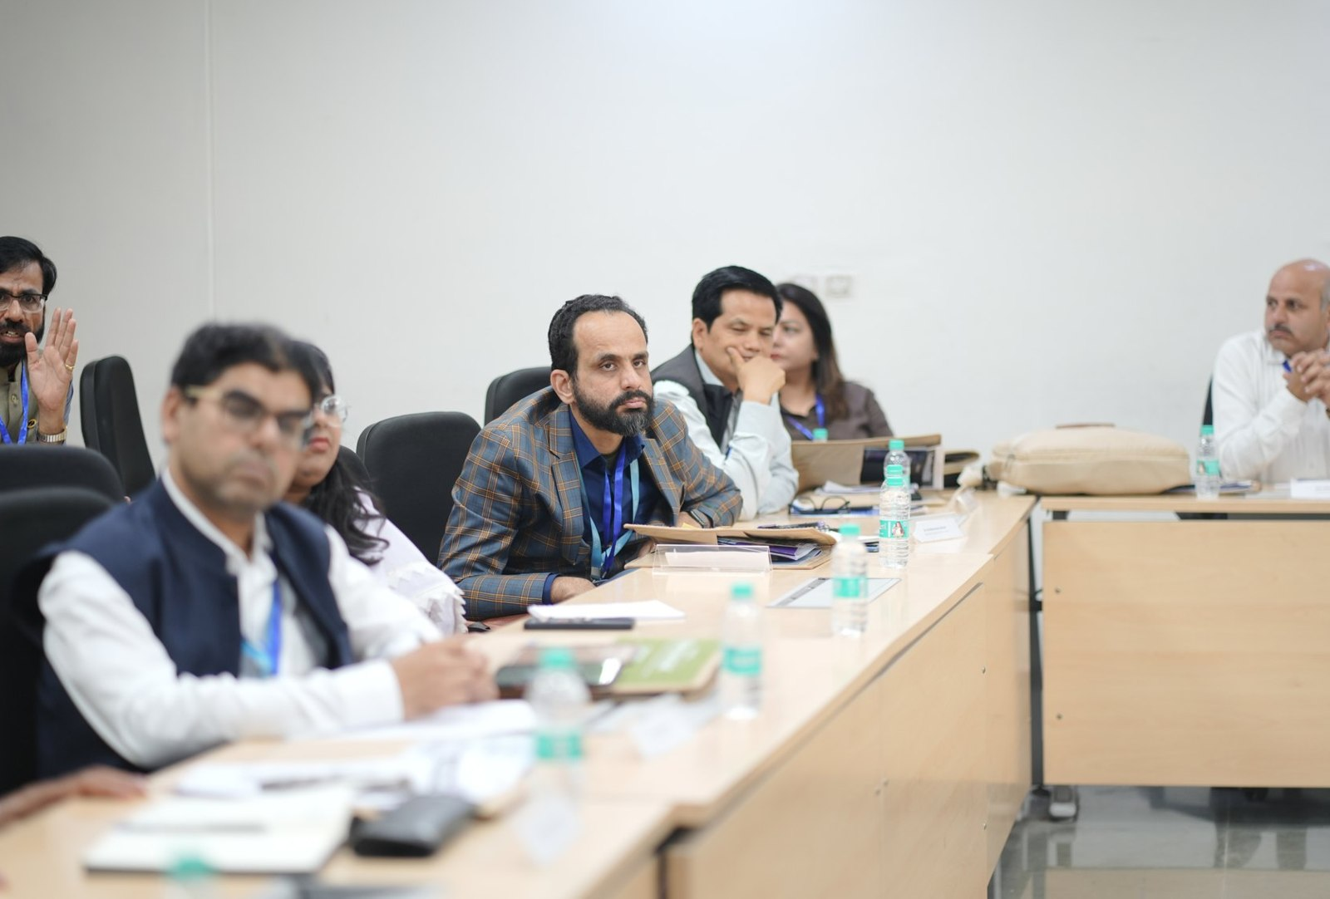



02 · WHAT WE HAVE BUILT, YOUTH & POLICY
SECTION 2 OF 5 · WHAT WE HAVE BUILT
Young talent and senior experts, working the same problem
A steady pipeline of engineers and policy minds, so road safety work never runs out of hands.
National Road Safety Dialogue Series
200+ live attendees; speakers from MoRTH, CIRT, AIIMS Trauma Centre, CSIR-CRRI and ARAI.
Three sessions so far
Bus safety · Delivery rider safety · Good Samaritan law & the Cashless Treatment Scheme.
NextMile: Road Safety Policy Ideathon, grand finale, 28 Sep 2025, New Delhi.
National Road Safety Implementation Forum, IIT Delhi: 60+ experts from MoRTH, WHO, UNICEF, iRAP and CSIR-CRRI reviewed the work.
Advocacy on video
Our YouTube channel documents hazards and fixes on camera: ground-audit walkthroughs, Dialogue Series recordings and victim-education explainers. A public record any authority can cite.
2,000+
250+
700+
10
Mentors and jury from the Government of Rajasthan, NIUA, OMI, NASSCOM and CSEP judged the student teams; winning tracks now feed our audit and research pipeline.
participants
concept notes
teams
finalist teams
Next: 'Be a Rakshak' university chapters at IITs, NITs and SPAs.
Crashfree India · Expression of Interest — Working Group 5
11 / 26

Slide 12
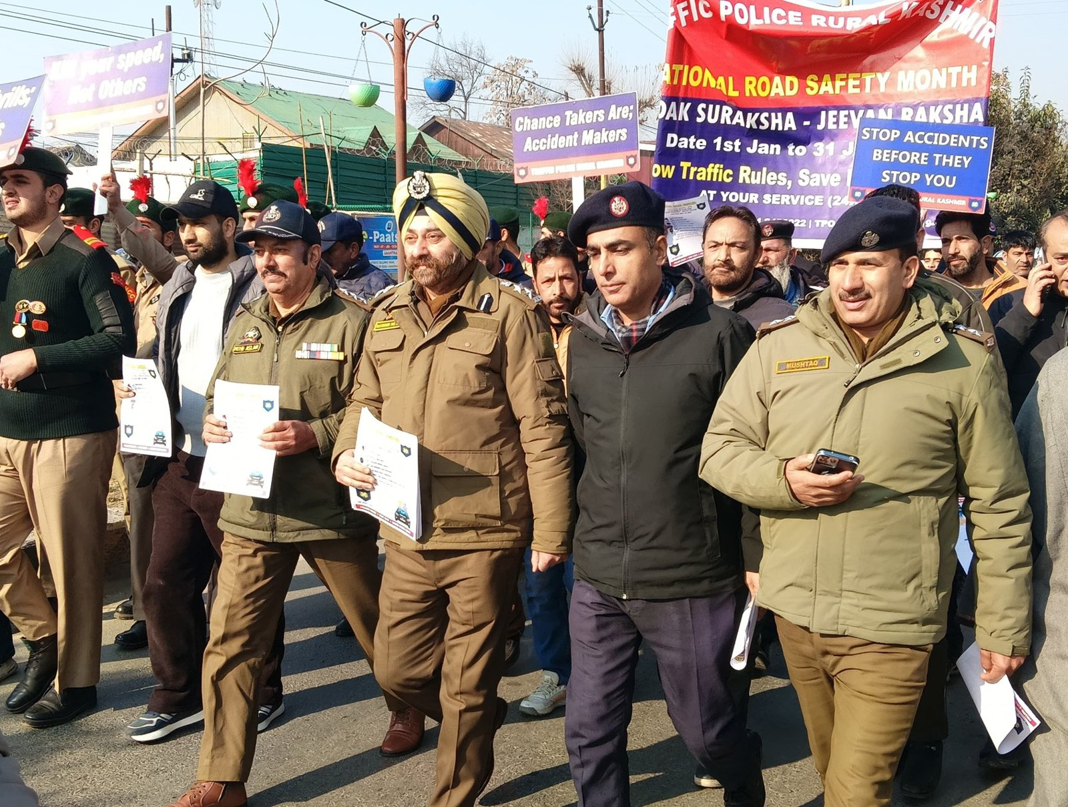
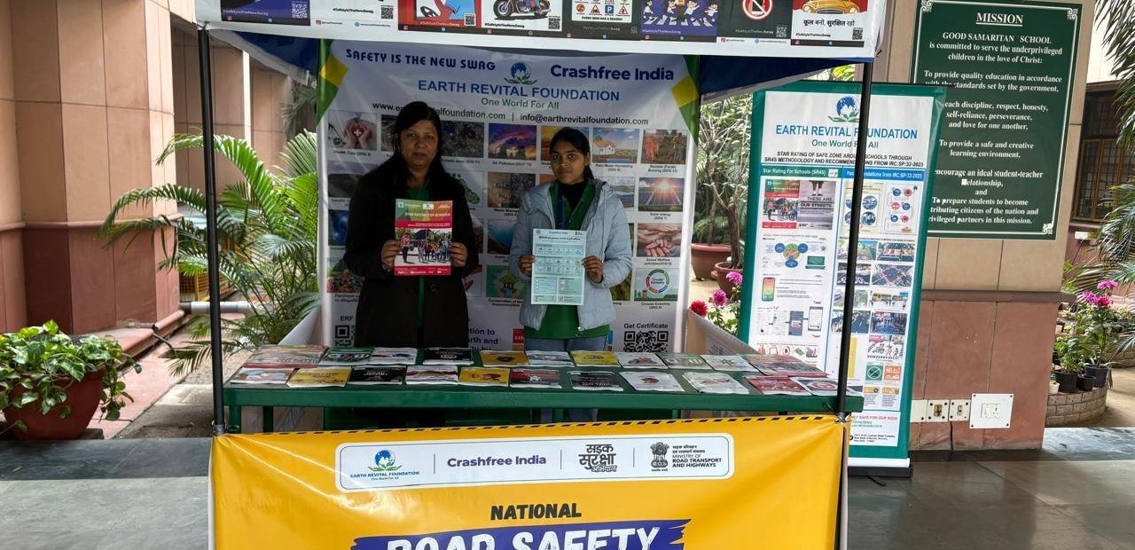
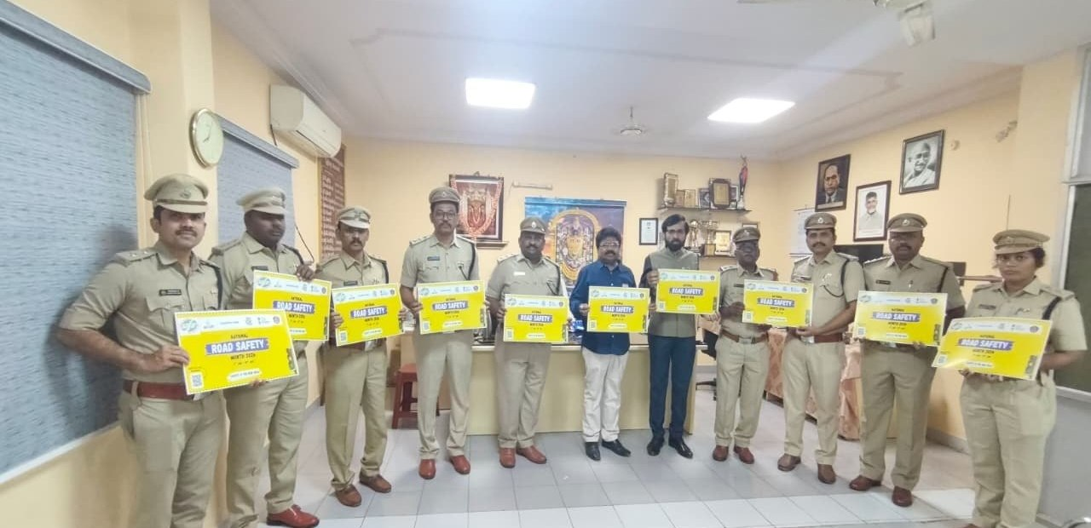
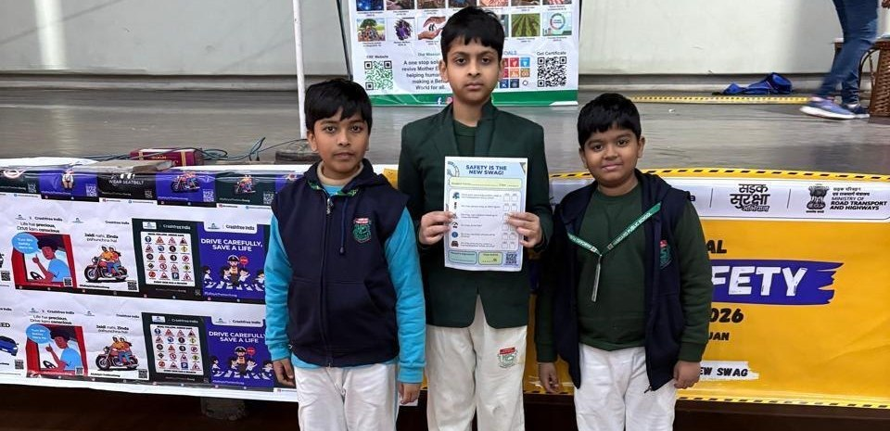
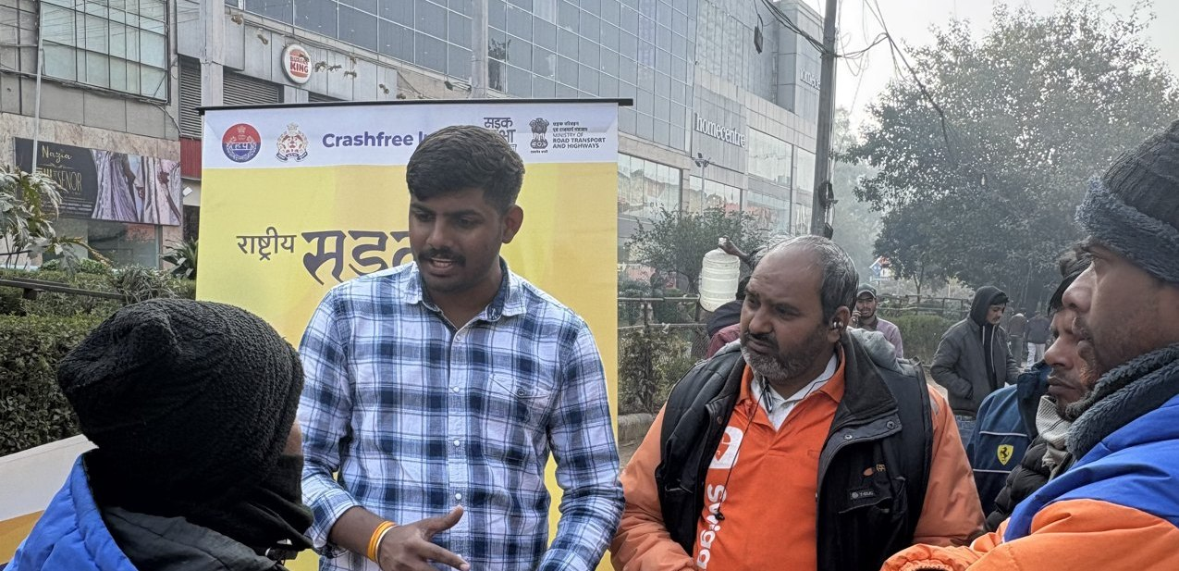
02 · WHAT WE HAVE BUILT, ON THE GROUND
SECTION 2 OF 5 · WHAT WE HAVE BUILT
Road Safety Month 2026, run with the system
With district police, schools, hospitals and delivery platforms, in Hindi and local languages.
CFI stall at a government office
Materials briefing with police staff
National Road Safety Month rally, on the road with district traffic police, Jan 2026.
School programme with certificates
Delivery-rider outreach, Swiggy & Instamart
1M+ citizens reached across campaigns in year one.
Crashfree India · Expression of Interest — Working Group 5
12 / 26

Slide 13
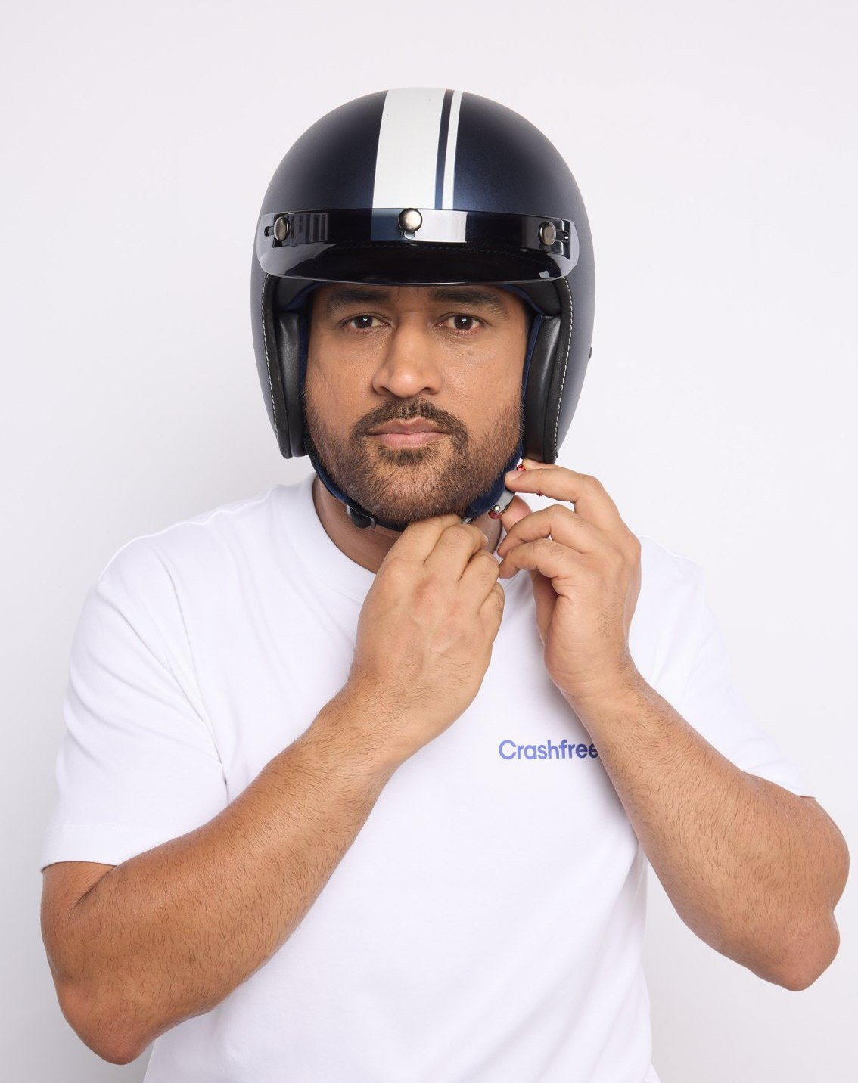
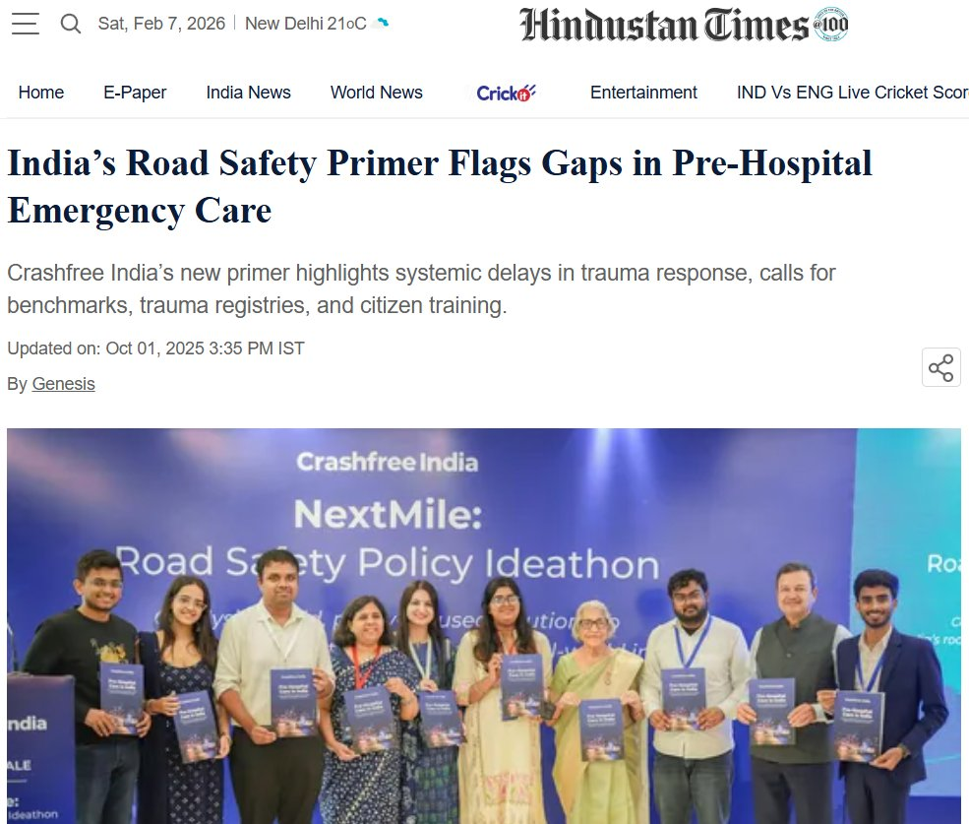
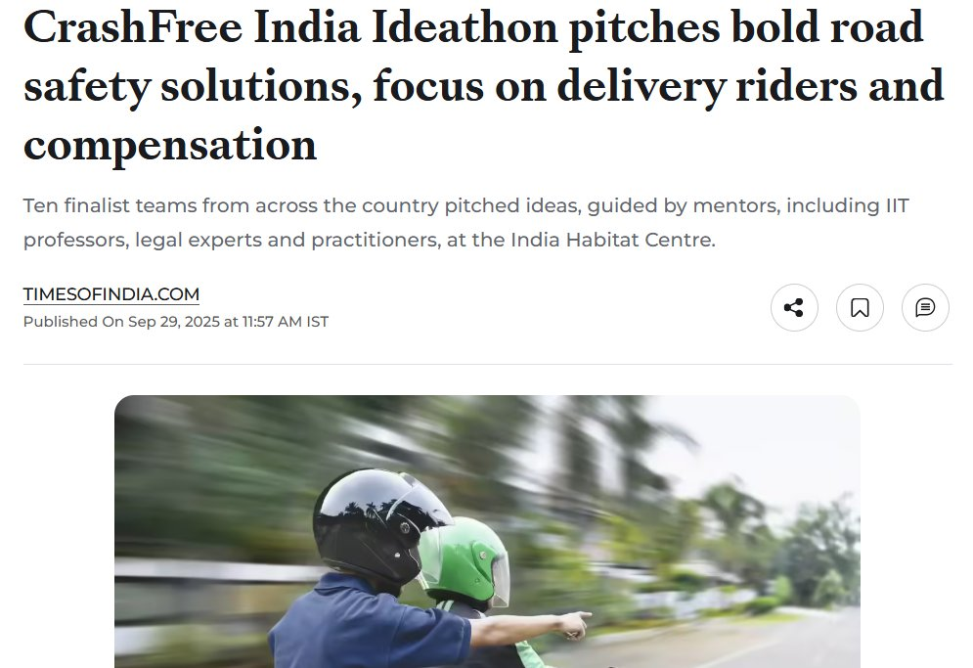

02 · WHAT WE HAVE BUILT, PUBLIC VOICE
SECTION 2 OF 5 · WHAT WE HAVE BUILT
MS Dhoni gives road safety a national voice
AS SEEN IN THE PRESS
"We already know what is going wrong. What we need now is more responsibility, more discipline, more respect for life."
ThePrint, on the NextMile
ideathon finale.
MS Dhoni, at the National Road Safety
Implementation Forum, IIT Delhi
Hindustan Times, on our
Pre-Hospital Care Primer.
Deccan Herald
Economic Times
Fortune India
MS Dhoni, Goodwill Ambassador, announced April 2026.
IndiaSpend
Scroll.in
The Wire
Dhoni's voice powers 'Be a Rakshak', school-zone safety and compensation-awareness campaigns.
Times of India
Business Standard
Crashfree India · Expression of Interest — Working Group 5
13 / 26

Slide 14
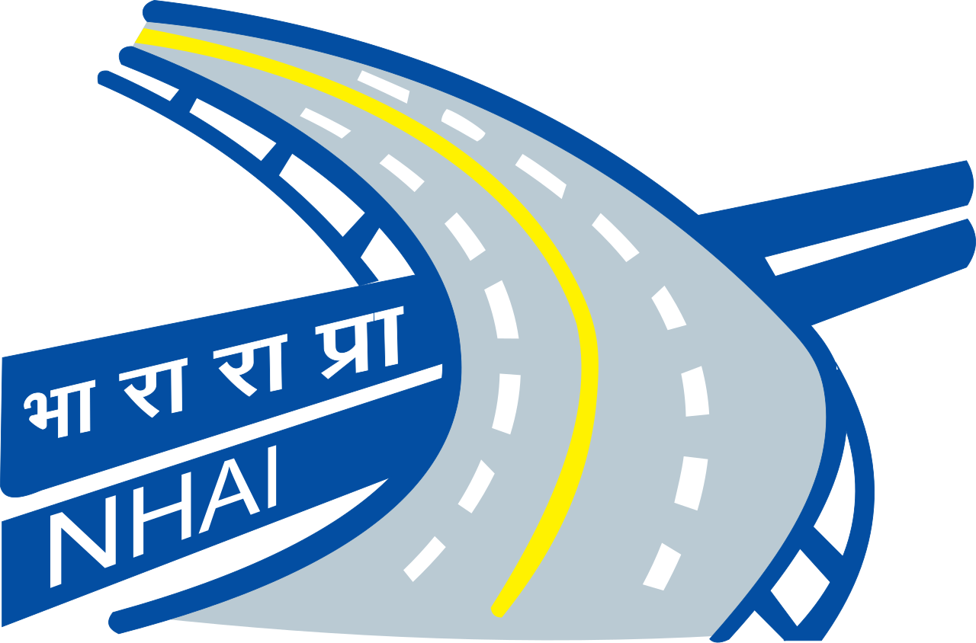
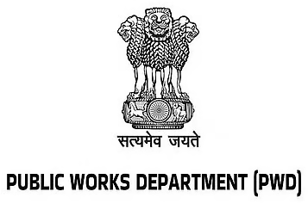
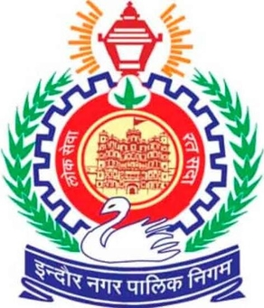
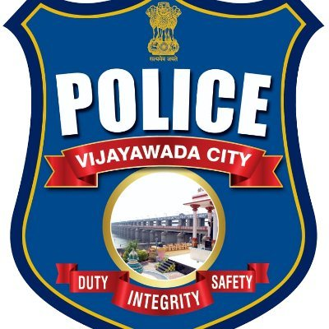
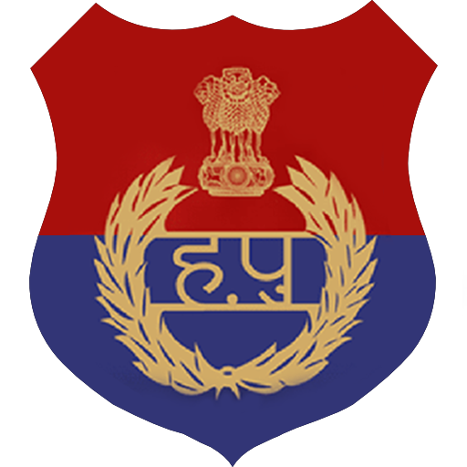


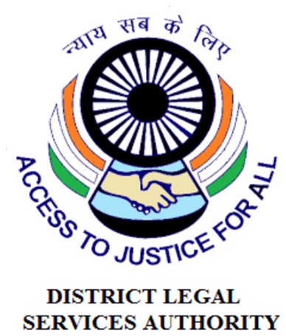















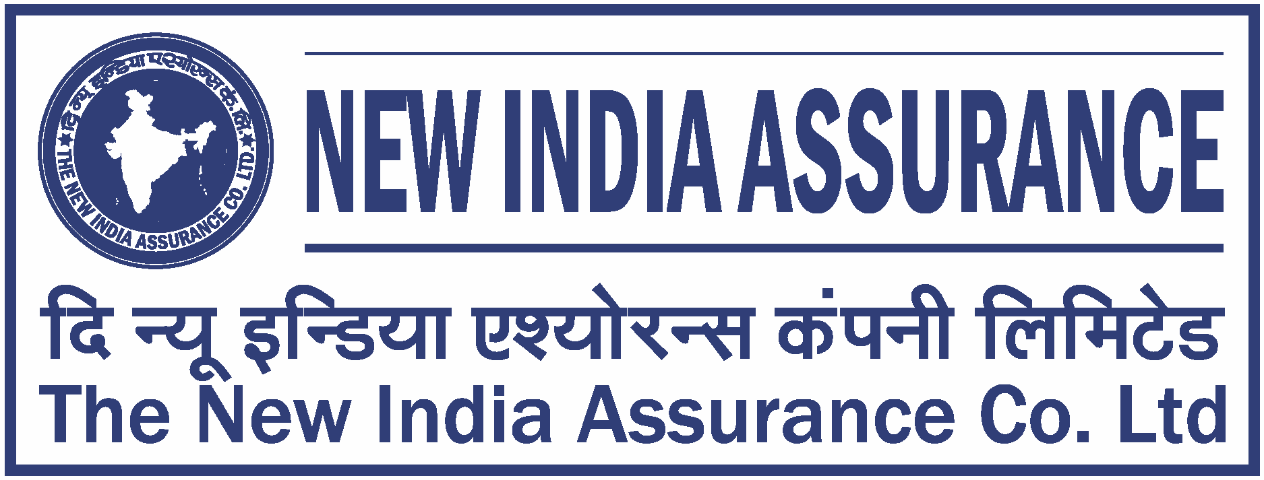
02 · WHAT WE HAVE BUILT, THE NETWORK
SECTION 2 OF 5 · WHAT WE HAVE BUILT
The institutions around the work
As they appear in our working decks, engagement ranges from formal MoUs and written approvals to jury, mentoring and research collaboration.
AUTHORITIES & PUBLIC BODIES WE WORK WITH
UNIVERSITIES & INSTITUTES FIELDING AUDIT TEAMS
EXPERT & ECOSYSTEM PARTNERS
Plus: Jaipur Traffic Police & Gurugram Police (MoUs) · CPWD & district administrations · Bloomberg, Johns Hopkins, Centre for Green Mobility and PwC experts on juries and reviews.
Crashfree India · Expression of Interest — Working Group 5
14 / 26

Slide 15
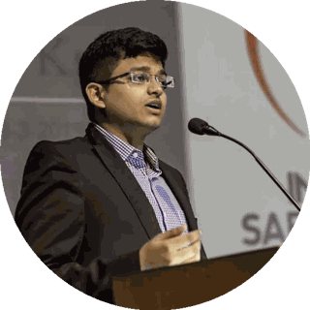
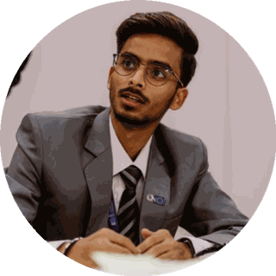
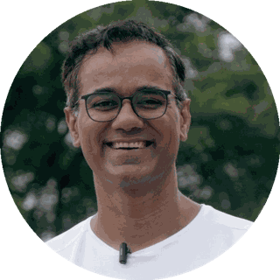
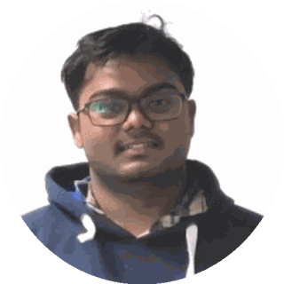
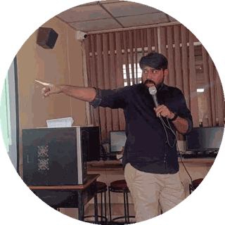
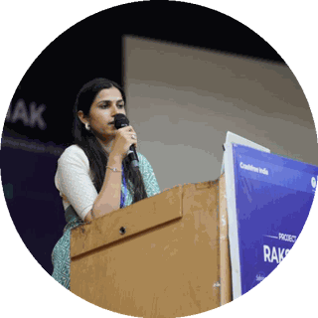
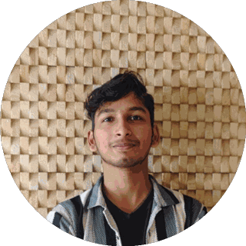
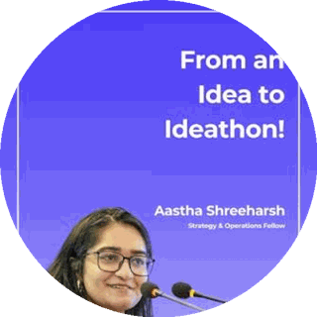
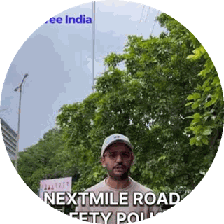
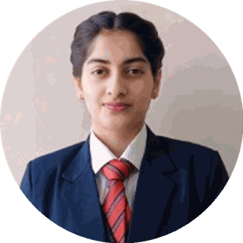



03 · OUR PEOPLE
SECTION 3 OF 5 · OUR PEOPLE
A full-time team built for this work
Engineering, law, policy, product and field operations, under trustees who have led Indian road safety for a decade.
Amar Srivastava
Deepanshu Gupta
Gajendra Jangid
President · Founder, Indian Road Safety Campaign · Member, National Road Safety Council
Managing Trustee · Founder, IRSC · Global Youth Coalition for Road Safety
General Secretary · Co-founder, Cars24
THE FULL-TIME TEAM
Akhtar Hussain Mission Lead
Shubham Kumar Policy & Advocacy
Muskan Yadav Programmes
IIT Delhi · ex-Bain · strategy, programmes, new initiatives, partnerships and product
NALSAR Hyderabad · programmes, policy advocacy, legal research, government relations
TISS · district programmes, Project Rakshak, infrastructure interventions, DRSC work
Krishna Tech & Product
Aastha Shreeharsh Development Communications
Rohan Sharma Cause Marketing
Builds and runs Aasha, SATARK and the open public data platforms
HKUST · institutional communications, government relations
Awareness campaigns, digital advocacy, community mobilisation
Ishita Rathore People & Culture
Yuvraj Yadav Operations
Lovish Creative (Video)
Talent and hiring, volunteers, the 75+ intern engineering corps
Field operations across 18 cities · works with police on SATARK and enforcement rollouts
Video explainers, ground-audit films and the YouTube channel
Shipra Kushwaha Creative (Graphic)
Plus 75+ engineering interns and 31 student audit teams.
Guides, comics and bilingual campaign material families actually read
In-house capabilities: road-engineering audits · legal & policy research · AI product development · district operations · behaviour-change communication
Crashfree India · Expression of Interest — Working Group 5
15 / 26

Slide 16










03 · OUR PEOPLE, THE EXPERT BENCH
SECTION 3 OF 5 · OUR PEOPLE
Advised by the people who built India's road safety practice
Prof. Geetam Tiwari, Board of Advisors
Piyush Tewari, Board of Advisors
Professor Emerita & Chair, TRIP Centre, IIT Delhi · four decades of transport safety research
Founder & CEO, SaveLIFE Foundation · Architect of the Good Samaritan Law · Zero-Fatality Corridors
JURY, MENTORS & REVIEWERS AROUND OUR WORK
Justice J.R. Midha
Abhay Damle
Vaibhav Dange
Dr. Maya Tandon
R. Venkat Ratnam
Delhi High Court (Retd.)
Ex-JS, MoRTH
Ex-Advisor, MoRTH
Sahayta Trust
Government of Punjab
Akhilesh Srivastava
Aishwarya Raman
Neeraj Kumar
R.S. Pandey
Dipak K. Dash
ITS India · IRF
OMI Foundation
Tata AIG
FICCI Road Safety
Times of India
Engaged through the National Road Safety Dialogue Series: Balraj Bhanot (ex-Chair, CMVR-TSC) · I.V. Rao (TERI; ex-Maruti Suzuki) · D.P. Saste (CIRT / ex-MoRTH) · Dr. Sushma Sagar (AIIMS Trauma) · Dr. S. Velmurugan (CSIR-CRRI), and jurors from OMI, NIUA, WRI, CII and Tata AIG.
Crashfree India · Expression of Interest — Working Group 5
16 / 26

Slide 17




04 · POST-CRASH CARE, THE PROBLEM, MEASURED
SECTION 4 OF 5 · POST-CRASH CARE
Compensation pendency, in numbers
Families and courts both lose to process friction. This is a pipeline problem, and pipelines can be fixed with standards and visibility.
₹80,000+ Cr
11 lakh
3.6 years
held up across 10.46 lakh pending MACT cases nationally
claims pending in MACT courts (FY 2023)
average time to settlement, for those who persist
WHAT OUR RESEARCH FOUND: 'DEPOSITED BUT NOT DELIVERED'
Money that families have already won in court, deposited by insurers, sitting unclaimed. The Supreme Court took note in 2025 and ordered public dashboards and claimant tracing.
UNCLAIMED, BY HIGH COURT
Bombay
₹459 Cr
Families are never told
No proactive notification exists when an insurer deposits the award; many families learn months or years later, or never.
Gujarat
₹282 Cr
Allahabad
₹239 Cr
Withdrawal stalls on paperwork
A 15–20 day process in theory; in practice, documents, missing bank details in older judgments, and office hand-offs stall it.
Goa
₹3.6 Cr
Calcutta
₹2.5 Cr
Advocate incentives cut against families
Consultations found contingency fees of 20–30%, and little reason for counsel to speed up the final hand-over.
Five HCs only
~₹986 Cr
Source: Supreme Court, In Re: Compensation Amounts Deposited with MACTs and Labour Courts (2025); CFI stakeholder consultations, Oct–Nov 2025. The national figure is likely far higher.
Crashfree India · Expression of Interest — Working Group 5
17 / 26

Slide 18



04 · POST-CRASH CARE, OUR RESEARCH FOUNDATION
SECTION 4 OF 5 · POST-CRASH CARE
'Justice Unserved', the evidence base we built first
Published January 2026 · launched at IIT Delhi · findings presented to MoRTH · covered by national press.
Awareness
70% of low-income families are unaware compensation exists.
THE CLAIM RATE, NATIONALLY
Timeliness
3.6-year average claim; MACT cases often run 8–10 years.
68,584 hit-and-run crashes recorded in 2024
Documentation
90% of pending hit-and-run claims stall on documents alone.
~30,000 of them kill, every year (MoRTH)
Adequacy
Informal workers are often valued at minimum wage in courts.
9,813 claims registered, FY 2025-26
Equity
14% of low-income households compensated vs 24% of high-income.
7,348 claims paid, to 28 Feb 2026
The report, file reviews, RTIs and
consultations across the pipeline.
About 1 claim for every 7 crashes, up 48x since FY23 (205), and still far from the loss. Source: Lok Sabha reply AU6419, April 2026.
Press: Deccan Herald · Economic Times · Fortune India · IndiaSpend · Scroll.in · The Wire, and cited in Parliament-facing briefings.
Crashfree India · Expression of Interest — Working Group 5
18 / 26

Slide 19





04 · POST-CRASH CARE, FROM RESEARCH TO DISTRICTS
SECTION 4 OF 5 · POST-CRASH CARE
Working inside the district machinery
Not commentary from outside, formal seats, formal tasking, files on the table.
Four DRSCs joined
Gurugram, South-West Delhi, North-West Delhi and Jaipur, with MoUs with Jaipur Traffic Police and Gurugram Police.
File-level pipeline support
With district administrations we work the hit-and-run pipeline file by file, mapping where eligible families drop out, and helping offices close those gaps.
Formally tasked
The South-West Delhi DRSC's signed minutes task Crashfree India with digitisation and analytics support for scheme files.
Legal-rights helpdesk with district administration, Jan 2026.
Embedded presence
A research fellow sits with Gurugram district offices, implementation support, not external commentary.
Law-student volunteers after a hospital helpdesk drive.
Crashfree India · Expression of Interest — Working Group 5
19 / 26

Slide 20




04 · POST-CRASH CARE, STATE ENGAGEMENT
SECTION 4 OF 5 · POST-CRASH CARE
With Rajasthan: from ground mapping to a working template
Supporting the State Road Safety Lead Agency and Transport Department on the Hit-and-Run Compensation Scheme.
What holds claims back
11–13 documents demanded vs the 7 court-agreed standard · ~50% of files lack a usable family phone number · manual hand-offs between six offices.
~180
of ~395 monthly hit-and-run claims in Rajasthan come from Jaipur alone (~46%)
The cautionary example
A state portal that changed how offices work saw monthly requests fall 350 → 25. Our design rule: no stakeholder changes their medium.
Not because crashes happen only there, because Jaipur runs active outreach and a single coordination cell. The template is replicable.
Office-by-office mapping
We walked the file's actual path, police, SDM office, insurer desk, treasury, and mapped every hand-off where families drop out.
Six asks → 60 days
Decisions identified with the Department that put Phase 1 (family traceability) in motion within 60 days.
Crashfree India · Expression of Interest — Working Group 5
20 / 26

Slide 21




04 · POST-CRASH CARE, THE PORTAL CONCEPT
SECTION 4 OF 5 · POST-CRASH CARE
Designed so no stakeholder changes how they work
Families stay on WhatsApp; officers keep their queues and sign-offs; the system connects them behind the scenes.
The family flow, day-one intake, document capture, live status. All inside WhatsApp, in Hindi.
Officer view, same cases, filtered to what each desk owns; AI pre-checks flag issues, the decision stays human.
Family keeps WhatsApp
Officer keeps every decision
Traceability before automation
Single-pass clarification
Dashboards for administrators
Crashfree India · Expression of Interest — Working Group 5
21 / 26

Slide 22






04 · POST-CRASH CARE, THE FIRST HOUR
SECTION 4 OF 5 · POST-CRASH CARE
The Pre-Hospital Care Primer, our EMS evidence line
Published September 2025. Contributors include Dr. Sushma Sagar (AIIMS JPN Apex Trauma Centre) and Dr. Richa Ahuja (IIT Kharagpur).
The response gap, measured
ERSS-112 is live across all 36 states & UTs, yet ambulance arrival averages 25–35 minutes, and the full care episode runs 55–75 minutes against a 60-minute golden hour.
State innovations documented
Maharashtra's MEMS, 937 ambulances under centralised dispatch; Tamil Nadu's TAEI trauma corridors, pre-arrival alerts and protocols.
The demand side too
Good Samaritan protections and the ₹1.5 lakh / 7-day Cashless Treatment Scheme 2025, explained in our public guides and helpdesks.
Ready for WG-5
A referenced baseline for the Group's EMS and trauma-care standards discussions, states already compared, gaps already mapped.
The Primer, ERSS-112, global
comparisons, state innovations.
The Chain of Survival, six links,
benchmarked for India.
Covered by Hindustan Times: 'India's Road Safety Primer Flags Gaps in Pre-Hospital Emergency Care.'
Crashfree India · Expression of Interest — Working Group 5
22 / 26

Slide 23




04 · POST-CRASH CARE, IN THE WARDS
SECTION 4 OF 5 · POST-CRASH CARE
Helpdesks where families actually are: trauma wards
What the desk does
FIR follow-up, document checklists, DLSA referrals and compensation guidance, at the bedside, in Hindi.
Who runs it
Trained law-student volunteers under practising advocates, with Neev Foundation and DLSA coordination.
Where it grows
Gurugram and Delhi trauma wards first; the district toolkit makes it replicable wherever a DRSC wants one.
Hospital legal helpdesk, 100+ victims supported in the first four days of operation.
Backed by materials
The Hindi legal-rights guide and 'Meet Aasha' comics live at every desk, and Aasha continues the help at home, 24/7.
Crashfree India · Expression of Interest — Working Group 5
23 / 26

Slide 24
04 · POST-CRASH CARE, THE PIPELINE, MEASURED
SECTION 4 OF 5 · POST-CRASH CARE
Numbers a standard can act on
Each one is a lever for a WG-5 standard, toolkit entry or communication norm, none requires new legislation.
921 of 1,026
11–13 vs 7
~50%
hit-and-run claims pending nationally were stalled at documentation alone (RTI, July 2024)
documents demanded of claimants in practice, against the court-agreed standard of seven
of case files lack a usable family phone number
The standard: A single national document checklist
The standard: Enforce the seven-document standard
The standard: A traceability norm at first contact
~60 days
1 in 7
20–40
typical intake delay where claims surface only through bi-monthly committee meetings
hit-and-run crashes becomes a claim: 9,813 claims against 68,584 crashes in 2024
office visits for a family to keep a single claim alive today
The standard: A time-bound intake standard
The standard: Awareness and intake norms at scale
The standard: A single-window process for families
The claim's other side: guidance from Justice J.R. Midha (Retd.), architect of the FaSTDAR process · consultations with insurers on settlement practice · working partners across MACT courts, DLSAs and legal-services clinics, Mishika Singh (Neev Foundation), Yash Agarwal (Public Policy India), Sanchit Seth (Advocate, Delhi MACT).
Crashfree India · Expression of Interest — Working Group 5
24 / 26

Slide 25
05 · HOW WE CAN CONTRIBUTE
SECTION 5 OF 5 · OUR CONTRIBUTION
Four concrete offers to Working Group 5
All four are ready today, need no funding from the Board, and can begin within weeks.
1
A victim-side evidence base
'Justice Unserved', 'Deposited But Not Delivered', 120+ victim and family interactions, and file-level pipeline data showing precisely where eligible families drop out.
2
A district toolkit, drawn from practice
Working DRSC integration experience, agendas, file digitisation, fellow placement, ready to be codified into the Group's district toolkit.
3
A reusable state portal blueprint
The Rajasthan case-management design, guided filing, stage-wise visibility, single-pass clarification, offered as a template any state can adapt.
4
Standards input from the claimant's side
Document standards (the court-agreed 7), communication norms and timeline benchmarks, grounded in what families actually experience.
Crashfree India · Expression of Interest — Working Group 5
25 / 26

Slide 26



We would be honoured to contribute
to Working Group 5.
Our evidence, our district relationships, our technology and our expert bench are available to the Board, in whichever form is most useful.
"We already know what is going wrong. What we need now is more responsibility, more discipline, more respect for life."
MS Dhoni · Goodwill Ambassador, Crashfree India
crashfreeindia.org
akhtar@crashfreeindia.org · helpdesk@crashfreeindia.org
Crashfree India · A Cars24 commitment · Operated by Vision Zero Trust, New Delhi

