Slide 1

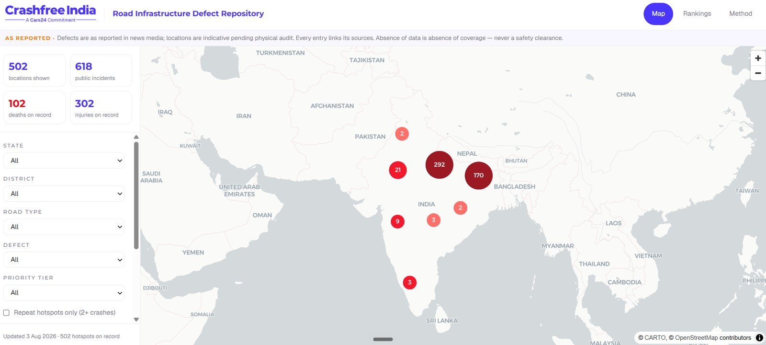
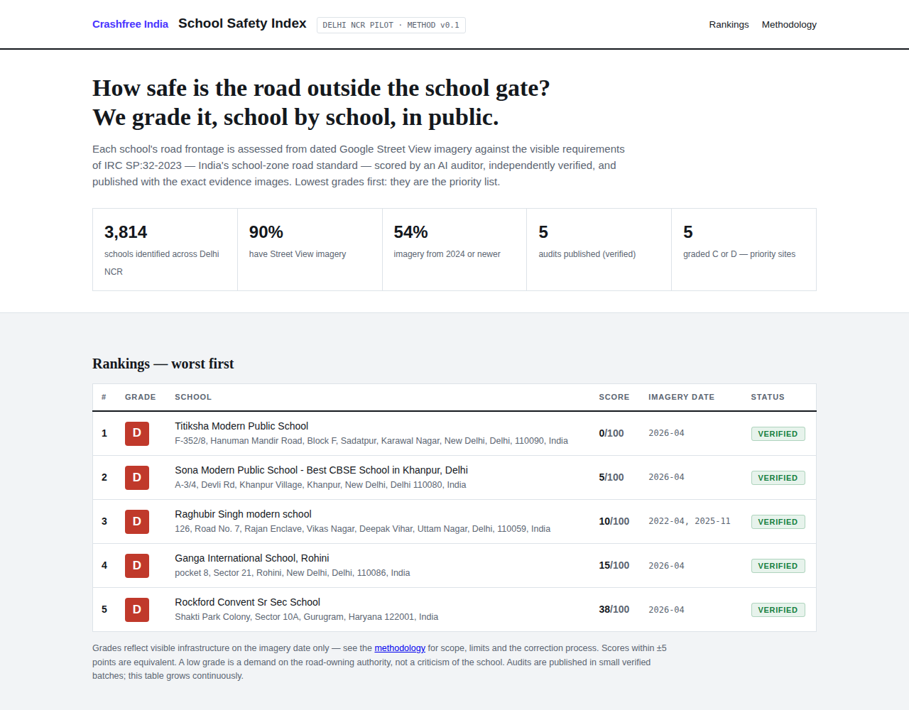



AUGUST 2026 · NEW DELHI
PRE-READ · CRASHFREE INDIA × GOOGLE MAPS PLATFORM
Crashfree India
The Defect Repository, live, 3 Aug 2026.
Our public road-safety products, and where
Roads Management Insights fits them
Live public data products: defect repository, school safety index, open dashboards
Working inside government: 4 district committees, police MoUs, 25+ written approvals
A pilot ready to start: cloud project configured, Jaipur corridors defined from police records
The School Safety Index, Delhi NCR pilot.
Prepared for the Roads Management Insights team, Google Maps Platform
crashfreeindia.org

Slide 2




HOW THIS PRE-READ IS ORGANISED
Five sections, from who we are to a ready pilot
1
About us
03 – 05
Who we are, and the public products we already run.
2
Where we work with government
06
District committees, police partnerships and written authority approvals.
3
Why speed data, and our read of RMI
07 – 08
The evidence on speed, what we understand RMI provides, what we would like to learn.
4
Three product directions
09 – 11
The Defect Repository, the School Safety Index, and an exploratory enforcement direction.
5
A ready pilot, and this call
12 – 13
What is already configured, the pilot we propose, and the questions we bring.
Crashfree India · Pre-read for Google Maps Platform, Roads Management Insights
02 / 14

Slide 3

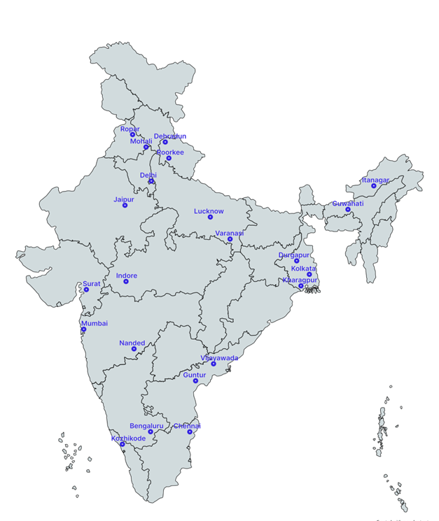


01 · ABOUT US
SECTION 1 OF 5 · ABOUT US
Crashfree India: a nonprofit that adds capacity to road safety work
Registered as the Vision Zero Trust · Co-founded by Cars24 and the Indian Road Safety Council · Working since June 2025 · New Delhi
Evidence first
Structured field audits, file reviews and research to official standards, IRC codes and MoRTH checklists.
Institutional collaboration
We work through PWDs, NHAI, transport departments, police and District Road Safety Committees.
Youth-led capacity
Trained student teams from IITs, NITs and SPAs add the auditing hands the system needs.
Technology for follow-through
Public dashboards track every recommendation from submission to completion.
Every product in this pre-read is live, public and free: built once, used by authorities every week, and designed to be shared.
Where we work today, 18 cities, north to south.
Crashfree India · Pre-read for Google Maps Platform, Roads Management Insights
03 / 14

Slide 4
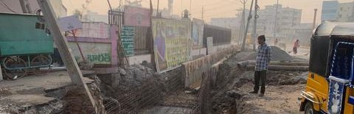
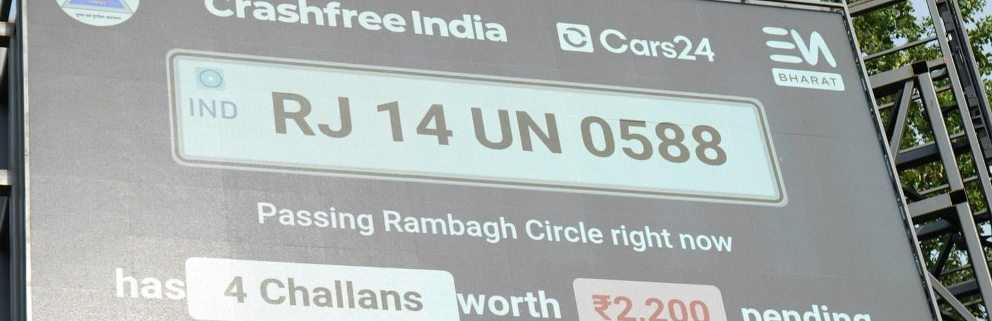
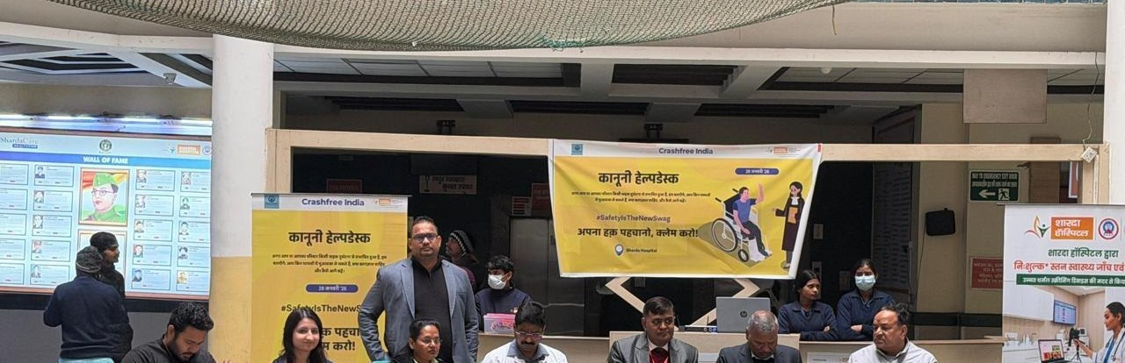

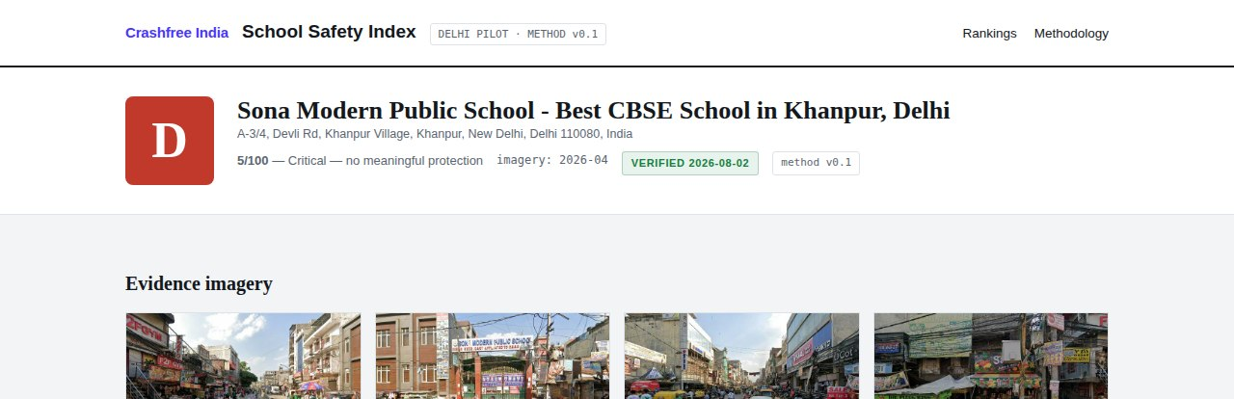

01 · ABOUT US, WHAT WE RUN
SECTION 1 OF 5 · ABOUT US
Six lines of work, one connected system
Audits create data · data supports policy · policy guides the field. Everything below is live today.
Project Rakshak
SATARK enforcement
Victim support
Student-led road audits, fixed with authorities
AI support that helps police find high-risk vehicles
Aasha chatbot, calculator, hospital helpdesks
31 sites · 15 in implementation
3,00,000+ vehicles screened
100+ victims helped in first 4 days
Open public data
School Safety Index
Youth & policy
Four self-updating data platforms, free to use
Public grading of school-zone road safety
NextMile ideathon and national dialogue series
36 states & 50 cities covered
3,814 Delhi NCR schools mapped
2,000+ participants engaged
Crashfree India · Pre-read for Google Maps Platform, Roads Management Insights
04 / 14

Slide 5
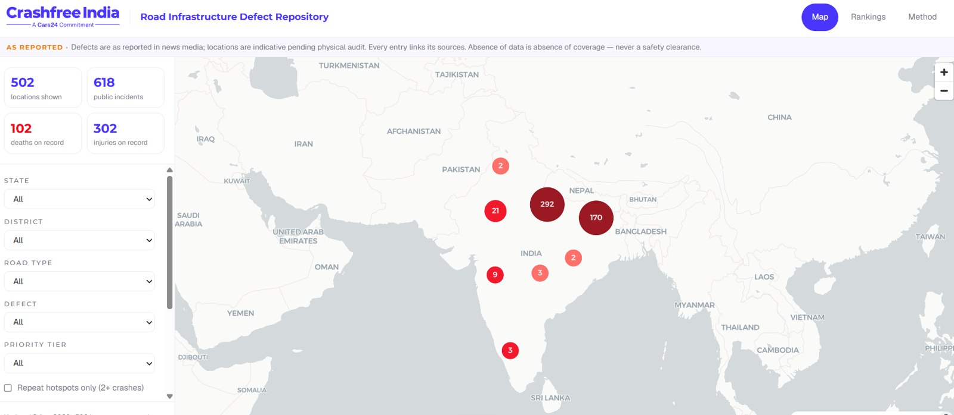
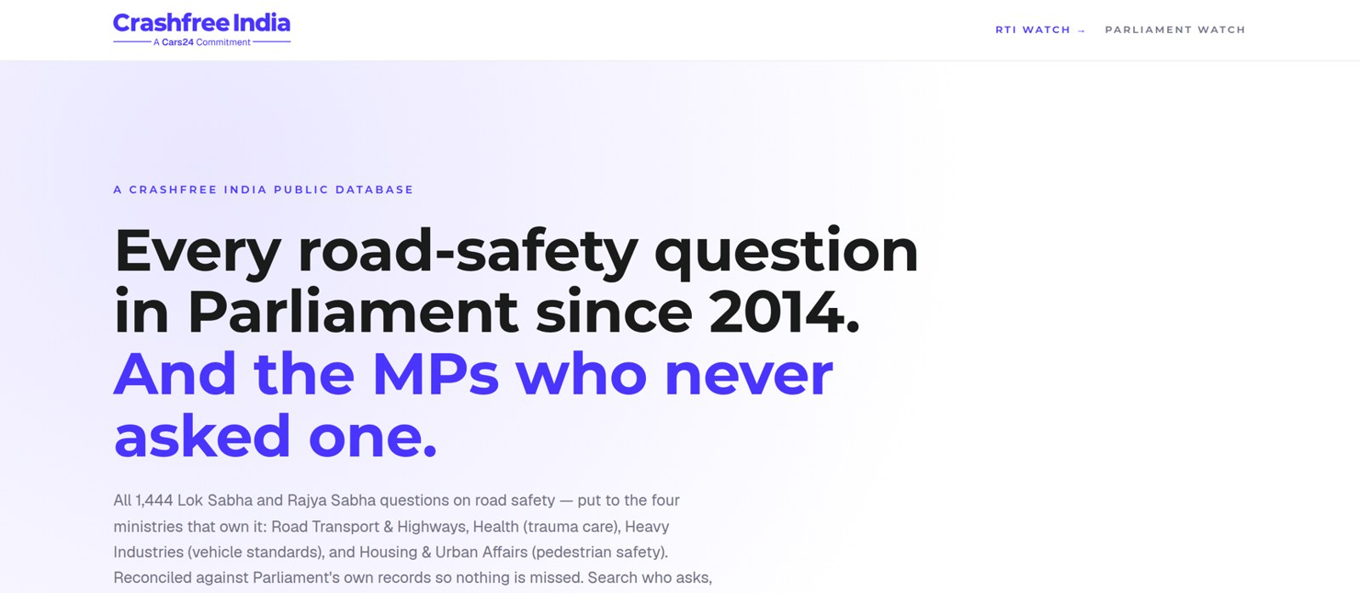


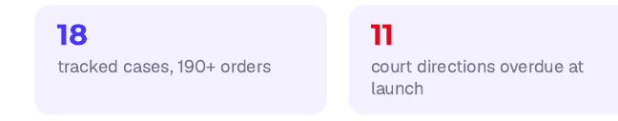
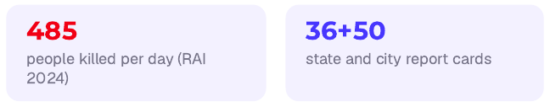
01 · ABOUT US, OPEN PUBLIC DATA
SECTION 1 OF 5 · ABOUT US
Live public data platforms, free for any authority
Each platform turns a scattered public record into structured, citable evidence. Both screenshots are live captures.
Road-Infrastructure Defect Repository, live 3 Aug 2026: 502 locations, 618 public incidents, 102 deaths and 302 injuries on record.
Road Safety in Parliament: all 1,444 questions since 2014 across four ministries, refreshed continuously.
Supreme Court Litigation Tracker
WEEKLY · LIVE
Crash Data Dashboard
ANNUAL · OPEN DATA
Every systemic road-safety matter before the Supreme Court, orders indexed, precedent judgments digested, refreshed every Tuesday.
MoRTH's annual 'Road Accidents in India' books as a usable product: report cards for 36 states and 50 cities, open licence (CC-BY).
Crashfree India · Pre-read for Google Maps Platform, Roads Management Insights
05 / 14

Slide 6
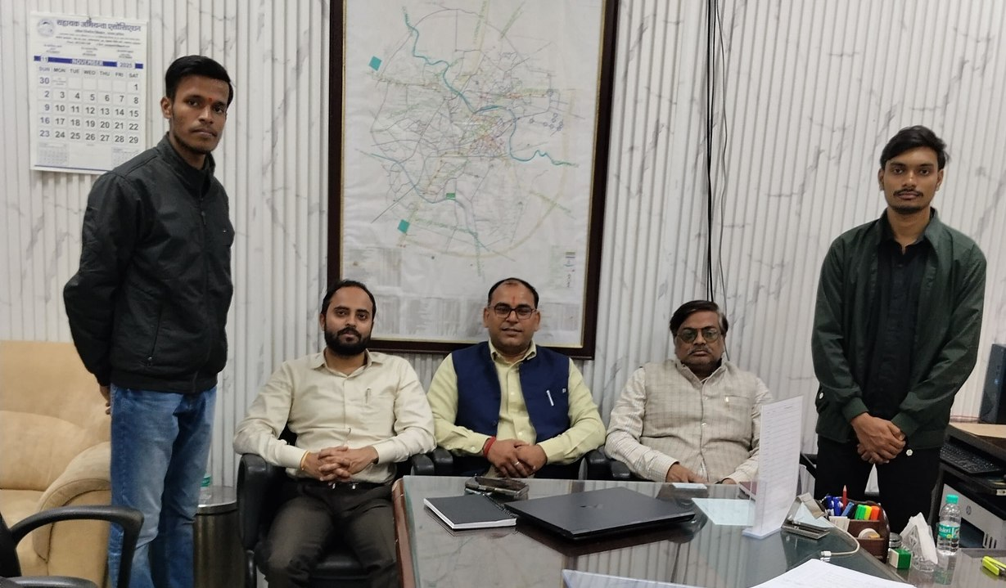



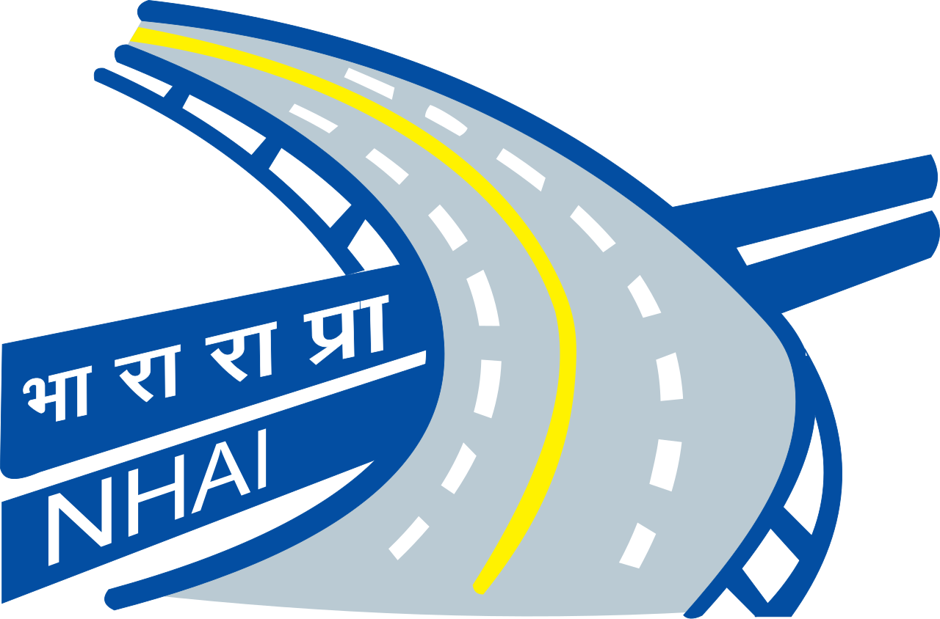
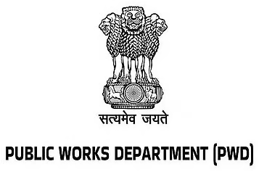
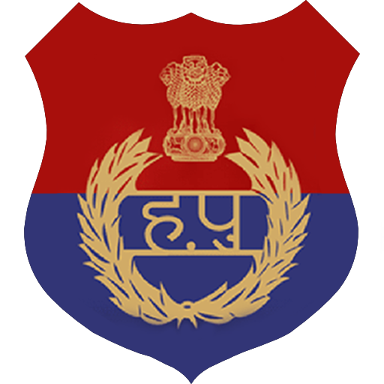



02 · WHERE WE WORK WITH GOVERNMENT
SECTION 2 OF 5 · GOVERNMENT
Working relationships across the road safety machinery
Roads Management Insights serves road authorities. We work with many of them every week, with formal seats and signed mandates.
Four District Road Safety Committees
Formal member in Gurugram, South-West Delhi, North-West Delhi and Jaipur, the statutory bodies that decide local road-safety action.
Police partnerships
MoUs with Jaipur Traffic Police and Gurugram Police; SATARK runs with police in three cities; challan and crash (e-DAR) data flow through these relationships.
Written authority approvals
25+ approvals in writing from road-owning authorities across six states: PWDs of Kerala, UP and Punjab, CPWD, R&B Andhra, GCC Chennai, ADDA Durgapur, Indore.
Presenting audit findings to the engineers who own the road.
National institutions
Expressions of Interest submitted to National Road Safety Board Working Groups 2 and 5; Rajasthan's compensation scheme mapped office-by-office with the Transport Department.
AUTHORITIES WE WORK WITH
Crashfree India · Pre-read for Google Maps Platform, Roads Management Insights
06 / 14

Slide 7

03 · WHY SPEED DATA MATTERS
SECTION 3 OF 5 · SPEED & RMI
Speed decides what a crash becomes
The case for measuring speed is written in the official record. Managed speeds are the single most direct lever on survival.
72.4%
10% → 90%
3–4%
of crashes on India's National Highways are attributed to speed (72.5% of the deaths)
a pedestrian's fatality risk as impact speed rises from 30 to 70 km/h
fewer fatal crashes for every 1 km/h reduction in mean traffic speed
MoRTH, Road Accidents in India 2023
Austroads, 2015
World Bank, Guide for Safe Speeds 2024
And in the crash records we work with every week
In the 361 GPS-located crashes at Jaipur's notified blackspots (2022–24, police e-DAR records via our District Road Safety Committee seat), high speed is the single most recorded violation. The worst cluster alone, on the Jaipur–Kishangarh Expressway near Bhankrota, carries 23 deaths from 13 crashes within about 150 metres.
What no one measures today is the speed itself: continuously, corridor by corridor, hour by hour. That is the layer Roads Management Insights carries.
Crashfree India · Pre-read for Google Maps Platform, Roads Management Insights
07 / 14

Slide 8
03 · OUR READ OF RMI
SECTION 3 OF 5 · SPEED & RMI
What we understand RMI provides, and what we would like to learn
Written after hands-on setup on Google Cloud. Please correct us wherever our understanding is incomplete.
OUR CURRENT UNDERSTANDING
WHAT WE WOULD LIKE TO LEARN FROM YOU
Historical travel times & speeds
Does RMI, or its roadmap, include crash-risk or hotspot layers, like the accident-prone-area alerts consumer Maps ships in India?
per subscribed corridor, accumulated hourly into BigQuery from subscription day onward
Near-real-time speeds
What segment granularity and coverage should we expect on smaller urban streets, for example the roads outside schools?
segment-level readings refreshed roughly every two minutes, streamed via Pub/Sub
Congestion vs free-flow
Can the speed-limit layer behind the India rollout be joined to RMI speeds for compliance analysis?
actual against baseline travel time, showing where and when a road degrades
Anomaly events
How do NGO and authority partnerships access RMI in practice: scope, terms, and the role Lepton plays?
sudden slowdown flags, the typical signature of a crash or closure, in near real time
As we understand it, RMI works at the level of traffic streams: no number plates and no individual vehicles. Police crash records are ours to bring.
Crashfree India · Pre-read for Google Maps Platform, Roads Management Insights
08 / 14

Slide 9



04 · PRODUCT 1, THE DEFECT REPOSITORY
SECTION 4 OF 5 · THE PRODUCTS
A national defect map, built jointly
Live today, built by us, open to all. With government blackspot data and the RMI speed layer, it becomes a national road-risk product.
What we bring
The live news-mined repository, human-reviewed with source evidence, plus government blackspot data we already hold: MoRTH's 13,795 notified black spots, and Jaipur's 96 police-mapped crash clusters.
What RMI adds
The measured speed and anomaly layer on defect corridors, so every reported defect carries real exposure alongside the report.
Live, 3 Aug 2026: 502 locations, 618 public incidents, 102 deaths, 302 injuries on record; filters by state, district, road type, defect and priority.
What it becomes
One public map where defects, crashes and speeds meet: a joint evidence product for authorities, published with attribution on every chart.
146
13
21
Daily
districts scanned daily
languages read
defect codes
07:00 IST auto-run
Crashfree India · Pre-read for Google Maps Platform, Roads Management Insights
09 / 14

Slide 10
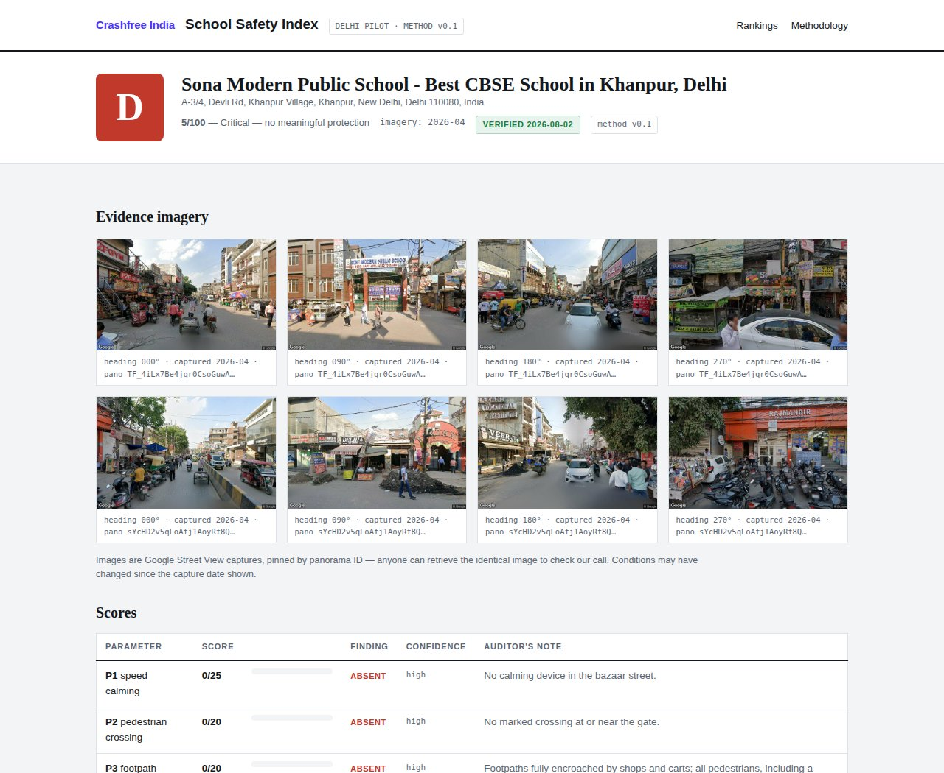



04 · PRODUCT 2, THE SCHOOL SAFETY INDEX
SECTION 4 OF 5 · THE PRODUCTS
School-zone safety, graded in public, school by school
Running today on Google's own imagery and APIs. RMI would add the one input a photograph cannot give: the speed past the gate.
WHERE RMI FITS
Imagery shows the missing crossing and the absent speed hump. RMI would add a speed-exposure score per school zone: the share of school-run hours with traffic above safe speed at the gate. Together they rank every school by measured danger, and prove the change after a district builds the fix.
READY IN JAIPUR
The public index, worst grades first.
A school's report card, with pinned
Street View evidence.
1,572
Jaipur schools already mapped for the next city build
HOW IT WORKS TODAY
361
GPS-located crashes at notified blackspots inform corridor choice
3,814 Delhi NCR schools sourced via the Places API
Street View coverage checked; 90% of schools have imagery
4 DRSCs
our committee seats carry the findings into the statutory forum
AI desk audit against an IRC SP:32 rubric, adversarially verified
Student teams field-verify the worst-graded zones
Crashfree India · Pre-read for Google Maps Platform, Roads Management Insights
10 / 14

Slide 11
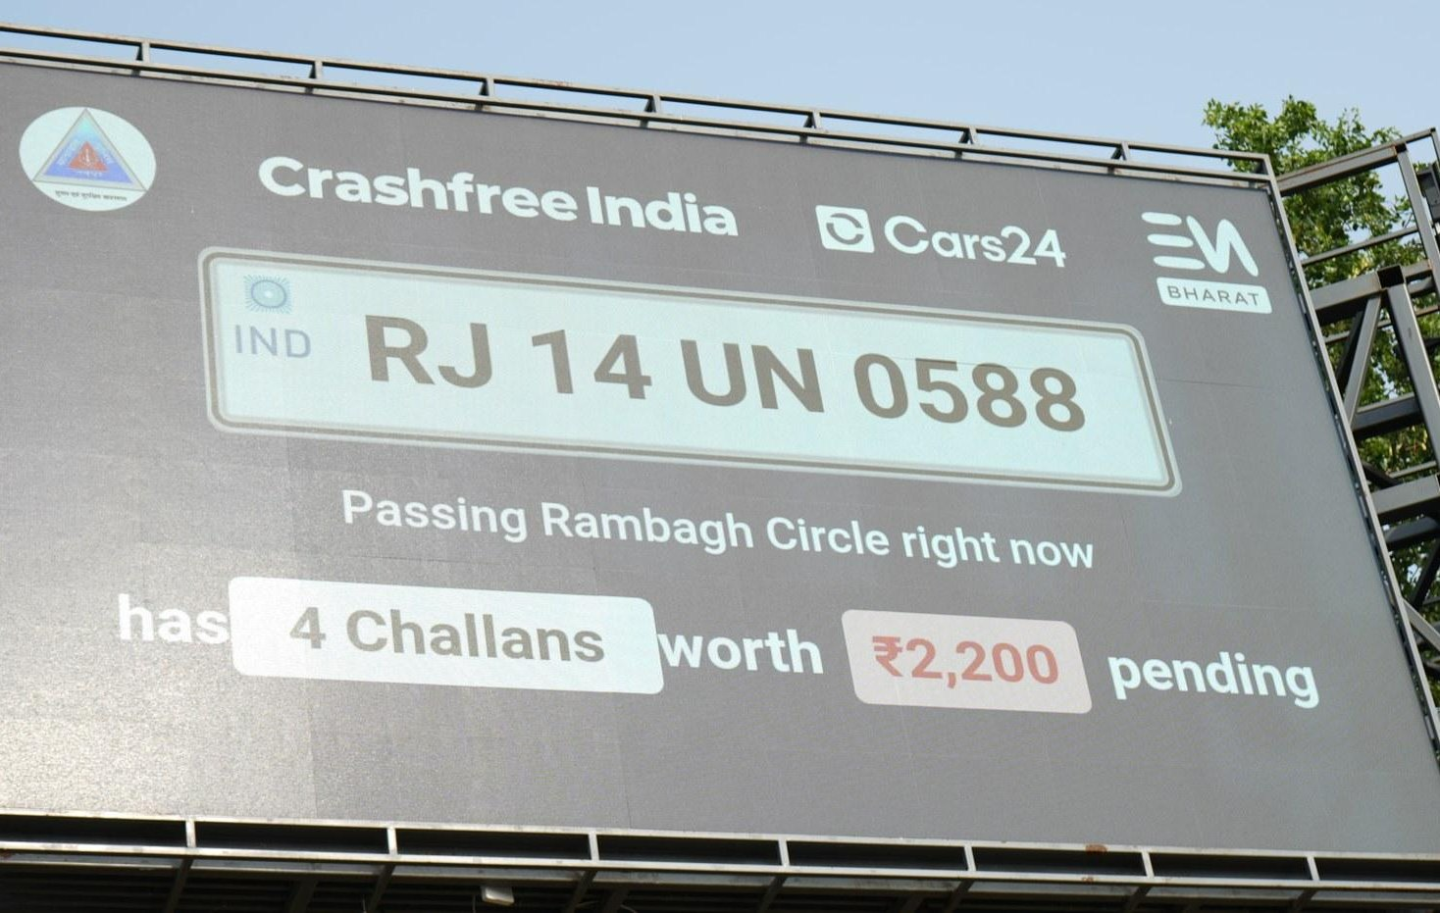

04 · PRODUCT 3, AN EXPLORATORY DIRECTION
SECTION 4 OF 5 · THE PRODUCTS
Enforcement support, shaped together if useful
An early idea, listed for completeness. It builds only on assets we already run with police partners, and carries no commitments.
EXPLORATORY · TO SHAPE TOGETHER
What already runs
SATARK screens vehicles for police in Jaipur, Bengaluru and Gurugram, 3,00,000+ screened; challan billboards operate in public view; MoUs govern the data.
What RMI could add
A weekly view of where and when speeding concentrates near people, so patrols, camera vans and SATARK sites stand where the risk is, corridor-hour by corridor-hour.
How we would keep it honest
Success measured as speeds before and after a deployment, never as challan counts; no vehicle identification anywhere in the loop; a small pilot before any scale.
A SATARK challan billboard, live with Jaipur Traffic Police.
Everything named here is ours or the police's. No third party is required for a first version.
Crashfree India · Pre-read for Google Maps Platform, Roads Management Insights
11 / 14

Slide 12




05 · A PILOT THAT IS READY
SECTION 5 OF 5 · THE PILOT
Configured, scripted, and waiting on one enablement
We prepared the ground before asking for the conversation. Everything on our side of a pilot is already done.
Cloud project configured
Roads API, BigQuery, Analytics Hub and Pub/Sub enabled on our Google Cloud project, verified end to end from Cloud Shell.
THE PILOT WE PROPOSE
Roads Management Insights enabled on our configured project for a 90-day Jaipur pilot: five corridors and fifty school zones. We can be receiving data into BigQuery the same day, and present the first speed-beside-crash evidence at the next District Road Safety Committee meeting.
Seven route subscriptions scripted
Five Jaipur blackspot corridors chosen from police crash records (162 deaths combined, 2022–24) and two school-zone test segments, ready to fire.
A lawful channel for action
Our Jaipur District Road Safety Committee seat carries every finding into the statutory forum that can act on it.
A PRECEDENT WE ADMIRE
Ground truth on call
Student audit teams verify in the field what the data flags, closing the loop between measurement and reality.
Google.org funds iRAP's Star Rating for Schools programme in Vietnam. India has no lead partner for school-zone safety yet. Every output of this pilot is published openly, with Google Maps Platform attribution on each chart.
Crashfree India · Pre-read for Google Maps Platform, Roads Management Insights
12 / 14

Slide 13


05 · FOR THIS CALL
SECTION 5 OF 5 · THE PILOT
What we would like to figure out together
Four questions, held loosely. The ranking of products is ours to lose; the starting point is yours to shape.
Correct our read of RMI
Choose the starting product
Where is our understanding of the data wrong or incomplete? What exists that we have not seen: risk layers, hotspot analytics, the speed-limit layer?
Which direction is most interesting from your side, for India and for RMI's own story: the Defect Repository, the School Safety Index, or something we have not thought of?
What makes this valuable for your team
The practical next step
Ground-truth data, a documented public-impact deployment, a partner already inside district machinery: tell us which of these matters most to you.
A technical working session with the Lepton and Maps teams, looking at real data together. Our cloud project and corridor definitions are ready whenever useful.
Crashfree India · Pre-read for Google Maps Platform, Roads Management Insights
13 / 14

Slide 14

Your maps see every road in India.
We would like to put them to work
for the people on those roads.
We look forward to the conversation.
Akhtar Hussain
Deepanshu Gupta
Gajendra Jangid
Mission Lead · akhtar@crashfreeindia.org
Trustee · deepanshu@crashfreeindia.org
Trustee · gajendra@crashfreeindia.org
Crashfree India · A Cars24 commitment · Operated by Vision Zero Trust, New Delhi · crashfreeindia.org

