Slide 1

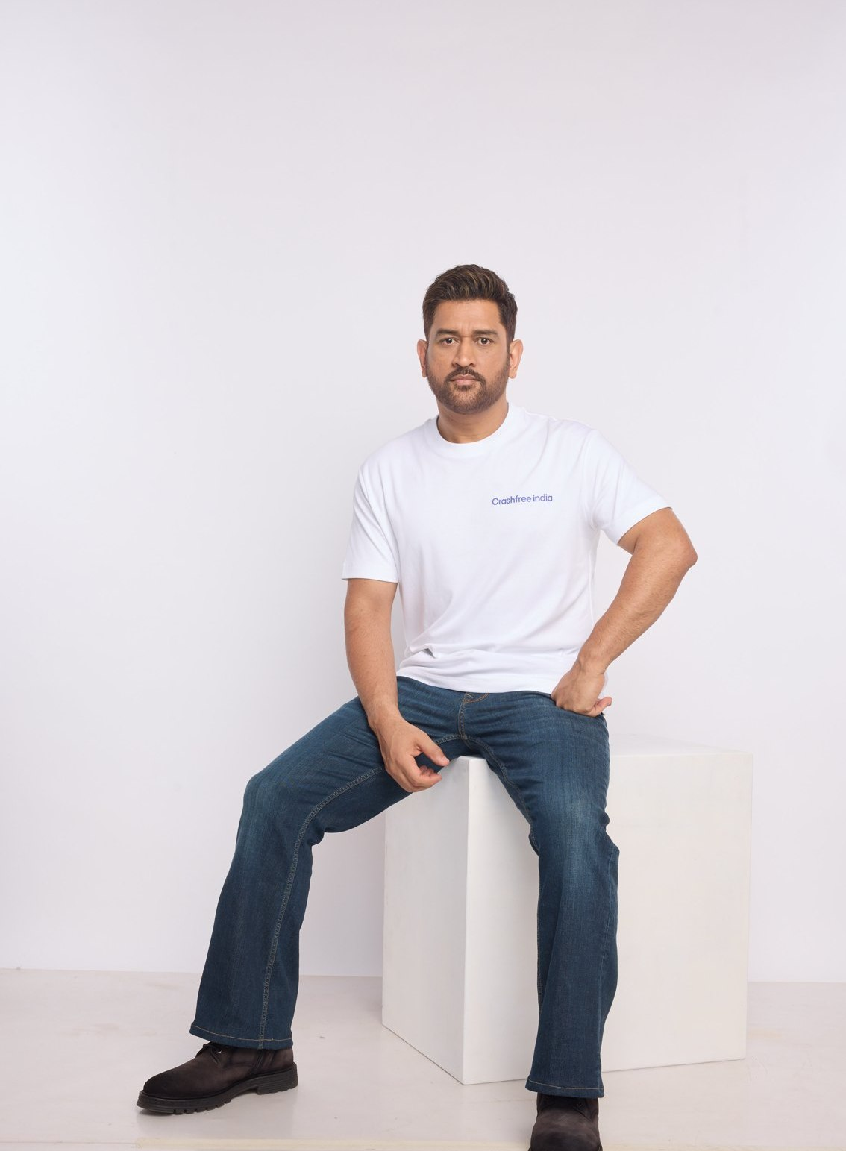



A BRIEFING FOR MENTORS · 2026
A ROAD SAFETY NONPROFIT · NEW DELHI
Crashfree India
Adding capacity to India's road safety system:
evidence, institutions, and technology that follows through
Field audits and research to official standards, fixed with the authorities that own the road
Technology for police, victims and the public: enforcement, open data, and a chatbot on WhatsApp
MS DHONI · GOODWILL AMBASSADOR,
CRASHFREE INDIA
Working inside the machinery: 4 district committees, police MoUs, 25+ written approvals
Registered as the Vision Zero Trust · A Cars24 commitment · Co-founded with the Indian Road Safety Council
crashfreeindia.org

Slide 2
BEFORE THE SLIDES
A personal note
New Delhi · August 2026
Dear friend,
This deck goes to a small set of people whose judgement I deeply admire. I am writing to ask for something specific: your counsel, from time to time, as Crashfree India grows.
Crashfree India is a road safety nonprofit, registered as the Vision Zero Trust, co-founded with the Indian Road Safety Council and backed by a three-year, US$3 million commitment from Cars24. India loses more than 1.7 lakh lives on its roads every year. In our first year we built an audit-to-implementation engine that has moved 15 dangerous sites into rectification, an AI enforcement platform running with three police forces, a compensation practice that follows crash victims' families from FIR to disbursal, and open data platforms that turn scattered public records into citable evidence. MS Dhoni carries this message to the country as our Goodwill Ambassador.
The work has reached the stage where ambition can outrun experience. We are deciding which programmes become institutions, how to work with government at scale, and how to build an organisation that can hold this mission for a decade. On questions like these, we have more energy than experience, and we know it.
The pages that follow are a short tour of what we have built. If the work speaks to you, I would be grateful for an hour of your time, and for the licence to write to you when we face a decision where your experience would show us the way.
With respect,
Akhtar Hussain
Mission Lead, Crashfree India · akhtar@crashfreeindia.org · crashfreeindia.org
Crashfree India · A briefing for mentors · 2026
02 / 15

Slide 3

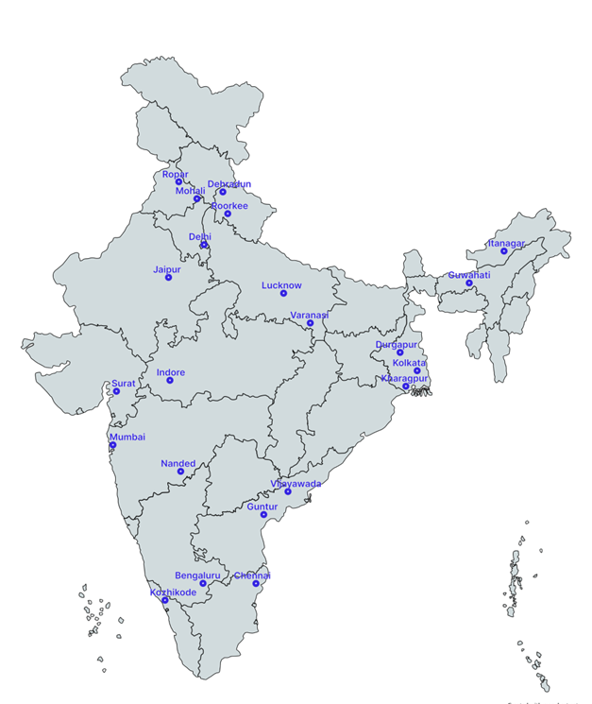


01 · ABOUT US
ABOUT US
Crashfree India: a nonprofit that adds capacity to road safety work
Registered as the Vision Zero Trust · Co-founded by Cars24 and the Indian Road Safety Council · Working since June 2025 · New Delhi
Evidence first
Structured field audits, file reviews and research to official standards, not opinion.
Institutional collaboration
We work through PWDs, NHAI, transport departments, police and District Road Safety Committees.
Youth-led capacity
Trained student teams from IITs, NITs and SPAs add the auditing hands the system needs.
Technology for follow-through
Public dashboards track every recommendation from submission to completion.
Backed by a US$3 million, three-year commitment from Cars24. Programmes, not overheads, receive 71% of the budget.
Where we work today, 18 cities, north to south.
Crashfree India · A briefing for mentors · 2026
03 / 15

Slide 4


01 · ABOUT US, OUR APPROACH
ABOUT US
Our approach: work with the system, and prove it with data
Four steps, applied to every problem we take up, from a dangerous junction to a stalled compensation claim.
1 · Evidence
2 · Institutional partnership
3 · Technology
4 · Follow-through
Field audits, file reviews and research to official standards.
→
Work through the authority that owns the problem, never around it.
→
Dashboards, AI and WhatsApp tools that fit how officials already work.
→
Every recommendation tracked publicly to completion.
31 sites audited · 50+ stakeholder consultations
31 sites audited · 50+ stakeholder consultations
25+ written approvals · 4 DRSCs · MoUs with police
25+ written approvals · 4 DRSCs · MoUs with police
Aasha · SATARK · 4 open data platforms
Aasha · SATARK · 4 open data platforms
Implementation started at 15 sites · 7 fully built
Implementation started at 15 sites · 7 fully built
We do not replace the system and we do not campaign against it. We add hands, evidence and tools to work the system has already committed to.
Crashfree India · A briefing for mentors · 2026
04 / 15

Slide 5
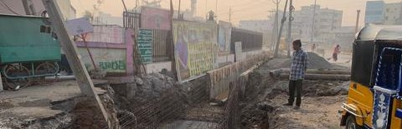
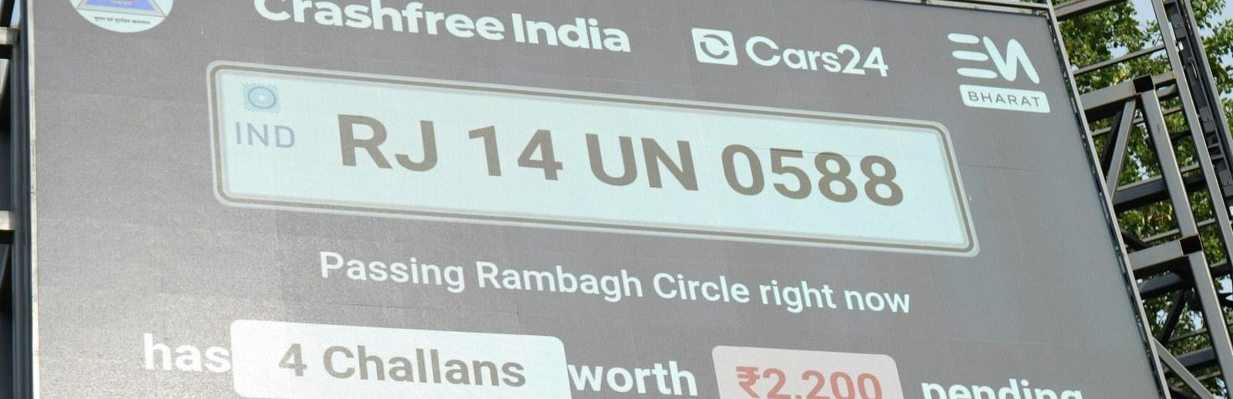
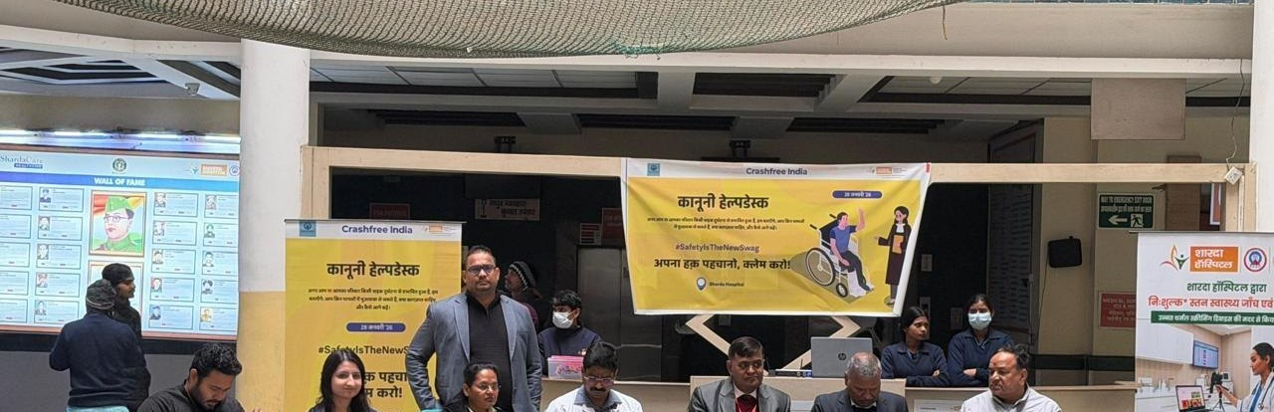
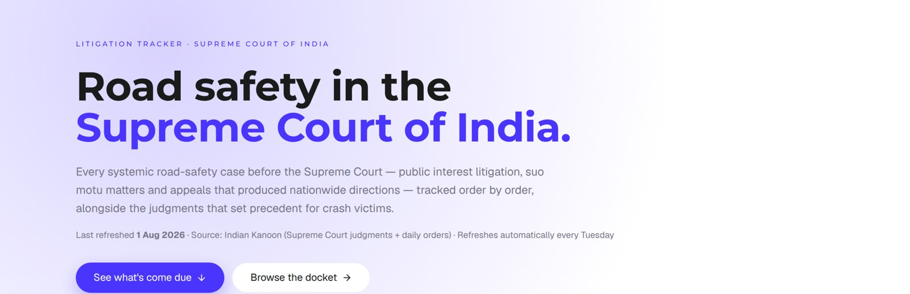
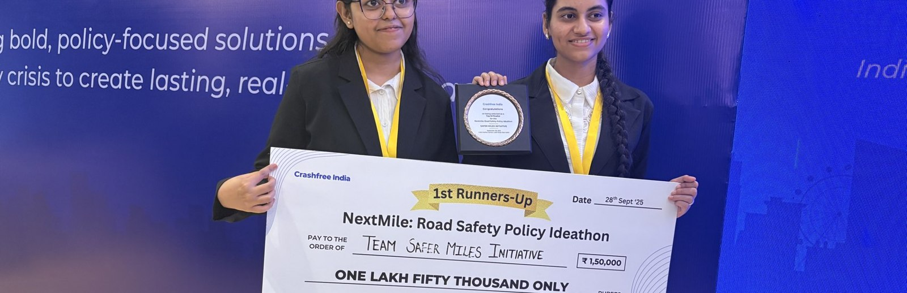
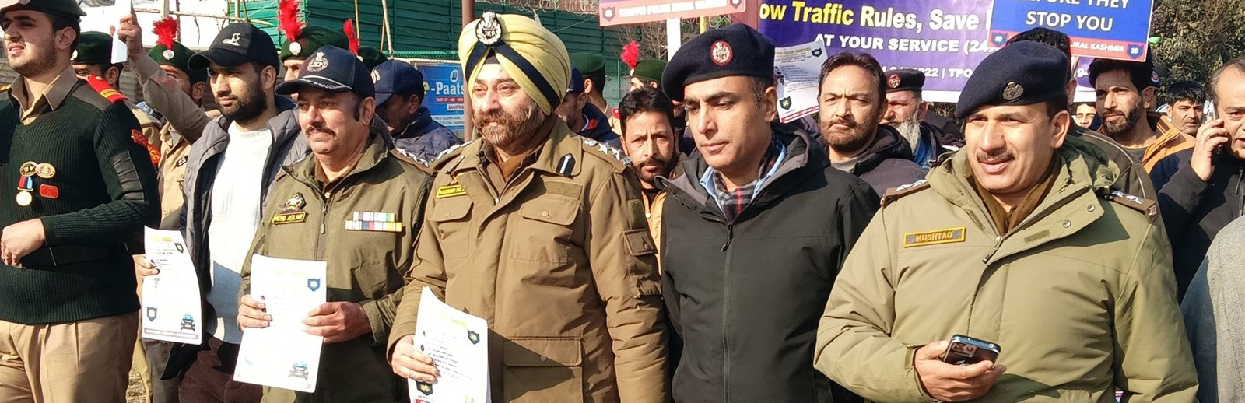
02 · WHAT WE HAVE BUILT
WHAT WE HAVE BUILT
Six lines of work, one connected system
Audits create data · data supports policy · policy guides the field. Everything below is live today.
Project Rakshak
SATARK enforcement
Victim support
Student-led road audits, fixed with authorities
AI support that helps police find high-risk vehicles
Aasha chatbot, calculator, hospital helpdesks
31 sites · 7 fixes fully built
3,00,000+ vehicles screened
100+ victims helped in first 4 days
Open public data
Youth & policy
Public campaigns
Four self-updating data platforms, free to use
NextMile ideathon and national dialogue series
Road Safety Month with police & schools; MS Dhoni
36 states & 50 cities covered
2,000+ participants engaged
1M+ citizens reached
Crashfree India · A briefing for mentors · 2026
05 / 15

Slide 6
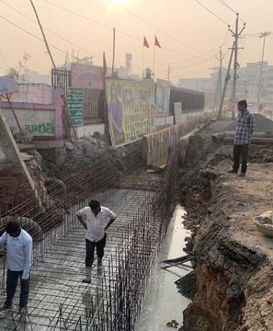
02 · WHAT WE HAVE BUILT, ROAD INFRASTRUCTURE
WHAT WE HAVE BUILT
Project Rakshak: student audits that end in built fixes
Trained student teams, guided by senior experts, audit dangerous locations to IRC codes, and we walk each fix through the road-owning authority until it is built.
120+
31
25+
15
→
→
→
locations screened
sites audited, 11 official black spots
written authority approvals
sites in implementation, 7 fully built
31 student teams · 20 institutions including nine IITs · 900+ stakeholder surveys · 17 subject-matter experts guiding every audit
MARQUEE CASE, OUTER RING ROAD, SOUTH DELHI
On our audit, PWD built a continuous 1.8 m accessible pedestrian corridor, upgraded drainage at ponding sites, installed bollards against footpath encroachment, and deployed camera-backed speed-feedback boards.
Every site is tracked on a public dashboard from submission through approval to completed construction, an honest read on how quickly agencies can act.
Construction underway after a student audit, tracked publicly to completion.
Crashfree India · A briefing for mentors · 2026
06 / 15

Slide 7
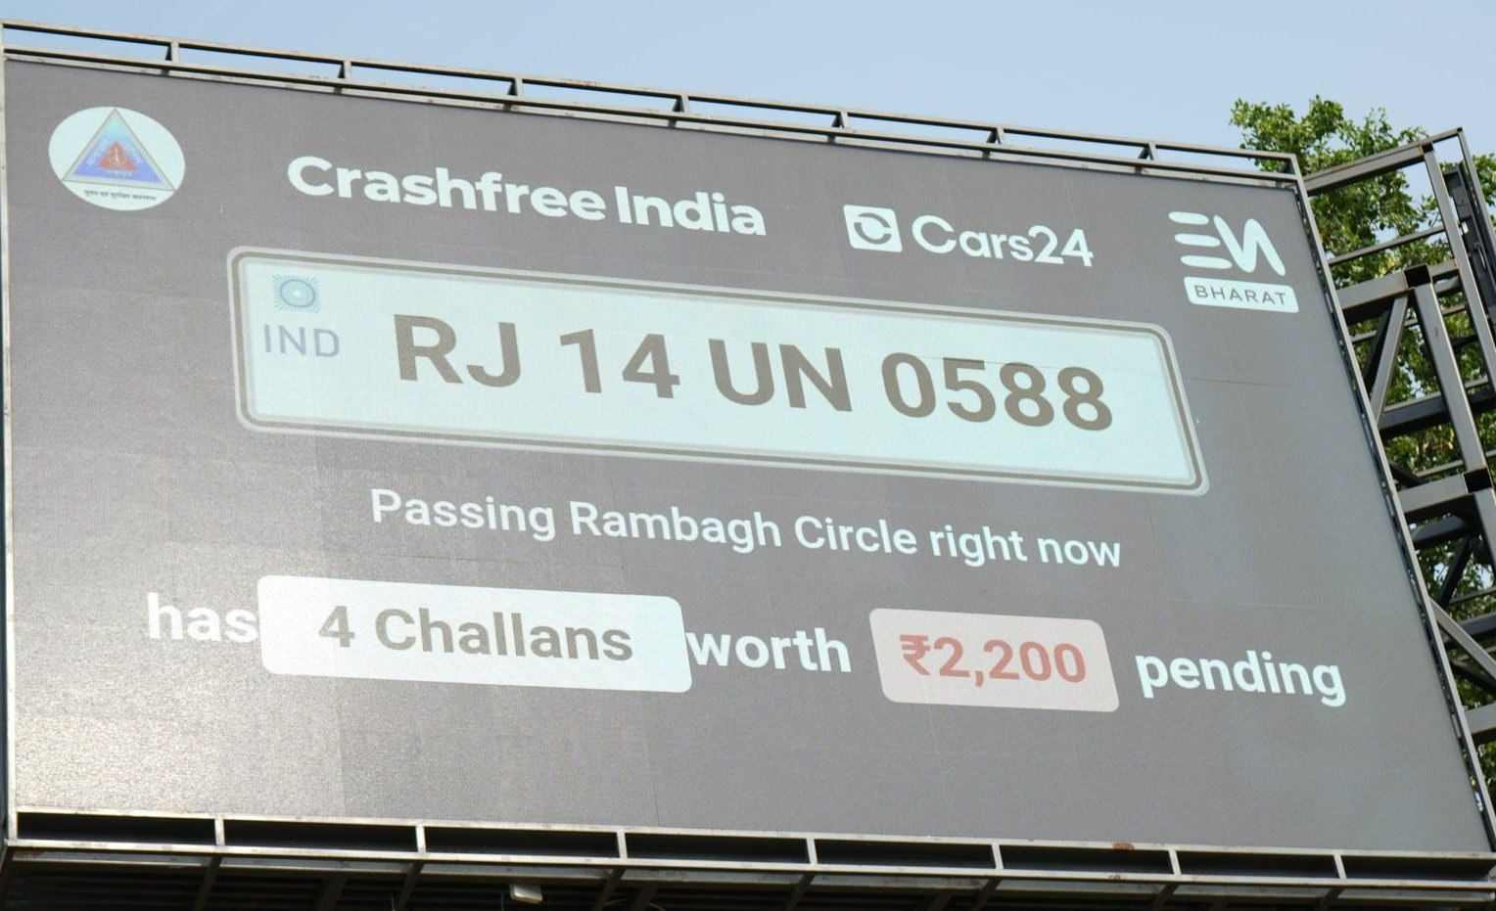
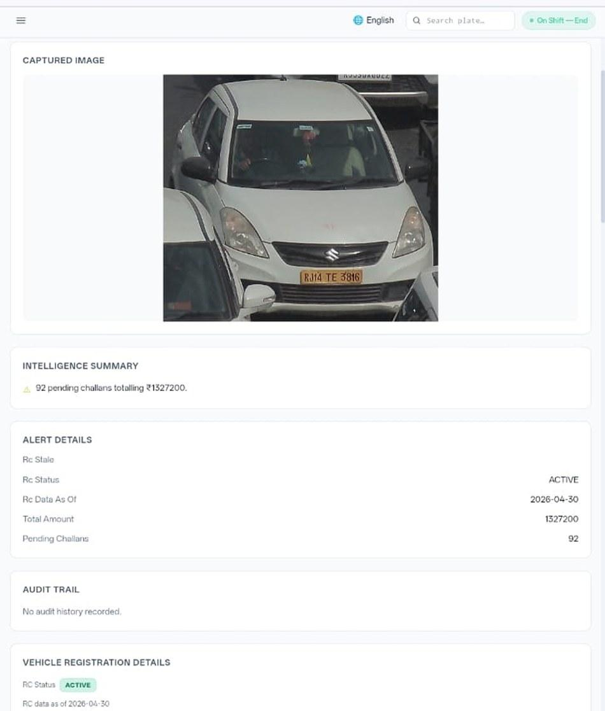








02 · WHAT WE HAVE BUILT, ENFORCEMENT TECHNOLOGY
WHAT WE HAVE BUILT
SATARK: AI that helps police stop the right vehicle
Built with Cars24 engineers. Reads number plates, checks government records, and alerts officers to repeat offenders, in real time.
3,00,000+
₹30 Cr+
vehicles screened
pending challan value identified
350+
70,019
high-risk vehicles intercepted
vehicles found with pending challans
LIVE · Jaipur & Bengaluru
NEW · Gurugram
Officer view, challans,
RC & compliance status.
Bengaluru's Trinity Circle billboard was India's first, covered by Deccan Herald and national press. Pune and Ahmedabad are next.
Rambagh Circle, Jaipur, live plate, pending challans and dues on a public billboard.
ANPR camera
Plate read
Records check
Risk flag
Officer alert
Billboard
Interception
Enforcement
Crashfree India · A briefing for mentors · 2026
07 / 15

Slide 8
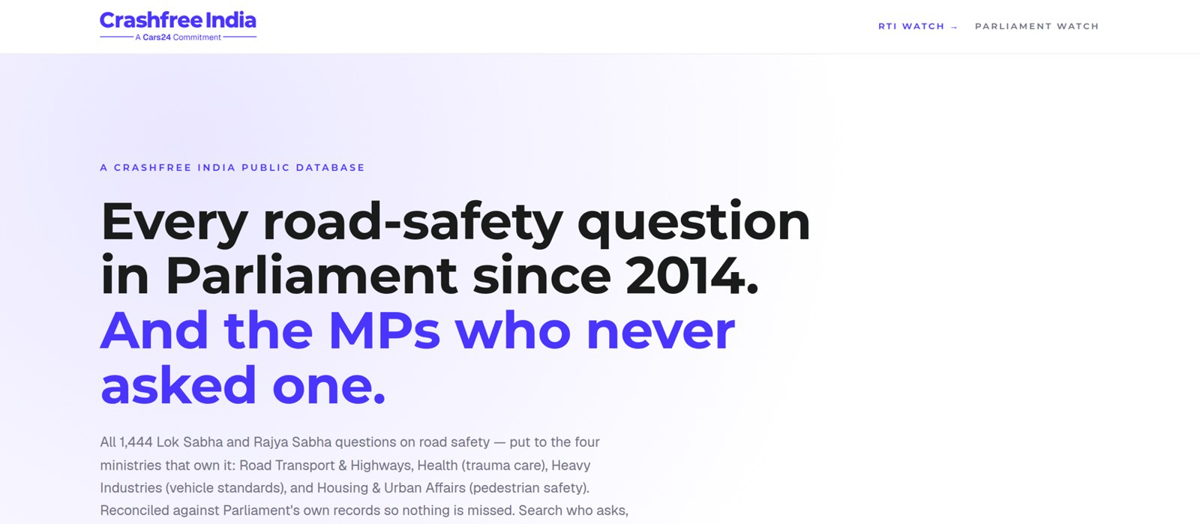



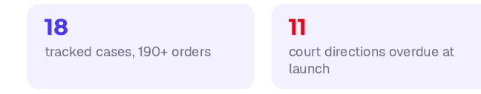
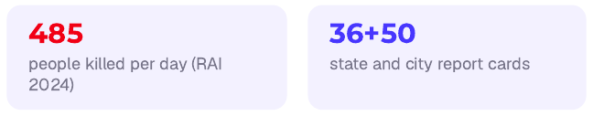
02 · WHAT WE HAVE BUILT, OPEN PUBLIC DATA
WHAT WE HAVE BUILT
Live public data platforms, free for any authority
Four platforms, each turning a scattered public record into structured, citable evidence. The Parliament tracker is shown live, as captured this week.
National Road-Infrastructure
Defect Repository
DAILY · 07:00 IST
An AI pipeline reads local-language news every morning and turns road-defect reports into structured, mapped, ranked evidence, each entry carrying its verbatim source.
Potholes
Missing signage
Unlit stretches
Blind curves
Broken dividers
146
districts scanned daily
13
languages read
21
defect codes tracked
Road Safety in Parliament: all 1,444 questions since 2014 across four ministries; 275 of 540 sitting Lok Sabha MPs have never asked one.
Local news → AI extraction → confidence gate → human review → public map. Live across Bihar, UP and Rajasthan districts today.
Supreme Court Litigation Tracker
WEEKLY · LIVE
Crash Data Dashboard
ANNUAL · OPEN DATA
Every systemic road-safety matter before the Supreme Court, orders indexed, precedent judgments digested, refreshed every Tuesday.
MoRTH's annual 'Road Accidents in India' books as a usable product: report cards for 36 states and 50 cities, every number reconciled against the printed books, open licence (CC-BY).
Crashfree India · A briefing for mentors · 2026
08 / 15

Slide 9
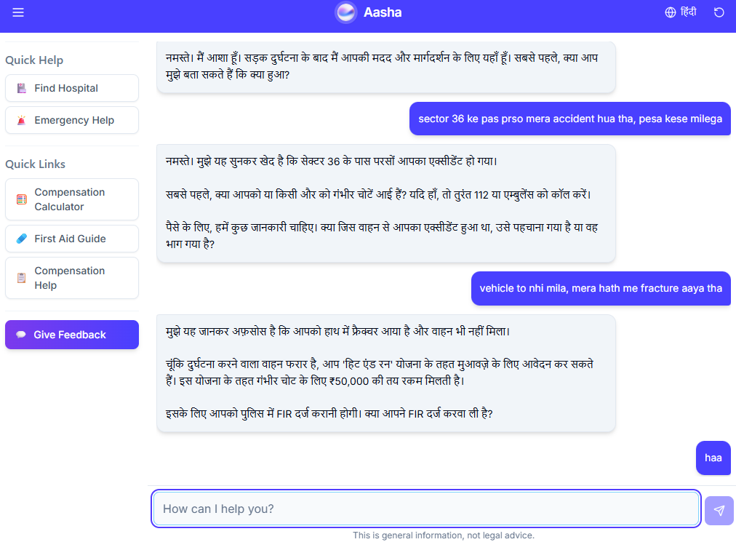
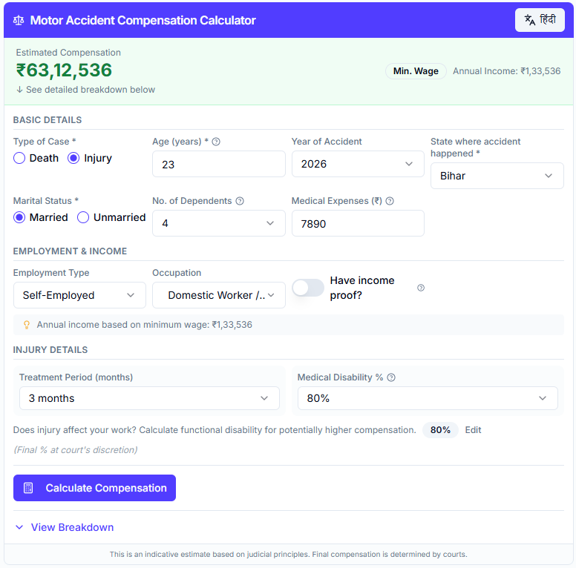
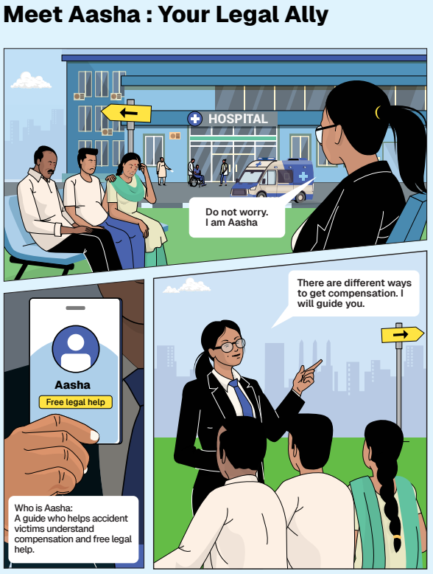
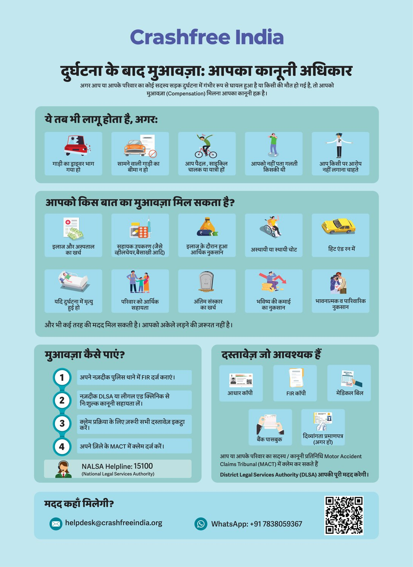




02 · WHAT WE HAVE BUILT, VICTIM SUPPORT
WHAT WE HAVE BUILT
Help a family can actually use, in their language
From the first hours after a crash to the final compensation order, on WhatsApp, on paper, and in person.
Aasha chatbot
Compensation Calculator
'Meet Aasha' comics
Hindi rights guide
India's first AI legal companion for crash victims, on WhatsApp and voice, no app needed.
Free instant estimates computed on Supreme Court principles (Sarla Verma, Pranay Sethi).
Plain-language legal education that families actually read, at desks and in schools.
All three compensation routes, NALSA 15100 and the Cashless Treatment Scheme 2025.
Hospital helpdesks bring all of this to the trauma-ward bedside , 100+ victims supported in the first four days, run with DLSA and Neev Foundation.
Crashfree India · A briefing for mentors · 2026
09 / 15

Slide 10
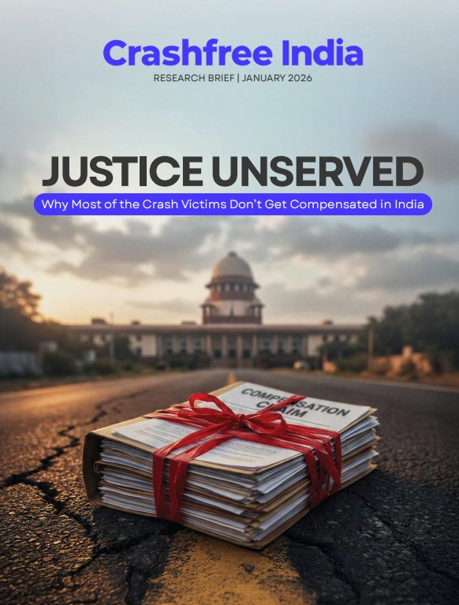
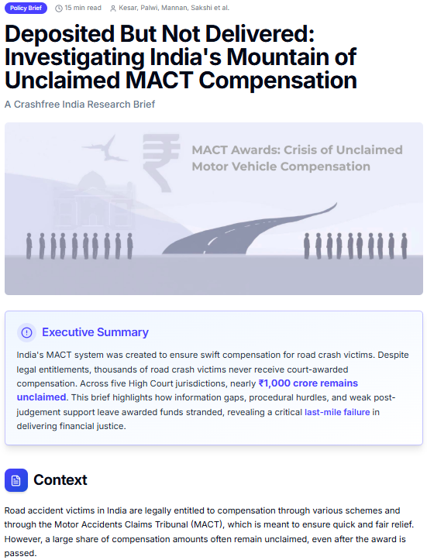
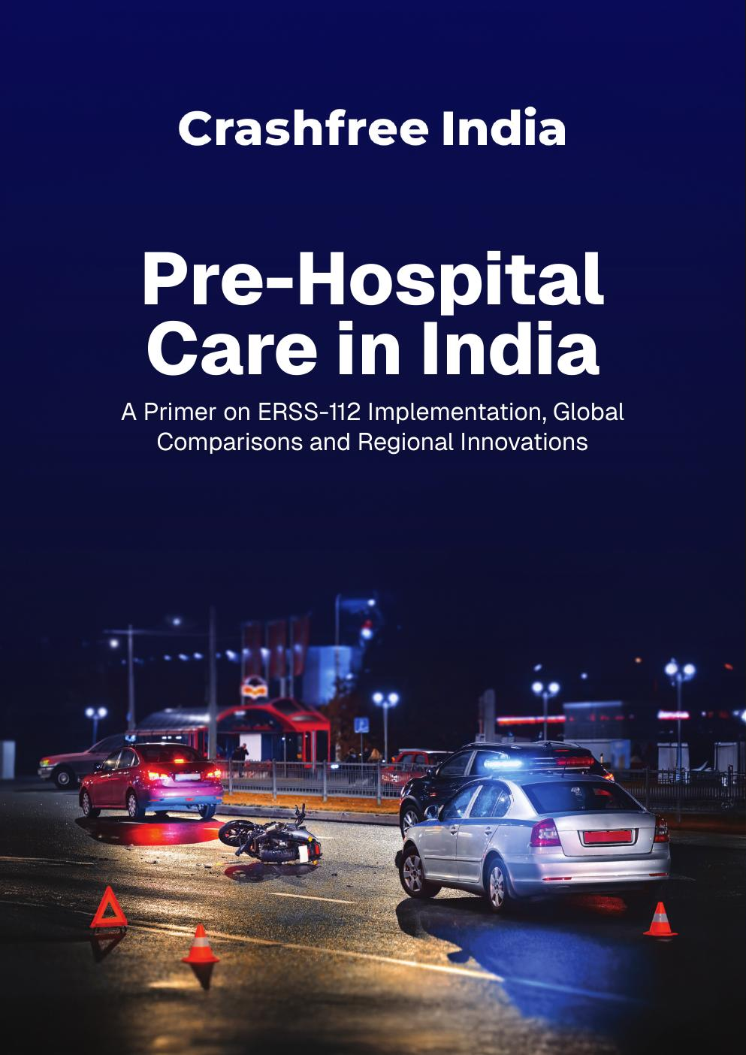
02 · WHAT WE HAVE BUILT, OUR RESEARCH
WHAT WE HAVE BUILT
Published evidence the sector cites
Original research, launched publicly and covered by national press. Each report turns a policy gap into something authorities can act on.
'Justice Unserved'
'Deposited But Not Delivered'
Pre-Hospital Care Primer
Jan 2026
2026
Sep 2025
Why so few hit-and-run and third-party claims reach the families entitled to them. Launched at IIT Delhi; findings presented to MoRTH.
~₹986 crore of court-awarded compensation lies unclaimed across five High Court jurisdictions, a bottleneck the Supreme Court noted in 2025.
Benchmarks ERSS-112 response and documents state EMS innovations, with contributions from the AIIMS Trauma Centre.
Plus: the gig-rider brief 'When Risks Become Routine', and four open public-data platforms, all free to use and openly licensed.
Crashfree India · A briefing for mentors · 2026
10 / 15

Slide 11
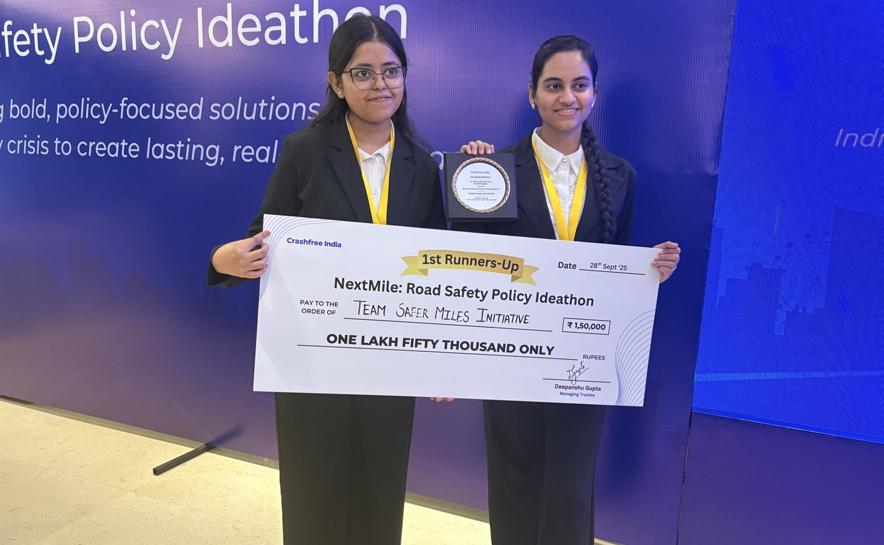
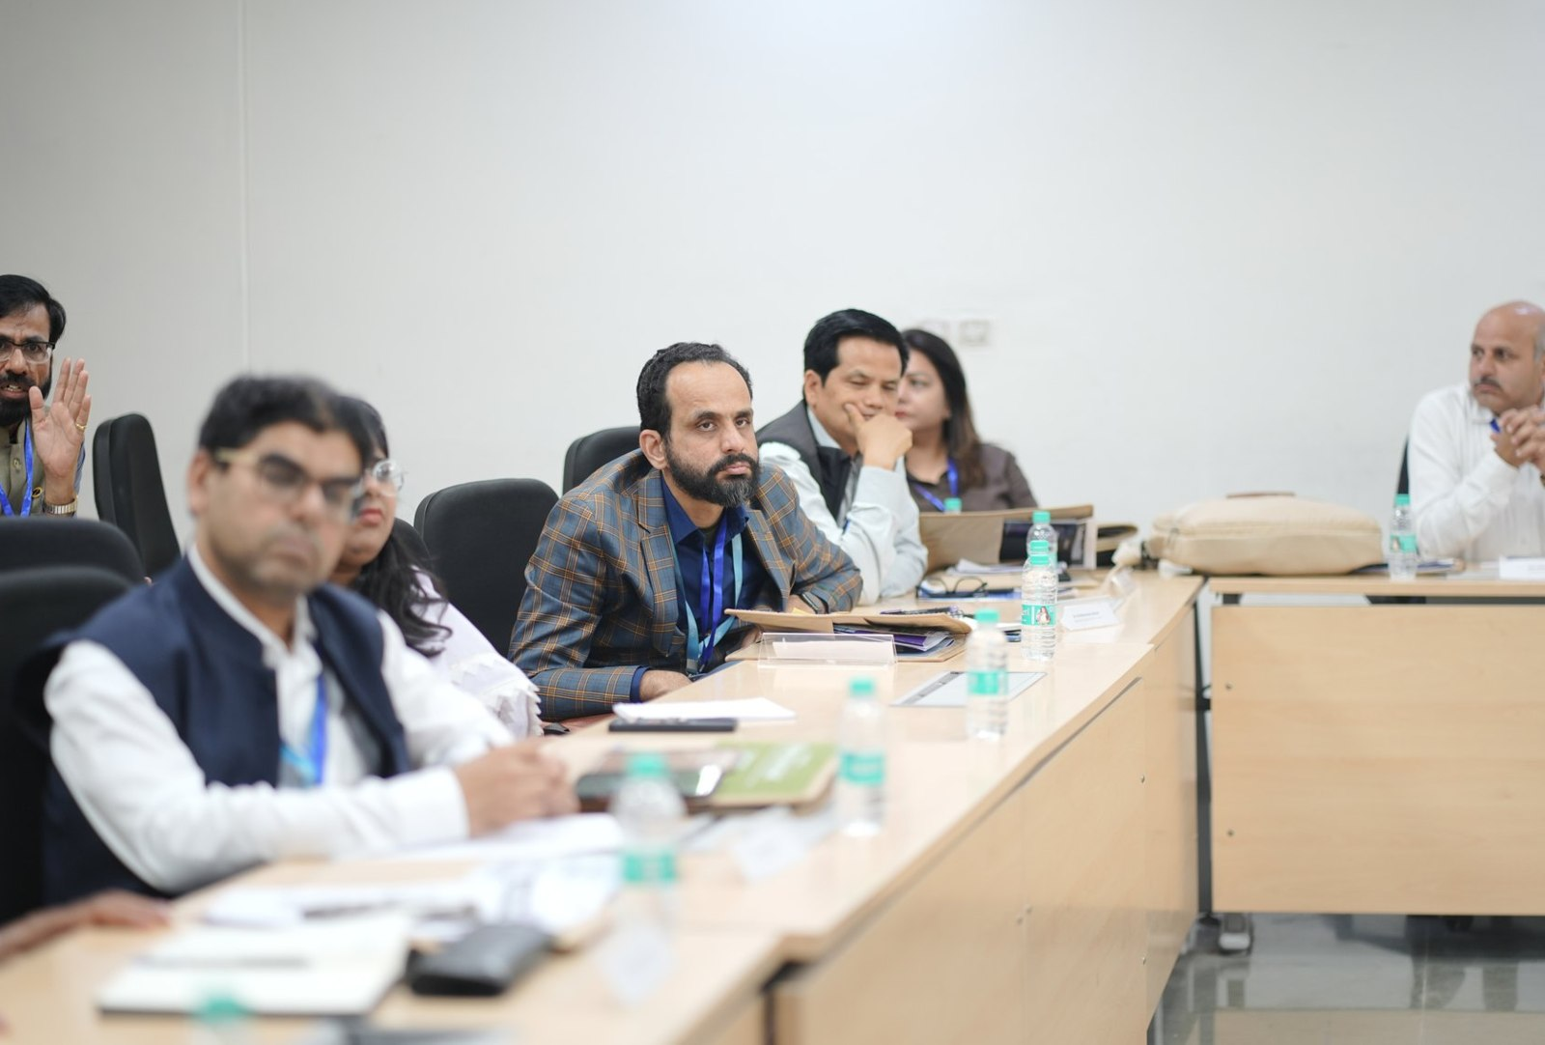



02 · WHAT WE HAVE BUILT, YOUTH & POLICY
WHAT WE HAVE BUILT
Young talent and senior experts, working the same problem
A steady pipeline of engineers and policy minds, so road safety work never runs out of hands.
National Road Safety Dialogue Series
200+ live attendees; speakers from MoRTH, CIRT, AIIMS Trauma Centre, CSIR-CRRI and ARAI.
Three sessions so far
Bus safety · Delivery rider safety · Good Samaritan law & the Cashless Treatment Scheme.
NextMile: Road Safety Policy Ideathon, grand finale, 28 Sep 2025, New Delhi.
National Road Safety Implementation Forum, IIT Delhi: 60+ experts from MoRTH, WHO, UNICEF, iRAP and CSIR-CRRI reviewed the work.
Advocacy on video
Our YouTube channel documents hazards and fixes on camera: ground-audit walkthroughs, Dialogue Series recordings and victim-education explainers. A public record any authority can cite.
2,000+
250+
700+
10
Mentors and jury from the Government of Rajasthan, NIUA, OMI, NASSCOM and CSEP judged the student teams; winning tracks now feed our audit and research pipeline.
participants
concept notes
teams
finalist teams
Next: 'Be a Rakshak' university chapters at IITs, NITs and SPAs.
Crashfree India · A briefing for mentors · 2026
11 / 15

Slide 12
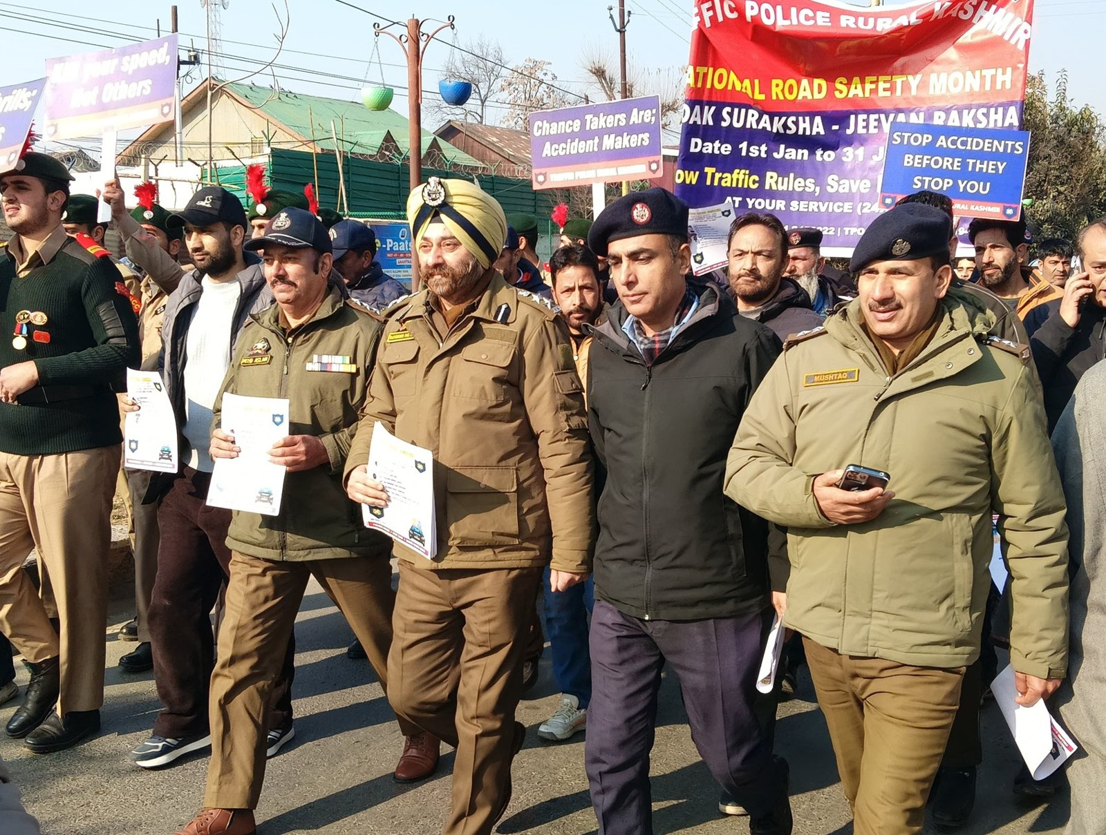
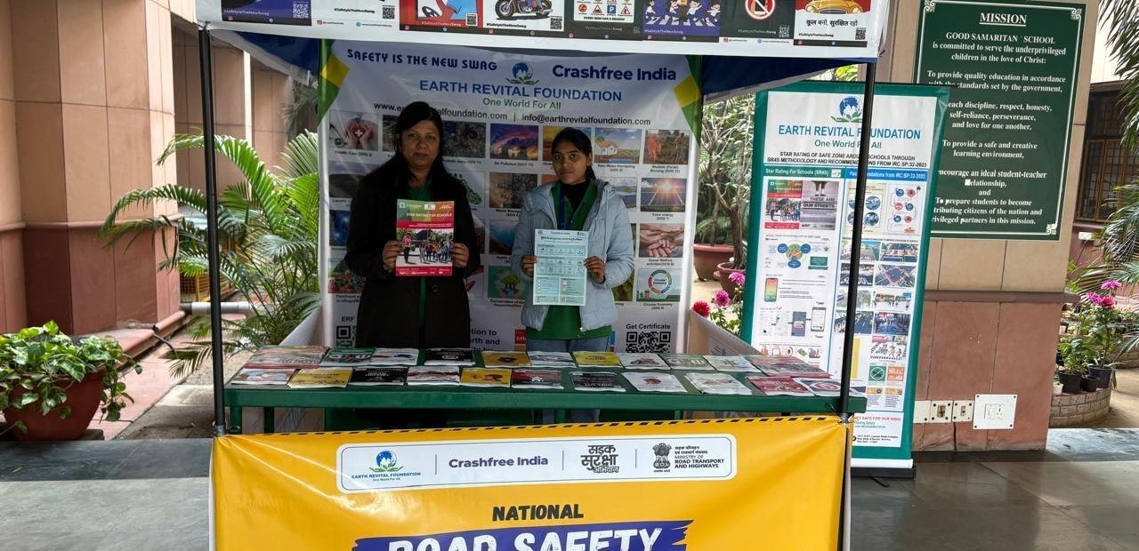
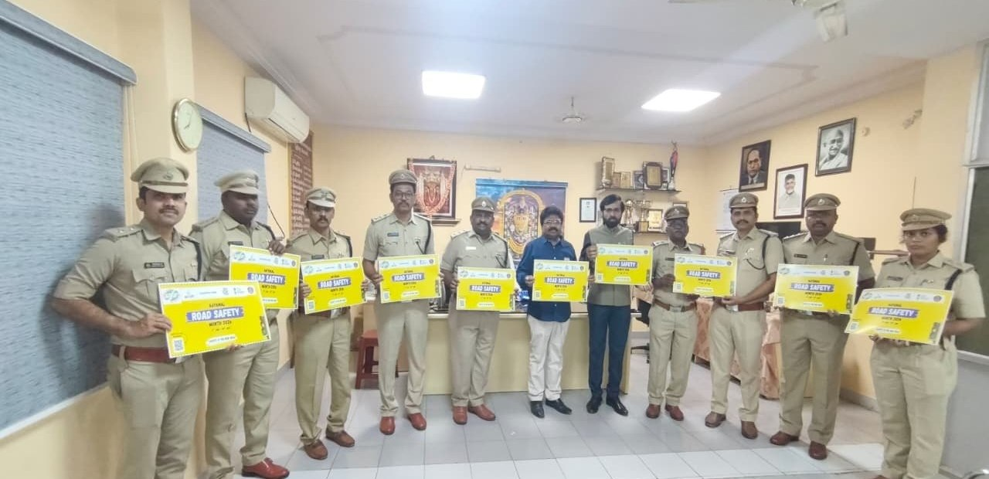
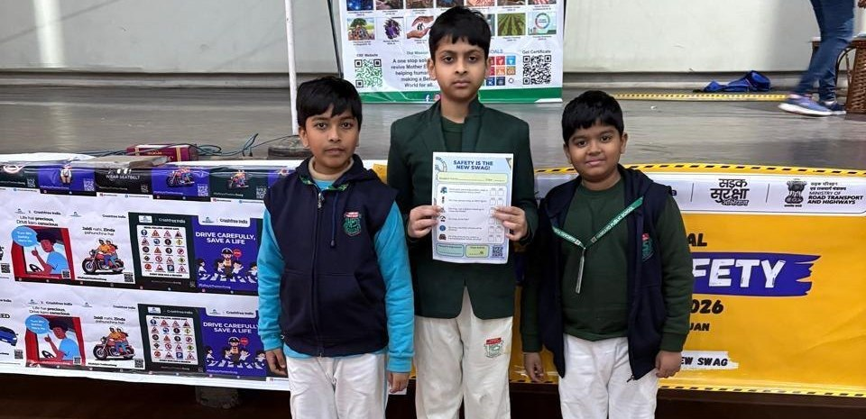
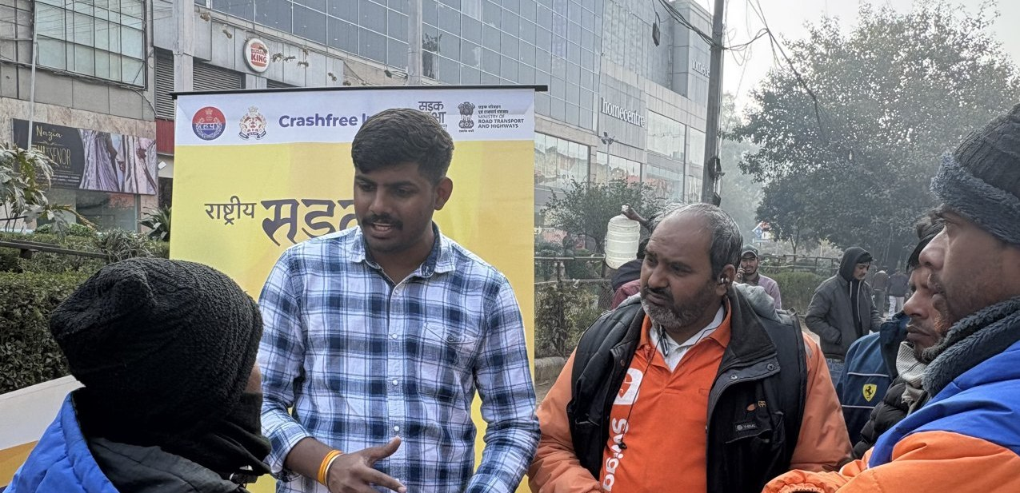
02 · WHAT WE HAVE BUILT, ON THE GROUND
WHAT WE HAVE BUILT
Road Safety Month 2026, run with the system
With district police, schools, hospitals and delivery platforms, in Hindi and local languages.
CFI stall at a government office
Materials briefing with police staff
National Road Safety Month rally, on the road with district traffic police, Jan 2026.
School programme with certificates
Delivery-rider outreach, Swiggy & Instamart
1M+ citizens reached across campaigns in year one.
Crashfree India · A briefing for mentors · 2026
12 / 15

Slide 13
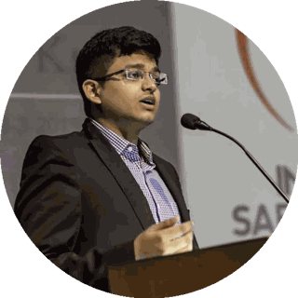
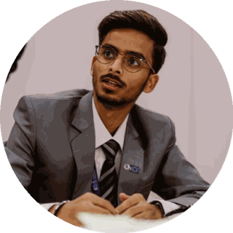
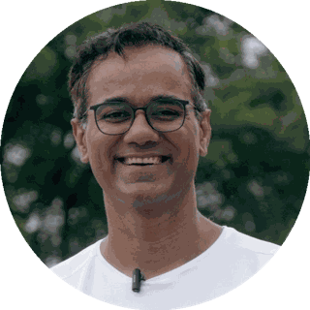
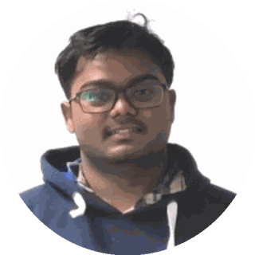
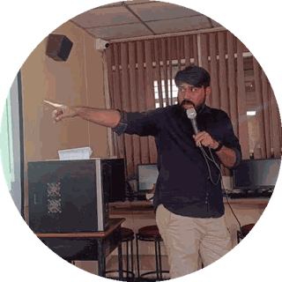
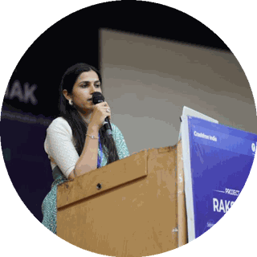
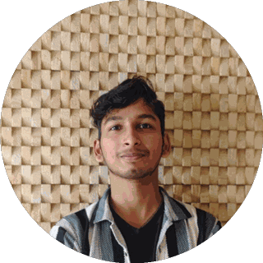
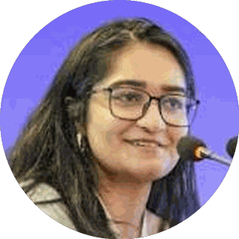
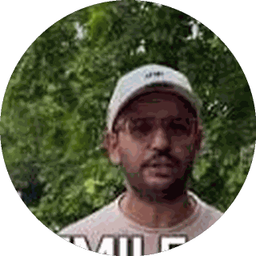
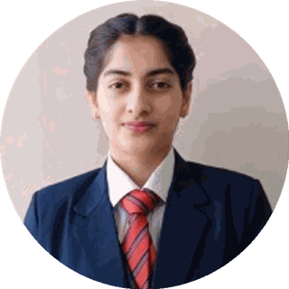
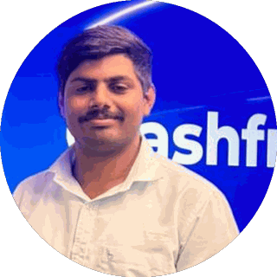
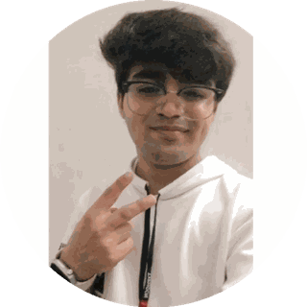
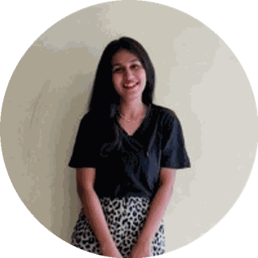
03 · OUR PEOPLE
OUR PEOPLE
A full-time team built for this work
Engineering, law, policy, product and field operations, under trustees who have led Indian road safety for a decade.
Amar Srivastava
Deepanshu Gupta
Gajendra Jangid
President · Founder, Indian Road Safety Campaign · Member, National Road Safety Council
Managing Trustee · Founder, IRSC · Global Youth Coalition for Road Safety
General Secretary · Co-founder, Cars24
THE FULL-TIME TEAM
Akhtar Hussain Mission Lead
Shubham Kumar Policy & Advocacy
Muskan Yadav Programmes
IIT Delhi · ex-Bain · strategy, programmes, new initiatives, partnerships and product
NALSAR Hyderabad · programmes, policy advocacy, legal research, government relations
TISS · district programmes, Project Rakshak, infrastructure interventions, DRSC work
Krishna Jain Tech & Product
Aastha Shreeharsh Development Communications
Rohan Sharma Cause Marketing
Builds and runs Aasha, SATARK and the open public data platforms
HKUST · institutional communications, government relations
Awareness campaigns, digital advocacy, community mobilisation
Ishita Rathore People & Culture
Yuvraj Yadav Operations
Lovish Creative (Video)
Talent and hiring, volunteers, the 75+ intern engineering corps
Field operations across 18 cities · works with police on SATARK and enforcement rollouts
Video explainers, ground-audit films and the YouTube channel
Shipra Kushwaha Creative (Graphic)
Plus 75+ engineering interns and 31 student audit teams.
Guides, comics and bilingual campaign material families actually read
In-house capabilities: road-engineering audits · legal & policy research · AI product development · district operations · behaviour-change communication
Crashfree India · A briefing for mentors · 2026
13 / 15

Slide 14








04 · THE YEAR AHEAD
THE YEAR AHEAD
Where we are going, and where your counsel would help
Year 2 moves from programmes to institutions. These are the goals, and the questions we would bring to a mentor.
THE YEAR AHEAD
WHERE GUIDANCE WOULD HELP
Project Rakshak
Audits running inside institutions, with 75+ implementations initiated and every one tracked publicly.
Institution building
Turning young programmes into bodies with standards, governance and a life beyond the founding team.
Crash compensation
Claim pipeline fixed in two districts, mapped in eight, with a playbook states can adopt.
Government at scale
Deepening state partnerships while keeping our independence and our habit of publishing everything.
SATARK
From 3 cities toward 30, as shared public infrastructure for traffic police.
People and leadership
Growing a young team into leaders, and drawing senior operators to a nonprofit mission.
Two exploratory bets
School Safety Index and gig rider safety, each scaled only if a small, honest pilot earns it.
Sustainability
Building funding lines beyond the founding commitment, without distorting what we work on.
Institutions that outlive us
An expert consortium, an audit manual and a publishing cadence that outlive any single cohort.
Focus
What to stop, what to scale, and when. The discipline of a small organisation with a national mission.
Crashfree India · A briefing for mentors · 2026
14 / 15

Slide 15



No life lost on an Indian road
is acceptable.
We add the hands, the evidence and the tools that turn that goal into work the system can carry, and we track it in public.
"We already know what is going wrong. What we need now is more responsibility, more discipline, more respect for life."
MS Dhoni · Goodwill Ambassador, Crashfree India
crashfreeindia.org
akhtar@crashfreeindia.org · helpdesk@crashfreeindia.org
Crashfree India · A Cars24 commitment · Operated by Vision Zero Trust, New Delhi

