Slide 1

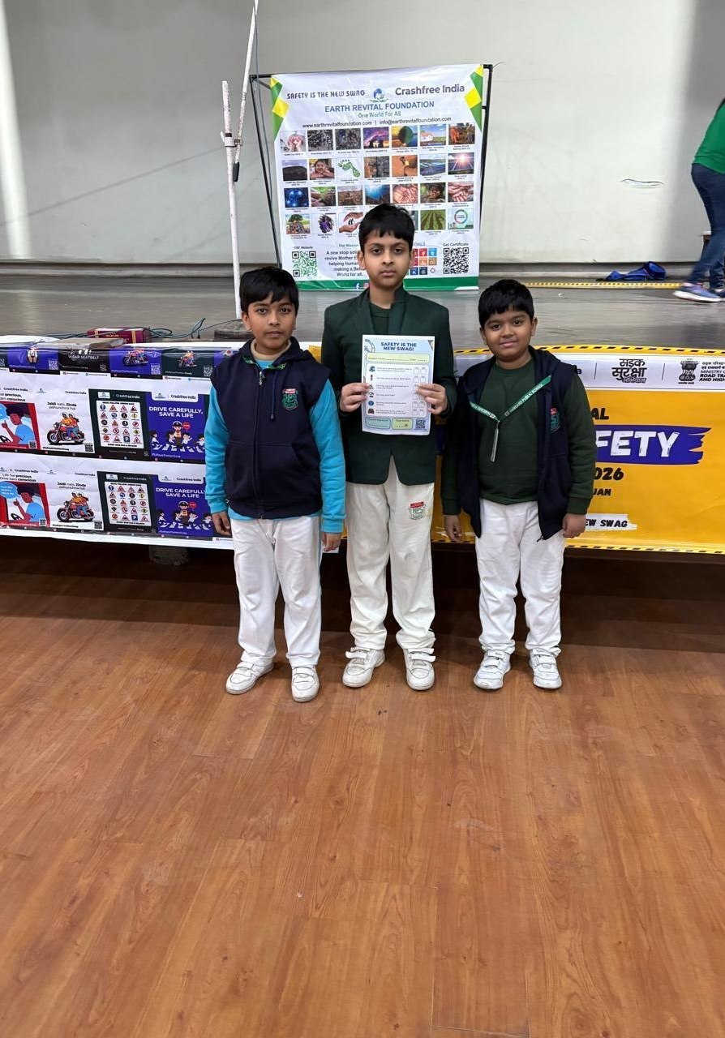




3 AUGUST 2026 · PREPARED FOR GOOGLE MAPS
AN INTRODUCTION, AHEAD OF THE ROADS MANAGEMENT INSIGHTS SHOWCASE
Crashfree India
We fix dangerous roads with students, experts
and the authorities. Your data can tell us where.
18 cities · 31 sites audited · 25+ approvals in writing
Next: India's first School Safety Index — 2,000 school zones
Inside district road-safety committees in Gurugram & Jaipur
SCHOOL ROAD-SAFETY PROGRAMME
CRASHFREE INDIA, 2026
Backed by a 3-year, US$3M commitment from Cars24
For Ravi Bhaskaran & the Google Maps team · arranged with Lepton Software
crashfreeindia.org

Slide 2
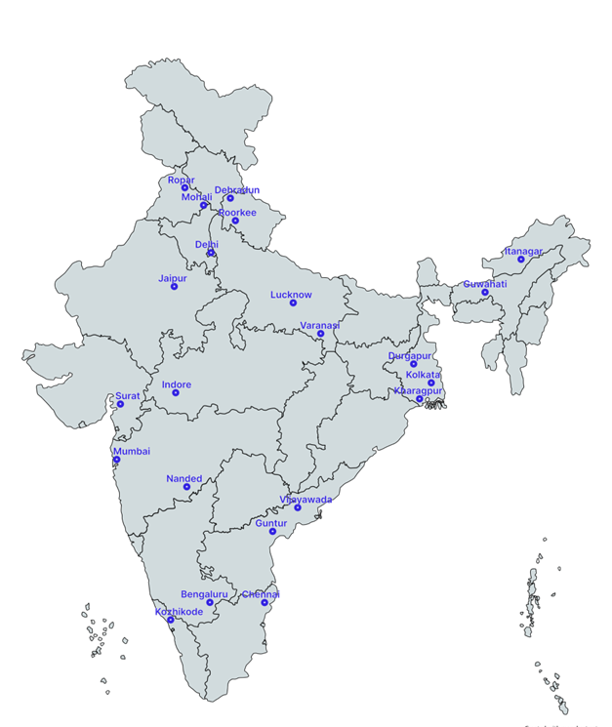



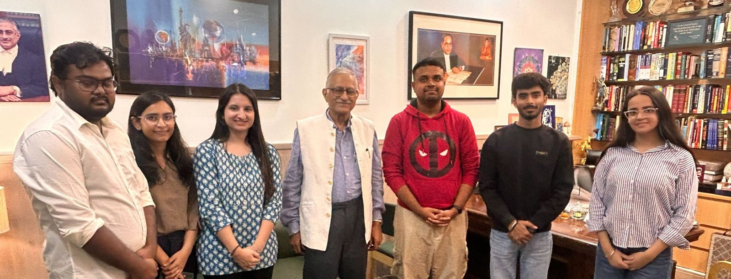
01 · WHO WE ARE
GOOGLE MAPS × CRASHFREE INDIA · AUG 2026
A young nonprofit that builds capacity for road safety work
Registered as the Vision Zero Trust · co-founded by Cars24 and the Indian Road Safety Council, June 2025.
With authorities
We work alongside PWDs, police and district administrations — never around them.
Evidence first
Every audit anchored to IRC codes; every claim to published data.
Students + experts
Trained student teams do the ground work, senior experts verify it.
Public goods
Everything we build is published free for any authority to use.
CFI footprint — 18 cities across India
18
20
75+
US$3M
cities with active
CFI work
institutions — incl.
9 IITs — engaged
road-engineering
interns trained
Cars24 commitment
over three years
Crashfree India · Introduction for the Google Maps team
02 / 10

Slide 3
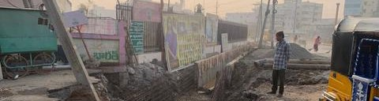
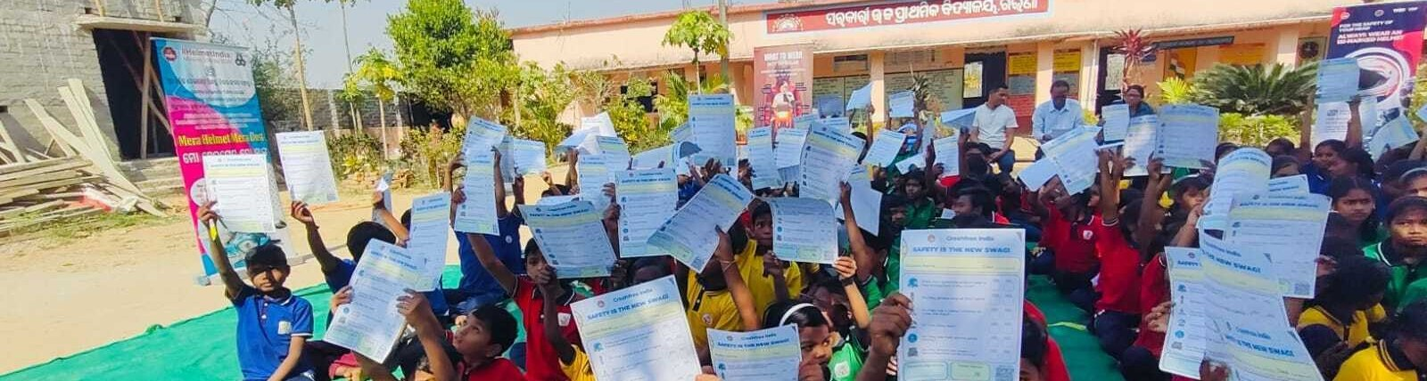
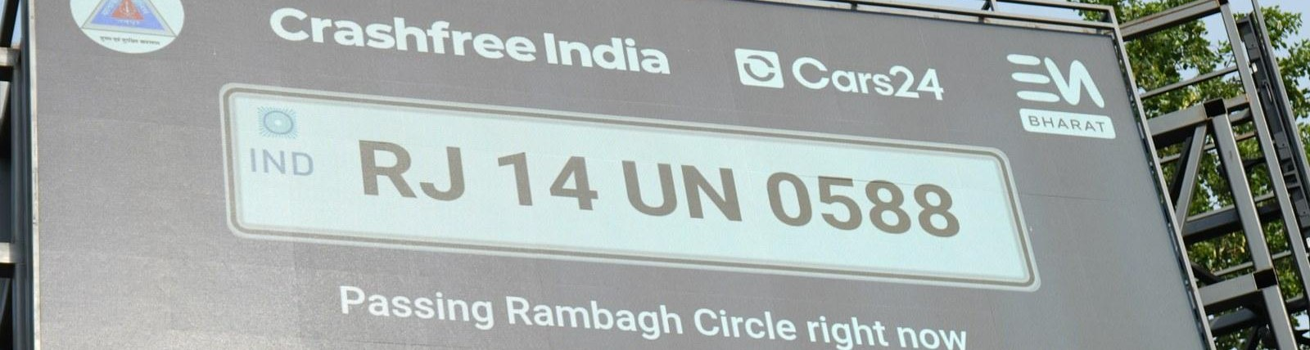
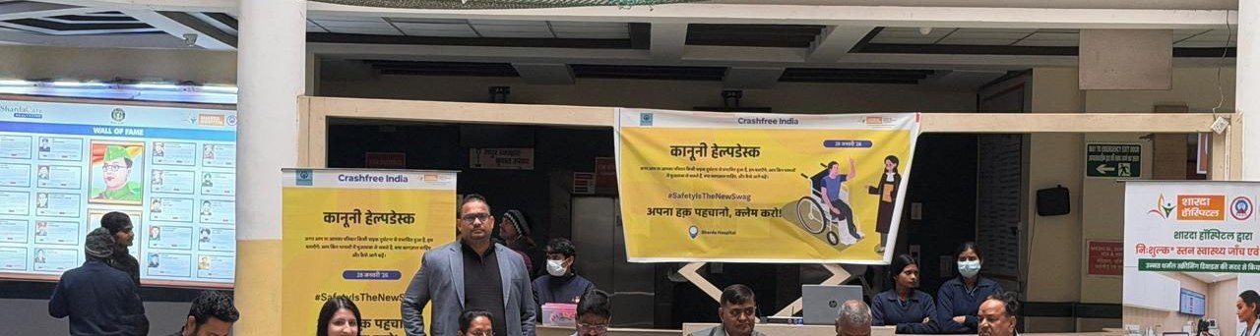
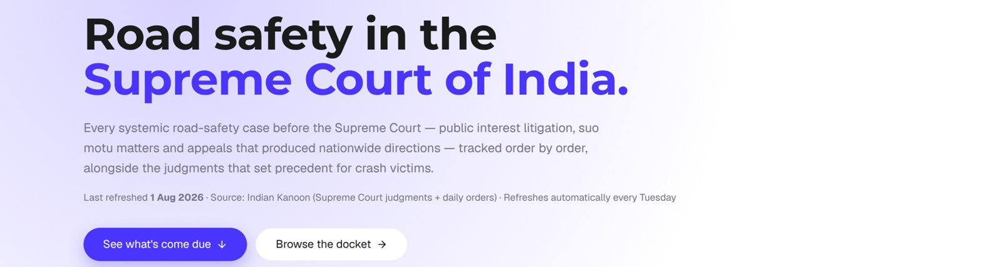

02 · WHAT WE HAVE BUILT
GOOGLE MAPS × CRASHFREE INDIA · AUG 2026
Six public-facing programmes, all running today
One line on each — then this deck goes deep on the two where Google Maps data changes the game.
Project Rakshak
School Safety Index
SATARK enforcement tech
Student-audited, expert-verified road fixes — walked through authorities until built.
India's first public index of school-zone road safety — in design, launching next.
Camera + billboard tech that helps police target repeat violators fairly.
25+ approvals in writing
2,000 school zones planned
3,00,000+ vehicles scanned
Victim support suite
Open data public goods
Youth & public campaigns
Aasha 24/7 chatbot, compensation calculator, hospital legal helpdesks.
SC litigation tracker, defect repository, Parliament tracker, crash dashboards.
NextMile ideathon, dialogue series, MS Dhoni as Goodwill Ambassador.
100+ victims in first 4 days
146 districts · 13 languages
2,000+ young participants
Crashfree India · Introduction for the Google Maps team
03 / 10

Slide 4



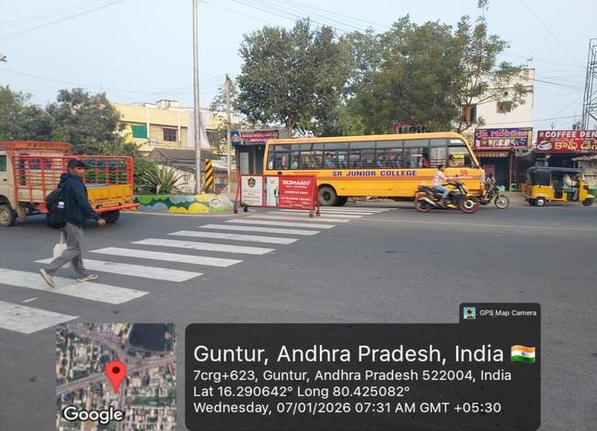

03 · PROJECT RAKSHAK
GOOGLE MAPS × CRASHFREE INDIA · AUG 2026
Trained students audit dangerous roads — and we walk each fix through the authority until it is built
Students audit
Experts verify
Authorities build
31 student audit teams from 20 institutions — including 9 IITs — survey sites on IRC codes and MoRTH checklists.
Every audit reviewed by senior engineers, guided by Prof. Geetam Tiwari (IIT Delhi, IRC H-7).
Recommendations handed to the road-owning authority; CFI tracks every site from submission to completion.
YEAR-ONE FUNNEL
120+
31
25+
15
sites screened
audited — incl. 11
official blackspots
approvals from
authorities, in writing
implementations
underway
Global evidence: low-cost engineering fixes of this kind
cut crashes 20–50% at treated sites (iRAP / World Bank).
Guntur junction — audited, approved, redesigned
Crashfree India · Introduction for the Google Maps team
04 / 10

Slide 5
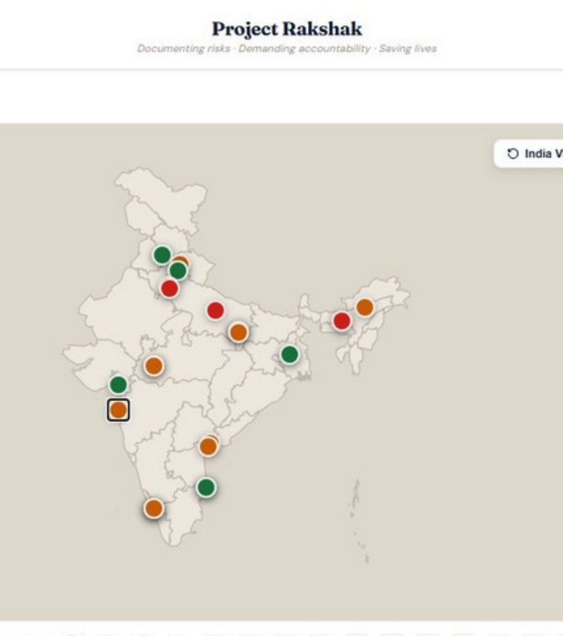

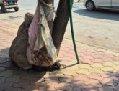
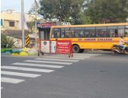
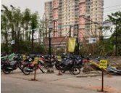
03 · PROJECT RAKSHAK
GOOGLE MAPS × CRASHFREE INDIA · AUG 2026
Authorities are building our fixes. What we cannot yet measure is the after.
APPROVALS IN WRITING, FROM
PWD Kerala
PWD Uttar Pradesh
PWD Punjab
CPWD
The missing layer:
measurement
R&B Andhra Pradesh
GCC Chennai
ADDA Durgapur
Addl. Collector, Indore
We know what was built. We cannot yet see, at network scale, what changed —
vehicle speeds before and after each fix, exposure around each site, risk on the corridors we haven't audited yet.
That is exactly the data Roads Management Insights holds.
Built interventions — footpaths, markings, parking, signage, drainage
Every site tracked in public — submission to completion
Crashfree India · Introduction for the Google Maps team
05 / 10

Slide 6

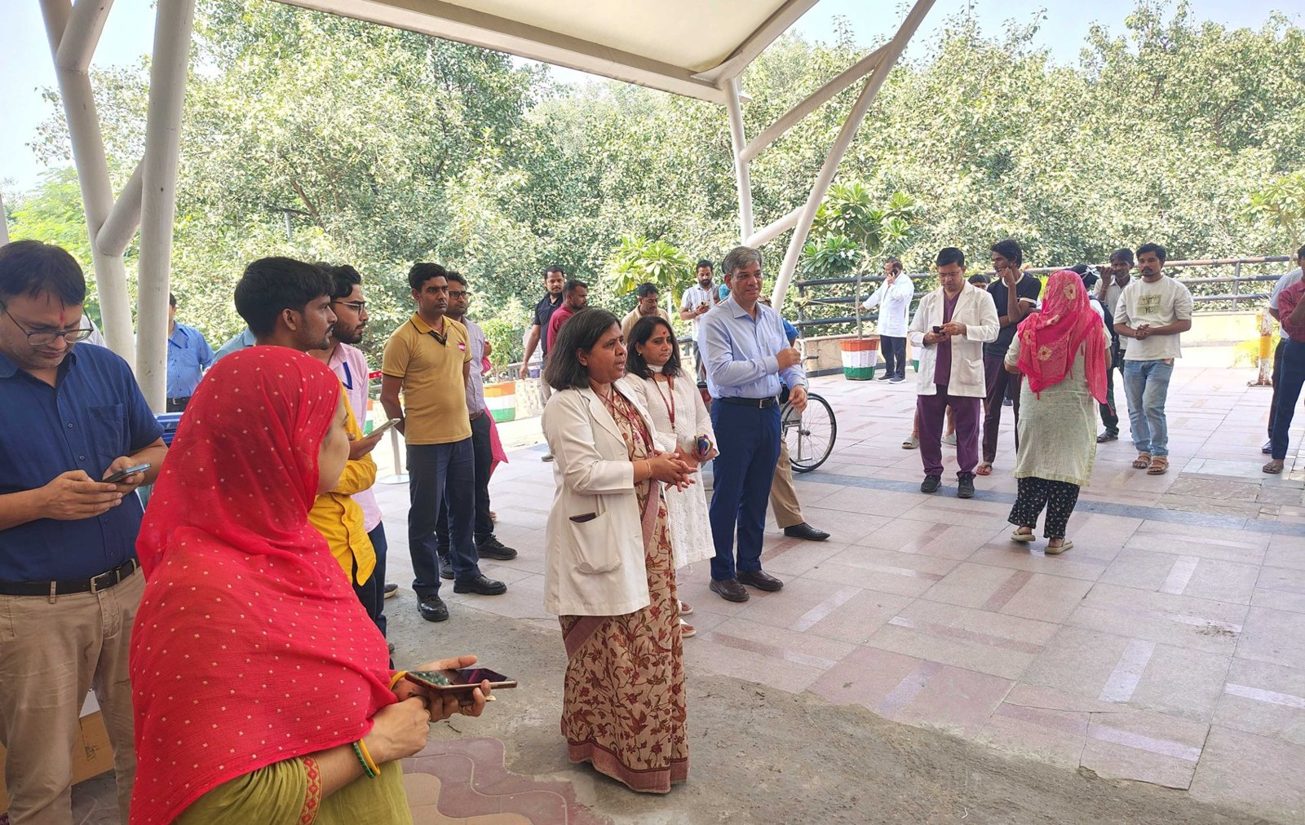

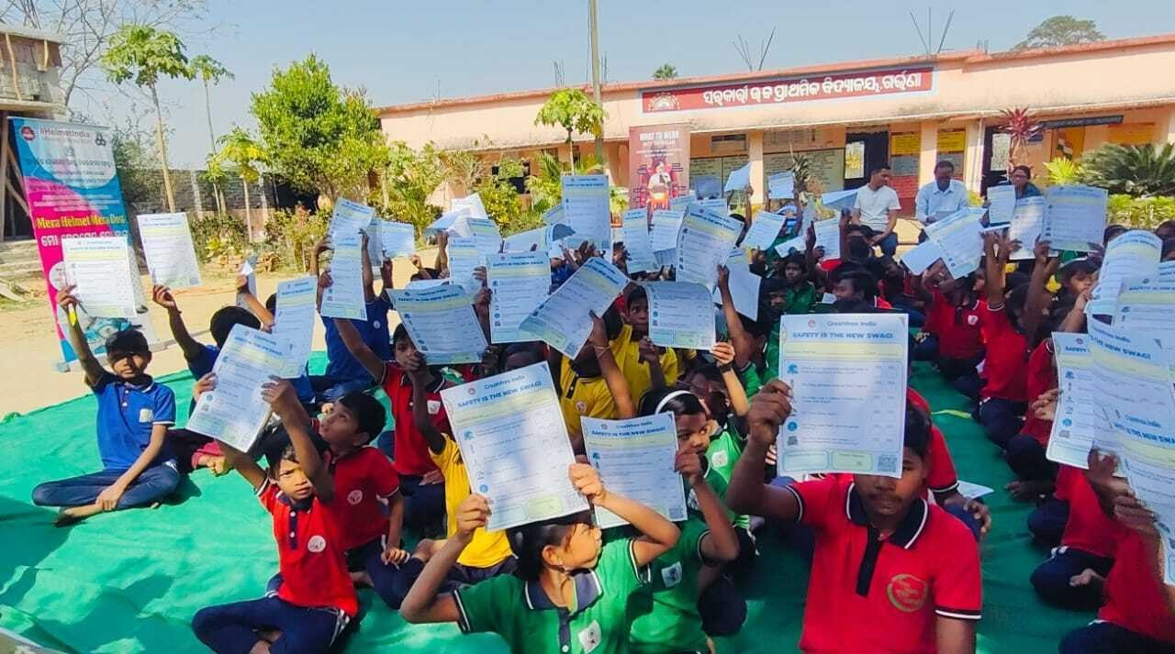

04 · SCHOOL SAFETY INDEX
GOOGLE MAPS × CRASHFREE INDIA · AUG 2026
Next build: India's first School Safety Index
In design now — a public, district-wise score of how safe the road outside every school actually is.
A standard rubric
44 scored checks across 13 sections, aligned to IRC:SP:32-2023 — the same standard authorities use.
Scaled by students
College audit teams and trained Zone Captains — the Rakshak model, pointed at school zones.
2,000 school zones
Across 15+ cities in the first wave; every score public, every gap actionable by the district.
Built to rank
Districts compete to climb; parents and authorities see the same number.
The hard part is not the checklist — it is speed and exposure data around 2,000 schools.
Collecting it manually is slow and patchy. Maps data makes it systematic.
Crashfree India · Introduction for the Google Maps team
CFI school programmes — Road Safety Month 2026
06 / 10

Slide 7


05 · WHERE GOOGLE MAPS FITS
GOOGLE MAPS × CRASHFREE INDIA · AUG 2026
Four places your data plugs straight into our work
Roads Management Insights is live in India. Here is what it unlocks, programme by programme.
Prioritise
PROJECT RAKSHAK
RMI segment speeds & risk insights → choose the next 100 Rakshak sites by evidence, not anecdote.
Score
SCHOOL SAFETY INDEX
Speed and exposure layers around schools → the data backbone of the School Safety Index, 2,000 zones at once.
Prove
IMPACT EVALUATION
Before-and-after speeds at treated sites → India's first measured evidence base for low-cost road fixes.
Publish
OPEN DATA — BOTH WAYS
Verified school zones & audit findings back to Google → ground truth for accident-prone alerts, beyond 4 cities.
Precedent: Google.org already funds iRAP's Star Rating for Schools with US$2M — deployed in Vietnam. India has no lead partner yet.
Crashfree India · Introduction for the Google Maps team
07 / 10

Slide 8



06 · WHY CRASHFREE INDIA
GOOGLE MAPS × CRASHFREE INDIA · AUG 2026
RMI serves governments. We already sit inside the government machinery.
District machinery
Authority relationships
Formal member of 4 District Road Safety Committees — Gurugram, SW Delhi, NW Delhi, Jaipur. MoUs with Jaipur Traffic Police and Gurugram Police.
Written approvals from 8 road-owning authorities across 6 states — we know how files move, and how to move them.
Academic bench
Corporate stability
Prof. Geetam Tiwari (IRC H-7) and experts from 9 IITs verify our work — credibility your government clients recognise.
Cars24's 3-year US$3M commitment and MS Dhoni as Goodwill Ambassador — a partner built to last, not a pilot NGO.
Your Nov 2025 safety launch covers Gurugram and Jaipur. Those are the two districts where we hold committee seats and police MoUs.
Crashfree India · Introduction for the Google Maps team
08 / 10

Slide 9
07 · WORKING TOGETHER
GOOGLE MAPS × CRASHFREE INDIA · AUG 2026
Three concrete ways to start — smallest first
1
2
3
Pilot where we overlap
School Safety Index partnership
Joint impact study
Gurugram or Jaipur: RMI data + Rakshak audits + our DRSC seat. One city, 90 days, results presented to the district committee.
Co-design the SSI data layer — RMI speeds & exposure as scoring inputs for the first 2,000 school zones. India's answer to Star Rating for Schools.
Before-and-after evaluation of implemented Rakshak fixes using RMI — published openly, first-of-its-kind evidence for India.
START: 90 DAYS
START: WITH SSI WAVE 1
START: 15 LIVE SITES
WE BRING
WE ASK
Ground teams in 18 cities · government access & committee seats · IIT-verified method · open publication
RMI data access for one pilot geography · a working session with the Lepton + Maps team to scope it
Crashfree India · Introduction for the Google Maps team
09 / 10

Slide 10

Your maps see every road in India.
Together, they can start fixing them.
Thank you — we look forward to the Roads Management Insights showcase.
Akhtar Hussain
Deepanshu Gupta
Gajendra Jangid
Mission Lead
Trustee
Trustee
akhtar@crashfreeindia.org
deepanshu@crashfreeindia.org
gajendra@crashfreeindia.org
crashfreeindia.org
10 / 10

