Slide 1

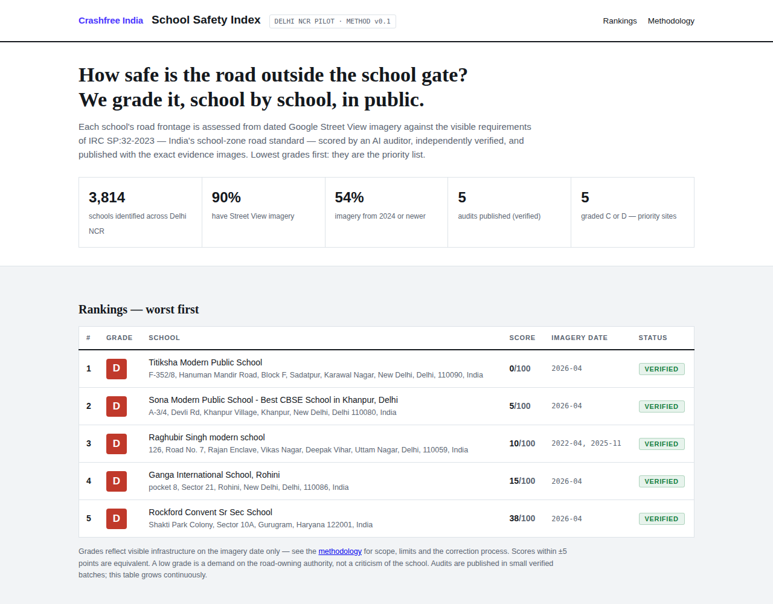
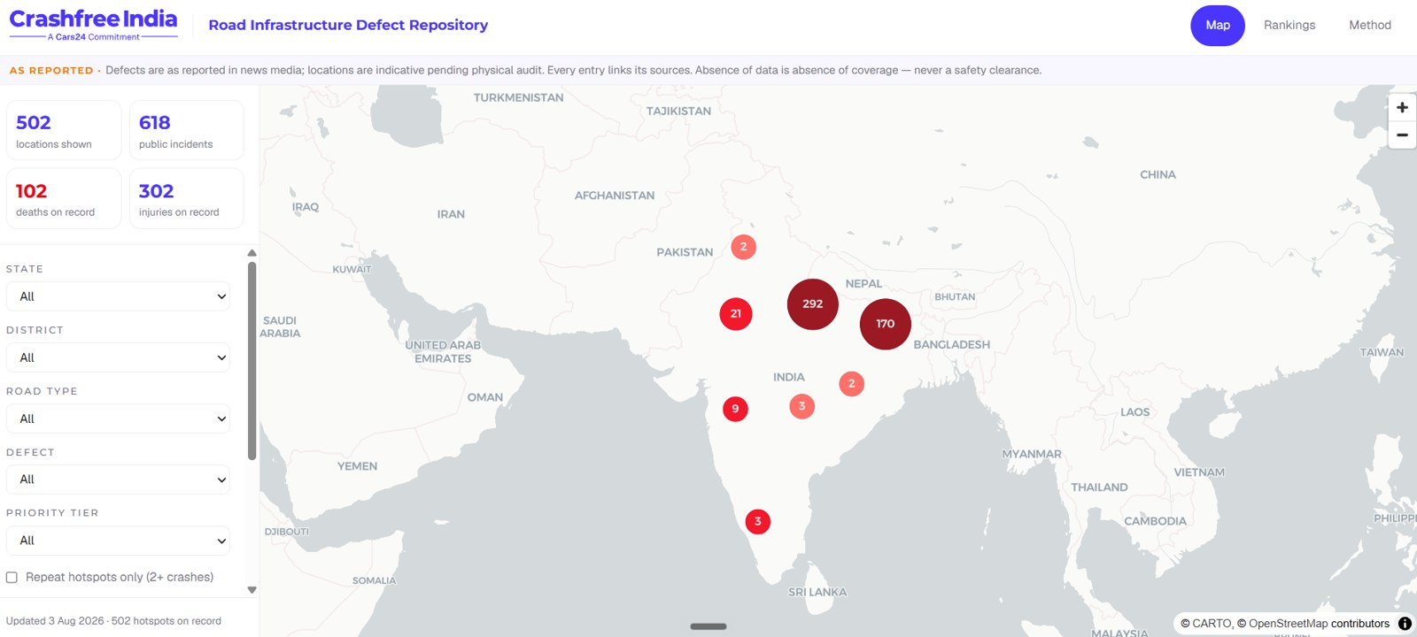



AUGUST 2026 · NEW DELHI
FOR DISCUSSION · CRASHFREE INDIA × TRAFFICURE · GOOGLE MAPS PLATFORM
The safety layer
Traffic data already manages congestion.
Together it can start preventing crashes.
School Safety Index, Delhi NCR prototype, live.
Lead idea: the School Safety Index, prototype built, launching with government
Second idea: live crash hotspots, solved together through Project Rakshak
Both run through government doors we already hold open
Road-Infrastructure Defect Repository, live.
Ideas to shape together. Nothing here is a commitment.
crashfreeindia.org

Slide 2



01 · UNDERSTANDING TRAFFICURE
TRAFFICURE
What TraffiCure is, and what Pune proved
Software only. No cameras, no sensors. Google Maps probe data, turned into a working tool for the people who run the roads.
Built by Lepton Software
Google Maps Platform Premier Partner, working with Google since 2010. TraffiCure launched 2025.
WHY PUNE MATTERS TO US
The police did not stop at watching traffic.
They ranked their worst junctions, diagnosed why each fails, and handed the municipal corporation an engineering brief. Fixes got built.
Data → ranked list → brief to authority → built fix.
That is exactly how Project Rakshak works. Same operating theory, different data.
Runs on Roads Management Insights
Google's public-sector traffic feed, launched Aug 2025. Every road, refreshed every 2 minutes.
Live with Pune City Traffic Police
Deployed January 2026, activated in weeks. Corridors also measured in Delhi, Hyderabad, Ahmedabad.
THE PUNE RESULT, POLICE-MEASURED
964
20 → 26.8
22
roads watched live, every 2 minutes
km/h average speed, in a year
worst junctions ranked and briefed
Crashfree India · Discussion deck · Crashfree India × TraffiCure, Google Maps Platform
02 / 15

Slide 3





01 · UNDERSTANDING THE DATA
THE DATA
Five signals in the feed, read through a safety lens
The product was built to manage traffic. Every signal in it has a second life in safety.
Live speeds
How fast traffic really moves past a school gate at 8 am.
Every road, every 2 minutes
Speed history
Baselines: what is normal, what changed after a fix was built.
Hourly, by road, in BigQuery
Vehicle counts
Exposure: how many vehicles pass the danger. Priority = risk × exposure.
NEW · MAY 2026
Per road, per hour
Harsh braking
Near-misses, visible before the crash. Their guide calls it the safety signal nobody else has.
NEW · MAY 2026
Anonymised points, junction scale
User-reported incidents
Incidents the official record may never see.
NEW · MAY 2026
Crashes and hazards, from Maps users
Crashfree India · Discussion deck · Crashfree India × TraffiCure, Google Maps Platform
03 / 15

Slide 4

WHAT WE BRING TO DISCUSS
Two ideas we believe in, one small one, and our questions
1
Idea 01 · School Safety Index × speed
05 – 08
The centrepiece: what is built, why it matters, the plan, and how we do it together.
2
Idea 02 · Live hotspots × Project Rakshak
09 – 10
The feed keeps the crash map alive; Rakshak turns it into audits, joint plans and built fixes.
3
Idea 03 · The DRSC data pack
11
Small and immediate: the feed, summarised monthly, on the table where districts decide.
4
About us, briefly
12 – 13
Who we are and SATARK, our enforcement platform with police.
5
Next steps
14
Three steps, two questions, one date to fix.
Crashfree India · Discussion deck · Crashfree India × TraffiCure, Google Maps Platform
04 / 15

Slide 5

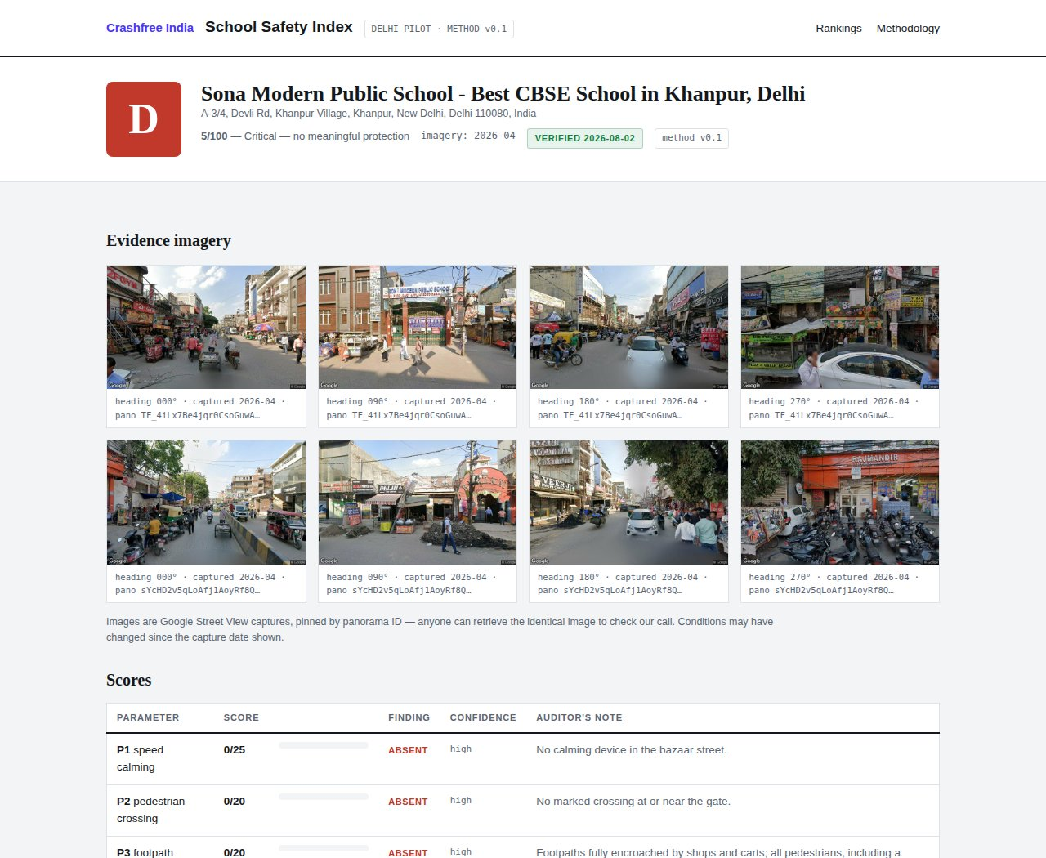

02 · IDEA 01 · SCHOOL SAFETY INDEX
IDEA 01 · SSI
A public grade for the road outside every school gate
Prototype built and live. It grades the road, never the school, against IRC:SP:32, India's own school-zone standard.
3,814
44
0–100
Delhi NCR schools mapped, prototype live
checks per school zone, from IRC:SP:32
score per school, evidence photos pinned
How a school gets its grade
Street View imagery of the gate zone, scored by an AI auditor, independently verified before anything is published.
The index, worst grades first.
Grades that demand action
A low grade is a demand on the road-owning authority: the missing crossing, the absent speed hump, the broken footpath.
Launch with government, planned
Public launch being prepared with a government partner; our four district committee seats carry the worst zones into the statutory forum.
A school's report card, evidence pinned.
Crashfree India · Discussion deck · Crashfree India × TraffiCure, Google Maps Platform
05 / 15

Slide 6

02 · IDEA 01 · WHY THIS MATTERS
IDEA 01 · SSI
Children die at fixable places, and nobody keeps score
The standard exists. The danger is measurable. What is missing is a public number that makes someone act.
~10,000
4.6%
10% → 90%
0
minors died on Indian roads in 2023 (MoRTH)
of crashes happen in school and college zones (e-DAR)
a child pedestrian's fatality risk, 30 vs 70 km/h impact
Indian cities that rank school-zone danger today
A number parents understand
A grade at the gate makes invisible risk visible to the people with the most reason to demand the fix.
A number authorities can act on
Worst-first rankings become work orders: which 10 zones, which fixes, this budget cycle — through committees we already sit on.
A number that proves change
Re-grade after the fix is built. With the speed layer, the improvement is measured, not claimed.
Crashfree India · Discussion deck · Crashfree India × TraffiCure, Google Maps Platform
06 / 15

Slide 7
02 · IDEA 01 · THE PLAN
IDEA 01 · SSI
From prototype to public institution
Four phases. The first is done. The speed layer is where TraffiCure changes what this can be.
DONE
NOW
WITH YOU
THEN
Prototype
Government launch
The speed layer
Fix, re-grade, scale
Delhi NCR: 3,814 schools mapped, rubric built on IRC:SP:32, pilot report cards live with pinned evidence.
Validated first batch of ~100 zones; DRSC resolution; public launch with a named government partner.
Speed past the gate at school-run hours, harsh braking, vehicle counts: every school ranked by measured danger, a first for India.
Worst zones into Rakshak audits and authority work orders; re-graded after fixes; Jaipur next, 1,572 schools already mapped.
›
›
›
The honest gate: the speed layer ships only if RMI segments resolve short gate streets and school-run-hour slices. One technical session on 10 corridors we have already defined settles it in a week.
Crashfree India · Discussion deck · Crashfree India × TraffiCure, Google Maps Platform
07 / 15

Slide 8


02 · IDEA 01 · HOW WE TAKE IT FORWARD
IDEA 01 · SSI
Clear roles, three steps, one date
We hold the method and the government seats. You hold the data and the tooling. The launch names both.
CRASHFREE INDIA
TRAFFICURE + GOOGLE
Index method, verification, publication
Speed, braking and count layers per school zone
Field checks by student teams at worst-graded zones
Corridor tooling and school-run-hour slices
DRSC resolutions and the government launch
Terms for a public, attributed, nonprofit index
NEXT STEPS
1
This week
2
Weeks 2 – 6
3
Launch window
Technical session: Lepton + Maps + CFI on 10 gate corridors, already defined on our cloud project.
Joint speed-exposure scoring on the ~100-zone launch batch, thresholds agreed up front.
Government launch of the index with the speed layer in, both names on it.
Crashfree India · Discussion deck · Crashfree India × TraffiCure, Google Maps Platform
08 / 15

Slide 9




03 · IDEA 02 · LIVE HOTSPOTS × PROJECT RAKSHAK
IDEA 02 · RAKSHAK
Keep the crash map alive, then fix what it shows
Official blackspot lists update every few years. The feed can refresh the danger map monthly — and Rakshak already turns danger maps into built fixes.
Live signals
+ Crash records
Live hotspot list
›
›
speeds · braking · counts
police e-DAR, via our DRSC seats
risk-ranked, refreshed monthly
⌄
Fix built & measured
Joint plan to authority
Rakshak audit
‹
‹
before/after speeds, public dashboard
the Pune move, for safety
student teams + certified auditors
Why it works: every piece already runs. 150+ audits planned this year, 15 fixes in implementation, 25+ authority approvals, dashboards live. The feed adds the one thing we cannot make: a danger map that never goes stale.
Crashfree India · Discussion deck · Crashfree India × TraffiCure, Google Maps Platform
09 / 15

Slide 10
03 · IDEA 02 · WHAT EXISTS, AND THE NEXT 90 DAYS
IDEA 02 · RAKSHAK
Nothing to invent — three moves to make
The audit machine, the government doors and the public dashboard exist. The feed plugs into all three.
96
150+
75+
4
police-mapped crash clusters in Jaipur, 361 GPS-located crashes
blackspot audits planned this Rakshak year
implementations targeted, each with a build date
district committees where a joint plan can be tabled
1
Overlay
2
Baseline
3
Dashboard
Harsh braking + speeds over Jaipur's 96 clusters. Does the feed see the danger police already know? Four weeks, answer either way.
Subscribe corridors for 2 Rakshak sites entering construction now — so before/after proof starts with the build, not after it.
A live speed panel per site on the public Rakshak dashboard: 'measured with Google road data'. The joint plan, visible to everyone.
The honest gate: if braking density is too thin at Jaipur's clusters, idea 02 narrows to before/after proof only — still worth having, and we say so in writing at day 30.
Crashfree India · Discussion deck · Crashfree India × TraffiCure, Google Maps Platform
10 / 15

Slide 11


04 · IDEA 03 · SMALL, IMMEDIATE
IDEA 03 · DRSC
The DRSC data pack: the feed, where decisions are made
District Road Safety Committees meet on a statutory calendar and decide with anecdotes. We sit on four of them.
What it is
One page per district, every month: speeds on the worst corridors, school-gate speeds, changes since last meeting. We format it; the committee decides with it.
THE PACK, EACH MONTH
Worst 5 corridors by measured speed
Why it is easy
Feed access for four districts, a template, nothing else. Live within a month of access; no product build, no launch, no risk.
School gates above safe speed at 8 am
Change since last meeting, corridor by corridor
What it does for you
Google's data enters the statutory record of four districts, every month, attributed — the quietest, fastest government-partnership story in this deck.
One before/after: did last month's action work?
Crashfree India · Discussion deck · Crashfree India × TraffiCure, Google Maps Platform
11 / 15

Slide 12
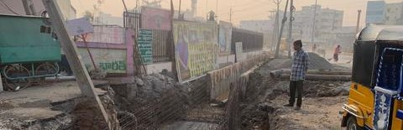
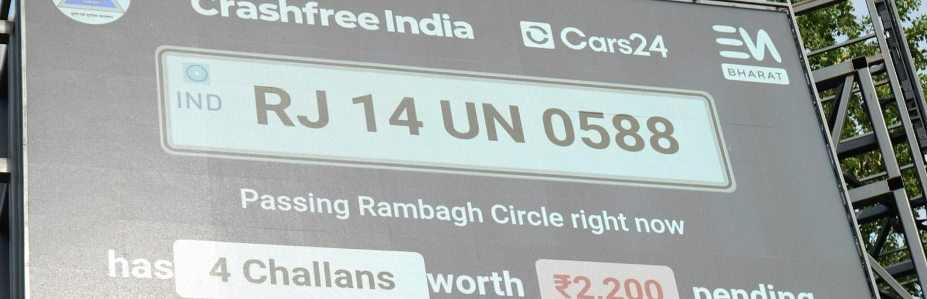
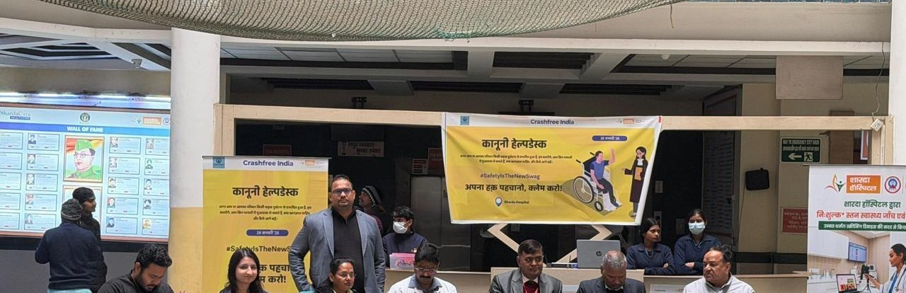

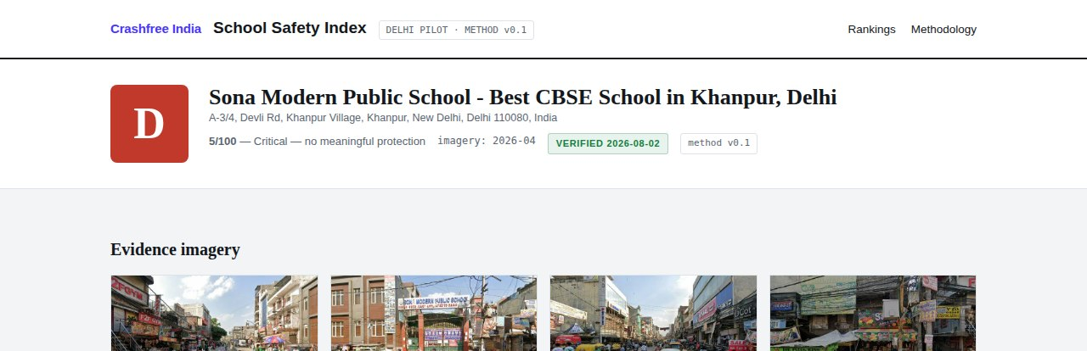

05 · ABOUT US
ABOUT US
Six lines of work, one connected system
A nonprofit registered as the Vision Zero Trust · Co-founded by Cars24 and the Indian Road Safety Council · 18 cities · everything below is live.
Project Rakshak
SATARK enforcement
Victim support
Student-led road audits, fixed with authorities
AI support that helps police find high-risk vehicles
Aasha chatbot, calculator, hospital helpdesks
31 sites · 15 in implementation
3,00,000+ vehicles screened
100+ victims helped in first 4 days
Open public data
School Safety Index
Youth & policy
Four self-updating data platforms, free to use
Public grading of school-zone road safety
NextMile ideathon and national dialogue series
36 states & 50 cities covered
3,814 Delhi NCR schools mapped
2,000+ participants engaged
Crashfree India · Discussion deck · Crashfree India × TraffiCure, Google Maps Platform
12 / 15

Slide 13
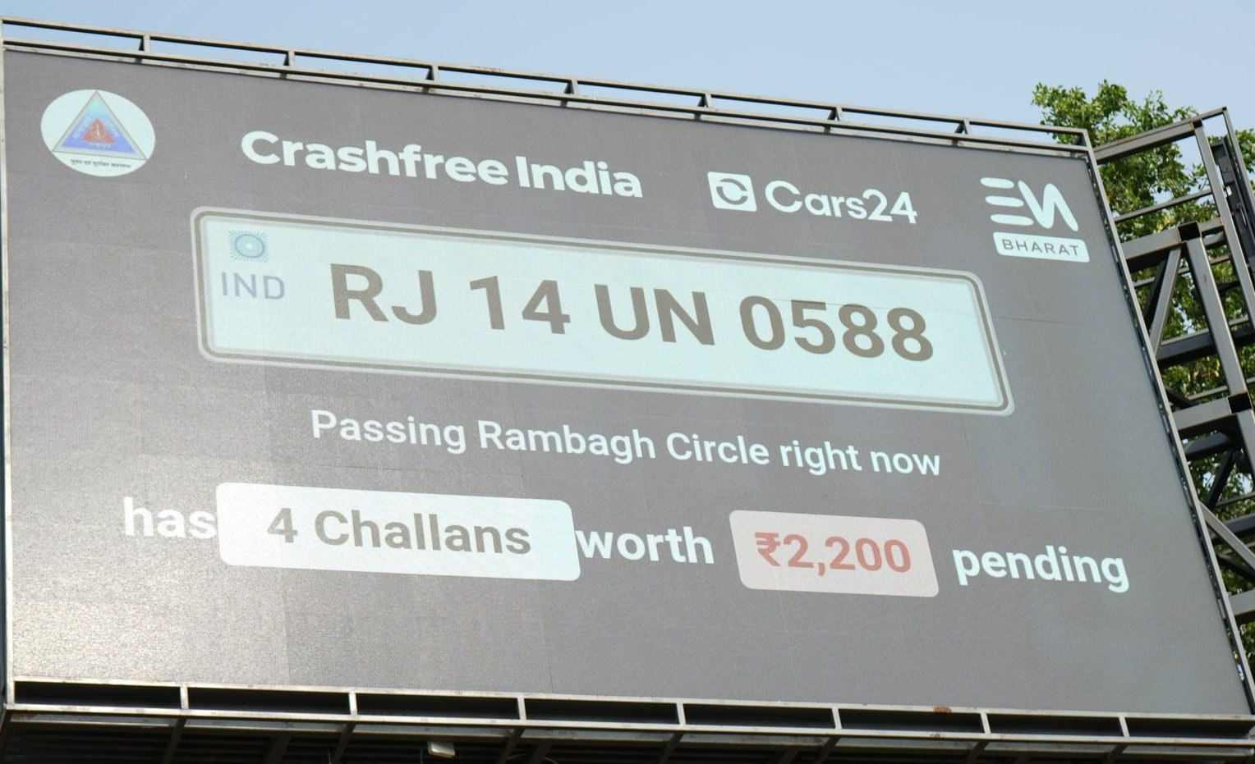
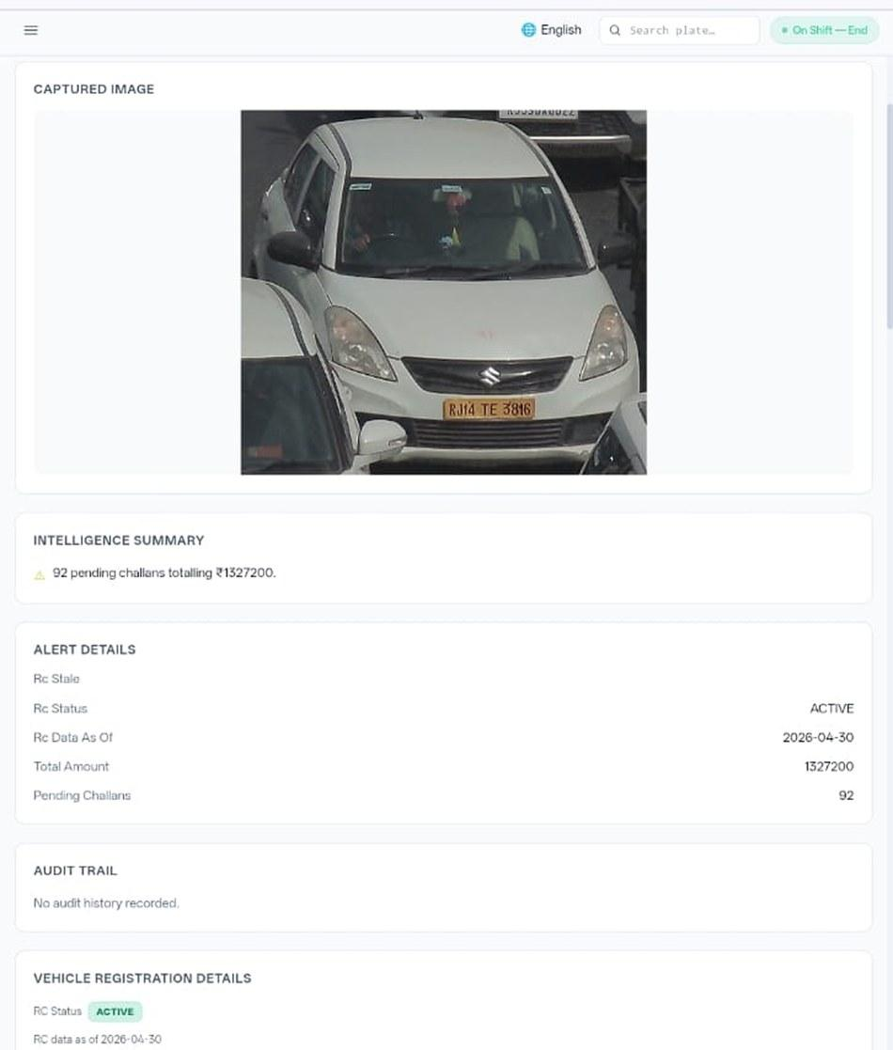







05 · ABOUT US, SATARK IN THE FIELD
ABOUT US
SATARK: AI that helps police stop the right vehicle
Built with Cars24 engineers. Reads number plates, checks government records, and alerts officers to repeat offenders, in real time.
3,00,000+
₹30 Cr+
vehicles screened
pending challan value identified
350+
70,019
high-risk vehicles intercepted
vehicles found with pending challans
LIVE · Jaipur & Bengaluru
NEW · Gurugram
Officer view, challans,
RC & compliance status.
Bengaluru's Trinity Circle billboard was India's first, covered by Deccan Herald and national press. Pune and Ahmedabad are next.
Rambagh Circle, Jaipur, live plate, pending challans and dues on a public billboard.
ANPR camera
Plate read
Records check
Risk flag
Officer alert
Billboard
Interception
Enforcement
Crashfree India · Discussion deck · Crashfree India × TraffiCure, Google Maps Platform
13 / 15

Slide 14
06 · WHERE WE WOULD TAKE THIS
NEXT STEPS
Three steps, two questions, one date to fix
Everything on our side is funded and ready. The first step costs one afternoon.
THREE STEPS
1
Fix the technical session
2
Run the two overlays
3
Put both names on what survives
Lepton + Maps + CFI, on real data: 10 school-gate corridors and Jaipur's 96 crash clusters, ready on our configured cloud project.
SSI speed scoring on the ~100-zone launch batch; braking over Jaipur's clusters. Thresholds agreed up front, results shared either way.
The index launch with government, and the live speed panel on the Rakshak dashboard.
TWO QUESTIONS
Access & terms
Which doors matter
Can a nonprofit public index sit on the feed — braking and counts included — with attribution? Through Google, Lepton, or both?
Which cities and stories help TraffiCure and RMI most next quarter? Our seats and MoUs work best pointed somewhere specific.
Crashfree India · Discussion deck · Crashfree India × TraffiCure, Google Maps Platform
14 / 15

Slide 15

Traffic data already runs the daily commute.
Together it can start preventing the crash.
Two ideas we believe in, one small one, and a technical session that settles the open questions in an afternoon.
Akhtar Hussain
Deepanshu Gupta
Gajendra Jangid
Mission Lead · akhtar@crashfreeindia.org
Trustee · deepanshu@crashfreeindia.org
Trustee · gajendra@crashfreeindia.org
Crashfree India · A Cars24 commitment · Operated by Vision Zero Trust, New Delhi · crashfreeindia.org

