Slide 1

I
THE SHIFT
CRASHFREE INDIA · A CARS24 COMMITMENT
Systems work because
II
THE INSTITUTION
we hold them accountable.
III
THE PROOF
An overview of the audit-and-accountability institution for India's roads.
IV
THE PEOPLE
Zero road fatalities
by 2040.
Partner overview · July 2026 · crashfreeindia.org

Slide 2



THE SHIFT
For seventy years, ‘driver error’ closed the file.
The data just reopened it.
59%
Crash records went digital
e-DAR and digitised FIRs make every death traceable to a place, a road design, a file.
Vehicles became identifiable
ANPR cameras and live national vehicle APIs surface repeat offenders instantly.
of road deaths in India involve no traffic
violation by the victim at all.
Failure became attributable
Open data ties deaths to specific junctions, specific processes, specific desks.
Ministry of Road Transport & Highways data
Once failure is attributable, it becomes fixable — and someone can be held to fixing it.
THE SHIFT
02 / 15

Slide 3
THE STAKES
485
people are killed on Indian roads every single day.
ONE DEATH EVERY 3 MINUTES
1,77,175
66%
1% → 11%
killed in 2024
aged 18–34
of world's vehicles → of its road deaths
Source: MoRTH, Road Accidents in India 2024 · Crashfree India Crash Data Dashboard
THE STAKES
03 / 15

Slide 4




THE FINDING
System failure, unowned.
Three audits of how India responds to a road death. The same defect each time: nobody owns the follow-through.
EXHIBIT A · ROADS
EXHIBIT B · JUSTICE
EXHIBIT C · ENFORCEMENT
Audits die at submission.
₹80,000 Cr sits undelivered.
Repeat offenders stay invisible.
Hazards get reported, studies get filed — and no institution tracks whether a single fix is ever built.
10.46 lakh compensation cases pending. In one Gurugram audit: 102 hit-and-run files since 2022 — 2 settled.
46 crore e-challans issued, ~75% unpaid — while roadside enforcement still stops vehicles at random.
That gap — between what is known and what gets done — is the institutional white space Crashfree India was built to fill.
THE FINDING
04 / 15

Slide 5






PART II · THE INSTITUTION
Not a charity.
The institution India's roads never had.
Crashfree India is the audit-and-accountability layer for road safety — launched June 2025 as a Cars24 commitment, operated by Vision Zero Trust, New Delhi.
Founded June 2025
$3M over 3 years
Vision Zero Trust
Launched by Cars24 with the Indian Road Safety Campaign; roots in a decade of IRSC campus audit work.
Cars24's committed institutional funding — programme-first: 71% of FY26-27 budget goes to programmes.
Registered public trust; trustees include Cars24 co-founder Gajendra Jangid.
One north star
18 cities and counting
MS Dhoni
Zero road fatalities in India by 2040 — pursued as system repair, not sensitisation.
Programmes live across India — Delhi NCR, Jaipur, Indore, Bengaluru, Chennai, Guwahati and more.
Goodwill Ambassador since April 2026 — lending India's most trusted voice to the cause.
ABOUT CRASHFREE INDIA
05 / 15

Slide 6





HOW WE WORK
We don't run campaigns.
We make the system move.
WHAT WE REFUSE TO BE
An awareness machine
AUDIT
ADVOCATE
ACCOUNTABILITY
An activity factory
Find
Name
Unblock
A government substitute
Field evidence to IRC / MoRTH standards — blackspots, claim files, enforcement gaps.
Findings published and presented — to district committees, state departments, MoRTH, the press.
Every recommendation tracked in public — from approval to build, from claim to payout.
A paper think tank
Every recommendation tracked to implementation.
Institutionally embedded: 4 District Road Safety Committees · MoUs with Jaipur Traffic Police & Gurugram Police · formally tasked by SW Delhi DRSC.
OPERATING MODEL
06 / 15

Slide 7
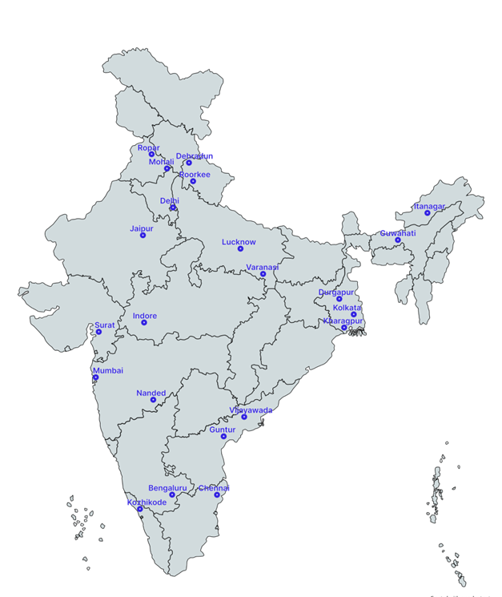


THE PROOF · 01 INFRASTRUCTURE — PROJECT RAKSHAK
Students audit.
Governments rebuild.
120+
31
25+
15
high-risk locations
screened nationwide
sites fully audited,
incl. 11 official blackspots
written government
approvals secured
implementations
begun on the ground
18 cities
20 institutions · 9 IITs
900+ stakeholder surveys
Case: Tejaji Nagar Junction, Indore
Student-audited redesign to IRC / MoRTH standards — signals, lighting, footpaths, speed management — approved by CPWD and the Additional Collector's office. Guided by Prof. Geetam Tiwari (TRIPC, IIT Delhi).
Every audit public: crashfreeindia.org/rakshak/dashboard
PROOF · PROJECT RAKSHAK
07 / 15

Slide 8




THE PROOF · 02 ENFORCEMENT — SATARK
Enforcement that knows
which vehicle to stop.
An AI co-pilot for traffic police: every passing plate checked against live national records, so officers intercept the riskiest vehicles — not random ones.
ANPR camera
reads every plate
Live vehicle record
via national APIs
Rule engine flags
habitual offenders
Public billboard
names the risk
Officer app routes
the interception
3,00,000+
₹30 Cr+
350+
2 cities live
vehicles scanned
pending challans surfaced
high-risk vehicles intercepted
Jaipur & Bengaluru · 5 police approvals
First 72 hours in Jaipur: 1,240 vehicles flagged, 58 intercepted. · 100 AI challan billboards already live in Gurugram; 12+ cities in discussion.
PROOF · SATARK
08 / 15

Slide 9





THE PROOF · 03 JUSTICE — AASHA & COMPENSATION
The law promises ₹80,000 crore.
We make it reach families.
THE GAP WE DOCUMENTED
THE MACHINERY WE BUILT
10.46 lakh
compensation cases pending nationwide — ₹80,000 Cr stuck
Aasha — India's first 24/7 multilingual AI compensation chatbot, on WhatsApp and voice
Compensation Calculator on Supreme Court principles (Sarla Verma, Pranay Sethi)
205 vs ~25,000
hit-and-run claims actually filed vs. eligible crashes (FY22-23)
Hospital legal helpdesks — 100+ victims supported in the first 4 days
3.6 years
average wait for a claim — with 20–40 office visits
Embedded in 4 district committees; ‘Justice Unserved’ findings presented to MoRTH
2 of 102
hit-and-run files settled since 2022 in our Gurugram audit
Hit-and-run claim pipeline being rebuilt with Rajasthan Transport Department
‘Justice Unserved’ (launched at IIT Delhi, 2026) is now the reference dataset on why crash compensation fails in India.
PROOF · JUSTICE & AASHA
09 / 15

Slide 10


THE PROOF · 04 PUBLIC DATA
We publish what the system
would rather not know.
Road Defect Repository
Road Safety in Parliament
AI reads local-language news in 13 languages across 146 districts — potholes, missing signage, unlit stretches — geocoded into public hotspot maps.
Every road-safety question since 2014 — 1,423 of them. And a finding: 282 sitting Lok Sabha MPs have never asked one.
SC Litigation Tracker
Crash Data Dashboard
18 live Supreme Court cases, 190+ orders, with an accountability ledger of deadlines — 11 already overdue at launch.
MoRTH's 266-page annual PDFs productised: report cards for 36 states and 50 cities, open CC-BY — the canonical source for our own claims.
‘JUSTICE UNSERVED’, IN PRINT
Deccan Herald
Economic Times
Fortune India
IndiaSpend
Moneycontrol
Scroll.in
The Wire
PROOF · PUBLIC DATA
10 / 15

Slide 11
IMPACT · YEAR ONE
Twelve months in,
the system is answering.
1M+
18
25+
THE FIRST 400 DAYS
citizens reached
cities active
govt approvals won
Jun 25
Launched as a Cars24 commitment
15
4
2
Sep 25
NextMile finale · first AI billboard live in Bengaluru
implementations begun
district committees joined
cities enforcing with SATARK
Jan 26
‘Justice Unserved’ published
Apr 26
IIT Delhi national forum · Dhoni joins
150+
50+
10+
Jun 26
SATARK live with Jaipur Police
members & interns
experts engaged
national media features
Jul 26
Rakshak Cohort 2 · 4 open-data products shipped
Every figure above is from our public dashboard and quarterly updates — audited numbers, not estimates.
IMPACT · YEAR ONE
11 / 15

Slide 12
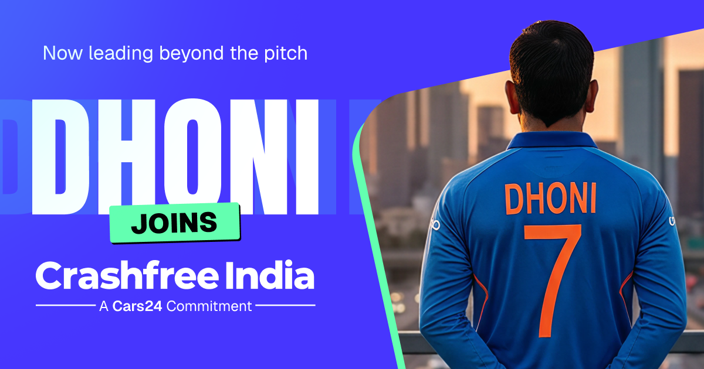

GOODWILL AMBASSADOR
A new captain
for road safety.
MS Dhoni joined Crashfree India in April 2026, unveiled at our national forum at IIT Delhi — lending the country's most trusted voice to a systems problem.
Voice of ‘Be a Rakshak’ — recruiting India's students into road audits
Champion for safe school zones
Announcement creative · April 2026
Amplifier for compensation rights & Aasha
“Because every ride deserves to end safely.”
Coverage: Business Standard · The Tribune · The Wire
GOODWILL AMBASSADOR
12 / 15

Slide 13
PART IV · THE PEOPLE — BOARD OF ADVISORS
The people who audit
the auditors.
PT
Piyush Tewari
GT
Prof. (Dr.) Geetam Tiwari
Founder & CEO, SaveLIFE Foundation
Professor Emerita, TRIPC, IIT Delhi
Architect of India's Good Samaritan Law (Supreme Court, 2016)
Three decades leading India's foremost road-safety research centre — a WHO Collaborating Centre
Built the Zero Fatality Corridor model — ~40% fewer deaths on Mumbai–Pune Expressway; now scaling with MoRTH
Global authority on vulnerable road users & safe-system design · PhD, University of Illinois Chicago
Rolex Award for Enterprise · Elevate Prize · MPA, Harvard
Guides Project Rakshak's audit methodology; anchors our Expert Consortium
THE EXPERT BENCH BEHIND OUR AUDITS
Justice J. R. Midha (Retd.)
Dr. S. Velmurugan
Dr. Richa Ahuja
Delhi High Court · FastDAR architect
Head, Traffic Engg. & Safety, CSIR-CRRI
IIT Kharagpur · Rakshak advisor
Akhilesh Srivastava
Col. Sanjeev Sharma
Sarika Panda Bhatt
IRF India
CoERS, IIT Madras
Raahgiri Foundation
B. N. Puri
Dr. P. K. Sikdar
A. M. Rao
Transport economist
Ex-Director, CRRI
Traffic engineering
BOARD OF ADVISORS & EXPERTS
13 / 15

Slide 14
PART IV · THE PEOPLE — TEAM
Built by people who
chose this problem.
TRUSTEES · VISION ZERO TRUST
AS
Amar Srivastava
DG
Deepanshu Gupta
GJ
Gajendra Jangid
President
Managing Trustee
General Secretary
Founder, Indian Road Safety Council — 50,000+ volunteers · Diana Award 2019
Founder, IRSC · Global Youth Coalition for Road Safety leadership board
Co-founder, Cars24 · ex-Schlumberger
FULL-TIME TEAM
AH
Akhtar Hussain
SK
Shubham Kumar
MY
Muskan Yadav
AS
Aastha Shreeharsh
Mission Lead
Policy Advocacy
Programs · Infrastructure
Strategy & Operations
IIT Delhi · ex-Bain & Co., Deloitte
DU + NALSAR · byline: Scroll.in
TISS Mumbai
HKUST · quoted in The Wire
RS
Rohan Sharma
IR
Ishita Rathore
YY
Yuvraj Yadav
SK
Shipra Kushwaha
Cause Marketing
People & Culture
Product Design
Graphic Design
+ 75+ part-time road-engineering interns across India
THE TEAM
14 / 15

Slide 15



Every three minutes, the system
fails someone on an Indian road.
We make it answer.
YEAR TWO, WITH YOU — THE TARGETS
START THE CONVERSATION
150+ blackspots audited by the national pipeline
crashfreeindia.org
Model districts: Gurugram · SW Delhi · Jaipur
helpdesk@crashfreeindia.org
12+ district-committee presentations
Live proof: crashfreeindia.org/rakshak/dashboard
Rakshak Audit Manual v1.0 — usable by NHAI without rework
Crashfree India · A Cars24 Commitment · operated by Vision Zero Trust

