Slide 1

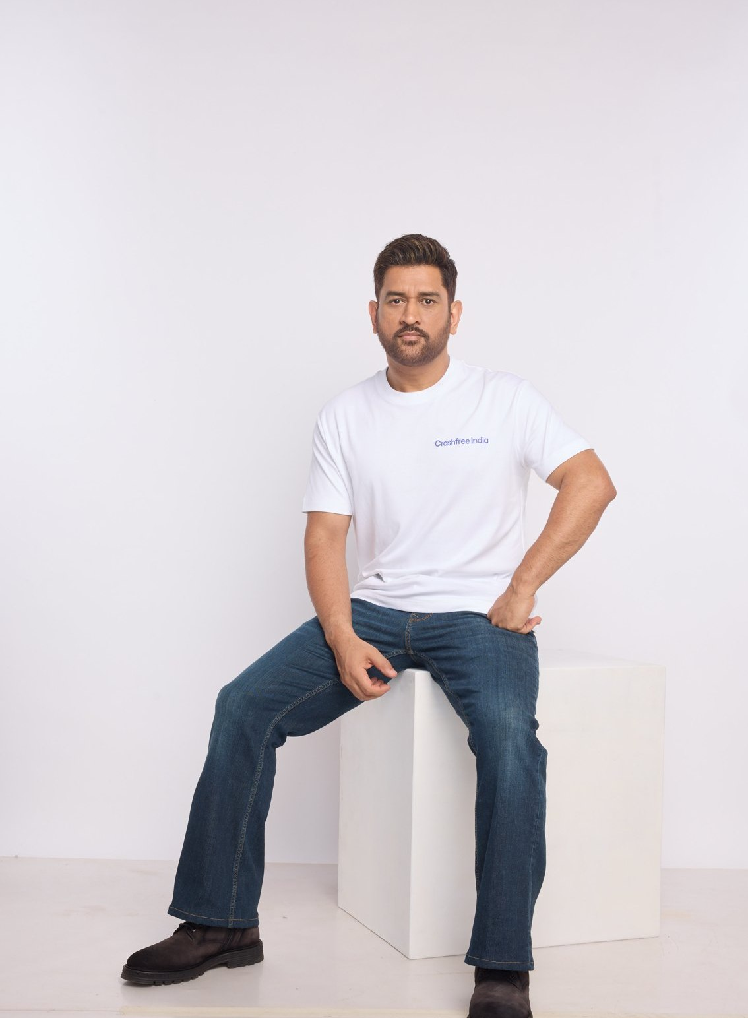



AUGUST 2026 · NEW DELHI
EXPRESSION OF INTEREST · NATIONAL ROAD SAFETY BOARD
Crashfree India
Application to Working Group 3:
Safe Vehicles, Commercial Transport & Future Mobility
Published research on gig and two-wheeler rider risk, a 300-rider study under way
Vehicle standards work with the people who wrote them: ARAI, CMVR-TSC, CIRT
MS DHONI · GOODWILL AMBASSADOR,
CRASHFREE INDIA
Compliance technology proven with police: 3,00,000+ vehicles screened by SATARK
Submitted to the Chairperson and Members, Working Group 3, National Road Safety Board
crashfreeindia.org

Slide 2
BEFORE THE SLIDES
A letter to the Working Group
New Delhi · August 2026
Respected Chairperson and Members of Working Group 3,
Crashfree India is a young road safety nonprofit, registered as the Vision Zero Trust, co-founded with the Indian Road Safety Council, and backed by a three-year, US$3 million commitment from Cars24. Our work meets this Working Group where the risk is growing fastest: two-wheeler riders, the commercial and gig fleets they increasingly ride for, and the standards and technology that keep vehicles safe and compliant. Through Cars24 we also carry an industry vantage point into vehicle markets, fleet operations and used-vehicle certification. MS Dhoni carries this message to the country as our Goodwill Ambassador.
Two-wheeler riders are the largest and fastest-growing category of road deaths, and gig and delivery riders spend entire working days inside that risk. We published 'When Risks Become Routine', our study of gig-rider road risk, in February 2026, and a 300-rider study is now in the field to quantify what it surfaced. Expert sessions on two-wheeler ADAS and bus fire safety have brought veterans of ARAI, CMVR-TSC and CIRT to our table, and an early review of ride-hailing vehicles found 56.8% carrying more than three recorded challans. SATARK, our vehicle-screening platform with police in three cities, shows compliance technology working at scale.
The pages that follow introduce the organisation briefly, then set out the work most relevant to this Working Group in the detail its mandate deserves. Everything shown is running today, is public, and is offered to the Board without cost. We would be honoured to contribute.
Respectfully,
Akhtar Hussain
Mission Lead, Crashfree India · akhtar@crashfreeindia.org · crashfreeindia.org

Slide 3





HOW THIS DECK IS ORGANISED
Five sections, from who we are to what we offer
1
About us, and how we work
04 – 06
Who we are, our approach to the road crash crisis, and why this Working Group.
2
What we have built
07 – 14
Every public-facing programme, audits, enforcement tech, victim support, open data, youth, campaigns.
3
Our people
15 – 16
The team, its capabilities, and the expert bench around the work.
4
Gig & two-wheeler safety in depth
17 – 24
The deep dive matched to this Working Group's mandate, evidence, method, results.
5
How we can contribute
25 – 26
Four concrete, no-cost offers to the Working Group.

Slide 4

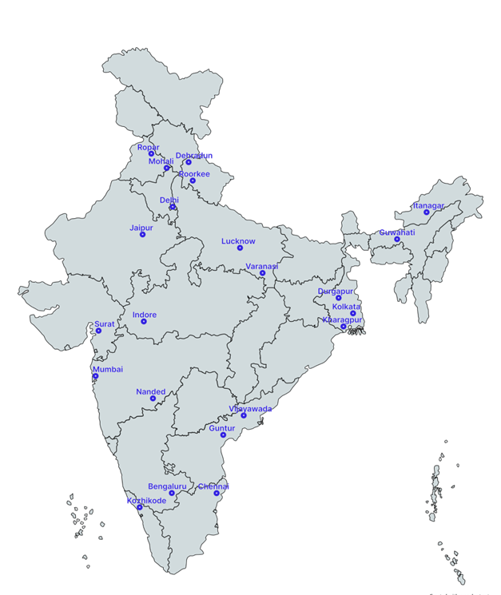



01 · ABOUT US
SECTION 1 OF 5 · ABOUT US
Crashfree India: a nonprofit that adds capacity to road safety work
Registered as the Vision Zero Trust · Co-founded by Cars24 and the Indian Road Safety Council · Working since June 2025 · New Delhi
Evidence first
Structured field audits, file reviews and research to official standards, not opinion.
Institutional collaboration
We work through PWDs, NHAI, transport departments, police and District Road Safety Committees.
Youth-led capacity
Trained student teams from IITs, NITs and SPAs add the auditing hands the system needs.
Technology for follow-through
Public dashboards track every recommendation from submission to completion.
The Group's mandate is our daily work: rider-risk research, vehicle-standards engagement with the people who wrote them, and compliance technology proven with police.
Where we work today, 18 cities, north to south.
Crashfree India · Expression of Interest — Working Group 3
04 / 26

Slide 5


01 · ABOUT US, OUR APPROACH
SECTION 1 OF 5 · ABOUT US
Our approach: work with the system, and prove it with data
Four steps, applied to every problem we take up, from a dangerous junction to a stalled compensation claim.
1 · Evidence
2 · Institutional partnership
3 · Technology
4 · Follow-through
Field audits, file reviews and research to official standards.
→
Work through the authority that owns the problem, never around it.
→
Dashboards, AI and WhatsApp tools that fit how officials already work.
→
Every recommendation tracked publicly to completion.
31 sites audited · 50+ stakeholder consultations
31 sites audited · 50+ stakeholder consultations
25+ written approvals · 4 DRSCs · MoUs with police
25+ written approvals · 4 DRSCs · MoUs with police
Aasha · SATARK · 4 open data platforms
Aasha · SATARK · 4 open data platforms
Implementation started at 15 sites · 7 fully built
Implementation started at 15 sites · 7 fully built
We do not replace the system and we do not campaign against it. We add hands, evidence and tools to work the system has already committed to.
Crashfree India · Expression of Interest — Working Group 3
05 / 26

Slide 6


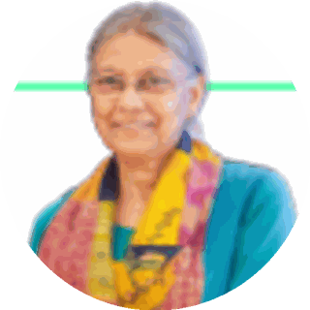
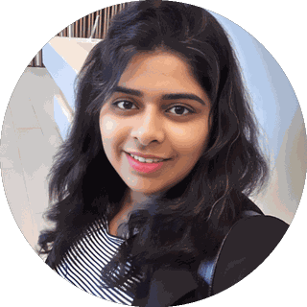
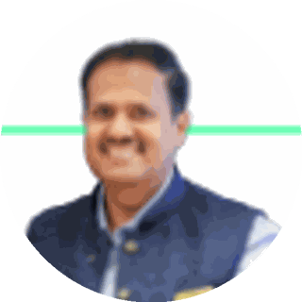
01 · WHY WORKING GROUP 3
SECTION 1 OF 5 · ABOUT US
Why Working Group 3, and what we bring to it
The Group's mandate matches the deepest part of our portfolio. Three focus areas where we are ready on day one.
Two-wheeler & rider safety evidence
Two-wheeler riders carry the fastest-growing share of road deaths; our published study and 300-rider fieldwork sit exactly here.
EXISTING CAPABILITIES WE PUT ON THE TABLE
Published gig-rider study
300-rider study in the field
ARAI · CMVR-TSC · CIRT bench
SATARK live in 3 cities
Vehicle standards & commercial fleets
Expert sessions on two-wheeler ADAS and bus fire safety, with the veterans of ARAI, CMVR-TSC and CIRT, and an industry vantage point through Cars24.
Aggregator challan evidence
Platform & police relationships
Compliance technology for fleets
SATARK screens vehicles at scale with police; our aggregator review shows exactly where challan verification breaks down.
SUBJECT-MATTER EXPERTS ALREADY ENGAGED ON THIS AGENDA
BB
Balraj Bhanot Ex-Chairman, CMVR-TSC · ex-ARAI
DS
Dattatraya Saste Ex-MoRTH · Bus Code Convener
Prof. Geetam Tiwari TRIP Centre, IIT Delhi
Dr. Richa Ahuja Asst Professor, IIT Kharagpur
Akhilesh Srivastava ITS India · IRF
Crashfree India · Expression of Interest — Working Group 3
06 / 26

Slide 7
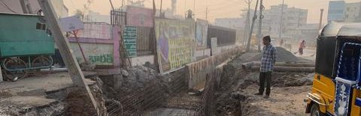
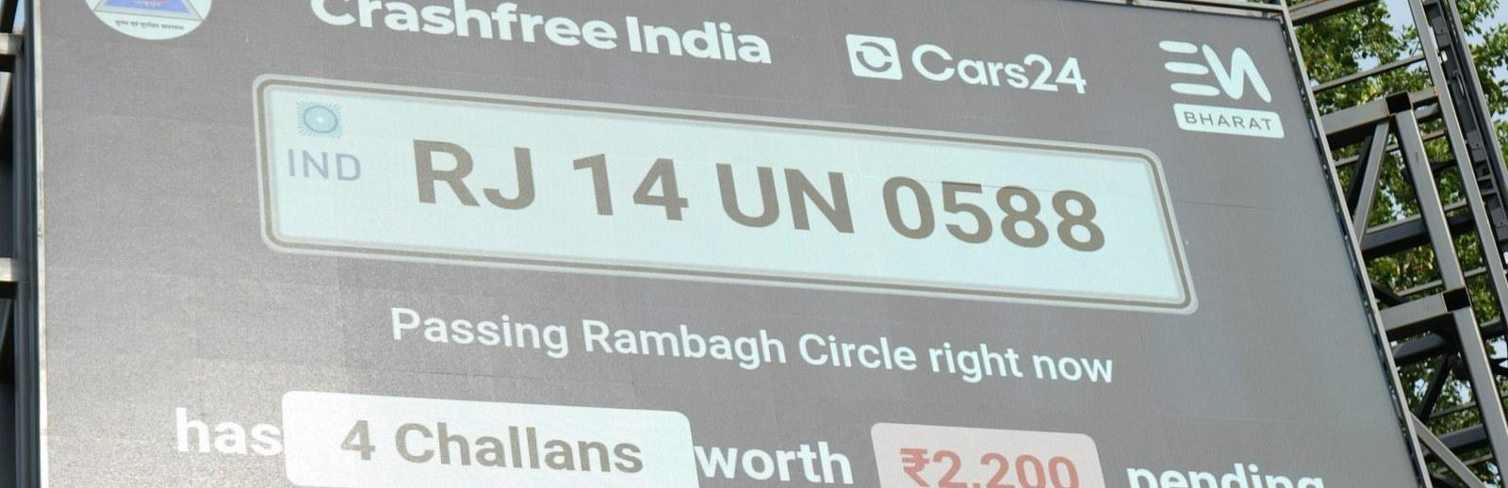
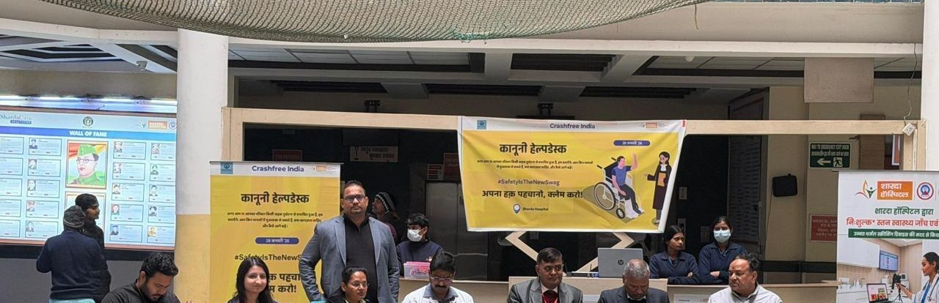

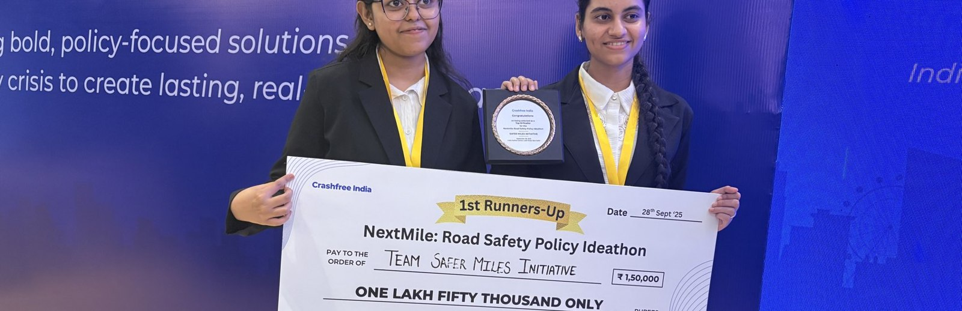
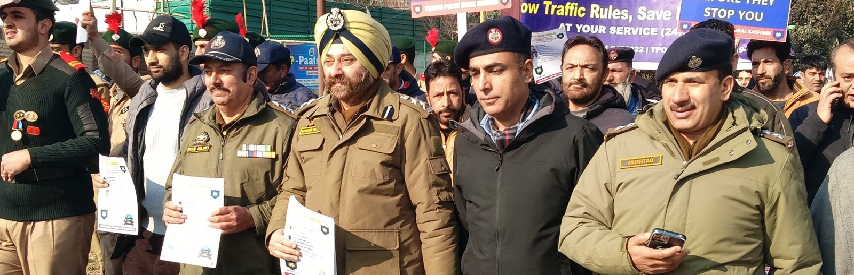
02 · WHAT WE HAVE BUILT
SECTION 2 OF 5 · WHAT WE HAVE BUILT
Six lines of work, one connected system
Audits create data · data supports policy · policy guides the field. Everything below is live today.
Project Rakshak
SATARK enforcement
Victim support
Student-led road audits, fixed with authorities
AI support that helps police find high-risk vehicles
Aasha chatbot, calculator, hospital helpdesks
31 sites · 7 fixes fully built
3,00,000+ vehicles screened
100+ victims helped in first 4 days
Open public data
Youth & policy
Public campaigns
Four self-updating data platforms, free to use
NextMile ideathon and national dialogue series
Road Safety Month with police & schools; MS Dhoni
36 states & 50 cities covered
2,000+ participants engaged
1M+ citizens reached
Crashfree India · Expression of Interest — Working Group 3
07 / 26

Slide 8
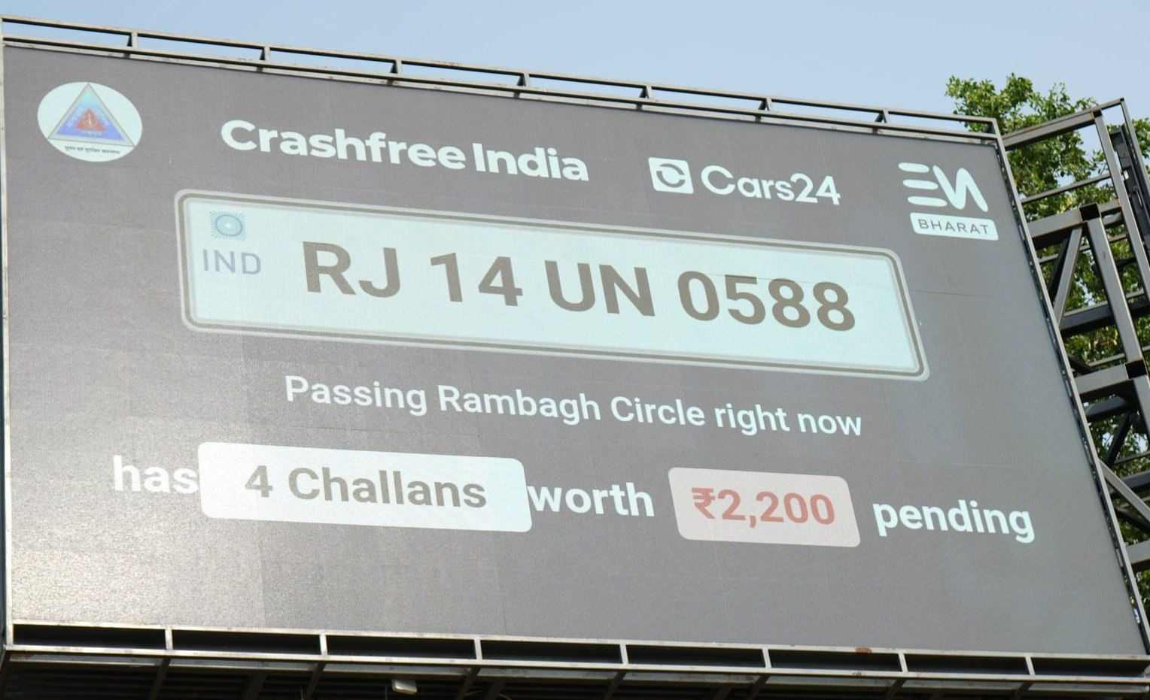
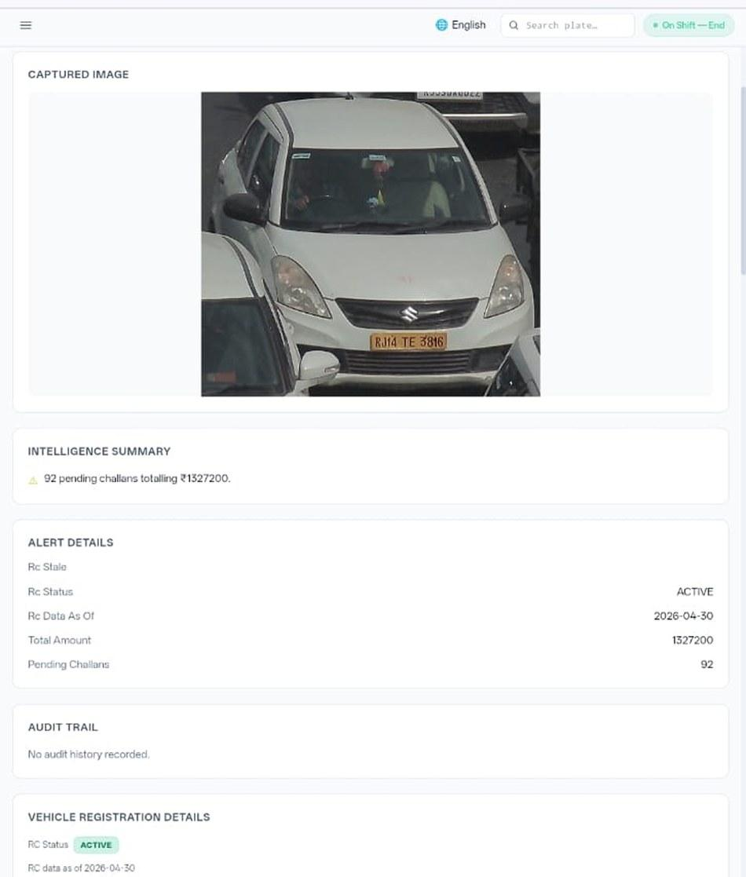








02 · WHAT WE HAVE BUILT, ENFORCEMENT TECHNOLOGY
SECTION 2 OF 5 · WHAT WE HAVE BUILT
SATARK: AI that helps police stop the right vehicle
Built with Cars24 engineers. Reads number plates, checks government records, and alerts officers to repeat offenders, in real time.
3,00,000+
₹30 Cr+
vehicles screened
pending challan value identified
350+
70,019
high-risk vehicles intercepted
vehicles found with pending challans
LIVE · Jaipur & Bengaluru
NEW · Gurugram
Officer view, challans,
RC & compliance status.
Bengaluru's Trinity Circle billboard was India's first, covered by Deccan Herald and national press. Pune and Ahmedabad are next.
Rambagh Circle, Jaipur, live plate, pending challans and dues on a public billboard.
ANPR camera
Plate read
Records check
Risk flag
Officer alert
Billboard
Interception
Enforcement
Crashfree India · Expression of Interest — Working Group 3
08 / 26

Slide 9
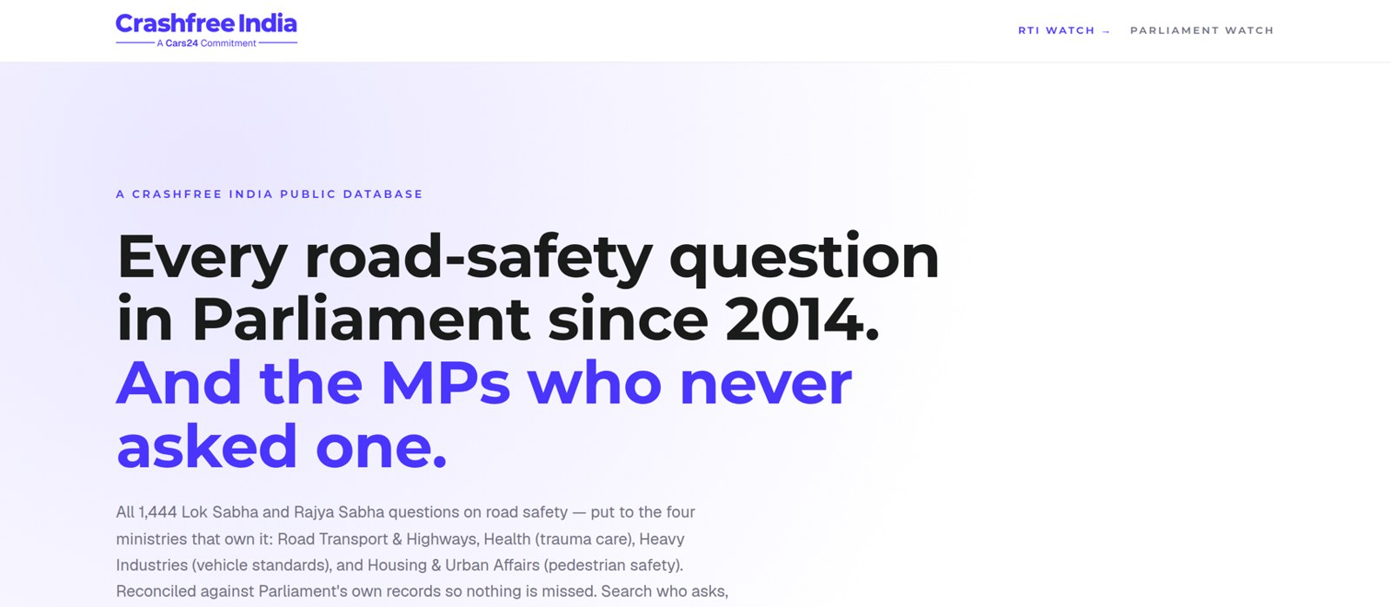



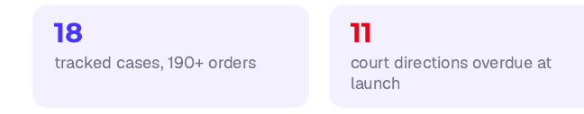
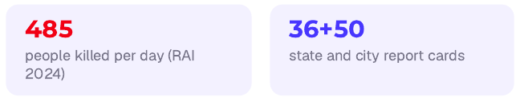
02 · WHAT WE HAVE BUILT, OPEN PUBLIC DATA
SECTION 2 OF 5 · WHAT WE HAVE BUILT
Live public data platforms, free for any authority
Four platforms, each turning a scattered public record into structured, citable evidence. The Parliament tracker is shown live, as captured this week.
National Road-Infrastructure
Defect Repository
DAILY · 07:00 IST
An AI pipeline reads local-language news every morning and turns road-defect reports into structured, mapped, ranked evidence, each entry carrying its verbatim source.
Potholes
Missing signage
Unlit stretches
Blind curves
Broken dividers
146
districts scanned daily
13
languages read
21
defect codes tracked
Road Safety in Parliament: all 1,444 questions since 2014 across four ministries; 275 of 540 sitting Lok Sabha MPs have never asked one.
Local news → AI extraction → confidence gate → human review → public map. Live across Bihar, UP and Rajasthan districts today.
Supreme Court Litigation Tracker
WEEKLY · LIVE
Crash Data Dashboard
ANNUAL · OPEN DATA
Every systemic road-safety matter before the Supreme Court, orders indexed, precedent judgments digested, refreshed every Tuesday.
MoRTH's annual 'Road Accidents in India' books as a usable product: report cards for 36 states and 50 cities, every number reconciled against the printed books, open licence (CC-BY).
Crashfree India · Expression of Interest — Working Group 3
09 / 26

Slide 10
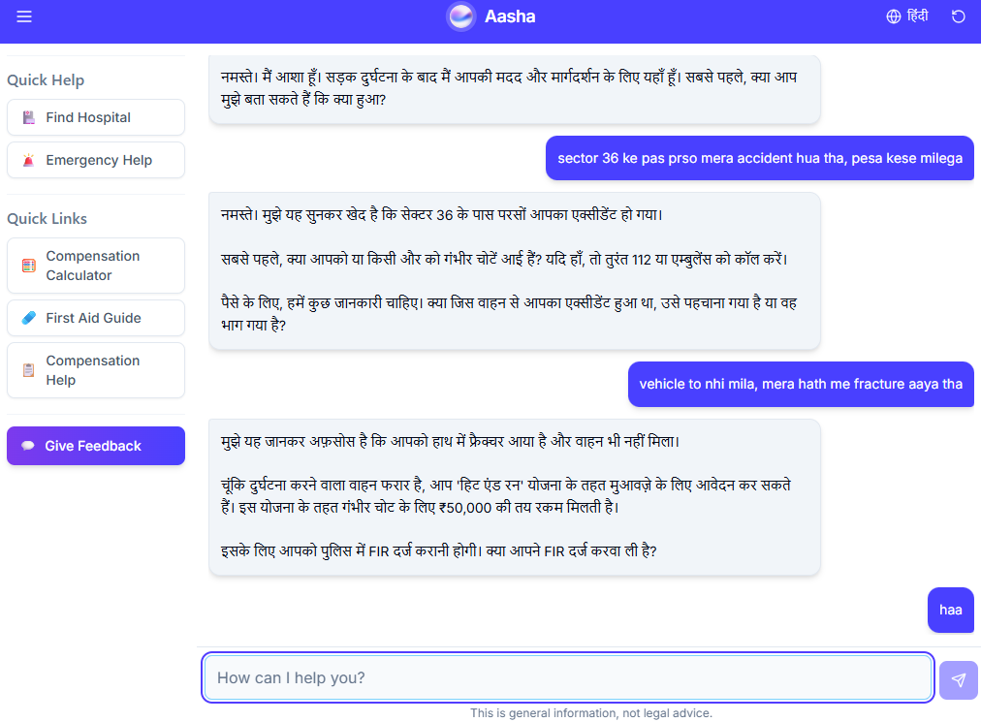
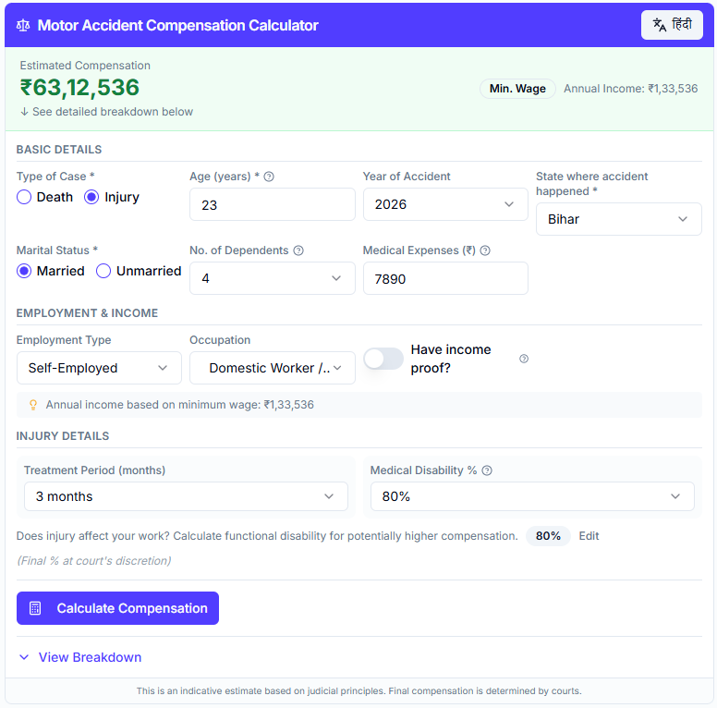
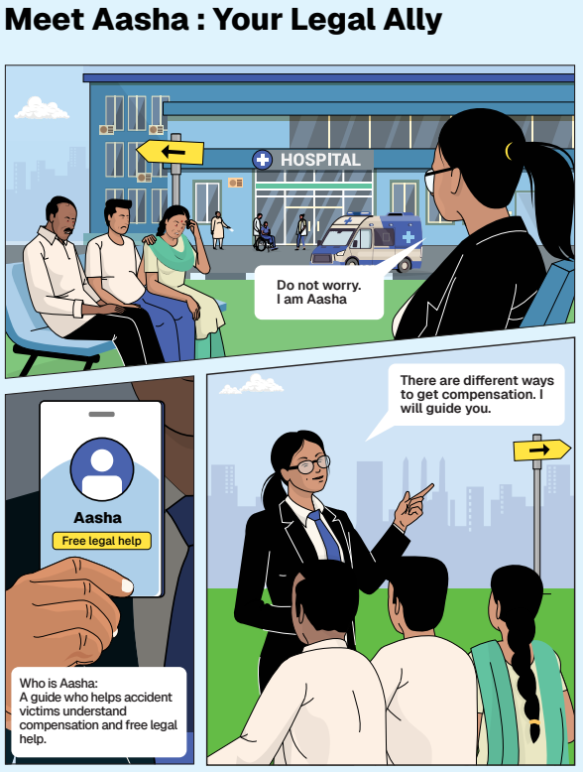
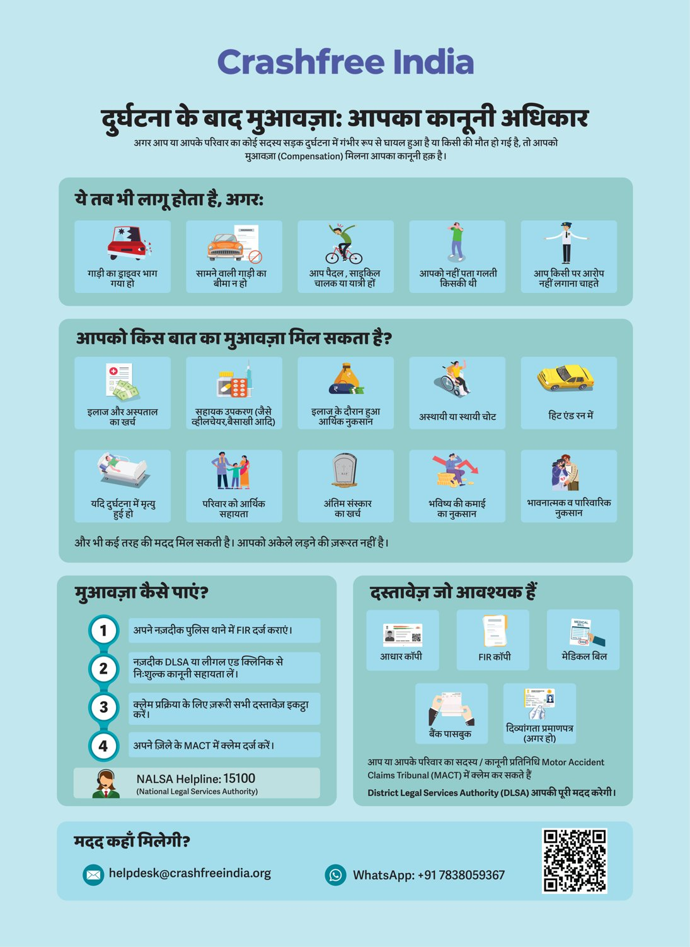




02 · WHAT WE HAVE BUILT, VICTIM SUPPORT
SECTION 2 OF 5 · WHAT WE HAVE BUILT
Help a family can actually use, in their language
From the first hours after a crash to the final compensation order, on WhatsApp, on paper, and in person.
Aasha chatbot
Compensation Calculator
'Meet Aasha' comics
Hindi rights guide
India's first AI legal companion for crash victims, on WhatsApp and voice, no app needed.
Free instant estimates computed on Supreme Court principles (Sarla Verma, Pranay Sethi).
Plain-language legal education that families actually read, at desks and in schools.
All three compensation routes, NALSA 15100 and the Cashless Treatment Scheme 2025.
Hospital helpdesks bring all of this to the trauma-ward bedside , 100+ victims supported in the first four days, run with DLSA and Neev Foundation.
Crashfree India · Expression of Interest — Working Group 3
10 / 26

Slide 11
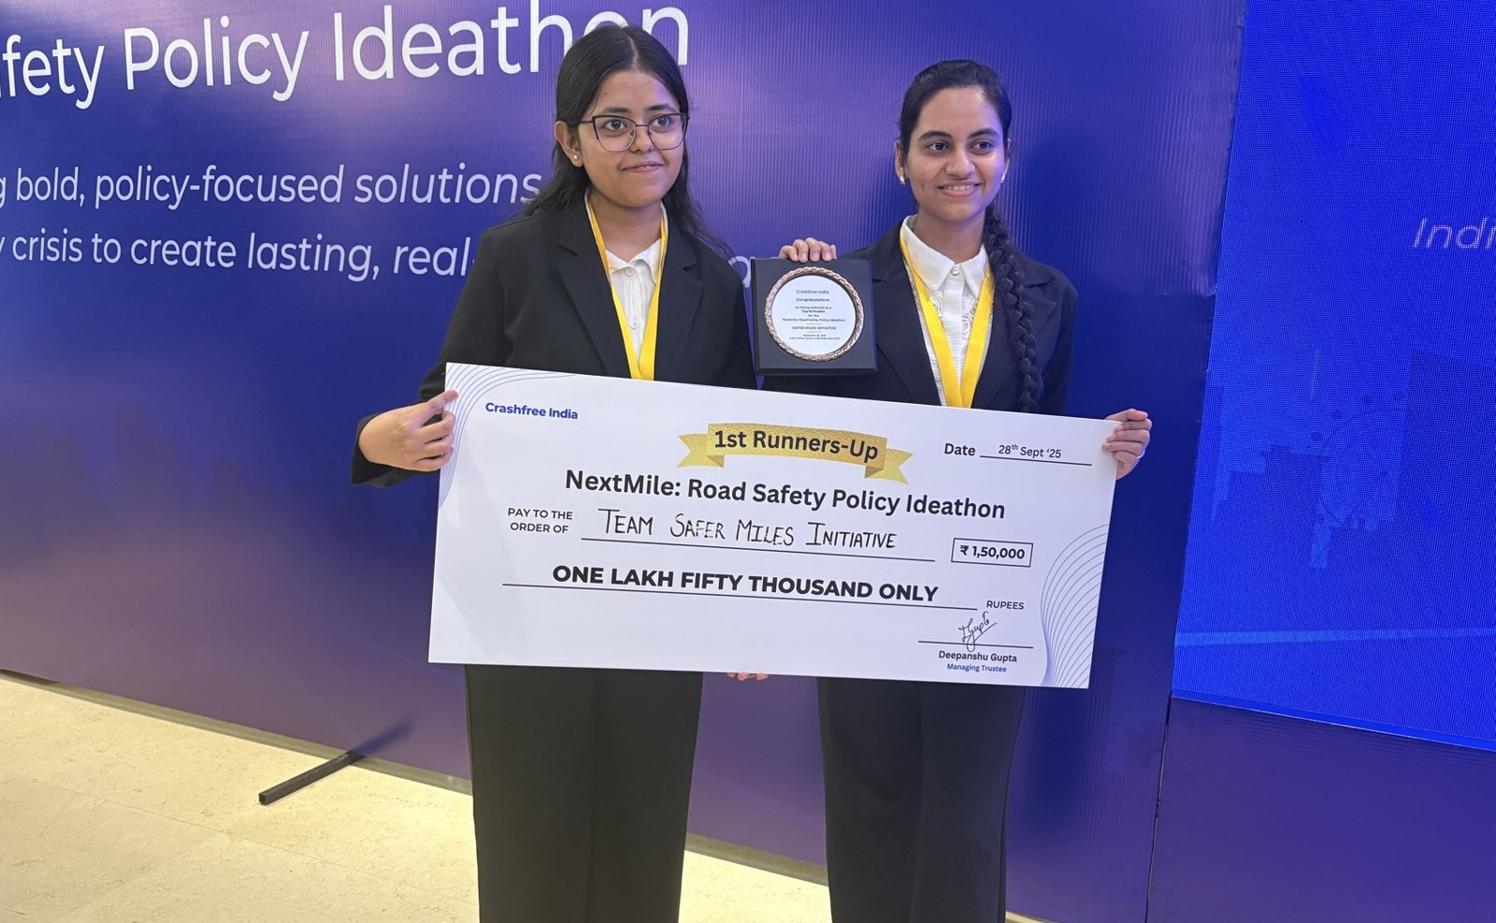
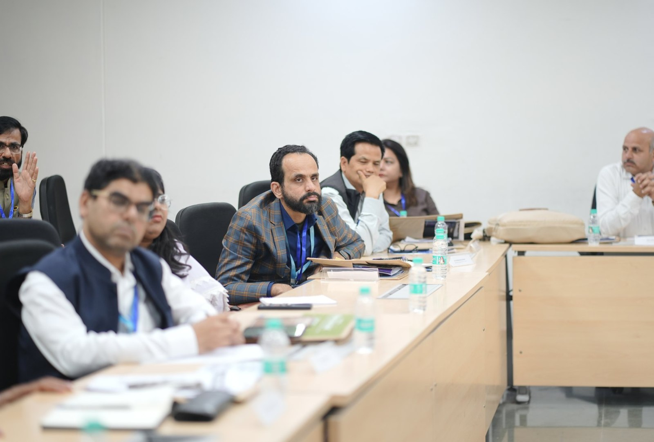



02 · WHAT WE HAVE BUILT, YOUTH & POLICY
SECTION 2 OF 5 · WHAT WE HAVE BUILT
Young talent and senior experts, working the same problem
A steady pipeline of engineers and policy minds, so road safety work never runs out of hands.
National Road Safety Dialogue Series
200+ live attendees; speakers from MoRTH, CIRT, AIIMS Trauma Centre, CSIR-CRRI and ARAI.
Three sessions so far
Bus safety · Delivery rider safety · Good Samaritan law & the Cashless Treatment Scheme.
NextMile: Road Safety Policy Ideathon, grand finale, 28 Sep 2025, New Delhi.
National Road Safety Implementation Forum, IIT Delhi: 60+ experts from MoRTH, WHO, UNICEF, iRAP and CSIR-CRRI reviewed the work.
Advocacy on video
Our YouTube channel documents hazards and fixes on camera: ground-audit walkthroughs, Dialogue Series recordings and victim-education explainers. A public record any authority can cite.
2,000+
250+
700+
10
Mentors and jury from the Government of Rajasthan, NIUA, OMI, NASSCOM and CSEP judged the student teams; winning tracks now feed our audit and research pipeline.
participants
concept notes
teams
finalist teams
Next: 'Be a Rakshak' university chapters at IITs, NITs and SPAs.
Crashfree India · Expression of Interest — Working Group 3
11 / 26

Slide 12
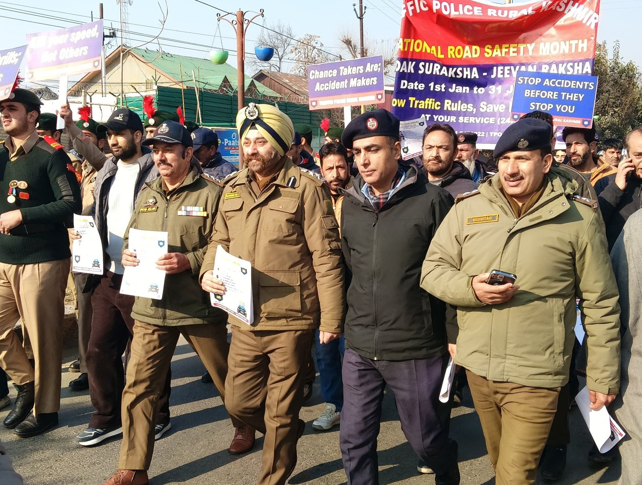
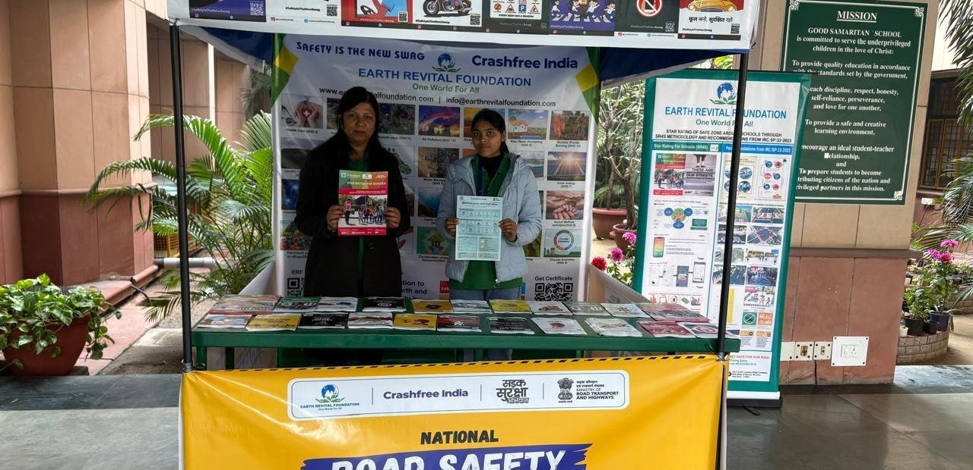
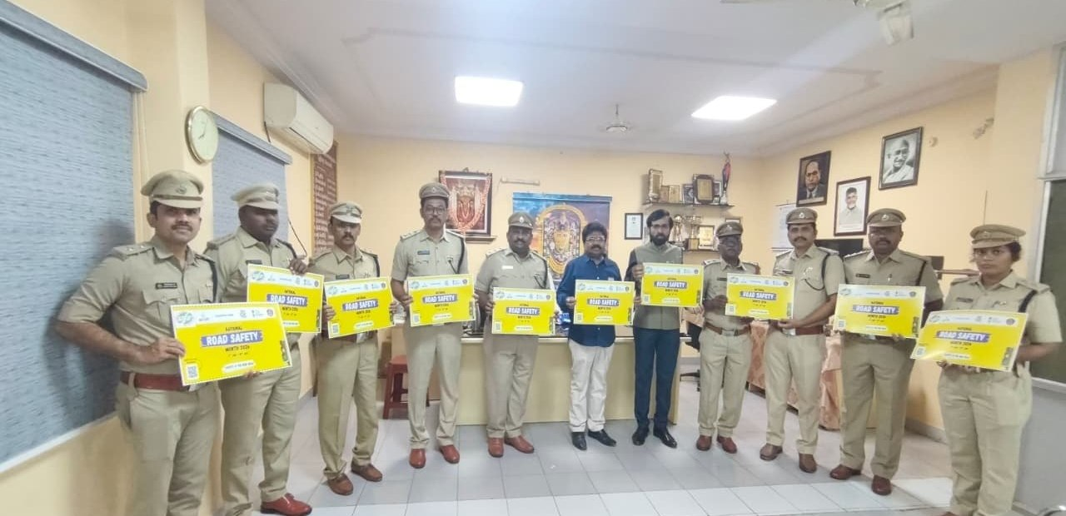
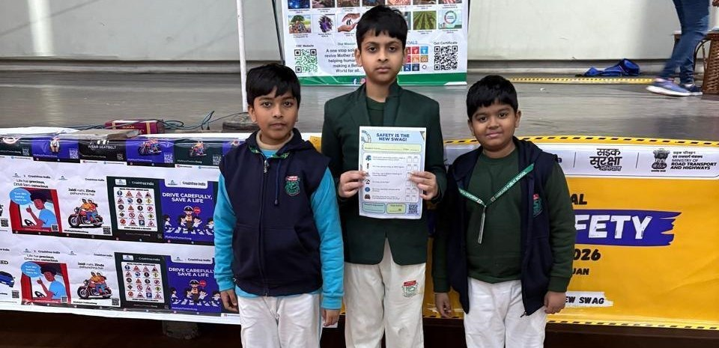
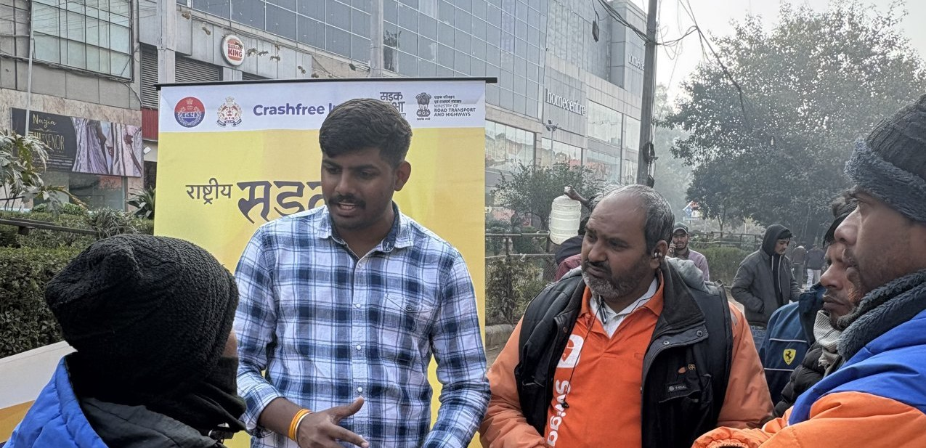
02 · WHAT WE HAVE BUILT, ON THE GROUND
SECTION 2 OF 5 · WHAT WE HAVE BUILT
Road Safety Month 2026, run with the system
With district police, schools, hospitals and delivery platforms, in Hindi and local languages.
CFI stall at a government office
Materials briefing with police staff
National Road Safety Month rally, on the road with district traffic police, Jan 2026.
School programme with certificates
Delivery-rider outreach, Swiggy & Instamart
1M+ citizens reached across campaigns in year one.
Crashfree India · Expression of Interest — Working Group 3
12 / 26

Slide 13
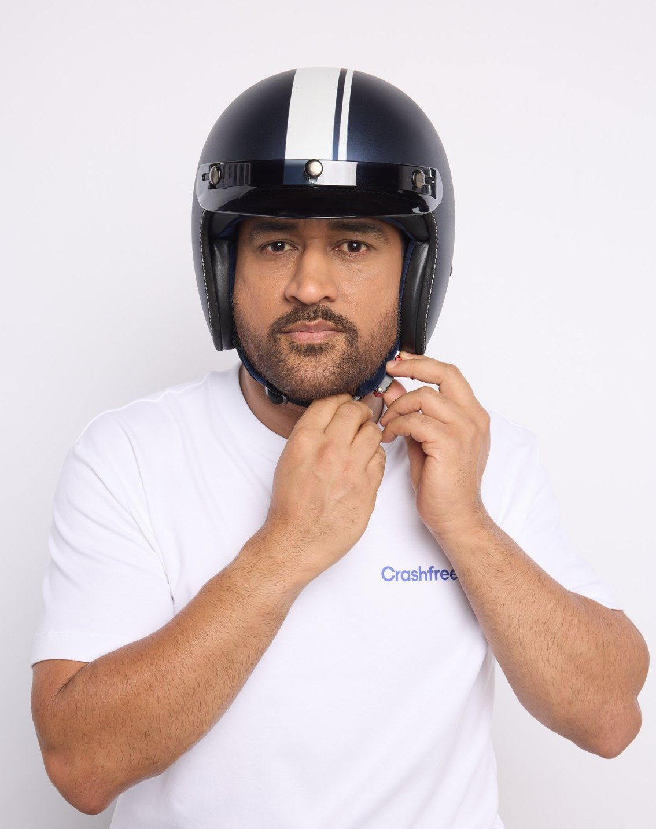
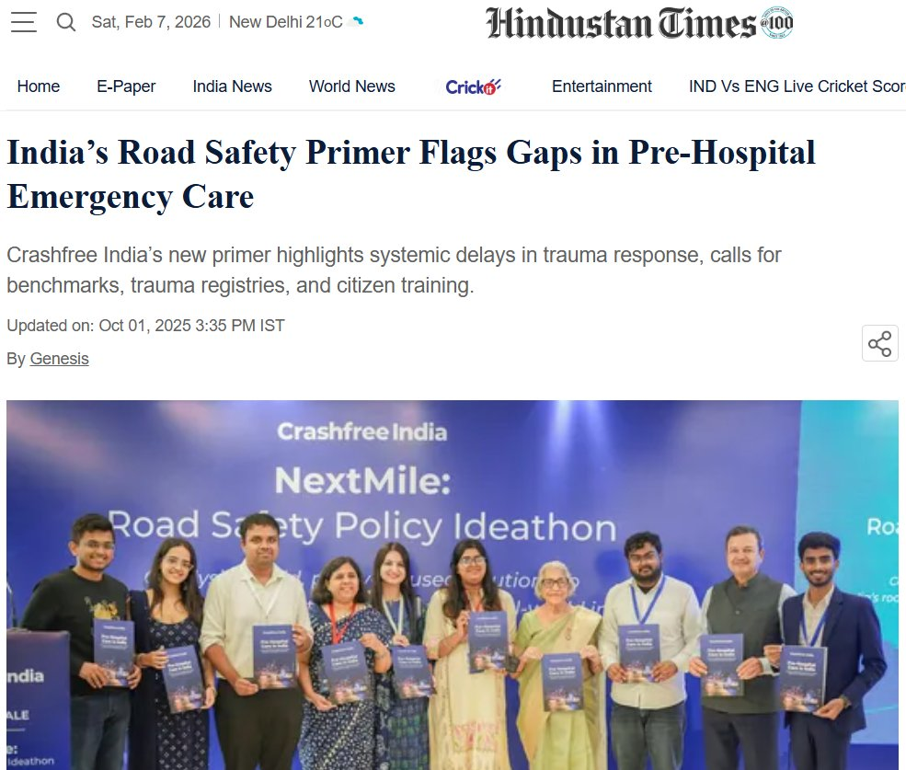
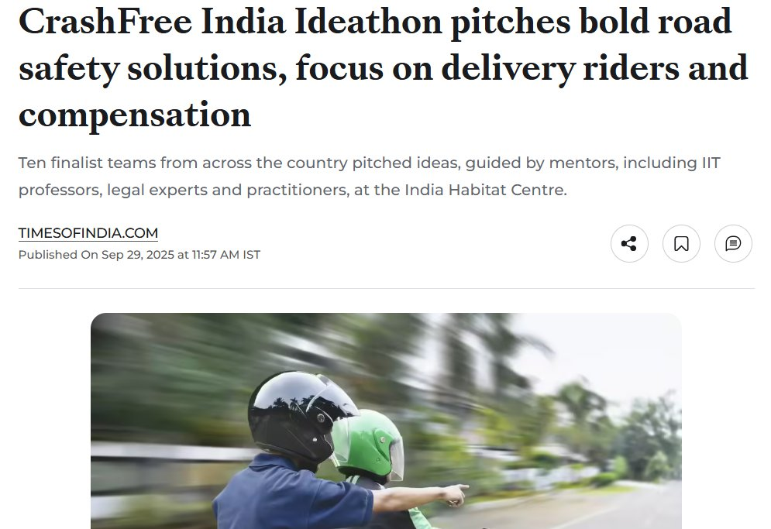

02 · WHAT WE HAVE BUILT, PUBLIC VOICE
SECTION 2 OF 5 · WHAT WE HAVE BUILT
MS Dhoni gives road safety a national voice
AS SEEN IN THE PRESS
"We already know what is going wrong. What we need now is more responsibility, more discipline, more respect for life."
ThePrint, on the NextMile
ideathon finale.
MS Dhoni, at the National Road Safety
Implementation Forum, IIT Delhi
Hindustan Times, on our
Pre-Hospital Care Primer.
Deccan Herald
Economic Times
Fortune India
MS Dhoni, Goodwill Ambassador, announced April 2026.
IndiaSpend
Scroll.in
The Wire
Dhoni's voice powers 'Be a Rakshak', school-zone safety and compensation-awareness campaigns.
Times of India
Business Standard
Crashfree India · Expression of Interest — Working Group 3
13 / 26

Slide 14
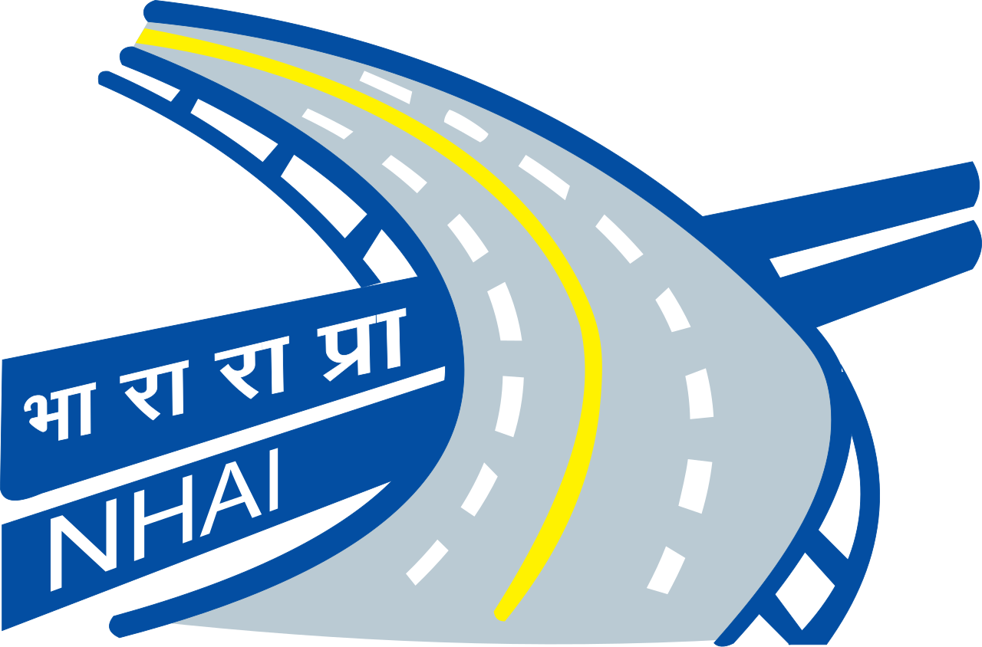
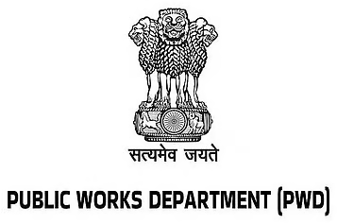

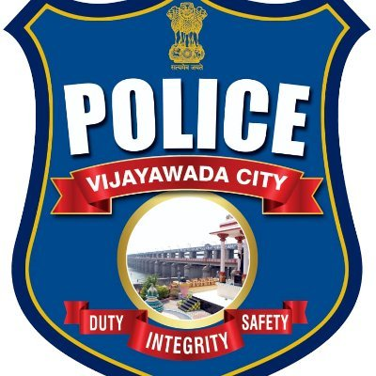
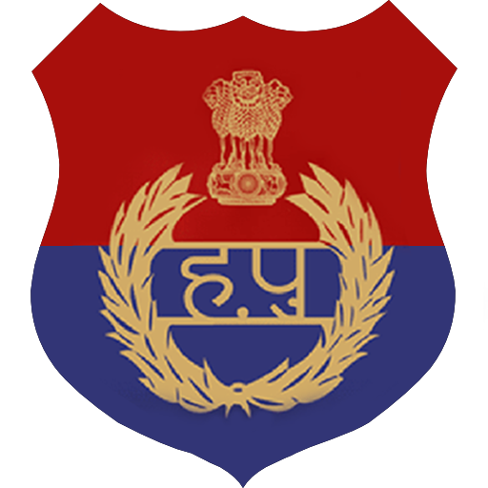



















02 · WHAT WE HAVE BUILT, THE NETWORK
SECTION 2 OF 5 · WHAT WE HAVE BUILT
The institutions around the work
As they appear in our working decks, engagement ranges from formal MoUs and written approvals to jury, mentoring and research collaboration.
AUTHORITIES & PUBLIC BODIES WE WORK WITH
UNIVERSITIES & INSTITUTES FIELDING AUDIT TEAMS
EXPERT & ECOSYSTEM PARTNERS
Plus: Jaipur Traffic Police & Gurugram Police (MoUs) · CPWD & district administrations · Bloomberg, Johns Hopkins, Centre for Green Mobility and PwC experts on juries and reviews.
Crashfree India · Expression of Interest — Working Group 3
14 / 26

Slide 15
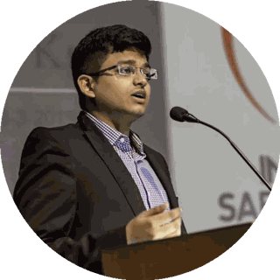
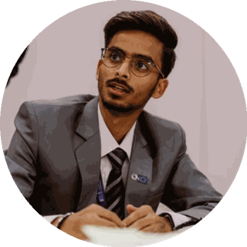
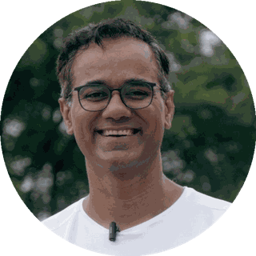
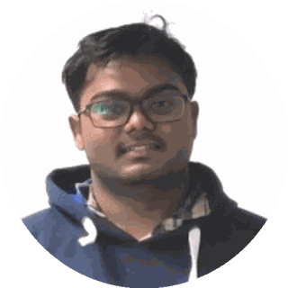
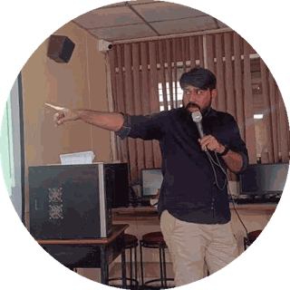
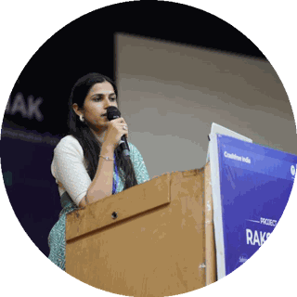
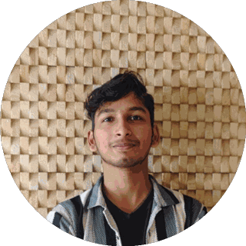
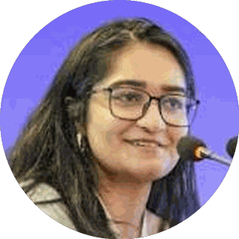
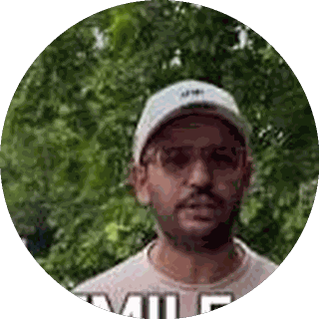
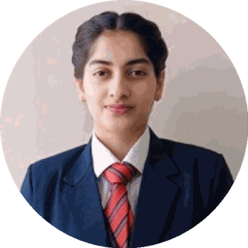
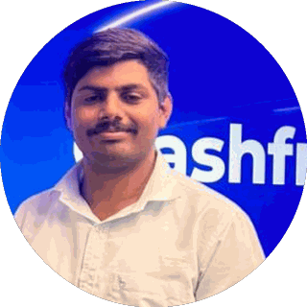
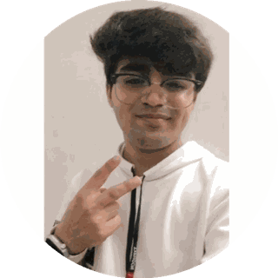
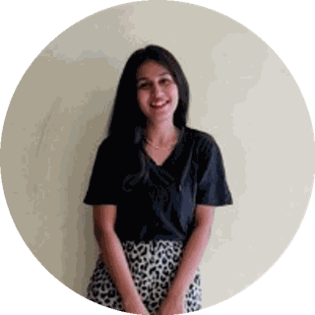
03 · OUR PEOPLE
SECTION 3 OF 5 · OUR PEOPLE
A full-time team built for this work
Engineering, law, policy, product and field operations, under trustees who have led Indian road safety for a decade.
Amar Srivastava
Deepanshu Gupta
Gajendra Jangid
President · Founder, Indian Road Safety Campaign · Member, National Road Safety Council
Managing Trustee · Founder, IRSC · Global Youth Coalition for Road Safety
General Secretary · Co-founder, Cars24
THE FULL-TIME TEAM
Akhtar Hussain Mission Lead
Shubham Kumar Policy & Advocacy
Muskan Yadav Programmes
IIT Delhi · ex-Bain · strategy, programmes, new initiatives, partnerships and product
NALSAR Hyderabad · programmes, policy advocacy, legal research, government relations
TISS · district programmes, Project Rakshak, infrastructure interventions, DRSC work
Krishna Jain Tech & Product
Aastha Shreeharsh Development Communications
Rohan Sharma Cause Marketing
Builds and runs Aasha, SATARK and the open public data platforms
HKUST · institutional communications, government relations
Awareness campaigns, digital advocacy, community mobilisation
Ishita Rathore People & Culture
Yuvraj Yadav Operations
Lovish Creative (Video)
Talent and hiring, volunteers, the 75+ intern engineering corps
Field operations across 18 cities · works with police on SATARK and enforcement rollouts
Video explainers, ground-audit films and the YouTube channel
Shipra Kushwaha Creative (Graphic)
Plus 75+ engineering interns and 31 student audit teams.
Guides, comics and bilingual campaign material families actually read
In-house capabilities: road-engineering audits · legal & policy research · AI product development · district operations · behaviour-change communication
Crashfree India · Expression of Interest — Working Group 3
15 / 26

Slide 16
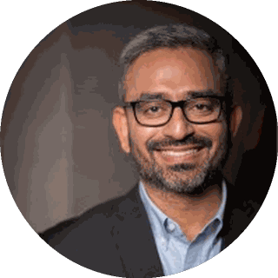
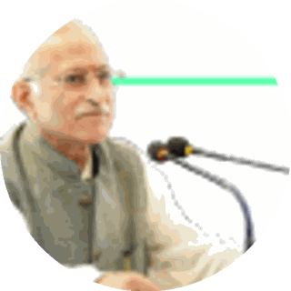
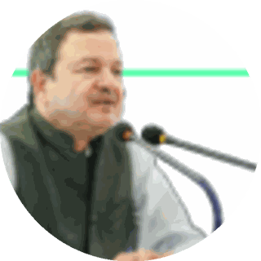
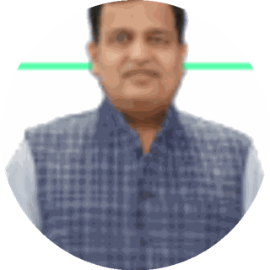






03 · OUR PEOPLE, THE EXPERT BENCH
SECTION 3 OF 5 · OUR PEOPLE
Advised by the people who built India's road safety practice
Prof. Geetam Tiwari, Board of Advisors
Piyush Tewari, Board of Advisors
Professor Emerita & Chair, TRIP Centre, IIT Delhi · four decades of transport safety research
Founder & CEO, SaveLIFE Foundation · Architect of the Good Samaritan Law · Zero-Fatality Corridors
JURY, MENTORS & REVIEWERS AROUND OUR WORK
Justice J.R. Midha
Abhay Damle
Vaibhav Dange
Dr. Maya Tandon
R. Venkat Ratnam
Delhi High Court (Retd.)
Ex-JS, MoRTH
Ex-Advisor, MoRTH
Sahayta Trust
Government of Punjab
Akhilesh Srivastava
Aishwarya Raman
Neeraj Kumar
R.S. Pandey
Dipak K. Dash
ITS India · IRF
OMI Foundation
Tata AIG
FICCI Road Safety
Times of India
Engaged through the National Road Safety Dialogue Series: Balraj Bhanot (ex-Chair, CMVR-TSC) · I.V. Rao (TERI; ex-Maruti Suzuki) · D.P. Saste (CIRT / ex-MoRTH) · Dr. Sushma Sagar (AIIMS Trauma) · Dr. S. Velmurugan (CSIR-CRRI), and jurors from OMI, NIUA, WRI, CII and Tata AIG.
Crashfree India · Expression of Interest — Working Group 3
16 / 26

Slide 17

04 · GIG & TWO-WHEELER SAFETY, THE PROBLEM
SECTION 4 OF 5 · GIG & TWO-WHEELER SAFETY
The fastest-growing risk on Indian roads rides a two-wheeler
Gig and delivery work concentrates the exposure: entire working days on the road, on vehicles and licences that see comparatively little scrutiny.
~45%
23.5 M
1 in 2
of India's crash fatalities are two-wheeler users, and the share rises year on year
gig and platform workers projected by 2029-30 (NITI Aayog)
delivery riders in a 431-rider Mumbai crash study had already been in a crash
This is also where our road safety and compensation work meet: many gig riders injured on the job are unaware of the compensation they are entitled to. Roughly 70% of the families at our crash-compensation helpdesks are vulnerable road users. Our NextMile ideathon saw student teams working on delivery-rider safety and on compensation reform arrive, independently, at the same population.
Enforcement sees the pressure too: Bengaluru's challans against delivery riders rose from 30,968 in 2023 to 63,718 in the first nine months of 2025.
Delivery-rider outreach with Swiggy and Instamart riders, Road Safety Month 2026.
Crashfree India · Expression of Interest — Working Group 3
17 / 26

Slide 18





04 · GIG & TWO-WHEELER SAFETY, OUR RESEARCH
SECTION 4 OF 5 · GIG & TWO-WHEELER SAFETY
'When Risks Become Routine', published February 2026
A study of the road risk produced by delivery and ride-hailing work: 40 pages, 87 references, fieldwork on the road with riders.
Structural & occupational conditions
Pay-per-piece incentive design and delivery timelines create sustained time pressure over long shifts.
FIELDWORK, NOT ONLY DESKWORK
The study included shadowing a delivery rider through a full nine-hour shift, documented on video, to capture pacing, routing and time pressure directly.
Operational & behavioural risk
Helmet non-compliance, largely self-taught rider training, and phone use while riding under app-driven time pressure.
Data fragmentation
Crash and near-miss data sit separately with platforms, insurers and police; no one holds a shared view of rider-level risk.
A regulatory blind spot
Low-speed e-bikes under 250W / 25 km/h require no licence or registration, leaving a growing share of last-mile fleets outside routine enforcement.
INTERNATIONAL PRECEDENT
Spain's 2021 Riders' Law brought algorithmic transparency to dispatch systems; Australia maps delivery-rider risk as a system. India's conversation is only beginning.
Infrastructure & site design
The layout of dark stores and delivery hubs can itself push riders into unsafe manoeuvres, through poorly designed access roads and pick-up zones.
Crashfree India · Expression of Interest — Working Group 3
18 / 26

Slide 19



04 · GIG & TWO-WHEELER SAFETY, THE NEXT STEP
SECTION 4 OF 5 · GIG & TWO-WHEELER SAFETY
A 300-rider study is now under way, to quantify what we surfaced
The published brief gives a clear qualitative picture. The study now in the field sizes it, by hearing directly from riders at scale.
How often
Which factors
Which riders
How frequently riders actually experience near-misses and crashes, measured across a large sample rather than a handful of conversations.
Which risk factors matter most in practice: fatigue, incentive design, training gaps, so interventions start where the risk is.
What distinct rider profiles exist, so that training, equipment and platform changes can be targeted rather than generic.
IN THE FIELD NOW · 2026
Reviewed by the people who know the terrain: research design reviewed by Dr. Richa Ahuja (IIT Kharagpur) · site-design dimension shaped with Dr. Deepty Jain and Prof. Geetam Tiwari (TRIP Centre, IIT Delhi) · enforcement realities from former traffic-police leadership of Delhi, Gurugram and Bengaluru.
Crashfree India · Expression of Interest — Working Group 3
19 / 26

Slide 20
04 · GIG & TWO-WHEELER SAFETY, AGGREGATOR VEHICLES
SECTION 4 OF 5 · GIG & TWO-WHEELER SAFETY
Vehicle compliance among aggregators, an early look
A February 2025 review of traffic challans against ride-hailing vehicles across four platforms, exploratory, and revealing.
56.8%
40+
2020
of ride-hailing vehicles reviewed carried more than three recorded challans
challans on a single vehicle, the outlier a per-vehicle view surfaces and an aggregate statistic hides
the Aggregator Guidelines first required e-challan clearance records; the 2025 revision makes clearance a precondition
The rule already exists. A vehicle still carrying forty-plus outstanding challans, found well after the requirement took effect, points to a gap in verification and enforcement rather than in the rule itself. That is a technology and process problem, and it is one we have worked on before.
SATARK shows per-vehicle verification working at scale: over 3,00,000 vehicles screened with police in Jaipur, Bengaluru and Gurugram, surfacing exactly the repeat-offender vehicles an onboarding check needs to catch.
Crashfree India · Expression of Interest — Working Group 3
20 / 26

Slide 21

04 · VEHICLE STANDARDS, OUR ENGAGEMENT
SECTION 4 OF 5 · GIG & TWO-WHEELER SAFETY
Working sessions with the people who wrote the standards
Two expert sessions pair the authors and auditors of India's vehicle-safety standards with newer technology and operational practice.
Two-wheeler safety technology
Bus safety
ADAS for two-wheelers, and the case for a national two-wheeler safety stack.
Fire detection and suppression systems, and the gap between code and ground-level compliance.
Balraj Bhanot, former Director ARAI, former Chairman CMVR-TSC & BIS TED-28, with Aayush Kumar, COO & co-founder, BYTES (acquired by Cautio).
Dattatraya Saste, former Technical Consultant MoRTH and former Convener, Bus Code & Safety Regulations, with Shekhar Dhole, Technical Secretariat in-charge, CIRT; Panel Convenor, AIS-052/119.
These sessions were a first step, and the relationships hold: with ARAI, CMVR-TSC and CIRT veterans, and with two-wheeler ADAS developers, all available to this Working Group.
Crashfree India · Expression of Interest — Working Group 3
21 / 26

Slide 22


04 · GIG & TWO-WHEELER SAFETY, THE CONVERSATION AHEAD
SECTION 4 OF 5 · GIG & TWO-WHEELER SAFETY
A safety conversation on gig work, ready to begin
Gig-work policy so far has been framed around social security and labour conditions. This Working Group can convene its road safety dimension.
What we heard from the Ministry
Our consultation with the Ministry of Labour and Employment confirmed the framing: platform-work policy centres on welfare boards, insurance and social security.
What is happening elsewhere
The road safety dimension of gig work has begun receiving dedicated attention in Vietnam and Taiwan; a comparable conversation in India is yet to take shape.
Who needs to sit together
Platforms, police, insurers, regulators and researchers each hold a fragment of rider risk. No one holds the shared view; a Working Group table can.
ALREADY CONSULTED FOR THIS WORK
Ministry of Labour & Employment
V.V. Giri National Labour Institute
Traffic police leadership: Delhi · Gurugram · Bengaluru
Ex-operations, Swiggy & Zomato
Fairwork India researchers
TRIP Centre, IIT Delhi · IIT Kharagpur
Crashfree India · Expression of Interest — Working Group 3
22 / 26

Slide 23




04 · GIG & TWO-WHEELER SAFETY, THE TALENT PIPELINE
SECTION 4 OF 5 · GIG & TWO-WHEELER SAFETY
Young policy talent is already working this problem
Delivery-rider safety was the most-discussed track of our NextMile policy ideathon, and it feeds a standing dialogue with experts.
Rider pods for fatigue management
Team Strategists (IIM Bangalore) proposed pod-based fatigue management, drawing on a Chennai model.
The SafeMile Protocol
Team A² (Kolkata) proposed aligning delivery ETAs to safe-speed benchmarks, with tiered delivery windows and digital rest-break enforcement.
A standing dialogue
Our National Road Safety Dialogue Series has run a dedicated session on delivery-rider safety, with platforms and researchers in the room.
NextMile grand finale, New Delhi: the delivery-rider safety track produced three finalist teams.
Our stated priority from that work: rider safety taken forward with governments and platforms together, small pilots first, progress reported transparently.
Crashfree India · Expression of Interest — Working Group 3
23 / 26

Slide 24




04 · WHAT THIS ADDS UP TO
SECTION 4 OF 5 · GIG & TWO-WHEELER SAFETY
A combination that is rare to find together
Few organisations working on vehicle standards, fleets or aggregator regulation sit inside both the industry and the research worlds at once.
Technical access on request
Standing relationships with the people who have written and audited India's vehicle-safety standards, from ARAI and the CMVR Technical Standing Committee to CIRT's bus-code veterans and two-wheeler ADAS developers.
An industry vantage point
Visibility into vehicle markets, fleet operations and used-vehicle certification that comes from our founding by Cars24, alongside the research and policy work.
A two-wheeler and last-mile evidence base
A growing, increasingly quantified body of research on the two-wheeler and gig-rider segment specifically, the fastest-growing source of road deaths in the country.
A safety-specific view on aggregators
Early evidence on vehicle-compliance verification gaps, and a perspective on aggregator accountability that sits alongside, rather than duplicates, the social-security lens.
Crashfree India · Expression of Interest — Working Group 3
24 / 26

Slide 25
05 · HOW WE CAN CONTRIBUTE
SECTION 5 OF 5 · OUR CONTRIBUTION
Four concrete offers to Working Group 3
All four are ready today, need no funding from the Board, and can begin within weeks.
1
A rider-risk evidence base for standards
The published study, the 300-rider quantification now in the field, and rider profiles that let two-wheeler, fleet and aggregator standards start from measured risk.
2
Technical access to standards veterans
Standing relationships with ARAI, CMVR-TSC and CIRT veterans and two-wheeler ADAS developers, available for drafting, review and technical input.
3
A safety-specific view on aggregators
Early vehicle-compliance evidence, and working relationships with platforms, police and labour institutions, for an aggregator conversation framed on road safety.
4
Compliance technology, proven with police
SATARK's per-vehicle screening experience, offered as working input to verification and enforcement design for commercial and aggregator fleets.
Crashfree India · Expression of Interest — Working Group 3
25 / 26

Slide 26



We would be honoured to contribute
to Working Group 3.
Our evidence, our district relationships, our technology and our expert bench are available to the Board, in whichever form is most useful.
"We already know what is going wrong. What we need now is more responsibility, more discipline, more respect for life."
MS Dhoni · Goodwill Ambassador, Crashfree India
crashfreeindia.org
akhtar@crashfreeindia.org · helpdesk@crashfreeindia.org
Crashfree India · A Cars24 commitment · Operated by Vision Zero Trust, New Delhi

