Slide 1

Expression of Interest
Working Group 2:
Safe Roads, Speeds & Vulnerable Road Users
Submitted to the National Road Safety Board
by Crashfree India (Vision Zero Trust) · August 2026
1M+ people reached
18 cities
25+ authority approvals
4 district committees
crashfreeindia.org · helpdesk@crashfreeindia.org

Slide 2




ABOUT US
Crashfree India: a nonprofit working for safer roads
Registered as Vision Zero Trust. Co-founded by Cars24 and the Indian Road Safety Council, June 2025. We follow the global Vision Zero principle: no loss of life on the road is acceptable.
Evidence first
Structured field audits, file reviews and research to official standards — not opinion.
Institutional collaboration
We work through PWDs, NHAI, transport departments, police and District Road Safety Committees.
Youth-led capacity
Trained student teams from IITs, NITs and SPAs add auditing hands the system needs.
Technology for follow-through
Public dashboards track every recommendation from submission to completion.
Backed by a US$3 million, three-year commitment from Cars24 — with programmes, not overheads, receiving 71% of the budget.
Crashfree India · NRSB Working Group 2 Application
2 / 20

Slide 3




OUR WORK
One year of work across four connected areas
Each area strengthens the others — audits create data, data supports policy, policy guides the field.
Project Rakshak
SATARK & enforcement technology
Youth-led road safety audits to IRC / MoRTH standards; 31 sites, 25+ approvals, 15 implementations underway.
AI number-plate platform built with traffic police — 3,00,000+ vehicles screened in Jaipur & Bengaluru.
Post-crash support & compensation
Open data & public education
'Justice Unserved' research, Aasha chatbot, hospital helpdesks, district committee integration, Rajasthan portal design.
Four public data platforms; comics, Hindi guides and a pre-hospital care primer.
Crashfree India · NRSB Working Group 2 Application
3 / 20

Slide 4
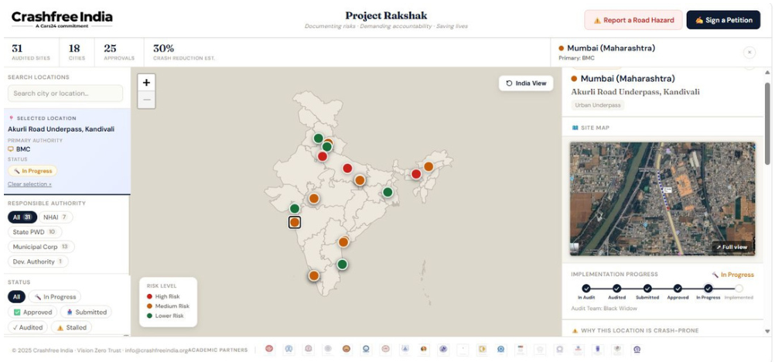
OUR TECHNOLOGY
We build serious public technology — and keep it open
Self-updating platforms that make road-safety work transparent, measurable and usable by government.
Rakshak accountability portal — rakshak.crashfreeindia.org — submission → committee ratification → completion
SATARK enforcement platform — ANPR + national vehicle records, officer app and public compliance billboards
Aasha — 24/7 multilingual AI guide for crash victims, on WhatsApp and voice
Compensation Calculator — Free estimates on Supreme Court principles (Sarla Verma, Pranay Sethi)
Project Rakshak public dashboard — every site, authority and status visible.
National crash data dashboard — MoRTH statistics productised: report cards for 36 states, 50 cities
Road defect repository — AI reads local news in 13 languages across 146 districts; hazards mapped publicly
Crashfree India · NRSB Working Group 2 Application
4 / 20

Slide 5
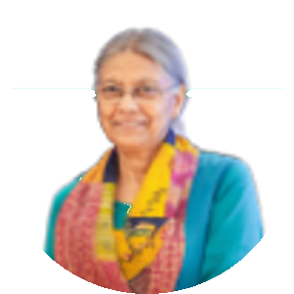
OUR PEOPLE
Academic leadership, senior advisors and a multidisciplinary team
Prof. Geetam Tiwari
PT
Piyush Tewari
Emeritus Professor & Chair, TRIP Centre, IIT Delhi · Member, IRC H-7 Committee on Road Safety Audit
Founder & CEO, SaveLIFE Foundation · Architect of the Good Samaritan Law
BOARD OF ADVISORS
Guided also by Dr. Richa Ahuja (IIT Kharagpur) and an expert network spanning CSIR-CRRI, IRF India, CoERS IIT Madras, IISc, IIT Bombay, IIT Roorkee, IIT Kanpur and the Schools of Planning & Architecture.
Trustees
Amar Srivastava (Founder, Indian Road Safety Council) · Deepanshu Gupta (Founder, IRSC) · Gajendra Jangid (Co-founder, Cars24)
Full-time team
Educated at IIT Delhi, NALSAR & Delhi University (law), TISS (development studies), HKUST — experience across engineering, law, policy, psychology and product
Field strength
75+ road-engineering interns and 31 student audit teams across 18 cities
Goodwill Ambassador
MS Dhoni — voice for youth participation and safer school zones
Crashfree India · NRSB Working Group 2 Application
5 / 20

Slide 6
WORKING GROUP 2
The mandate, and where we align
Safe roads, speed management and the protection of vulnerable road users.
Road design
Black spots
Speed limits
School zones
Pedestrians
Cyclists
Black-spot rectification
31 sites audited in year one — 11 official blackspots among them — with 25+ authority approvals and 15 implementations underway.
Road design to standard
Every audit anchored in IRC codes and MoRTH checklists, guided by a member of the IRC H-7 Committee on Road Safety Audit.
Speed & school zones
Speed-calming measures in approved designs; college-led school-zone screening under exploration.
Vulnerable road users
Dedicated research on two-wheeler and gig-rider risk — the largest VRU category — plus pedestrian-first audit findings.
Crashfree India · NRSB Working Group 2 Application
6 / 20

Slide 7


THE OPPORTUNITY
Identification has outpaced rectification — capacity is the constraint
The knowledge exists; the pipeline that turns identified risk into completed engineering needs more hands, and better tracking.
13,795
5,036
44
black spots identified nationally (MoRTH)
permanently rectified so far (Parliamentary Standing Committee, 2024)
certified Road Safety Auditors on the national registry (July 2026)
Low-cost engineering measures — raised crossings, traffic calming, lighting, safer intersections — reduce crashes by 20–80% (IRF conference, Prof. Geetam Tiwari).
Roughly 80% of crashes are attributed to 'human error', yet outcomes are shaped most by the road environment people operate in — which is fixable by design.
Project Rakshak was designed for precisely this constraint: trained, supervised auditing capacity that supports road-owning agencies — and tracks every fix to completion.
Crashfree India · NRSB Working Group 2 Application
7 / 20

Slide 8



PROJECT RAKSHAK
A structured, standards-based audit programme
Conceptualised and guided by Prof. Geetam Tiwari (TRIP Centre, IIT Delhi) and Dr. Richa Ahuja (IIT Kharagpur).
Phase 1 · Jul–Aug
Phase 2 · Aug–Sep
Phase 3 · Oct–Nov
Phase 4 · Nov onwards
Research & problem identification
Stakeholder engagement & audits
Analysis & solution development
Reporting & authority engagement
Crash data, FIRs, RTIs, police records, site mapping
Structured surveys; audits against IRC / MoRTH standards
Benchmarking, costed intervention design
Consolidated reports to municipal bodies, PWDs, police
Teams train under expert masterclasses (Prof. Tiwari on the Safe System approach; Dr. S. Velmurugan, CSIR-CRRI, on the 5Es and IRC-131).
Every recommendation is presented to the road-owning authority in its own format — and tracked publicly after submission.
Crashfree India · NRSB Working Group 2 Application
8 / 20

Slide 9
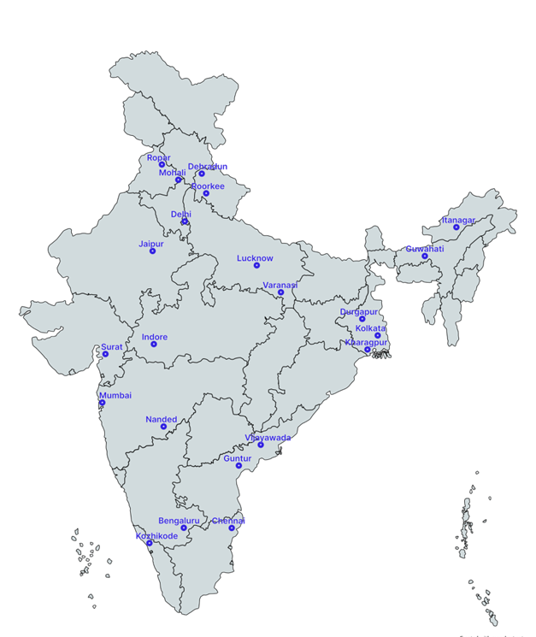
PROJECT RAKSHAK · YEAR ONE
Cohort 1: a national footprint in the first year
120+
31
25+
15
locations screened
sites audited (11 official black spots)
authority approvals
implementations underway
31 student teams · 20 institutions including nine IITs · 900+ stakeholder surveys · guided by 8 mentors and independent evaluators
North: Ropar, Dehradun, Roorkee, Delhi · Uttar Pradesh: Lucknow, Varanasi · East: Guwahati, Durgapur · West & Central: Surat, Indore, Mumbai, Nanded · South: Vijayawada, Guntur, Kozhikode, Chennai — among others.
Example: Tejaji Nagar Junction, Indore — an official black spot; redesign approved by CPWD and the Additional Collector's office.
Crashfree India · NRSB Working Group 2 Application
9 / 20

Slide 10
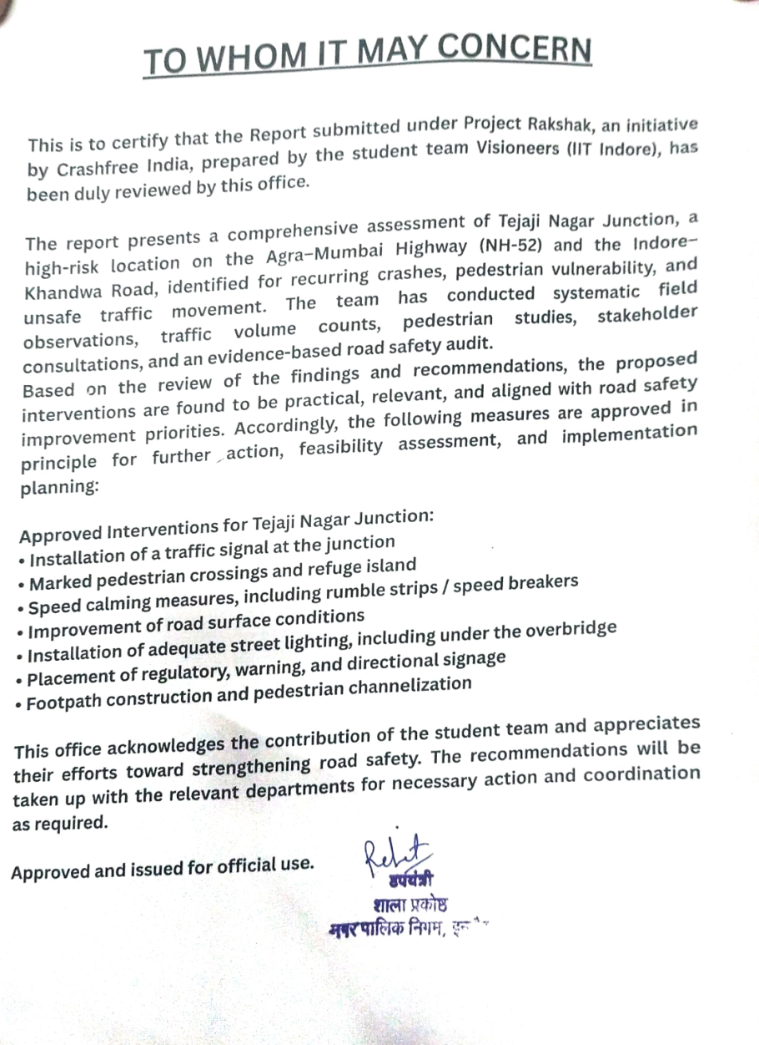
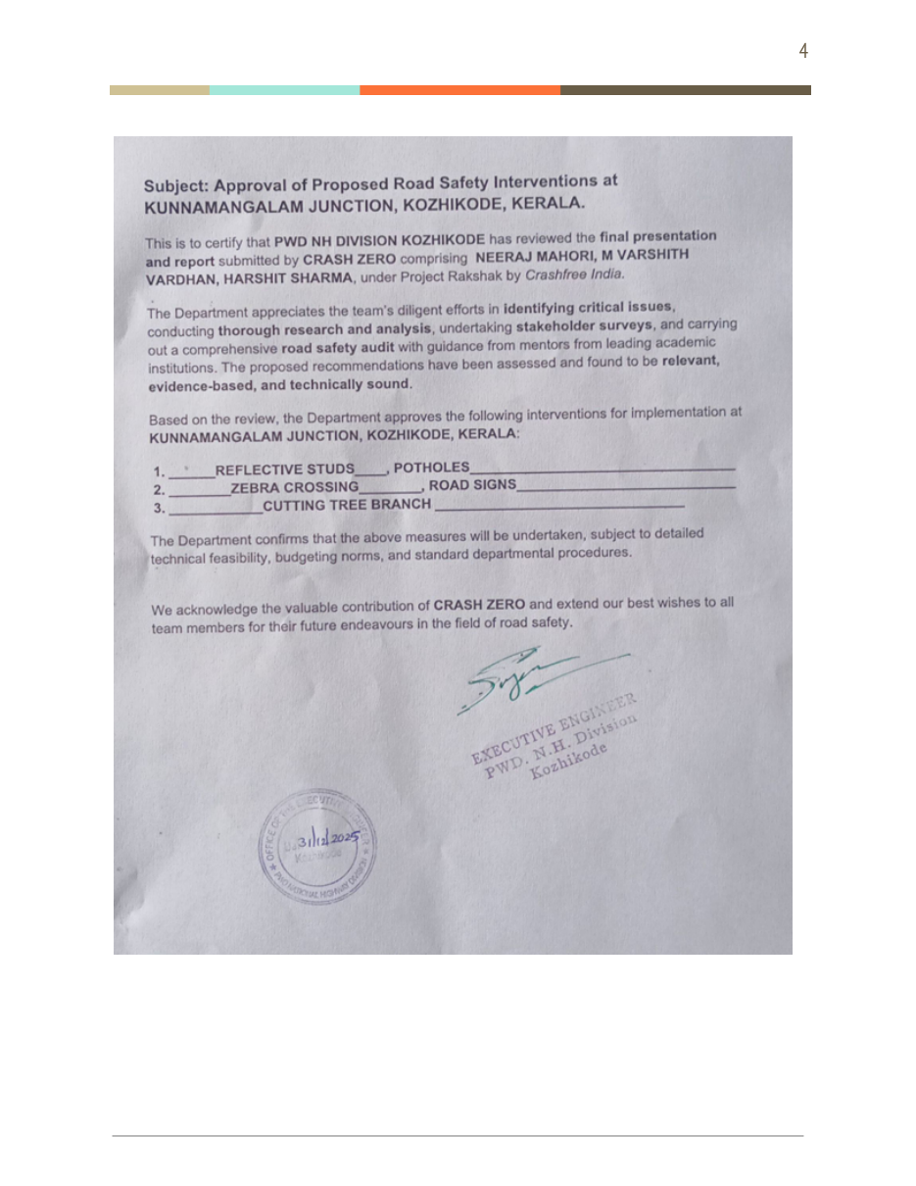
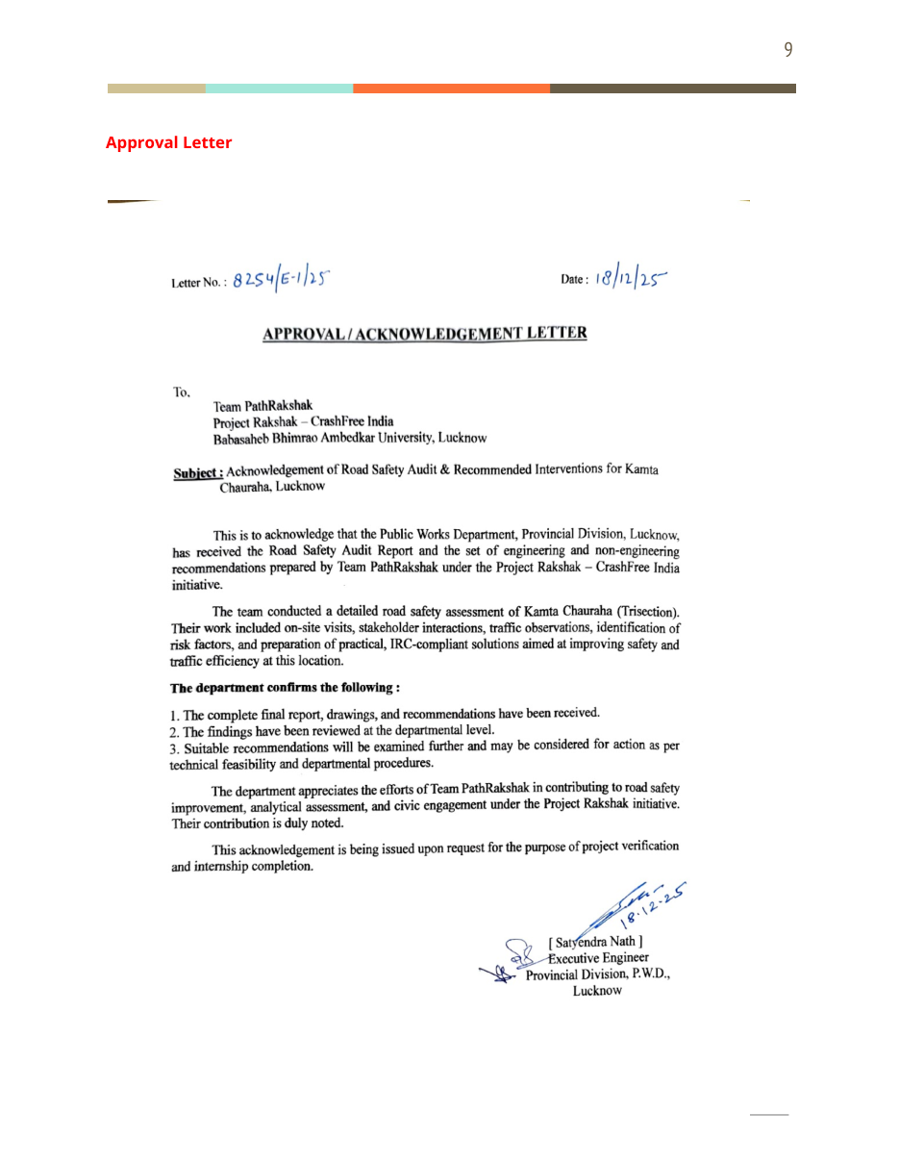
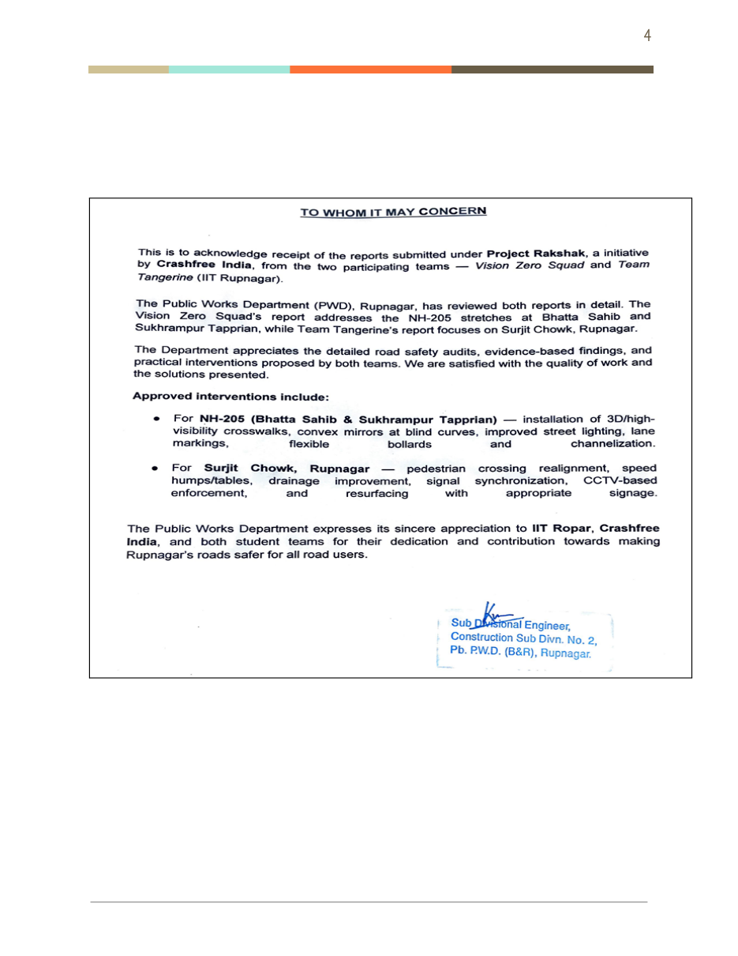
PROJECT RAKSHAK · THE PAPER TRAIL
Authority approvals, in writing
A sample of the 25+ approval and acknowledgement letters issued by public works and district authorities.
Tejaji Nagar, Indore
Kozhikode — PWD Kerala
Lucknow — PWD (UP)
Ropar — PWD (Punjab)
Approving authorities include PWD Kerala, PWD Uttar Pradesh, PWD Punjab, CPWD & the Additional Collector (Indore), ADDA Durgapur, R&B Andhra Pradesh and GCC Chennai.
Crashfree India · NRSB Working Group 2 Application
10 / 20

Slide 11
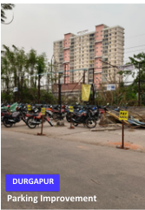
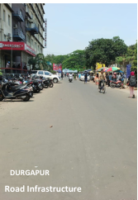
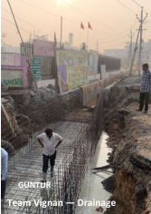
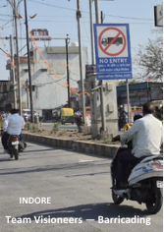
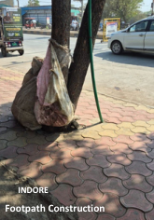
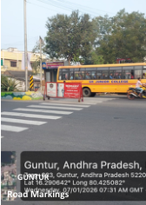
PROJECT RAKSHAK · ON THE GROUND
From approval to construction: implementations under way
Parking, drainage, road markings, signage, footpaths and barricading — city by city.
Parking — Durgapur
Road works — Durgapur
Drainage — Guntur
Barricading — Indore
Footpath — Indore
Markings — Guntur
Estimated 20–50% crash reduction at treated sites once complete, based on WHO / iRAP evidence for these counter-measures — to be verified with before/after data.
Crashfree India · NRSB Working Group 2 Application
11 / 20

Slide 12
PROJECT RAKSHAK · TRANSPARENCY
A public portal that tracks every site to completion
The design principle: transparency, not repeated follow-up, is what moves a recommendation from acknowledgement to action.
Every site tracked — From submission through DRSC ratification to engineering completion — regardless of who audited it.
The PRAGATI parallel — The PMO's PRAGATI platform resolved 7,150+ of ~7,700 flagged issues across ₹85 lakh crore of projects — public, real-time review works at national scale.
What the Board gains — A live, honest read on how quickly road-owning agencies can act — evidence for capacity planning, not just compliance.
rakshak.crashfreeindia.org — live public accountability portal.
Crashfree India · NRSB Working Group 2 Application
12 / 20

Slide 13

PROJECT RAKSHAK · SCALING
Why this model scales: three tracks, one standard
Cohort 2 matches each road type to the right auditing capacity — reserving scarce certified auditors for the most complex sites.
Track
Road type
Implementing authority
Who audits
A — Institutional
Urban arterials, in-town state highways, district roads
ULB, State / District PWD
IIT / NIT / SPA teams under expert mentors, IRC-aligned rubric
B — NGO partners
District & peri-urban corridors
District PWD, ULB
NGO field teams; desk-reviewed, share re-verified by CFI
C — Certified RSAs
National Highways, complex junctions
NHAI Project Director, State PWD
CSIR-CRRI-certified auditors; full IRC SP:88; usable by NHAI without rework
Site selection in Cohort 2 is anchored to locations that district administrations, DRSCs and road-owning agencies have themselves flagged as priorities.
Crashfree India · NRSB Working Group 2 Application
13 / 20

Slide 14

PROJECT RAKSHAK · THE LONG VIEW
Built to be institutionalised — not to depend on us
Our role narrows over time to standard-setter and platform steward; the ecosystem runs the audits.
Today
CFI runs cohorts, quality-controls audits and stewards the public portal
Next
Rakshak Audit Manual v1.0 codifies the method; universities field their own teams; NGOs run Track B directly
Mature state
States engage certified RSAs for Track C without CFI as intermediary; the portal remains the shared public record
The same standards-anchored approach is being explored for school-zone safety — college-led screening under the same public-tracking discipline.
Crashfree India · NRSB Working Group 2 Application
14 / 20

Slide 15
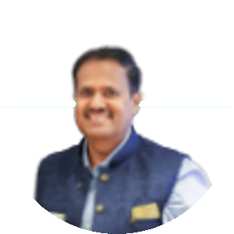
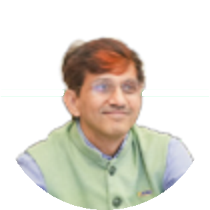
OUR NETWORK
The technical bench behind the audits
Mentors, evaluators and forum experts who review and strengthen every cohort's work.
Prof. Geetam Tiwari
RA
Dr. Richa Ahuja
SV
Dr. S. Velmurugan
TRIP Centre, IIT Delhi · IRC H-7
IIT Kharagpur
Chief Scientist, CSIR-CRRI
Akhilesh Srivastava
AM
Dr. A. M. Rao
Rama Shankar Pandey
President, IRF India
Chief Scientist, CSIR-CRRI
FICCI Road Safety Roundtable
AV
Prof. Ashish Verma
SC
Prof. Satish Chandra
GR
Prof. Gopal R. Patil
IISc Bengaluru
IIT Roorkee
IIT Bombay
Plus mentors and evaluators from KPMG, EY, CTRANS, SVNIT Surat, SPA Vijayawada & Bhopal, IIT Mandi, Vignan's University and the TRIP Centre — and forum participation from MoRTH, WHO, UNICEF, WRI, IFFCO Tokio, district administrations and traffic police leadership.
This bench is available to the Working Group for drafting, review and technical input on road design, speed and VRU standards.
Crashfree India · NRSB Working Group 2 Application
15 / 20

Slide 16

THE TALENT PIPELINE
Youth mobilisation that keeps the model supplied
Scaling audits needs a steady flow of trained, motivated young engineers and planners — we have built that funnel.
700+
250+
37
10
ideathon registrations (IITs, IIMs, NLUs)
policy concept notes
teams mentored
finalists judged by 24 experts
NextMile (2025), our national road-safety policy ideathon, closed at India Habitat Centre with a jury including Justice J.R. Midha and former MoRTH leadership.
Winning tracks — blackspot identification, speed management, delivery-rider safety — feed directly into our audit and research pipeline.
Next: 'Be a Rakshak' university chapters at IITs, NITs and SPAs, with MS Dhoni as the recruiting voice — a self-renewing national audit corps.
Crashfree India · NRSB Working Group 2 Application
16 / 20

Slide 17


VULNERABLE ROAD USERS
A growing evidence base on those most at risk
Two-wheeler riders and pedestrians carry most of the burden — our research follows them specifically.
Gig & delivery riders
'When Risks Become Routine' (Feb 2026): incentive pressure, helmet compliance, training gaps and data fragmentation — now being quantified through a 300-rider study across Delhi NCR.
Pedestrian-first audits
Rakshak audits document crossings, footpaths and lighting as designable protections — 900+ stakeholder surveys included road users themselves.
School zones
College-led, standards-based school-zone screening under exploration as the next extension of the audit platform.
Enforcement that protects VRUs
SATARK helps police prioritise the small share of vehicles with the worst records — targeted, fair and technology-led.
Crashfree India · NRSB Working Group 2 Application
17 / 20

Slide 18
OUR CONTRIBUTION
Four concrete contributions to Working Group 2
1
Ready evidence for standard-setting
Site-level audit data, crash-pattern analysis and intervention designs across emerging hotspots and official black spots — a working evidence base for rectification protocols and speed-management guidance.
2
A live testing ground
Active district relationships in Gurugram, South-West Delhi and Jaipur offer a ready pipeline to pilot or stress-test draft recommendations before national rollout.
3
Ground-level implementation diagnostics
Granular, field-verified insight into how DRSCs function — meeting cadence, data use, follow-through — to inform the Group's governance recommendations.
4
Technical bench strength on request
Our academic and expert network stands ready for drafting, review and technical input on road design, speed and VRU standards.
Crashfree India · NRSB Working Group 2 Application
18 / 20

Slide 19
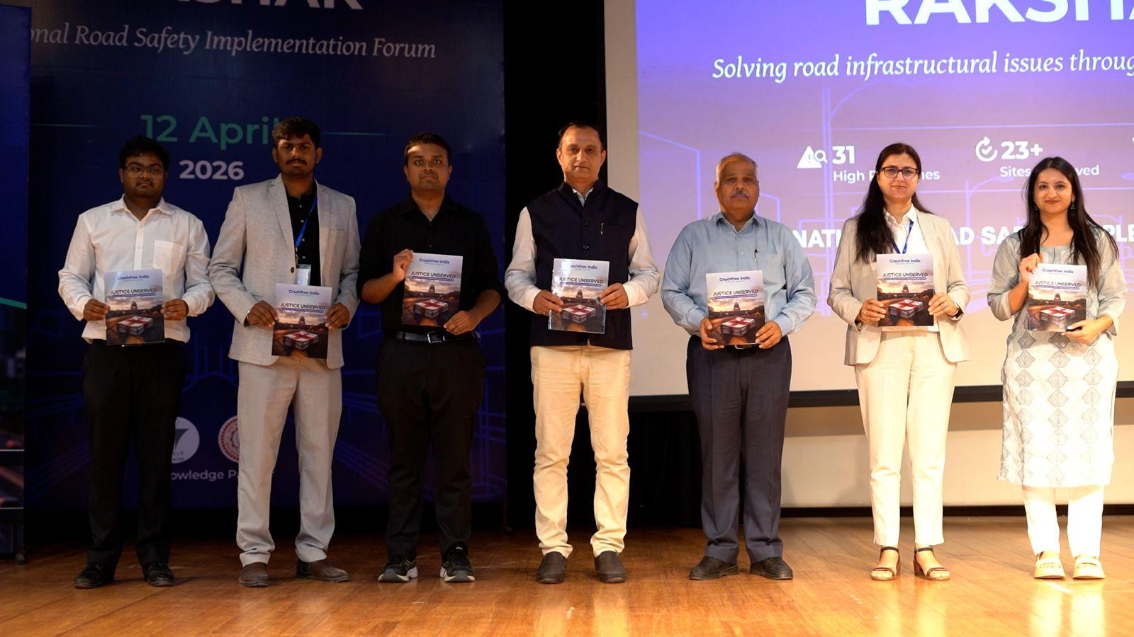
RECOGNITION
A young organisation the ecosystem already engages with
National forum at IIT Delhi — 60+ experts; MoRTH, WHO, UNICEF, IRF and CSIR-CRRI participation; hosted with the TRIP Centre
MS Dhoni, Goodwill Ambassador — announced at the forum; covered by Business Standard, The Tribune and The Wire
Research in national press — 'Justice Unserved' covered by Deccan Herald, Economic Times, Fortune India, IndiaSpend, Moneycontrol, Scroll.in and The Wire
National Road Safety Implementation Forum, IIT Delhi — April 2026.
Government partnerships — MoUs with Jaipur Traffic Police & Gurugram Police; formal tasking by the South-West Delhi DRSC; Rajasthan Transport Department engagement
Crashfree India · NRSB Working Group 2 Application
19 / 20

Slide 20




We would be honoured to contribute to
Working Group 2.
Our evidence, our district relationships, our technology and our expert network are available to the Board — in whichever form is most useful.
crashfreeindia.org
helpdesk@crashfreeindia.org
Live portal: rakshak.crashfreeindia.org
Crashfree India · A Cars24 Commitment · operated by Vision Zero Trust, New Delhi

