Slide 1

Expression of Interest
Working Group 5:
Post-Crash Care, Policy Standards & State Implementation
Submitted to the National Road Safety Board
by Crashfree India (Vision Zero Trust) · August 2026
1M+ people reached
18 cities
25+ authority approvals
4 district committees
crashfreeindia.org · helpdesk@crashfreeindia.org

Slide 2




ABOUT US
Crashfree India: a nonprofit working for safer roads
Registered as Vision Zero Trust. Co-founded by Cars24 and the Indian Road Safety Council, June 2025. We follow the global Vision Zero principle: no loss of life on the road is acceptable.
Evidence first
Structured field audits, file reviews and research to official standards — not opinion.
Institutional collaboration
We work through PWDs, NHAI, transport departments, police and District Road Safety Committees.
Youth-led capacity
Trained student teams from IITs, NITs and SPAs add auditing hands the system needs.
Technology for follow-through
Public dashboards track every recommendation from submission to completion.
Backed by a US$3 million, three-year commitment from Cars24 — with programmes, not overheads, receiving 71% of the budget.
Crashfree India · NRSB Working Group 5 Application
2 / 19

Slide 3




OUR WORK
One year of work across four connected areas
Each area strengthens the others — audits create data, data supports policy, policy guides the field.
Project Rakshak
SATARK & enforcement technology
Youth-led road safety audits to IRC / MoRTH standards; 31 sites, 25+ approvals, 15 implementations underway.
AI number-plate platform built with traffic police — 3,00,000+ vehicles screened in Jaipur & Bengaluru.
Post-crash support & compensation
Open data & public education
'Justice Unserved' research, Aasha chatbot, hospital helpdesks, district committee integration, Rajasthan portal design.
Four public data platforms; comics, Hindi guides and a pre-hospital care primer.
Crashfree India · NRSB Working Group 5 Application
3 / 19

Slide 4
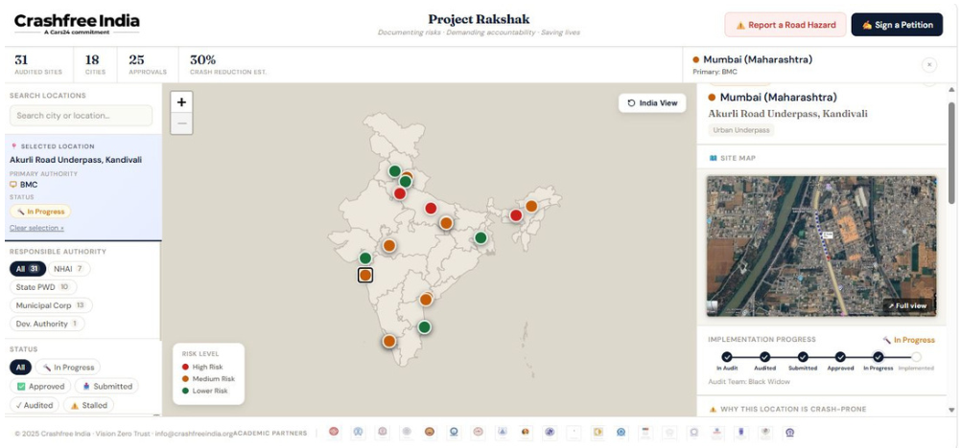
OUR TECHNOLOGY
We build serious public technology — and keep it open
Self-updating platforms that make road-safety work transparent, measurable and usable by government.
Rakshak accountability portal — rakshak.crashfreeindia.org — submission → committee ratification → completion
SATARK enforcement platform — ANPR + national vehicle records, officer app and public compliance billboards
Aasha — 24/7 multilingual AI guide for crash victims, on WhatsApp and voice
Compensation Calculator — Free estimates on Supreme Court principles (Sarla Verma, Pranay Sethi)
Project Rakshak public dashboard — every site, authority and status visible.
National crash data dashboard — MoRTH statistics productised: report cards for 36 states, 50 cities
Road defect repository — AI reads local news in 13 languages across 146 districts; hazards mapped publicly
Crashfree India · NRSB Working Group 5 Application
4 / 19

Slide 5
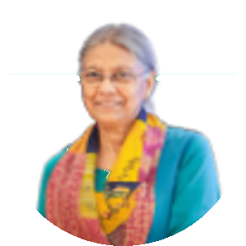
OUR PEOPLE
Academic leadership, senior advisors and a multidisciplinary team
Prof. Geetam Tiwari
PT
Piyush Tewari
Emeritus Professor & Chair, TRIP Centre, IIT Delhi · Member, IRC H-7 Committee on Road Safety Audit
Founder & CEO, SaveLIFE Foundation · Architect of the Good Samaritan Law
BOARD OF ADVISORS
Guided also by Dr. Richa Ahuja (IIT Kharagpur) and an expert network spanning CSIR-CRRI, IRF India, CoERS IIT Madras, IISc, IIT Bombay, IIT Roorkee, IIT Kanpur and the Schools of Planning & Architecture.
Trustees
Amar Srivastava (Founder, Indian Road Safety Council) · Deepanshu Gupta (Founder, IRSC) · Gajendra Jangid (Co-founder, Cars24)
Full-time team
Educated at IIT Delhi, NALSAR & Delhi University (law), TISS (development studies), HKUST — experience across engineering, law, policy, psychology and product
Field strength
75+ road-engineering interns and 31 student audit teams across 18 cities
Goodwill Ambassador
MS Dhoni — voice for youth participation and safer school zones
Crashfree India · NRSB Working Group 5 Application
5 / 19

Slide 6
WORKING GROUP 5
The mandate, and where we align
Post-crash care, policy standards and state implementation.
EMS
Trauma care
Laws
Standards catalogue
State support
District toolkit
Compensation delivery
'Justice Unserved' research; file-level audits with districts; claim-pipeline rebuild with the Rajasthan Transport Department.
District machinery
Working inside four District Road Safety Committees — formally tasked by the South-West Delhi DRSC; a fellow embedded with Gurugram district offices.
Victim-facing standards
Aasha chatbot, Compensation Calculator on Supreme Court principles, plain-language Hindi guides and hospital helpdesks.
Emergency response
A Pre-Hospital Care Primer benchmarking India's golden-hour response against global standards, with state innovations documented.
Crashfree India · NRSB Working Group 5 Application
6 / 19

Slide 7
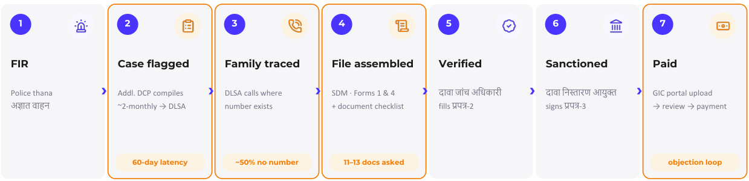
THE STARTING POINT
A family experiences many institutions — not one programme
Hospitals, police, district offices, enquiry officers, insurers, legal-services bodies and tribunals each do their part; the journey across them is what we work to simplify.
The hit-and-run claim journey as we mapped it with officials in Jaipur — seven stages across six institutions.
Our work: make each hand-off visible, guide the family at every stage, and give administrators the dashboards to see where files wait.
Crashfree India · NRSB Working Group 5 Application
7 / 19

Slide 8
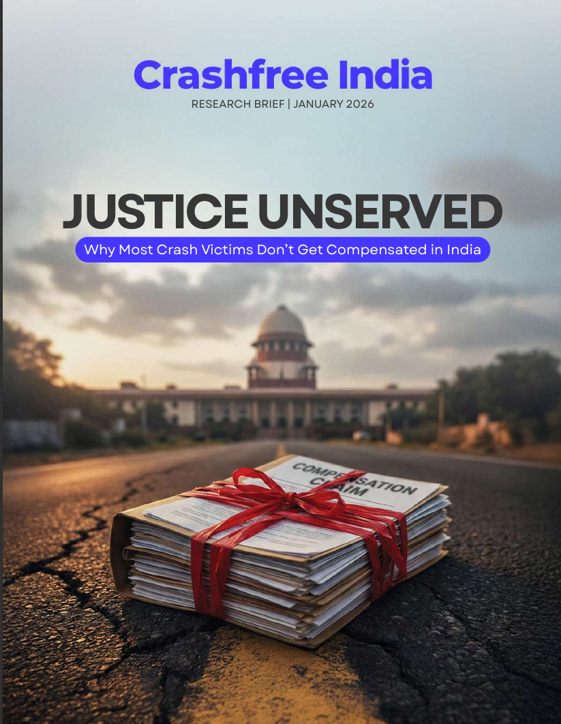
OUR RESEARCH FOUNDATION
'Justice Unserved' — the evidence base we built first
Published January 2026 · launched at IIT Delhi · findings presented to MoRTH · cited by national press.
Awareness — 70% of low-income families are unaware compensation exists
Timeliness — 3.6-year average claim; MACT cases often run 8–10 years
Documentation — 90% of pending hit-and-run claims stall on documents alone
Adequacy — Informal workers valued at minimum wage until courts enhance
Equity — 14% of low-income households compensated vs 24% of high-income
Headline finding: only 205 hit-and-run claims were filed in FY22-23 against ~25,000 eligible crashes. The scheme is sound — the pipeline to it needs support.
Crashfree India · NRSB Working Group 5 Application
8 / 19

Slide 9



FROM RESEARCH TO DISTRICTS
Working inside the district machinery
We took the research to where claims actually move: District Road Safety Committees and district offices.
Four DRSCs joined
Gurugram, South-West Delhi, North-West Delhi and Jaipur — with formal MoUs with Jaipur Traffic Police and Gurugram Police.
File-level understanding
With Gurugram's administration, we reviewed 102 hit-and-run files from 2022 onwards — mapping exactly where eligible families drop out.
Formally tasked
The South-West Delhi DRSC's signed minutes task Crashfree India with digitisation and analytics support for scheme files.
Embedded presence
A research fellow placed with Gurugram district offices — implementation support, not external commentary.
This is district-toolkit experience in practice — the working knowledge WG-5's state-implementation mandate needs.
Crashfree India · NRSB Working Group 5 Application
9 / 19

Slide 10
STATE ENGAGEMENT
With Rajasthan: from mapping to a working template
Supporting the state Lead Agency and Transport Department on the Hit-and-Run Compensation Scheme.
Ground mapping first
Consultations across every office a claim touches in Jaipur — police thanas, DLSA, ADM office, SDM cell, DM and GIC.
What the data showed
Jaipur alone delivers roughly half of Rajasthan's hit-and-run claims (~180 of ~395 in 2025) — active outreach and a single coordination cell explain the difference.
Findings shared as asks
Document standard (7 court-agreed items vs 11–13 demanded), family traceability, stage-wise SLAs and five clarification queries prepared for GIC.
Portal design
A guided-filing, stage-visible case-management portal for the scheme — designed so no stakeholder changes their medium, and officials retain every decision.
Crashfree India · NRSB Working Group 5 Application
10 / 19

Slide 11

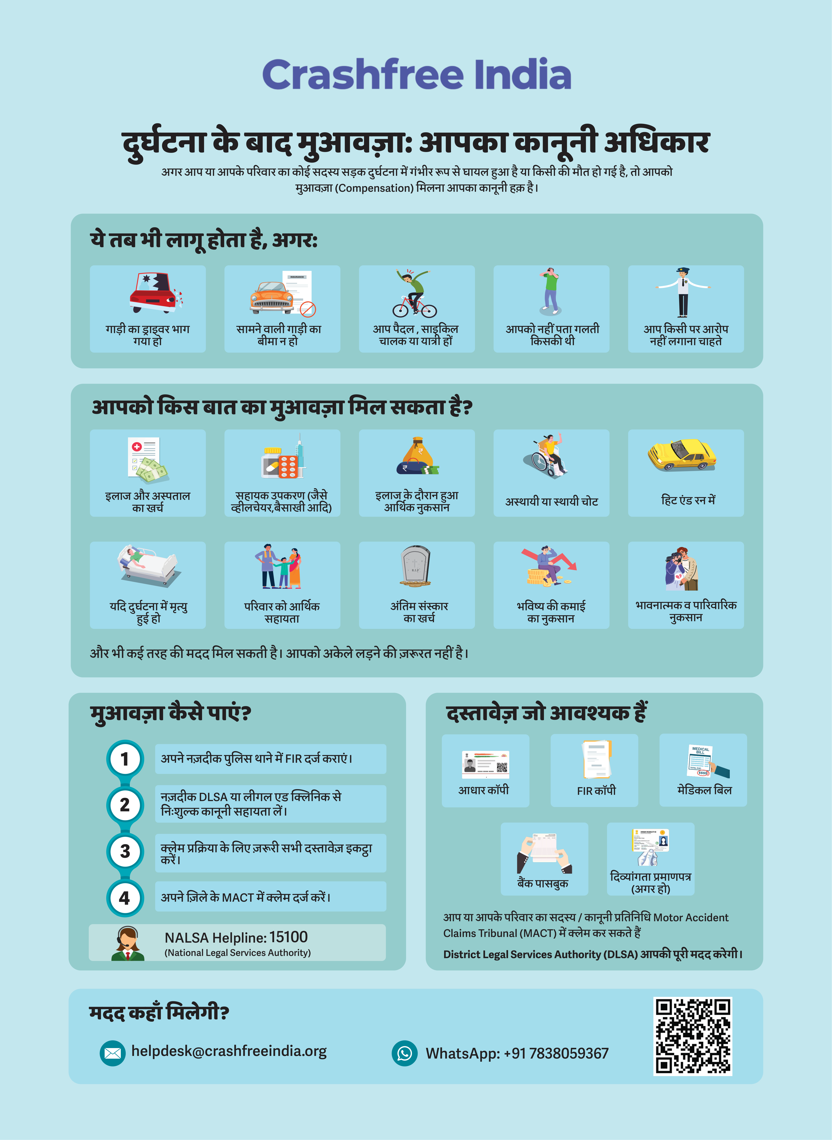


VICTIM-FACING TOOLS
Aasha and the tools that guide families through the process
Built so that a family's first hours after a crash come with clear, correct guidance — in their language.
Aasha
India's first 24/7 multilingual AI companion for crash victims — step-by-step guidance on rights, schemes and documents, on WhatsApp and voice.
Compensation Calculator
Free, instant estimates based on Supreme Court principles (Sarla Verma, Pranay Sethi) — strengthening families' position.
Hospital helpdesks
Legal helpdesks in trauma wards — 100+ victims supported in the first four days of operation.
Plain-language education
Comics ('Know Your Rights with Aasha') and Hindi guides covering all three compensation routes, NALSA 15100 and the Cashless Treatment Scheme 2025.
Hindi legal-rights guide — hospitals & police stations.
Crashfree India · NRSB Working Group 5 Application
11 / 19

Slide 12




EMERGENCY RESPONSE
The Pre-Hospital Care Primer: our EMS evidence line
Published September 2025 — benchmarking India's golden-hour response and documenting what states are getting right.
The response gap, measured
ERSS-112 is live in all 36 states and UTs, yet highway ambulance arrival averages 25–35 minutes; the full episode runs 55–75 minutes against a 60-minute global benchmark.
State innovations documented
Maharashtra's MEMS centralised dispatch across 937 ambulances; Tamil Nadu's TAEI model — pre-arrival alerts, trauma registries, automated triage — improving district response times.
Good Samaritan awareness
Bystander protections and the Cashless Treatment Scheme 2025 (₹1.5 lakh / 7 days) explained in our public guides — the demand side of trauma care.
Where this serves WG-5
A ready, referenced baseline for the Group's EMS and trauma-care standards discussions — with state models already compared.
Crashfree India · NRSB Working Group 5 Application
12 / 19

Slide 13
TECHNOLOGY, CAREFULLY
Design principles for public post-crash systems
What we have learned building for the compensation pipeline — offered as reusable standards for any state.
No stakeholder changes their medium
Families use WhatsApp and calls; officials keep their existing files and formats — the system adapts to them, not the reverse.
Officials retain every decision
Technology flags, reminds and organises; sanctioning and verification stay entirely with the designated authorities.
Traceability before automation
Phase 1 simply makes every file findable and every stage visible — the single largest lever we observed.
Single-pass clarification
Objections batched and resolved once, not loops that reset the clock for a family.
Evidence for administrators
Dashboards reveal where files wait, which documents fail and where outreach is needed — reform guided by data.
Crashfree India · NRSB Working Group 5 Application
13 / 19

Slide 14
THE PIPELINE, MEASURED
The numbers WG-5's standards can move
Specialist figures from our research and file work — each one a lever the Group's standards and toolkits can act on.
205 vs ~25,000
921 of 1,026
~60 days
hit-and-run claims filed vs eligible crashes (FY22-23)
pending claims stalled on documentation alone (Jul 2024)
intake latency where claim surfacing waits for bi-monthly meetings
~50%
7 vs 11–13
FY23-24: 12%
of FIRs lack a usable family phone number — traceability is the first lever
court-agreed documents vs documents demanded in practice
of eligible crashes converted to filed claims — improving, far from done
None of these require new legislation. Each responds to a standard, a toolkit entry or a communication norm — exactly what WG-5 exists to produce.
Crashfree India · NRSB Working Group 5 Application
14 / 19

Slide 15


THE WIDER ECOSYSTEM
We already work with the claim's other side
Compensation standards only work if insurers, tribunals and legal-services institutions are in the room — we engage all three.
GIC & insurers
Five clarification queries prepared for GIC on MACT-affidavit objections; consultations with IFFCO Tokio and New India Assurance on settlement practice.
Tribunal & legal practice
Guidance from Justice J. R. Midha (Retd., Delhi High Court), architect of the FastDAR process; working partners across MACT courts and DLSAs.
Right-to-information evidence
22+ RTIs filed on scheme performance (12 answered) — building the public record that standards work needs.
Victim-side ground truth
120+ victim and family interactions; 300+ citizens reached through awareness sessions; 30+ expert consultations.
Crashfree India · NRSB Working Group 5 Application
15 / 19

Slide 16


WHY OUR TEAM FITS
Post-crash care needs more than one discipline
A legally sound framework can still be hard to use; a good portal can still miss district workflows. Our team is built across that whole chain.
Law & policy
Technology & product
Field & development practice
Behaviour & communication
NALSAR and Delhi University-trained; scheme analysis, RTIs, MoRTH engagement
IIT-trained; Aasha, calculator, dashboards and portal architecture
TISS-trained; victim interviews, district engagement, DRSC work
Psychology and design; guides, comics and multilingual communication
Advised by Piyush Tewari (SaveLIFE Foundation), Prof. Geetam Tiwari (IIT Delhi) and Justice J. R. Midha (Retd., Delhi High Court — architect of the FastDAR process), with practitioner partners across MACT courts, DLSAs and insurers.
Crashfree India · NRSB Working Group 5 Application
16 / 19

Slide 17
OUR CONTRIBUTION
Four concrete contributions to Working Group 5
1
A victim-side evidence base
'Justice Unserved', 120+ victim and family interactions, and file-level audit data showing precisely where eligible families drop out of the process.
2
A district toolkit, drawn from practice
Working DRSC integration experience — agendas, file digitisation, fellow placement — ready to be codified into the Group's district toolkit.
3
A reusable state portal blueprint
The Rajasthan case-management design — guided filing, stage-wise visibility, single-pass clarification — offered as a template any state can adapt.
4
Standards input from the claimant's side
Document standards (the court-agreed 7), communication standards and timeline benchmarks, grounded in what families actually experience.
Crashfree India · NRSB Working Group 5 Application
17 / 19

Slide 18
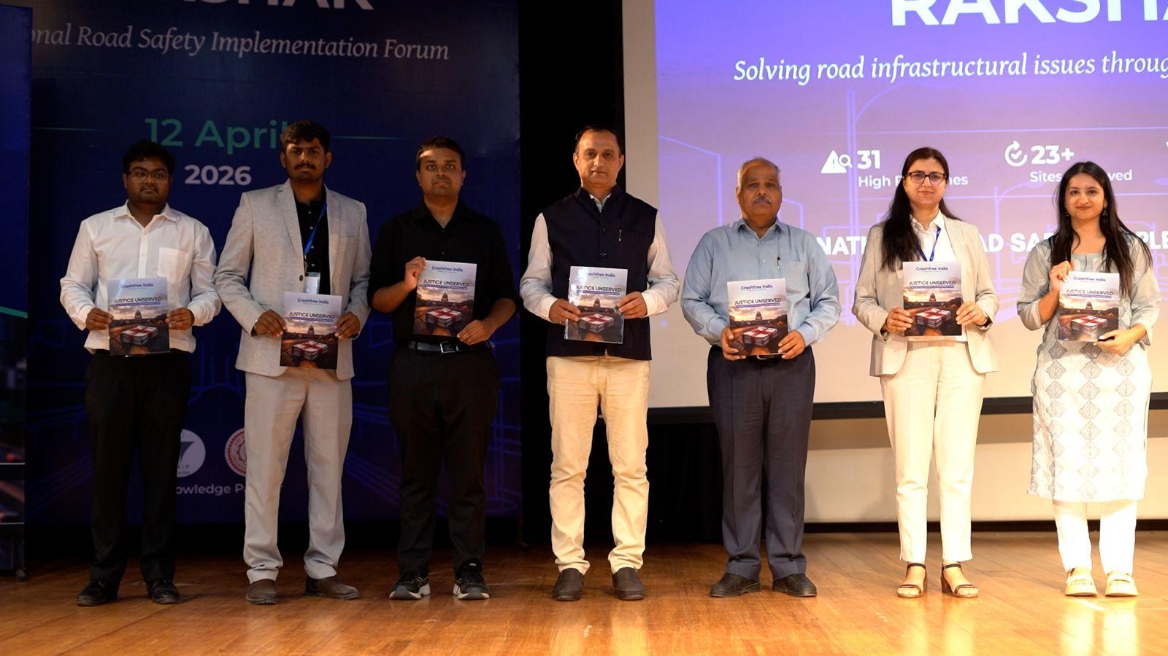
RECOGNITION
A young organisation the ecosystem already engages with
National forum at IIT Delhi — 60+ experts; MoRTH, WHO, UNICEF, IRF and CSIR-CRRI participation; hosted with the TRIP Centre
MS Dhoni, Goodwill Ambassador — announced at the forum; covered by Business Standard, The Tribune and The Wire
Research in national press — 'Justice Unserved' covered by Deccan Herald, Economic Times, Fortune India, IndiaSpend, Moneycontrol, Scroll.in and The Wire
National Road Safety Implementation Forum, IIT Delhi — April 2026.
Government partnerships — MoUs with Jaipur Traffic Police & Gurugram Police; formal tasking by the South-West Delhi DRSC; Rajasthan Transport Department engagement
Crashfree India · NRSB Working Group 5 Application
18 / 19

Slide 19




We would be honoured to contribute to
Working Group 5.
Our evidence, our district relationships, our technology and our expert network are available to the Board — in whichever form is most useful.
crashfreeindia.org
helpdesk@crashfreeindia.org
Live portal: rakshak.crashfreeindia.org
Crashfree India · A Cars24 Commitment · operated by Vision Zero Trust, New Delhi

