Slide 1

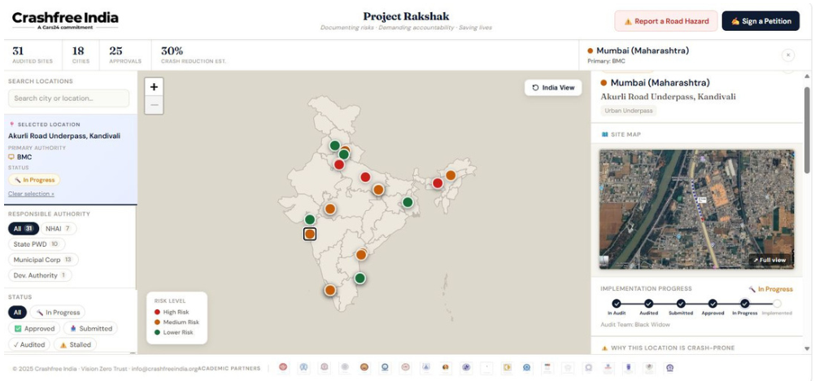
I
THE PROBLEM
II
WHO WE ARE
CRASHFREE INDIA · A CARS24 COMMITMENT
Building safer roads for India —
III
WHAT WE DO
audit by audit, fix by fix.
IV
OUR PEOPLE
A nonprofit working alongside government — finding road-safety gaps, getting fixes approved, and staying until they are built.
ROAD INFRASTRUCTURE
ENFORCEMENT TECHNOLOGY
POLICY & VICTIM SUPPORT
YOUTH MOBILISATION
Live: crashfreeindia.org/rakshak/dashboard
Year one: 1M+ people reached · 18 cities · 25+ government approvals · ₹30 Cr+ unpaid challans surfaced
Partner overview · July 2026 · crashfreeindia.org
Goodwill Ambassador: MS Dhoni

Slide 2
THE PROBLEM
India loses 485 lives on its roads every day —
most of them preventable with follow-through.
485
59%
of road deaths involve no traffic violation by the victim — better road design, supported enforcement and faster post-crash care decide who survives.
people killed every single day
66% of victims are aged 18–34 — India's workforce bears the loss
ONE DEATH EVERY 3 MINUTES
1% of world's vehicles, 11% of its road deaths — the gap is systemic
₹80,000 Cr in compensation undelivered — the failure continues after the crash
MoRTH, Road Accidents in India 2024: 1,77,175 deaths
India has strong laws and committed institutions. What they need is more capacity for follow-through — that is the gap we fill.
THE PROBLEM
02 / 25

Slide 3




THE PROBLEM · WHERE WE HELP
Three pendencies we help the system clear.
We studied how India responds to a road death. Departments know the problems — what they need is dedicated hands, tools and follow-through.
01 · ROAD FIXES PENDING
02 · CLAIMS PENDING
03 · RECORDS UNUSED
Audits await execution.
₹80,000 Cr awaits families.
Enforcement lacks live tools.
Hazards are identified and studies filed — stretched departments need help converting reports into built fixes.
10.46 lakh compensation cases pending. Our Gurugram file audit shows where each claim gets stuck — and how to unblock it.
46 crore e-challans on record, ~75% unpaid. Police need technology that turns records into targeted, fair action.
Our role: give the system the hands, tools and follow-through to convert intent into outcomes on the ground.
THE PROBLEM · WHERE WE HELP
03 / 25

Slide 4





WHO WE ARE · ABOUT CRASHFREE INDIA
A partner to the system — with the
hands and tools to finish the job.
A Cars24-backed nonprofit ($3M over 3 years, run by Vision Zero Trust) working with governments towards zero road deaths by 2040.
FOUR PILLARS OF WORK
OUR PHILOSOPHY
Road infrastructure
Road deaths are a solvable systems problem. We work as a support layer to government — auditing on the ground, building tools, and staying with every fix until it is done.
Project Rakshak — audits that end in built fixes
Enforcement technology
SATARK & AI billboards, run with police
AUDIT
ADVOCATE
FOLLOW THROUGH
Policy & victim support
Aasha, compensation research, district committees
1M+
18
25+
₹30 Cr+
Open data & education
people reached
cities
govt approvals
dues surfaced
Public dashboards, comics, guides
Trustees: Amar Srivastava (Founder, IRSC) · Deepanshu Gupta (Founder, IRSC) · Gajendra Jangid (Co-founder, Cars24) Board of Advisors: Piyush Tewari (SaveLIFE Foundation) · Prof. Geetam Tiwari (IIT Delhi)
ABOUT CRASHFREE INDIA
04 / 25

Slide 5





WHO WE ARE · OUR APPROACH
How we work: audit, advocate, and
follow through until the fix is built.
HOW WE STAY FOCUSED
No campaigns without follow-up
AUDIT
ADVOCATE
ACCOUNTABILITY
No event-counting as impact
Find
Name
Unblock
Never duplicating govt's role
Field evidence to IRC / MoRTH standards — blackspots, claim files, enforcement gaps.
Findings published and presented — to district committees, state departments, MoRTH, the press.
Every recommendation tracked in public — from approval to build, from claim to payout.
No reports that end at submission
Every recommendation tracked to implementation.
Institutionally embedded: 4 District Road Safety Committees · MoUs with Jaipur Traffic Police & Gurugram Police · formally tasked by SW Delhi DRSC.
OPERATING MODEL
05 / 25

Slide 6
WHAT WE DO · AT A GLANCE
Four working pillars,
one accountability engine.
Each pillar is explained on the following slides; detailed briefs are in the appendix.
01 · ROAD INFRASTRUCTURE
02 · ENFORCEMENT TECHNOLOGY
Project Rakshak
SATARK & AI billboards
Engineering students audit dangerous roads to official standards; governments approve and build the fixes.
AI reads number plates, checks live records and helps traffic police stop the riskiest vehicles.
25+ approvals · 15 builds begun
₹30 Cr+ dues surfaced · 2 cities live
03 · POLICY & VICTIM SUPPORT
04 · OPEN DATA & EDUCATION
Aasha & compensation reform
Public platforms & guides
Research, victim tools and government partnerships that make legal compensation actually reach families.
Self-updating public data tools plus comics and plain-language guides that make problems impossible to ignore.
100+ victims helped in first 4 days
4 platforms · 36 states covered
WHAT WE DO · OVERVIEW
06 / 25

Slide 7

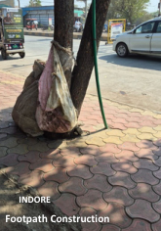
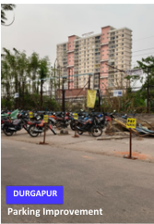

WHAT WE DO · 01 ROAD INFRASTRUCTURE
Project Rakshak — engineering students
audit dangerous roads; governments fix them.
A national programme that mobilises trained student teams to audit high-risk locations to official standards and hand authorities ready-to-build fixes.
WHY THIS
HOW IT WORKS
WHY WE'RE PLACED TO DO IT
Black spots are known and studied — converting reports into built fixes is the bottleneck we remove.
Trained student teams audit to IRC / MoRTH standards and hand authorities ready-to-approve proposals.
A 9-IIT talent pipeline, mentors led by Prof. Geetam Tiwari (IIT Delhi), and a public tracking dashboard.
120+
31
25+
15
The live implementation dashboard — every site, authority and status public.
locations
screened
sites audited ·
11 blackspots
government
approvals
builds
begun
18 cities · 20 institutions incl. 9 IITs · 900+ stakeholder surveys · every site public on the dashboard
Institutionalising the model: Cohort 2 runs three tracks — students, NGO partners, CRRI-certified auditors — building towards the Rakshak Audit Manual v1.0, usable by NHAI without rework.
Footpath — Indore
Parking — Durgapur
WHAT WE DO · PROJECT RAKSHAK
07 / 25

Slide 8
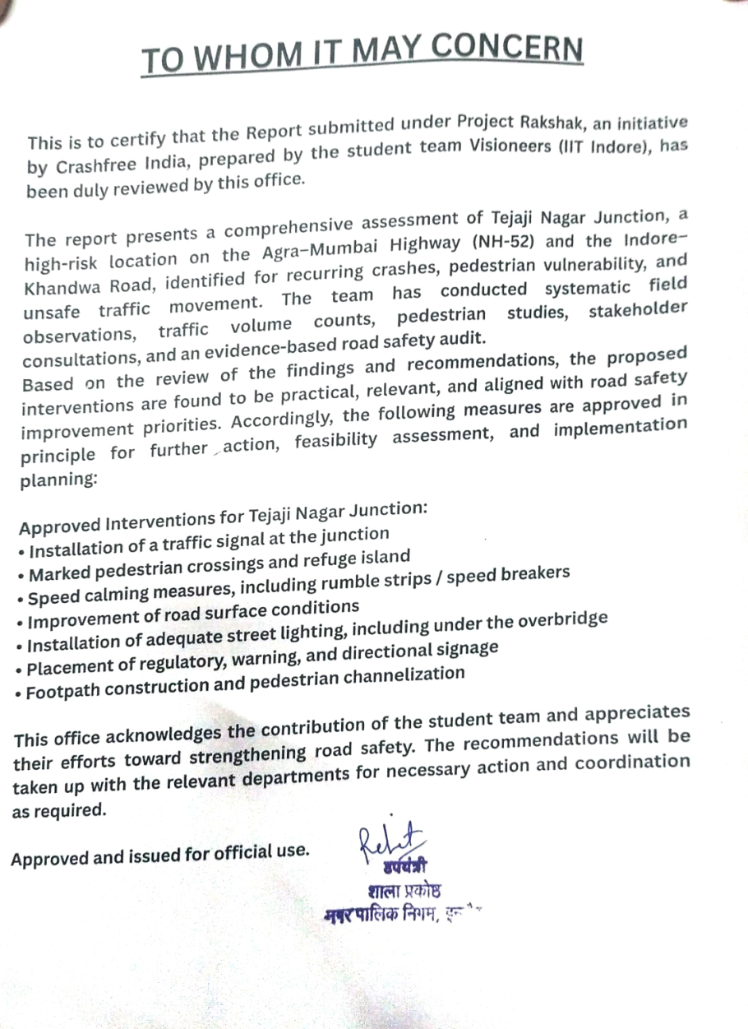
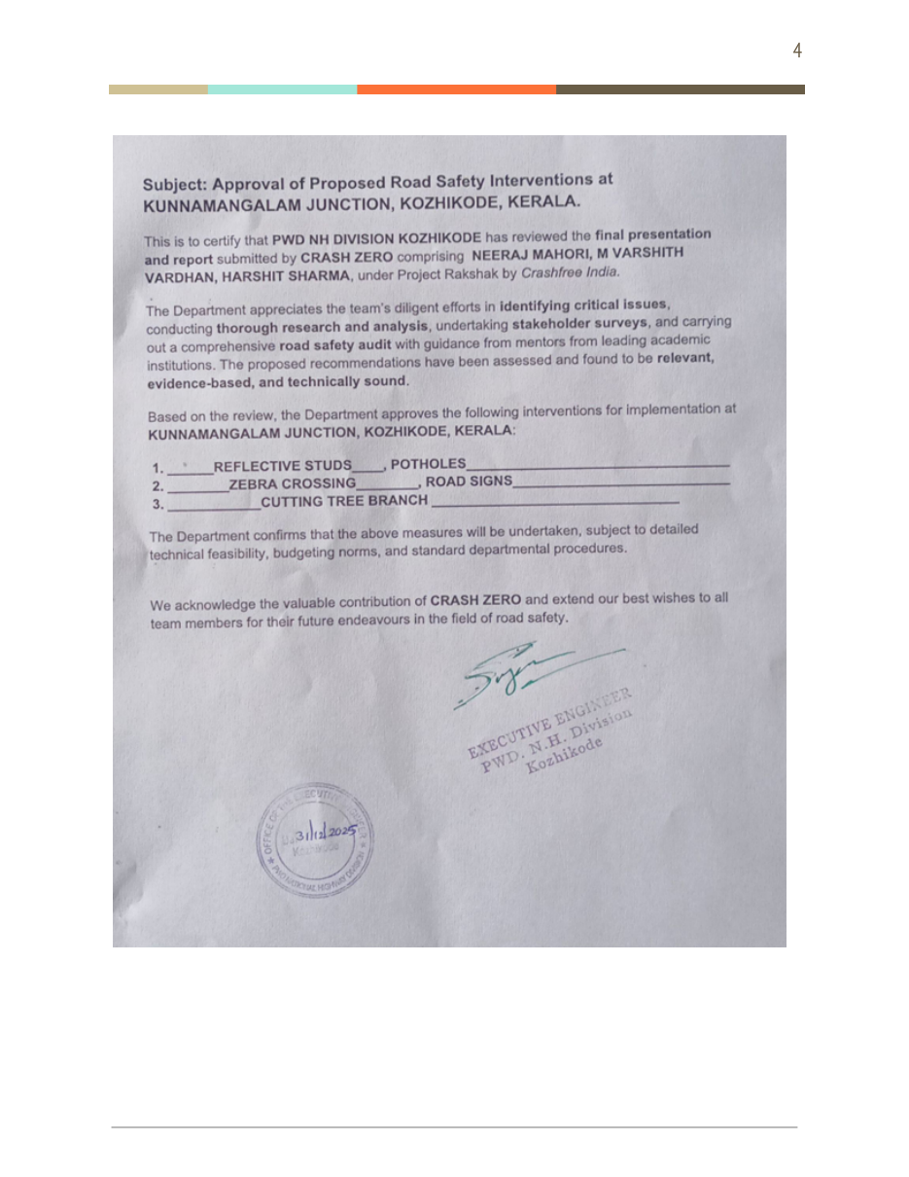
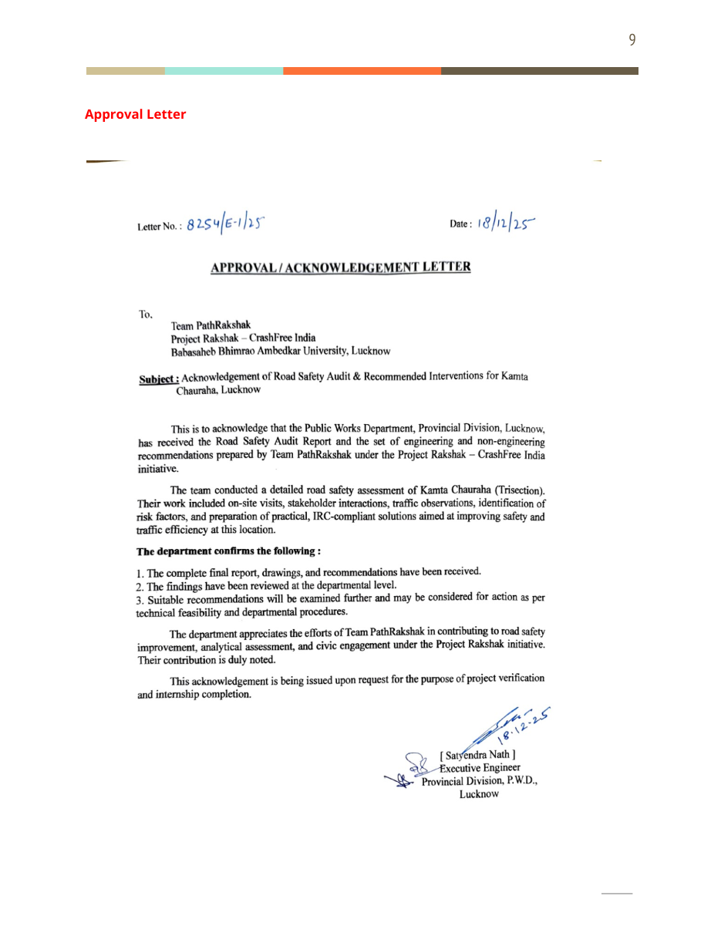
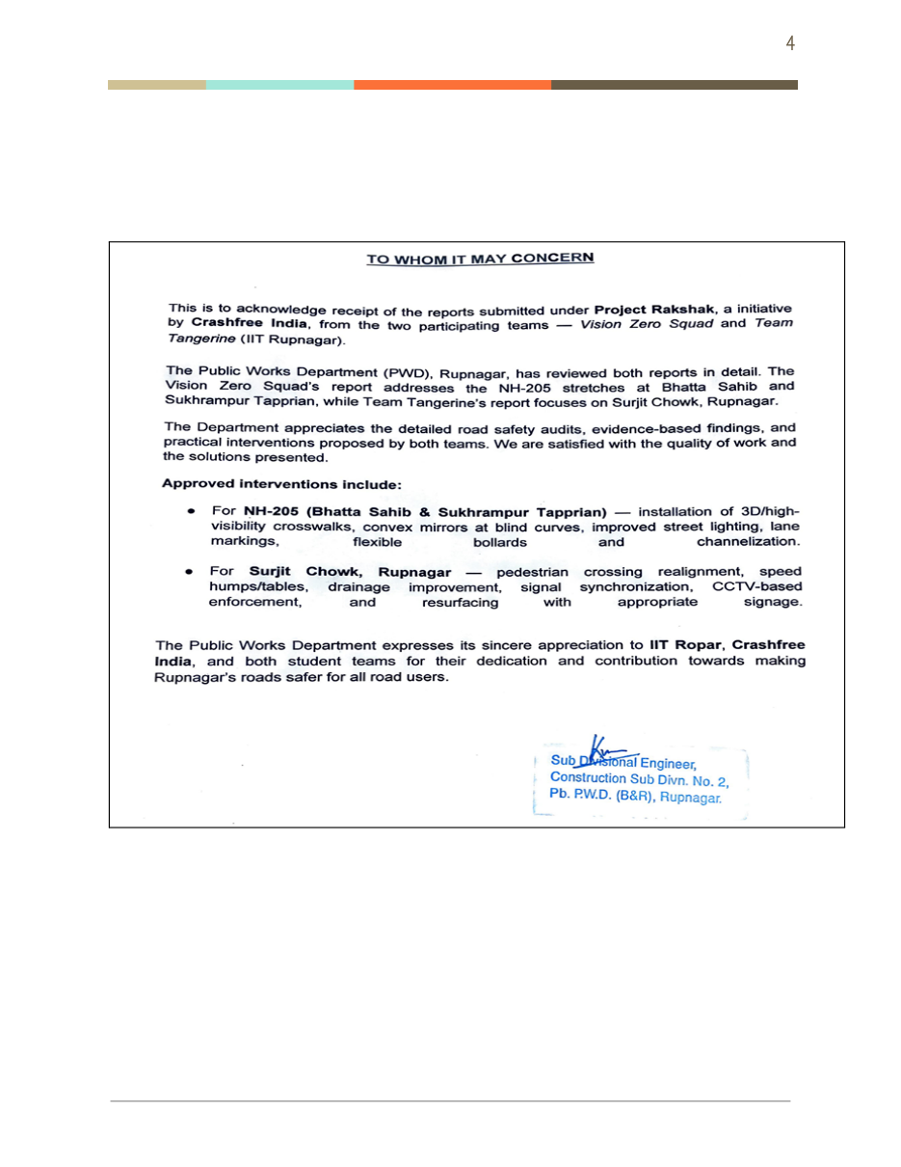
WHAT WE DO · 01 ROAD INFRASTRUCTURE — THE PROOF
Government approval, in writing:
25+ signed authority letters and counting.
A sample of the approval and acknowledgement letters issued to Rakshak student teams by public works and district authorities.
Tejaji Nagar, Indore — approved interventions
Kunnamangalam Jn., Kozhikode — PWD Kerala
Kamta Chauraha, Lucknow — PWD (UP)
NH-205 & Surjit Chowk, Ropar — PWD (Punjab)
Authorities include: PWD Kerala · PWD UP · PWD Punjab · CPWD & Addl. Collector Indore · ADDA Durgapur · R&B Andhra Pradesh · GCC Chennai
PROJECT RAKSHAK · APPROVALS
08 / 25

Slide 9
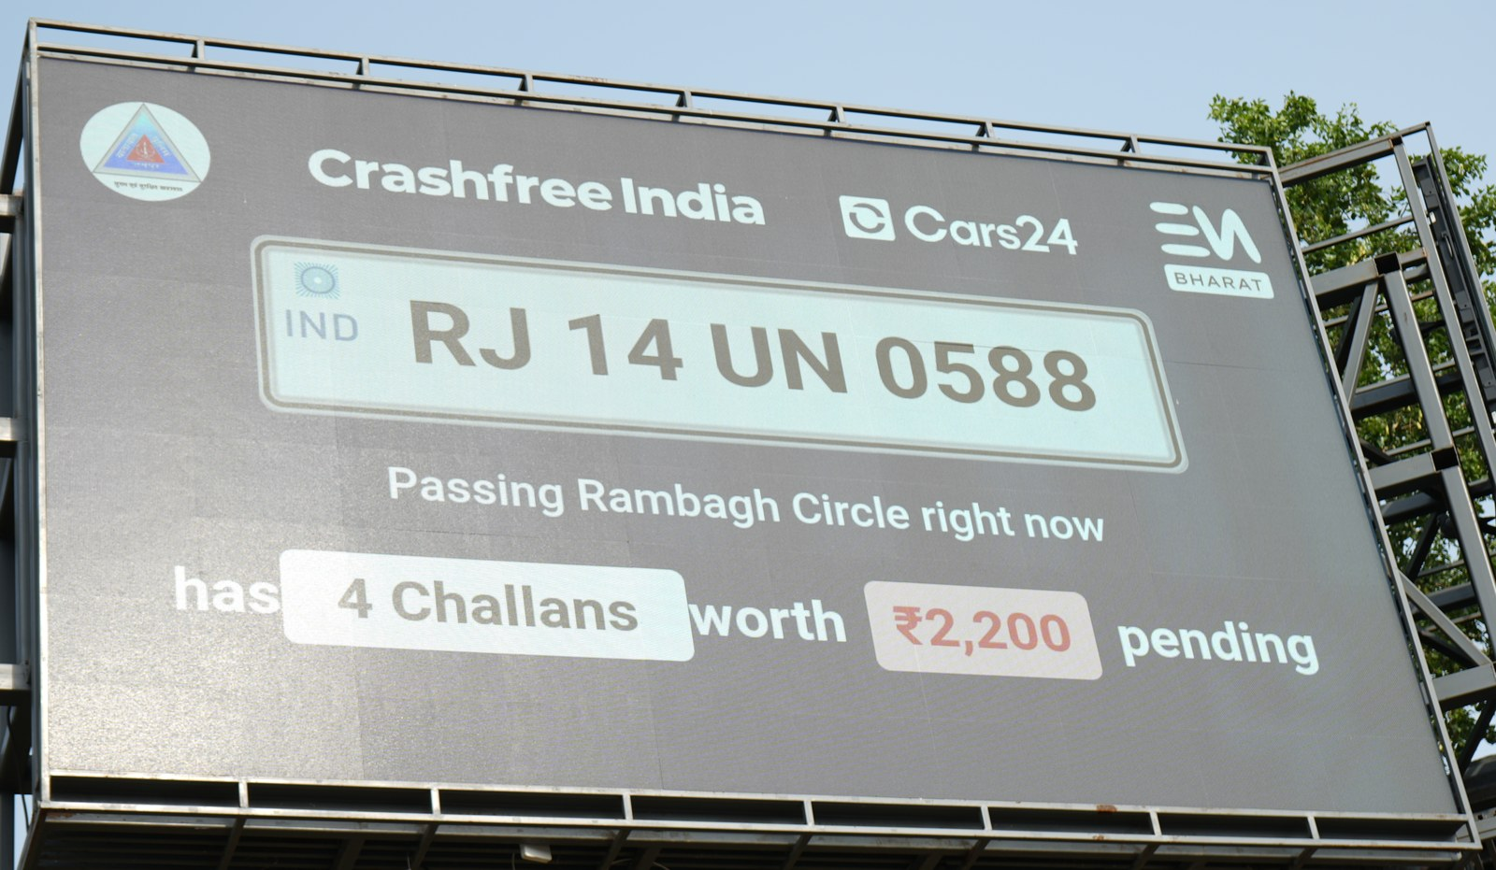
WHAT WE DO · 02 ENFORCEMENT TECHNOLOGY
SATARK — an AI platform that helps traffic
police identify and stop high-risk vehicles.
Cameras read every passing number plate and check it against live national records — officers act on evidence instead of stopping vehicles at random.
3,00,000+
₹30 Cr+
vehicles scanned
pending challans surfaced
350+
2 cities live
high-risk vehicles intercepted
Jaipur & Bengaluru · 5 police approvals
Plate read
Record check
Rule engine
Billboard + app
Intercept
Built with police, not for them — departments set the flagging rules; CFI provides the technology. First 72 hours in Jaipur: 1,240 flagged, 58 intercepted.
Live SATARK billboard, Rambagh Circle, Jaipur — naming a passing vehicle's 4 pending challans in real time.
WHAT WE DO · SATARK
09 / 25

Slide 10
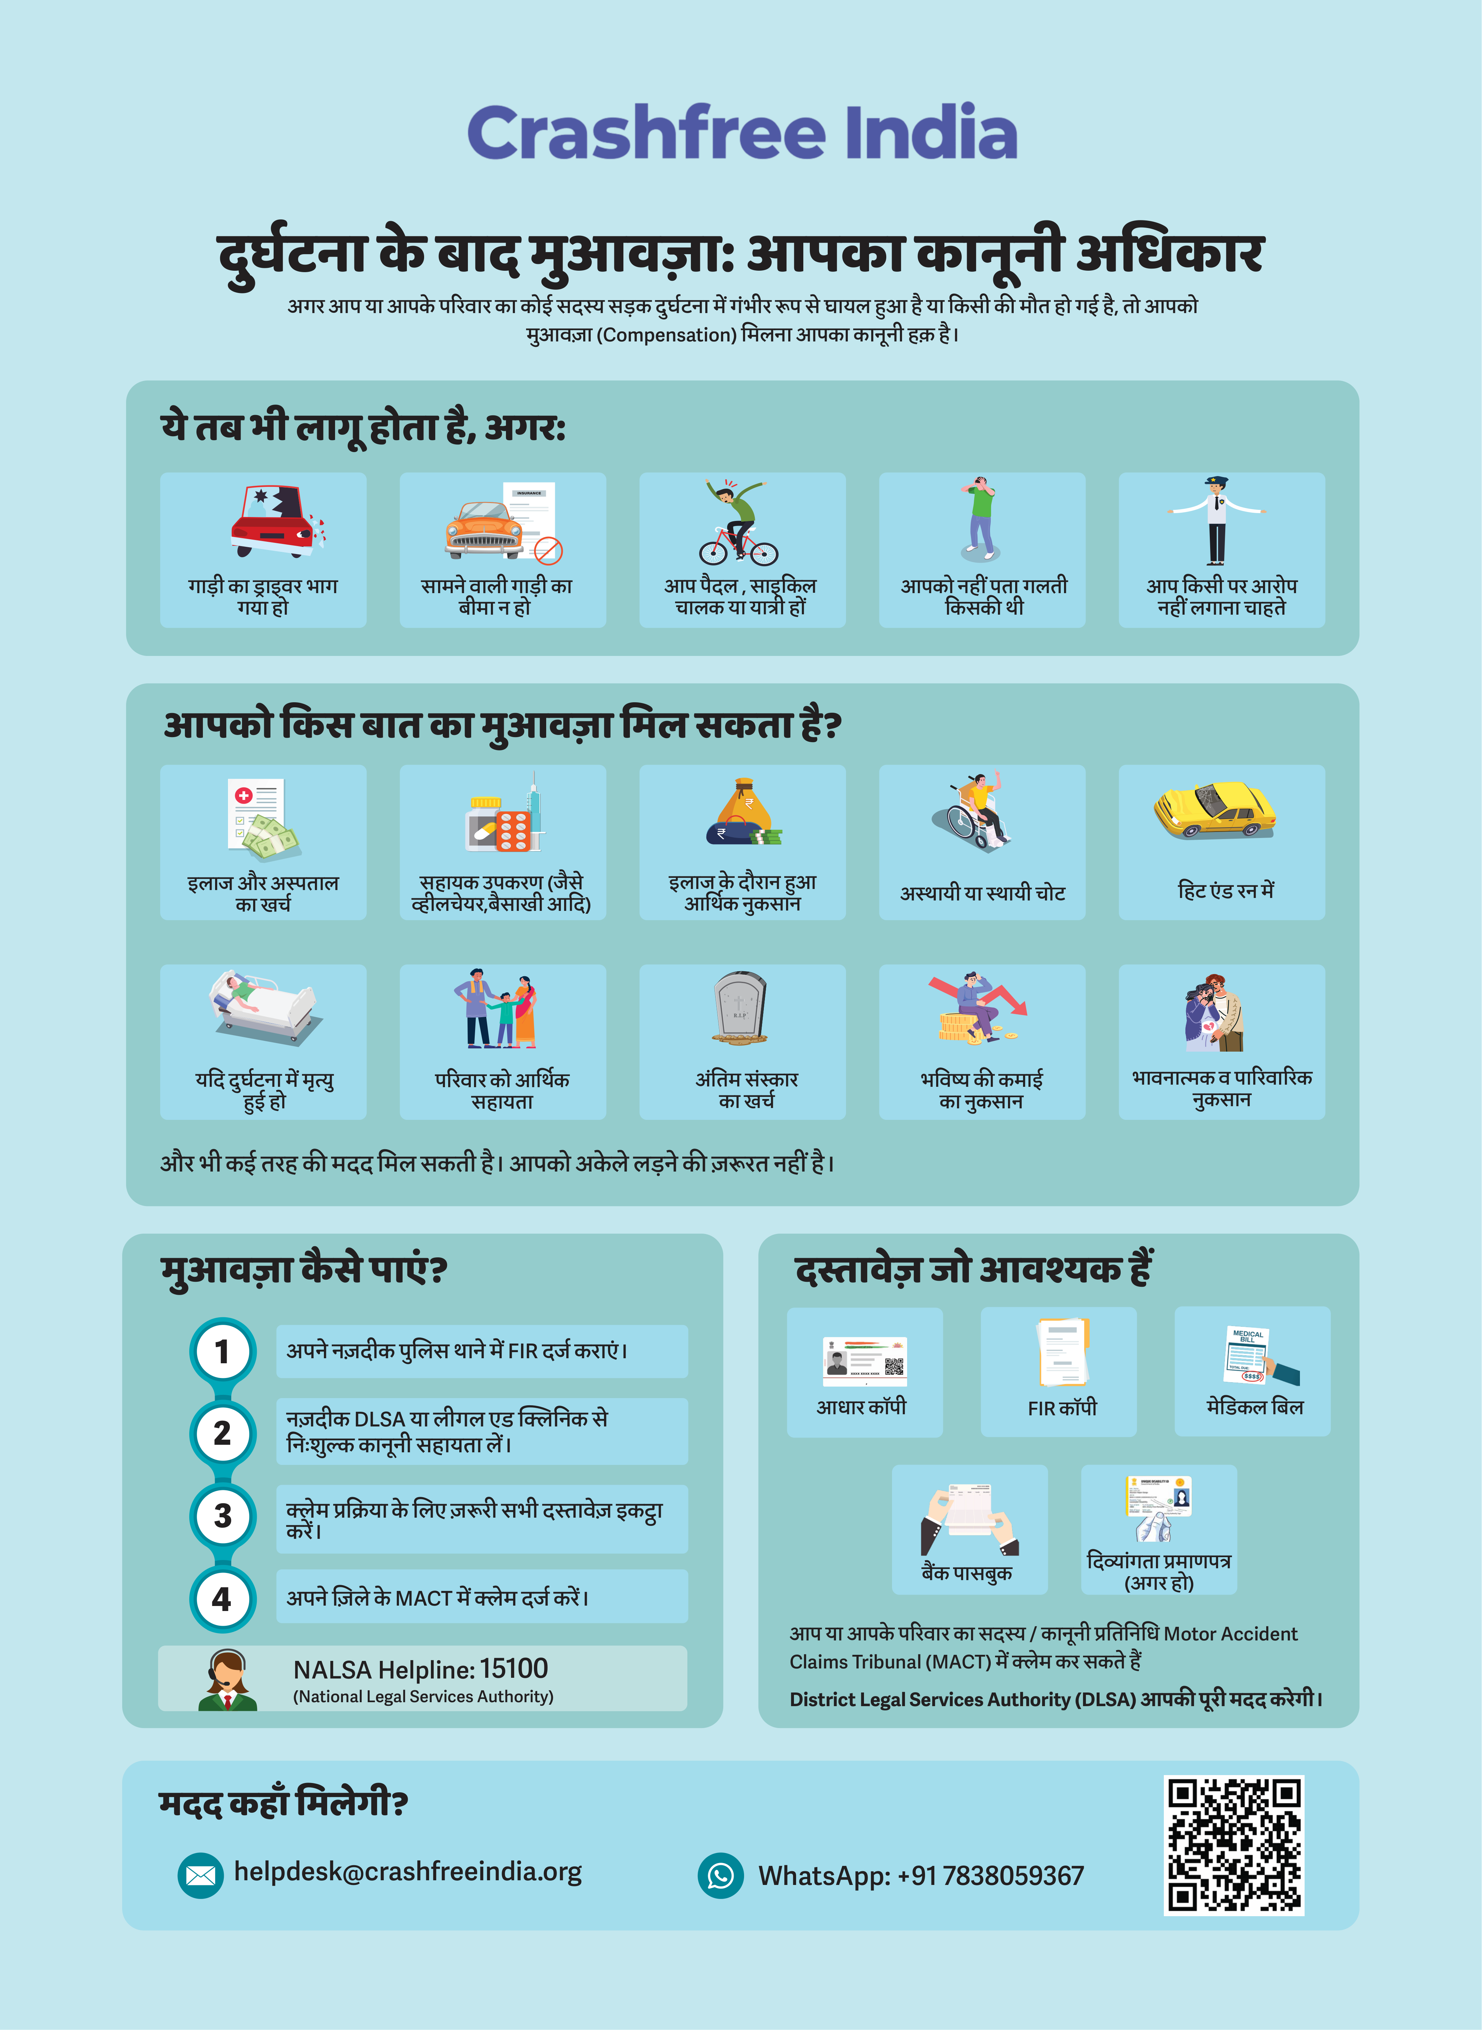
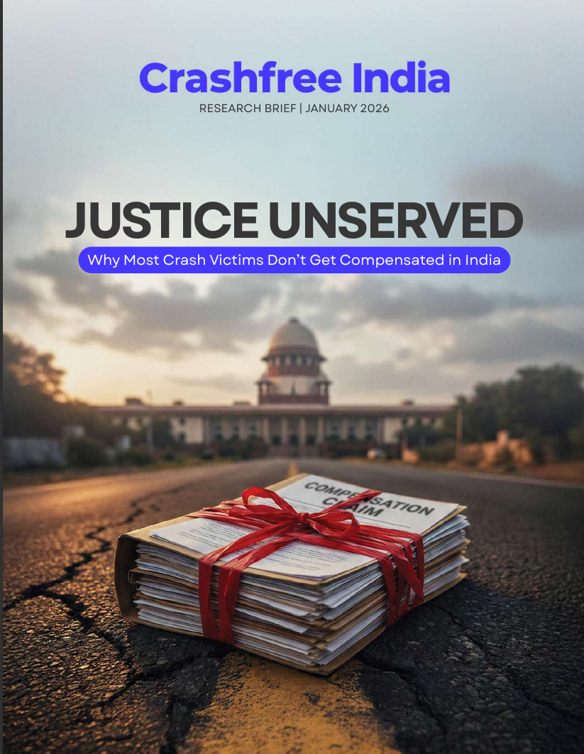





WHAT WE DO · 03 POLICY & VICTIM SUPPORT
Helping crash victims and families claim
the compensation the law promises them.
10.46 lakh
205 vs ~25,000
3.6 years
2 of 102
cases pending
hit-and-run claims filed vs eligible
average wait
files settled in our Gurugram audit
WHAT WE BUILT AND DO
Aasha — India's first 24/7 multilingual AI chatbot guiding victims step-by-step on WhatsApp & voice
Free Compensation Calculator based on Supreme Court principles (Sarla Verma, Pranay Sethi)
Legal helpdesks in hospital trauma wards — 100+ victims supported in the first 4 days
Embedded in 4 District Road Safety Committees — formally tasked by SW Delhi DRSC; fellow placed with Gurugram district offices
'Justice Unserved' presented to MoRTH; hit-and-run claim pipeline rebuild underway with Rajasthan Transport Dept.
Hindi legal-rights guide (hospitals & police stations) · 'Justice Unserved' research brief.
WHAT WE DO · VICTIM SUPPORT
10 / 25

Slide 11
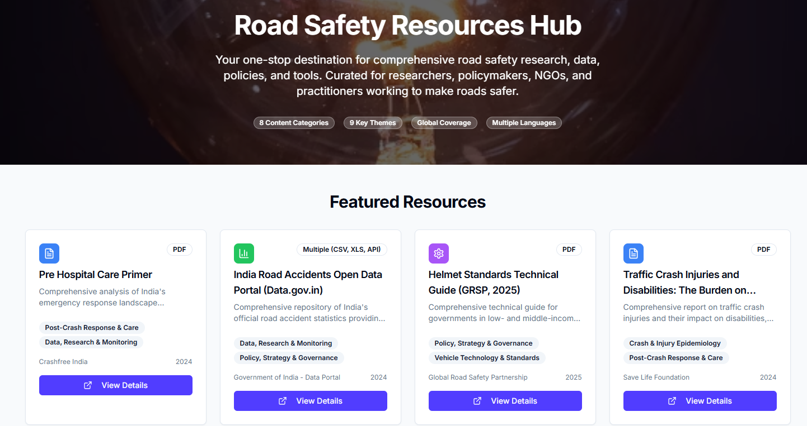


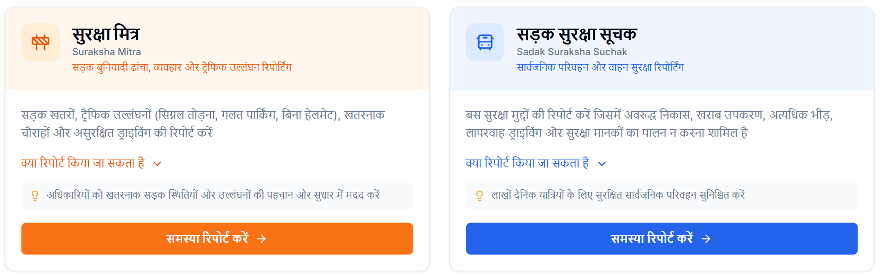
WHAT WE DO · 04 OPEN DATA PLATFORMS
Public data tools we built so that
road-safety problems cannot be ignored.
Four self-updating platforms — free for government, researchers, journalists and citizens.
National Road Defect Repository
Road Safety in Parliament
AI reads local news in 13 languages across 146 districts — potholes, missing signage, unlit stretches — mapped publicly.
All 1,423 parliamentary road-safety questions since 2014, searchable by MP — 282 sitting MPs have never asked one.
Supreme Court Litigation Tracker
National Crash Data Dashboard
Road Safety Resources Hub — the public front door.
18 live road-safety cases, 190+ orders, every government deadline tracked — 11 already overdue at launch.
Official crash statistics (2019–2024) turned into report cards for 36 states and 50 cities — openly licensed.
'Justice Unserved' in print: Deccan Herald · ET · Fortune India · IndiaSpend · Moneycontrol · Scroll.in · The Wire
WHAT WE DO · OPEN DATA
Citizen hazard-reporting apps — 50+ hazards in first 20 days.
11 / 25

Slide 12
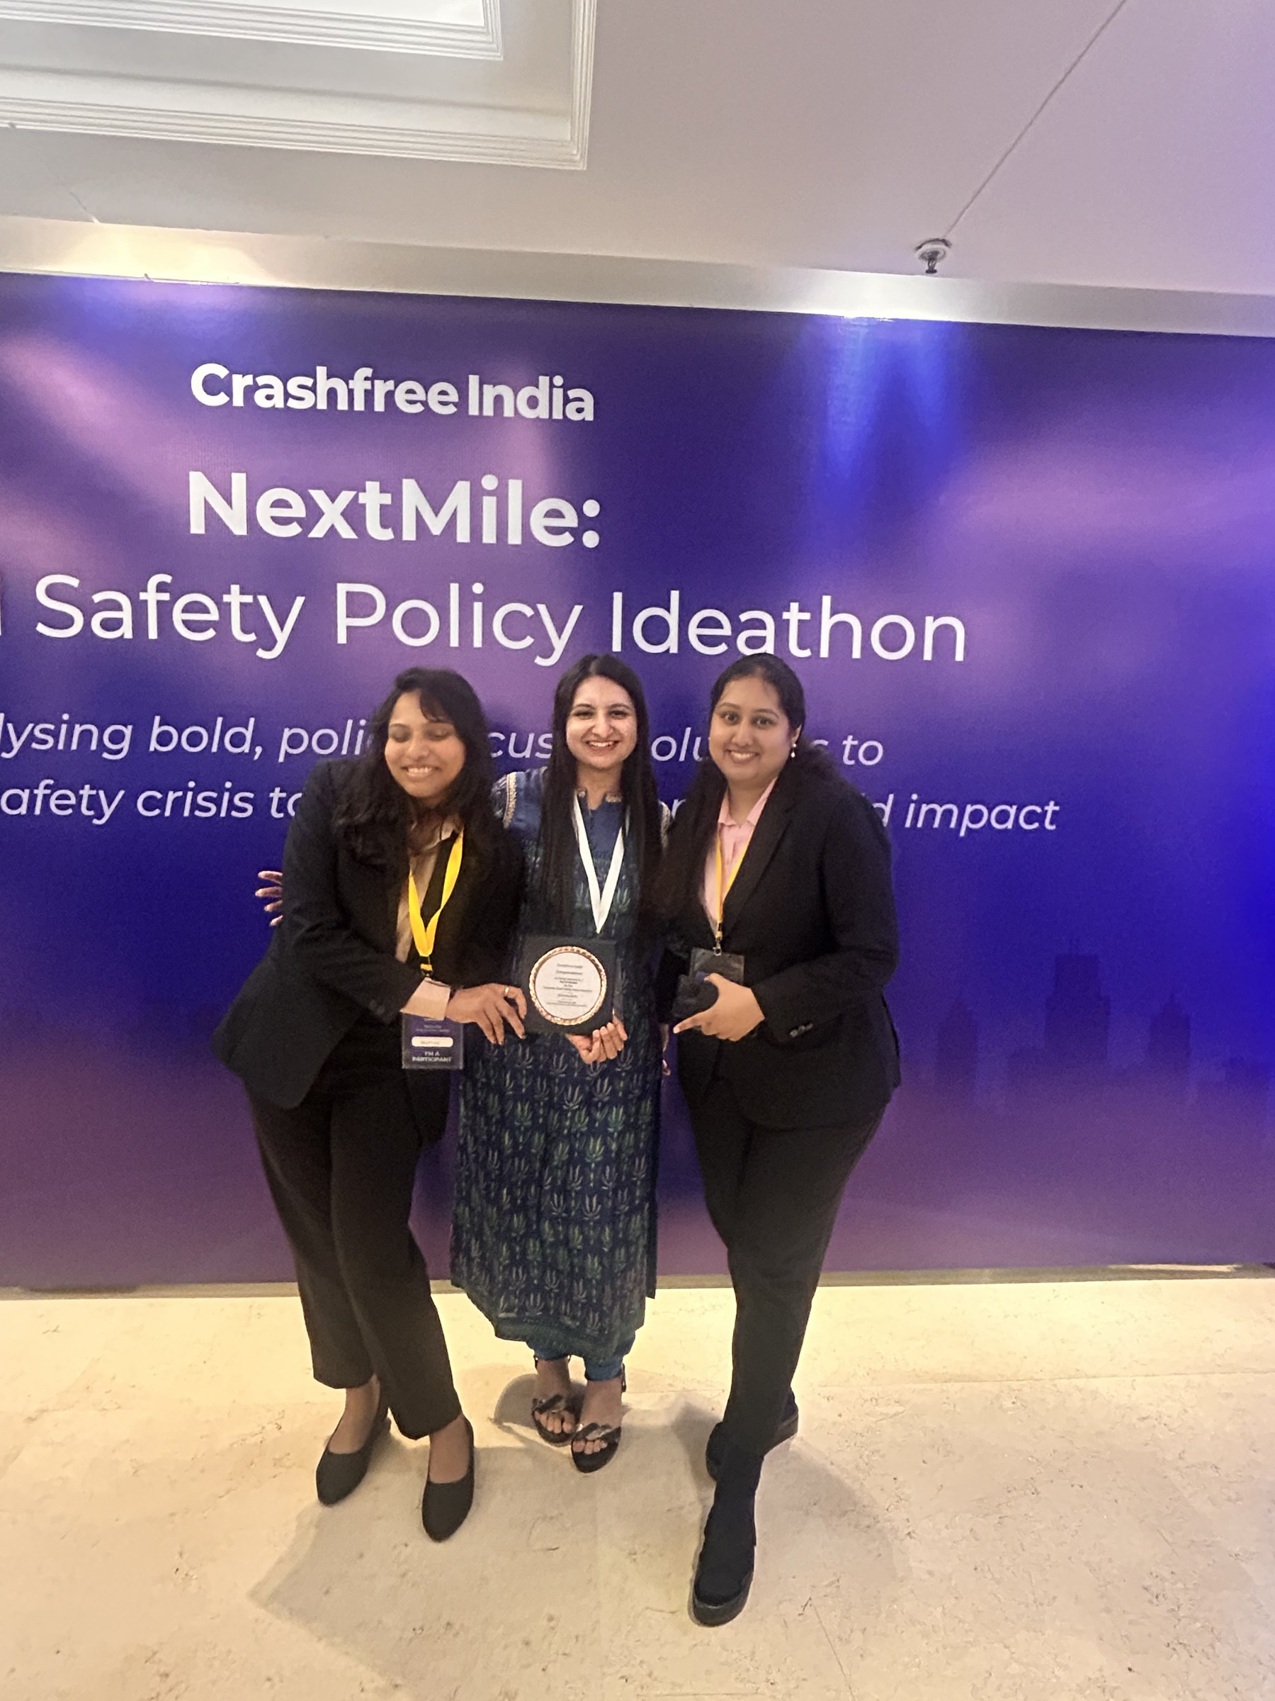




WHAT WE DO · YOUTH MOBILISATION & PUBLIC EDUCATION
NextMile, campus programmes and street-level
education that bring citizens into road safety.
NEXTMILE — NATIONAL ROAD SAFETY POLICY IDEATHON (2025)
700+
250+
37
10
registrations from
IITs, IIMs, NLUs
policy concept
notes submitted
teams mentored
for four weeks
finalists judged by
24 national experts
Grand Finale at India Habitat Centre, Sept 2025 — jury included Justice J.R. Midha and ex-MoRTH leadership.
Winning ideas feed CFI's own pipeline — compensation reform and rider safety became live workstreams.
Street plays, comics and multilingual guides carry road-safety education beyond campuses.
Next: 'Be a Rakshak' university chapters at IITs, NITs and SPAs, with MS Dhoni as the recruiting voice.
NextMile Grand Finale — winners on stage, Sept 2025.
WHAT WE DO · YOUTH & EDUCATION
12 / 25

Slide 13









IMPACT · OUR FIRST YEAR
Year one: measurable results
across 18 Indian cities.
1M+
18
25+
THE FIRST 400 DAYS
citizens reached
cities active
govt approvals won
Jun 25
Launched as a Cars24 commitment
15
4
2
Sep 25
NextMile finale · first AI billboard live in Bengaluru
implementations begun
district committees joined
cities enforcing with SATARK
Jan 26
'Justice Unserved' published
Apr 26
IIT Delhi national forum · Dhoni joins
150+
50+
10+
Jun 26
SATARK live with Jaipur Police
members & interns
experts engaged
national media features
Jul 26
Rakshak Cohort 2 · 4 open-data products shipped
WORKING ALONGSIDE:
MoRTH
WHO
UNICEF
CSIR-CRRI
IRF
FICCI
IIT Delhi
Jaipur Traffic Police
Gurugram Police
IMPACT · OUR FIRST YEAR
13 / 25

Slide 14
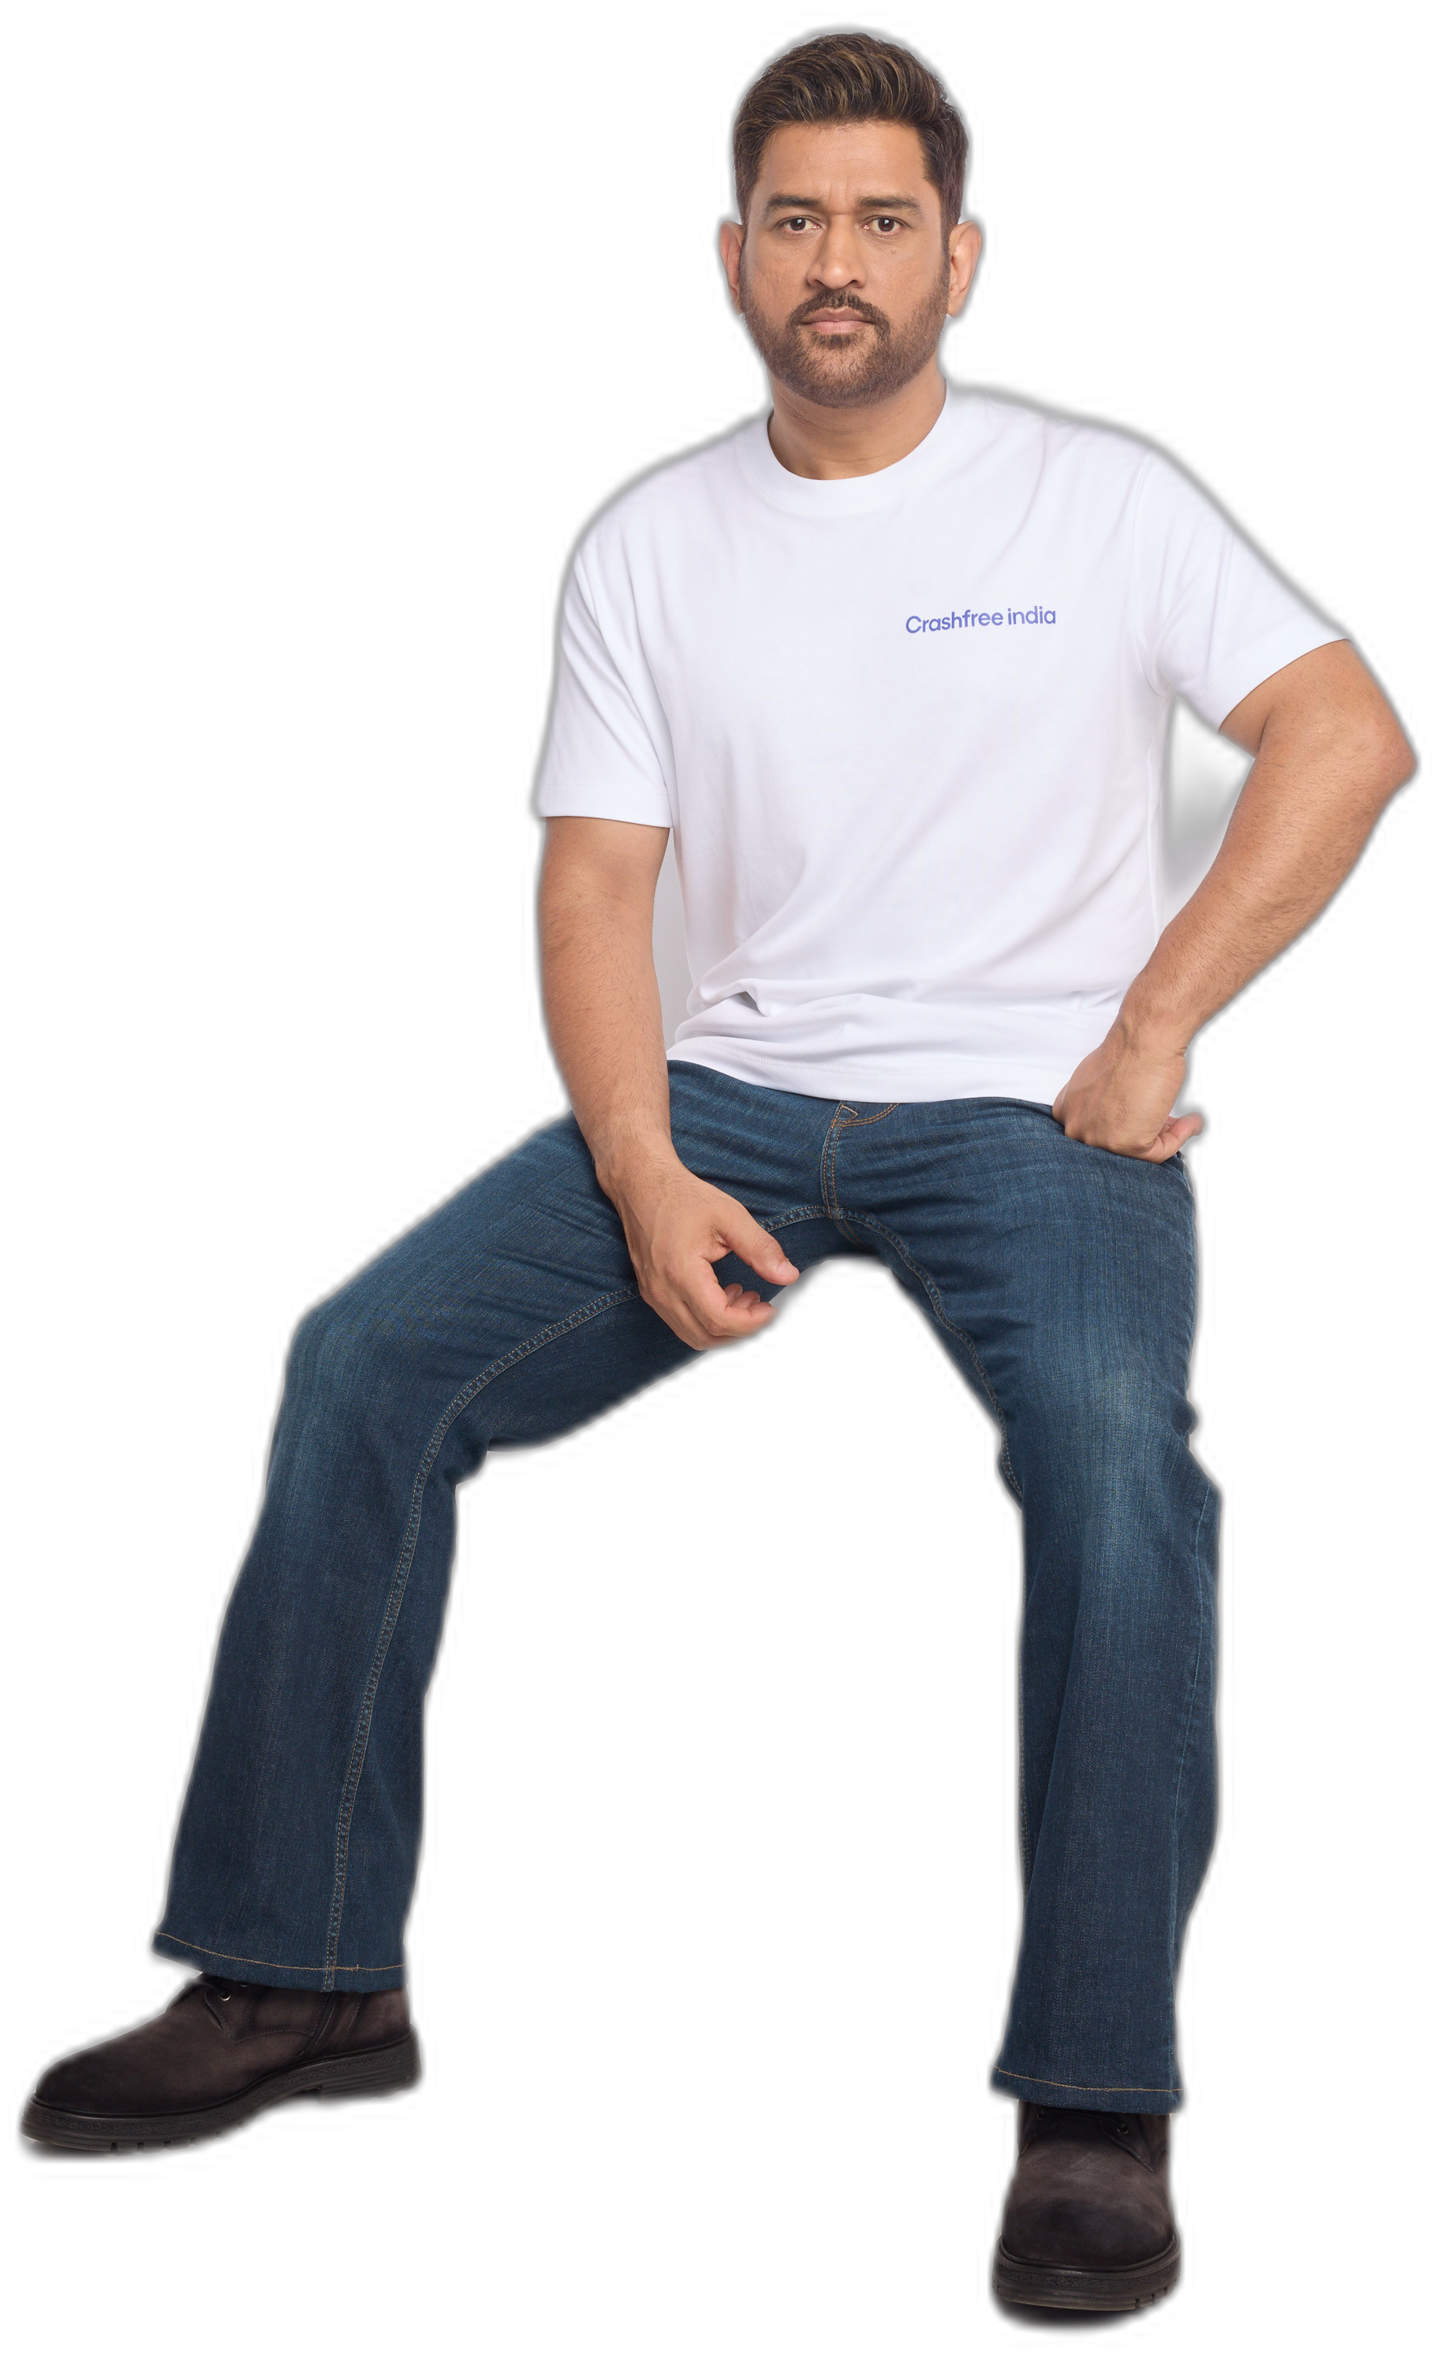

OUR AMBASSADOR
MS Dhoni is Crashfree India's
Goodwill Ambassador.
One of India's most trusted public figures joined us in April 2026, unveiled at our national forum at IIT Delhi. His role — lending his voice where it moves people to act:
Inviting India's students to join Project Rakshak road audits
Championing safer school zones
Spreading awareness of victims' compensation rights and Aasha
“Because every ride deserves to end safely.”
Announcement covered by Business Standard · The Tribune · The Wire
CFI shoot · June 2026
OUR AMBASSADOR
14 / 25

Slide 15
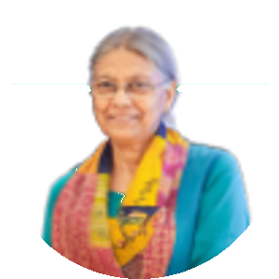
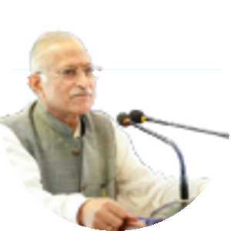
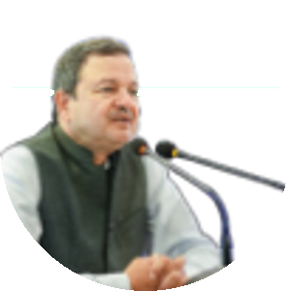
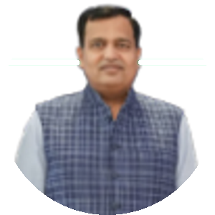
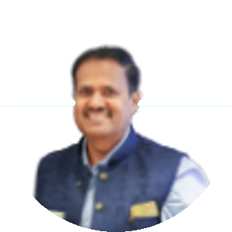
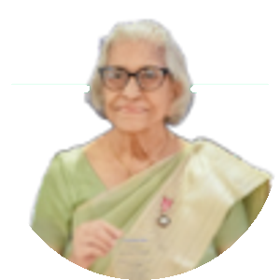
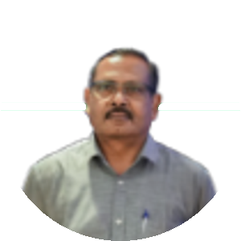
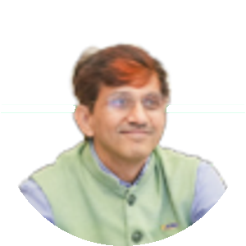
OUR PEOPLE · BOARD OF ADVISORS & EXPERTS
Guided by two of India's foremost
road-safety experts.
PT
Piyush Tewari
Prof. (Dr.) Geetam Tiwari
Founder & CEO, SaveLIFE Foundation
Professor Emerita, TRIPC, IIT Delhi
Architect of India's Good Samaritan Law (Supreme Court, 2016)
Three decades leading India's foremost road-safety research centre — a WHO Collaborating Centre
Built the Zero Fatality Corridor model — ~40% fewer deaths on Mumbai–Pune Expressway; scaling with MoRTH
Global authority on vulnerable road users & safe-system design · PhD, University of Illinois Chicago
Rolex Award for Enterprise · Elevate Prize · MPA, Harvard
Guides Project Rakshak's audit methodology; anchors our Expert Consortium
THE EXPERT BENCH BEHIND OUR WORK
Justice J. R. Midha (Retd.)
Abhay Damle
Vaibhav Dange
Delhi High Court · FastDAR architect
Former Joint Secretary, MoRTH
Former Advisor, MoRTH
SV
Dr. S. Velmurugan
RA
Dr. Richa Ahuja
Akhilesh Srivastava
Head, Traffic Engg. & Safety, CSIR-CRRI
IIT Kharagpur · Rakshak advisor
ITS India · IRF
Dr. Maya Tandon
R. Venkat Ratnam
Rama Shankar Pandey
Sahayta Trust, Jaipur
DG, Punjab Road Safety Lead Agency
FICCI Road Safety
BOARD OF ADVISORS & EXPERTS
15 / 25

Slide 16
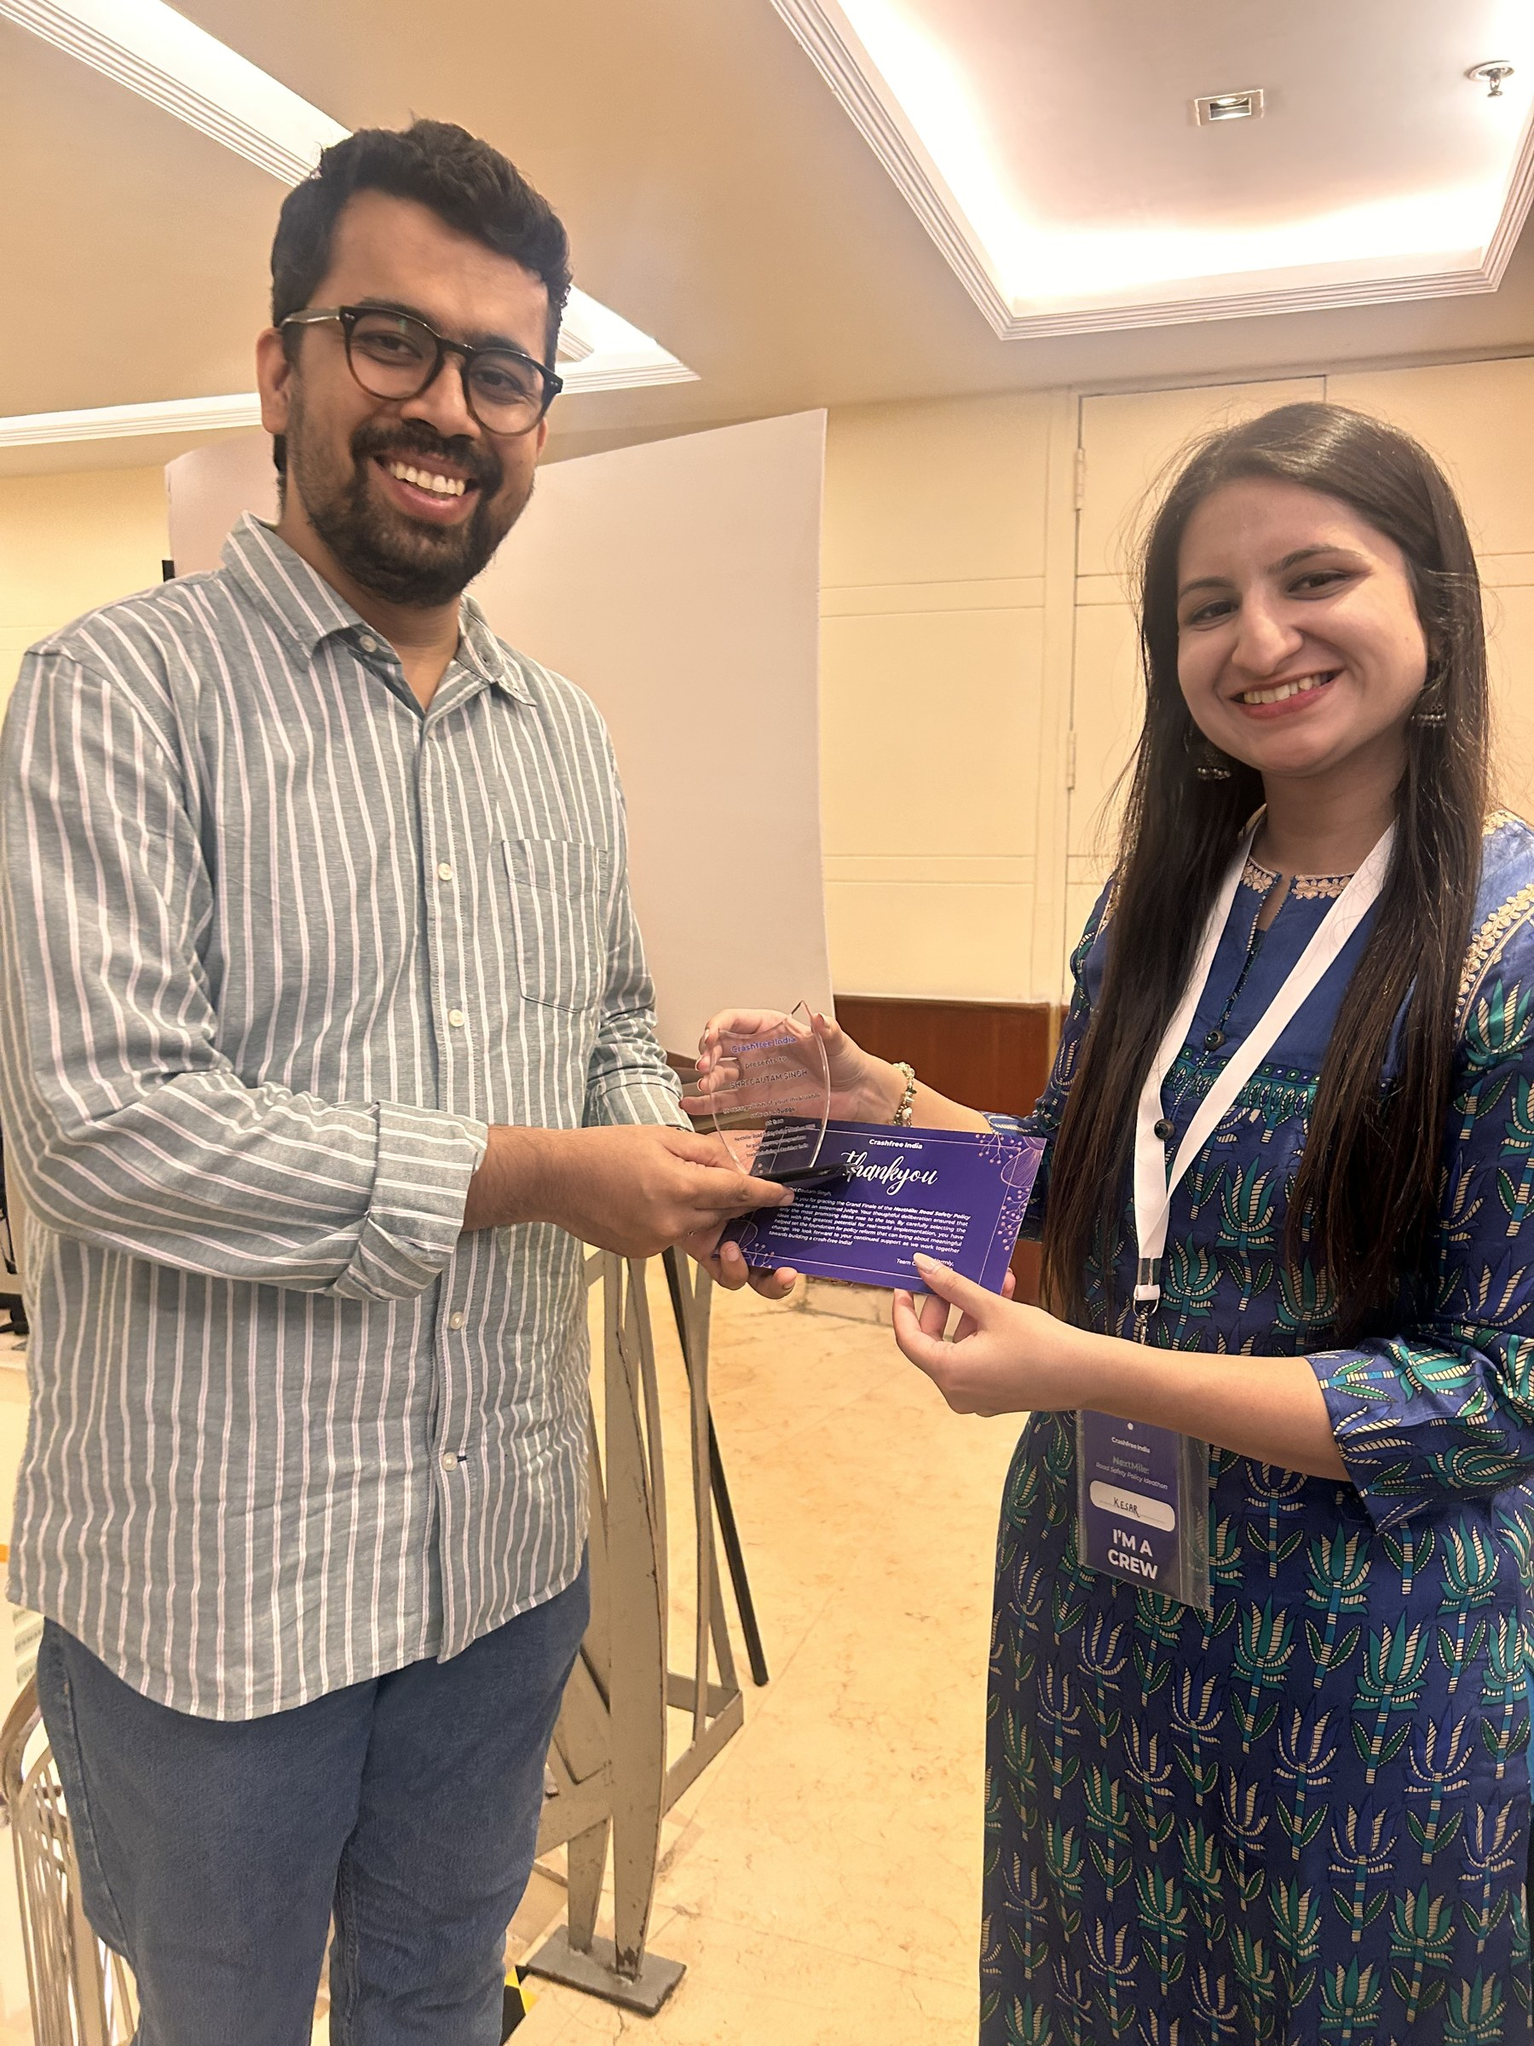
OUR PEOPLE · THE TEAM
A full-time team of eight, three trustees,
and 75+ engineering interns nationwide.
TRUSTEES · VISION ZERO TRUST
AS
Amar Srivastava
DG
Deepanshu Gupta
GJ
Gajendra Jangid
President
Managing Trustee
General Secretary
Founder, Indian Road Safety Council — 50,000+ volunteers · Diana Award 2019
Founder, IRSC · Global Youth Coalition for Road Safety leadership board
Co-founder, Cars24 · ex-Schlumberger
FULL-TIME TEAM
AH
Akhtar Hussain
SK
Shubham Kumar
MY
Muskan Yadav
AS
Aastha Shreeharsh
Mission Lead
Policy Advocacy
Programs · Infrastructure
Strategy & Operations
IIT Delhi · ex-Bain & Co., Deloitte
DU + NALSAR · byline: Scroll.in
TISS Mumbai
HKUST · quoted in The Wire
RS
Rohan Sharma
IR
Ishita Rathore
YY
Yuvraj Yadav
SK
Shipra Kushwaha
Cause Marketing
People & Culture
Product Design
Graphic Design
Team members at the NextMile Grand Finale, Sept 2025.
ex-Unacademy
+ 75+ part-time road-engineering interns across India
THE TEAM
16 / 25

Slide 17



THE YEAR AHEAD
Year two: fewer bets, deeper districts,
and more fixes built on the ground.
Every three minutes, a life is lost on an Indian road. Join us in changing that.
YEAR TWO, WITH YOU — THE TARGETS
START THE CONVERSATION
150+ blackspots audited by the national pipeline
crashfreeindia.org
Model districts: Gurugram · SW Delhi · Jaipur
helpdesk@crashfreeindia.org
12+ district-committee presentations
Live proof: crashfreeindia.org/rakshak/dashboard
Rakshak Audit Manual v1.0 — usable by NHAI without rework
Lasting change happens when someone owns the follow-through. That is the job we have taken on.
Crashfree India · A Cars24 Commitment · operated by Vision Zero Trust

Slide 18
A
REFERENCE MATERIAL
Appendix:
programme deep-dives.
A1 Project Rakshak — model & Cohort 2
A2 Rakshak — approvals & site evidence
A3 SATARK — product & deployment
A4 'Justice Unserved' — key findings
A5 Open-data platforms in detail
A6 NextMile & public education
A7 Press & contact
APPENDIX
18 / 25

Slide 19
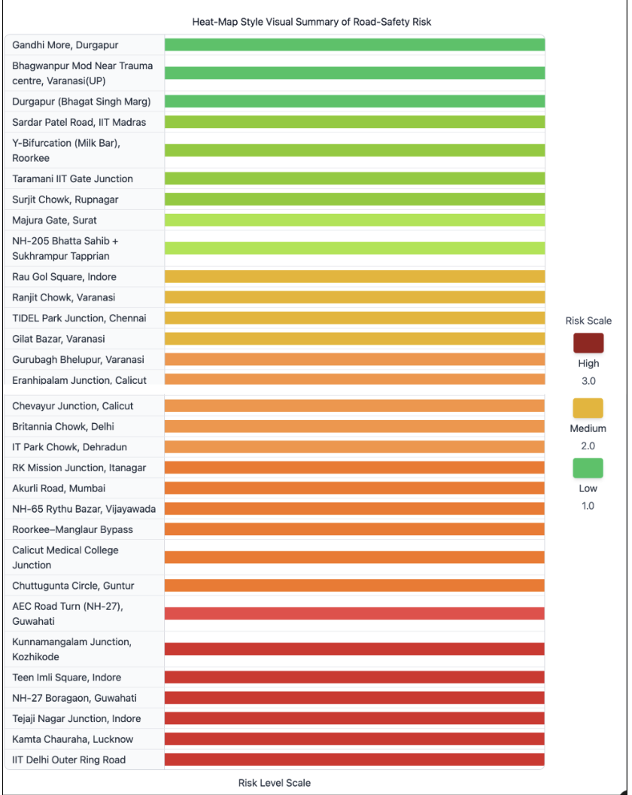
APPENDIX A1 · PROJECT RAKSHAK
The Rakshak model: a four-phase audit
pipeline, now scaling into three tracks.
P1 · Jul–Aug
P2 · Aug–Sep
P3 · Oct–Nov
P4 · Nov onwards
Research
Field work
Solutions
Accountability
Teams form at campuses; risks identified via FIRs, RTIs, police data and local media.
30+ stakeholder surveys per team; audits to IRC / MoRTH checklists under expert masterclasses.
Root-cause analysis; costed, standards-compliant redesigns reviewed by mentors.
Authority-format reports presented to PWD / municipal / police officials; approvals & builds tracked publicly.
COHORT 2 (2026-27) — THREE TRACKS, ALL [TARGETS]
Institutional
IIT / NIT / SPA student teams — ~90 sites
NGO partners
~20 sites · 100% desk review · 10–15% CFI re-checks
Certified RSAs
CRRI-certified auditors · full IRC SP:88 · 'usable by NHAI without rework' · ~40 sites
Risk heat-map of the 31 audited corridors.
APPENDIX · RAKSHAK MODEL
19 / 25

Slide 20
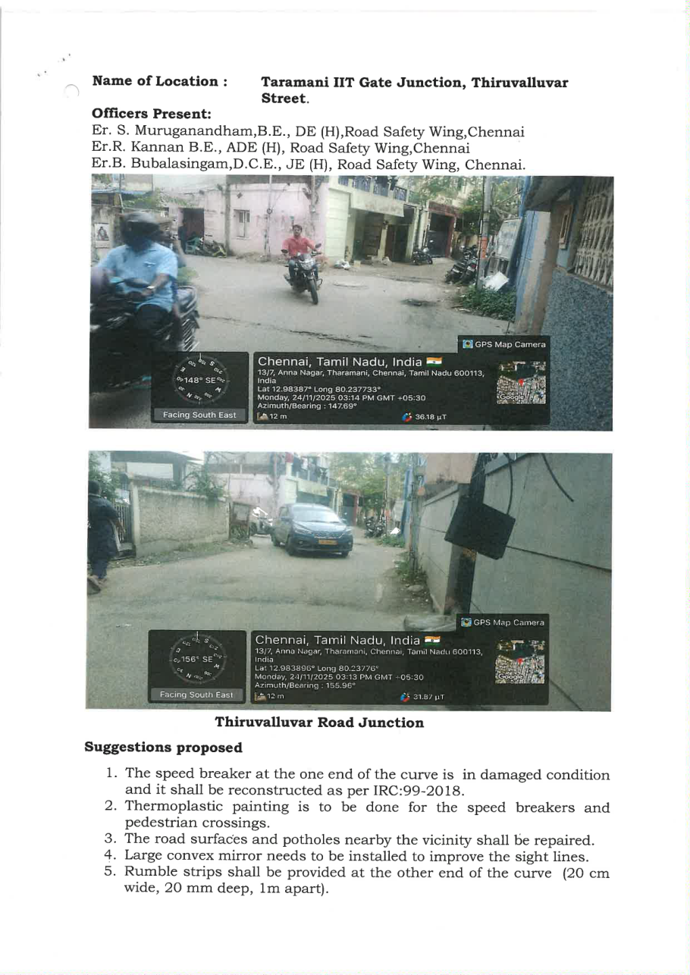
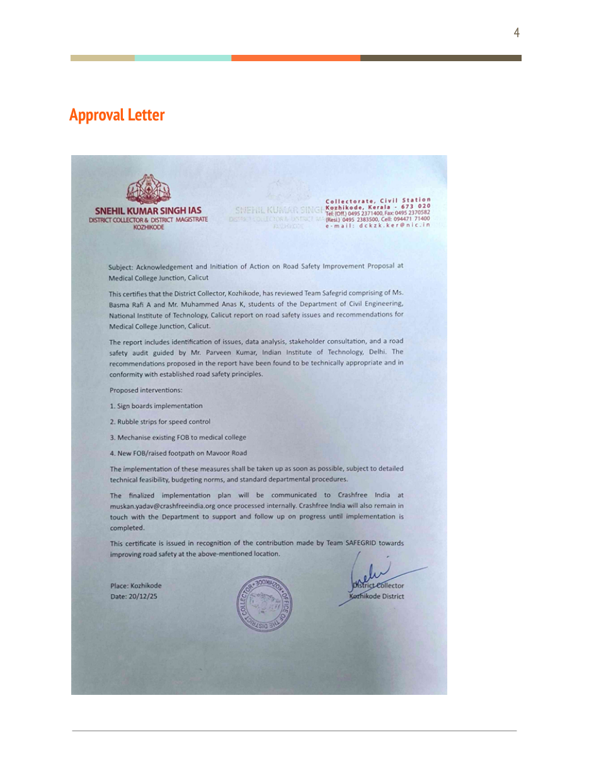
APPENDIX A2 · PROJECT RAKSHAK
From site survey to signed approval:
what the paper trail looks like.
WHAT AUTHORITIES APPROVED (EXAMPLES)
Tejaji Nagar, Indore — signal, refuge island, speed calming, footpaths — CPWD & Addl. Collector
Kamta Chauraha, Lucknow — complete junction redesign package — PWD
NH-205 / Surjit Chowk, Ropar — high-friction surfacing, signage, crossings — PWD Punjab
Kunnamangalam Jn., Kozhikode — reflective studs, markings, signage — PWD Kerala
Thiruvottiyur Jn., Chennai — speed breakers repaired to IRC spec, thermoplastic paint — GCC
Chennai: site photos + engineer suggestions (Team Sentinels).
Official acknowledgement on state letterhead (Team Safegrid).
Full set of 25+ letters available in the Rakshak approvals folder.
APPENDIX · RAKSHAK EVIDENCE
20 / 25

Slide 21
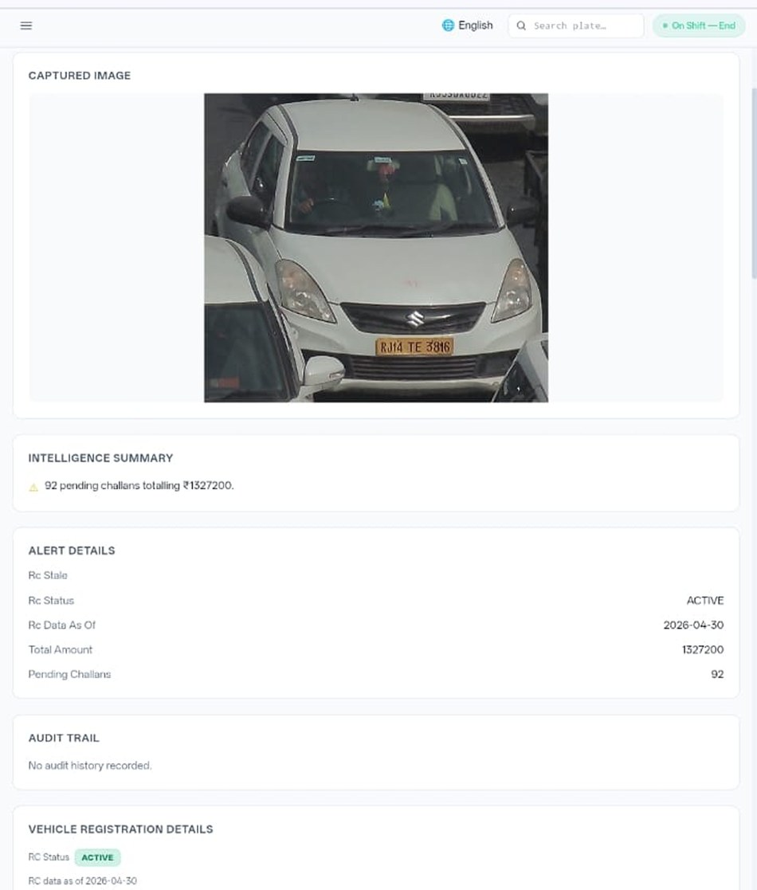





APPENDIX A3 · SATARK
Inside SATARK: from camera to
intercept in under a minute.
ANPR camera
reads every plate
Live vehicle record
via national APIs
Rule engine flags
habitual offenders
Public billboard
names the risk
Officer app routes
the interception
DEPLOYMENT
Live: Jaipur (Rambagh Circle billboard, officer app) & Bengaluru (Trinity Circle billboard) · approvals from 5 police forces · upcoming: Gurugram, Pune, Ahmedabad
OFFICER APP
Prioritised vehicle queue · full challan history via national APIs · plain-language intelligence summary · one-tap outcome logging (intercepted / missed / dismissed)
WHY IT MATTERS
46 Cr e-challans issued nationally, ~75% unpaid — SATARK turns that dormant record into live, targeted roadside enforcement
FLAGGING CRITERIA
Set by police, not CFI — e.g. 10+ pending challans or ₹10,000+ outstanding · 20,000+ vehicles flagged on these rules so far
The officer app: captured vehicle, live intelligence summary.
APPENDIX · SATARK
21 / 25

Slide 22





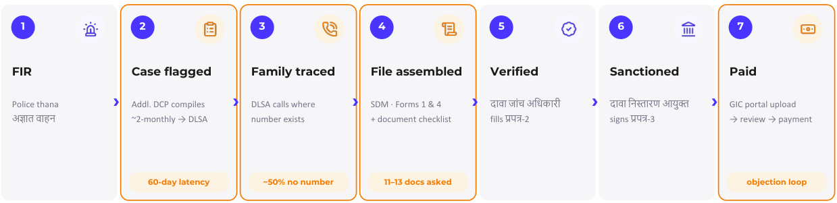
APPENDIX A4 · RESEARCH
'Justice Unserved': why crash compensation
fails, in five measured gaps.
Published January 2026; launched at IIT Delhi; findings presented to MoRTH and cited by national press.
Awareness
Timeliness
Legal efficiency
Adequacy
Equity
70% of low-income families don't know compensation exists; tout networks fill the vacuum.
3.6-year average claim; typical MACT case runs 8–10 years.
90% of pending hit-and-run claims are stalled on documentation alone.
Informal workers valued at minimum wage; courts repeatedly enhance awards on appeal.
14% of low-income households receive insurance compensation vs 24% of high-income.
205 claims filed vs ~25,000 eligible.
The pipeline, not the scheme, is the gap — so that is what we are fixing, office by office.
The claim journey we mapped in Jaipur — six institutions from FIR to payment; every hand-off manual today.
APPENDIX · JUSTICE UNSERVED
22 / 25

Slide 23
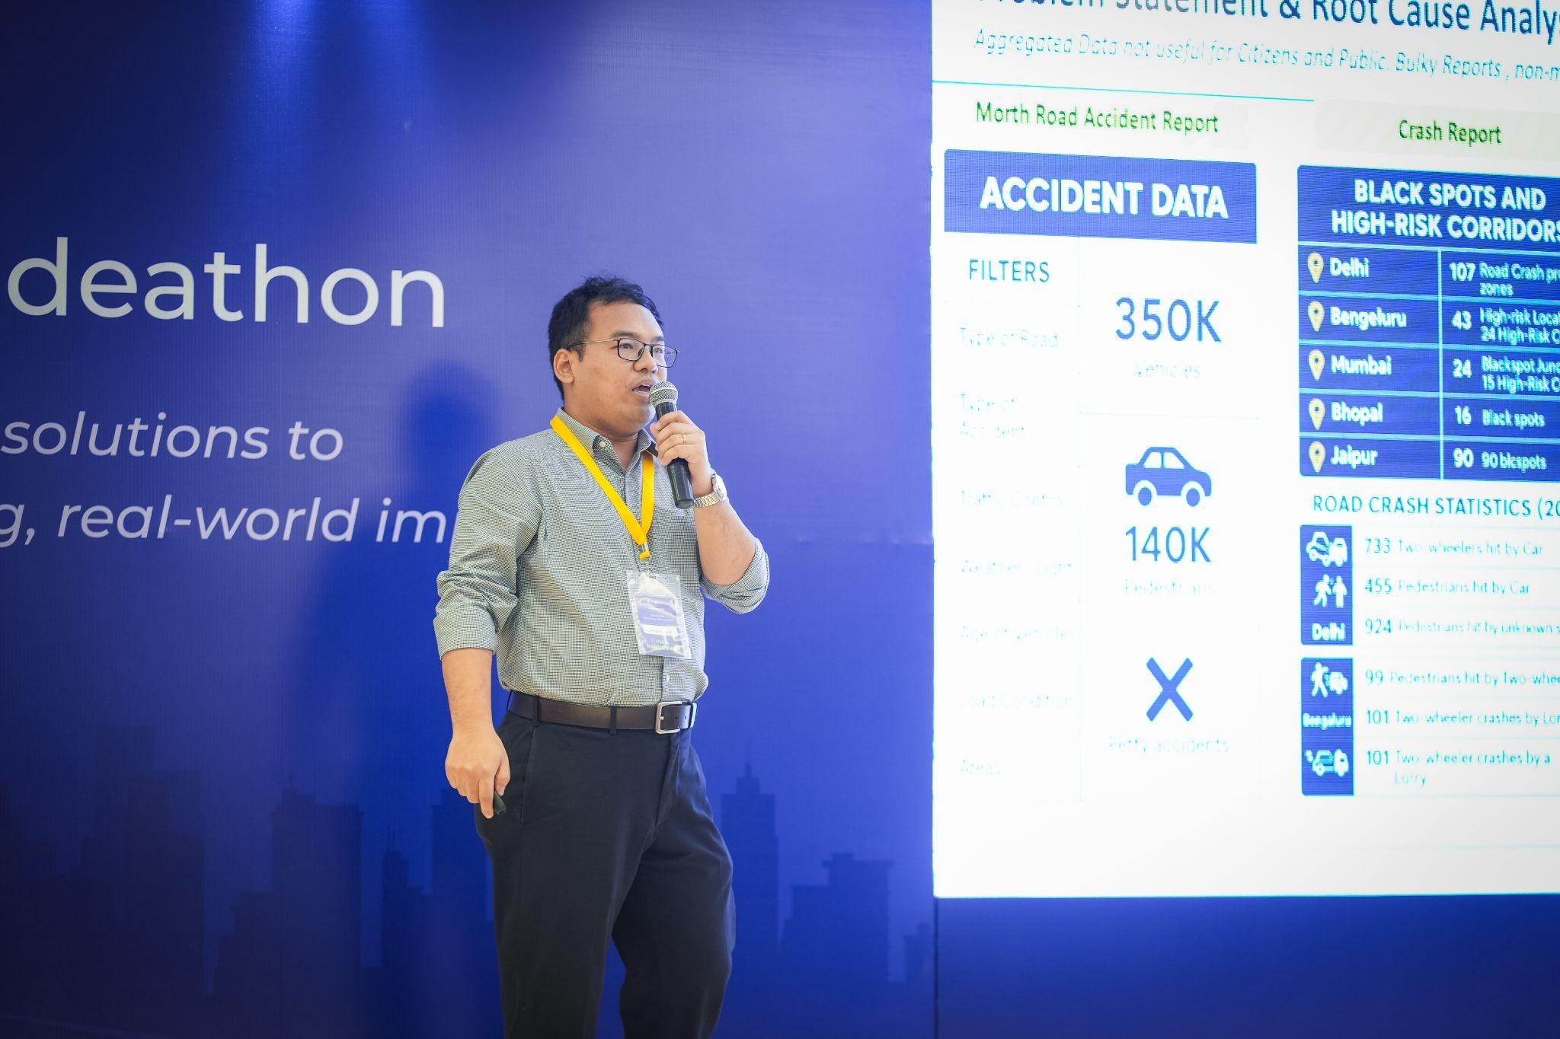
APPENDIX A5 · OPEN DATA
The data commons, in numbers.
National Road Defect Repository
cfi-defect-repository.vercel.app
AI reads local-language news daily in 13 languages across 146 districts (Bihar, UP, Rajasthan); defects geocoded and clustered into ranked public hotspot maps with verbatim source evidence.
Road Safety in Parliament
road-safety-parliament.vercel.app
1,423 questions across 4 ministries since 2014; find-your-MP report cards; live session tracking; RTI Watch pairs it with CFI's Delhi MACT RTI campaign.
SC Litigation Tracker
sc-litigation-tracker
18 live cases, 190+ orders, 27 precedent judgments; an accountability ledger of Supreme Court directions with auto-flipping deadlines — 11 overdue at launch.
Live crash-data walkthrough at the NextMile finale — the dashboards in use.
Crash Data Dashboard
cfi-crash-dashboard.vercel.app
MoRTH's 266-page annual reports productised: 2019–2024 data, report cards for 36 states + 50 cities, 21 verified findings, CC-BY open license.
All four platforms are self-updating cloud services — nothing depends on any one person's laptop.
APPENDIX · OPEN DATA
23 / 25

Slide 24
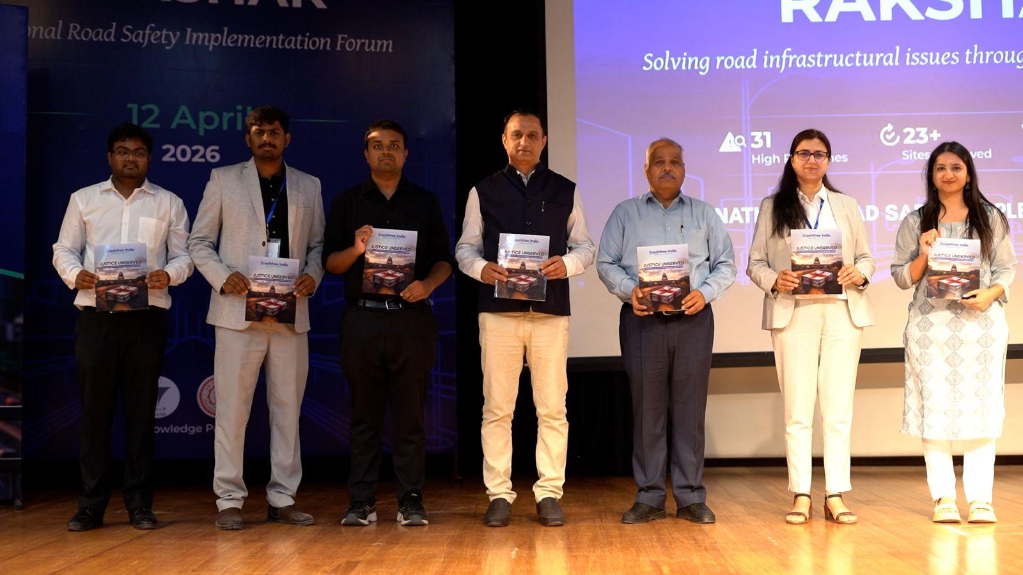

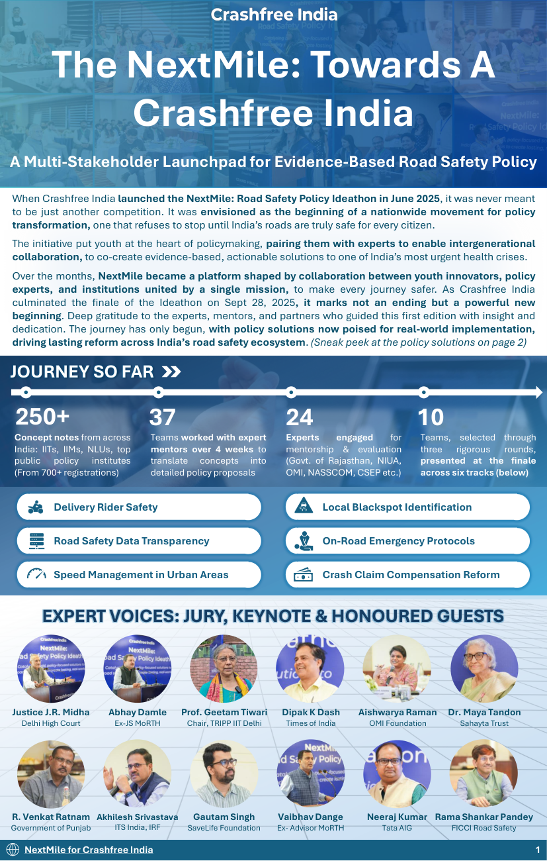


APPENDIX A6 · YOUTH & EDUCATION
NextMile's six policy tracks, and the
education assets that travel beyond campuses.
Speed management
Delivery-rider safety
Road-safety data transparency
Crash-claim compensation reform
Local blackspot identification
On-road emergency protocols
'Know Your Rights with Aasha' comic
Three compensation pathways explained in comic form — Hit & Run Scheme (₹2L), Section 164 no-fault (₹5L), Section 166 full claims.
Hindi crash-claim guides
On stage at the National Road Safety Implementation Forum, IIT Delhi — April 2026.
4-step claim process, free DLSA legal aid, NALSA 15100, Cashless Treatment Scheme 2025 (₹1.5L / 7 days) — distributed at hospitals and police stations.
Pre-Hospital Care Primer
Golden Hour, ERSS-112, ambulance benchmarks — India's emergency-response gaps mapped against global standards.
Road Safety Dialogue Series
1,000+ participants across sessions with police, transport departments and professionals.
The NextMile newsletter.
APPENDIX · NEXTMILE & EDUCATION
24 / 25

Slide 25

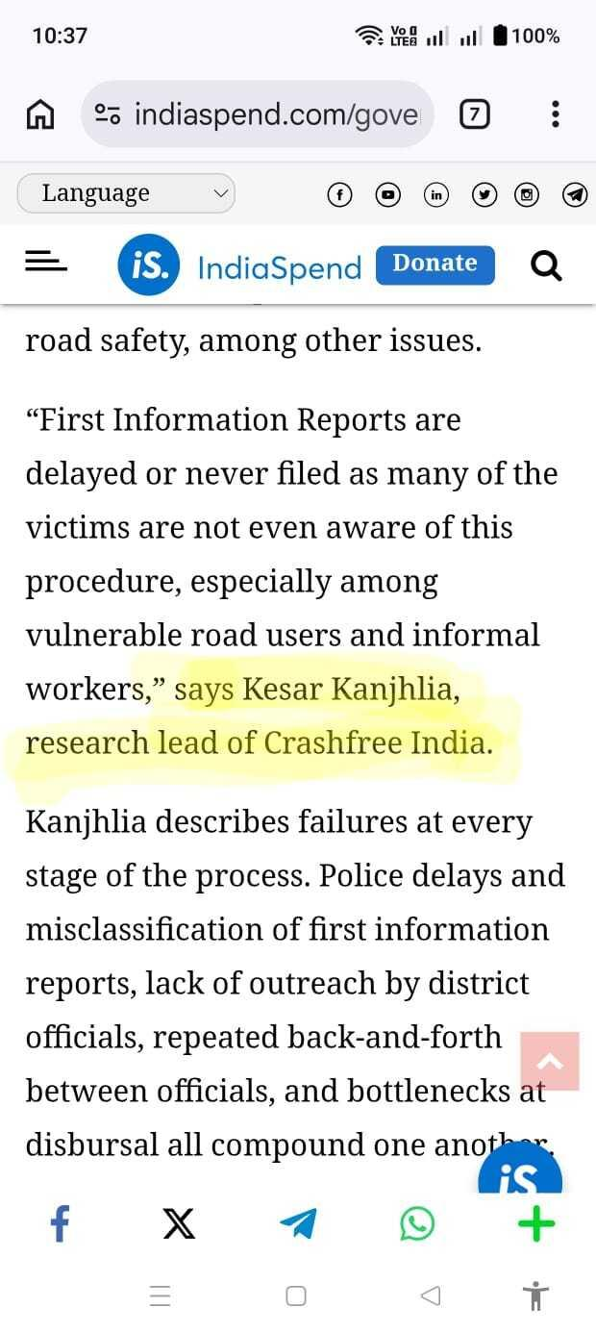
APPENDIX A7 · PRESS & CONTACT
Where you may have read about us.
'Justice Unserved' coverage
Deccan Herald · Economic Times · Fortune India · IndiaSpend · Moneycontrol · Scroll.in · The Wire
MS Dhoni announcement (Apr 2026)
Business Standard · The Tribune · The Wire (PTI) · Team-BHP · MediaBrief · Adgully
Launch coverage (Jun 2025)
TheCSRUniverse · Team-BHP · Adgully · MediaInfoline — 'Cars24 launches Crashfree India to eliminate road fatalities by 2040'
Team bylines & citations
Scroll.in op-ed on underage-driving law (Shubham Kumar) · The Wire / IndiaSpend on gig-rider crash data (Aastha Shreeharsh)
IndiaSpend citing CFI research, 2026.
crashfreeindia.org · helpdesk@crashfreeindia.org · WhatsApp +91 78380 59367 · Live dashboard: crashfreeindia.org/rakshak/dashboard
APPENDIX · PRESS & CONTACT
25 / 25

