Slide 1

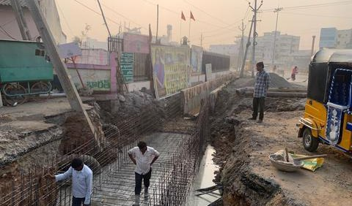
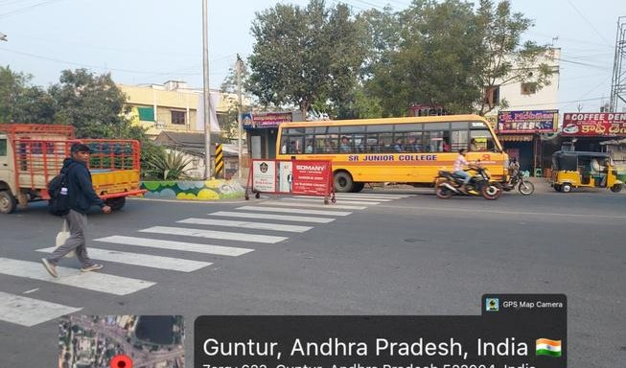

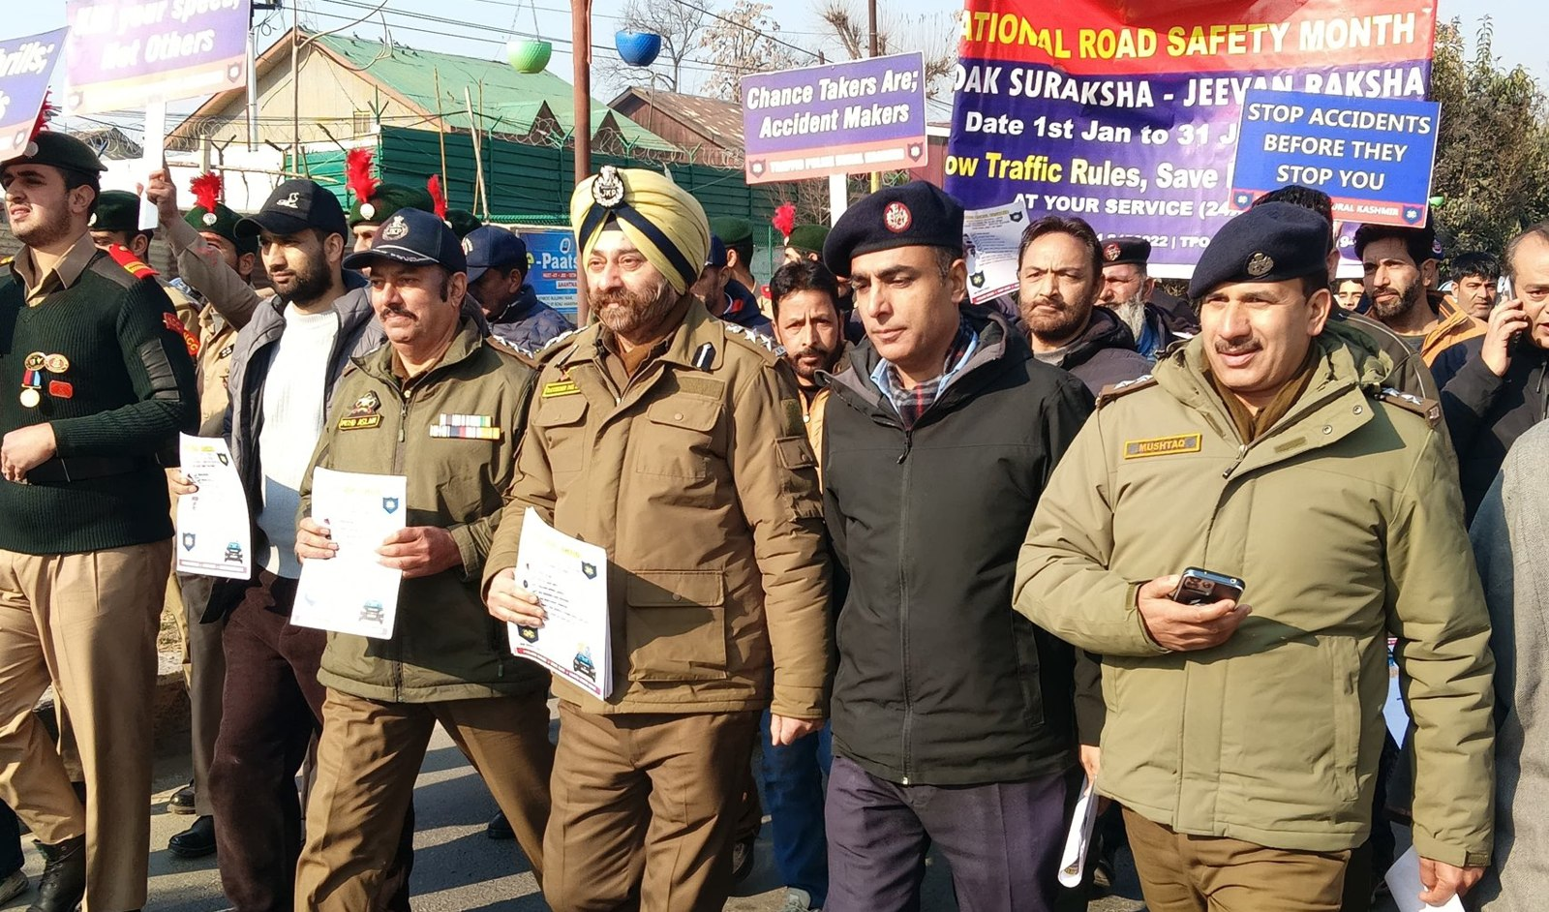
AUGUST 2026 · NEW DELHI
EXPRESSION OF INTEREST · NATIONAL ROAD SAFETY BOARD
Working Group 2: Safe Roads, Speeds &
Vulnerable Road Users
Submitted by Crashfree India (Vision Zero Trust) — a technology-led road safety nonprofit backed by Cars24,
working with public authorities across 18 cities.
31
25+
15
3,00,000+
sites audited across 18 cities
written authority approvals
implementations underway
vehicles screened by SATARK
Submitted to the Chairperson and Members, Working Group 2, National Road Safety Board
crashfreeindia.org

Slide 2
BEFORE THE SLIDES
A letter to the Working Group
New Delhi · August 2026
Respected Chairperson and Members of Working Group 2,
Crashfree India is a young road safety nonprofit — registered as the Vision Zero Trust, co-founded with the Indian Road Safety Council, and backed by a three-year, US$3 million commitment from Cars24. We work alongside public authorities: our student teams audit dangerous locations under senior experts, our technology helps police and administrators see their own pipelines, and our support tools stand with families after a crash.
In our first year we audited 31 high-risk locations across 18 cities, secured 25+ written approvals from road-owning authorities, and began implementation at 15 sites — each tracked on a public dashboard. SATARK, our AI enforcement platform, has screened over 3,00,000 vehicles for police in Jaipur and Bengaluru and has now reached Gurugram. Four open-data platforms, the Aasha victim chatbot, hospital helpdesks and MS Dhoni as our Goodwill Ambassador complete the picture.
The pages that follow introduce the organisation briefly, then set out the work most relevant to this Working Group in the detail its mandate deserves. Everything shown is running today, is public, and is offered to the Board without cost. We would be honoured to contribute.
Respectfully,
Akhtar Hussain
Mission Lead, Crashfree India · akhtar@crashfreeindia.org · crashfreeindia.org

Slide 3





HOW THIS DECK IS ORGANISED
Five sections, three minutes to skim
1
About Crashfree India
04
Who we are, how we are set up, and the principles we work by.
2
What we have built
05 – 11
Every public-facing programme — audits, enforcement tech, victim support, open data, youth, campaigns.
3
Our people
12
Trustees, Board of Advisors, and the expert bench behind the work.
4
Project Rakshak in depth
13 – 21
The deep dive matched to this Working Group's mandate — evidence, method, and results.
5
How we can contribute
22 – 23
Four concrete, no-cost offers to the Working Group.

Slide 4

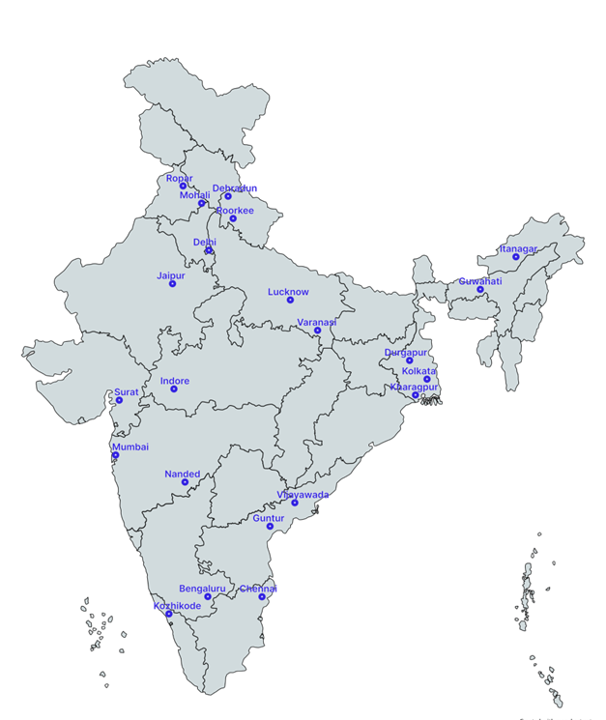



01 · ABOUT US
SECTION 1 OF 5 · ABOUT US
Crashfree India: a nonprofit that adds capacity to road safety work
Registered as the Vision Zero Trust · Co-founded by Cars24 and the Indian Road Safety Council · Working since June 2025 · New Delhi
Evidence first
Structured field audits, file reviews and research to official standards — not opinion.
Institutional collaboration
We work through PWDs, NHAI, transport departments, police and District Road Safety Committees.
Youth-led capacity
Trained student teams from IITs, NITs and SPAs add the auditing hands the system needs.
Technology for follow-through
Public dashboards track every recommendation from submission to completion.
Backed by a US$3 million, three-year commitment from Cars24 — programmes, not overheads, receive 71% of the budget.
Crashfree India · Expression of Interest — Working Group 2
Where we work today — 18 cities, north to south.
04 / 23

Slide 5
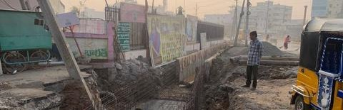
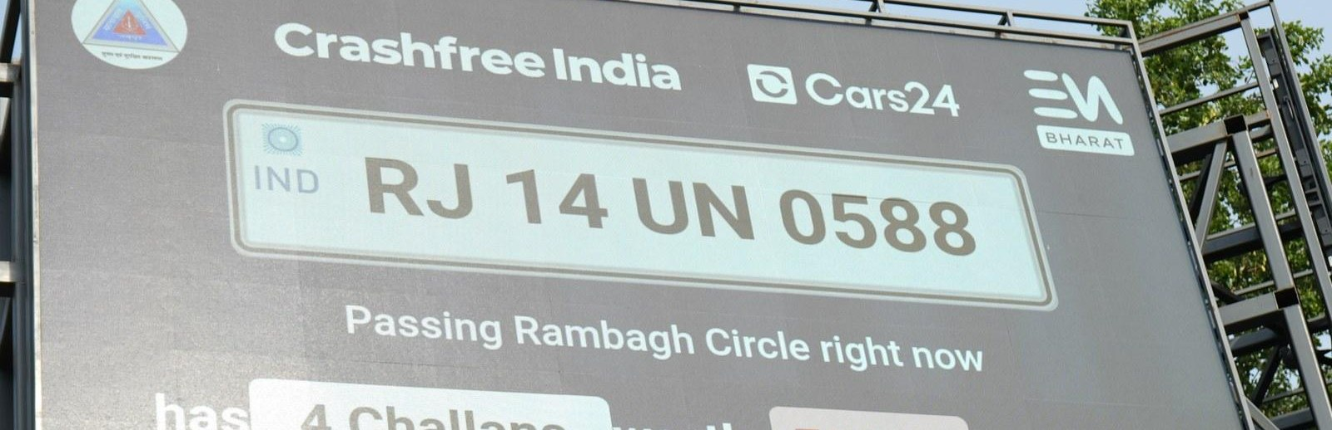
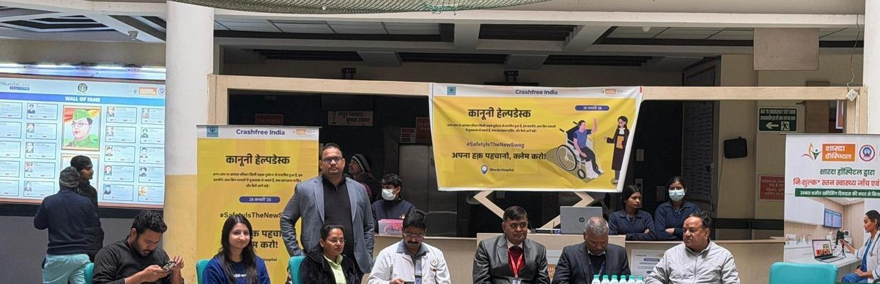
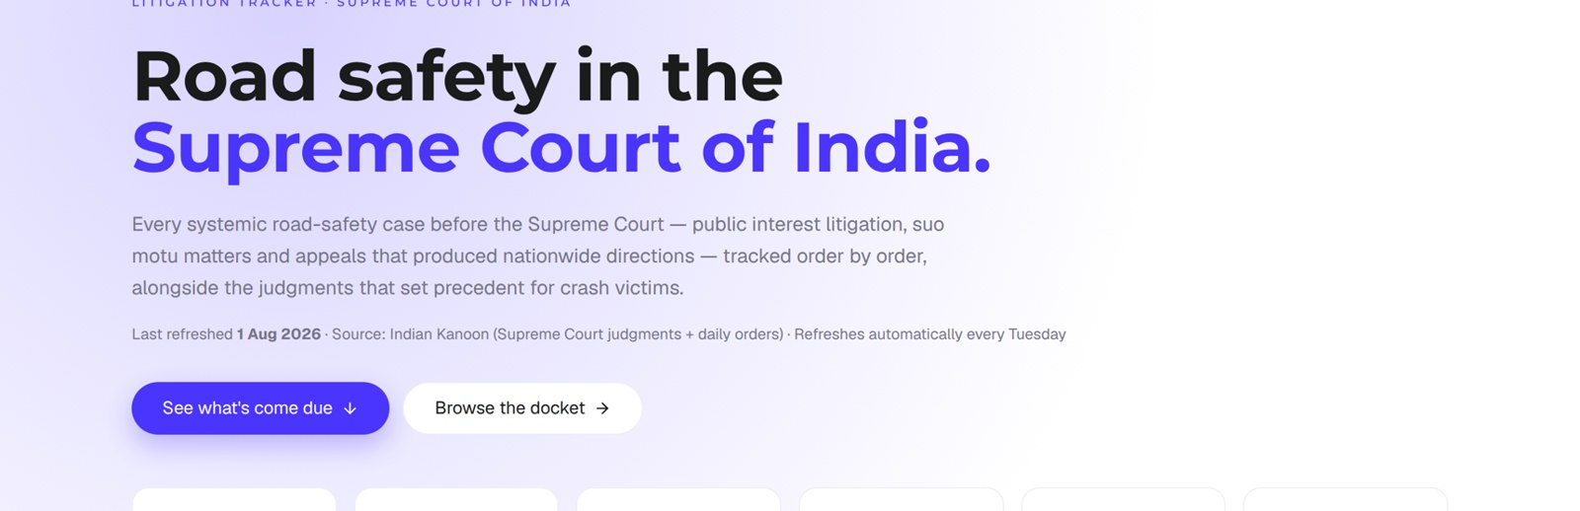
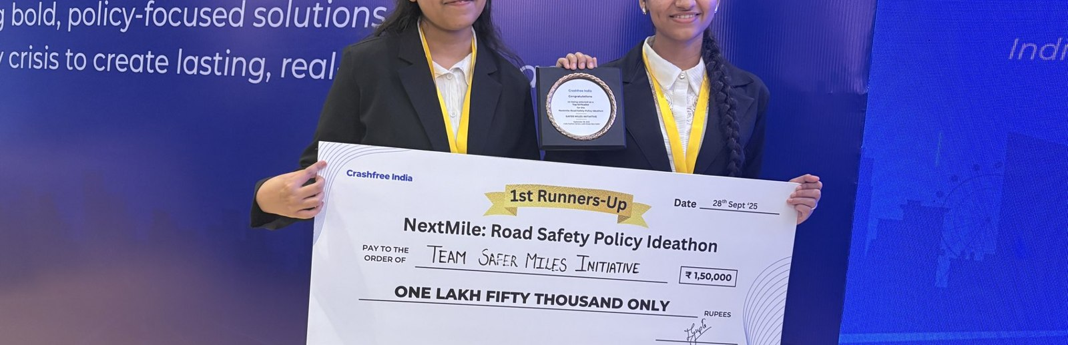
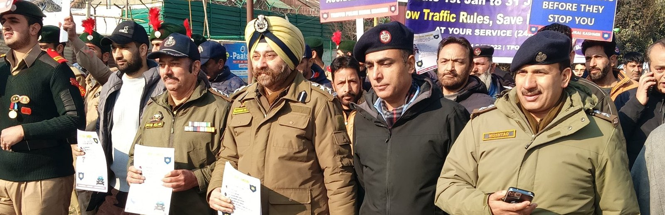
02 · WHAT WE HAVE BUILT
SECTION 2 OF 5 · WHAT WE HAVE BUILT
Six lines of work, one connected system
Audits create data · data supports policy · policy guides the field. Everything below is live today.
Project Rakshak
SATARK enforcement
Victim support
Student-led road audits, fixed with authorities
AI support that helps police find high-risk vehicles
Aasha chatbot, calculator, hospital helpdesks
31 sites · 15 under implementation
3,00,000+ vehicles screened
100+ victims helped in first 4 days
Open public data
Youth & policy
Public campaigns
Four self-updating data platforms, free to use
NextMile ideathon and national dialogue series
Road Safety Month with police & schools; MS Dhoni
36 states & 50 cities covered
2,000+ participants engaged
1M+ citizens reached
Crashfree India · Expression of Interest — Working Group 2
05 / 23

Slide 6
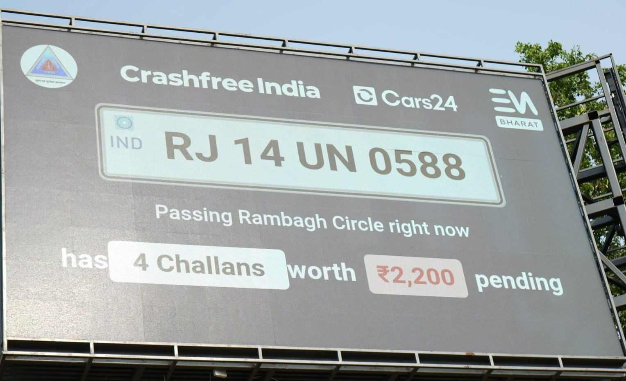
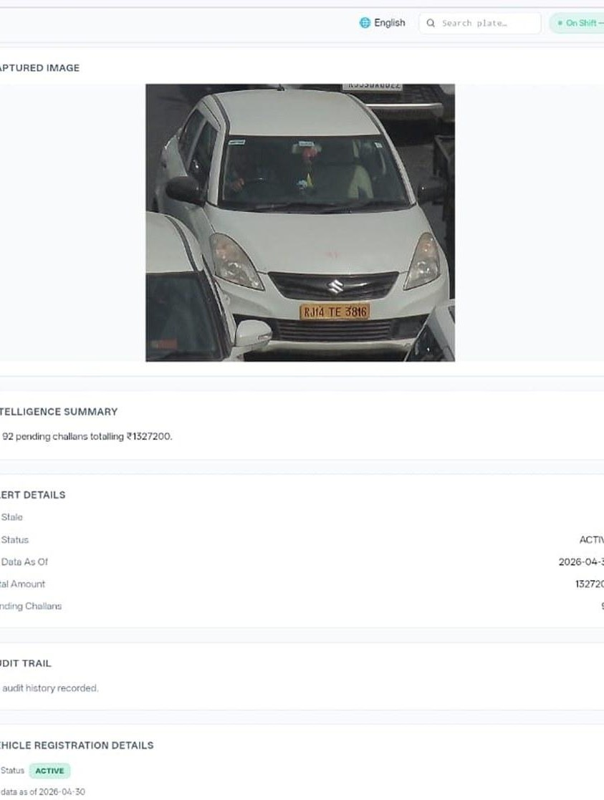








02 · WHAT WE HAVE BUILT — ENFORCEMENT TECHNOLOGY
SECTION 2 OF 5 · WHAT WE HAVE BUILT
SATARK: AI that helps police stop the right vehicle
Built with Cars24 engineers. Reads number plates, checks government records, and alerts officers to repeat offenders — in real time.
3,00,000+
₹30 Cr+
vehicles screened
pending challan value identified
350+
70,019
high-risk vehicles intercepted
vehicles found with pending challans
LIVE · Jaipur & Bengaluru
NEW · Gurugram
Bengaluru's Trinity Circle billboard was India's first — covered by Deccan Herald and national press. Pune and Ahmedabad are next.
Rambagh Circle, Jaipur — live plate, pending challans and dues on a public billboard.
Officer view — pending challans,
RC & compliance status.
ANPR camera
Plate read
Records check
Risk flag
Officer alert
Billboard
Interception
Enforcement
Crashfree India · Expression of Interest — Working Group 2
06 / 23

Slide 7
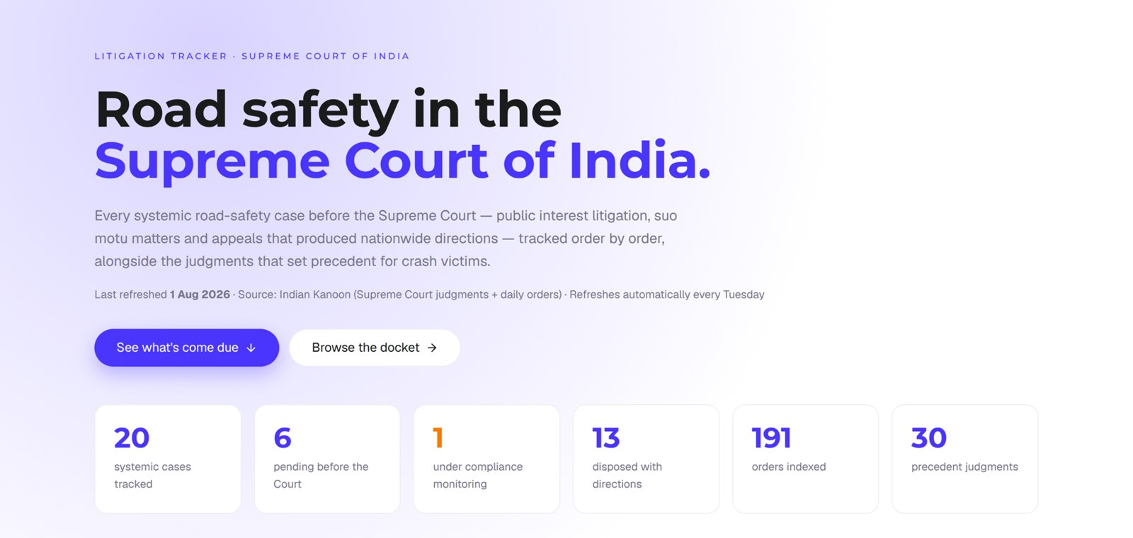
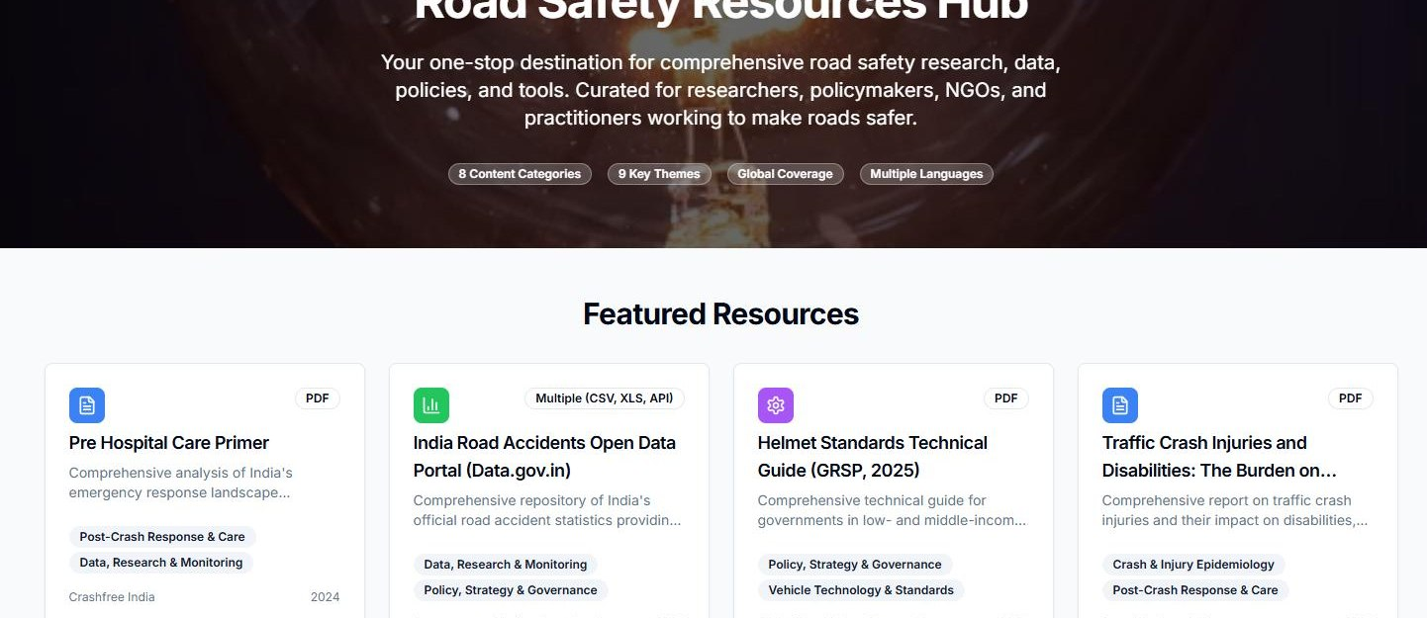

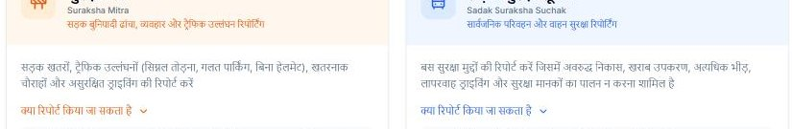

02 · WHAT WE HAVE BUILT — OPEN PUBLIC DATA
SECTION 2 OF 5 · WHAT WE HAVE BUILT
Public data platforms any authority can use, free
Built and maintained by our team; self-updating; no login, no fee. Shown live below.
Road Safety Resources Hub — primers, data portals and guides in one place.
Supreme Court Litigation Tracker — live: 20 systemic cases, 191 orders indexed, 30 precedent judgments (1 Aug 2026).
Road Defect Repository
146 districts · 13 languages — defect news, mapped publicly.
Parliament tracker
1,423 road-safety questions indexed across the Lok Sabha & Rajya Sabha.
Crash Data Dashboard
MoRTH statistics made usable — 36 states, 50 cities, open licence.
Suraksha Mitra & Sadak Suraksha Suchak — citizen hazard reporting in Hindi (50+ hazards in the first 20 days).
Crashfree India · Expression of Interest — Working Group 2
07 / 23

Slide 8
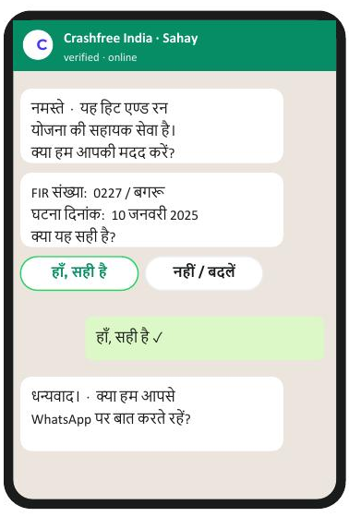
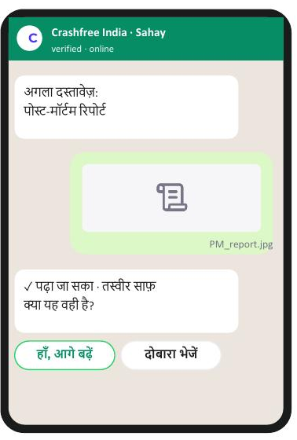
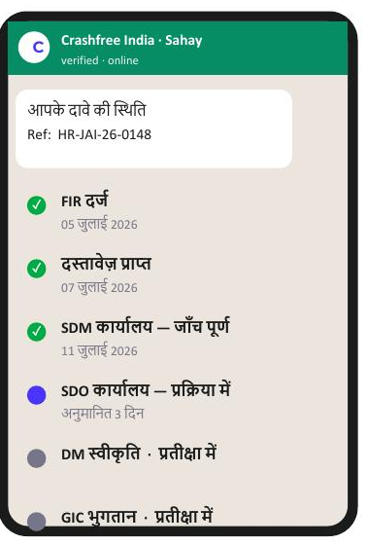

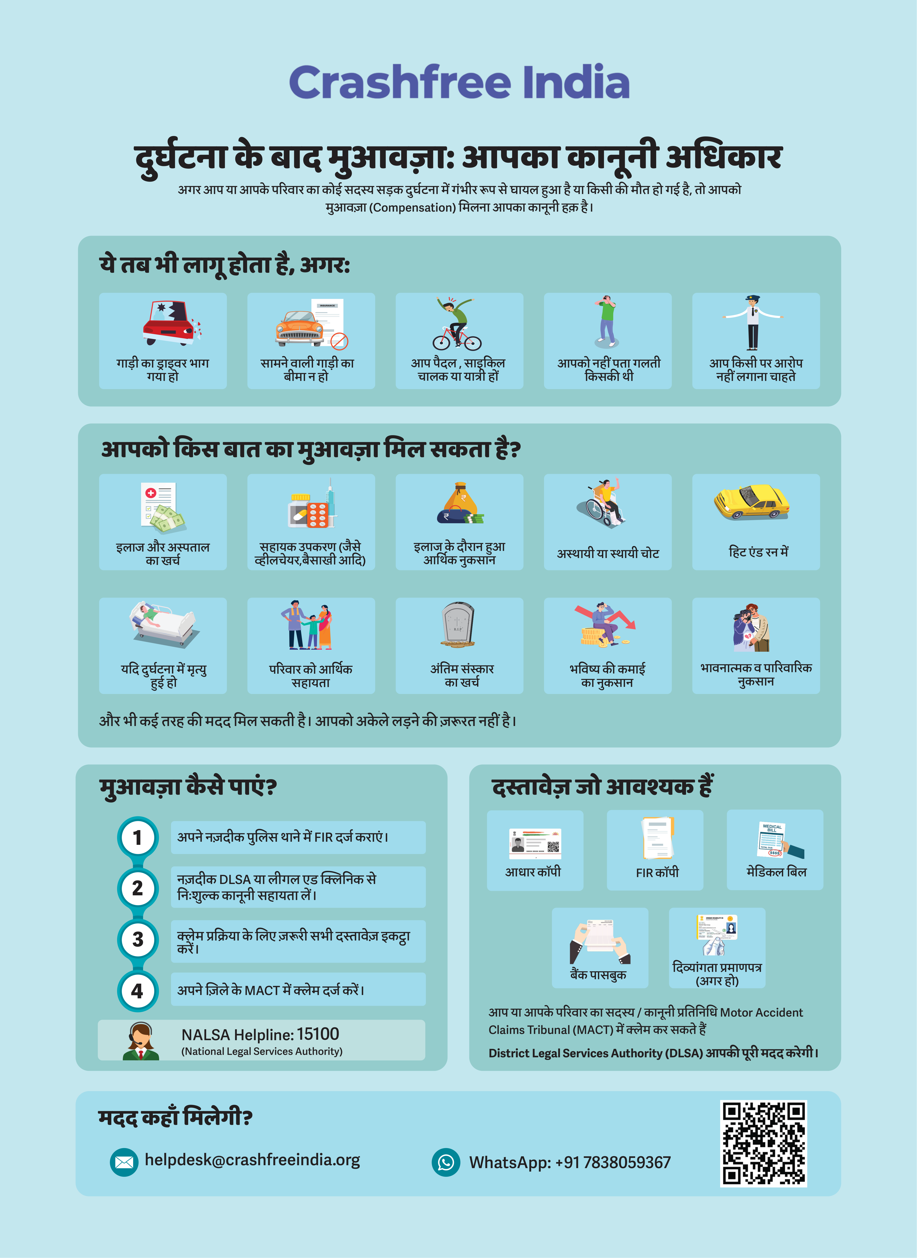



02 · WHAT WE HAVE BUILT — VICTIM SUPPORT
SECTION 2 OF 5 · WHAT WE HAVE BUILT
Help a family can actually use, in their language
From the first hours after a crash to the final compensation order — on WhatsApp, on paper, and in person.
Aasha chatbot
Step-by-step guidance on rights, schemes and documents — 24/7, multilingual.
Compensation Calculator
Free instant estimates on Supreme Court principles (Sarla Verma, Pranay Sethi).
Hospital helpdesks
Legal desks in trauma wards — 100+ victims supported in the first four days.
Day one after FIR
Document capture
Live case status
Plain-language education
Comics and Hindi guides on all three compensation routes, NALSA 15100 and the Cashless Treatment Scheme 2025.
Aasha — our 24/7 multilingual AI companion. The family needs no app and no portal; everything runs on WhatsApp and voice, in Hindi.
Hindi legal-rights guide — used in
hospitals & police stations.
Crashfree India · Expression of Interest — Working Group 2
08 / 23

Slide 9
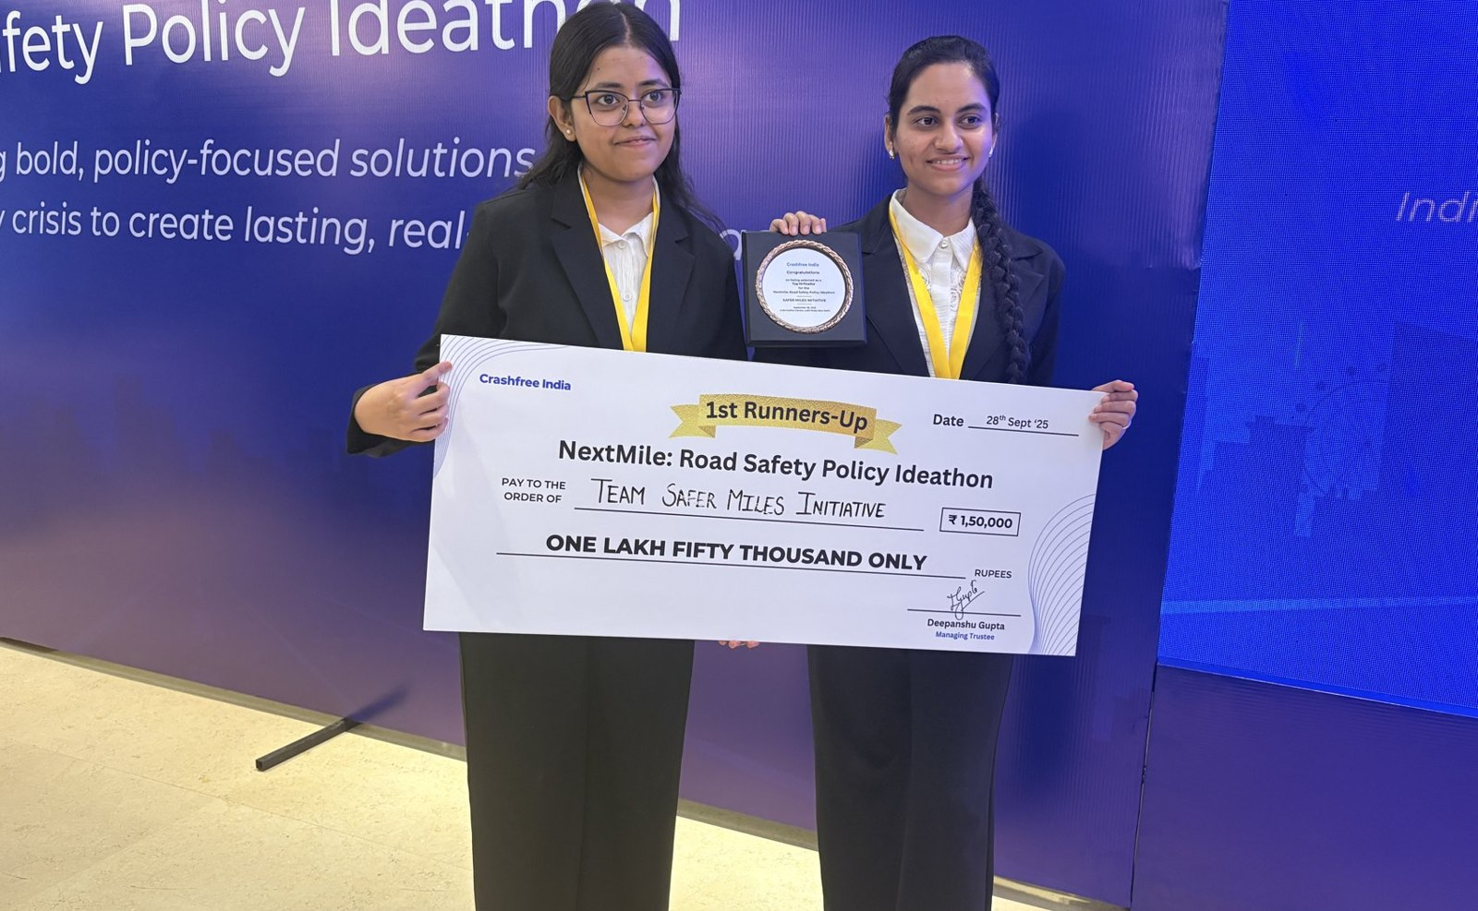
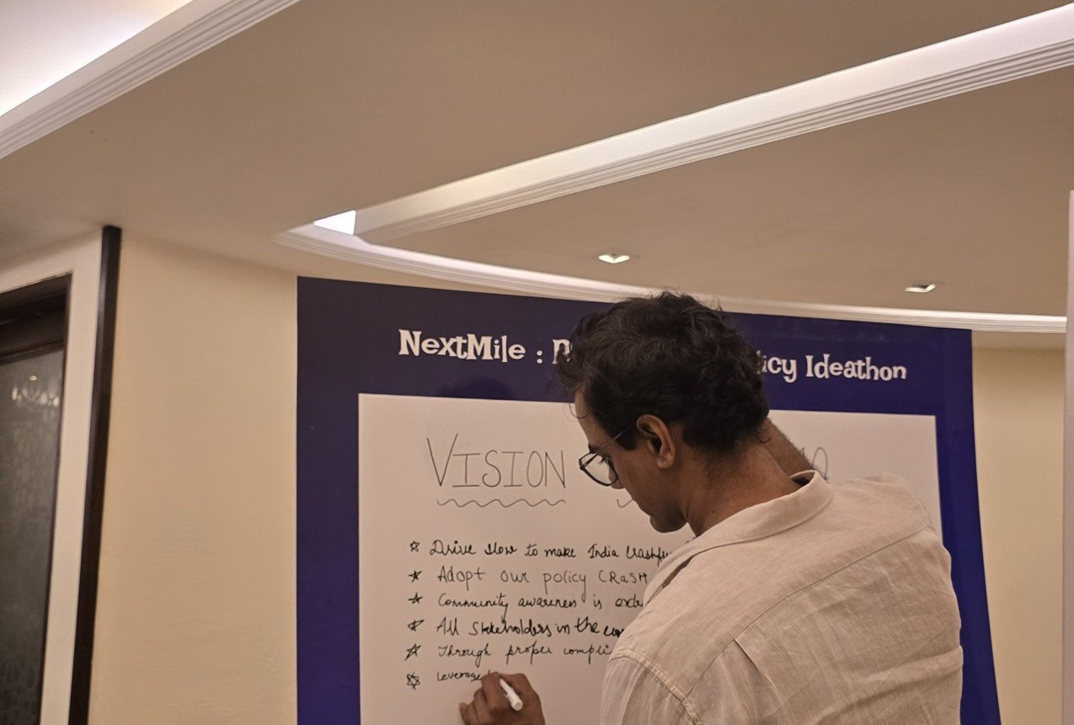



02 · WHAT WE HAVE BUILT — YOUTH & POLICY
SECTION 2 OF 5 · WHAT WE HAVE BUILT
Young talent and senior experts, working the same problem
A steady pipeline of engineers and policy minds — so road safety work never runs out of hands.
National Road Safety Dialogue Series
200+ live attendees; speakers from MoRTH, CIRT, AIIMS Trauma Centre, CSIR-CRRI and ARAI.
Three sessions so far
Bus safety · Delivery rider safety · Good Samaritan law & the Cashless Treatment Scheme.
NextMile: Road Safety Policy Ideathon — grand finale, 28 Sep 2025, New Delhi.
Vision Wall 2040 — participants write the road-safety future they want.
Public YouTube channel
Session recordings, victim-education videos and explainers — free to reuse in trainings.
2,000+
250+
700+
10
Mentors and evaluators came from the Government of Rajasthan, NIUA, OMI, NASSCOM and CSEP. Winning tracks now feed our audit and research pipeline.
participants
concept notes
teams
finalist teams
Next: 'Be a Rakshak' university chapters at IITs, NITs and SPAs.
Crashfree India · Expression of Interest — Working Group 2
09 / 23

Slide 10
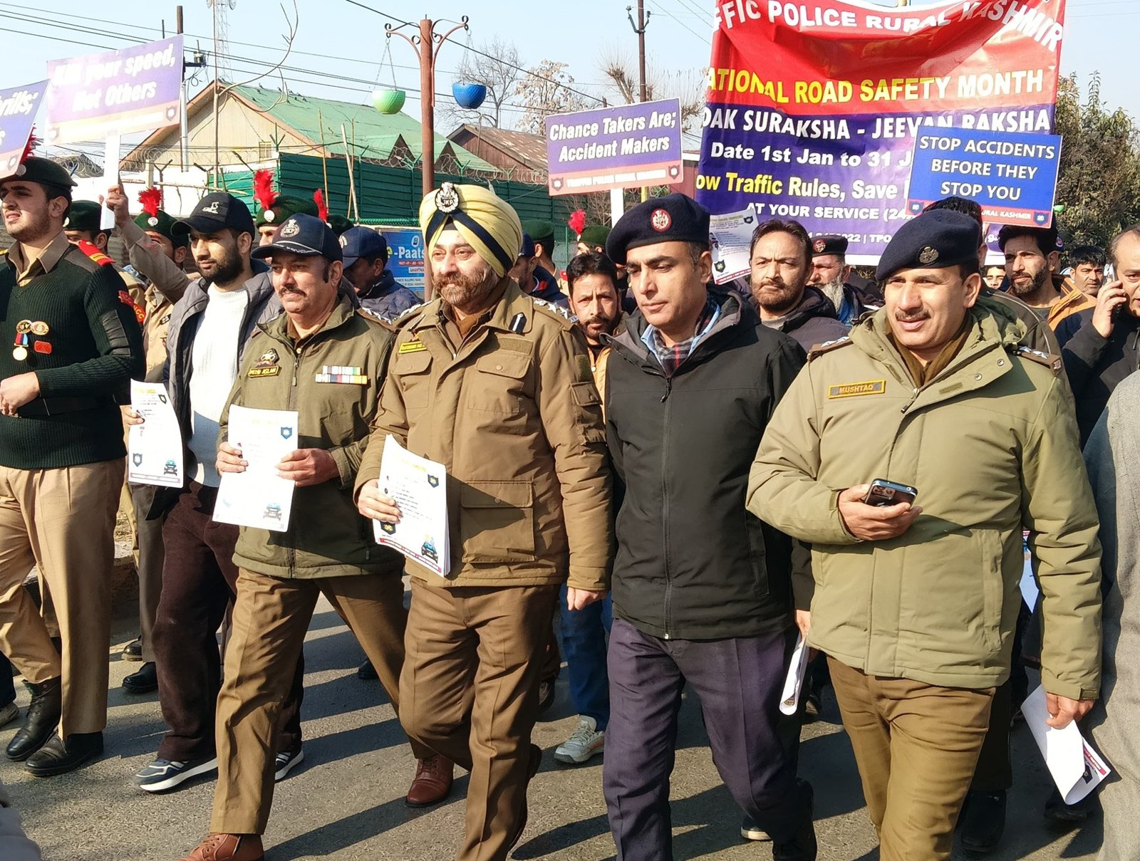
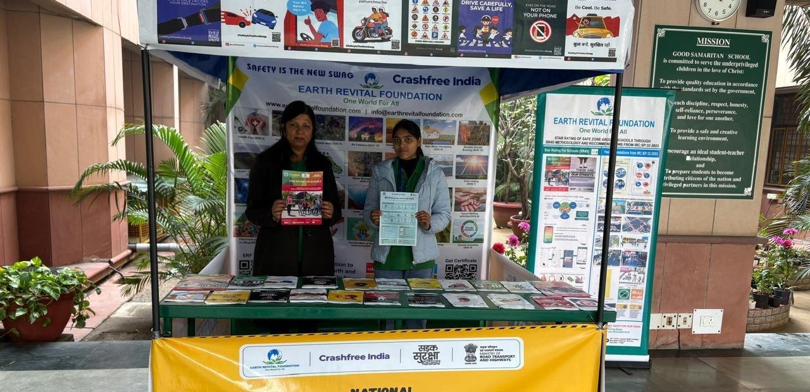
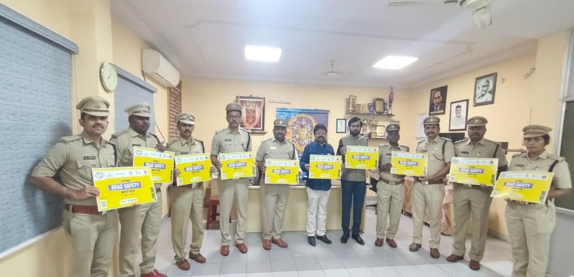
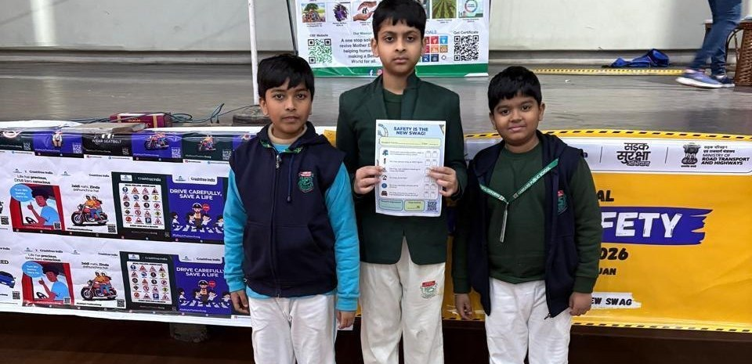
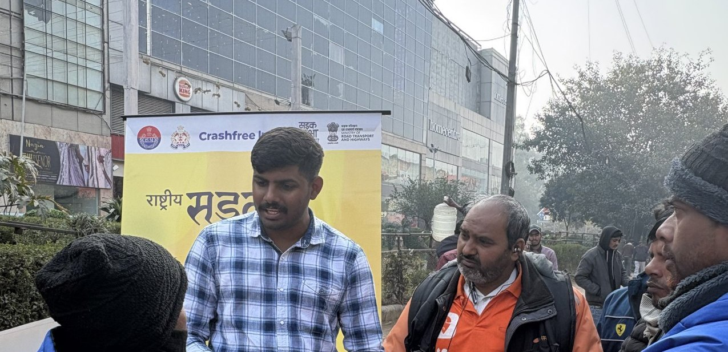
02 · WHAT WE HAVE BUILT — ON THE GROUND
SECTION 2 OF 5 · WHAT WE HAVE BUILT
Road Safety Month 2026, run with the system
With district police, schools, hospitals and delivery platforms — in Hindi and local languages.
CFI stall at a government office
Materials briefing with police staff
National Road Safety Month rally — on the road with district traffic police, Jan 2026.
School programme with certificates
Delivery-rider outreach — Swiggy & Instamart
1M+ citizens reached across campaigns in year one.
Crashfree India · Expression of Interest — Working Group 2
10 / 23

Slide 11
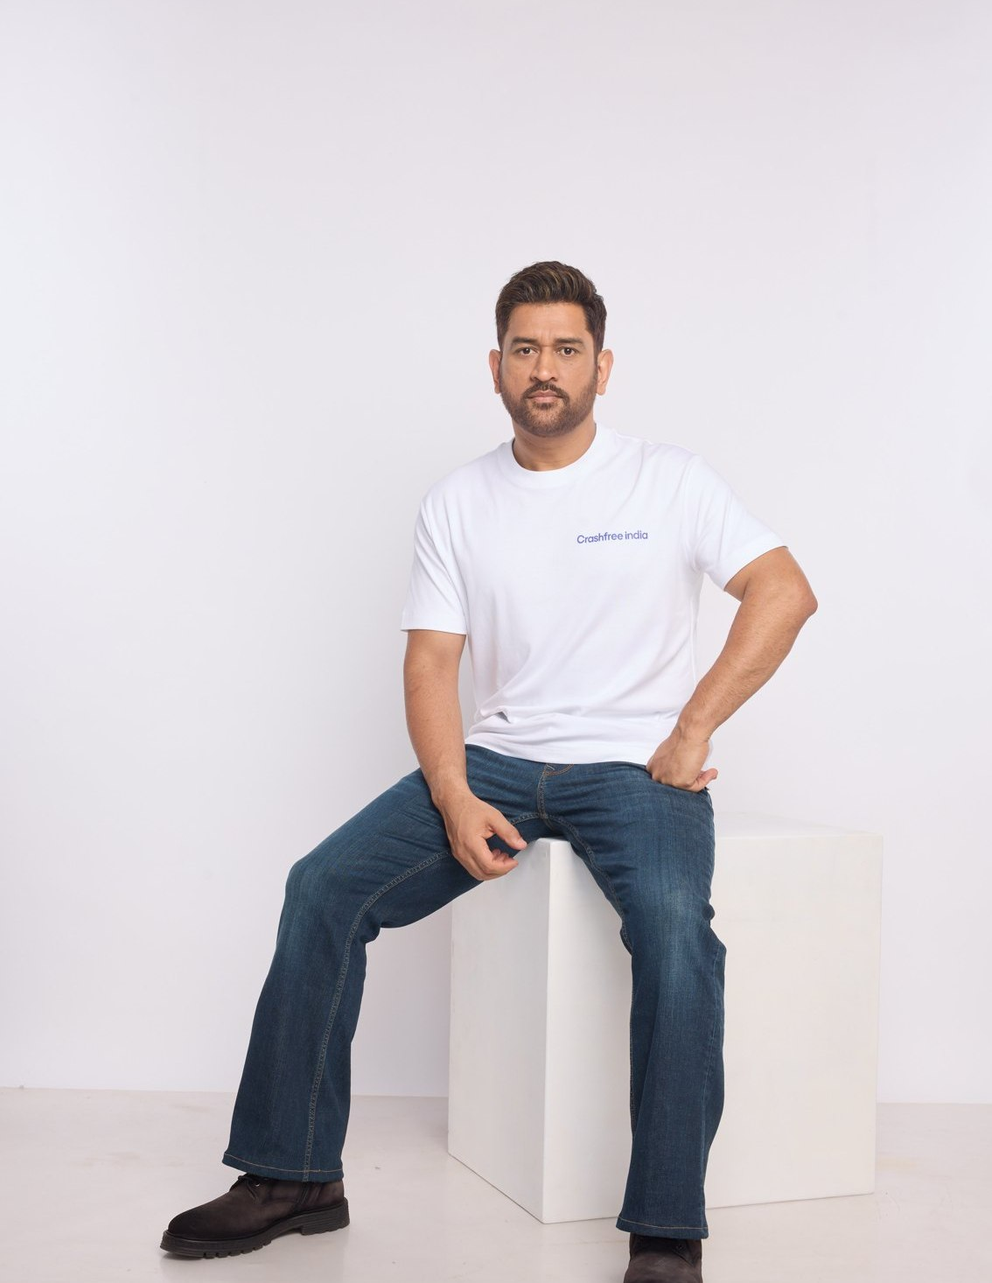
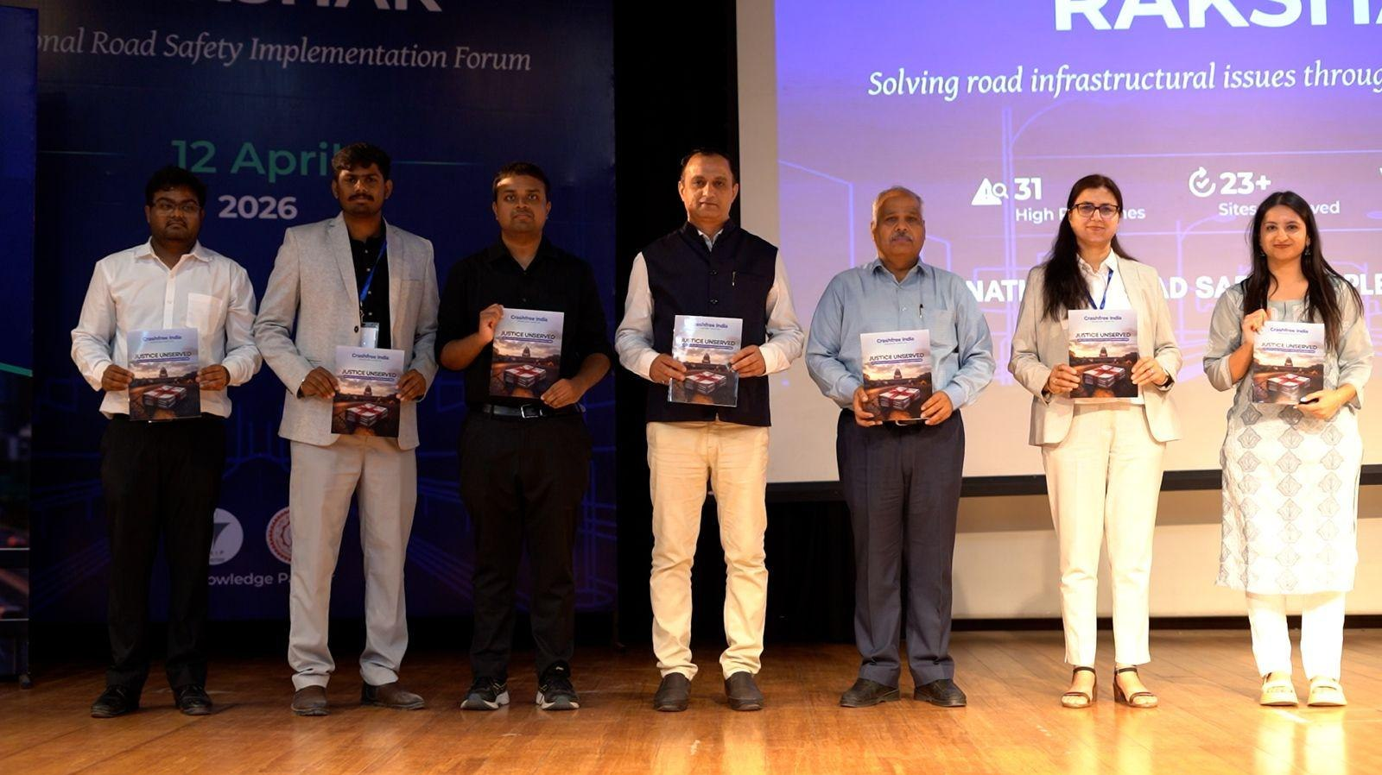
02 · WHAT WE HAVE BUILT — PUBLIC VOICE
SECTION 2 OF 5 · WHAT WE HAVE BUILT
MS Dhoni carries the message; the ecosystem engages
"We already know what is going wrong. What we need now is more responsibility, more discipline, more respect for life."
MS Dhoni, at the National Road Safety
Implementation Forum, IIT Delhi
National Road Safety Implementation Forum, IIT Delhi — 60+ experts including MoRTH, WHO, UNICEF, iRAP and CSIR-CRRI.
COVERED IN NATIONAL PRESS
Deccan Herald
Economic Times
MS Dhoni — Goodwill Ambassador, announced April 2026.
Dhoni's voice powers 'Be a Rakshak', school-zone safety and compensation-awareness campaigns.
Fortune India
IndiaSpend
Scroll.in
The Wire
Times of India
Business Standard
Crashfree India · Expression of Interest — Working Group 2
11 / 23

Slide 12
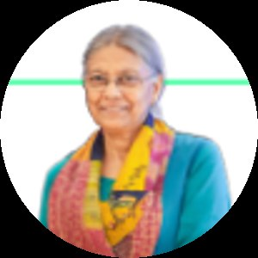
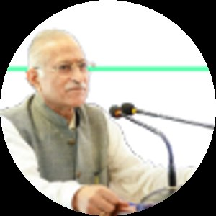
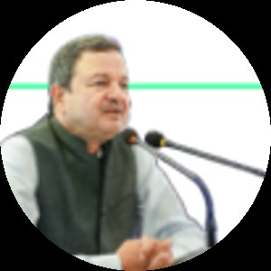
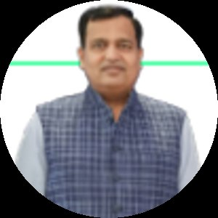
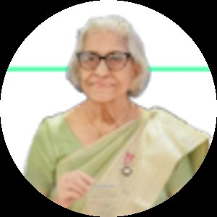
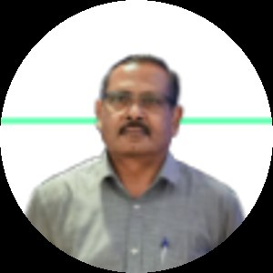
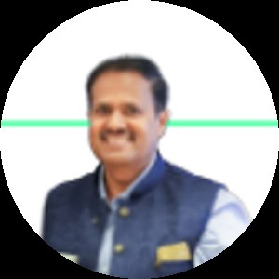
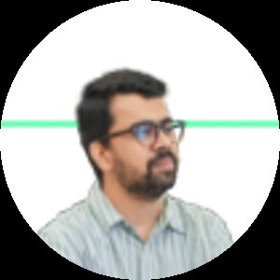
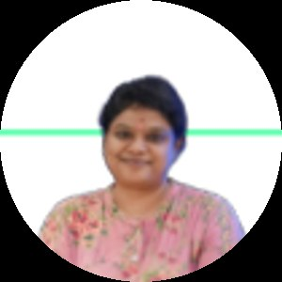
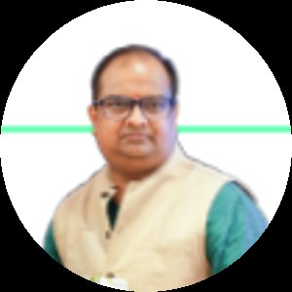
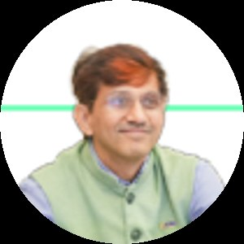
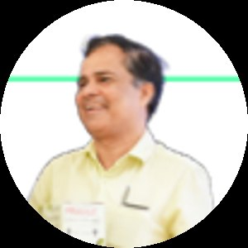
03 · OUR PEOPLE
SECTION 3 OF 5 · OUR PEOPLE
Advised by the people who built India's road safety practice
Prof. Geetam Tiwari — Board of Advisors
PT
Piyush Tewari — Board of Advisors
Professor Emerita & Chair, TRIP Centre, IIT Delhi · Member, IRC H-7 Committee on Road Safety Audit
Founder & CEO, SaveLIFE Foundation · Architect of the Good Samaritan Law · Zero-Fatality Corridors
THE EXPERT BENCH AROUND OUR WORK — JURY, MENTORS & REVIEWERS
Justice J.R. Midha
Abhay Damle
Vaibhav Dange
Dr. Maya Tandon
R. Venkat Ratnam
Akhilesh Srivastava
Delhi High Court (Retd.)
Ex-JS, MoRTH
Ex-Advisor, MoRTH
Sahayta Trust
Government of Punjab
ITS India · IRF
Gautam Singh
Aishwarya Raman
Neeraj Kumar
R.S. Pandey
Dipak K. Dash
SaveLIFE Foundation
OMI Foundation
Tata AIG
FICCI Road Safety
Times of India
Trustees: Amar Srivastava (President · Founder, IRSC) · Deepanshu Gupta (Managing Trustee) · Gajendra Jangid (Co-founder, Cars24) Team: IIT Delhi, NALSAR, TISS & HKUST alumni · 75+ engineering interns · 31 student audit teams
Crashfree India · Expression of Interest — Working Group 2
12 / 23

Slide 13
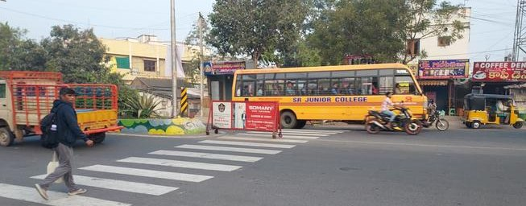
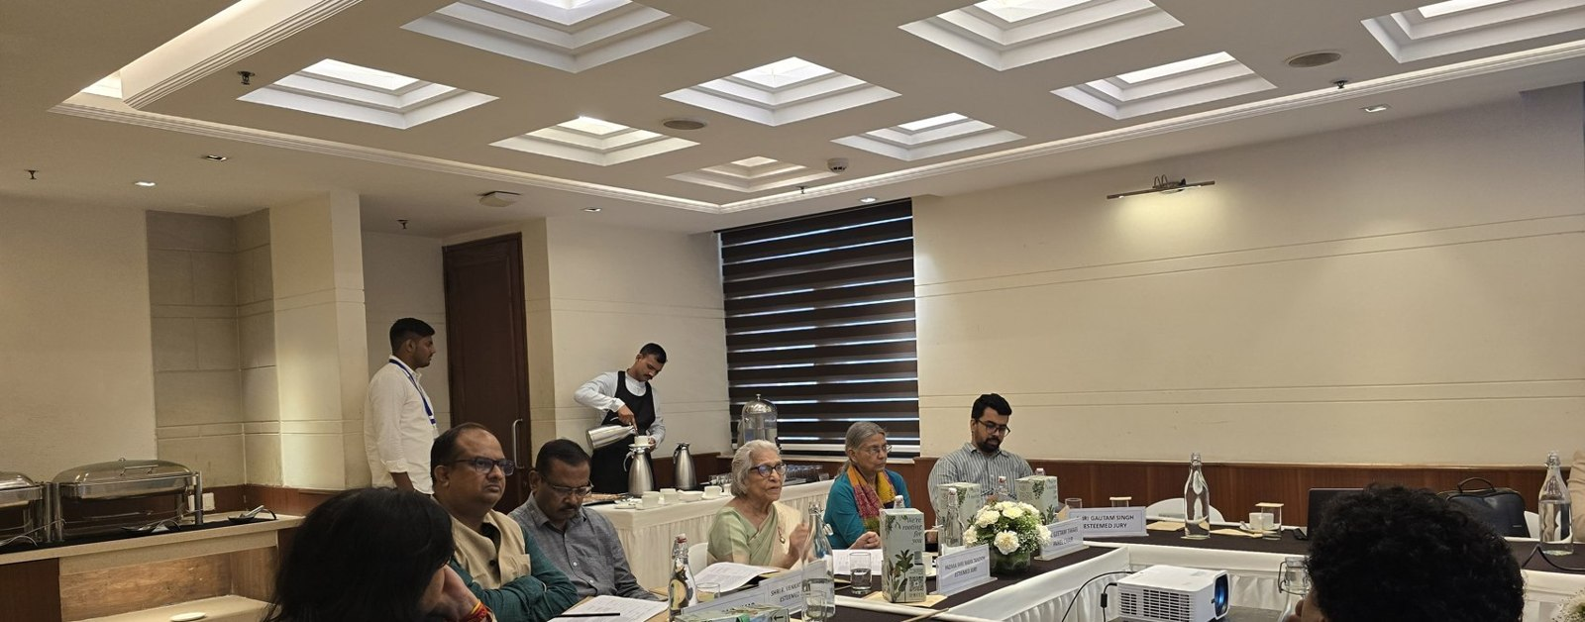
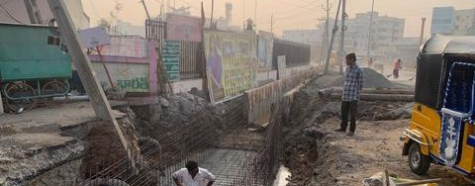



04 · PROJECT RAKSHAK — WHAT IT IS
SECTION 4 OF 5 · PROJECT RAKSHAK
Project Rakshak, in one sentence
Trained student teams, guided by senior road-safety experts, audit dangerous road locations — and Crashfree India walks each recommended fix through the road-owning authority until it is built.
Students audit
Experts verify
Authorities build
Teams from IITs, NITs and SPAs collect data on-site: traffic, conflicts, 900+ stakeholder surveys.
Mentors anchor every audit to IRC codes and MoRTH checklists before anything is proposed.
The fix goes to the PWD, corporation or NHAI in its own format — and we track it to completion.
Four phases each cohort: Research & problem identification → Stakeholder engagement & audits → Analysis & costed solutions → Reporting & authority engagement
Crashfree India · Expression of Interest — Working Group 2
13 / 23

Slide 14

04 · PROJECT RAKSHAK — WHY IT MATTERS TO WG-2
SECTION 4 OF 5 · PROJECT RAKSHAK
Identification has outpaced rectification — capacity is the constraint
The knowledge exists; the pipeline that turns identified risk into completed engineering needs more trained hands.
13,795
5,036
44
black spots identified nationally (MoRTH)
permanently rectified so far (Parliamentary Standing Committee, 2024)
certified Road Safety Auditors on the national registry (July 2026)
Low-cost engineering measures — raised crossings, traffic calming, lighting, safer intersections — reduce crashes by 20–80% where applied (iRAP & PIARC evidence). What limits progress is steady, supervised auditing capacity and follow-up, working under the road-owning authority.
Project Rakshak was designed for precisely this constraint: trained auditing capacity that supports road-owning agencies — and tracks every fix to completion.
Guntur, Andhra Pradesh — drainage correction underway after audit.
Crashfree India · Expression of Interest — Working Group 2
14 / 23

Slide 15
04 · PROJECT RAKSHAK — YEAR ONE
SECTION 4 OF 5 · PROJECT RAKSHAK
Cohort 1: a national footprint in the first year
120+
31
25+
15
→
→
→
locations screened
sites audited — 11 official black spots
written authority approvals
implementations underway
31 student teams · 20 institutions including nine IITs · 900+ stakeholder surveys · guided by 8 mentors and independent evaluators
North: Ropar, Dehradun, Roorkee, Delhi, Lucknow, Varanasi · East: Guwahati, Durgapur · West & Central: Indore, Mumbai, Surat · South: Vijayawada, Guntur, Kozhikode, Chennai — among 18 cities.
Estimated 20–50% crash reduction at treated sites once complete — based on WHO / iRAP evidence for these counter-measures; we will verify with before-and-after data as implementations finish.
Cohort-1 sites across India.
Crashfree India · Expression of Interest — Working Group 2
15 / 23

Slide 16
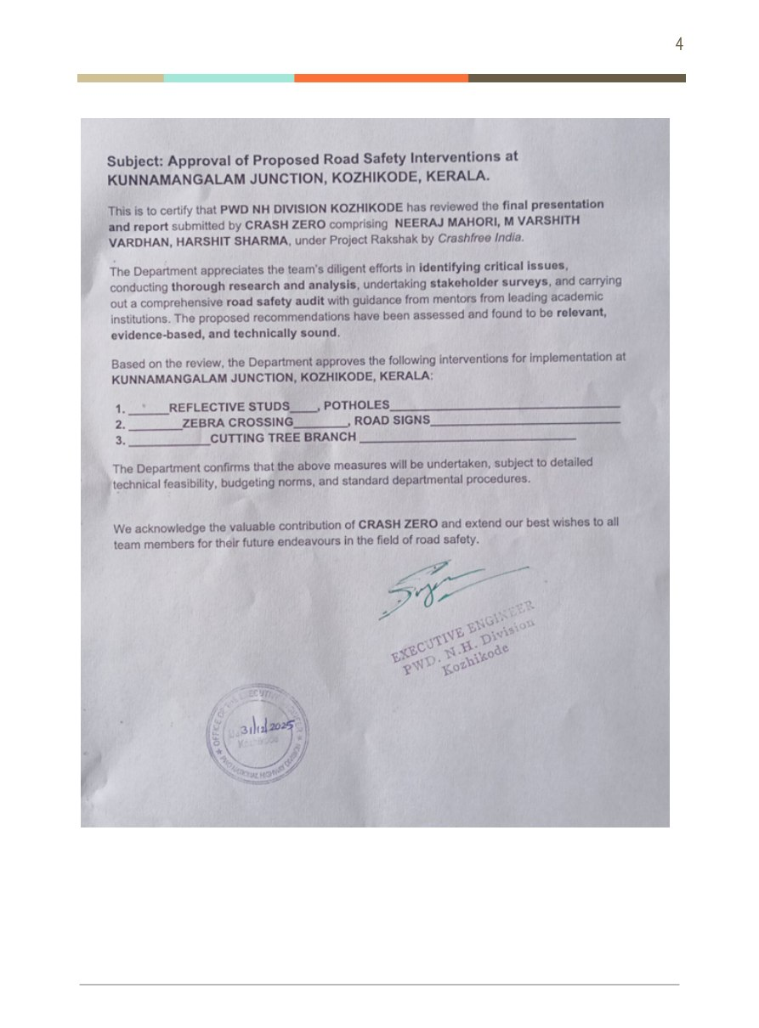
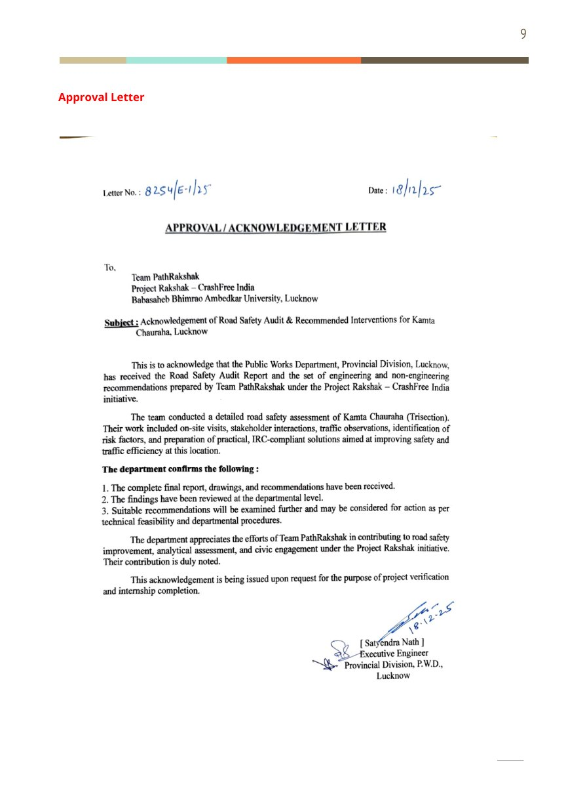
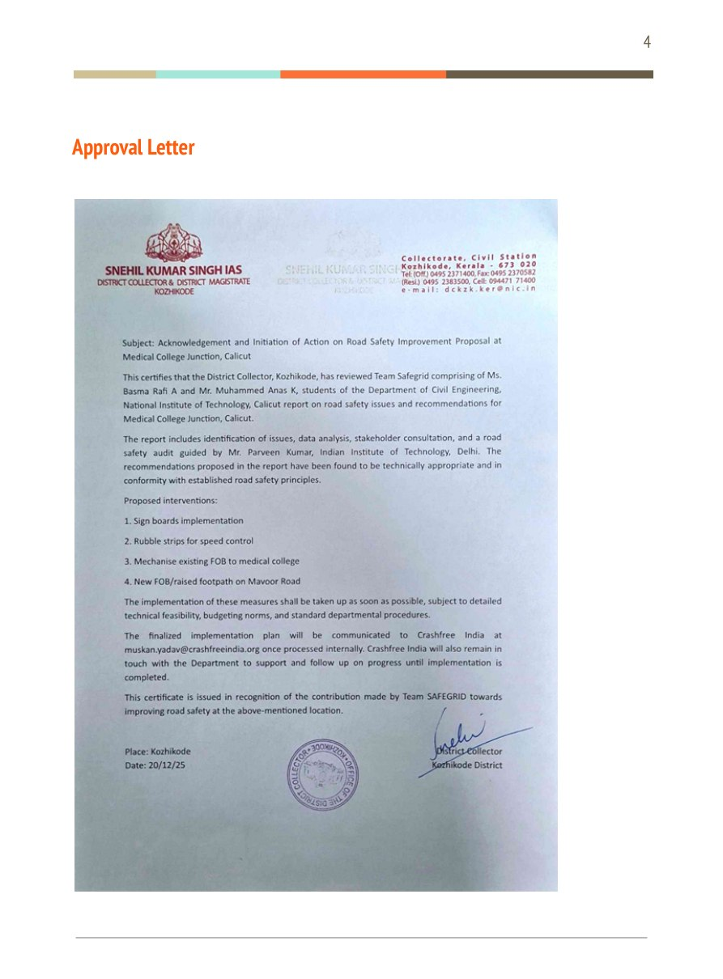
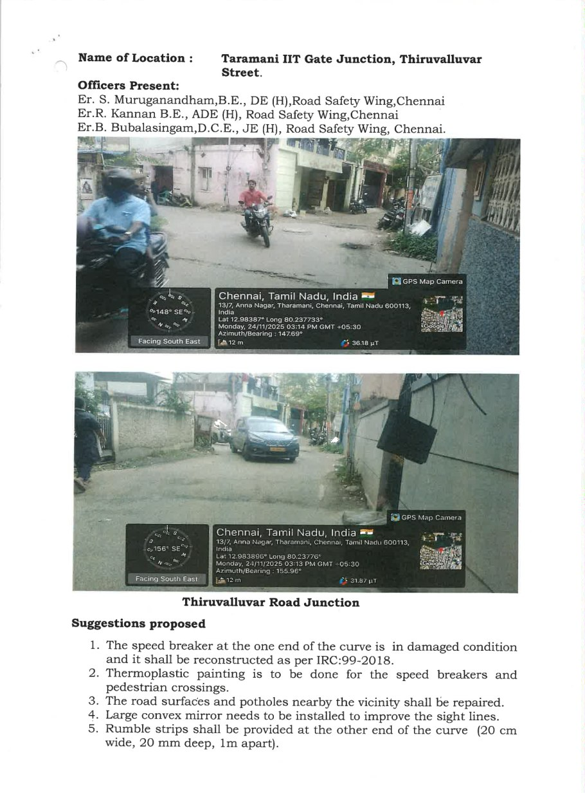
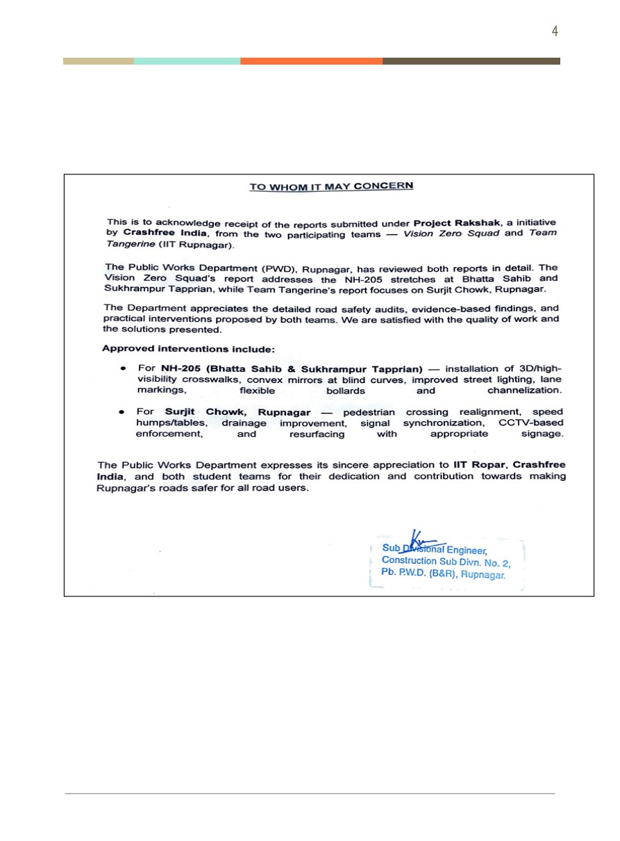
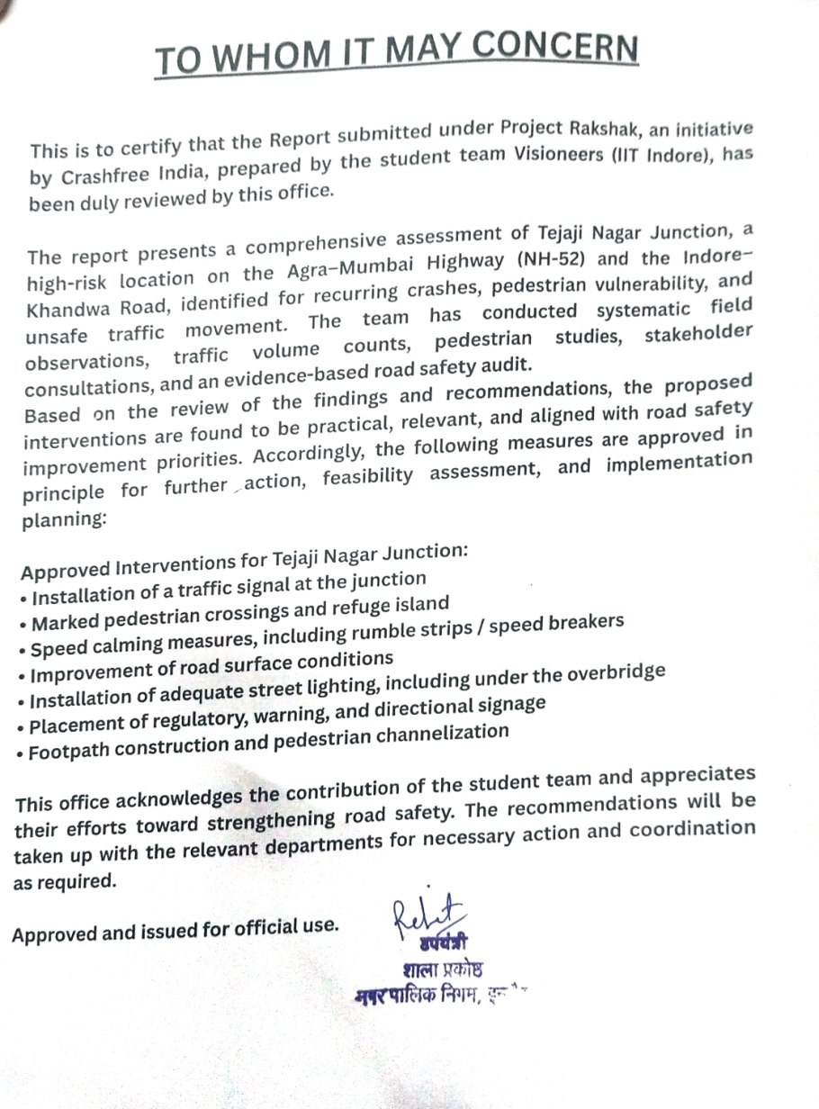
04 · PROJECT RAKSHAK — THE PAPER TRAIL
SECTION 4 OF 5 · PROJECT RAKSHAK
Approvals in writing, from the authorities that own the roads
A sample of the 25+ approval and acknowledgement letters issued by public works and district authorities.
APPROVING AUTHORITIES INCLUDE
PWD Kerala
PWD Uttar Pradesh
PWD Punjab
CPWD + Addl. Collector, Indore
ADDA Durgapur
R&B Andhra Pradesh
GCC Chennai
BMC Mumbai
Crashfree India · Expression of Interest — Working Group 2
16 / 23

Slide 17





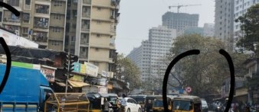
04 · PROJECT RAKSHAK — ON THE GROUND
SECTION 4 OF 5 · PROJECT RAKSHAK
From approval to construction: implementations under way
Parking rationalisation — Durgapur
Road & shoulder work — Durgapur
Fresh markings — Guntur
Barricading — Indore
Footpath construction — Indore
Signage — Mumbai
Case: Tejaji Nagar Junction, Indore — an official black spot; redesign approved by CPWD and the Additional Collector's office.
Crashfree India · Expression of Interest — Working Group 2
17 / 23

Slide 18




04 · PROJECT RAKSHAK — TRANSPARENCY
SECTION 4 OF 5 · PROJECT RAKSHAK
A public dashboard tracks every site to completion
Every site tracked
From submission through approval to completed construction — regardless of who audited it.
The PRAGATI parallel
The PM's PRAGATI platform showed what visible follow-up does for stuck projects. Same principle here, for road safety fixes.
What the Board gains
Live public dashboard — every site, its authority, risk level and implementation stage.
An honest, live read on how quickly road-owning agencies can act — evidence for capacity planning, not just compliance.
Crashfree India · Expression of Interest — Working Group 2
18 / 23

Slide 19






04 · PROJECT RAKSHAK — METHOD
SECTION 4 OF 5 · PROJECT RAKSHAK
Anchored to the codes your engineers already use
IRC codes & MoRTH checklists
Every audit instrument is built on them — nothing bespoke, nothing incompatible.
A line into IRC H-7
Prof. Geetam Tiwari, member of the IRC H-7 Committee on Road Safety Audit, chairs our advisory work.
Masterclasses before fieldwork
Prof. Tiwari on the Safe System approach; Dr. S. Velmurugan (CSIR-CRRI) on IRC-131 and SP-55.
Mentor and authority engagement is continuous — not a one-time submission.
Handover in the authority's format
Findings arrive as the PWD or corporation needs them — ready to action, tracked publicly after.
Crashfree India · Expression of Interest — Working Group 2
19 / 23

Slide 20
04 · PROJECT RAKSHAK — THE LONG VIEW
SECTION 4 OF 5 · PROJECT RAKSHAK
Built to be institutionalised — not to depend on us
Three audit tracks matched to road types, and a role for CFI that narrows over time.
Track A — Institutional
Track B — NGO partners
Track C — Certified RSAs
IIT / NIT / SPA teams under expert mentors
Field teams; desk-reviewed and re-verified by CFI
CSIR-CRRI-certified auditors, full IRC SP-88
Urban arterials, in-town state highways, district roads
District & peri-urban corridors
National highways, complex junctions
Today
CFI runs cohorts, quality-controls audits and stewards the public portal.
Next
Rakshak Audit Manual v1.0 codifies the method; universities field their own teams; NGOs run Track B directly.
Mature
States engage certified RSAs for Track C without CFI as intermediary; the portal remains the shared public record.
Crashfree India · Expression of Interest — Working Group 2
20 / 23

Slide 21






04 · VULNERABLE ROAD USERS
SECTION 4 OF 5 · PROJECT RAKSHAK
A growing evidence base on those most at risk
Gig & delivery riders
'When Risks Become Routine' (Feb 2026): incentive pressure, helmet compliance and training gaps — 300+ rider study, Delhi NCR.
Pedestrian-first audits
Rakshak audits document crossings, footpaths and lighting as designable protections — 900+ stakeholders consulted.
School zones
College-led, standards-based school-zone screening under exploration as the next extension of the audit platform.
Delivery-rider outreach — materials and rights briefings at shift points.
Enforcement that protects VRUs
SATARK helps police prioritise the small share of vehicles with the worst records — targeted, fair, technology-led.
Crashfree India · Expression of Interest — Working Group 2
21 / 23

Slide 22
05 · HOW WE CAN CONTRIBUTE
SECTION 5 OF 5 · OUR CONTRIBUTION
Four concrete offers to Working Group 2
All four are ready today, need no funding from the Board, and can begin within weeks.
1
Ready evidence for standard-setting
Site-level audit data, crash-pattern analysis and costed intervention designs across emerging hotspots and official black spots — for rectification protocols and speed-management guidance.
2
A live testing ground
Active district relationships in Gurugram, South-West Delhi and Jaipur offer a ready pipeline to pilot or stress-test draft recommendations before national rollout.
3
Ground-level implementation diagnostics
Granular, field-verified insight into how DRSCs and road-owning agencies actually move — meeting cadence, data use, follow-through.
4
Technical bench strength on request
Our academic and expert network stands ready for drafting, review and technical input on road design, speed and VRU standards.
Crashfree India · Expression of Interest — Working Group 2
22 / 23

Slide 23




We would be honoured to contribute
to Working Group 2.
Our evidence, our district relationships, our technology and our expert bench are available to the Board — in whichever form is most useful.
crashfreeindia.org
akhtar@crashfreeindia.org · helpdesk@crashfreeindia.org
Live portals: Rakshak dashboard · SC litigation tracker · crash data · defect repository
Crashfree India · A Cars24 commitment · Operated by Vision Zero Trust, New Delhi

