Slide 1

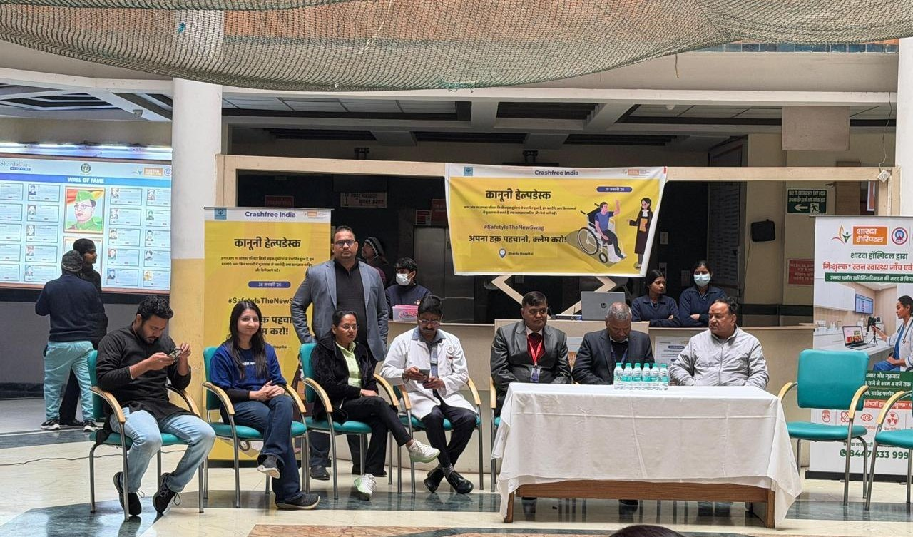
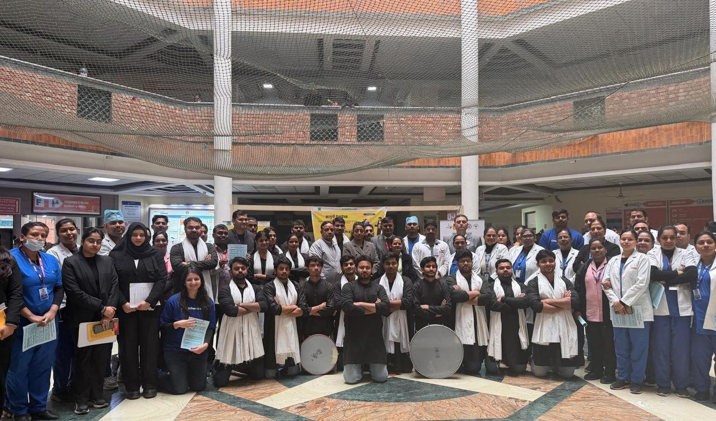
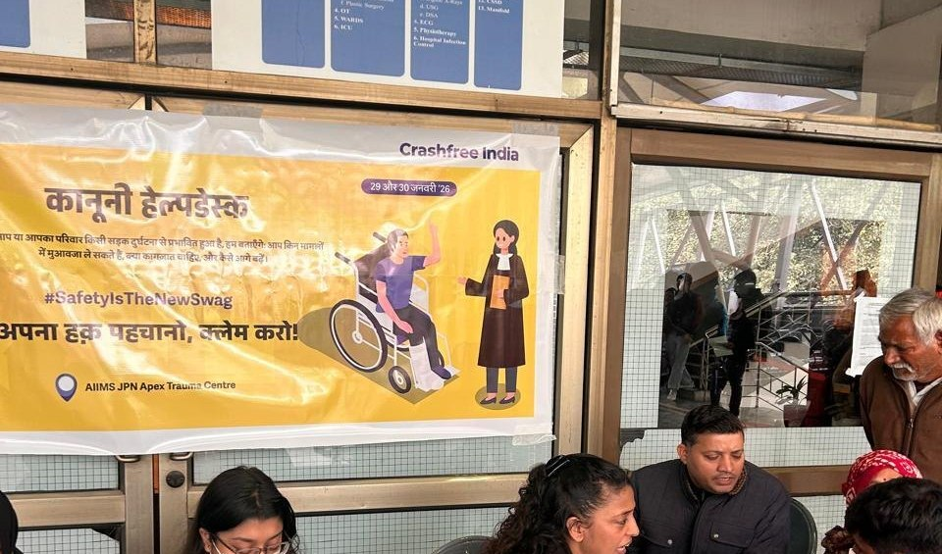
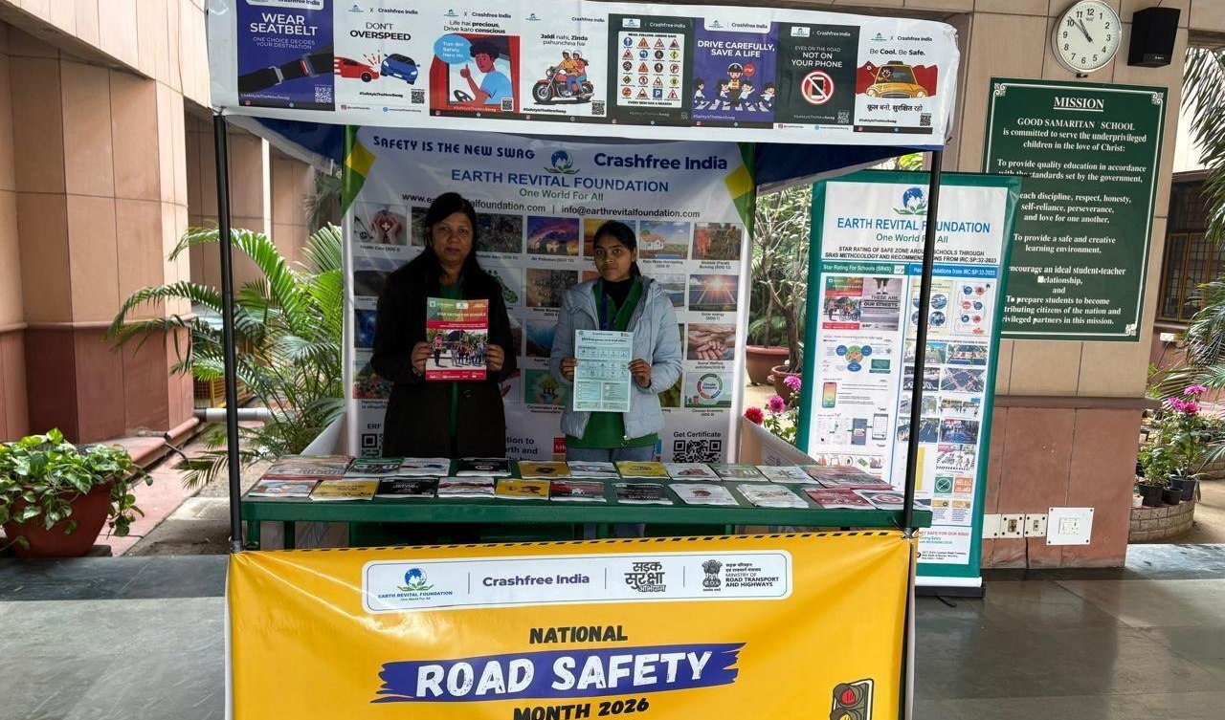
AUGUST 2026 · NEW DELHI
EXPRESSION OF INTEREST · NATIONAL ROAD SAFETY BOARD
Working Group 5: Post-Crash Care, Policy Standards
& State Implementation
Submitted by Crashfree India (Vision Zero Trust) — a technology-led road safety nonprofit backed by Cars24,
working with public authorities across 18 cities.
4
102
100+
~46%
District Road Safety Committees joined
hit-and-run files reviewed with districts
victims helped in helpdesks' first 4 days
of Rajasthan's monthly claims mapped in Jaipur
Submitted to the Chairperson and Members, Working Group 5, National Road Safety Board
crashfreeindia.org

Slide 2
BEFORE THE SLIDES
A letter to the Working Group
New Delhi · August 2026
Respected Chairperson and Members of Working Group 5,
Crashfree India is a young road safety nonprofit — registered as the Vision Zero Trust, co-founded with the Indian Road Safety Council, and backed by a three-year, US$3 million commitment from Cars24. We work alongside public authorities: our student teams audit dangerous locations under senior experts, our technology helps police and administrators see their own pipelines, and our support tools stand with families after a crash.
Our post-crash work began with evidence. 'Justice Unserved', our study of the hit-and-run compensation pipeline, found only 205 claims filed in FY22-23 against roughly 25,000 eligible crashes. Since then we have joined four District Road Safety Committees, reviewed 102 case files with the Gurugram administration, mapped Rajasthan's scheme office-by-office with the Transport Department, and built the tools families actually use — the Aasha chatbot, a compensation calculator, hospital helpdesks that supported 100+ victims in their first four days, and plain-language guides in Hindi.
The pages that follow introduce the organisation briefly, then set out the work most relevant to this Working Group in the detail its mandate deserves. Everything shown is running today, is public, and is offered to the Board without cost. We would be honoured to contribute.
Respectfully,
Akhtar Hussain
Mission Lead, Crashfree India · akhtar@crashfreeindia.org · crashfreeindia.org

Slide 3





HOW THIS DECK IS ORGANISED
Five sections, three minutes to skim
1
About Crashfree India
04
Who we are, how we are set up, and the principles we work by.
2
What we have built
05 – 11
Every public-facing programme — audits, enforcement tech, victim support, open data, youth, campaigns.
3
Our people
12
Trustees, Board of Advisors, and the expert bench behind the work.
4
Post-crash care in depth
13 – 21
The deep dive matched to this Working Group's mandate — evidence, method, and results.
5
How we can contribute
22 – 23
Four concrete, no-cost offers to the Working Group.

Slide 4

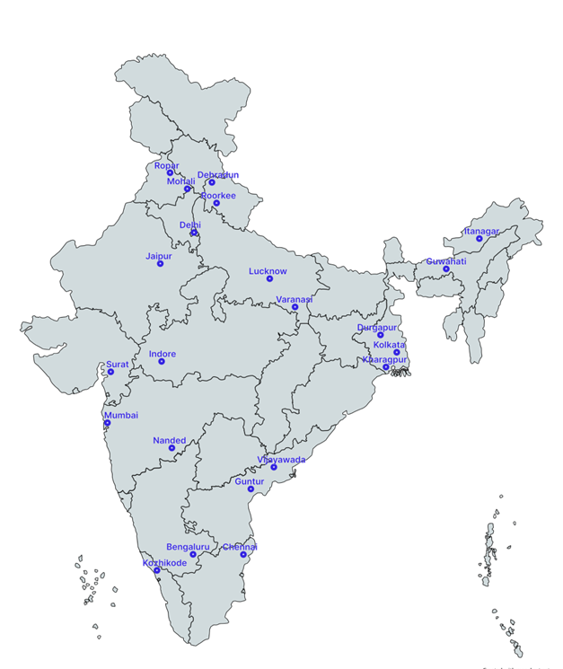



01 · ABOUT US
SECTION 1 OF 5 · ABOUT US
Crashfree India: a nonprofit that adds capacity to road safety work
Registered as the Vision Zero Trust · Co-founded by Cars24 and the Indian Road Safety Council · Working since June 2025 · New Delhi
Evidence first
Structured field audits, file reviews and research to official standards — not opinion.
Institutional collaboration
We work through PWDs, NHAI, transport departments, police and District Road Safety Committees.
Youth-led capacity
Trained student teams from IITs, NITs and SPAs add the auditing hands the system needs.
Technology for follow-through
Public dashboards track every recommendation from submission to completion.
Backed by a US$3 million, three-year commitment from Cars24 — programmes, not overheads, receive 71% of the budget.
Crashfree India · Expression of Interest — Working Group 5
Where we work today — 18 cities, north to south.
04 / 23

Slide 5
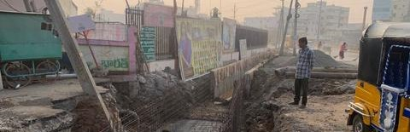
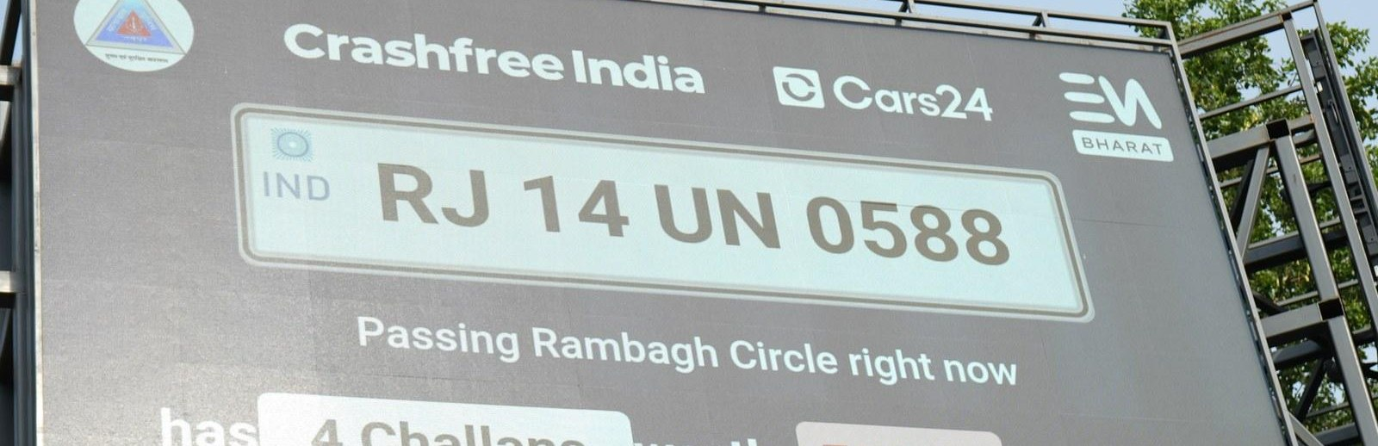
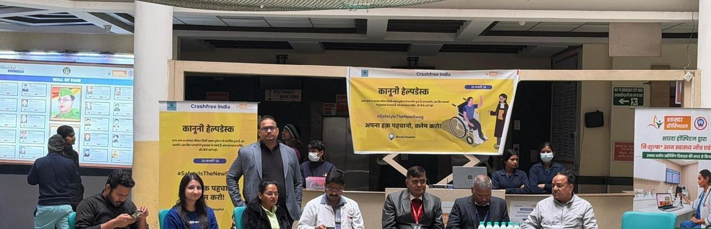
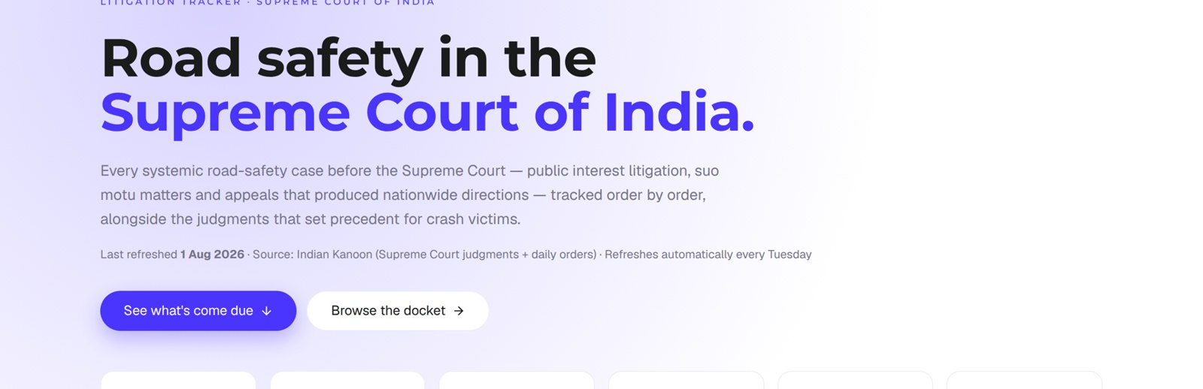
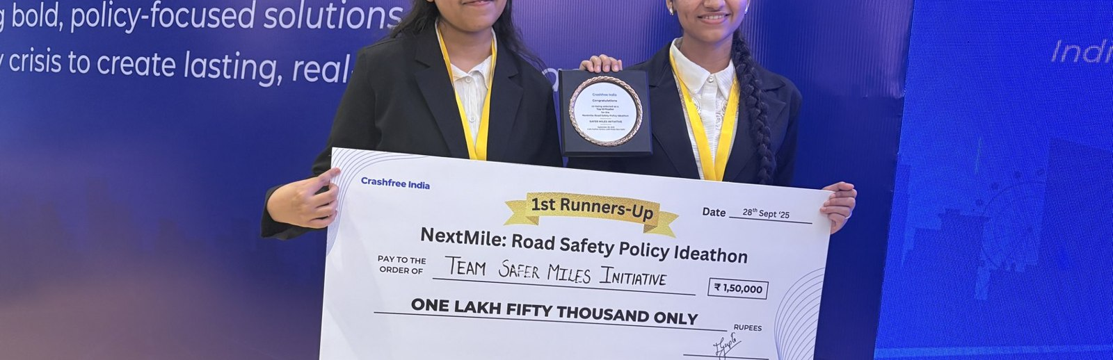
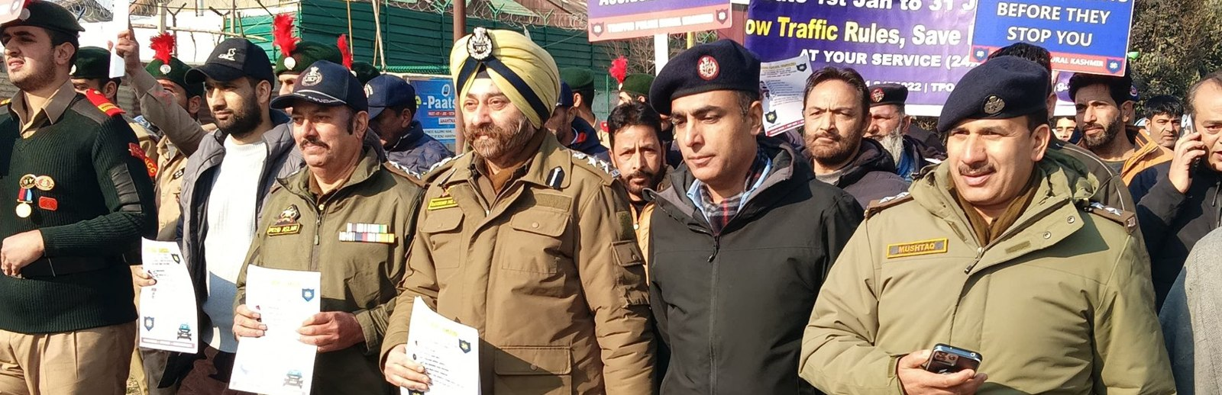
02 · WHAT WE HAVE BUILT
SECTION 2 OF 5 · WHAT WE HAVE BUILT
Six lines of work, one connected system
Audits create data · data supports policy · policy guides the field. Everything below is live today.
Project Rakshak
SATARK enforcement
Victim support
Student-led road audits, fixed with authorities
AI support that helps police find high-risk vehicles
Aasha chatbot, calculator, hospital helpdesks
31 sites · 15 under implementation
3,00,000+ vehicles screened
100+ victims helped in first 4 days
Open public data
Youth & policy
Public campaigns
Four self-updating data platforms, free to use
NextMile ideathon and national dialogue series
Road Safety Month with police & schools; MS Dhoni
36 states & 50 cities covered
2,000+ participants engaged
1M+ citizens reached
Crashfree India · Expression of Interest — Working Group 5
05 / 23

Slide 6
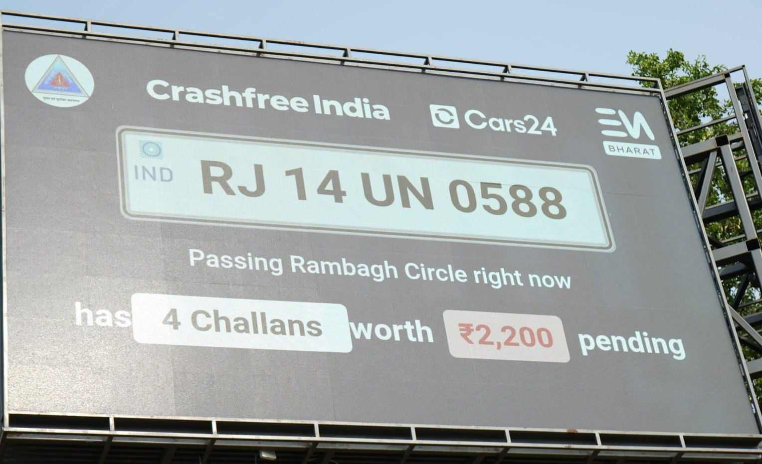
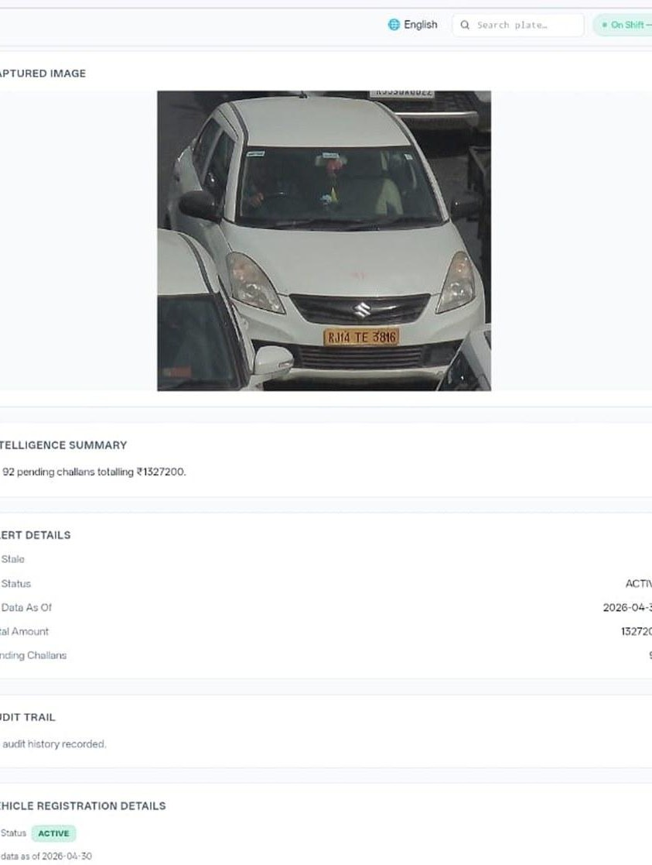








02 · WHAT WE HAVE BUILT — ENFORCEMENT TECHNOLOGY
SECTION 2 OF 5 · WHAT WE HAVE BUILT
SATARK: AI that helps police stop the right vehicle
Built with Cars24 engineers. Reads number plates, checks government records, and alerts officers to repeat offenders — in real time.
3,00,000+
₹30 Cr+
vehicles screened
pending challan value identified
350+
70,019
high-risk vehicles intercepted
vehicles found with pending challans
LIVE · Jaipur & Bengaluru
NEW · Gurugram
Bengaluru's Trinity Circle billboard was India's first — covered by Deccan Herald and national press. Pune and Ahmedabad are next.
Rambagh Circle, Jaipur — live plate, pending challans and dues on a public billboard.
Officer view — pending challans,
RC & compliance status.
ANPR camera
Plate read
Records check
Risk flag
Officer alert
Billboard
Interception
Enforcement
Crashfree India · Expression of Interest — Working Group 5
06 / 23

Slide 7
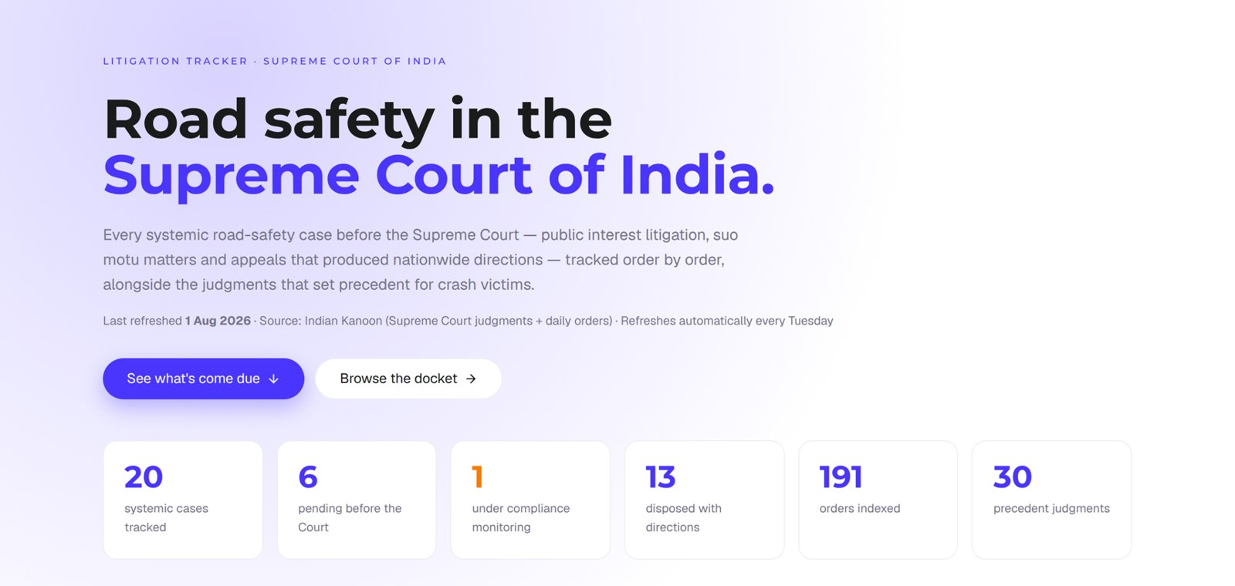
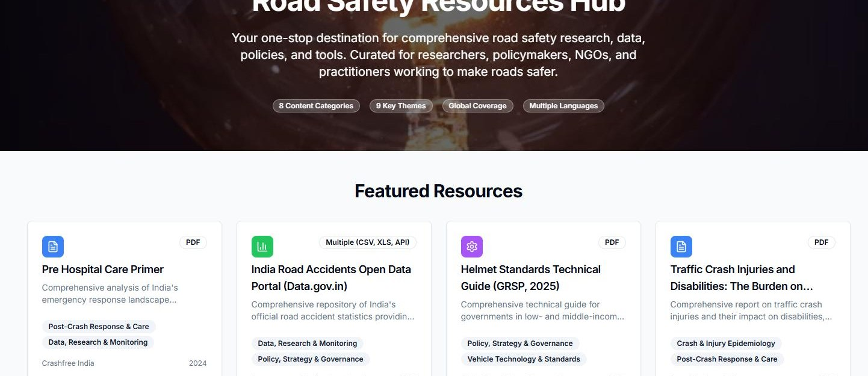

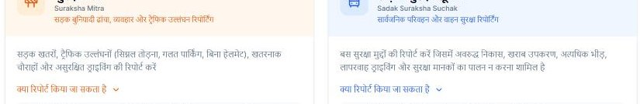

02 · WHAT WE HAVE BUILT — OPEN PUBLIC DATA
SECTION 2 OF 5 · WHAT WE HAVE BUILT
Public data platforms any authority can use, free
Built and maintained by our team; self-updating; no login, no fee. Shown live below.
Road Safety Resources Hub — primers, data portals and guides in one place.
Supreme Court Litigation Tracker — live: 20 systemic cases, 191 orders indexed, 30 precedent judgments (1 Aug 2026).
Road Defect Repository
146 districts · 13 languages — defect news, mapped publicly.
Parliament tracker
1,423 road-safety questions indexed across the Lok Sabha & Rajya Sabha.
Crash Data Dashboard
MoRTH statistics made usable — 36 states, 50 cities, open licence.
Suraksha Mitra & Sadak Suraksha Suchak — citizen hazard reporting in Hindi (50+ hazards in the first 20 days).
Crashfree India · Expression of Interest — Working Group 5
07 / 23

Slide 8
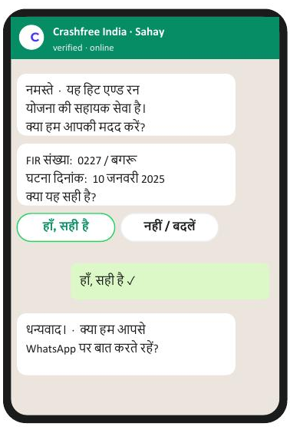
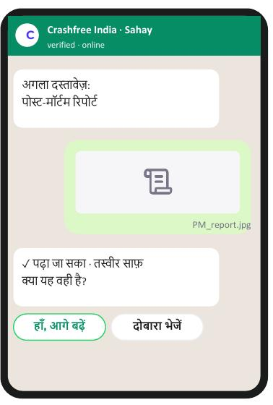
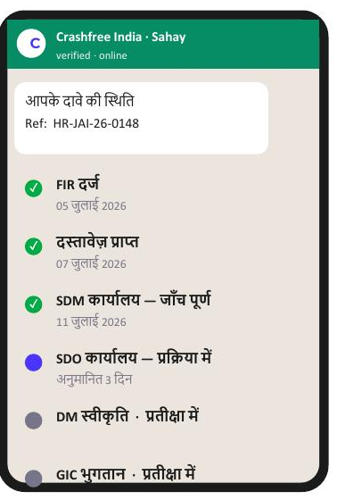

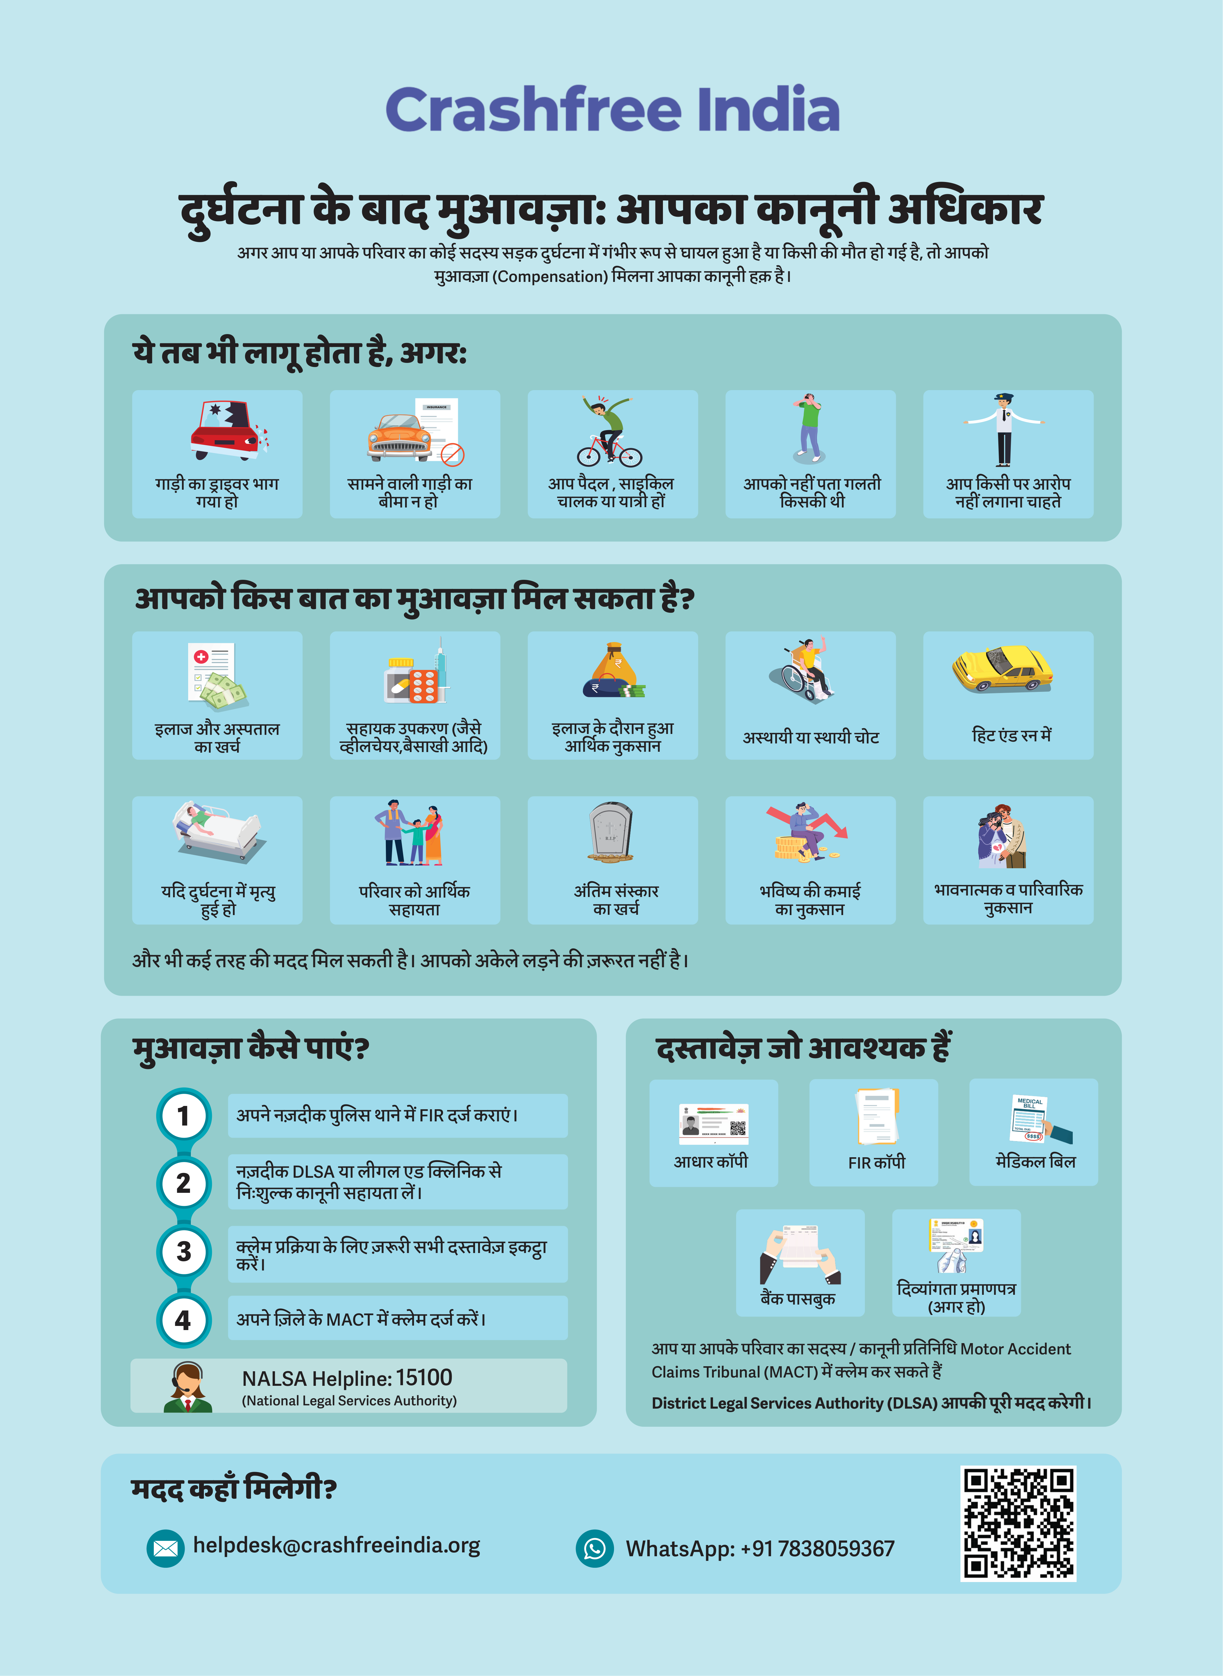



02 · WHAT WE HAVE BUILT — VICTIM SUPPORT
SECTION 2 OF 5 · WHAT WE HAVE BUILT
Help a family can actually use, in their language
From the first hours after a crash to the final compensation order — on WhatsApp, on paper, and in person.
Aasha chatbot
Step-by-step guidance on rights, schemes and documents — 24/7, multilingual.
Compensation Calculator
Free instant estimates on Supreme Court principles (Sarla Verma, Pranay Sethi).
Hospital helpdesks
Legal desks in trauma wards — 100+ victims supported in the first four days.
Day one after FIR
Document capture
Live case status
Plain-language education
Comics and Hindi guides on all three compensation routes, NALSA 15100 and the Cashless Treatment Scheme 2025.
Aasha — our 24/7 multilingual AI companion. The family needs no app and no portal; everything runs on WhatsApp and voice, in Hindi.
Hindi legal-rights guide — used in
hospitals & police stations.
Crashfree India · Expression of Interest — Working Group 5
08 / 23

Slide 9
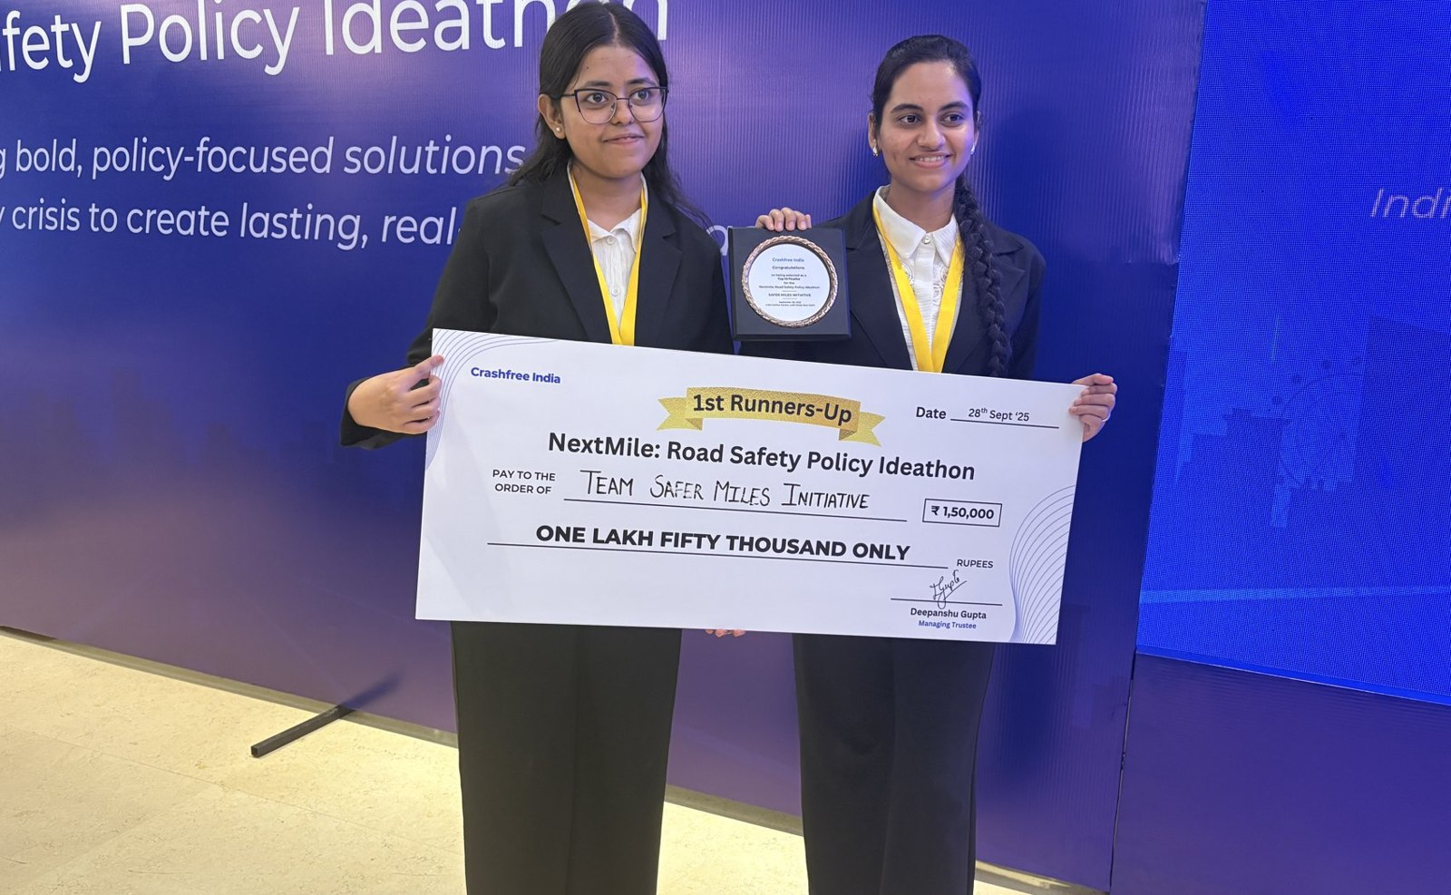
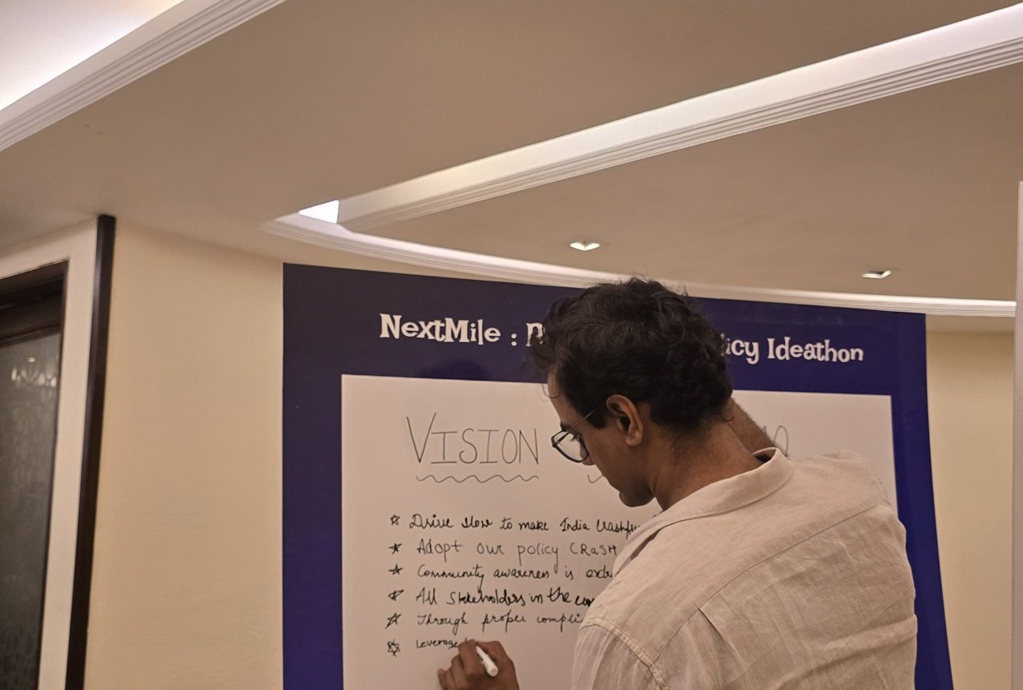



02 · WHAT WE HAVE BUILT — YOUTH & POLICY
SECTION 2 OF 5 · WHAT WE HAVE BUILT
Young talent and senior experts, working the same problem
A steady pipeline of engineers and policy minds — so road safety work never runs out of hands.
National Road Safety Dialogue Series
200+ live attendees; speakers from MoRTH, CIRT, AIIMS Trauma Centre, CSIR-CRRI and ARAI.
Three sessions so far
Bus safety · Delivery rider safety · Good Samaritan law & the Cashless Treatment Scheme.
NextMile: Road Safety Policy Ideathon — grand finale, 28 Sep 2025, New Delhi.
Vision Wall 2040 — participants write the road-safety future they want.
Public YouTube channel
Session recordings, victim-education videos and explainers — free to reuse in trainings.
2,000+
250+
700+
10
Mentors and evaluators came from the Government of Rajasthan, NIUA, OMI, NASSCOM and CSEP. Winning tracks now feed our audit and research pipeline.
participants
concept notes
teams
finalist teams
Next: 'Be a Rakshak' university chapters at IITs, NITs and SPAs.
Crashfree India · Expression of Interest — Working Group 5
09 / 23

Slide 10
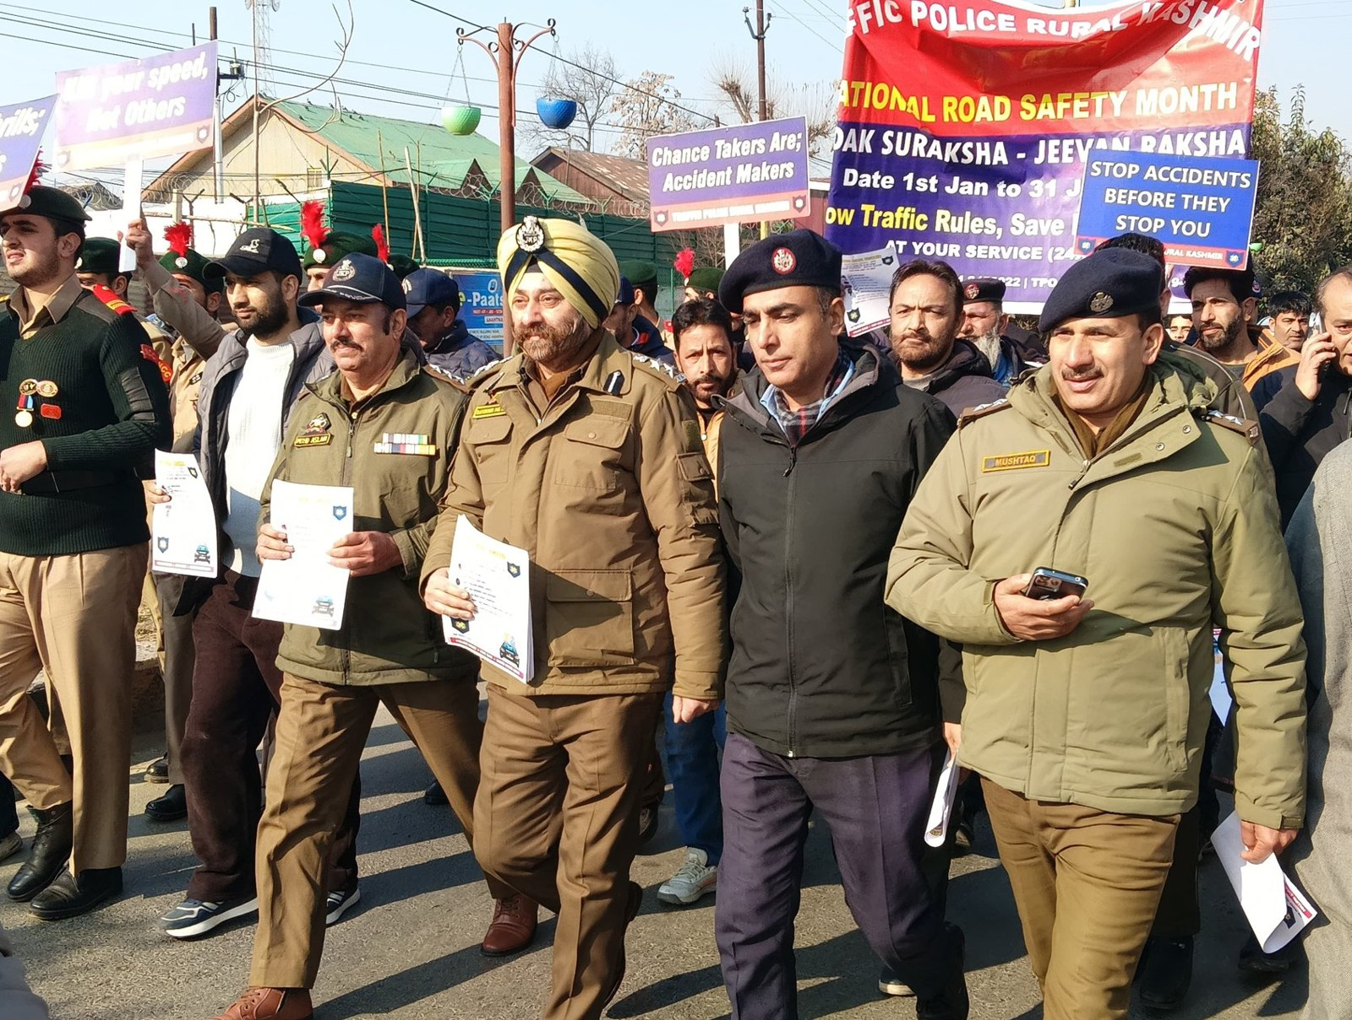
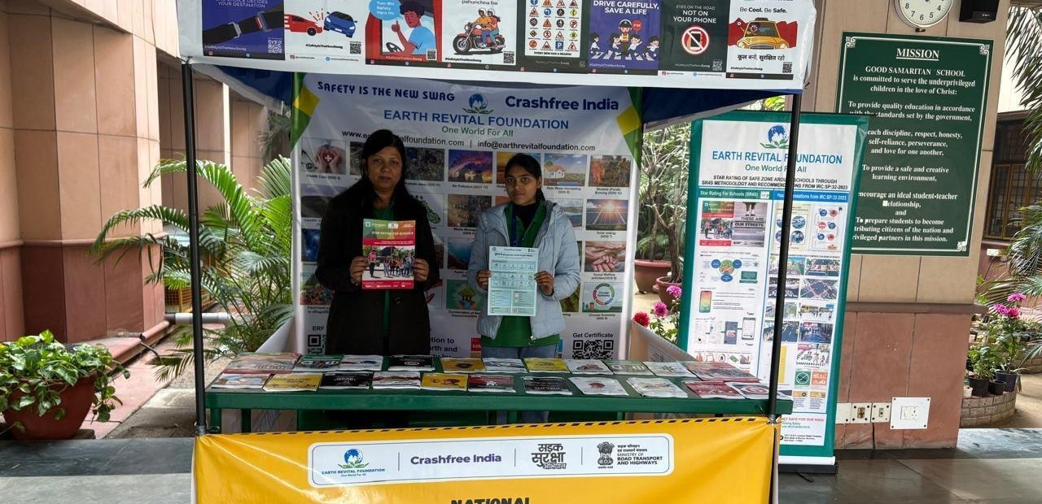
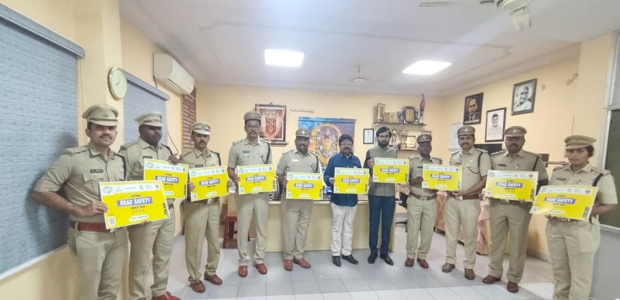
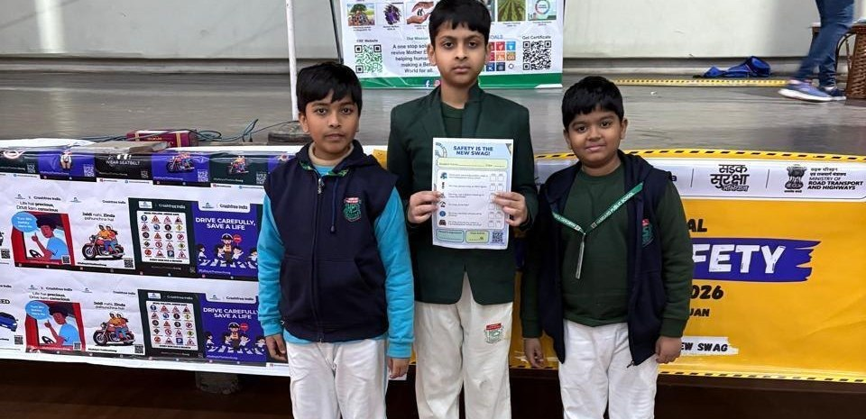
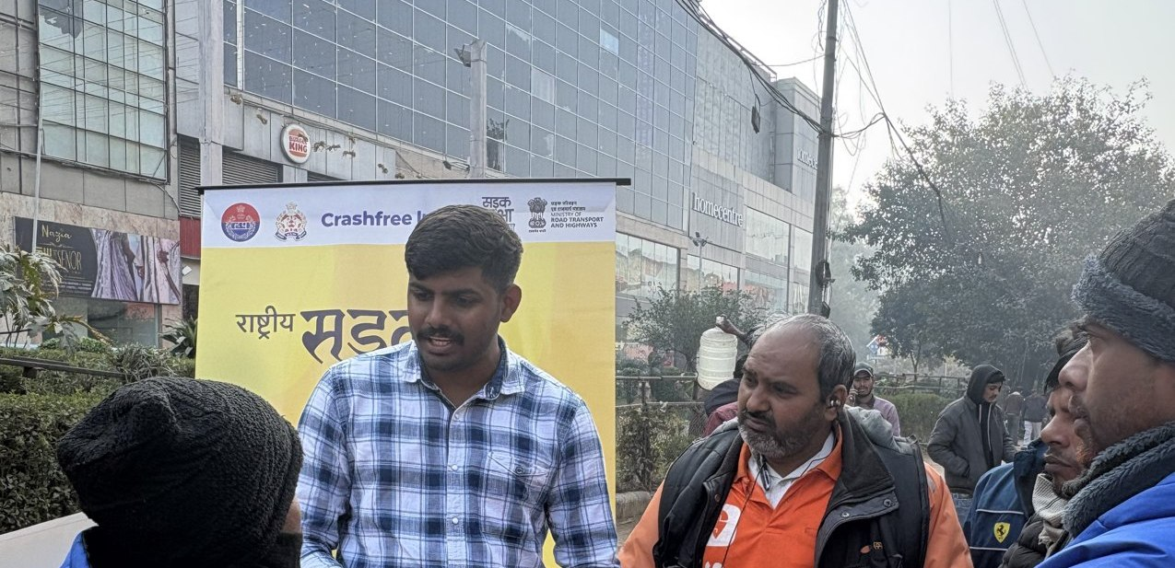
02 · WHAT WE HAVE BUILT — ON THE GROUND
SECTION 2 OF 5 · WHAT WE HAVE BUILT
Road Safety Month 2026, run with the system
With district police, schools, hospitals and delivery platforms — in Hindi and local languages.
CFI stall at a government office
Materials briefing with police staff
National Road Safety Month rally — on the road with district traffic police, Jan 2026.
School programme with certificates
Delivery-rider outreach — Swiggy & Instamart
1M+ citizens reached across campaigns in year one.
Crashfree India · Expression of Interest — Working Group 5
10 / 23

Slide 11
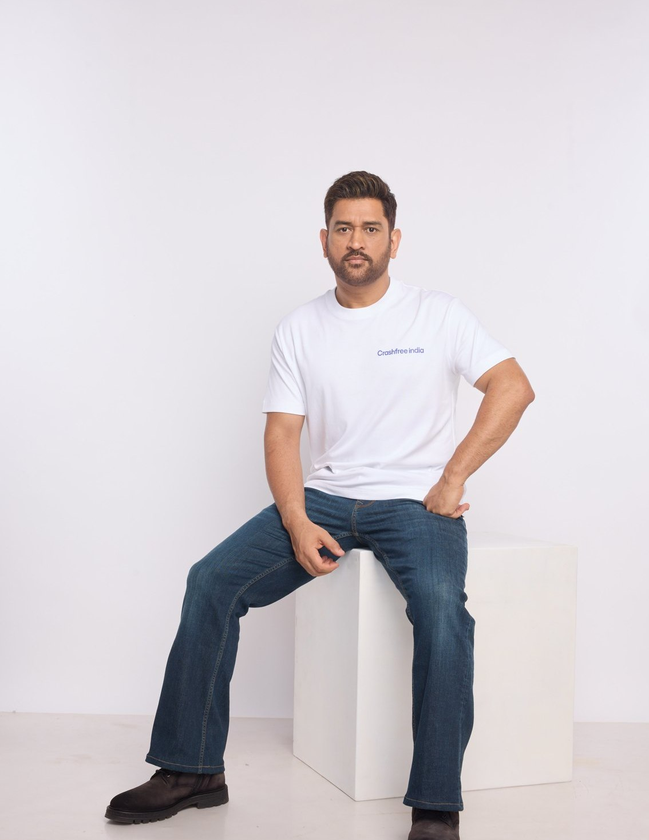
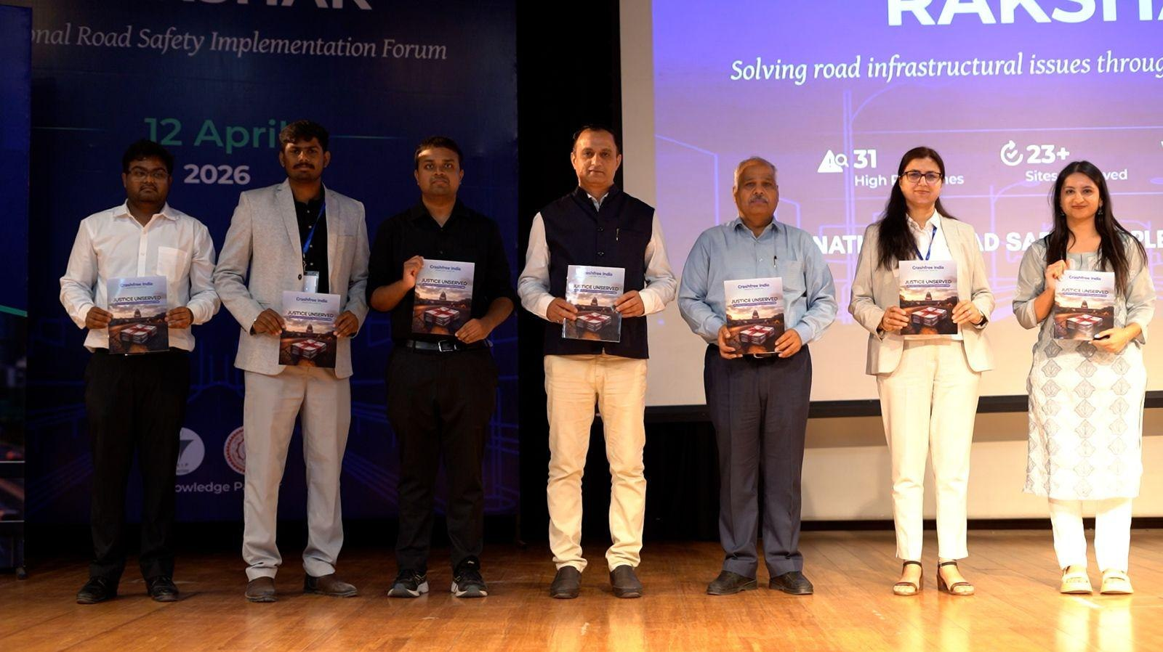
02 · WHAT WE HAVE BUILT — PUBLIC VOICE
SECTION 2 OF 5 · WHAT WE HAVE BUILT
MS Dhoni carries the message; the ecosystem engages
"We already know what is going wrong. What we need now is more responsibility, more discipline, more respect for life."
MS Dhoni, at the National Road Safety
Implementation Forum, IIT Delhi
National Road Safety Implementation Forum, IIT Delhi — 60+ experts including MoRTH, WHO, UNICEF, iRAP and CSIR-CRRI.
COVERED IN NATIONAL PRESS
Deccan Herald
Economic Times
MS Dhoni — Goodwill Ambassador, announced April 2026.
Dhoni's voice powers 'Be a Rakshak', school-zone safety and compensation-awareness campaigns.
Fortune India
IndiaSpend
Scroll.in
The Wire
Times of India
Business Standard
Crashfree India · Expression of Interest — Working Group 5
11 / 23

Slide 12
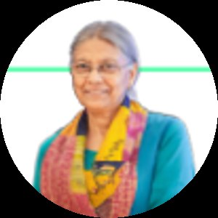
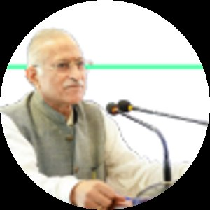
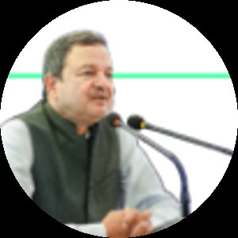
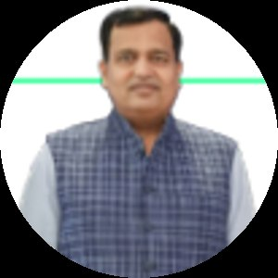
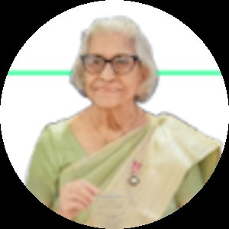
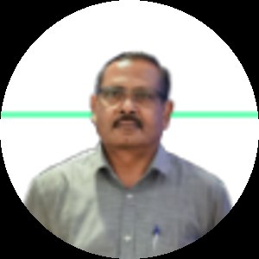
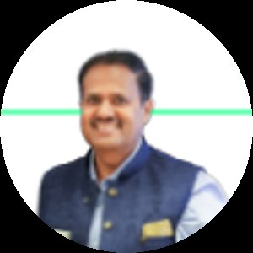
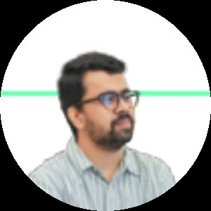
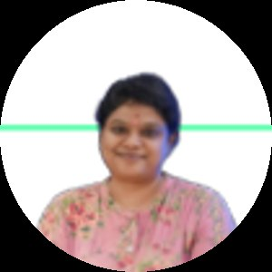
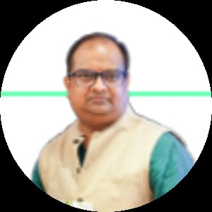
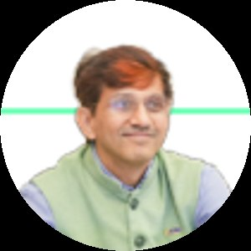
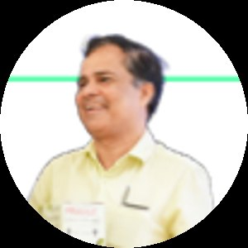
03 · OUR PEOPLE
SECTION 3 OF 5 · OUR PEOPLE
Advised by the people who built India's road safety practice
Prof. Geetam Tiwari — Board of Advisors
PT
Piyush Tewari — Board of Advisors
Professor Emerita & Chair, TRIP Centre, IIT Delhi · Member, IRC H-7 Committee on Road Safety Audit
Founder & CEO, SaveLIFE Foundation · Architect of the Good Samaritan Law · Zero-Fatality Corridors
THE EXPERT BENCH AROUND OUR WORK — JURY, MENTORS & REVIEWERS
Justice J.R. Midha
Abhay Damle
Vaibhav Dange
Dr. Maya Tandon
R. Venkat Ratnam
Akhilesh Srivastava
Delhi High Court (Retd.)
Ex-JS, MoRTH
Ex-Advisor, MoRTH
Sahayta Trust
Government of Punjab
ITS India · IRF
Gautam Singh
Aishwarya Raman
Neeraj Kumar
R.S. Pandey
Dipak K. Dash
SaveLIFE Foundation
OMI Foundation
Tata AIG
FICCI Road Safety
Times of India
Trustees: Amar Srivastava (President · Founder, IRSC) · Deepanshu Gupta (Managing Trustee) · Gajendra Jangid (Co-founder, Cars24) Team: IIT Delhi, NALSAR, TISS & HKUST alumni · 75+ engineering interns · 31 student audit teams
Crashfree India · Expression of Interest — Working Group 5
12 / 23

Slide 13
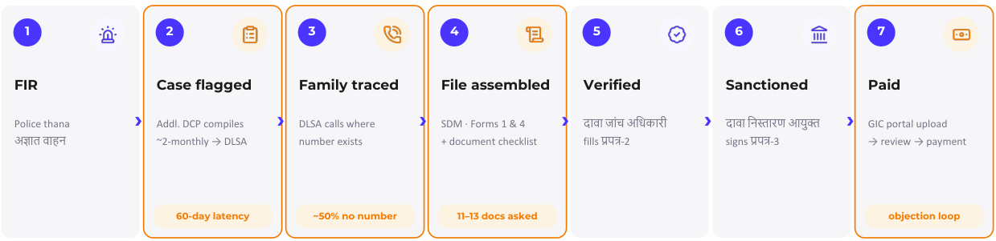
04 · POST-CRASH CARE — THE STARTING POINT
SECTION 4 OF 5 · POST-CRASH CARE
A family meets many institutions — not one programme
We mapped the hit-and-run claim journey with officials in Jaipur — seven stages, six hand-offs, every one manual today.
The claim journey as it actually runs — FIR to payment. Source: CFI mapping with district officials, Jaipur.
Our work: make each hand-off visible, guide the family at every stage, and give administrators the dashboards to see where files wait.
Crashfree India · Expression of Interest — Working Group 5
13 / 23

Slide 14
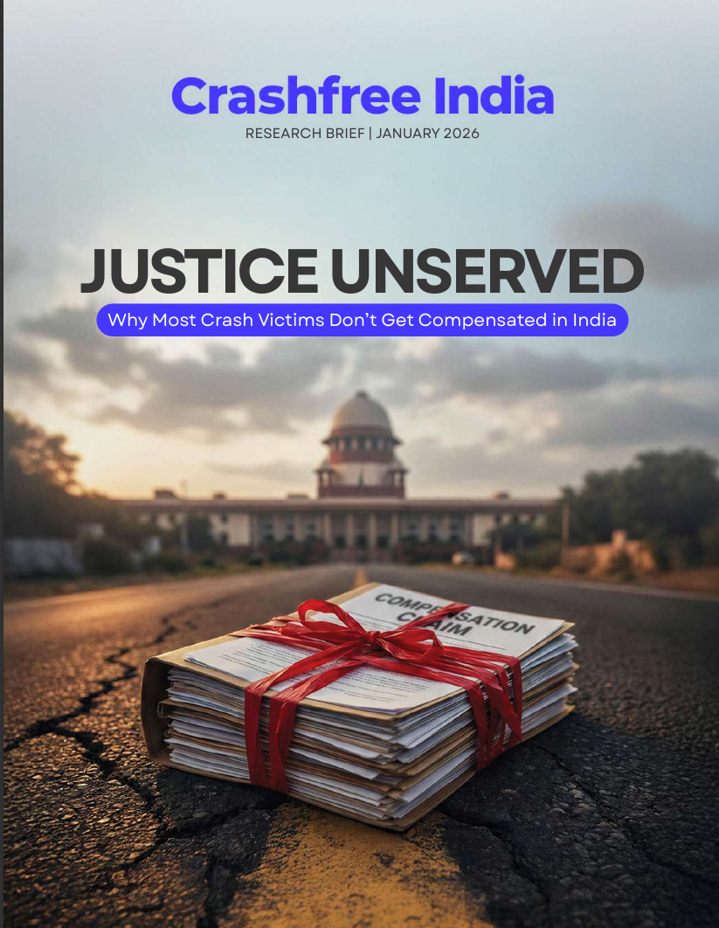




04 · POST-CRASH CARE — OUR RESEARCH FOUNDATION
SECTION 4 OF 5 · POST-CRASH CARE
'Justice Unserved' — the evidence base we built first
Published January 2026 · launched at IIT Delhi · findings presented to MoRTH · covered by national press.
Awareness
70% of low-income families are unaware compensation exists.
205
Timeliness
3.6-year average claim; MACT cases often run 8–10 years.
hit-and-run claims filed in FY22-23…
Documentation
90% of pending hit-and-run claims stall on documents alone.
against ~25,000 eligible crashes.
Adequacy
Informal workers are often valued at minimum wage in courts.
The scheme is sound — the pipeline to it needs support.
Equity
14% of low-income households compensated vs 24% of high-income.
The report — file reviews, RTIs and
consultations across the pipeline.
Press: Deccan Herald · Economic Times · Fortune India · IndiaSpend · Scroll.in · The Wire — and cited in Parliament-facing briefings.
Crashfree India · Expression of Interest — Working Group 5
14 / 23

Slide 15
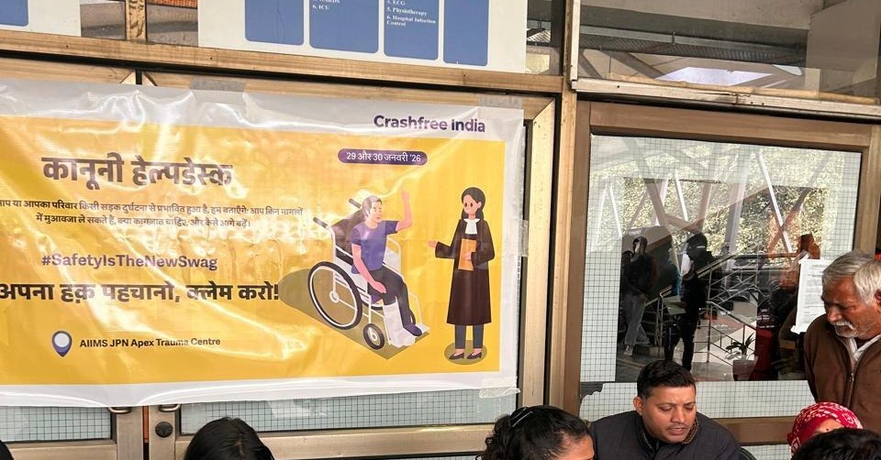


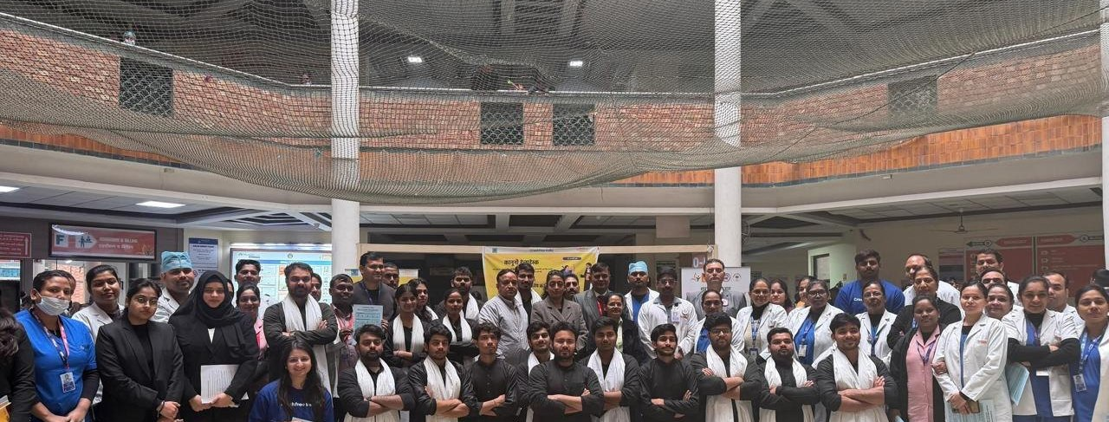

04 · POST-CRASH CARE — FROM RESEARCH TO DISTRICTS
SECTION 4 OF 5 · POST-CRASH CARE
Working inside the district machinery
Not commentary from outside — formal seats, formal tasking, files on the table.
Four DRSCs joined
Gurugram, South-West Delhi, North-West Delhi and Jaipur — with MoUs with Jaipur Traffic Police and Gurugram Police.
102 files, read page by page
With Gurugram's administration we reviewed every hit-and-run file since 2022 — mapping exactly where eligible families drop out.
Formally tasked
The South-West Delhi DRSC's signed minutes task Crashfree India with digitisation and analytics support for scheme files.
Legal-rights helpdesk with district administration, Jan 2026.
Embedded presence
A research fellow sits with Gurugram district offices — implementation support, not external commentary.
Law-student volunteers after a hospital helpdesk drive.
Crashfree India · Expression of Interest — Working Group 5
15 / 23

Slide 16




04 · POST-CRASH CARE — STATE ENGAGEMENT
SECTION 4 OF 5 · POST-CRASH CARE
With Rajasthan: from ground mapping to a working template
Supporting the State Road Safety Lead Agency and Transport Department on the Hit-and-Run Compensation Scheme.
What holds claims back
11–13 documents demanded vs the 7 court-agreed standard · ~50% of files lack a usable family phone number · manual hand-offs between six offices.
~180
of ~395 monthly hit-and-run claims in Rajasthan come from Jaipur alone (~46%)
The cautionary example
A state portal that changed how offices work saw monthly requests fall 350 → 25. Our design rule: no stakeholder changes their medium.
Not because crashes happen only there — because Jaipur runs active outreach and a single coordination cell. The template is replicable.
Five GIC queries drafted
Clarification questions ready for the insurer consortium — a joint ask from the Department lands harder.
Six asks → 60 days
Decisions identified with the Department that put Phase 1 (family traceability) in motion within 60 days.
Crashfree India · Expression of Interest — Working Group 5
16 / 23

Slide 17
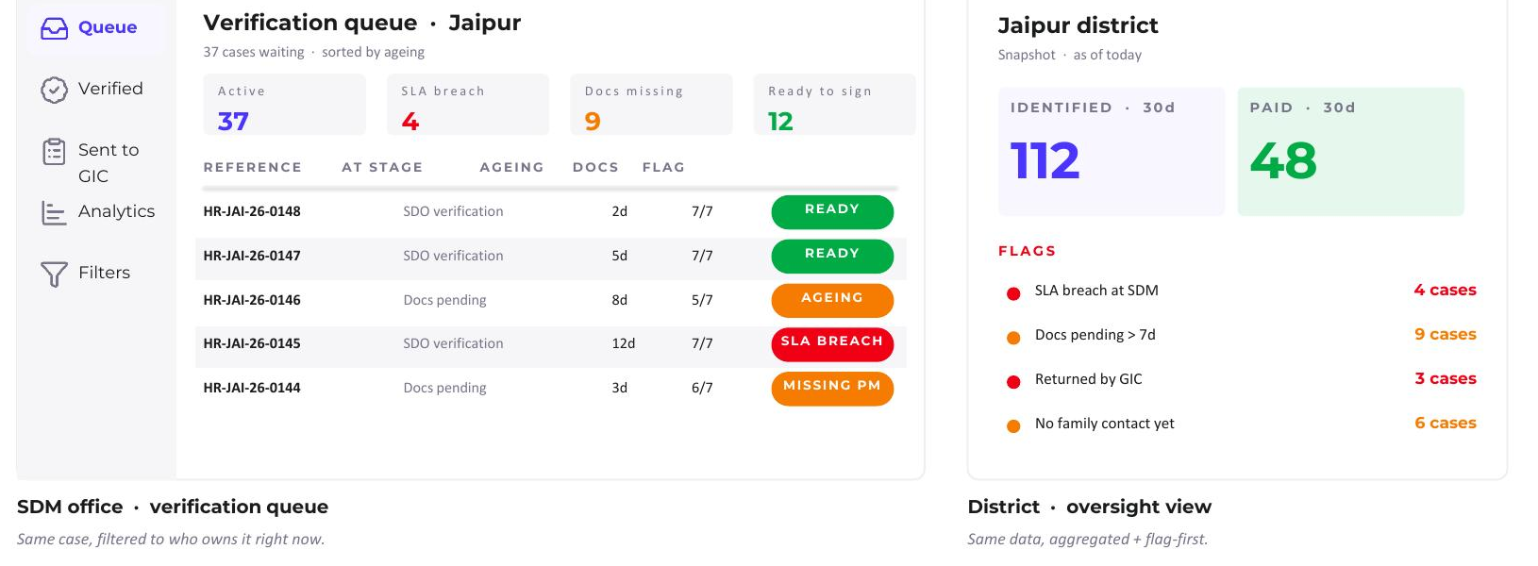
04 · POST-CRASH CARE — THE PORTAL CONCEPT
SECTION 4 OF 5 · POST-CRASH CARE
Designed so no stakeholder changes how they work
Families stay on WhatsApp; officers keep their queues and sign-offs; the system connects them behind the scenes.
The family flow — day-one intake, document capture, live status. All inside WhatsApp, in Hindi.
Officer view — same cases, filtered to what each desk owns; AI pre-checks flag issues, the decision stays human.
Family keeps WhatsApp
Officer keeps every decision
Traceability before automation
Single-pass clarification
Dashboards for administrators
Crashfree India · Expression of Interest — Working Group 5
17 / 23

Slide 18


04 · POST-CRASH CARE — STANDARDS, READY TO ADOPT
SECTION 4 OF 5 · POST-CRASH CARE
The claimant-side standards WG-5 could set
Small, procedural standards — none needing new legislation — each drawn from files we have read and offices we work with.
THE 7-DOCUMENT STANDARD — AS AGREED BEFORE THE SUPREME COURT
ASKED ON TOP TODAY — EACH ONE A TRIP, A FEE, OR A DROP-OUT
Application (Form I & IV)
Court-certified copies of FIR & FR
Copy of FIR / FAR
Full challan file / e-DAR / iRAD
Post-mortem or injury report
Site map / naksha mauka
Death certificate (in death cases)
Notarised affidavit — name mismatch
Claimant / victim ID proof
Notarised affidavit — non-filing of MACT claim
Bank passbook (IFSC visible)
Legal-heir / succession certificate
Cashless-treatment amount received
Also ready: stage-wise SLA benchmarks · family-communication norms at every state change · a document-quality checklist for AI-assisted pre-verification.
Crashfree India · Expression of Interest — Working Group 5
18 / 23

Slide 19
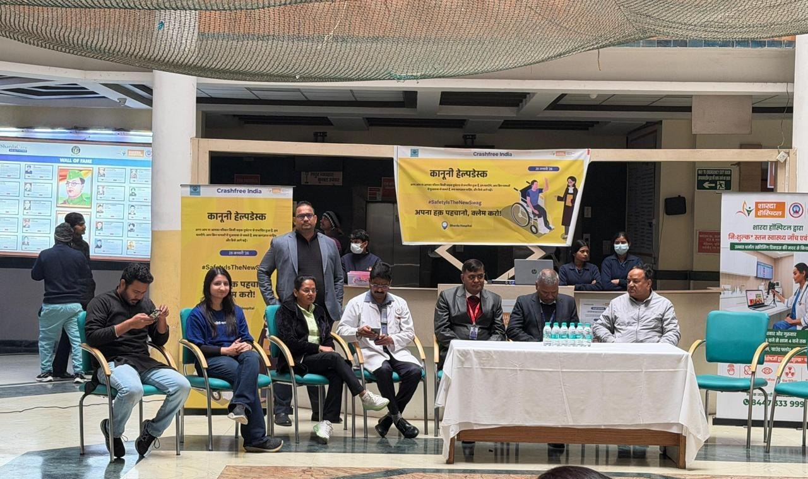



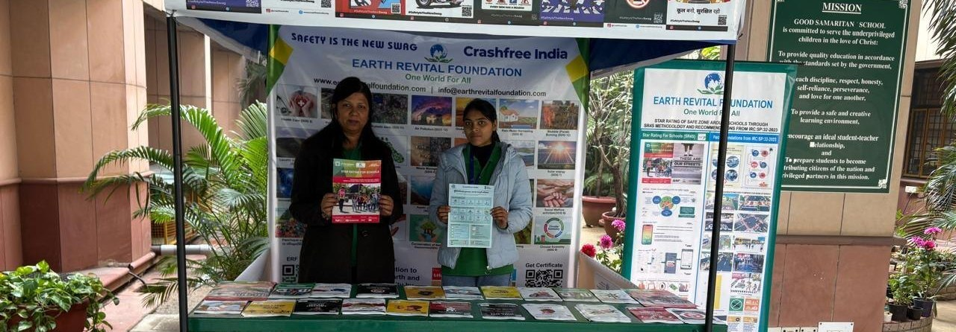

04 · POST-CRASH CARE — THE FIRST HOURS
SECTION 4 OF 5 · POST-CRASH CARE
Helpdesks in trauma wards, and an EMS evidence line
The response gap, measured
Our Pre-Hospital Care Primer (Sept 2025): ERSS-112 is live across 36 states & UTs, yet ambulance arrival averages 25–35 minutes and the full care episode runs 55–75 minutes — against a 60-minute golden hour.
State innovations documented
Maharashtra's MEMS — 937 ambulances under centralised dispatch; Tamil Nadu's TAEI trauma corridors — pre-arrival alerts and treatment protocols.
Good Samaritan & Cashless 2025
Bystander protections and the ₹1.5 lakh / 7-day Cashless Treatment Scheme, explained in our public guides — the demand side of trauma care.
Hospital legal helpdesk — 100+ victims supported in the first four days of operation.
Where this serves WG-5
A ready, referenced baseline for the Group's EMS and trauma-care standards discussions — with state models already compared.
Crashfree India · Expression of Interest — Working Group 5
19 / 23

Slide 20
04 · POST-CRASH CARE — THE PIPELINE, MEASURED
SECTION 4 OF 5 · POST-CRASH CARE
Numbers a standard can act on
Each one is a lever for a WG-5 standard, toolkit entry or communication norm — none requires new legislation.
921 of 1,026
~60 days
~50%
claims pending nationally were stalled at documentation alone (July 2024)
typical intake latency where claims surface only via bi-monthly meetings
of case files lack a usable family phone number — traceability is the first lever
7 vs 11–13
FY23-24: 12%
5 + 22
court-agreed documents vs what claimants are asked for in practice
of eligible crashes converted to filed claims — improving, from a 2% base
GIC clarification queries drafted · RTIs building the public record
The claim's other side: consultations with GIC and insurers on settlement practice · guidance from Justice J.R. Midha (Retd.), architect of the FaSTDAR process · working partners across MACT courts, DLSAs and legal-services clinics.
Crashfree India · Expression of Interest — Working Group 5
20 / 23

Slide 21




04 · WHY OUR TEAM FITS THIS MANDATE
SECTION 4 OF 5 · POST-CRASH CARE
Post-crash care needs more than one discipline
A legally sound framework can still be hard to use; a good portal can still miss district workflows. Our team is built across the whole chain.
Law & policy
Technology & product
Field & district practice
Behaviour & communication
NALSAR and Delhi University-trained; scheme analysis, RTIs, MoRTH and Parliament-facing engagement.
IIT-trained; Aasha, the calculator, dashboards and the portal architecture shown earlier.
TISS-trained; district embedding, DRSC work, helpdesk operations, victim interviews.
Psychology and design; guides, comics and multilingual communication families actually read.
Advised by Piyush Tewari (SaveLIFE Foundation), Prof. Geetam Tiwari (IIT Delhi) and Justice J.R. Midha (Retd., Delhi High Court) — with practitioner partners across MACT courts, DLSAs and insurers.
Crashfree India · Expression of Interest — Working Group 5
21 / 23

Slide 22
05 · HOW WE CAN CONTRIBUTE
SECTION 5 OF 5 · OUR CONTRIBUTION
Four concrete offers to Working Group 5
All four are ready today, need no funding from the Board, and can begin within weeks.
1
A victim-side evidence base
'Justice Unserved', 120+ victim and family interactions, and file-level audit data showing precisely where eligible families drop out of the process.
2
A district toolkit, drawn from practice
Working DRSC integration experience — agendas, file digitisation, fellow placement — ready to be codified into the Group's district toolkit.
3
A reusable state portal blueprint
The Rajasthan case-management design — guided filing, stage-wise visibility, single-pass clarification — offered as a template any state can adapt.
4
Standards input from the claimant's side
Document standards (the court-agreed 7), communication standards and timeline benchmarks, grounded in what families actually experience.
Crashfree India · Expression of Interest — Working Group 5
22 / 23

Slide 23




We would be honoured to contribute
to Working Group 5.
Our evidence, our district relationships, our technology and our expert bench are available to the Board — in whichever form is most useful.
crashfreeindia.org
akhtar@crashfreeindia.org · helpdesk@crashfreeindia.org
Live portals: Rakshak dashboard · SC litigation tracker · crash data · defect repository
Crashfree India · A Cars24 commitment · Operated by Vision Zero Trust, New Delhi

