Slide 1

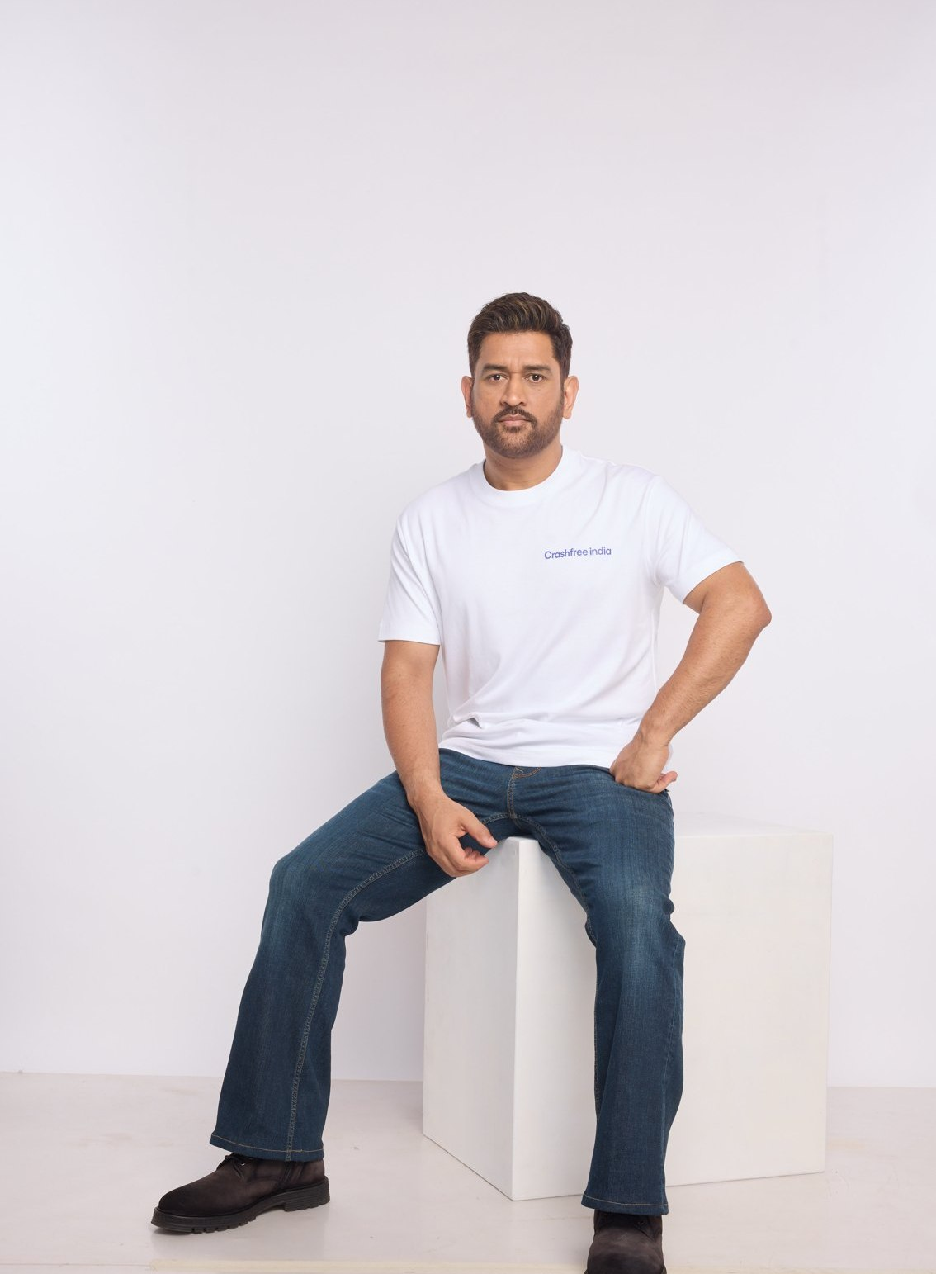
AUGUST 2026 · NEW DELHI
EXPRESSION OF INTEREST · NATIONAL ROAD SAFETY BOARD
Crashfree India
Application to Working Group 5:
Post-Crash Care, Policy Standards & State Implementation
A technology-led road safety nonprofit — backed by Cars24, operated by the Vision Zero
Trust — working with public authorities across 18 cities.
24/7
100+
4
Aasha — AI legal companion for victims
victims helped in helpdesks' first 4 days
District Road Safety Committees joined
MS DHONI · GOODWILL AMBASSADOR,
CRASHFREE INDIA
Submitted to the Chairperson and Members, Working Group 5, National Road Safety Board
crashfreeindia.org

Slide 2
BEFORE THE SLIDES
A letter to the Working Group
New Delhi · August 2026
Respected Chairperson and Members of Working Group 5,
Crashfree India is a young road safety nonprofit — registered as the Vision Zero Trust, co-founded with the Indian Road Safety Council, and backed by a three-year, US$3 million commitment from Cars24. We work alongside public authorities: our student teams audit dangerous locations under senior experts, our technology helps police and administrators see their own pipelines, and our support tools stand with families after a crash. MS Dhoni carries this message to the country as our Goodwill Ambassador.
Our post-crash work began with evidence. 'Justice Unserved', our study of the hit-and-run compensation pipeline, showed how few eligible families ever receive what the law promises — and our follow-up brief, 'Deposited But Not Delivered', found ~₹986 crore of already-awarded compensation sitting unclaimed in just five cities. Since then we have joined four District Road Safety Committees, mapped Rajasthan's scheme office-by-office with the Transport Department, and built the tools families actually use — the Aasha chatbot, a compensation calculator, hospital helpdesks that supported 100+ victims in their first four days, and plain-language guides in Hindi.
The pages that follow introduce the organisation briefly, then set out the work most relevant to this Working Group in the detail its mandate deserves. Everything shown is running today, is public, and is offered to the Board without cost. We would be honoured to contribute.
Respectfully,
Akhtar Hussain
Mission Lead, Crashfree India · akhtar@crashfreeindia.org · crashfreeindia.org

Slide 3





HOW THIS DECK IS ORGANISED
Five sections, three minutes to skim
1
About us — and how we work
04 – 06
Who we are, our approach to the road crash crisis, and why this Working Group.
2
What we have built
07 – 14
Every public-facing programme — audits, enforcement tech, victim support, open data, youth, campaigns.
3
Our people
15 – 16
The team, its capabilities, and the expert bench around the work.
4
Post-crash care in depth
17 – 24
The deep dive matched to this Working Group's mandate — evidence, method, results.
5
How we can contribute
25 – 26
Four concrete, no-cost offers to the Working Group.

Slide 4

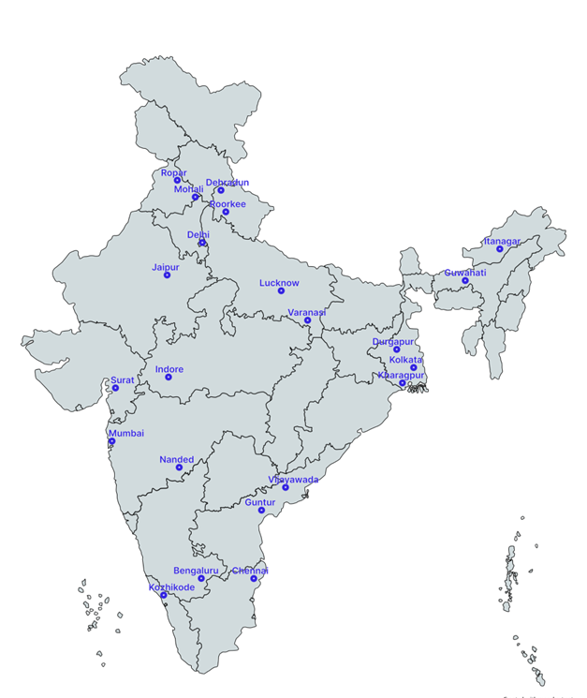



01 · ABOUT US
SECTION 1 OF 5 · ABOUT US
Crashfree India: a nonprofit that adds capacity to road safety work
Registered as the Vision Zero Trust · Co-founded by Cars24 and the Indian Road Safety Council · Working since June 2025 · New Delhi
Evidence first
Structured field audits, file reviews and research to official standards — not opinion.
Institutional collaboration
We work through PWDs, NHAI, transport departments, police and District Road Safety Committees.
Youth-led capacity
Trained student teams from IITs, NITs and SPAs add the auditing hands the system needs.
Technology for follow-through
Public dashboards track every recommendation from submission to completion.
Backed by a US$3 million, three-year commitment from Cars24 — programmes, not overheads, receive 71% of the budget.
Crashfree India · Expression of Interest — Working Group 5
Where we work today — 18 cities, north to south.
04 / 26

Slide 5


01 · ABOUT US — OUR APPROACH
SECTION 1 OF 5 · ABOUT US
Our approach: work with the system, and prove it with data
Four steps, applied to every problem we take up — from a dangerous junction to a stalled compensation claim.
1 · Evidence
2 · Institutional partnership
3 · Technology
4 · Follow-through
Field audits, file reviews and research to official standards.
→
Work through the authority that owns the problem — never around it.
→
Dashboards, AI and WhatsApp tools that fit how officials already work.
→
Every recommendation tracked publicly to completion.
31 sites audited · 50+ stakeholder consultations
31 sites audited · 50+ stakeholder consultations
25+ written approvals · 4 DRSCs · MoUs with police
25+ written approvals · 4 DRSCs · MoUs with police
6 live public products
6 live public products
7 sites fully implemented · 6 more partially
7 sites fully implemented · 6 more partially
We do not replace the system and we do not campaign against it. We add hands, evidence and tools to work the system has already committed to.
Crashfree India · Expression of Interest — Working Group 5
05 / 26

Slide 6



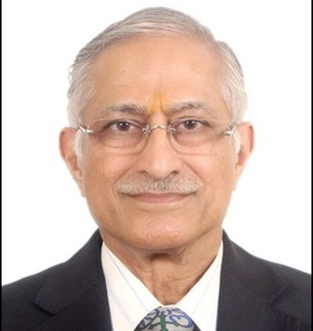
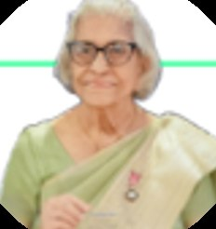
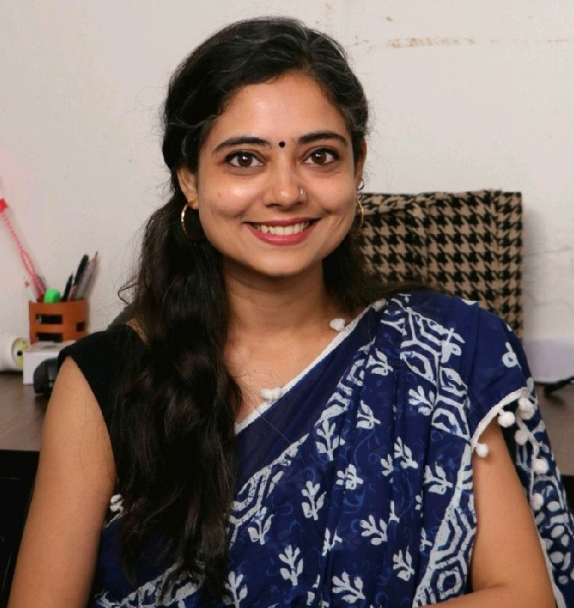
01 · WHY WORKING GROUP 5
SECTION 1 OF 5 · ABOUT US
Why Working Group 5 — and what we bring to it
The Group's mandate matches the deepest part of our portfolio. Three focus areas where we are ready on day one.
Clearing the compensation pipeline
Pendency is measured in years and thousands of crores. Our district work shows exactly where files stall — and how visibility clears them.
EXISTING CAPABILITIES WE PUT ON THE TABLE
Justice Unserved evidence
Rajasthan portal blueprint
4 DRSC working seats
Legal bench: MACT + DLSA
Victim-facing standards & tools
Aasha, the calculator, guides and helpdesks — working models for the citizen-facing standards WG-5 will set.
Aasha + calculator live
Trauma-ward helpdesks
EMS & trauma-care evidence
The Pre-Hospital Care Primer benchmarks ERSS-112 and documents state innovations — a ready baseline for care standards.
SUBJECT-MATTER EXPERTS ALREADY ENGAGED ON THIS AGENDA
Justice J.R. Midha
PT
Piyush Tewari
Dr. Maya Tandon
Mishika Singh
Retd., Delhi HC · MACT process architect
SaveLIFE Foundation · Good Samaritan Law
Sahayta Trust · trauma-response pioneer
Neev Foundation · legal helpdesks
Crashfree India · Expression of Interest — Working Group 5
06 / 26

Slide 7
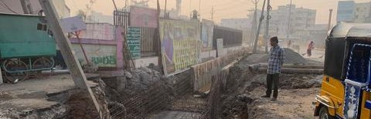
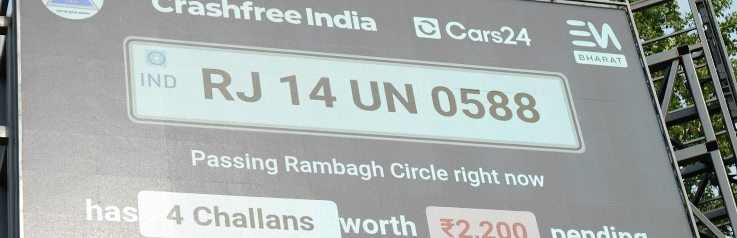
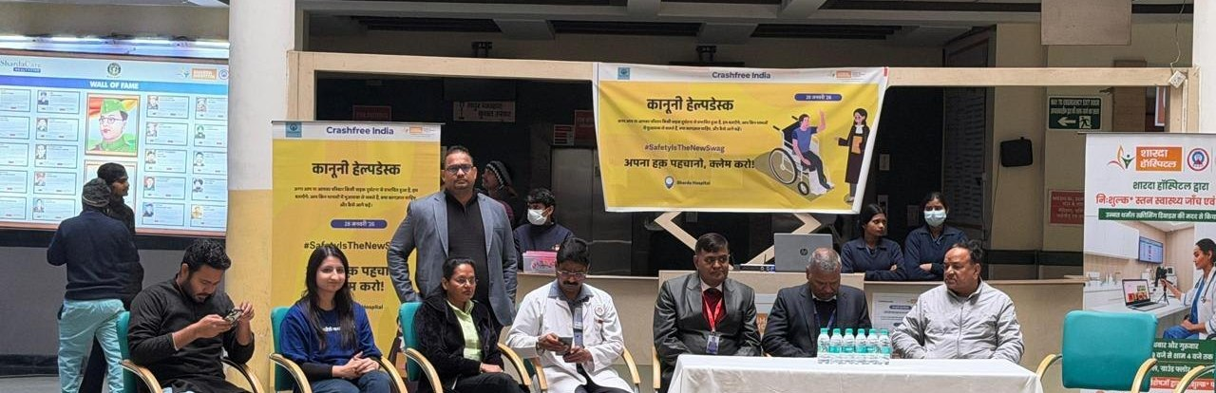
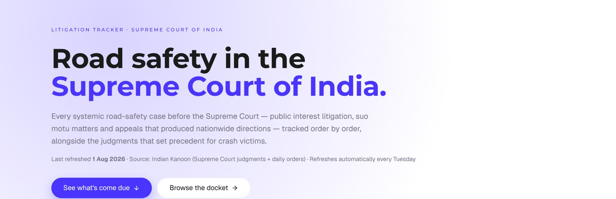
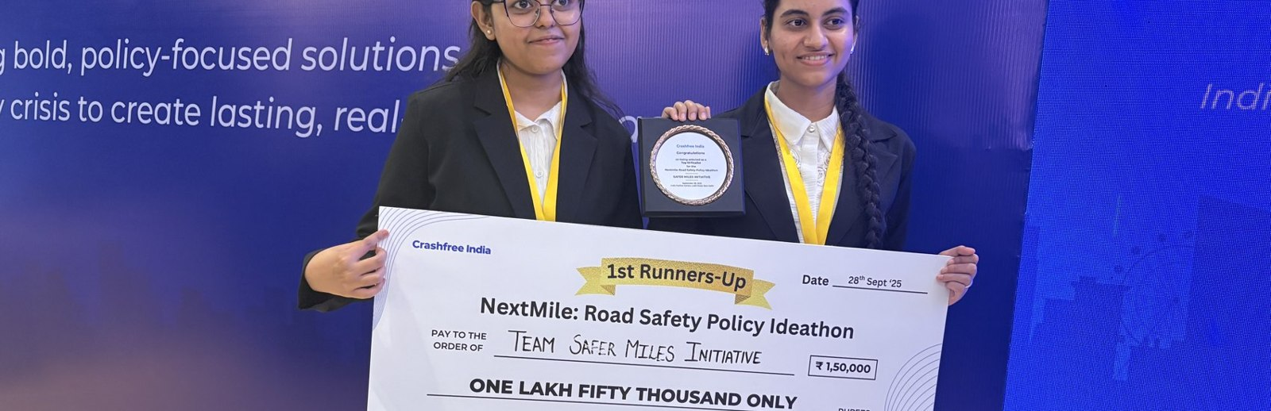
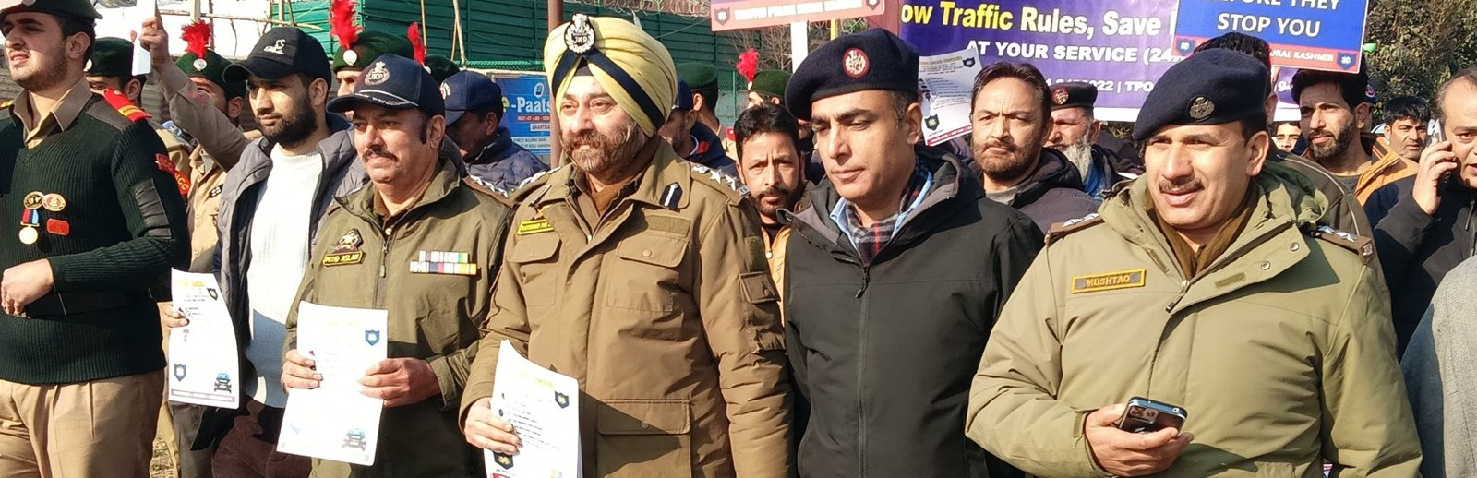
02 · WHAT WE HAVE BUILT
SECTION 2 OF 5 · WHAT WE HAVE BUILT
Six lines of work, one connected system
Audits create data · data supports policy · policy guides the field. Everything below is live today.
Project Rakshak
SATARK enforcement
Victim support
Student-led road audits, fixed with authorities
AI support that helps police find high-risk vehicles
Aasha chatbot, calculator, hospital helpdesks
31 sites · 7 fixes fully built
3,00,000+ vehicles screened
100+ victims helped in first 4 days
Open public data
Youth & policy
Public campaigns
Four self-updating data platforms, free to use
NextMile ideathon and national dialogue series
Road Safety Month with police & schools; MS Dhoni
36 states & 50 cities covered
2,000+ participants engaged
1M+ citizens reached
Crashfree India · Expression of Interest — Working Group 5
07 / 26

Slide 8
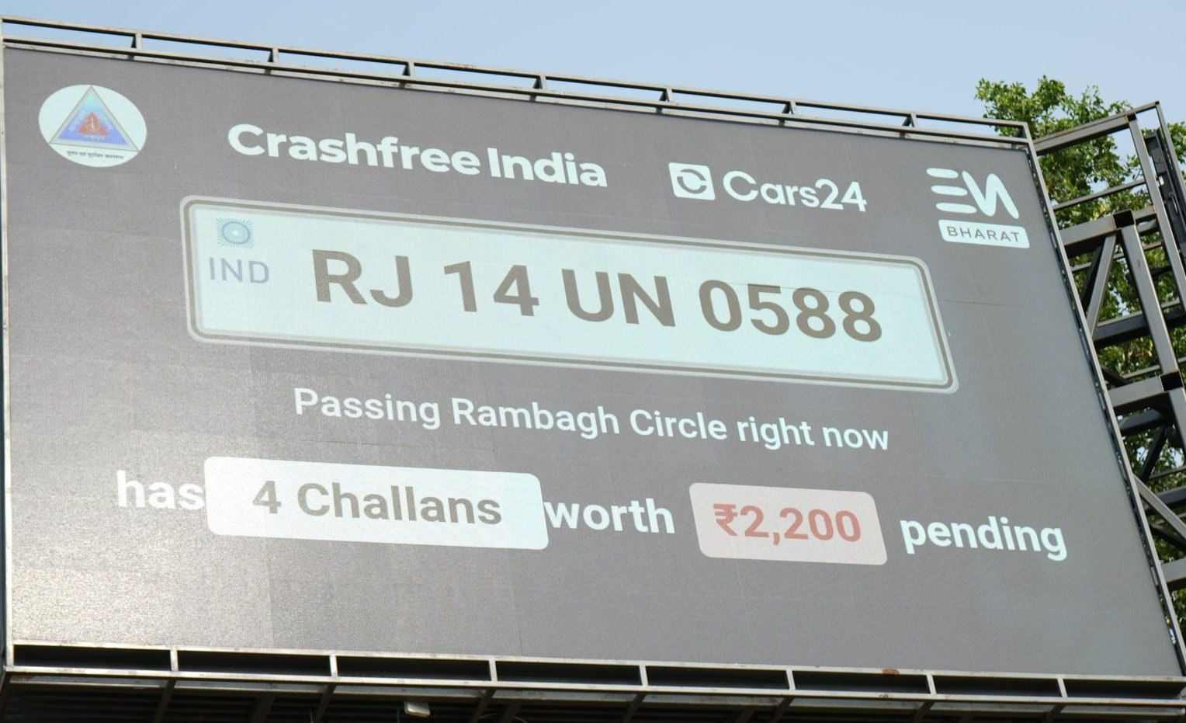
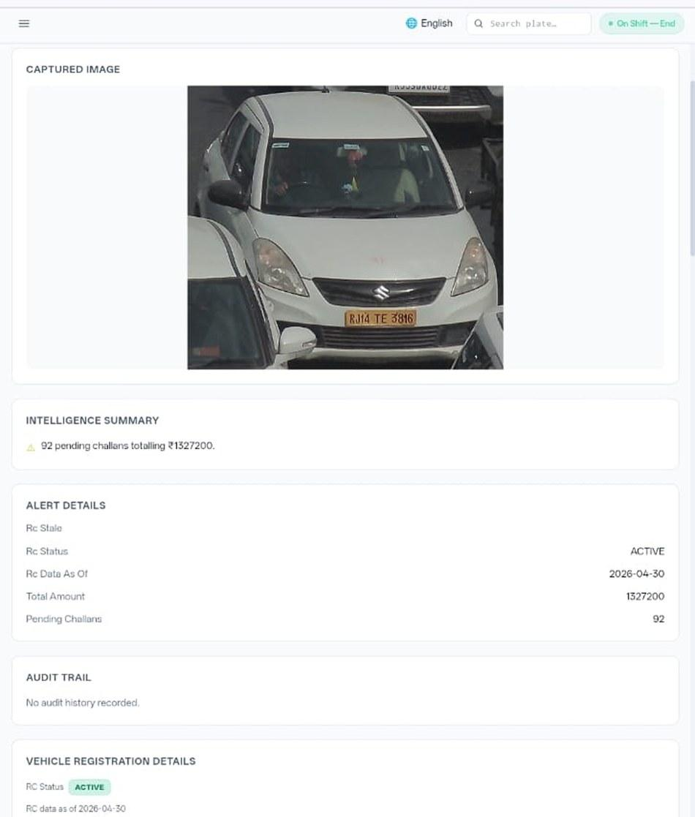








02 · WHAT WE HAVE BUILT — ENFORCEMENT TECHNOLOGY
SECTION 2 OF 5 · WHAT WE HAVE BUILT
SATARK: AI that helps police stop the right vehicle
Built with Cars24 engineers. Reads number plates, checks government records, and alerts officers to repeat offenders — in real time.
3,00,000+
₹30 Cr+
vehicles screened
pending challan value identified
350+
70,019
high-risk vehicles intercepted
vehicles found with pending challans
LIVE · Jaipur & Bengaluru
NEW · Gurugram
Officer view — challans,
RC & compliance status.
Bengaluru's Trinity Circle billboard was India's first — covered by Deccan Herald and national press. Pune and Ahmedabad are next.
Rambagh Circle, Jaipur — live plate, pending challans and dues on a public billboard.
ANPR camera
Plate read
Records check
Risk flag
Officer alert
Billboard
Interception
Enforcement
Crashfree India · Expression of Interest — Working Group 5
08 / 26

Slide 9
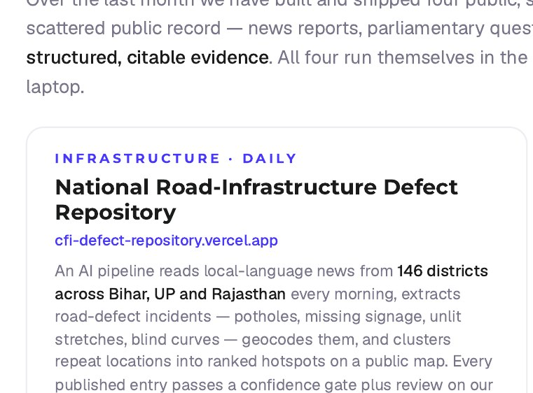
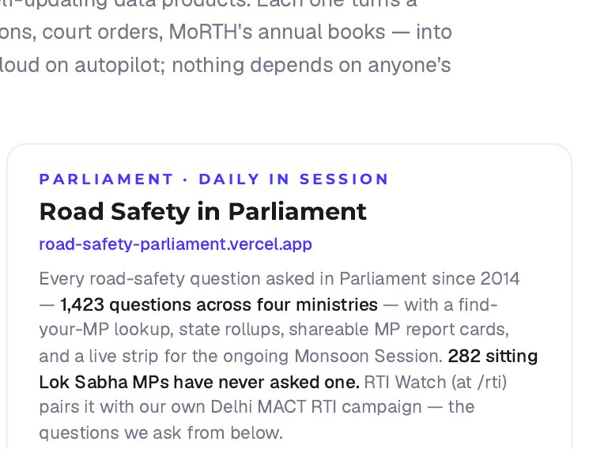
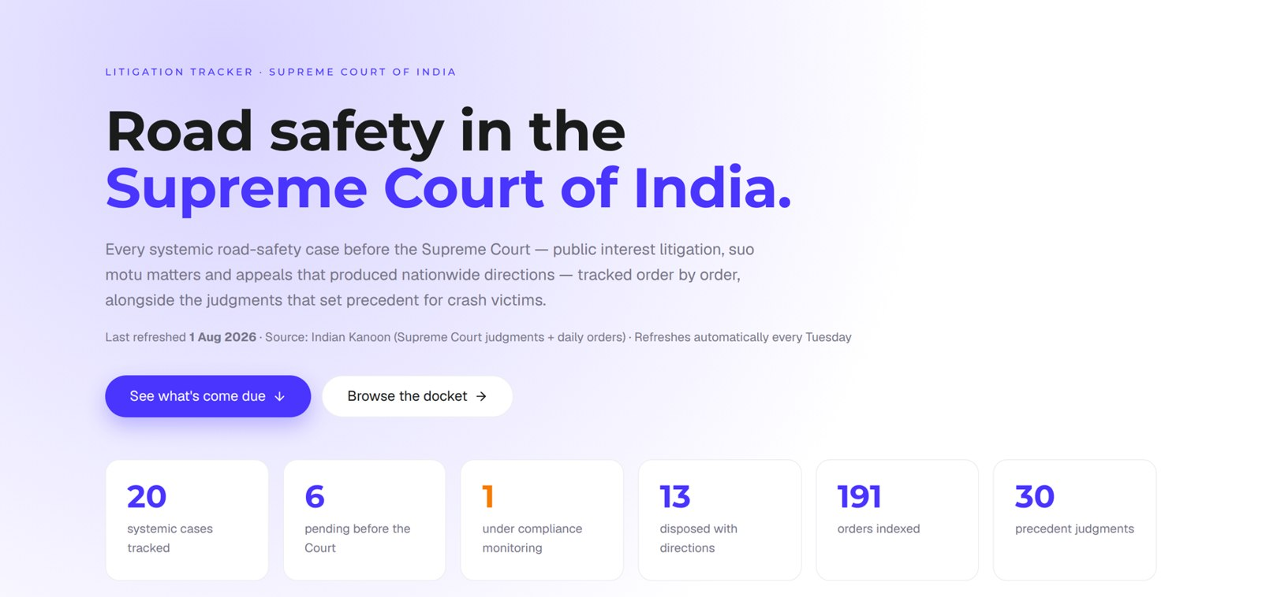
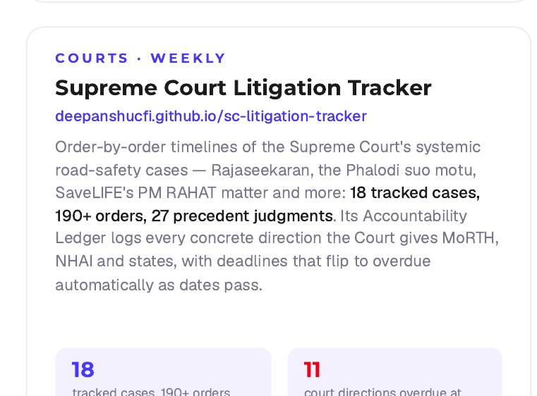
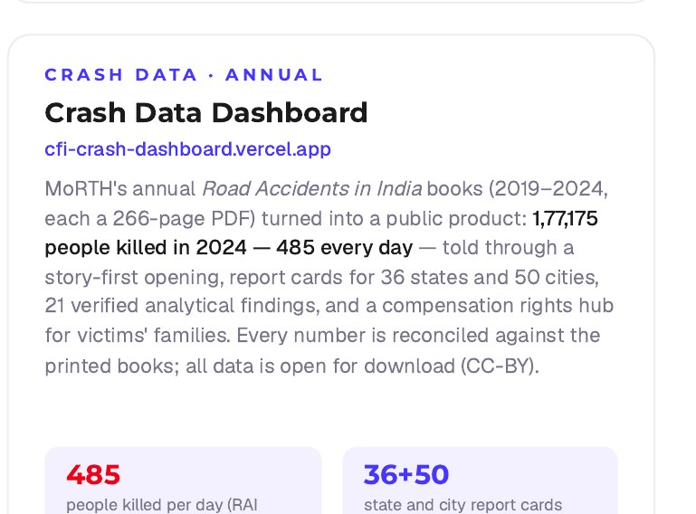
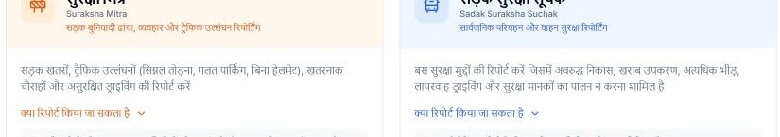
02 · WHAT WE HAVE BUILT — OPEN PUBLIC DATA
SECTION 2 OF 5 · WHAT WE HAVE BUILT
Four live data platforms — free for any authority
Each one turns a scattered public record into structured, citable evidence. Self-updating; no login, no fee.
Live view, 1 Aug 2026 — 20 systemic cases · 191 orders indexed · 30 precedent judgments. Refreshes every Tuesday.
Plus: Suraksha Mitra & Sadak Suraksha Suchak — citizen hazard reporting in Hindi (50+ hazards in the first 20 days).
Product cards from our internal data-stack brief, July 2026 — descriptions as shipped.
Crashfree India · Expression of Interest — Working Group 5
09 / 26

Slide 10
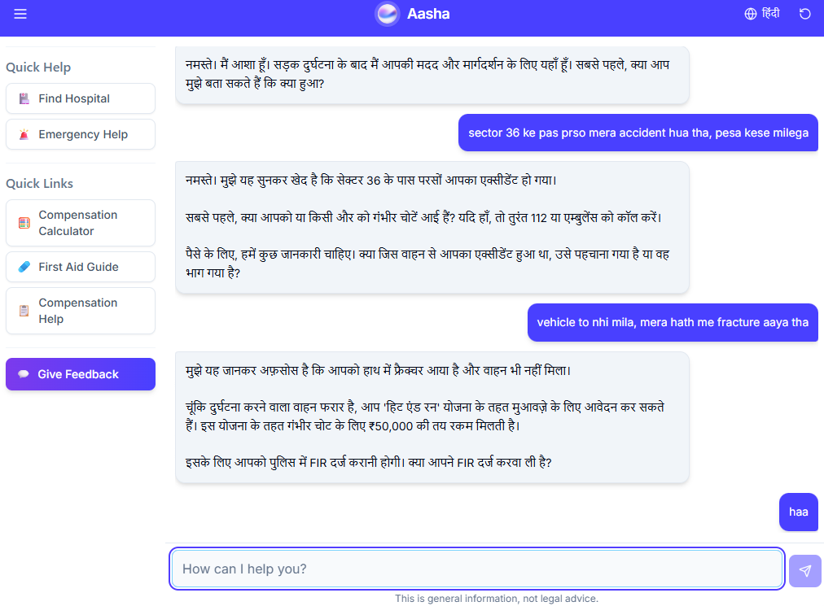
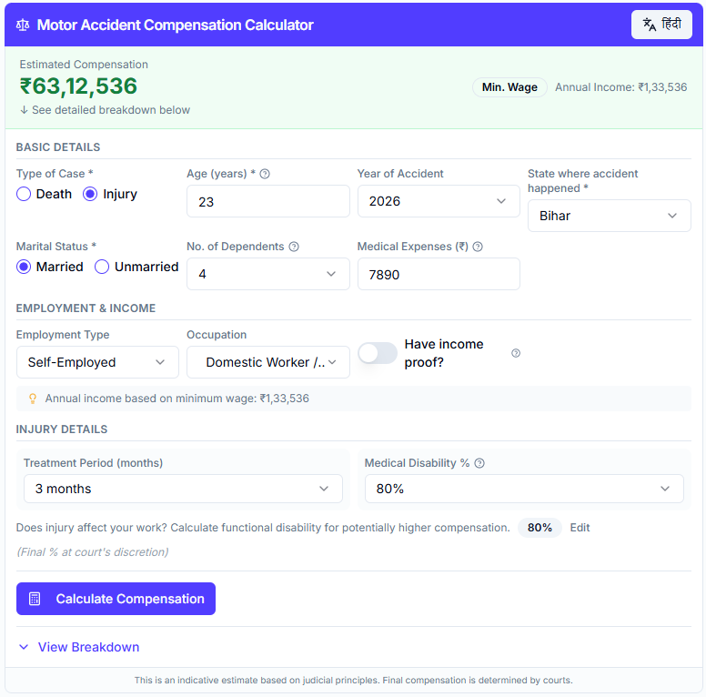
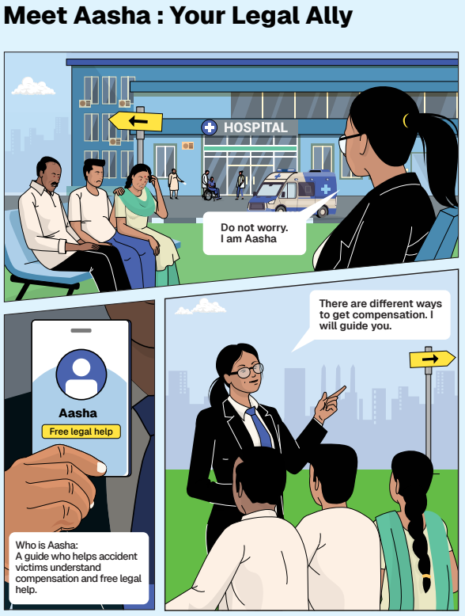
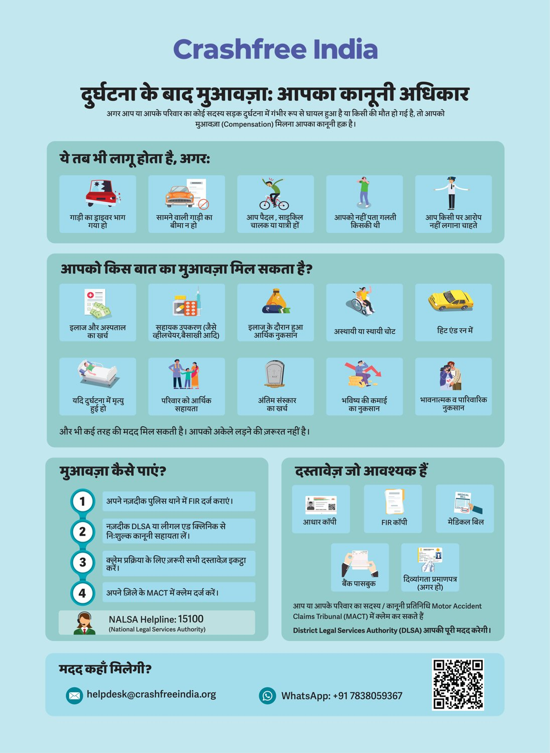




02 · WHAT WE HAVE BUILT — VICTIM SUPPORT
SECTION 2 OF 5 · WHAT WE HAVE BUILT
Help a family can actually use, in their language
From the first hours after a crash to the final compensation order — on WhatsApp, on paper, and in person.
Hindi legal-rights
guide.
Aasha, live on WhatsApp — 24/7, multilingual, step-by-step guidance on rights, schemes and documents.
The Calculator — a sample estimate
computed on SC principles.
'Meet Aasha' comic — legal education
families actually read.
Aasha chatbot — India's first AI legal companion for crash victims — no app, no portal, just WhatsApp and voice.
Compensation Calculator — Free instant estimates on Supreme Court principles (Sarla Verma, Pranay Sethi).
Hospital helpdesks — Legal desks in trauma wards — 100+ victims supported in the first four days.
Plain-language education — Comics and Hindi guides on all three compensation routes, NALSA 15100 and the Cashless Treatment Scheme 2025.
Crashfree India · Expression of Interest — Working Group 5
10 / 26

Slide 11
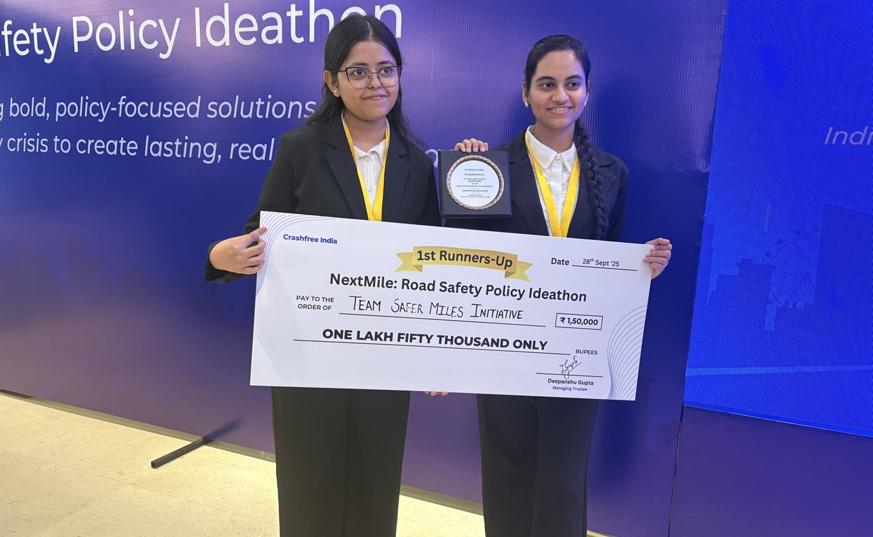
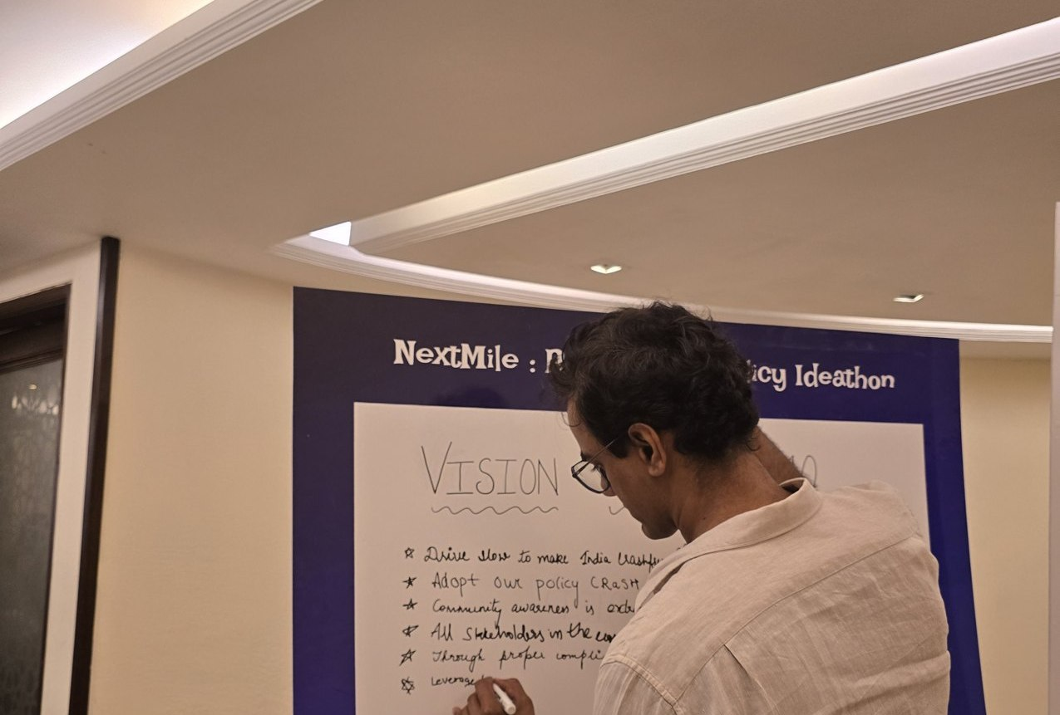



02 · WHAT WE HAVE BUILT — YOUTH & POLICY
SECTION 2 OF 5 · WHAT WE HAVE BUILT
Young talent and senior experts, working the same problem
A steady pipeline of engineers and policy minds — so road safety work never runs out of hands.
National Road Safety Dialogue Series
200+ live attendees; speakers from MoRTH, CIRT, AIIMS Trauma Centre, CSIR-CRRI and ARAI.
Three sessions so far
Bus safety · Delivery rider safety · Good Samaritan law & the Cashless Treatment Scheme.
NextMile: Road Safety Policy Ideathon — grand finale, 28 Sep 2025, New Delhi.
Vision Wall 2040 — participants write the road-safety future they want.
Public YouTube channel
Session recordings, victim-education videos and explainers — free to reuse in trainings.
2,000+
250+
700+
10
Mentors and evaluators came from the Government of Rajasthan, NIUA, OMI, NASSCOM and CSEP. Winning tracks now feed our audit and research pipeline.
participants
concept notes
teams
finalist teams
Next: 'Be a Rakshak' university chapters at IITs, NITs and SPAs.
Crashfree India · Expression of Interest — Working Group 5
11 / 26

Slide 12
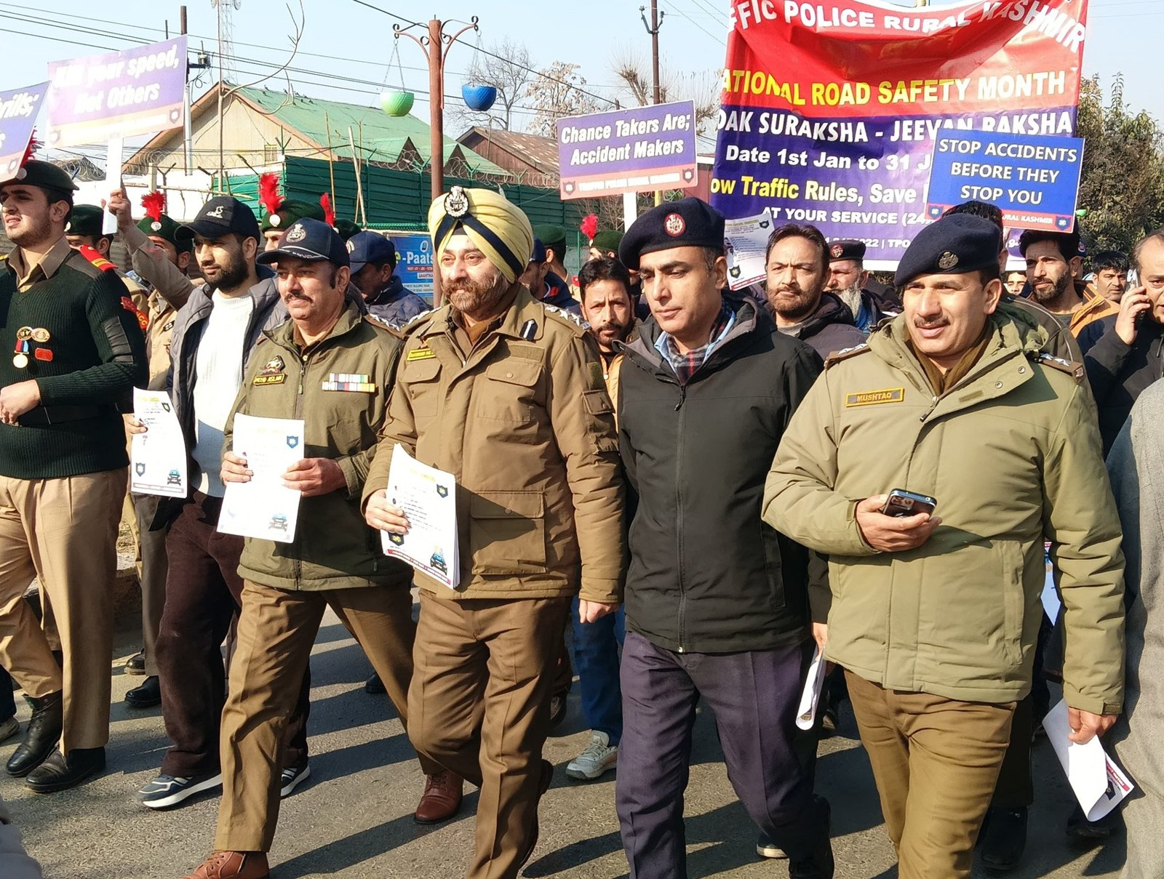
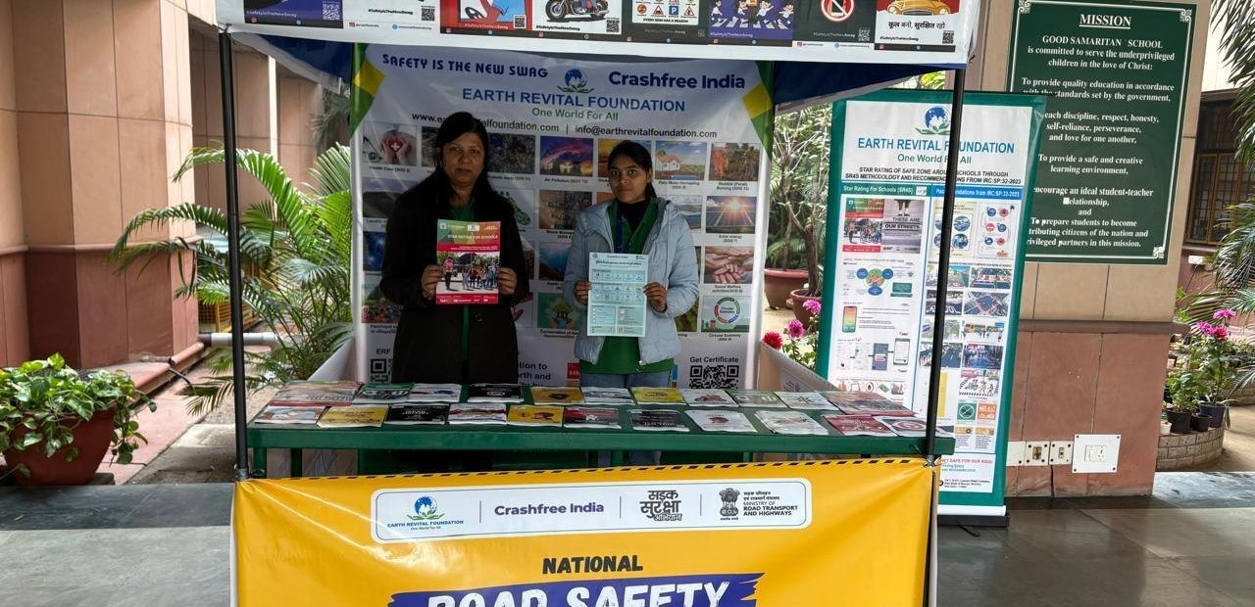
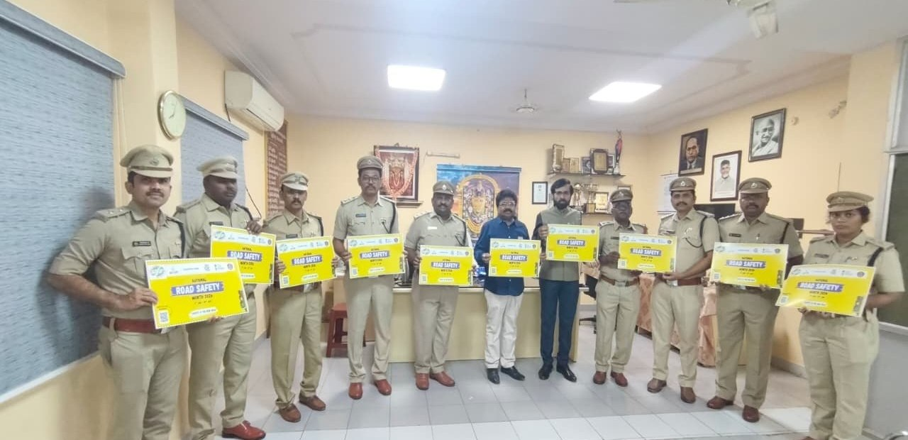
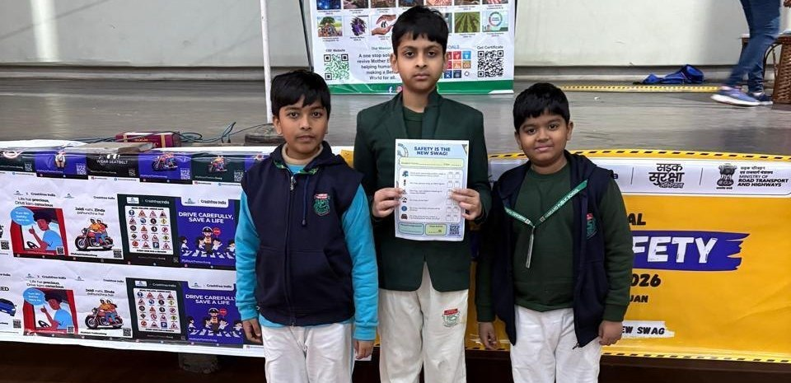
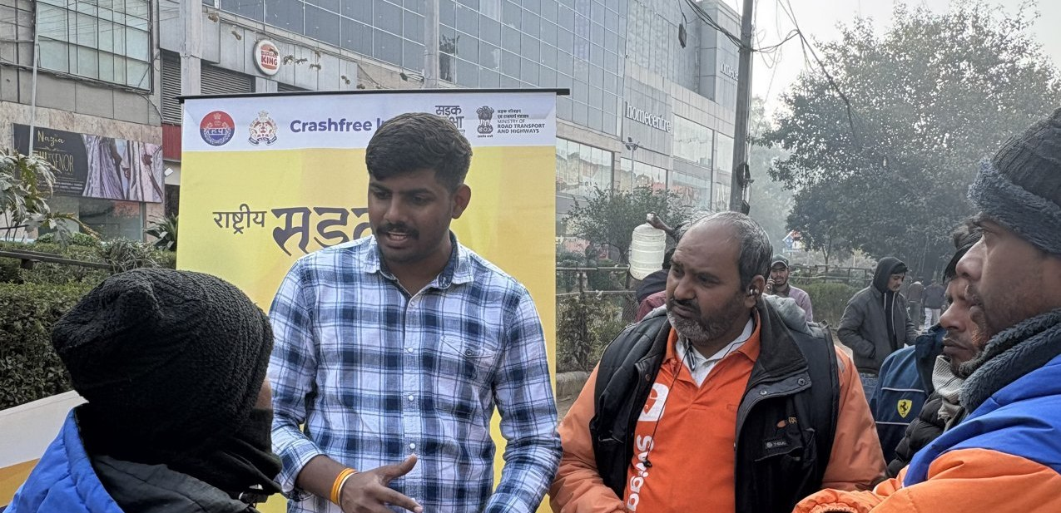
02 · WHAT WE HAVE BUILT — ON THE GROUND
SECTION 2 OF 5 · WHAT WE HAVE BUILT
Road Safety Month 2026, run with the system
With district police, schools, hospitals and delivery platforms — in Hindi and local languages.
CFI stall at a government office
Materials briefing with police staff
National Road Safety Month rally — on the road with district traffic police, Jan 2026.
School programme with certificates
Delivery-rider outreach — Swiggy & Instamart
1M+ citizens reached across campaigns in year one.
Crashfree India · Expression of Interest — Working Group 5
12 / 26

Slide 13
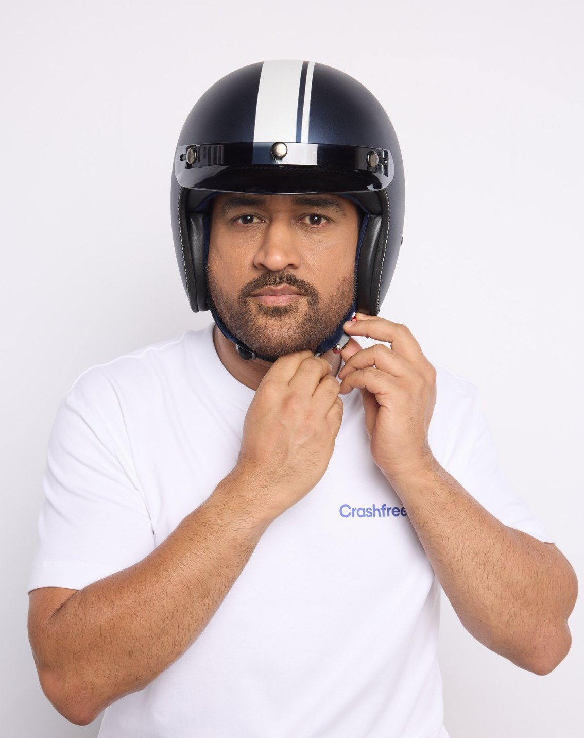
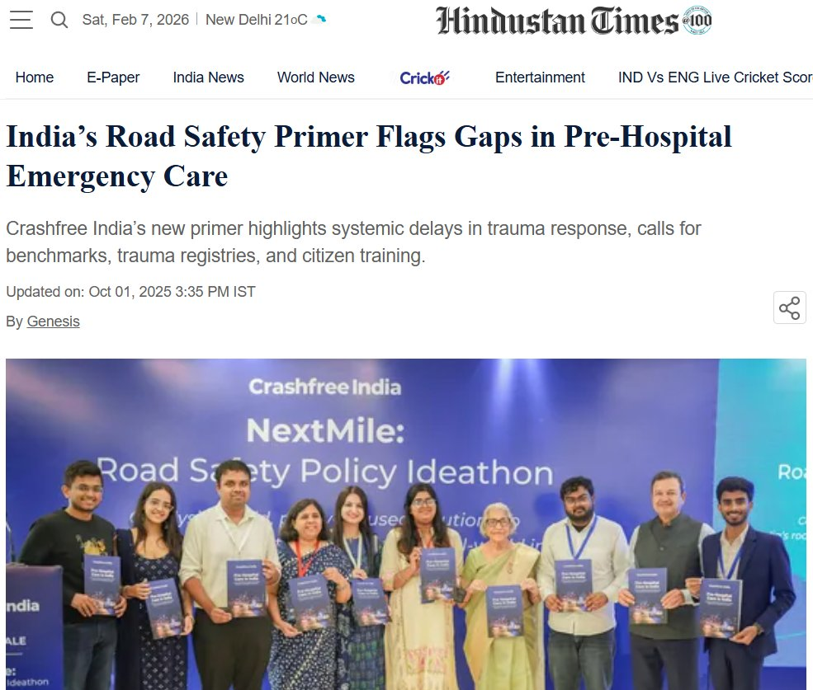
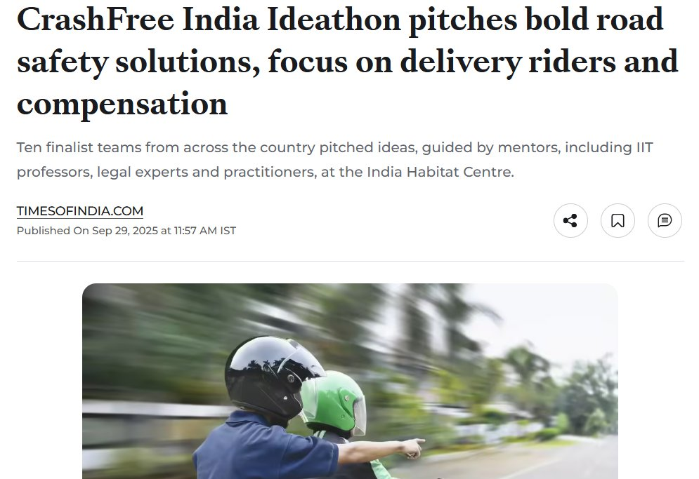

02 · WHAT WE HAVE BUILT — PUBLIC VOICE
SECTION 2 OF 5 · WHAT WE HAVE BUILT
MS Dhoni carries the message; the press covers the work
IN THE NATIONAL PRESS
"We already know what is going wrong. What we need now is more responsibility, more discipline, more respect for life."
ThePrint — on the NextMile
ideathon finale.
MS Dhoni, at the National Road Safety
Implementation Forum, IIT Delhi
Hindustan Times — on our
Pre-Hospital Care Primer.
Deccan Herald
Economic Times
Fortune India
MS Dhoni — Goodwill Ambassador, announced April 2026.
IndiaSpend
Scroll.in
The Wire
Dhoni's voice powers 'Be a Rakshak', school-zone safety and compensation-awareness campaigns.
Times of India
Business Standard
Crashfree India · Expression of Interest — Working Group 5
13 / 26

Slide 14
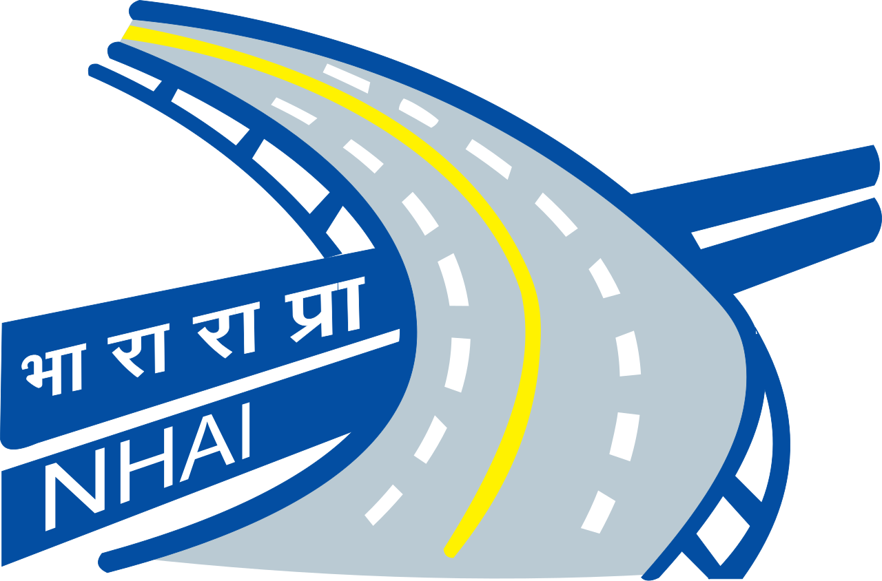
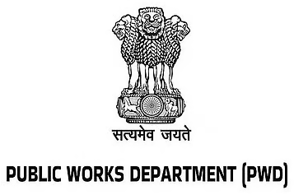
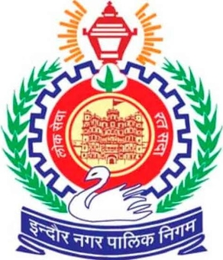
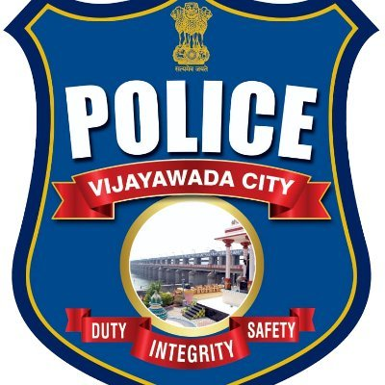
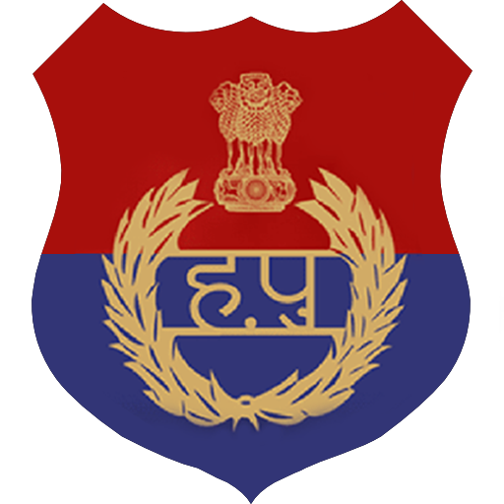


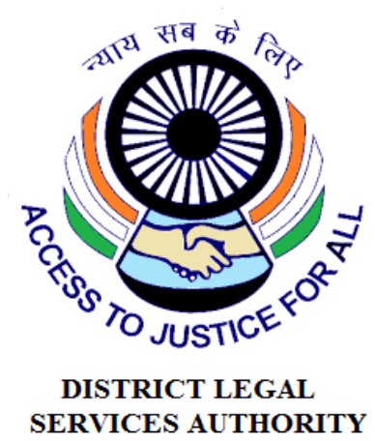















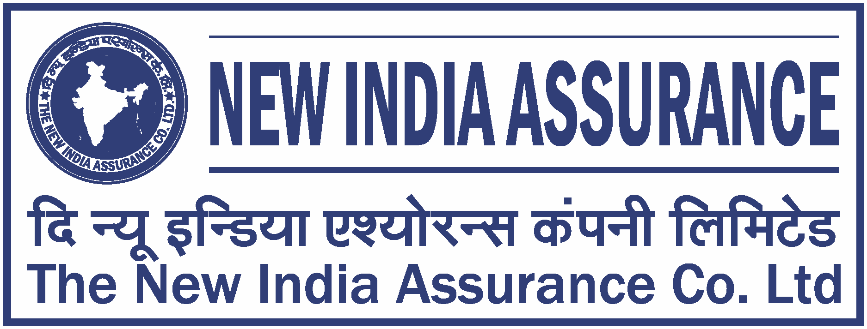
02 · WHAT WE HAVE BUILT — THE NETWORK
SECTION 2 OF 5 · WHAT WE HAVE BUILT
The institutions around the work
As they appear in our working decks — engagement ranges from formal MoUs and written approvals to jury, mentoring and research collaboration.
AUTHORITIES & PUBLIC BODIES WE WORK WITH
UNIVERSITIES & INSTITUTES FIELDING AUDIT TEAMS
EXPERT & ECOSYSTEM PARTNERS
Plus: Jaipur Traffic Police & Gurugram Police (MoUs) · CPWD & district administrations · Bloomberg, Johns Hopkins, Centre for Green Mobility and PwC experts on juries and reviews.
Crashfree India · Expression of Interest — Working Group 5
14 / 26

Slide 15
03 · OUR PEOPLE
SECTION 3 OF 5 · OUR PEOPLE
A full-time team built for this work
Engineering, law, policy, product and field operations — under trustees who have led Indian road safety for a decade.
AS
Amar Srivastava
DG
Deepanshu Gupta
GJ
Gajendra Jangid
President · Founder, Indian Road Safety Campaign · Member, National Road Safety Council
Managing Trustee · Founder, IRSC · Global Youth Coalition for Road Safety
General Secretary · Co-founder, Cars24
THE FULL-TIME TEAM
AH
Akhtar Hussain
SK
Shubham Kumar
MY
Muskan Yadav
AS
Aastha Shreeharsh
Mission Lead
Policy & Advocacy
Programmes
Strategy & Ops
IIT Delhi
NALSAR Hyderabad
TISS
HKUST
RS
Rohan Sharma
IR
Ishita Rathore
YY
Yuvraj Yadav
SK
Shipra Kushwaha
Cause Marketing
People & Culture
Product Design
Graphic Design
In-house capabilities: road-engineering audits · legal & policy research · AI product development · district operations · behaviour-change communication. Plus 75+ engineering interns and 31 student audit teams.
Crashfree India · Expression of Interest — Working Group 5
15 / 26

Slide 16
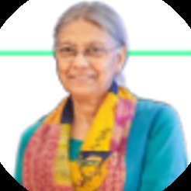
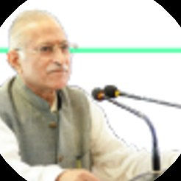
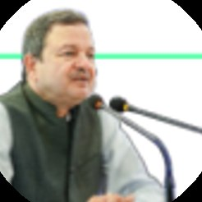
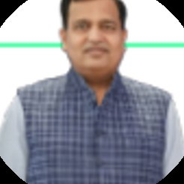
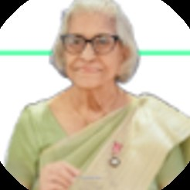
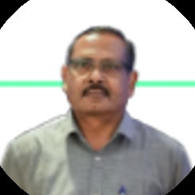
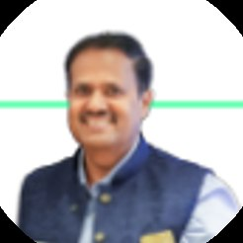
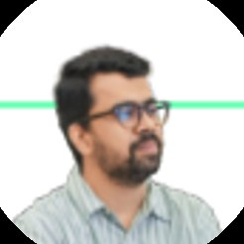
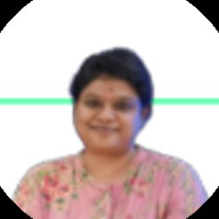
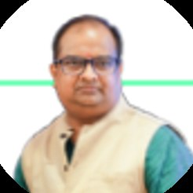


03 · OUR PEOPLE — THE EXPERT BENCH
SECTION 3 OF 5 · OUR PEOPLE
Advised by the people who built India's road safety practice
Prof. Geetam Tiwari — Board of Advisors
PT
Piyush Tewari — Board of Advisors
Professor Emerita & Chair, TRIP Centre, IIT Delhi · Member, IRC H-7 Committee on Road Safety Audit
Founder & CEO, SaveLIFE Foundation · Architect of the Good Samaritan Law · Zero-Fatality Corridors
JURY, MENTORS & REVIEWERS AROUND OUR WORK
Justice J.R. Midha
Abhay Damle
Vaibhav Dange
Dr. Maya Tandon
R. Venkat Ratnam
Akhilesh Srivastava
Delhi High Court (Retd.)
Ex-JS, MoRTH
Ex-Advisor, MoRTH
Sahayta Trust
Government of Punjab
ITS India · IRF
Gautam Singh
Aishwarya Raman
Neeraj Kumar
R.S. Pandey
Dipak K. Dash
SaveLIFE Foundation
OMI Foundation
Tata AIG
FICCI Road Safety
Times of India
Engaged through the National Road Safety Dialogue Series: Balraj Bhanot (ex-Chair, CMVR-TSC) · I.V. Rao (TERI; ex-Maruti Suzuki) · D.P. Saste (CIRT / ex-MoRTH) · Dr. Sushma Sagar (AIIMS Trauma) · Dr. S. Velmurugan (CSIR-CRRI) — and jurors from OMI, NIUA, WRI, CII and Tata AIG.
Crashfree India · Expression of Interest — Working Group 5
16 / 26

Slide 17

04 · POST-CRASH CARE — THE PROBLEM, MEASURED
SECTION 4 OF 5 · POST-CRASH CARE
Compensation pendency, in numbers
Families and courts both lose to process friction. This is a pipeline problem — and pipelines can be fixed with standards and visibility.
₹80,000+ Cr
11 lakh
3.6 years
held up across 10.46 lakh pending MACT cases nationally
claims pending in MACT courts (FY 2023)
average time to settlement — for those who persist
20–40
<5%
~₹986 Cr
office visits to keep a single claim alive
of hit-and-run victims actually receive compensation
awarded but unclaimed in MACT accounts, in just 5 cities
'Deposited But Not Delivered' — our research brief on court-awarded money that never reaches families — maps exactly where the pipeline leaks: awareness, documents, traceability, and the hand-offs between offices.
Crashfree India · Expression of Interest — Working Group 5
17 / 26

Slide 18





04 · POST-CRASH CARE — OUR RESEARCH FOUNDATION
SECTION 4 OF 5 · POST-CRASH CARE
'Justice Unserved' — the evidence base we built first
Published January 2026 · launched at IIT Delhi · findings presented to MoRTH · covered by national press.
Awareness
70% of low-income families are unaware compensation exists.
<5%
Timeliness
3.6-year average claim; MACT cases often run 8–10 years.
of hit-and-run victims actually receive compensation under the scheme built for them.
Documentation
90% of pending hit-and-run claims stall on documents alone.
Adequacy
Informal workers are often valued at minimum wage in courts.
FY22-23: 205 claims filed against ~25,000 eligible crashes. Focused outreach lifted conversion to ~12% by FY23-24 — proof the pipeline responds.
Equity
14% of low-income households compensated vs 24% of high-income.
The report — file reviews, RTIs and
consultations across the pipeline.
Press: Deccan Herald · Economic Times · Fortune India · IndiaSpend · Scroll.in · The Wire — and cited in Parliament-facing briefings.
Crashfree India · Expression of Interest — Working Group 5
18 / 26

Slide 19





04 · POST-CRASH CARE — FROM RESEARCH TO DISTRICTS
SECTION 4 OF 5 · POST-CRASH CARE
Working inside the district machinery
Not commentary from outside — formal seats, formal tasking, files on the table.
Four DRSCs joined
Gurugram, South-West Delhi, North-West Delhi and Jaipur — with MoUs with Jaipur Traffic Police and Gurugram Police.
File-level pipeline support
With district administrations we work the hit-and-run pipeline file by file — mapping where eligible families drop out, and helping offices close those gaps.
Formally tasked
The South-West Delhi DRSC's signed minutes task Crashfree India with digitisation and analytics support for scheme files.
Legal-rights helpdesk with district administration, Jan 2026.
Embedded presence
A research fellow sits with Gurugram district offices — implementation support, not external commentary.
Law-student volunteers after a hospital helpdesk drive.
Crashfree India · Expression of Interest — Working Group 5
19 / 26

Slide 20




04 · POST-CRASH CARE — STATE ENGAGEMENT
SECTION 4 OF 5 · POST-CRASH CARE
With Rajasthan: from ground mapping to a working template
Supporting the State Road Safety Lead Agency and Transport Department on the Hit-and-Run Compensation Scheme.
What holds claims back
11–13 documents demanded vs the 7 court-agreed standard · ~50% of files lack a usable family phone number · manual hand-offs between six offices.
~180
of ~395 monthly hit-and-run claims in Rajasthan come from Jaipur alone (~46%)
The cautionary example
A state portal that changed how offices work saw monthly requests fall 350 → 25. Our design rule: no stakeholder changes their medium.
Not because crashes happen only there — because Jaipur runs active outreach and a single coordination cell. The template is replicable.
Five GIC queries drafted
Clarification questions ready for the insurer consortium — a joint ask from the Department lands harder.
Six asks → 60 days
Decisions identified with the Department that put Phase 1 (family traceability) in motion within 60 days.
Crashfree India · Expression of Interest — Working Group 5
20 / 26

Slide 21




04 · POST-CRASH CARE — THE PORTAL CONCEPT
SECTION 4 OF 5 · POST-CRASH CARE
Designed so no stakeholder changes how they work
Families stay on WhatsApp; officers keep their queues and sign-offs; the system connects them behind the scenes.
The family flow — day-one intake, document capture, live status. All inside WhatsApp, in Hindi.
Officer view — same cases, filtered to what each desk owns; AI pre-checks flag issues, the decision stays human.
Family keeps WhatsApp
Officer keeps every decision
Traceability before automation
Single-pass clarification
Dashboards for administrators
Crashfree India · Expression of Interest — Working Group 5
21 / 26

Slide 22






04 · POST-CRASH CARE — THE FIRST HOUR
SECTION 4 OF 5 · POST-CRASH CARE
The Pre-Hospital Care Primer — our EMS evidence line
Published September 2025. Contributors include Dr. Sushma Sagar (AIIMS JPN Apex Trauma Centre) and Dr. Richa Ahuja (IIT Kharagpur).
The response gap, measured
ERSS-112 is live across all 36 states & UTs — yet ambulance arrival averages 25–35 minutes, and the full care episode runs 55–75 minutes against a 60-minute golden hour.
State innovations documented
Maharashtra's MEMS — 937 ambulances under centralised dispatch; Tamil Nadu's TAEI trauma corridors — pre-arrival alerts and protocols.
The demand side too
Good Samaritan protections and the ₹1.5 lakh / 7-day Cashless Treatment Scheme 2025, explained in our public guides and helpdesks.
Ready for WG-5
A referenced baseline for the Group's EMS and trauma-care standards discussions — states already compared, gaps already mapped.
The Primer — ERSS-112, global
comparisons, state innovations.
The Chain of Survival — six links,
benchmarked for India.
Covered by Hindustan Times: 'India's Road Safety Primer Flags Gaps in Pre-Hospital Emergency Care.'
Crashfree India · Expression of Interest — Working Group 5
22 / 26

Slide 23



04 · POST-CRASH CARE — IN THE WARDS
SECTION 4 OF 5 · POST-CRASH CARE
Helpdesks where families actually are: trauma wards
What the desk does
FIR follow-up, document checklists, DLSA referrals and compensation guidance — at the bedside, in Hindi.
Who runs it
Trained law-student volunteers under practising advocates — with Neev Foundation and DLSA coordination.
Where it grows
Gurugram and Delhi trauma wards first; the district toolkit makes it replicable wherever a DRSC wants one.
Hospital legal helpdesk — 100+ victims supported in the first four days of operation.
Backed by materials
The Hindi legal-rights guide and 'Meet Aasha' comics live at every desk — and Aasha continues the help at home, 24/7.
Crashfree India · Expression of Interest — Working Group 5
23 / 26

Slide 24
04 · POST-CRASH CARE — THE PIPELINE, MEASURED
SECTION 4 OF 5 · POST-CRASH CARE
Numbers a standard can act on
Each one is a lever for a WG-5 standard, toolkit entry or communication norm — none requires new legislation.
921 of 1,026
~60 days
~50%
claims pending nationally were stalled at documentation alone (RTI, July 2024)
typical intake latency where claims surface only via bi-monthly meetings
of case files lack a usable family phone number — traceability is the first lever
7 vs 11–13
FY23-24: 12%
5 + 22
court-agreed documents vs what claimants are asked for in practice
of eligible crashes converted to filed claims — improving, from a 2% base
GIC clarification queries drafted · RTIs building the public record
The claim's other side: consultations with GIC and insurers on settlement practice · guidance from Justice J.R. Midha (Retd.), architect of the FaSTDAR process · working partners across MACT courts, DLSAs and legal-services clinics — Mishika Singh (Neev Foundation), Yash Agarwal (Public Policy India), Sanchit Seth (Advocate, Delhi MACT).
Crashfree India · Expression of Interest — Working Group 5
24 / 26

Slide 25
05 · HOW WE CAN CONTRIBUTE
SECTION 5 OF 5 · OUR CONTRIBUTION
Four concrete offers to Working Group 5
All four are ready today, need no funding from the Board, and can begin within weeks.
1
A victim-side evidence base
'Justice Unserved', 'Deposited But Not Delivered', 120+ victim and family interactions, and file-level pipeline data showing precisely where eligible families drop out.
2
A district toolkit, drawn from practice
Working DRSC integration experience — agendas, file digitisation, fellow placement — ready to be codified into the Group's district toolkit.
3
A reusable state portal blueprint
The Rajasthan case-management design — guided filing, stage-wise visibility, single-pass clarification — offered as a template any state can adapt.
4
Standards input from the claimant's side
Document standards (the court-agreed 7), communication norms and timeline benchmarks, grounded in what families actually experience.
Crashfree India · Expression of Interest — Working Group 5
25 / 26

Slide 26




We would be honoured to contribute
to Working Group 5.
Our evidence, our district relationships, our technology and our expert bench are available to the Board — in whichever form is most useful.
"We already know what is going wrong. What we need now is more responsibility, more discipline, more respect for life."
MS Dhoni · Goodwill Ambassador, Crashfree India
crashfreeindia.org
akhtar@crashfreeindia.org · helpdesk@crashfreeindia.org
Crashfree India · A Cars24 commitment · Operated by Vision Zero Trust, New Delhi

