Slide 1

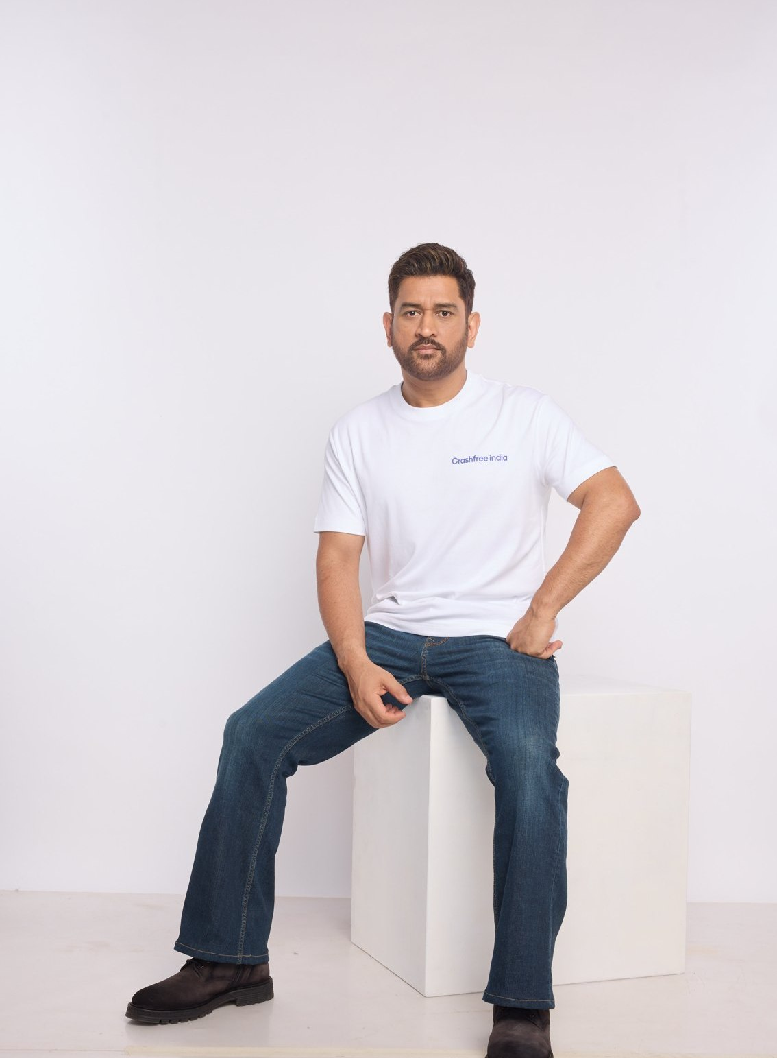



A BRIEFING FOR MENTORS · 2026
A ROAD SAFETY NONPROFIT · NEW DELHI
Crashfree India
Technology and governance for road safety,
built into an institution designed to make itself redundant
Digital public goods: enforcement AI, open data platforms, victim tools on WhatsApp
Governance from inside: 4 district committee seats, police MoUs, 25+ written approvals
MS DHONI · GOODWILL AMBASSADOR,
CRASHFREE INDIA
Standards, manuals and dashboards built so the system can run this work without us
FOCUS AREAS Road infrastructure · Enforcement · Crash compensation · Gig rider safety · School zones · Open data
Registered as the Vision Zero Trust · A Cars24 commitment · Co-founded with the Indian Road Safety Council
crashfreeindia.org

Slide 2
BEFORE THE SLIDES
A personal note
New Delhi · August 2026
Dear friend,
This deck goes to a small set of people whose judgement I deeply admire. I am writing to ask for something specific: your counsel, from time to time, as Crashfree India grows.
Crashfree India is a road safety nonprofit, registered as the Vision Zero Trust, co-founded with the Indian Road Safety Council and backed by Cars24. India loses more than 1.7 lakh lives on its roads every year. In our first year we built an audit-to-implementation engine that has moved 15 dangerous sites into rectification, an AI enforcement platform running with three police forces, a compensation practice that follows crash victims' families from FIR to disbursal, and open data platforms that turn scattered public records into citable evidence. MS Dhoni carries this message to the country as our Goodwill Ambassador.
The work has reached the stage where ambition can outrun experience. We are deciding which programmes become institutions, how to work with government at scale, and how to build an organisation that can hold this mission for a decade. On questions like these, we have more energy than experience, and we know it.
The pages that follow are a short tour of what we have built. If the work speaks to you, I would be grateful for an hour of your time, and for the licence to write to you when we face a decision where your experience would show us the way.
With respect,
Akhtar Hussain
Mission Lead, Crashfree India · akhtar@crashfreeindia.org · crashfreeindia.org
Crashfree India · A briefing for mentors · 2026
02 / 16

Slide 3

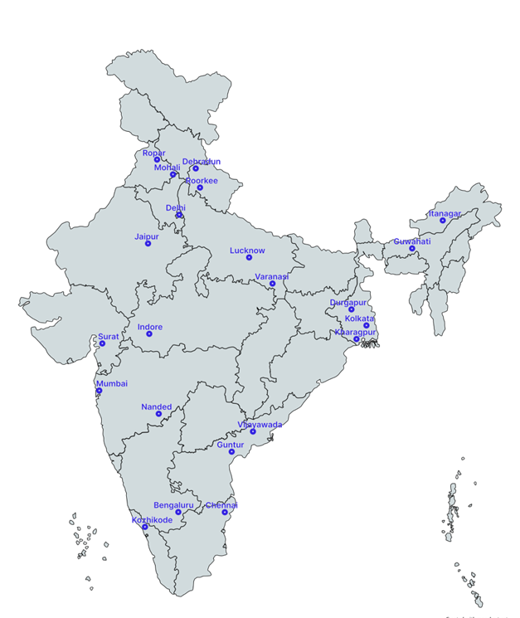



01 · ABOUT US
ABOUT US
Crashfree India: technology and policy, built to be handed over
Registered as the Vision Zero Trust · Co-founded by Cars24 and the Indian Road Safety Council · Working since June 2025 · New Delhi
Evidence first
Structured field audits, file reviews and research to official standards, not opinion.
Technology as public goods
Enforcement AI, open data platforms and WhatsApp tools, built with authorities and free for any of them to adopt.
Policy that lands
Research written so officials can act on it: briefed to ministries and district committees, cited by national newsrooms.
Built to make ourselves redundant
Standards, audit manuals and public dashboards designed so institutions can run the work without us.
Proof in year one: 31 sites audited · 25+ written authority approvals · implementation started at 15 sites · 3,00,000+ vehicles screened · seats on 4 district committees
Where we work today, 18 cities, north to south.
Crashfree India · A briefing for mentors · 2026
03 / 16

Slide 4
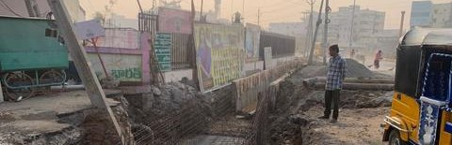
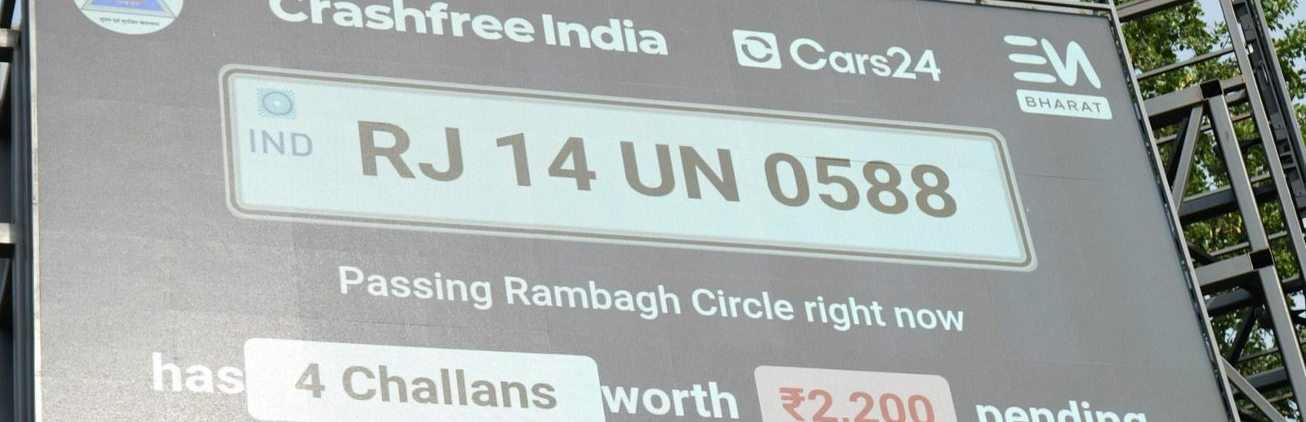
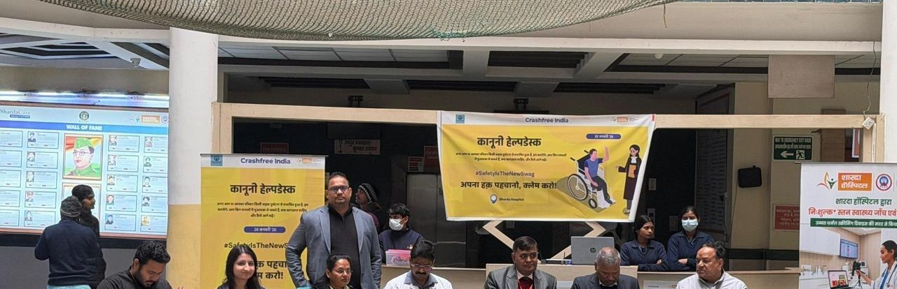
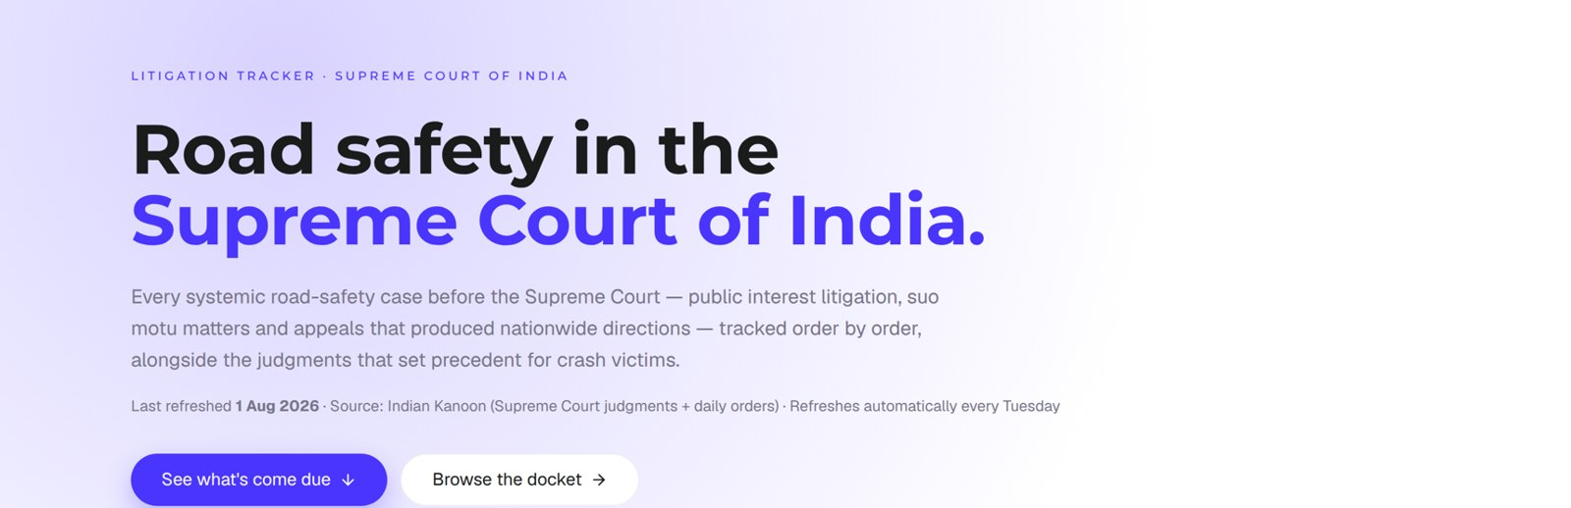
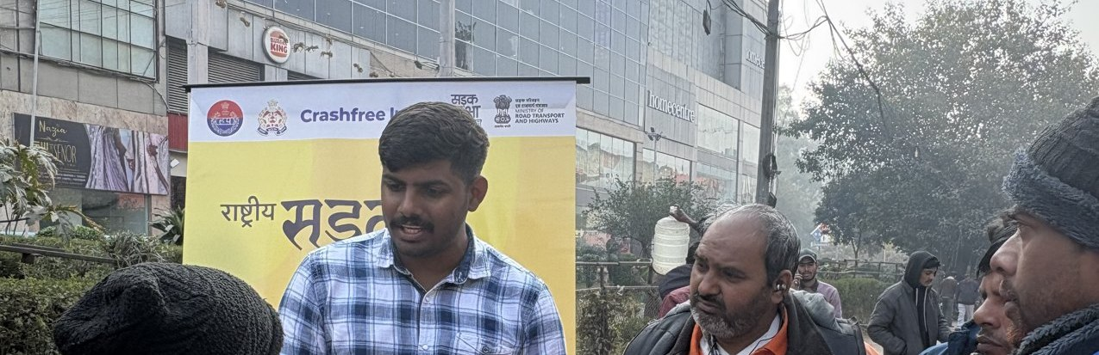
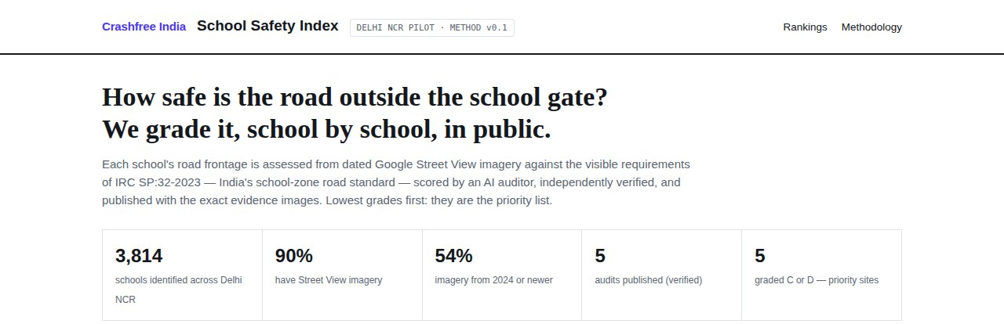
02 · WHAT WE HAVE BUILT
WHAT WE HAVE BUILT
Six lines of work, one connected system
Audits create data · data supports policy · policy guides the field. Six focus areas, one system.
Project Rakshak
SATARK enforcement
Crash compensation
Student-led road audits, fixed with authorities
AI support that helps police find high-risk vehicles
A policy implementation gap we close with tech, embedded in districts and DRSCs
31 sites · 7 fixes fully built
3,00,000+ vehicles screened
Rajasthan portal · 4 DRSC seats
Open public data
Gig rider safety
School Safety Index
Four self-updating data platforms, free to use
Research-led: published brief, 300-rider study, platform engagement
A public 0–100 score for the road outside every school gate
36 states & 50 cities covered
1 in 2 of 431 riders had crashed
Delhi & Jaipur · 5,386 schools mapped
Crashfree India · A briefing for mentors · 2026
04 / 16

Slide 5
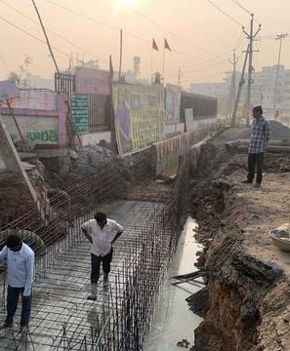
02 · WHAT WE HAVE BUILT, ROAD INFRASTRUCTURE
WHAT WE HAVE BUILT
Project Rakshak: student audits that end in built fixes
Trained student teams, guided by senior experts, audit dangerous locations to IRC codes, and we walk each fix through the road-owning authority until it is built.
120+
31
25+
15
→
→
→
locations screened
sites audited, 11 official black spots
written authority approvals
sites in implementation, 7 fully built
31 student teams · 20 institutions including nine IITs · 900+ stakeholder surveys · 17 subject-matter experts guiding every audit
MARQUEE CASE, OUTER RING ROAD, SOUTH DELHI
On our audit, PWD built a continuous 1.8 m accessible pedestrian corridor, upgraded drainage at ponding sites, installed bollards against footpath encroachment, and deployed camera-backed speed-feedback boards.
Every site is tracked on a public dashboard from submission through approval to completed construction, an honest read on how quickly agencies can act.
Construction underway after a student audit, tracked publicly to completion.
Crashfree India · A briefing for mentors · 2026
05 / 16

Slide 6
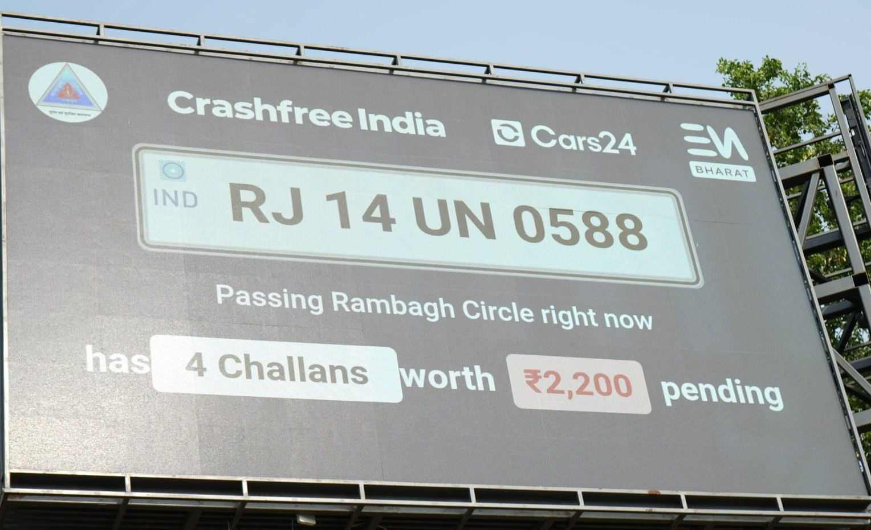
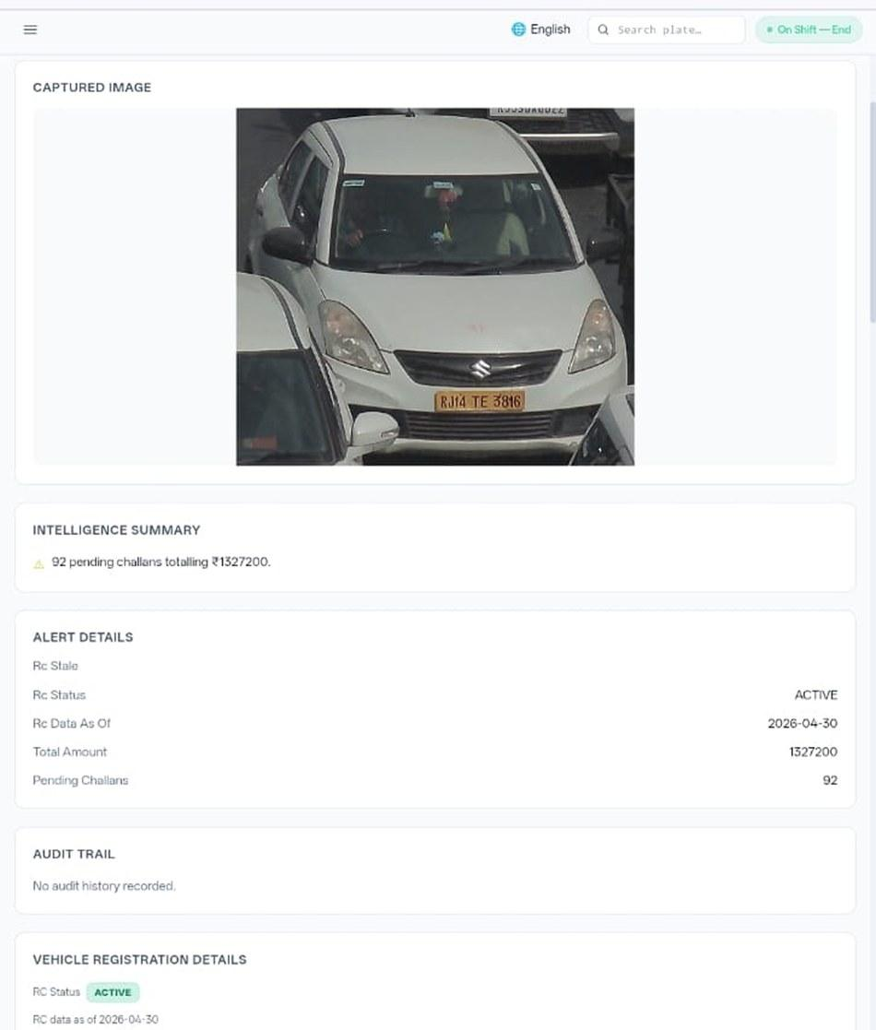








02 · WHAT WE HAVE BUILT, ENFORCEMENT TECHNOLOGY
WHAT WE HAVE BUILT
SATARK: AI that helps police stop the right vehicle
Built with Cars24 engineers. Reads number plates, checks government records, and alerts officers to repeat offenders, in real time.
3,00,000+
₹30 Cr+
vehicles screened
pending challan value identified
350+
70,019
high-risk vehicles intercepted
vehicles found with pending challans
LIVE · Jaipur & Bengaluru
NEW · Gurugram
Officer view, challans,
RC & compliance status.
Bengaluru's Trinity Circle billboard was India's first, covered by Deccan Herald and national press. Pune and Ahmedabad are next.
Rambagh Circle, Jaipur, live plate, pending challans and dues on a public billboard.
ANPR camera
Plate read
Records check
Risk flag
Officer alert
Billboard
Interception
Enforcement
Crashfree India · A briefing for mentors · 2026
06 / 16

Slide 7
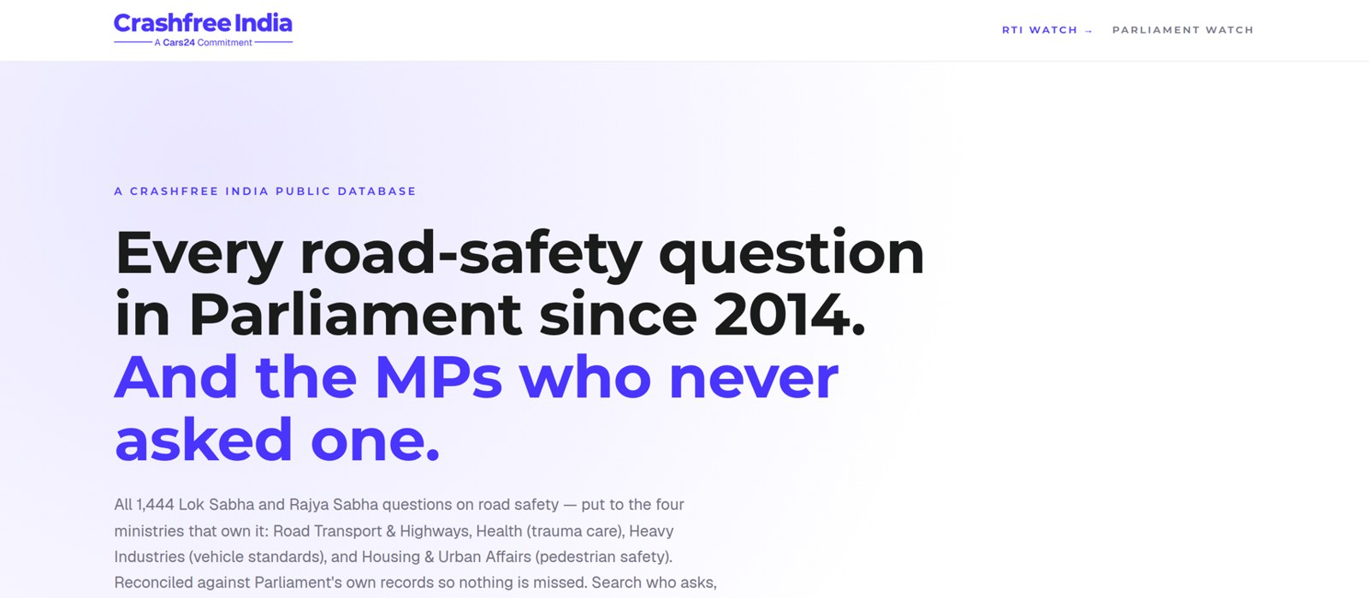


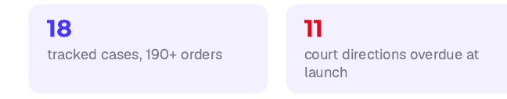
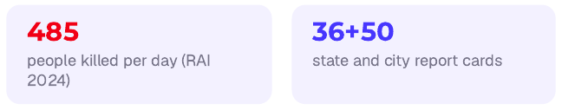
02 · WHAT WE HAVE BUILT, OPEN PUBLIC DATA
WHAT WE HAVE BUILT
Live public data platforms, free for any authority
Four platforms, each turning a scattered public record into structured, citable evidence. The Parliament tracker is shown live, as captured this week.
National Road-Infrastructure
Defect Repository
DAILY · 07:00 IST
An AI pipeline reads local-language news every morning and turns road-defect reports into structured, mapped, ranked evidence, each entry carrying its verbatim source.
Potholes
Missing signage
Unlit stretches
Blind curves
Broken dividers
146
districts scanned daily
13
languages read
21
defect codes tracked
Road Safety in Parliament: all 1,444 questions since 2014 across four ministries; 275 of 540 sitting Lok Sabha MPs have never asked one.
Local news → AI extraction → confidence gate → human review → public map. Live across Bihar, UP and Rajasthan districts today.
Supreme Court Litigation Tracker
WEEKLY · LIVE
Crash Data Dashboard
ANNUAL · OPEN DATA
Every systemic road-safety matter before the Supreme Court, orders indexed, precedent judgments digested, refreshed every Tuesday.
MoRTH's annual 'Road Accidents in India' books as a usable product: report cards for 36 states and 50 cities, every number reconciled against the printed books, open licence (CC-BY).
Crashfree India · A briefing for mentors · 2026
07 / 16

Slide 8
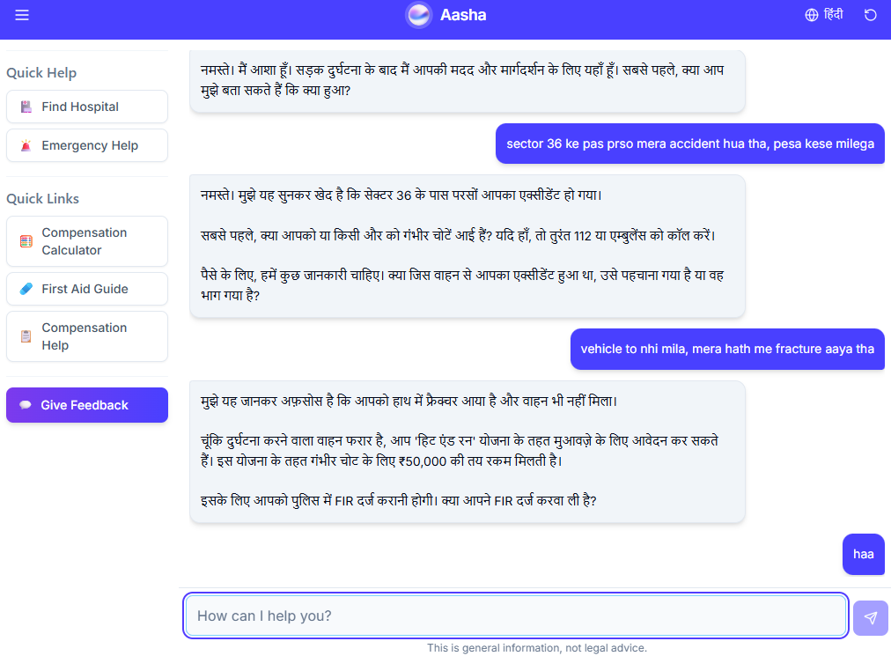
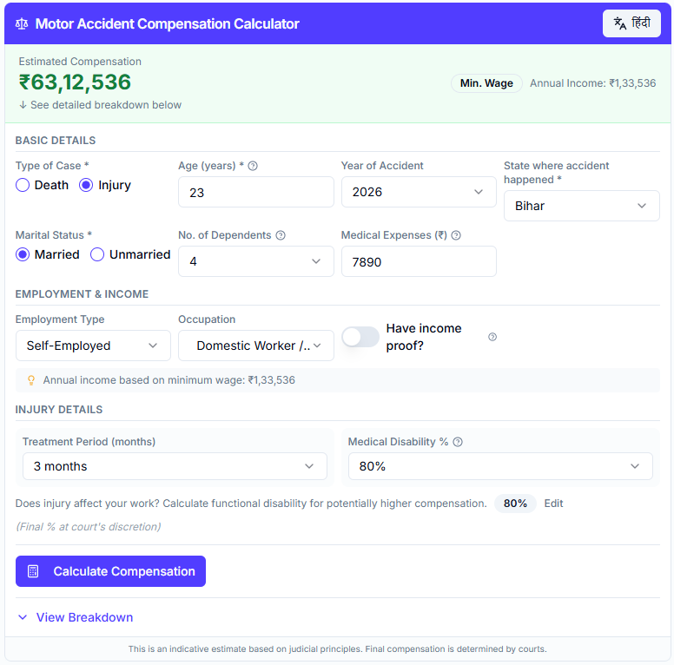
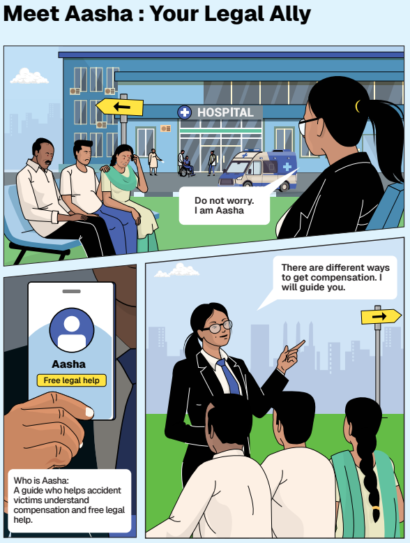
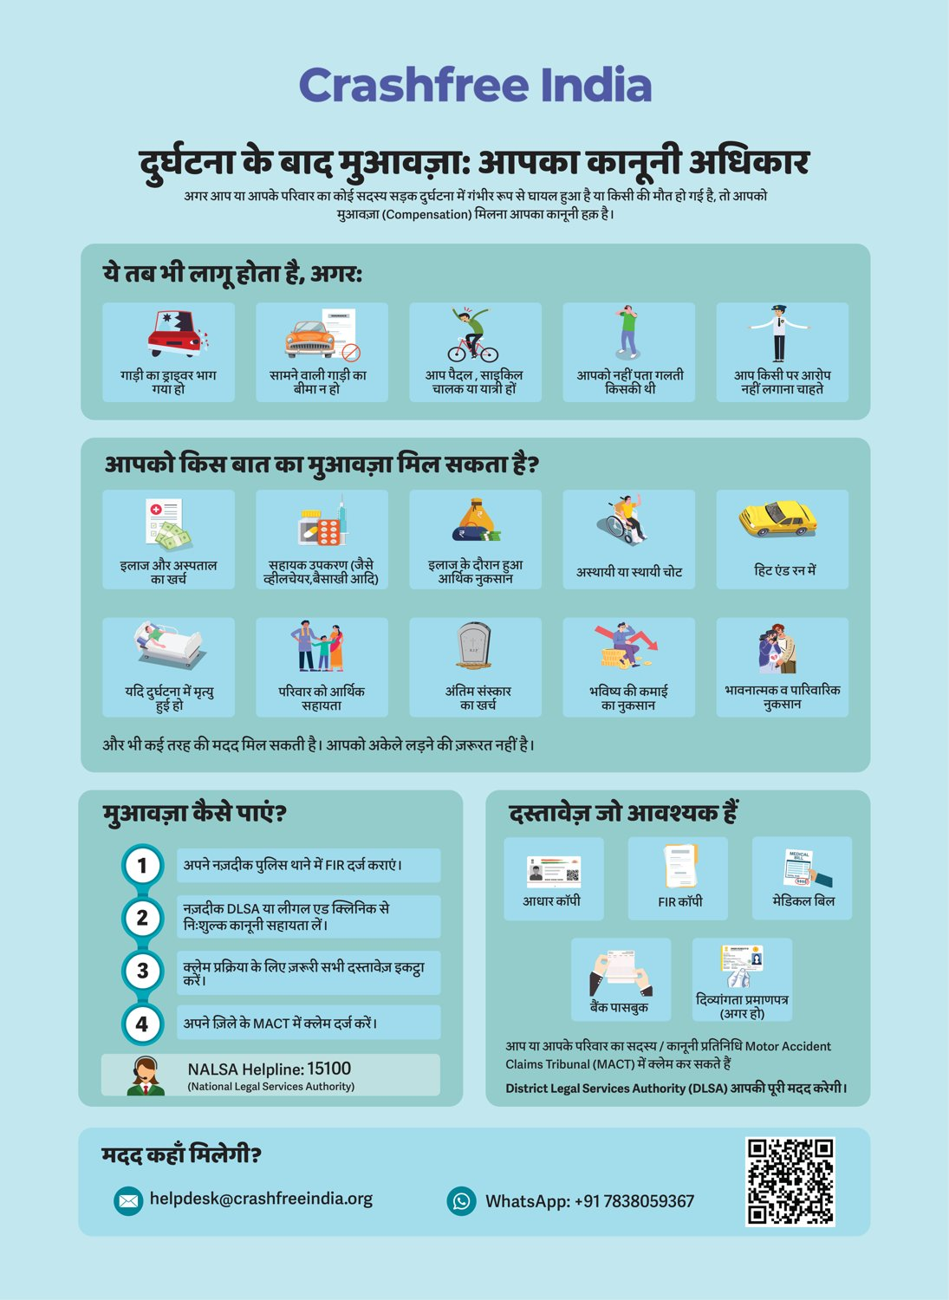




02 · WHAT WE HAVE BUILT, VICTIM SUPPORT
WHAT WE HAVE BUILT
Help a family can actually use, in their language
From the first hours after a crash to the final compensation order, on WhatsApp, on paper, and in person.
Aasha chatbot
Compensation Calculator
'Meet Aasha' comics
Hindi rights guide
India's first AI legal companion for crash victims, on WhatsApp and voice, no app needed.
Free instant estimates computed on Supreme Court principles (Sarla Verma, Pranay Sethi).
Plain-language legal education that families actually read, at desks and in schools.
All three compensation routes, NALSA 15100 and the Cashless Treatment Scheme 2025.
Hospital helpdesks bring all of this to the trauma-ward bedside , 100+ victims supported in the first four days, run with DLSA and Neev Foundation.
Crashfree India · A briefing for mentors · 2026
08 / 16

Slide 9
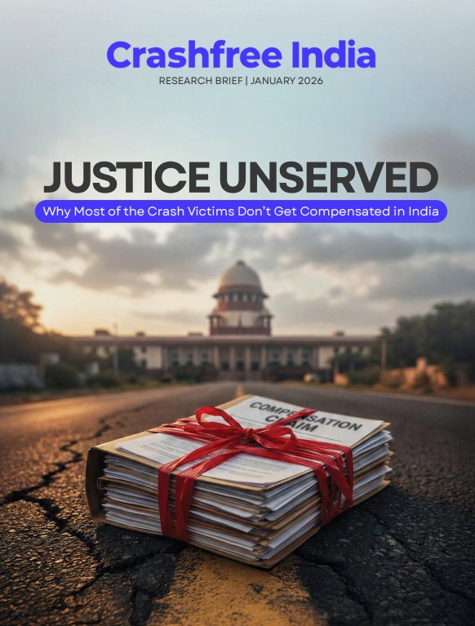
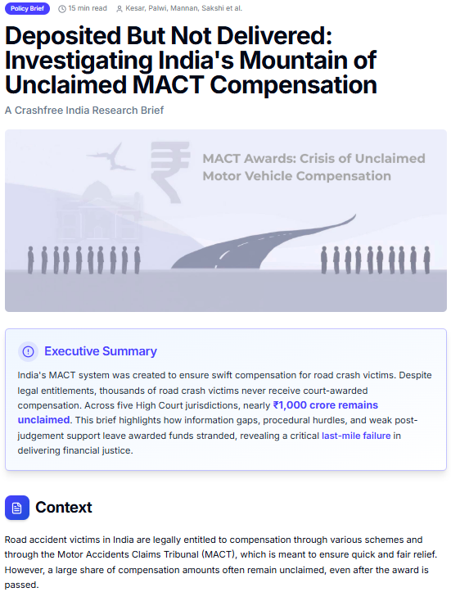
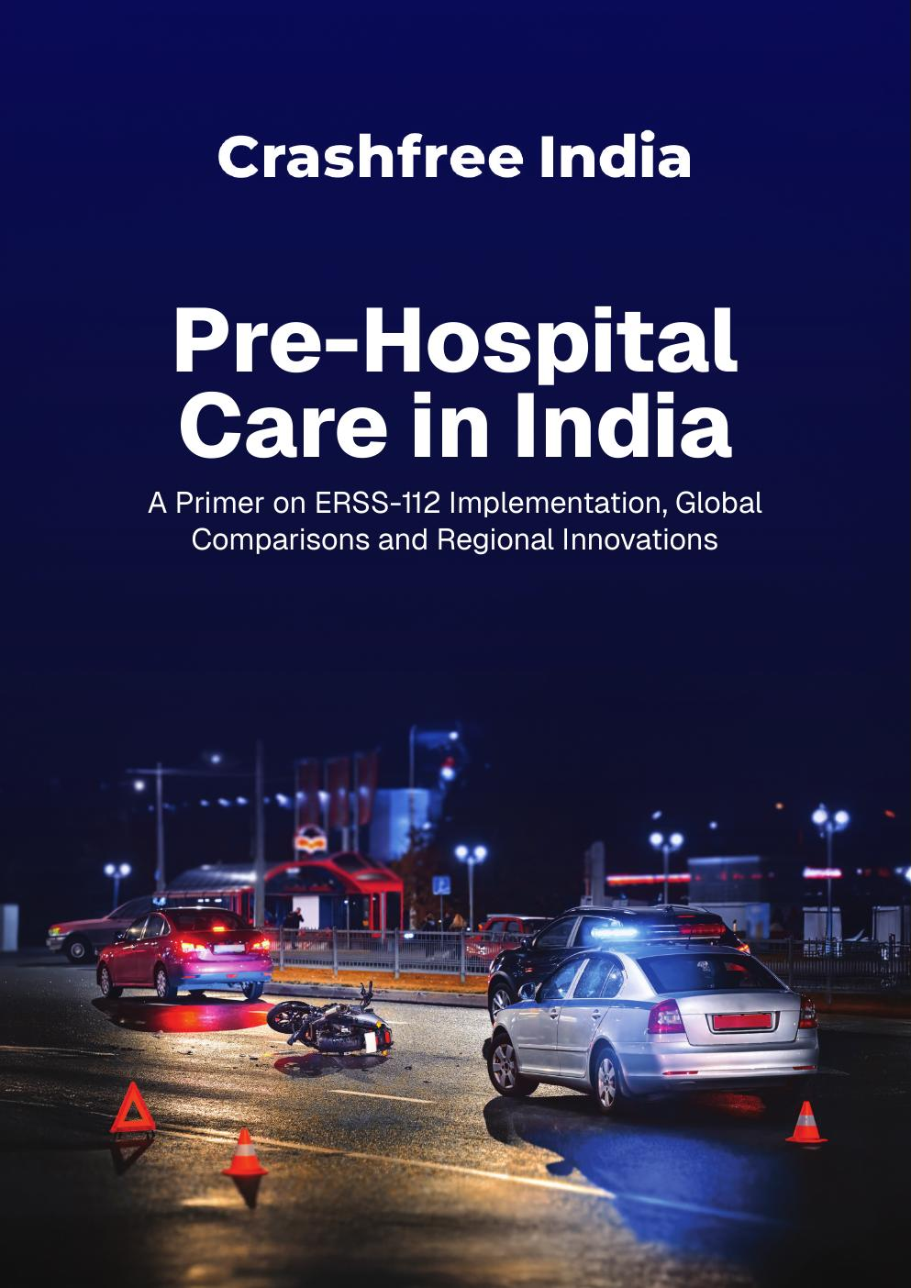
02 · WHAT WE HAVE BUILT, OUR RESEARCH
WHAT WE HAVE BUILT
Published evidence the sector cites
Original research, launched publicly and covered by national press. Each report turns a policy gap into something authorities can act on.
'Justice Unserved'
'Deposited But Not Delivered'
Pre-Hospital Care Primer
Jan 2026
2026
Sep 2025
Why so few hit-and-run and third-party claims reach the families entitled to them. Launched at IIT Delhi; findings presented to MoRTH.
~₹986 crore of court-awarded compensation lies unclaimed across five High Court jurisdictions, a bottleneck the Supreme Court noted in 2025.
Benchmarks ERSS-112 response and documents state EMS innovations, with contributions from the AIIMS Trauma Centre.
Plus: the gig-rider brief 'When Risks Become Routine', and four open public-data platforms, all free to use and openly licensed.
Crashfree India · A briefing for mentors · 2026
09 / 16

Slide 10
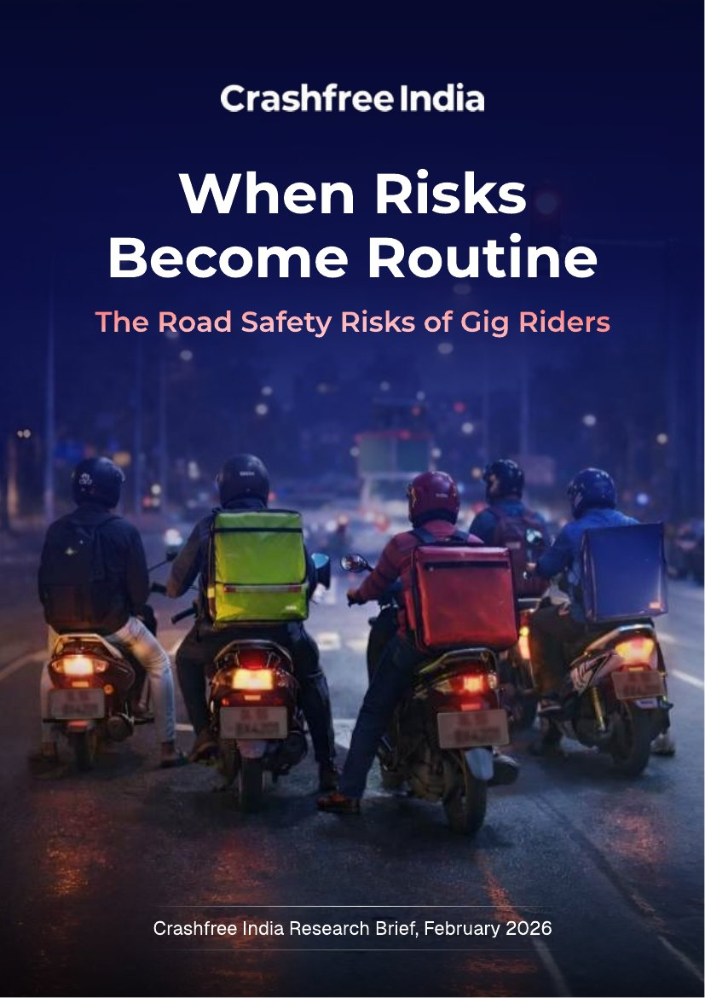



02 · WHAT WE HAVE BUILT, VULNERABLE ROAD USERS
WHAT WE HAVE BUILT
The fastest-growing risk on Indian roads rides a two-wheeler
Two-wheeler riders carry the largest share of road deaths, and gig and delivery work concentrates that exposure. We study it, and we work it.
~45%
23.5 M
1 in 2
of India's crash fatalities are two-wheeler users, rising year on year
gig and platform workers projected by 2029-30 (NITI Aayog)
delivery riders in a 431-rider Mumbai crash study had already crashed
A published study
'When Risks Become Routine' (Feb 2026): 40 pages, 87 references, from incentive design and helmet compliance to the e-bike regulatory blind spot.
A 300-rider study, now in the field
Quantifying how often riders face near-misses, which risk factors matter most, and what rider profiles exist, so interventions can be targeted.
Field, not only desk
Fieldwork included shadowing a delivery rider through a full nine-hour shift, documented on video.
'When Risks Become Routine' · Crashfree India research brief, February 2026.
Crashfree India · A briefing for mentors · 2026
10 / 16

Slide 11
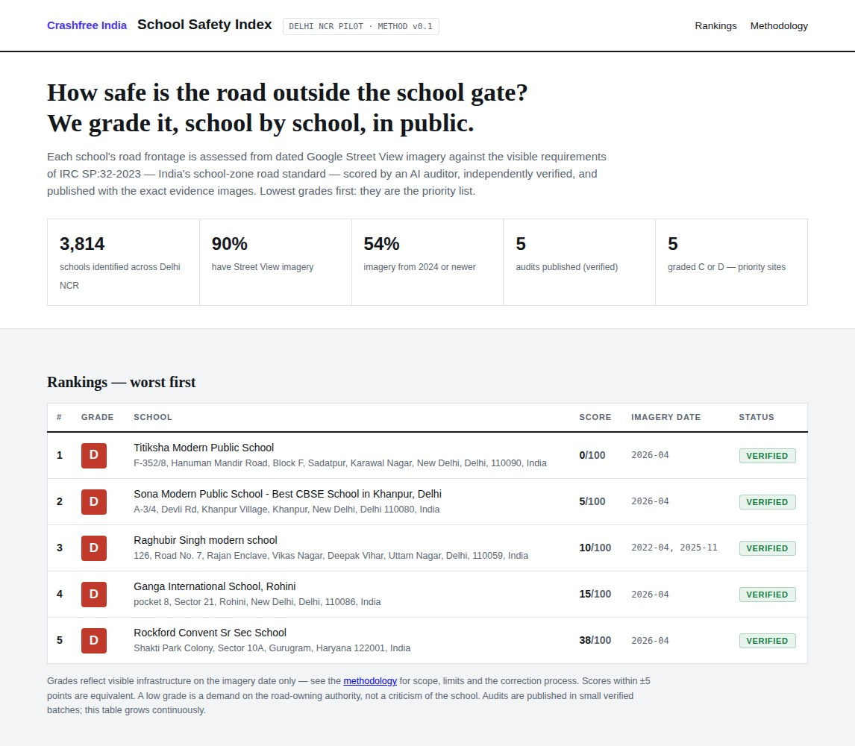


02 · WHAT WE HAVE BUILT, SCHOOL ZONES
WHAT WE HAVE BUILT
School Safety Index: a public score for every school's road
A child's walk to school can be graded. We grade it against India's own standard, publish the evidence, and hand the worst zones to field teams and the road-owning authority.
Screening at city scale
Dated Street View imagery, scored 0–100 by an AI auditor against IRC:SP:32-2023, India's school-zone standard, and independently verified before publication.
Delhi and Jaipur first
5,386 schools mapped across the two cities. Named schools and per-school photo evidence published from the first batch, re-audited every six months.
It measures the road, never the school
A low score is a demand on the road-owning authority, not a criticism of the school. The worst zones feed our student field audits, the 41-check ground tier.
~10,000
4.6%
730+
minors died on Indian roads in 2023 (MoRTH)
of crashes occur in school and college zones (e-DAR 2024)
schools graded from imagery worldwide, validating the method (iRAP)
The pilot dashboard: score-first, evidence-pinned. Delhi and Jaipur batches are in build now.
Crashfree India · A briefing for mentors · 2026
11 / 16

Slide 12
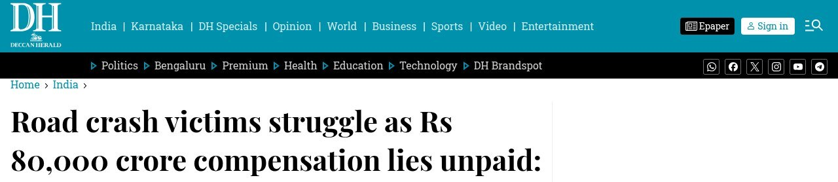
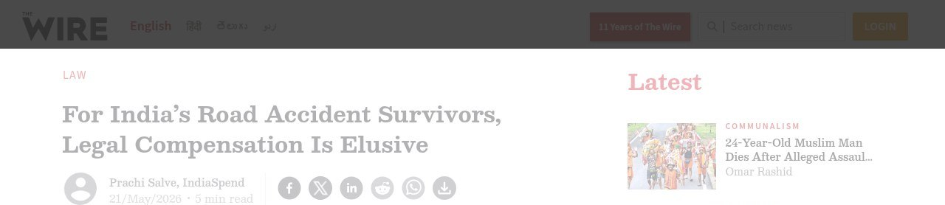
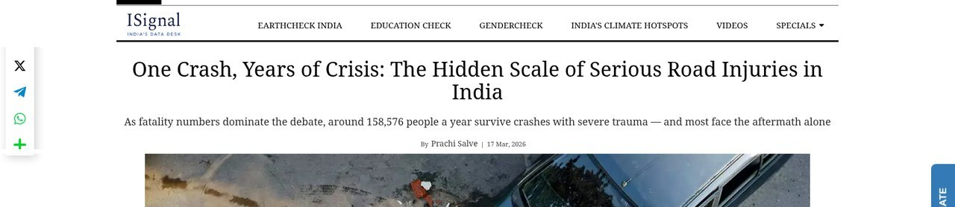
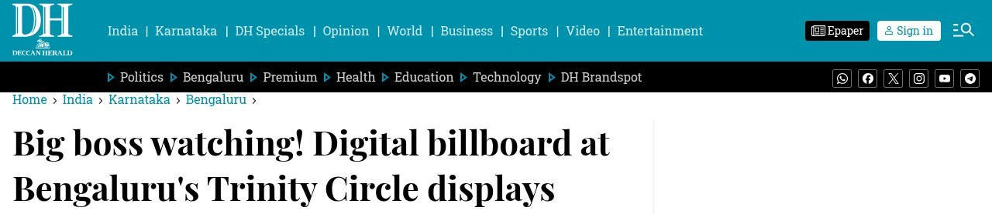
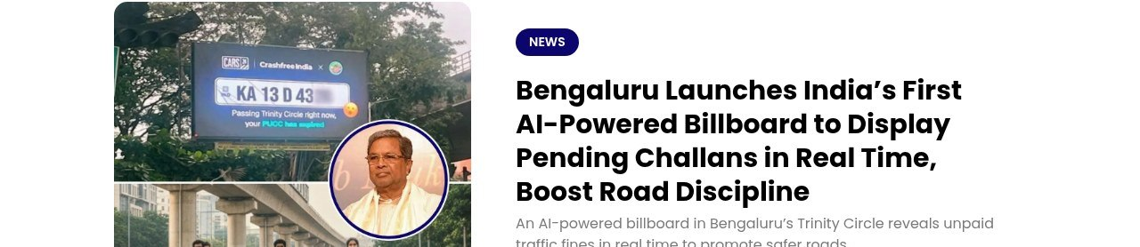
02 · WHAT WE HAVE BUILT, IN THE NEWS
WHAT WE HAVE BUILT
The work, as the press tells it
National newsrooms cite our research, cover our deployments, and quote our researchers by name.
DECCAN HERALD · MARCH 2026
THE WIRE · INDIASPEND · MAY 2026
INDIASPEND · ISIGNAL · MARCH 2026
Road crash victims struggle as ₹80,000 crore compensation lies unpaid
For India's road accident survivors, legal compensation is elusive
One crash, years of crisis: the hidden scale of serious road injuries
National coverage of our 'Justice Unserved' brief; DH hosts the full report for readers.
Quotes our research lead Kesar Kanjhlia on where claims stall.
Cites our gig-rider research; quotes Aastha Shreeharsh on missing risk data.
FROM OUR POLICY DESK
A steady line of published argument
DECCAN HERALD · SEPT 2025
THE LOGICAL INDIAN · SEPT 2025
Big boss watching! Billboard at Trinity Circle displays violations in real time
India's first AI-powered billboard to display pending challans in real time
Articles and explainers by Shubham Kumar and our policy team, from claim pipelines to enforcement design.
Our live challan billboard with Bengaluru Traffic Police and Cars24.
Also covered by Siasat, CarToq, Media Infoline and Daily Jagran.
Also in the record: 'Justice Unserved' launched at IIT Delhi and presented to MoRTH · launch coverage in Team-BHP, Adgully and The CSR Universe.
Crashfree India · A briefing for mentors · 2026
12 / 16

Slide 13
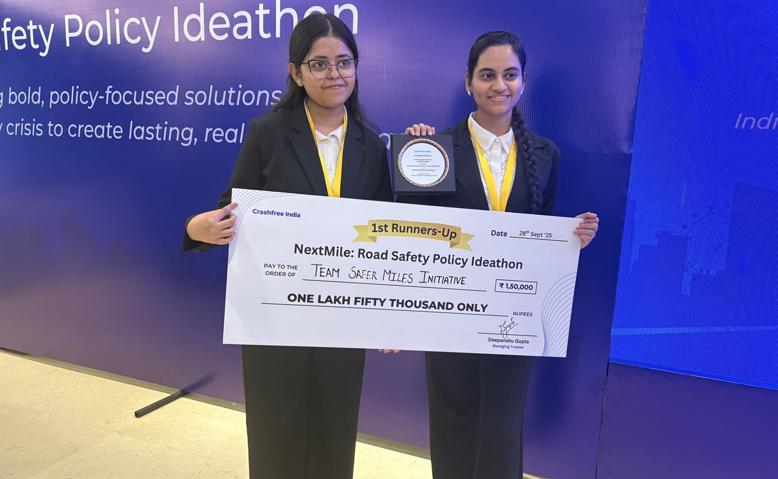
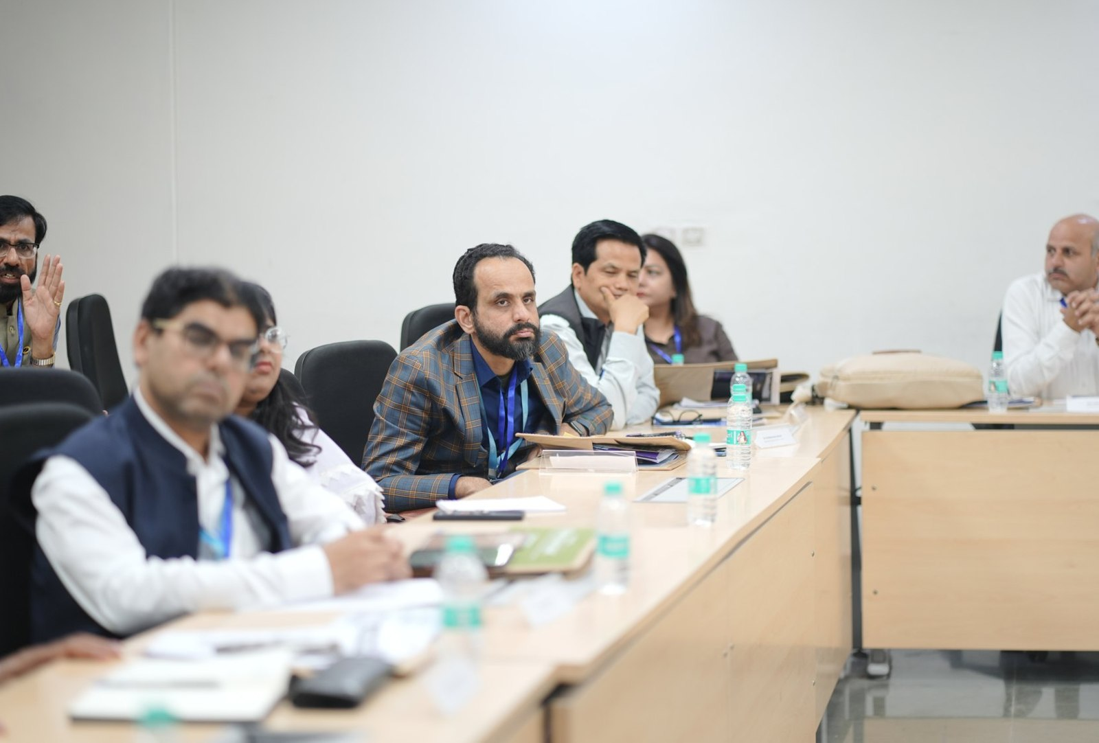



02 · WHAT WE HAVE BUILT, YOUTH & POLICY
WHAT WE HAVE BUILT
Young talent and senior experts, working the same problem
A steady pipeline of engineers and policy minds, so road safety work never runs out of hands.
National Road Safety Dialogue Series
200+ live attendees; speakers from MoRTH, CIRT, AIIMS Trauma Centre, CSIR-CRRI and ARAI.
Three sessions so far
Bus safety · Delivery rider safety · Good Samaritan law & the Cashless Treatment Scheme.
NextMile: Road Safety Policy Ideathon, grand finale, 28 Sep 2025, New Delhi.
National Road Safety Implementation Forum, IIT Delhi: 60+ experts from MoRTH, WHO, UNICEF, iRAP and CSIR-CRRI reviewed the work.
Advocacy on video
Our YouTube channel documents hazards and fixes on camera: ground-audit walkthroughs, Dialogue Series recordings and victim-education explainers. A public record any authority can cite.
2,000+
250+
700+
10
Mentors and jury from the Government of Rajasthan, NIUA, OMI, NASSCOM and CSEP judged the student teams; winning tracks now feed our audit and research pipeline.
participants
concept notes
teams
finalist teams
Next: 'Be a Rakshak' university chapters at IITs, NITs and SPAs.
Crashfree India · A briefing for mentors · 2026
13 / 16

Slide 14
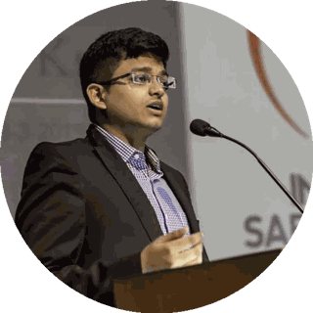
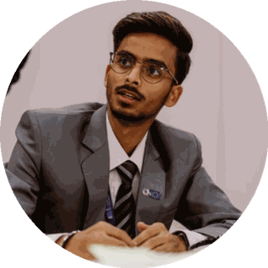
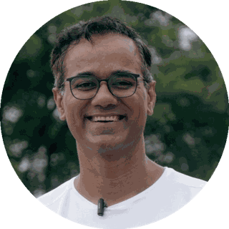
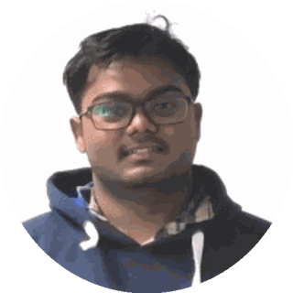
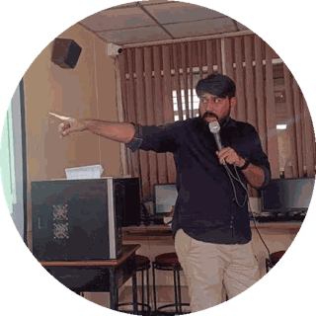
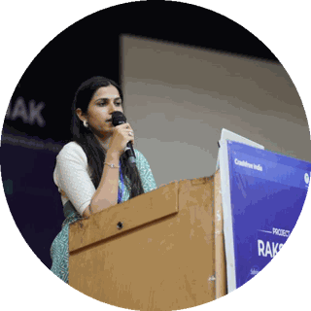
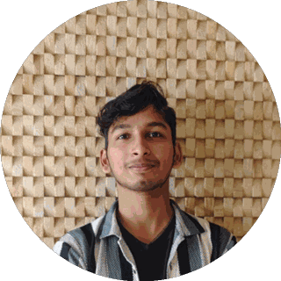
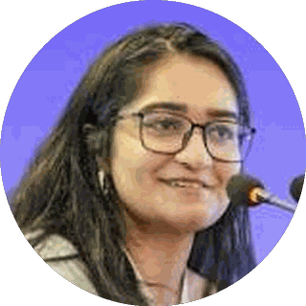
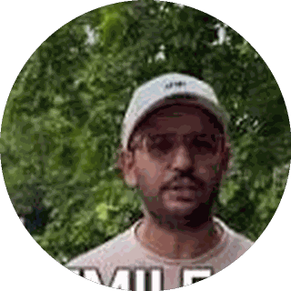
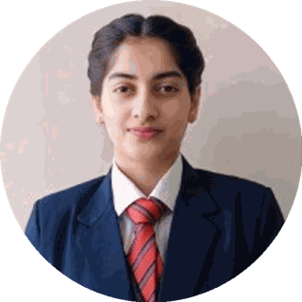
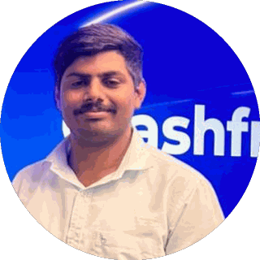
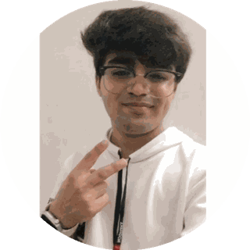
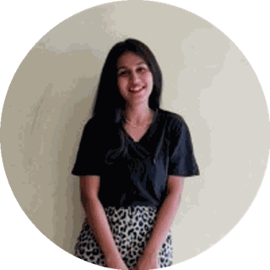
03 · OUR PEOPLE
OUR PEOPLE
A full-time team built for this work
Engineering, law, policy, product and field operations, under trustees who have led Indian road safety for a decade.
Amar Srivastava
Deepanshu Gupta
Gajendra Jangid
President · Founder, Indian Road Safety Campaign · Member, National Road Safety Council
Managing Trustee · Founder, IRSC · Global Youth Coalition for Road Safety
General Secretary · Co-founder, Cars24
THE FULL-TIME TEAM
Akhtar Hussain Mission Lead
Shubham Kumar Policy & Advocacy
Muskan Yadav Programmes
IIT Delhi · ex-Bain · strategy, programmes, new initiatives, partnerships and product
NALSAR Hyderabad · programmes, policy advocacy, legal research, government relations
TISS · district programmes, Project Rakshak, infrastructure interventions, DRSC work
Krishna Jain Tech & Product
Aastha Shreeharsh Development Communications
Rohan Sharma Cause Marketing
Builds and runs Aasha, SATARK and the open public data platforms
HKUST · institutional communications, government relations
Awareness campaigns, digital advocacy, community mobilisation
Ishita Rathore People & Culture
Yuvraj Yadav Operations
Lovish Creative (Video)
Talent and hiring, volunteers, the 75+ intern engineering corps
Field operations across 18 cities · works with police on SATARK and enforcement rollouts
Video explainers, ground-audit films and the YouTube channel
Shipra Kushwaha Creative (Graphic)
Plus 75+ engineering interns and 31 student audit teams.
Guides, comics and bilingual campaign material families actually read
In-house capabilities: road-engineering audits · legal & policy research · AI product development · district operations · behaviour-change communication
Crashfree India · A briefing for mentors · 2026
14 / 16

Slide 15







04 · THE YEAR AHEAD
THE YEAR AHEAD
Where we are going, and where your counsel would help
Year 2 moves from programmes to institutions. These are the goals, and what we hope to learn from your experience.
THE YEAR AHEAD
WHERE WE SEEK YOUR GUIDANCE
Project Rakshak
Audits running inside institutions, with 75+ implementations initiated and every one tracked publicly.
How you built institutions
Organisations that outlast their founders: the standards, governance and culture that takes.
Crash compensation
Claim pipeline fixed in two districts, mapped in eight, with a playbook states can adopt.
How you solved the hardest problems
The judgement earned on ambiguous, high-stakes problems. We would bring you ours early.
SATARK
From 3 cities toward 30, as shared public infrastructure for traffic police.
Working with government at scale
Partnerships that deepen while we keep our independence and publish everything.
Two exploratory bets
School Safety Index and gig rider safety, each scaled only if a small, honest pilot earns it.
People and leadership
Growing a young team into leaders, and drawing senior operators to a nonprofit mission.
Institutions that outlive us
An expert consortium, an audit manual and a publishing cadence that outlive any single cohort.
Focus
What to stop, what to scale, and when. The discipline of a small organisation with a national mission.
Crashfree India · A briefing for mentors · 2026
15 / 16

Slide 16



No life lost on an Indian road
is acceptable.
We add the hands, the evidence and the tools that turn that goal into work the system can carry, and we track it in public.
"We already know what is going wrong. What we need now is more responsibility, more discipline, more respect for life."
MS Dhoni · Goodwill Ambassador, Crashfree India
crashfreeindia.org
akhtar@crashfreeindia.org · helpdesk@crashfreeindia.org
Crashfree India · A Cars24 commitment · Operated by Vision Zero Trust, New Delhi

