Slide 1

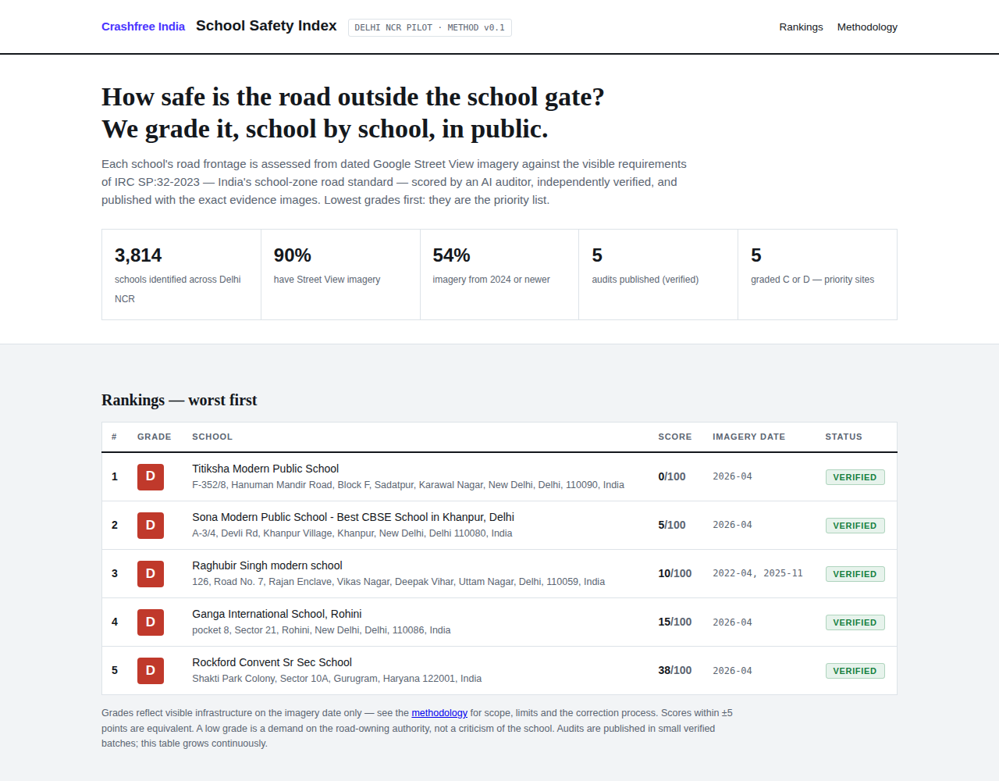
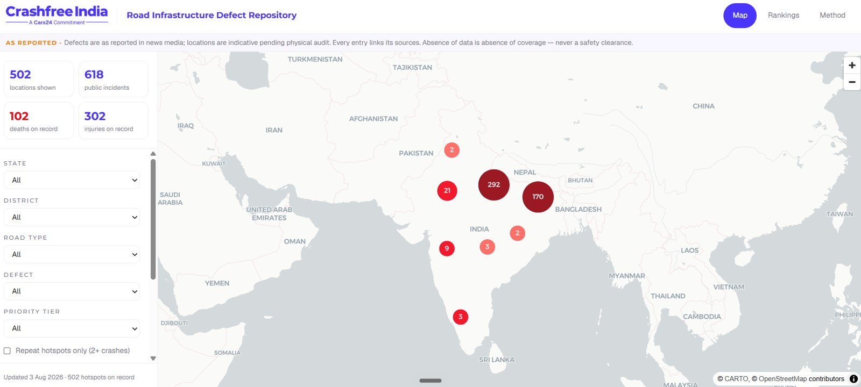



AUGUST 2026 · NEW DELHI
FOR DISCUSSION · CRASHFREE INDIA × TRAFFICURE · GOOGLE MAPS PLATFORM
The safety layer
Traffic data already manages congestion.
Together it can start preventing crashes.
School Safety Index, Delhi NCR prototype, live.
School Safety Index × speed — prototype built, launching with government
Live crash hotspots — found in the data, fixed through Project Rakshak
The district knowledge pack — joint thought leadership, monthly, where decisions are made
Road-Infrastructure Defect Repository, live.
Three ideas, one ask: one district's data, 90 days, MVPs built together.
crashfreeindia.org

Slide 2



01 · UNDERSTANDING TRAFFICURE
TRAFFICURE
What TraffiCure is, and what Pune proved
Software only. No cameras, no sensors. Google Maps probe data, turned into a working tool for the people who run the roads.
Built by Lepton Software
Google Maps Platform Premier Partner, working with Google since 2010. TraffiCure launched 2025.
WHY PUNE MATTERS TO US
The police did not stop at watching traffic.
They ranked their worst junctions, diagnosed why each fails, and handed the municipal corporation an engineering brief. Fixes got built.
Data → ranked list → brief to authority → built fix.
That is exactly how Project Rakshak works. Same operating theory, different data.
Runs on Roads Management Insights
Google's public-sector traffic feed, launched Aug 2025. Every road, refreshed every 2 minutes.
Live with Pune City Traffic Police
Deployed January 2026, activated in weeks. Corridors also measured in Delhi, Hyderabad, Ahmedabad.
THE PUNE RESULT, POLICE-MEASURED
964
20 → 26.8
22
roads watched live, every 2 minutes
km/h average speed, in a year
worst junctions ranked and briefed
Crashfree India · Discussion deck · Crashfree India × TraffiCure, Google Maps Platform
02 / 10

Slide 3





01 · UNDERSTANDING THE DATA
THE DATA
Five signals in the feed, read through a safety lens
The product was built to manage traffic. Every signal in it has a second life in safety.
Live speeds
How fast traffic really moves past a school gate at 8 am.
Every road, every 2 minutes
Speed history
Baselines: what is normal, what changed after a fix was built.
Hourly, by road, in BigQuery
Vehicle counts
Exposure: how many vehicles pass the danger. Priority = risk × exposure.
NEW · MAY 2026
Per road, per hour
Harsh braking
Near-misses, visible before the crash. Their guide calls it the safety signal nobody else has.
NEW · MAY 2026
Anonymised points, junction scale
User reports
Incidents the official record may never see.
NEW · MAY 2026
Crashes and hazards, from Maps users
Crashfree India · Discussion deck · Crashfree India × TraffiCure, Google Maps Platform
03 / 10

Slide 4
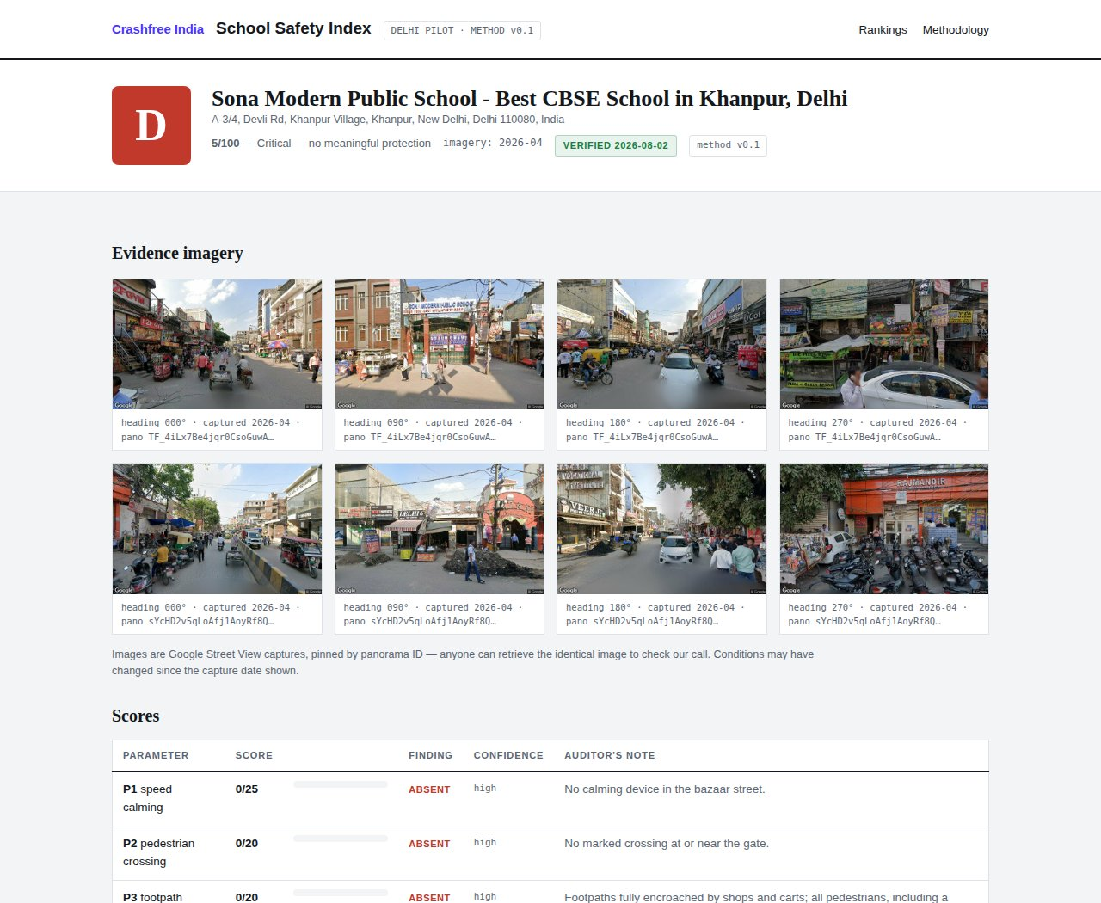
02 · IDEA 01 · SCHOOL SAFETY INDEX × SPEED
IDEA 01 · SSI
Grade every school gate by measured danger
A public 0–100 grade for the road outside every school. Built, live for 3,814 Delhi NCR schools, launching with government. Speed past the gate is the one input it still lacks.
WHY
~10,000
4.6%
0
minors die on Indian roads every year (MoRTH)
of crashes happen in school & college zones (e-DAR)
Indian cities rank school-zone danger today
WHY CFI × TRAFFICURE
WHY CFI
WHY TRAFFICURE
The index exists: IRC:SP:32 method, verification, public report cards — and DRSC seats to launch it with government.
The one input a photo cannot give: speed past the gate at school-run hours, plus counts as exposure. No one else has it.
Live: the index, worst grades first.
NEXT STEPS, SPECIFICALLY
1
Week 1
Demo access + technical session on 10 gate corridors, already defined on our cloud project.
2
Weeks 2–6
Speed-exposure scoring on the ~100-zone government-launch batch; thresholds agreed up front.
3
Weeks 6–10
Speed layer into the public index; student teams field-verify the worst 20 zones.
4
This quarter
Government launch of the index — speed layer in, both names on it.
A school's report card, evidence pinned.
Crashfree India · Discussion deck · Crashfree India × TraffiCure, Google Maps Platform
04 / 10

Slide 5




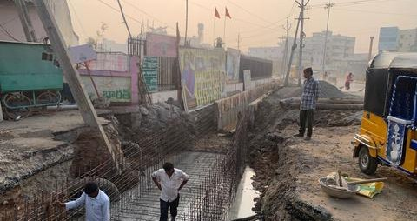



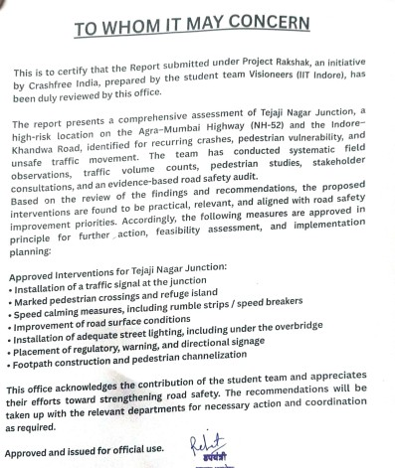
02 · IDEA 02 · LIVE HOTSPOTS × PROJECT RAKSHAK
IDEA 02 · RAKSHAK
Find danger in the data, fix it on the ground
Official blackspot lists go stale for years. The feed refreshes the danger map monthly — and Rakshak already turns danger maps into audits, joint plans and built fixes.
Signals + crashes
›
Live hotspot list
›
Rakshak audit
›
Joint plan to authority
›
Fix built & measured
THE DESK DIAGNOSIS — ANSWERS THAT TODAY NEED A PHYSICAL AUDIT
When
Speeding windows: 11 pm chaos or 8 am school-run?
Where
Braking clusters mark the exact conflict point
Why
Stop-go congestion, free-flow speeding, or design failure
Who
Counts say how many people the danger exposes
A Rakshak fix under construction — one of 15 in implementation.
Field teams arrive knowing the corridor's story — the visit confirms it and designs the fix.
WHY CFI
WHY TRAFFICURE
150+ audits a year, 25+ authority approvals, 4 DRSC seats to table joint plans — and a public tracker for every step.
The only live all-roads feed, plus the Pune playbook: ranked list → engineering brief → built fix.
First 90 days: overlay braking on Jaipur's 96 crash clusters · baseline 2 sites entering construction · live speed panel on the Rakshak dashboard.
An authority approval letter. Every site tracked in public: crashfreeindia.org/rakshak/dashboard
Crashfree India · Discussion deck · Crashfree India × TraffiCure, Google Maps Platform
05 / 10

Slide 6
02 · IDEA 03 · THE DISTRICT KNOWLEDGE PACK
IDEA 03 · DRSC
Joint thought leadership, on the table where districts decide
A co-branded CFI × TraffiCure pack on the district's key traffic problems — monthly or bi-monthly, tabled at the District Road Safety Committee.
HOW THE FEED BECOMES THE PACK
GURUGRAM ROAD SAFETY BRIEF · SEPT 2026
Raw speeds & delay
→
Worst five corridors, ranked by measured speed and delay
01
Corridor watch
NH-48 service road slowest at 6 pm; speeds up 12% at night
School-hour speeds
→
School gates above safe speed at 8 am, named
02
School gates
Harsh-braking points
→
The district's top conflict junctions, mapped
3 gates above 40 km/h during morning school-run
03
Conflict points
Before / after
→
Did last meeting's action work? Measured, not claimed
Iffco Chowk ramp: highest braking density this month
04
Action check
WHY CFI
WHY TRAFFICURE
Sector 29 signal retiming: -18% delay, held for 6 weeks
We sit on four DRSCs, and we write evidence the way government reads it. The pack enters the statutory record.
The data no district has ever seen about itself — attributed, every month, in the room.
05
For the record
One recommendation for this meeting, with the data behind it
The quiet door: around that table sit the district's decision-makers — administration, police, PWD, transport. A page they rely on every month is the most natural introduction a data partnership can have. District trust is where state conversations begin.
Illustrative contents · co-branded · one page
Crashfree India · Discussion deck · Crashfree India × TraffiCure, Google Maps Platform
06 / 10

Slide 7
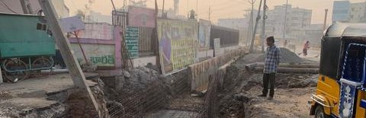
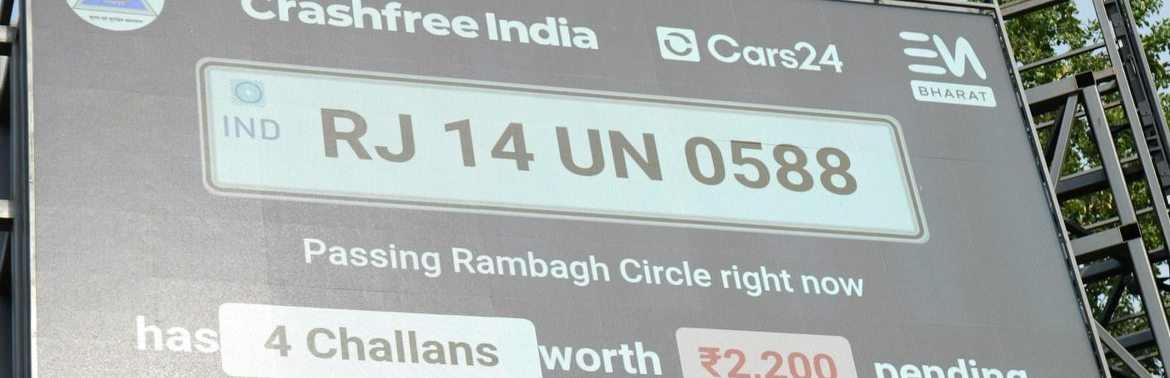
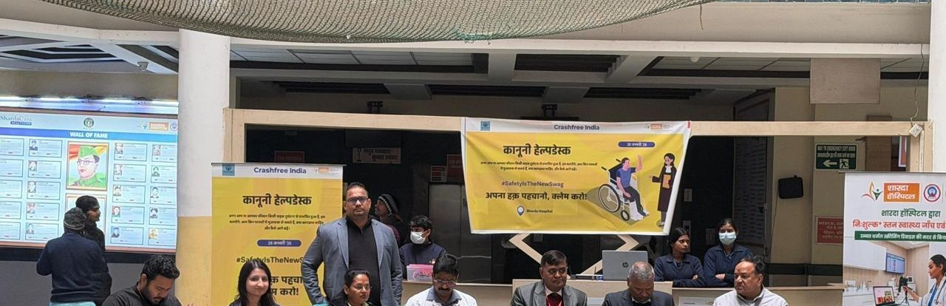

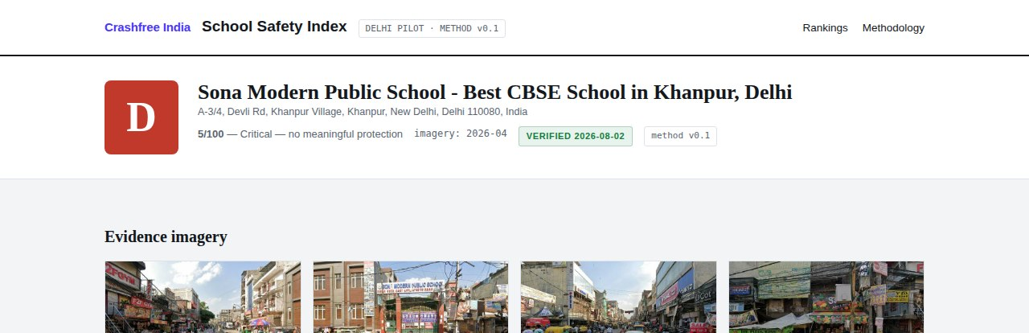
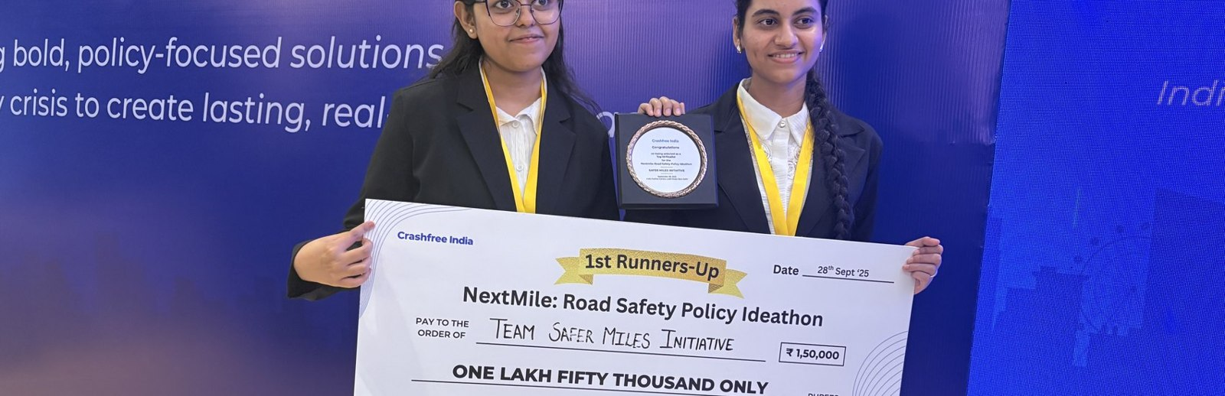
03 · ABOUT US
ABOUT US
Six lines of work, one connected system
A nonprofit registered as the Vision Zero Trust · Co-founded by Cars24 and the Indian Road Safety Council · 18 cities · everything below is live.
Project Rakshak
SATARK enforcement
Victim support
Student-led road audits, fixed with authorities
AI support that helps police find high-risk vehicles
Aasha chatbot, calculator, hospital helpdesks
31 sites · 15 in implementation
3,00,000+ vehicles screened
100+ victims helped in first 4 days
Open public data
School Safety Index
Youth & policy
Four self-updating data platforms, free to use
Public grading of school-zone road safety
NextMile ideathon and national dialogue series
36 states & 50 cities covered
3,814 Delhi NCR schools mapped
2,000+ participants engaged
Crashfree India · Discussion deck · Crashfree India × TraffiCure, Google Maps Platform
07 / 10

Slide 8
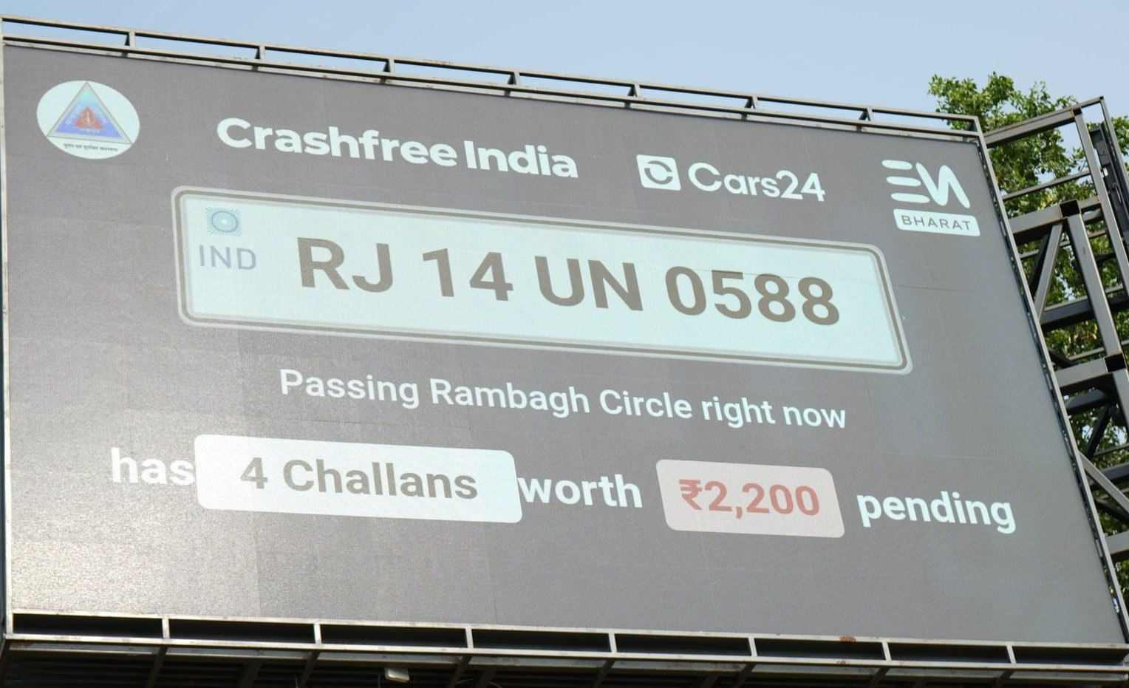
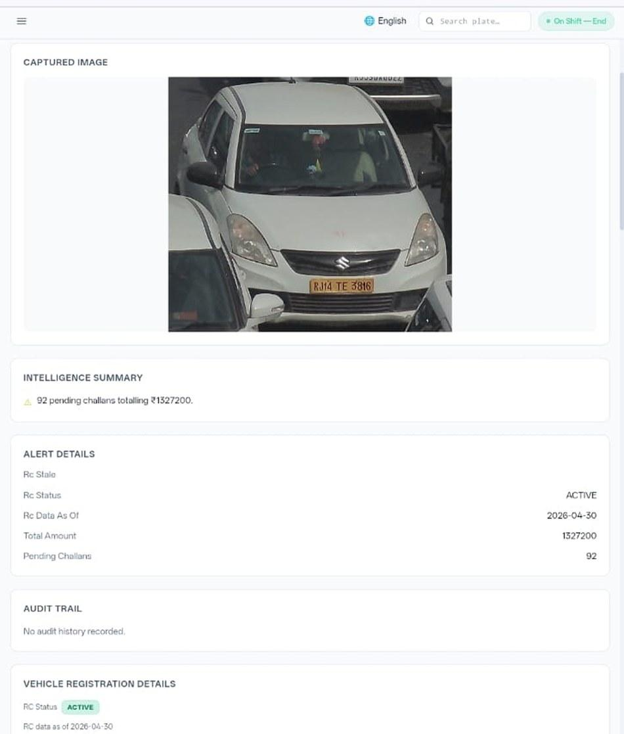








03 · ABOUT US, SATARK IN THE FIELD
ABOUT US
SATARK: AI that helps police stop the right vehicle
Built with Cars24 engineers. Reads number plates, checks government records, and alerts officers to repeat offenders, in real time.
3,00,000+
₹30 Cr+
vehicles screened
pending challan value identified
350+
70,019
high-risk vehicles intercepted
vehicles found with pending challans
LIVE · Jaipur & Bengaluru
NEW · Gurugram
Officer view, challans,
RC & compliance status.
Bengaluru's Trinity Circle billboard was India's first, covered by Deccan Herald and national press. Pune and Ahmedabad are next.
Rambagh Circle, Jaipur, live plate, pending challans and dues on a public billboard.
ANPR camera
Plate read
Records check
Risk flag
Officer alert
Billboard
Interception
Enforcement
Crashfree India · Discussion deck · Crashfree India × TraffiCure, Google Maps Platform
08 / 10

Slide 9





04 · NEXT STEPS
NEXT STEPS
One district, 90 days, three MVPs built together
Everything on our side is funded and ready. The ask is small and specific.
WHAT WE WILL DO — AT OUR COST
WHAT WE ASK OF TRAFFICURE + GOOGLE
SSI MVP: speed-exposure scores on the ~100-zone launch batch; field-verify worst 20
Demo access for ONE district — Gurugram or Jaipur: speeds, counts, harsh braking
Rakshak MVP: braking overlay on Jaipur's 96 clusters; live speed panel on the public dashboard
One technical session: Lepton + Maps + CFI, on our corridors, this week
Knowledge pack MVP: first co-branded district brief, tabled at a DRSC we sit on
Terms for public, attributed use in the index, the dashboard and the pack
Student field teams, verification, government formatting, all follow-through
A named counterpart to review the MVPs with us at day 90
The shape of the next 90 days: demo access on one district → three MVPs built on real data → reviewed together at day 90 → then we decide, with evidence, how far to go. If an MVP fails its test, we say so and shelve it.
Crashfree India · Discussion deck · Crashfree India × TraffiCure, Google Maps Platform
09 / 10

Slide 10

Traffic data already runs the daily commute.
Together it can start preventing the crash.
Three ideas, one district, ninety days. We bring the method, the field force and the government seats; the data does the rest.
Akhtar Hussain
Deepanshu Gupta
Gajendra Jangid
Mission Lead · akhtar@crashfreeindia.org
Trustee · deepanshu@crashfreeindia.org
Trustee · gajendra@crashfreeindia.org
Crashfree India · A Cars24 commitment · Operated by Vision Zero Trust, New Delhi · crashfreeindia.org

